Slide 1

An-Najah National University
Engineering Faculty
Civil Engineering Department
Design of Mechanically Stabilized Earth Retaining Walls
Graduation Project
Prepared by:
Omar Hindia (11924081) Yazan Ghanim (11925105)
Qassim dababseh (11927489) Mohamad jabareen (11925003)
Submitted to: Dr. Isam Jardaneh

Slide 2
Introduction :
There are different methods to retain soil cuts or support vertical sides of soil embankments. Traditional methods are simply different types of typical retaining walls, such as, gravity retaining walls, semi-gravity retaining walls, cantilever retaining walls, counterfort retaining walls, etc. However, new modern trends are now available for these projects and the most common one is soil reinforcement. It is simply based on reinforcing the soil by horizontal strong intrusion made by steel or geosynthetic materials. This system is first suggested by Vidal in the 60’s of the last century. The system specialized for supporting soil vertical cuts is called Mechanically Stabilized Earth Retaining Wall and mainly composed of facing elements, reinforcing bars and backfill soils.

Slide 3
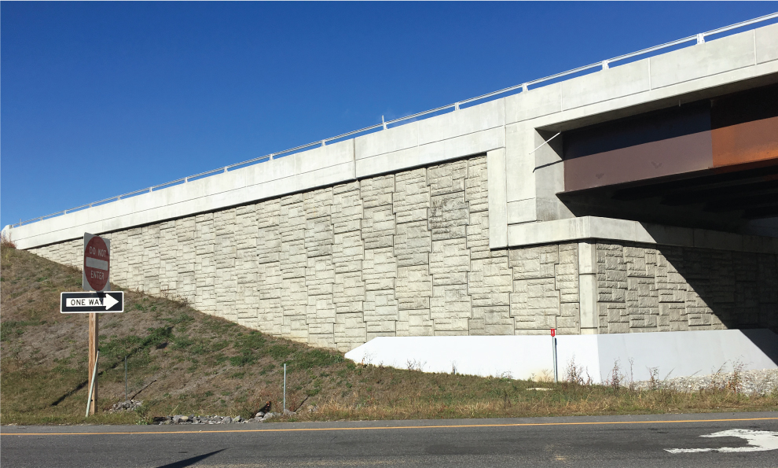
Objectives :
The aim of this project is to design mechanically stabilized earth retaining walls for different heights and compare this design with traditional retaining walls, such as, cantilever retaining walls which the most common types in our region. Finally, comparisons will be made between the two types of retaining walls from economical and time of construction point of views.

Slide 4
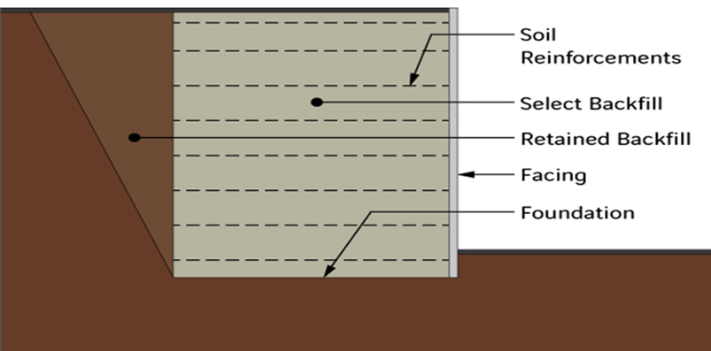
Main component of (MSERW) :
1) facing elements
2) reinforcing bars
3) backfill soils

Slide 5
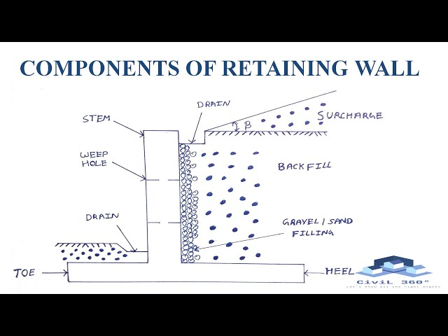
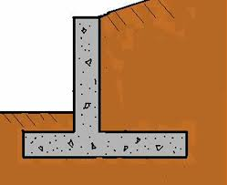
Main component of cantilever retaining wall :
1) slab
2) stem

Slide 6
Chapter Five
Design Of Mechanically Stabilized Earth Retaining Walls (MSERW)

Slide 7
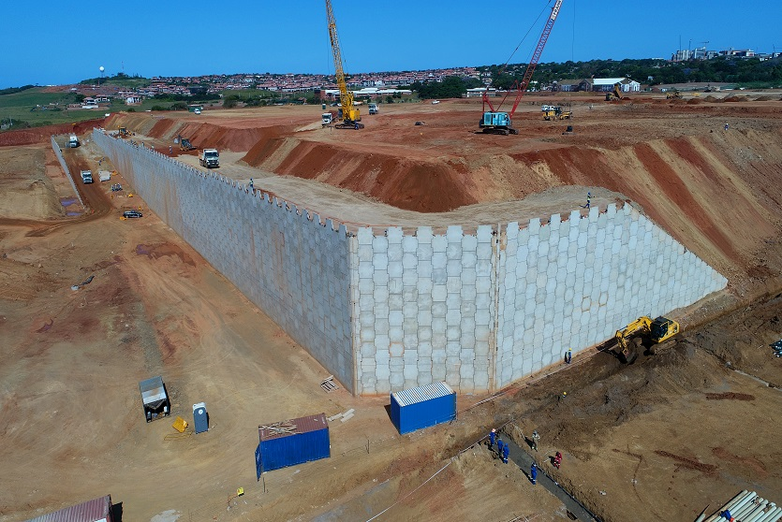
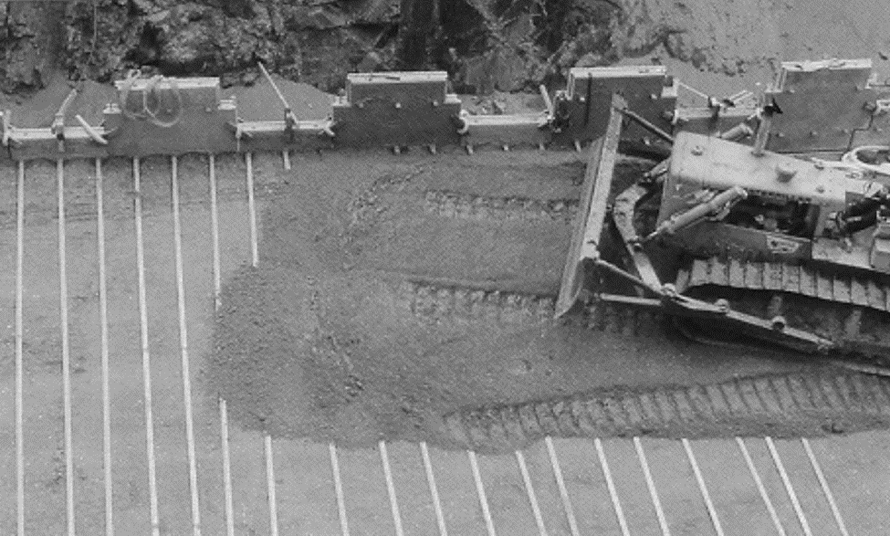
Introduction
Mechanically stabilized retaining wall (MSREW) is a new geotechnical technology that uses
galvanized steel bars that extend within soil layers.

Slide 8
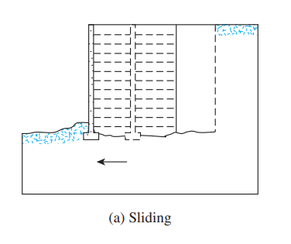
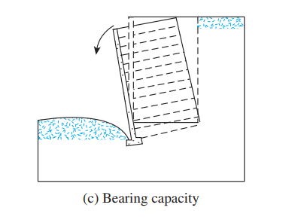
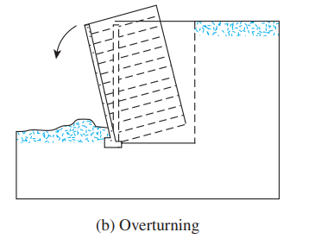
The general design procedure of (MSERW) can be divided into two parts:
Satisfying internal stability requirements
The internal stability checks involve determining tie breaking and tie pullout in the reinforcing elements.
Checking the external stability of the wall.
As for the external Stability checks, they include checks for overturning, sliding and bearing capacity failure.

Slide 9
calculation
Properties of granular backfill material:
ϕ՛ = 30°
γ = 18 kN/m2
C = 0 KN/m2
Properties of foundation soil:
Qall = 220KN/m2
width of strip (w) = 75 mm
fy = 240000 KN/m2
Assume that the soil - tie friction angle (ϕ՛µ= 20°)
(The factor of safety against tie breaking) Required FS(B) = 3
(The factor of safety against tie pullout) Required FS(p) = 3
Assume the corrosion of galvanize steel to be 0.025mm/year and the life span of the structure to be 50 years.

Slide 10
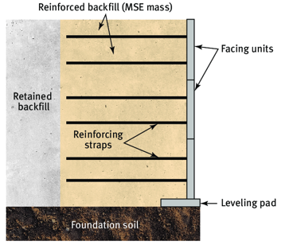


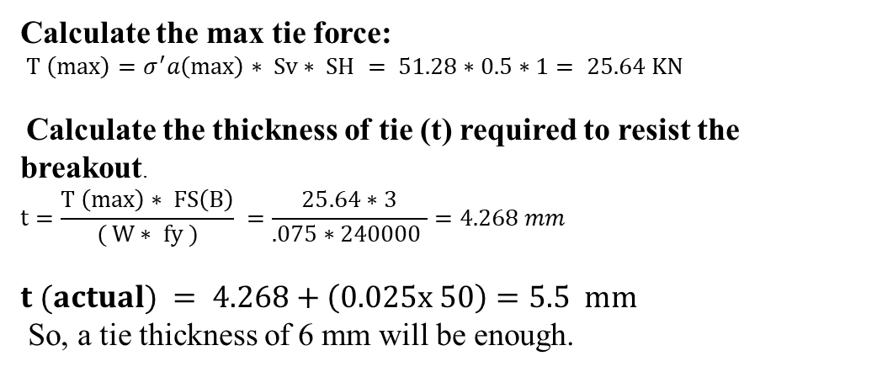
Design (MSERW) at H=8м
(Vertical length between strips) Sv = 0.5 m
(Horizontal length between strips) SH = 1 m
Calculate the length of the tie (L):
$L = Le + Lr=\frac{Fs∗σ^{′}a∗Sv∗SH}{2W∗σ^{′}o∗tan(ϕ՛ϻ)}$ + $\frac{\left(H−Z \right)}{tan(45+(ϕ/2)}$
$L$= $\frac{3∗51.28∗0.5∗1}{2∗0.075∗154∗tan(20) }$ + $\frac{8−2}{\tan{60}}=12.61 =13m$
active pressure:
$$σ^{′}a=γ∗Z∗Ka+ q∗Ka \\ Ka=\left(\frac{1−\sin\left(ϕ՛\right)}{1+\sin\left(ϕ՛\right)}\right)=\frac{.5}{1.5}= 0.333 \\ σ^{′}a= (18∗8∗0.333)+(10∗0.333) = 51.28KN/m2 \\ σ^{′}o=γ∗z+ q =18∗8+ 10=154 KN/m2$$
Calculate the max tie force:
$T \left(max\right)=σ^{′}a\left(max\right)∗ Sv∗ SH = 51.28∗0.5∗1= 25.64 KN$
Calculate the thickness of tie (t) required to resist the breakout.
$$t=\frac{T \left(max\right)∗ FS\left(B\right)}{( W∗ fy )} =\frac{25.64∗3}{.075∗240000 }=4.268 mm$$
$$t (actual) = 4.268+（0.025x 50）=5.5 mm$$
So, a tie thickness of 6 mm will be enough.

Slide 11
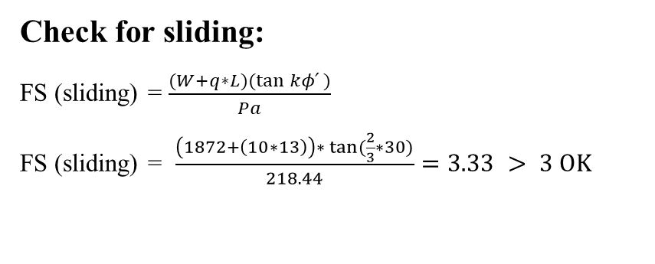
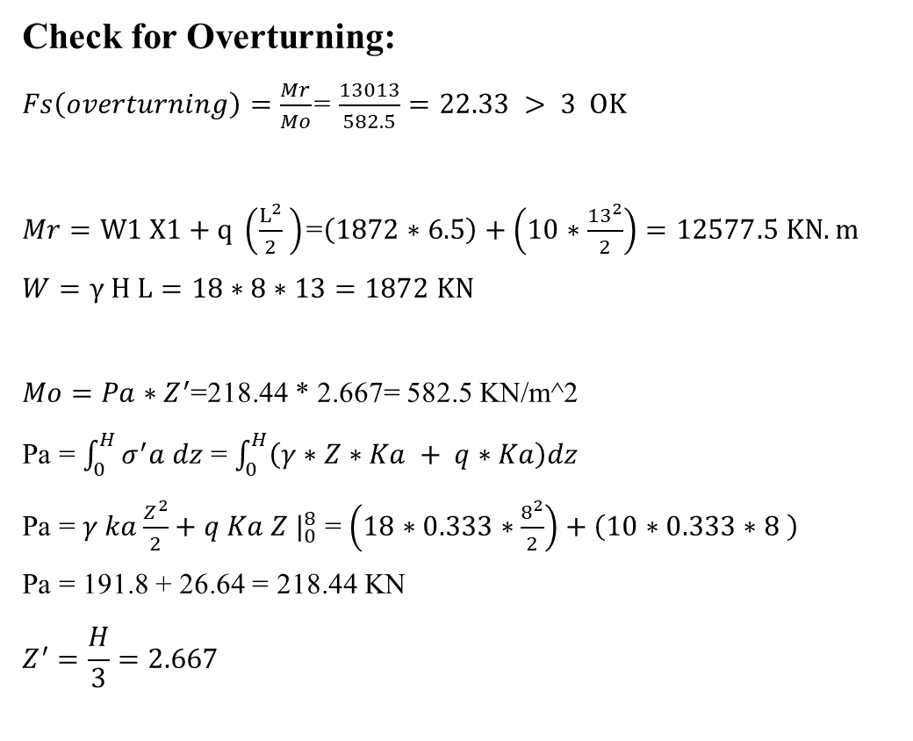
Check for Overturning:
$Fs\left(overturning\right)=\frac{Mr}{Mo}$= $\frac{13013}{582.5}=22.33 > 3 OK$
$Mr=W1 X1+q \left(\frac{L^{2}}{2} \right)$=$\left(1872∗6.5\right)+\left(10∗\frac{{13}^{2}}{2}\right)=12577.5 KN.m$
$$W=γ H L=18∗8∗13=1872 KN$$
$Mo=Pa∗Z^{′}$=218.44 * 2.667= 582.5 KN/m^2
Pa = $\int_{0}^{H}{σ^{′}a dz}$ = $\int_{0}^{H}{\left(γ∗Z∗Ka + q∗Ka\right)dz}$
Pa = $γ ka\frac{Z^{2}}{2}+q Ka Z |_{0}^{8}$ = $\left(18∗0.333∗\frac{8^{2}}{2}\right)+\left(10∗0.333∗8 \right)$
Pa = 191.8 + 26.64 = 218.44 KN
$$Z^{′}=\frac{H}{3}=2.667$$
Check for sliding:
FS (sliding) = $\frac{(W+q∗L)(\tan{kφ՛} )}{Pa}$
FS (sliding) = $\frac{\left(1872+\left(10∗13\right)\right)∗ \tan{(\frac{2}{3}∗30)}}{218.44}=3.33 > 3 OK$
Check for ultimate Bearing Capacity:
Po ≤ Q_{all}
Po = (γ * Z) + q = (18 * 8) + 10 = 154 KN/m^2
154 ≤ 220 OK

Slide 12



Design (MSERW) at H=10м
(Vertical length between strips) Sv = 0.6 m
(Horizontal length between strips) SH = 1 m
Calculate the length of the tie (L):
$L = Le + Lr=\frac{Fs∗σ^{′}a∗Sv∗SH}{2W∗σ^{′}o∗tan(ϕ՛ϻ)}$ + $\frac{\left(H−Z \right)}{tan(45+(ϕ/2)}$
$L$= $\frac{3∗62.7∗0.6∗1}{2∗0.075∗190∗tan(20) }$ + $\frac{10−2}{\tan{60}}=15.5 =16m$
active pressure:
$$σ^{′}a=γ∗Z∗Ka+ q∗Ka \\ Ka=\left(\frac{1−\sin\left(ϕ՛\right)}{1+\sin\left(ϕ՛\right)}\right)=\frac{.5}{1.5}= 0.333 \\ σ^{′}a= (18∗10∗0.333)+(10∗0.333) =62.7KN/m2 \\ σ^{′}o=γ∗z+ q =18∗10+ 10=190 KN/m2$$
Calculate the max tie force:
$T \left(max\right)=σ^{′}a\left(max\right)∗ Sv∗ SH =62.7∗.6∗1=37.62KN$
Calculate the thickness of tie (t) required to resist the breakout.
$$t=\frac{T \left(max\right)∗ FS\left(B\right)}{( W∗ fy )} =\frac{37.62∗3}{.075∗240000 }=6.27 mm$$
$$t (actual) =6.27+（0.025x 50）=7.52 mm$$
So, a tie thickness of 8 mm will be enough.

Slide 13
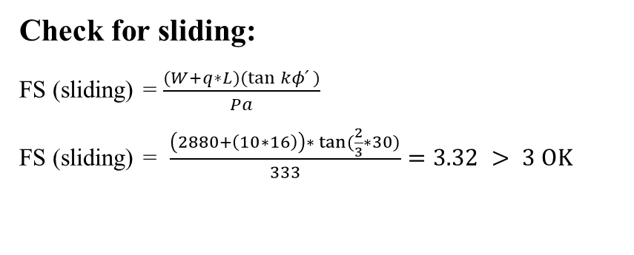
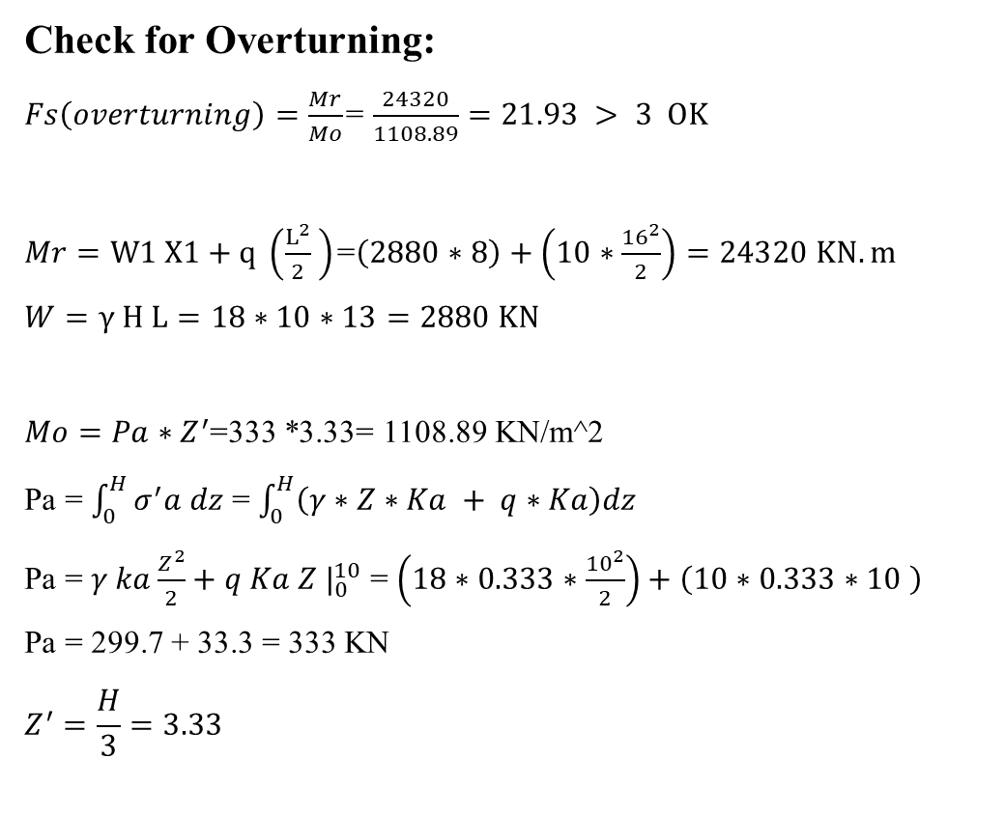
Check for Overturning:
$Fs\left(overturning\right)=\frac{Mr}{Mo}$= $\frac{24320}{1108.89}=21.93 > 3 OK$
$Mr=W1 X1+q \left(\frac{L^{2}}{2} \right)$=$\left(2880∗8\right)+\left(10∗\frac{{16}^{2}}{2}\right)=24320 KN.m$
$$W=γ H L=18∗10∗13=2880 KN$$
$Mo=Pa∗Z^{′}$=333 *3.33= 1108.89 KN/m^2
Pa = $\int_{0}^{H}{σ^{′}a dz}$ = $\int_{0}^{H}{\left(γ∗Z∗Ka + q∗Ka\right)dz}$
Pa = $γ ka\frac{Z^{2}}{2}+q Ka Z |_{0}^{10}$ = $\left(18∗0.333∗\frac{{10}^{2}}{2}\right)+\left(10∗0.333∗10 \right)$
Pa = 299.7 + 33.3 = 333 KN
$$Z^{′}=\frac{H}{3}=3.33$$
Check for sliding:
FS (sliding) = $\frac{(W+q∗L)(\tan{kφ՛} )}{Pa}$
FS (sliding) = $\frac{\left(2880+\left(10∗16\right)\right)∗ \tan{(\frac{2}{3}∗30)}}{333}=3.32 > 3 OK$
Check for ultimate Bearing Capacity:
Po ≤ Q_{all}
Po = (γ * Z) + q = (18 * 10) + 10 = 190 KN/m^2
190 ≤ 220 OK

Slide 14



Design (MSERW) at H=14м
(Vertical length between strips) Sv = 0.5 m
(Horizontal length between strips) SH = 1 m
Calculate the length of the tie (L):
$L = Le + Lr=\frac{Fs∗σ^{′}a∗Sv∗SH}{2W∗σ^{′}o∗tan(ϕ՛ϻ)}$ + $\frac{\left(H−Z \right)}{tan(45+(ϕ/2)}$
$L$= $\frac{3∗86.46∗0.5∗1}{2∗0.075∗262∗tan(20) }$ + $\frac{14−1}{\tan{60}}=16.56=17m$
active pressure:
$$σ^{′}a=γ∗Z∗Ka+ q∗Ka \\ Ka=\left(\frac{1−\sin\left(ϕ՛\right)}{1+\sin\left(ϕ՛\right)}\right)=\frac{.5}{1.5}= 0.333 \\ σ^{′}a= (18∗14∗0.333)+(10∗0.333) =86.46KN/m2 \\ σ^{′}o=γ∗z+ q =18∗14+ 10=262 KN/m2$$
Calculate the max tie force:
$T \left(max\right)=σ^{′}a\left(max\right)∗ Sv∗ SH =86.46∗.5∗1=43.23KN$
Calculate the thickness of tie (t) required to resist the breakout.
$$t=\frac{T \left(max\right)∗ FS\left(B\right)}{( W∗ fy )} =\frac{43.23∗3}{.075∗240000 }=7.205 mm$$
$$t (actual) =7.205+（0.025x 50）=8.455 mm$$
So, a tie thickness of 9 mm will be enough.

Slide 15
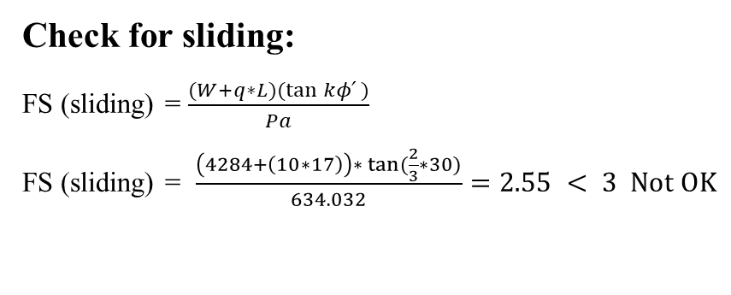
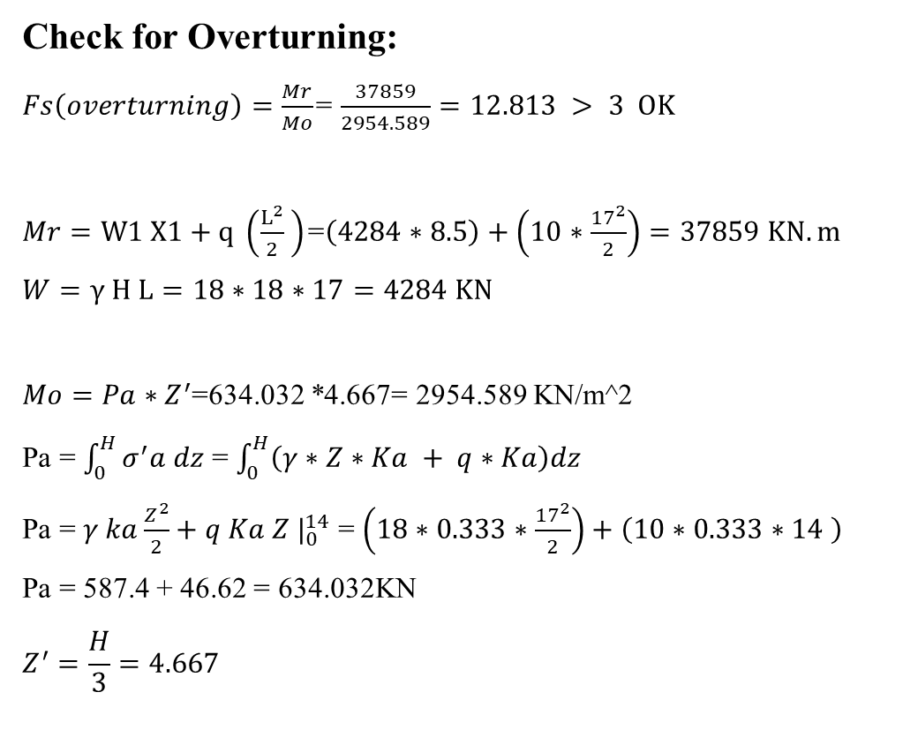
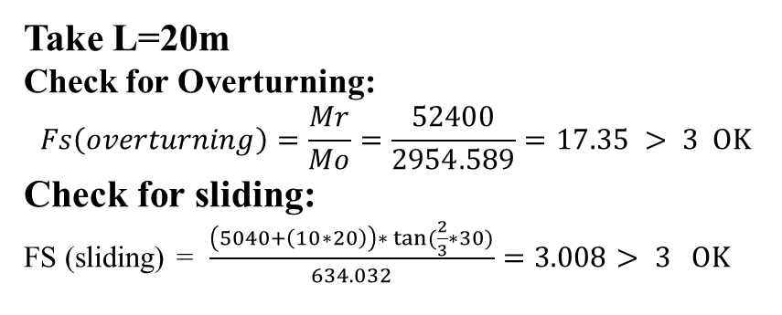
Check for Overturning:
$Fs\left(overturning\right)=\frac{Mr}{Mo}$= $\frac{37859}{2954.589}=12.813 > 3 OK$
$Mr=W1 X1+q \left(\frac{L^{2}}{2} \right)$=$\left(4284∗8.5\right)+\left(10∗\frac{{17}^{2}}{2}\right)=37859 KN.m$
$$W=γ H L=18∗18∗17=4284 KN$$
$Mo=Pa∗Z^{′}$=634.032 *4.667= 2954.589 KN/m^2
Pa = $\int_{0}^{H}{σ^{′}a dz}$ = $\int_{0}^{H}{\left(γ∗Z∗Ka + q∗Ka\right)dz}$
Pa = $γ ka\frac{Z^{2}}{2}+q Ka Z |_{0}^{14}$ = $\left(18∗0.333∗\frac{{17}^{2}}{2}\right)+\left(10∗0.333∗14 \right)$
Pa = 587.4 + 46.62 = 634.032KN
$$Z^{′}=\frac{H}{3}=4.667$$
Check for sliding:
FS (sliding) = $\frac{(W+q∗L)(\tan{kφ՛} )}{Pa}$
FS (sliding) = $\frac{\left(4284+\left(10∗17\right)\right)∗ \tan{(\frac{2}{3}∗30)}}{634.032}=2.55 < 3 Not OK$
Take L=20m
Check for Overturning:
$$Fs\left(overturning\right)=\frac{Mr}{Mo}=\frac{52400}{2954.589}=17.35 > 3 OK$$
Check for sliding:
FS (sliding) = $\frac{\left(5040+\left(10∗20\right)\right)∗ \tan{(\frac{2}{3}∗30)}}{634.032}=3.008> 3 OK$
Check for ultimate Bearing Capacity:
Po ≤ Q_{all}
Po = (γ * Z) + q = (18 * 14) + 10 = 262 KN/m^2
262 ≥ 220 Not OK
In this case, we must improve the soil until it becomes Q_{all} ≥ P_{o}

Slide 16



Design (MSERW) at H=18м
(Vertical length between strips) Sv = 0.5 m
(Horizontal length between strips) SH = 1 m
Calculate the length of the tie (L):
$L = Le + Lr=\frac{Fs∗σ^{′}a∗Sv∗SH}{2W∗σ^{′}o∗tan(ϕ՛ϻ)}$ + $\frac{\left(H−Z \right)}{tan(45+(ϕ/2)}$
$L$= $\frac{3∗111.222∗0.5∗1}{2∗0.075∗334∗tan(20) }$ + $\frac{18−2}{\tan{60}}=18.37=19m$
Take L=25m
active pressure:
$$σ^{′}a=γ∗Z∗Ka+ q∗Ka \\ Ka=\left(\frac{1−\sin\left(ϕ՛\right)}{1+\sin\left(ϕ՛\right)}\right)=\frac{.5}{1.5}= 0.333 \\ σ^{′}a= (18∗18∗0.333)+(10∗0.333) =111.222KN/m2 \\ σ^{′}o=γ∗z+ q =18∗18+ 10=334 KN/m2$$
Calculate the max tie force:
$T \left(max\right)=σ^{′}a\left(max\right)∗ Sv∗ SH =111.222∗.5∗1=55.611KN$
Calculate the thickness of tie (t) required to resist the breakout.
$$t=\frac{T \left(max\right)∗ FS\left(B\right)}{( W∗ fy )} =\frac{55.611∗3}{.075∗240000 }=9.26 mm$$
$$t (actual) =9.26+（0.025x 50）=10.5 mm$$
So, a tie thickness of 11 mm will be enough.

Slide 17
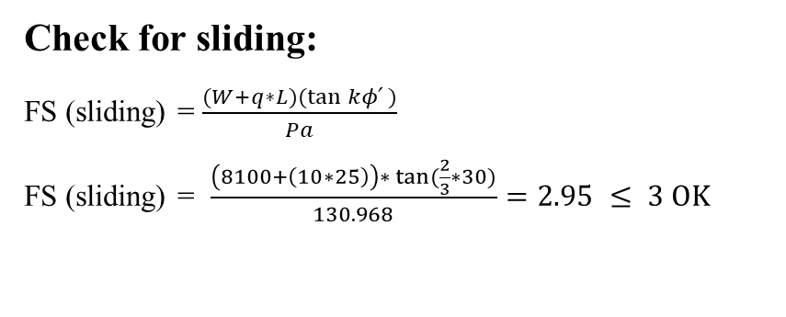
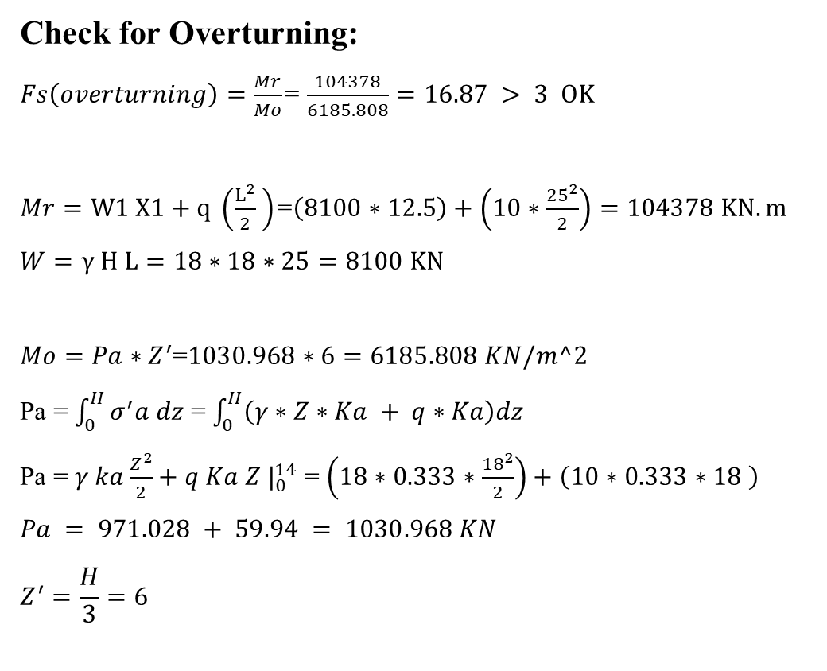
Check for Overturning:
$Fs\left(overturning\right)=\frac{Mr}{Mo}$= $\frac{104378}{6185.808}=16.87 > 3 OK$
$Mr=W1 X1+q \left(\frac{L^{2}}{2} \right)$=$\left(8100∗12.5\right)+\left(10∗\frac{{25}^{2}}{2}\right)=104378 KN.m$
$$W=γ H L=18∗18∗25=8100 KN$$
$Mo=Pa∗Z^{′}$=$1030.968∗6=6185.808 KN/m^2$
Pa = $\int_{0}^{H}{σ^{′}a dz}$ = $\int_{0}^{H}{\left(γ∗Z∗Ka + q∗Ka\right)dz}$
Pa = $γ ka\frac{Z^{2}}{2}+q Ka Z |_{0}^{14}$ = $\left(18∗0.333∗\frac{{18}^{2}}{2}\right)+\left(10∗0.333∗18 \right)$
$$Pa = 971.028 + 59.94 = 1030.968 KN$$
$$Z^{′}=\frac{H}{3}=6$$
Check for sliding:
FS (sliding) = $\frac{(W+q∗L)(\tan{kφ՛} )}{Pa}$
FS (sliding) = $\frac{\left(8100+\left(10∗25\right)\right)∗ \tan{(\frac{2}{3}∗30)}}{130.968}=2.95 ≤ 3 OK$
Check for ultimate Bearing Capacity:
Po ≤ Q_{all}
Po = (γ * Z) + q = (18 * 14) + 10 = 334 KN/m^2
334 ≥ 220 Not OK
In this case, we must improve the soil until it becomes Q_{all} ≥ P_{o}

Slide 18
Chapter Six
Design Of Traditional Retaining Walls
(Cantilever wall )

Slide 19
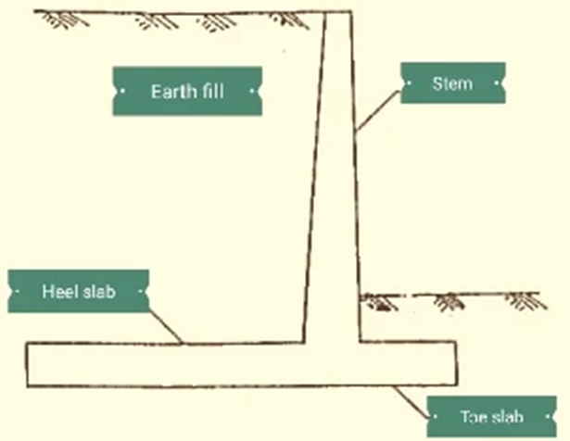
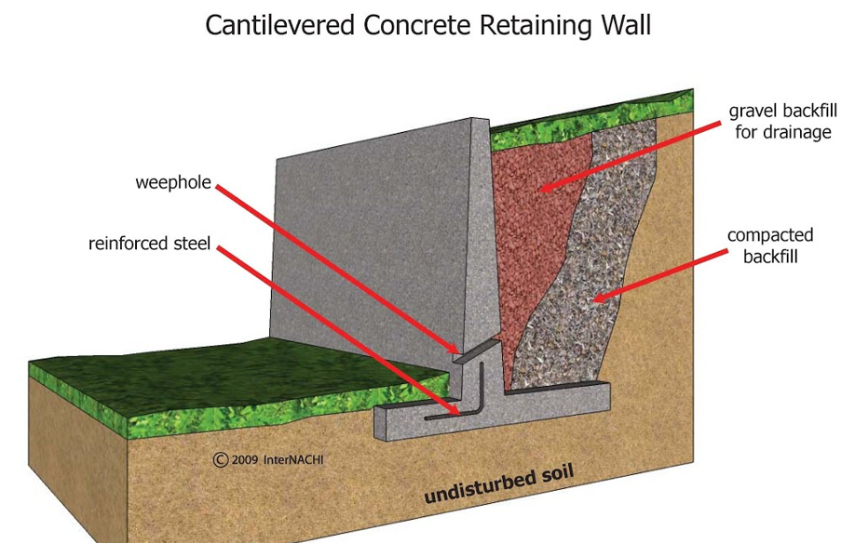
Introduction
Cantilever walls are built using reinforced concrete, with an L-shaped, or inverted T-shaped, foundation. This kind of retaining wall consists of a stem and a base slab (or footing) which sits under the backfill.

Slide 20
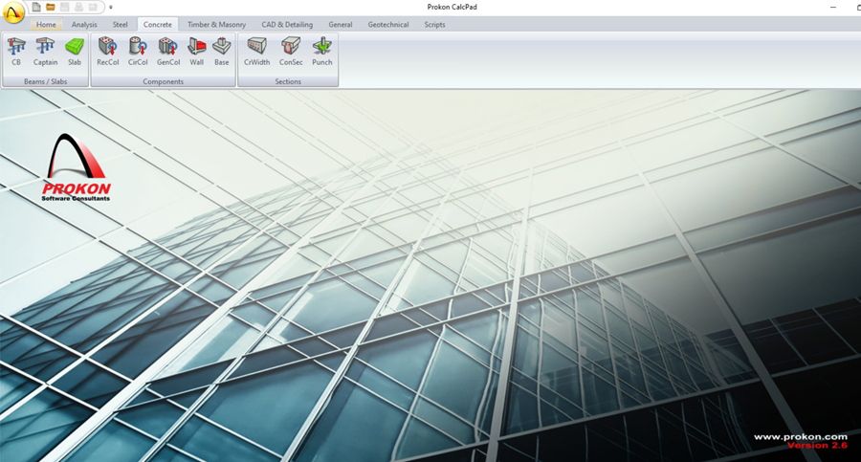
We designed a cantilever wall using the Prokon program with different lengths and dimensions so that they are within the necessary conditions for the wall to remain standing.

Slide 21
Through this program we will design two main factors through which we will calculate the cost :
Wall dimensions
Steel distribution
At four different heights:
H=8m
H=10m
H=14m
H=18m

Slide 22
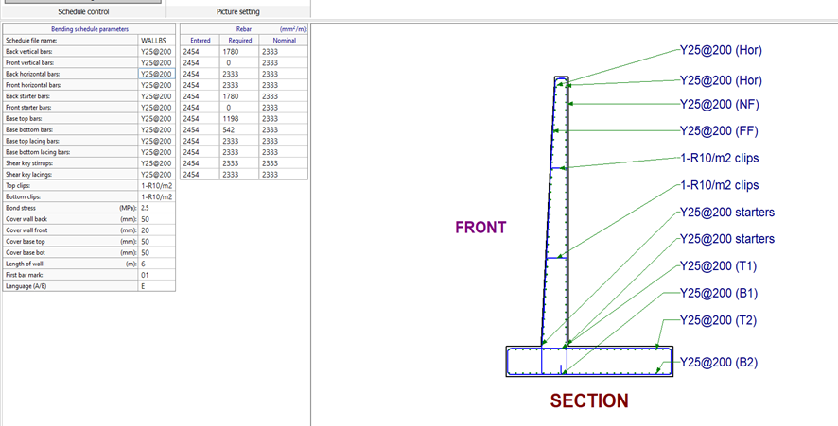
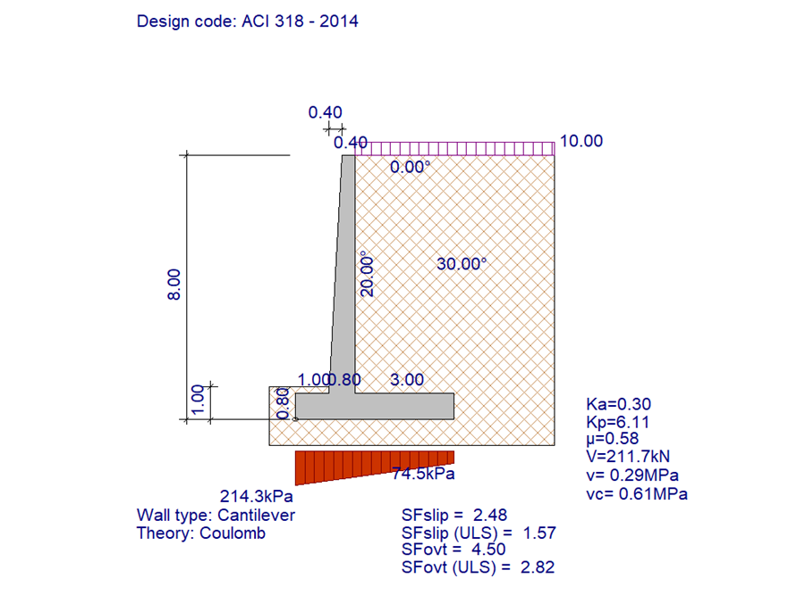
At Wall height = 8 m
Top stem = 0.4m
Bottom stem = 0.8m
Length of stem = 7.2m
Length of slab =4.8m
Thickness of slab = 0.8m
Steel : Φ 25 @ 200cm

Slide 23
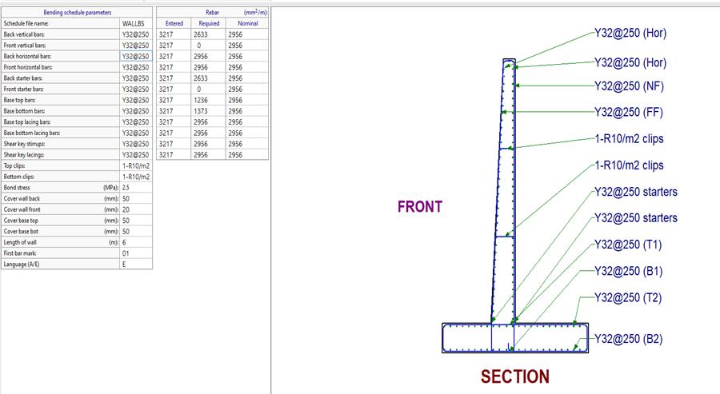
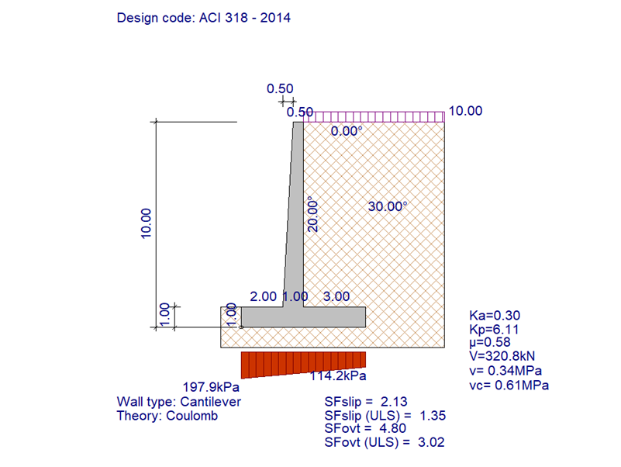
Wall height = 10 m
Steel : Φ 32 @ 250cm
Top stem = 0.5m
Bottom stem = 1.0m
Length of stem = 9.0m
Length of slab =6.0m
Thickness of slab = 1.0m

Slide 24
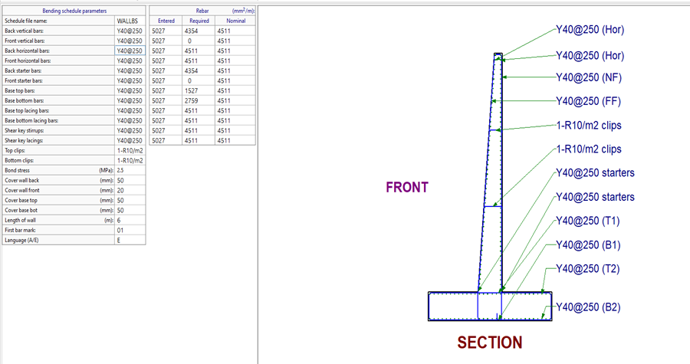
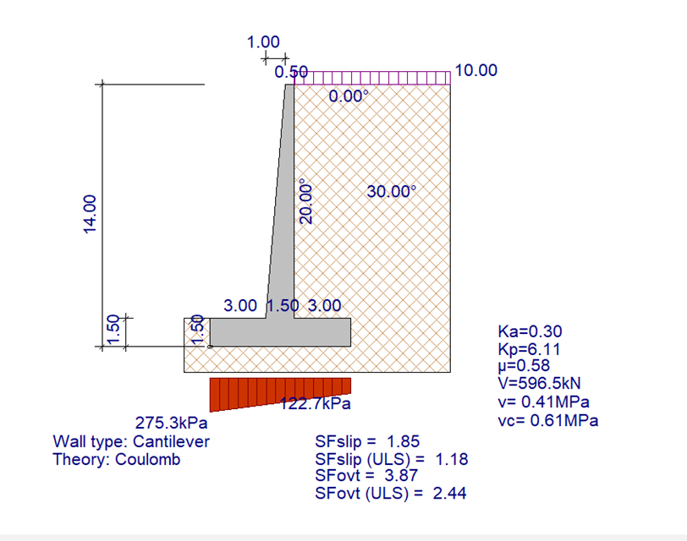
Wall height = 14 m
Top stem = 0.5m
Bottom stem = 1.5m
Length of stem = 12.5m
Length of slab = 7.5m
Thickness of slab = 1.5m
Steel : Φ 40 @ 250 cm

Slide 25
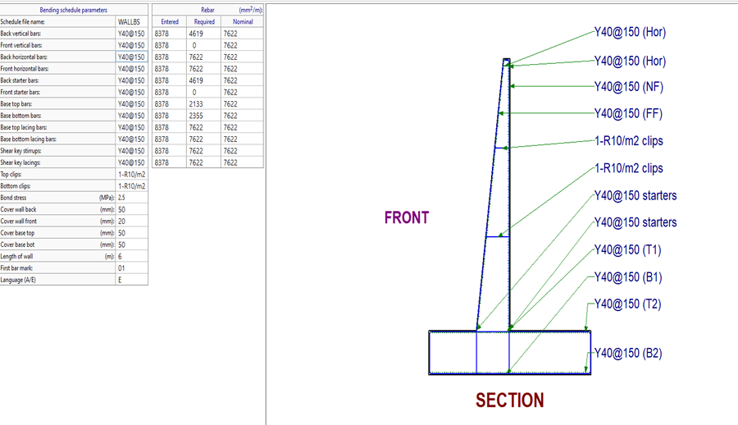
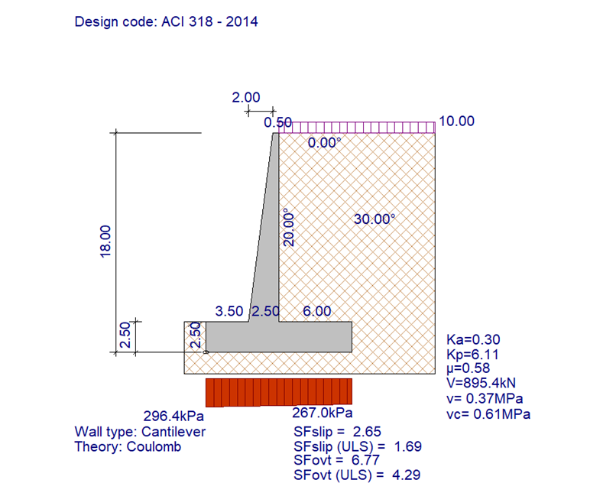
Wall height = 18 m
Steel : Φ 40 @ 150cm
Top stem = 0.5m
Bottom stem = 2.5m
Length of stem = 15.5m
Length of slab = 12m
Thickness of slab = 2.5m

Slide 26
Chapter Seven
Conclusions And Recommendation

Slide 27
Introduction
This final approach of this project aims to conduct a partial comparison between the Designs of Mechanically Stabilized Earth Retaining Walls (MSERW) and Conventional Retaining Walls.
Such a comparison will discuss the differences in terms of quantities and cost.
These calculated quantities will refer to the actual examples demonstrated in the previous chapters.

Slide 28
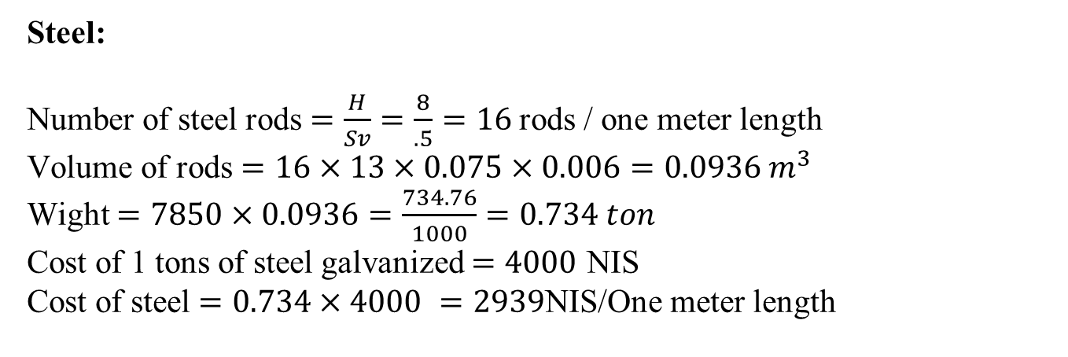
Calculation of quantities and cost of (MSERW) and Cantilever walls
Quantities and cost at H=8m
Calculation of quantities and cost for (MSERW):
H = 8m SV = 0.5m SH = 1m L = 13m T = 6mm W = 75mm
Steel:
Number of steel rods $=\frac{H}{Sv}=\frac{8}{.5}=16$rods / one meter length
Volume of rods $=16×13×0.075×0.006=0.0936 m^{3}$
Wight $=7850×0.0936=\frac{734.76}{1000}=0.734 ton$
Cost of 1 tons of steel galvanized $=4000$ NIS
Cost of steel $=0.734×4000 =2939$NIS/One meter length

Slide 29
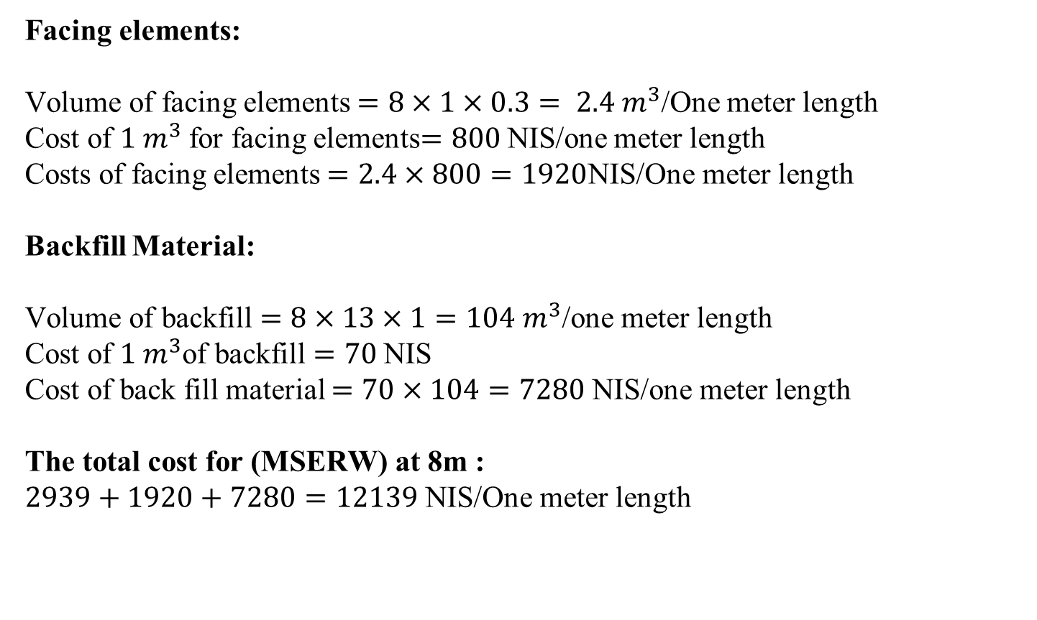
Facing elements:
Volume of facing elements $=8×1×0.3= 2.4 m^{3}$/One meter length
Cost of $1 m^{3}$for facing elements$=800$NIS/one meter length
Costs of facing elements $=2.4×800=1920$NIS/One meter length
Backfill Material:
Volume of backfill $=8×13×1=104 m^{3}$/one meter length
Cost of $1 m^{3}$of backfill $=70$NIS
Cost of back fill material $=70×104=7280$NIS/one meter length
The total cost for (MSERW) at 8m :
$2939+1920+7280=12139$NIS/One meter length

Slide 30
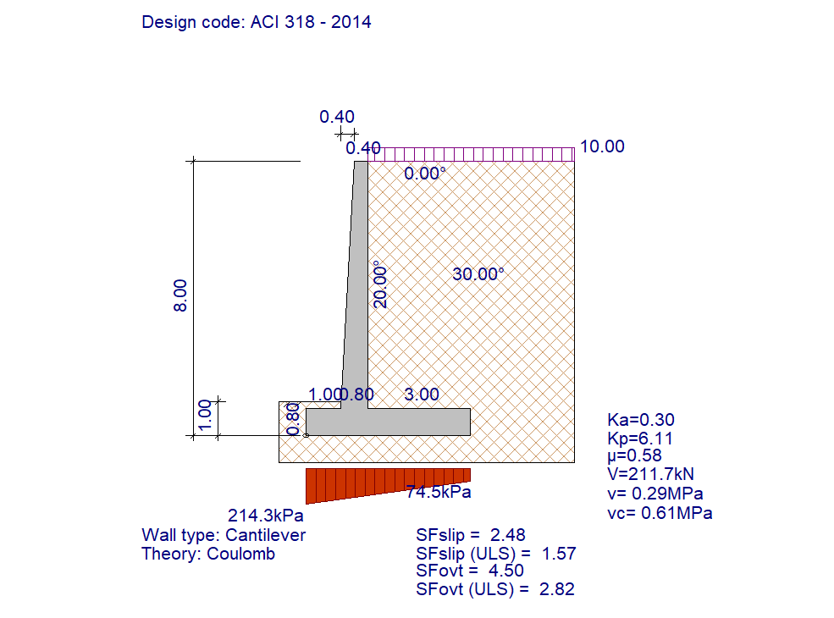
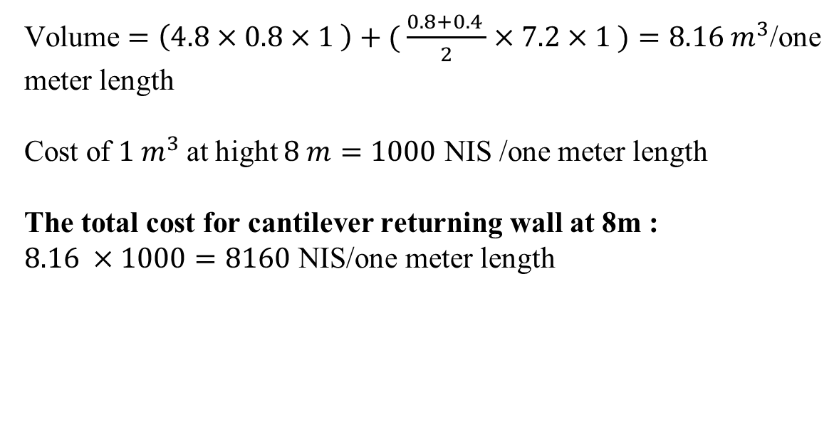
Calculation of quantities and cost for Cantilever Returning Walls:
Volume $=\left(4.8×0.8×1 \right)+( \frac{0.8+0.4 }{2}×7.2×1 )=8.16 m^{3}$/one
meter length
Cost of $1 m^{3}$at hight $8 m=1000$ NIS /one meter length
The total cost for cantilever returning wall at 8m :
$8.16 ×1000=8160$ NIS/one meter length

Slide 31
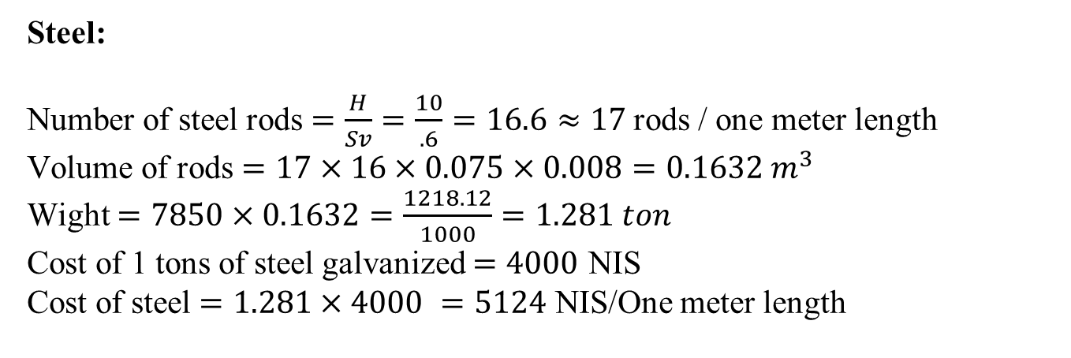
Quantities and cost at H=10m
Calculation of quantities and cost for (MSERW):
H = 10m SV = 0.6m SH = 1m L = 16m T = 8mm W = 75mm
Steel:
Number of steel rods $=\frac{H}{Sv}=\frac{10}{.6}=16.6≈17$rods / one meter length
Volume of rods $=17×16×0.075×0.008=0.1632 m^{3}$
Wight $=7850×0.1632=\frac{1218.12}{1000}=1.281 ton$
Cost of 1 tons of steel galvanized $=4000$ NIS
Cost of steel $=1.281×4000 =5124$ NIS/One meter length

Slide 32
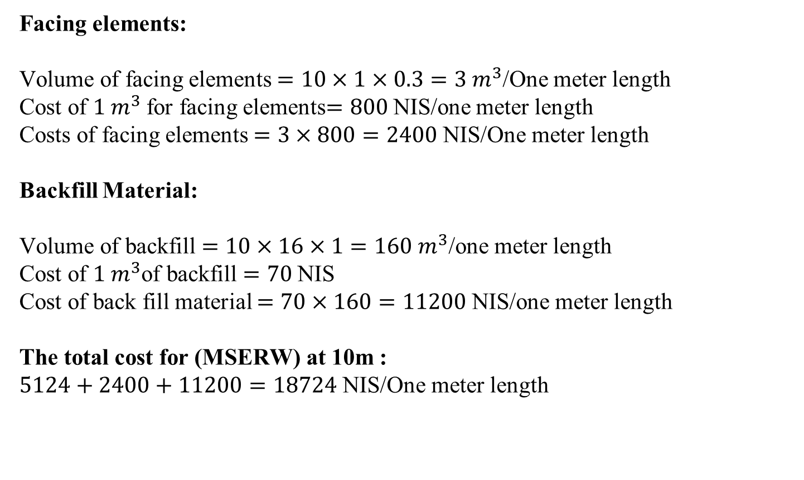
Facing elements:
Volume of facing elements $=10×1×0.3=3 m^{3}$/One meter length
Cost of $1 m^{3}$for facing elements$=800$NIS/one meter length
Costs of facing elements $=3×800=2400$NIS/One meter length
Backfill Material:
Volume of backfill $=10×16×1=160 m^{3}$/one meter length
Cost of $1 m^{3}$of backfill $=70$NIS
Cost of back fill material $=70×160=11200$NIS/one meter length
The total cost for (MSERW) at 10m :
$5124+2400+11200=18724$NIS/One meter length

Slide 33

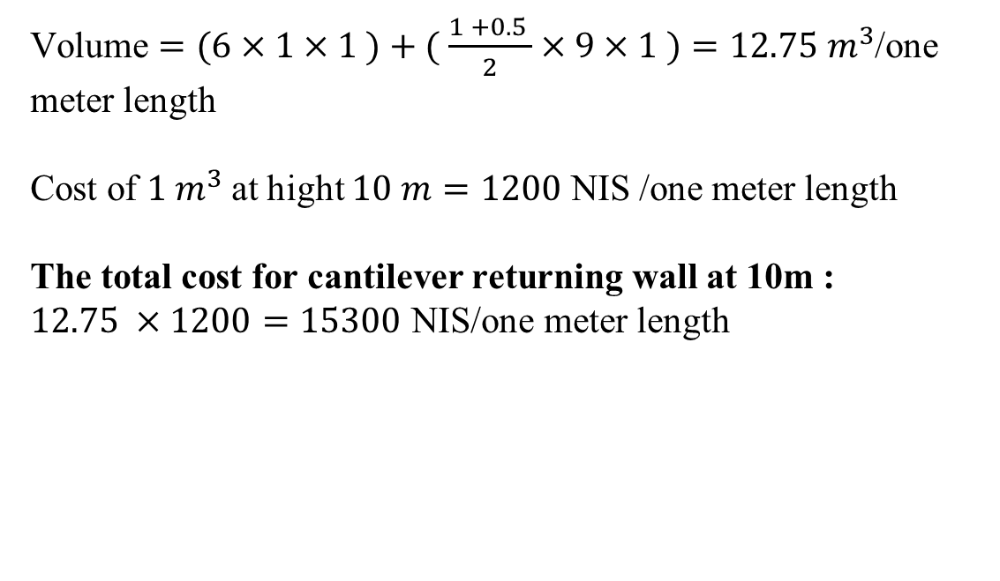
Calculation of quantities and cost for Cantilever Returning Walls:
Volume $=(6×1×1 )+( \frac{1 +0.5 }{2}×9×1 )=12.75 m^{3}$/one
meter length
Cost of $1 m^{3}$at hight $10 m=1200$ NIS /one meter length
The total cost for cantilever returning wall at 10m :
$12.75 ×1200=15300$ NIS/one meter length

Slide 34
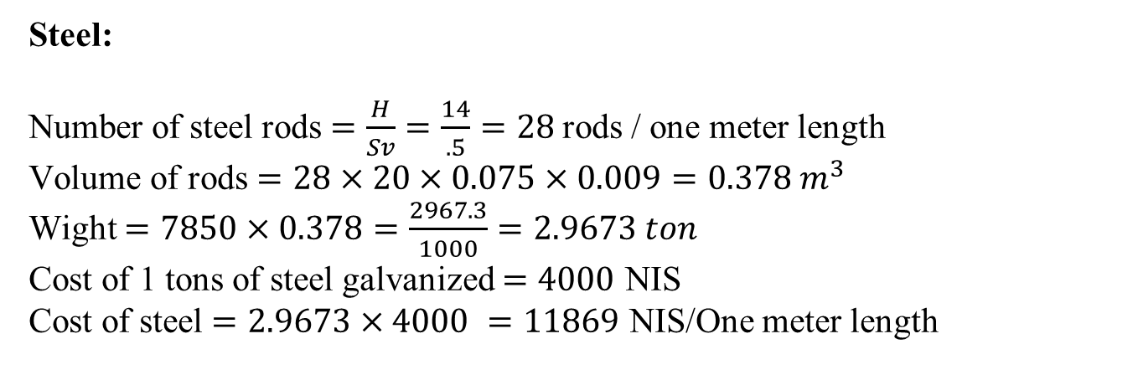
Quantities and cost at H=14m
Calculation of quantities and cost for (MSERW):
H = 14m SV = 0.5m SH = 1m L = 20m T = 9mm W = 75mm
Steel:
Number of steel rods $=\frac{H}{Sv}=\frac{14}{.5}=28$rods / one meter length
Volume of rods $=28×20×0.075×0.009=0.378 m^{3}$
Wight $=7850×0.378=\frac{2967.3}{1000}=2.9673 ton$
Cost of 1 tons of steel galvanized $=4000$ NIS
Cost of steel $=2.9673×4000 =11869$ NIS/One meter length

Slide 35

Facing elements:
Volume of facing elements $=14×1×0.3=4.2 m^{3}$/One meter length
Cost of $1 m^{3}$for facing elements$=800$NIS/one meter length
Costs of facing elements $=4.2×800=3360$NIS/One meter length
Backfill Material:
Volume of backfill $=14×20×1=280 m^{3}$/one meter length
Cost of $1 m^{3}$of backfill $=70$NIS
Cost of back fill material $=70×280=19600$NIS/one meter length
The total cost for (MSERW) at 14m :
$11869+3360+19600=34830$NIS/One meter length

Slide 36


Calculation of quantities and cost for Cantilever Returning Walls:
Volume$=(7.5×1.5×1)+(\frac{1.5+0.5 }{2}×12.5×1)=23.75 m^{3}$/one
meter length
Cost of $1 m^{3}$at hight $14 m=1600$ NIS /one meter length
The total cost for cantilever returning wall at 14m :
$23.75 ×1600=38000$ NIS/one meter length

Slide 37

Quantities and cost at H=18m
Calculation of quantities and cost for (MSERW):
H = 18m SV = 0.5m SH = 1m L = 25m T = 11mm W = 75mm
Steel:
Number of steel rods $=\frac{H}{Sv}=\frac{18}{.5}=36$rods / one meter length
Volume of rods $=36×25×0.075×0.011=0.7425 m^{3}$
Wight $=7850×0.7425=\frac{5828.62}{1000}=5.82 ton$
Cost of 1 tons of steel galvanized $=4000$ NIS
Cost of steel $=5.82×4000 =23280$ NIS/One meter length

Slide 38

Facing elements:
Volume of facing elements $=18×1×0.3=5.4 m^{3}$/One meter length
Cost of $1 m^{3}$for facing elements$=800$NIS/one meter length
Costs of facing elements $=5.4×800=4320$NIS/One meter length
Backfill Material:
Volume of backfill $=18×25×1=450 m^{3}$/one meter length
Cost of $1 m^{3}$of backfill $=70$NIS
Cost of back fill material $=70×450=31500$NIS/one meter length
The total cost for (MSERW) at 18m :
$23280+4320+31500=59100$NIS/One meter length

Slide 39


Calculation of quantities and cost for Cantilever Returning Walls:
Volume$=(12×2.5×1)+(\frac{2.5+0.5 }{2}×15.5×1)=53.25 m^{3}$/one
meter length
Cost of $1 m^{3}$at hight $18 m=2000$ NIS /one meter length
The total cost for cantilever returning wall at 18m :
$53.25 ×2000=106500$ NIS/one meter length

Slide 40
Height of wall (m) | Total cost of (MSERW) (NIS/One meter length) | Total cost of Cantilever Wall (NIS/One meter length) | Discrubtion
H=8m | 12139 | 8160 | the cantilever retaining wall is less expensive than (MSERW).
H=10m | 18424 | 15300 | the cantilever retaining wall is less expensive than (MSERW). But the difference becomes less at this height, meaning that the height of 10 m can be considered the turning point.
H=14m | 34830 | 38000 | the cantilever retaining wall is more expensive than (MSERW).
H=18m | 59100 | 106500 | the cantilever retaining wall is more expensive than (MSERW). We also notice that as the height increases, the difference between the two walls increases.

Slide 41
Thank you

