Slide 1

Integrated Design of
Public Library
By Murad H.Al-jawhary Anas M.Qaddara
Maha N.Jadallah Hala M.Salameh
An-Najah National University
Faculty of Engineering
Building Engineering Department
Supervised By
Eng. Fadi A.Fatayer
1

Slide 2
Introduction
Architectural Design
Environmental Design
Electrical Design
Quantity Surveying and Cost Estimation
Mechanical Design
Structural Design
Outline
2

Slide 3
Introduction
3

Slide 4
Public library building:
located in Nablus, Wadee Al Toffah
Nablus city does not have a public library with a complete design that satisfies all requirements of public library building
The goal was to provide an integrated design of a public library building that takes into account all design aspects
4

Slide 5
Architectural Design
5

Slide 6
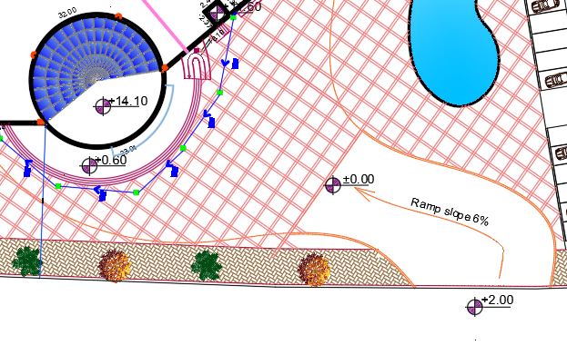
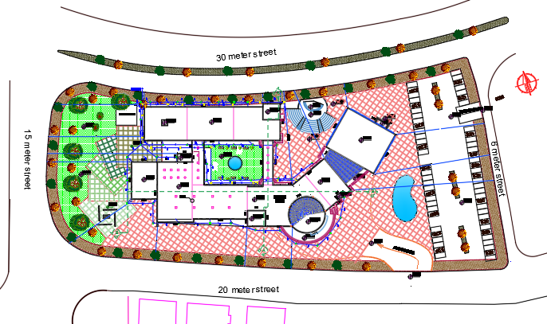
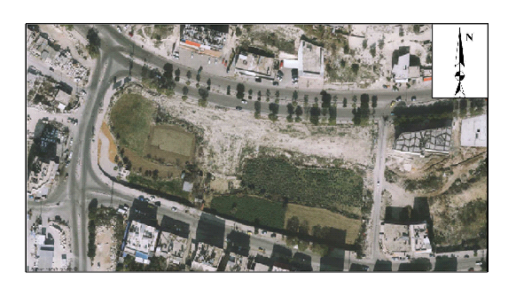
Site Plan
Site map
Main entrance
6

Slide 7
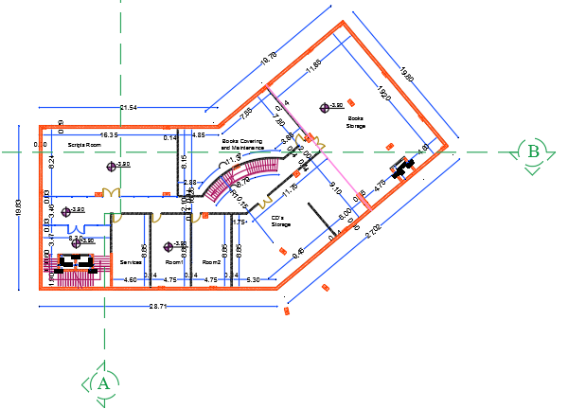
Architectural Design
Basement floor
7

Slide 8
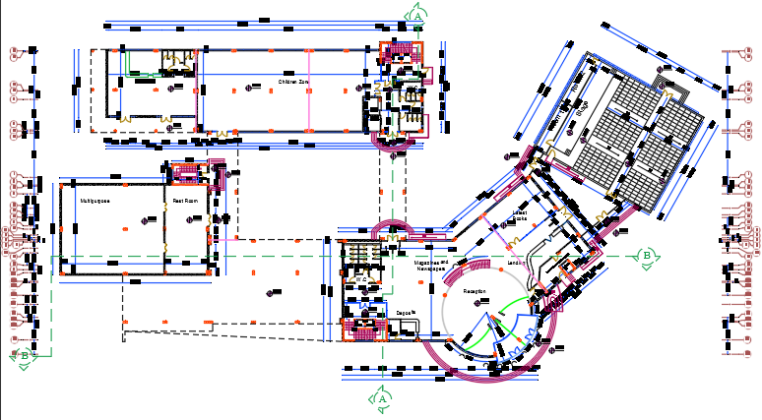
Architectural Design
Ground
floor
8

Slide 9
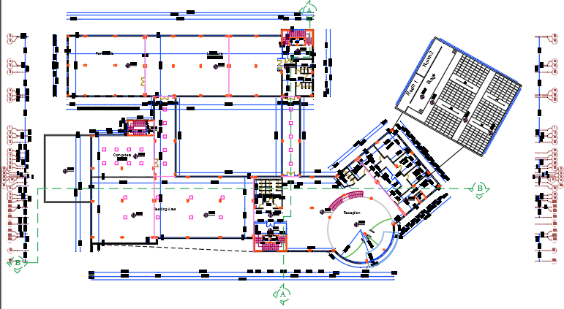
Architectural Design
First
floor
9

Slide 10
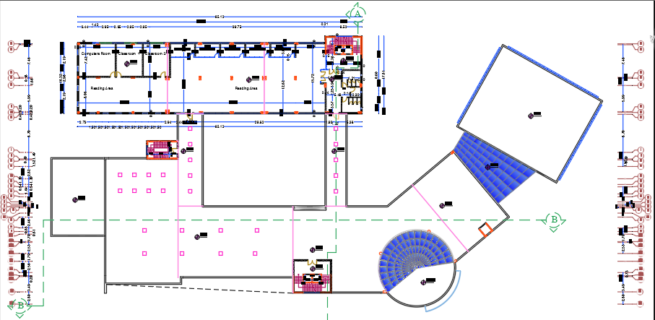
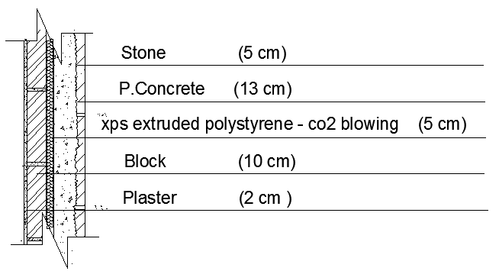
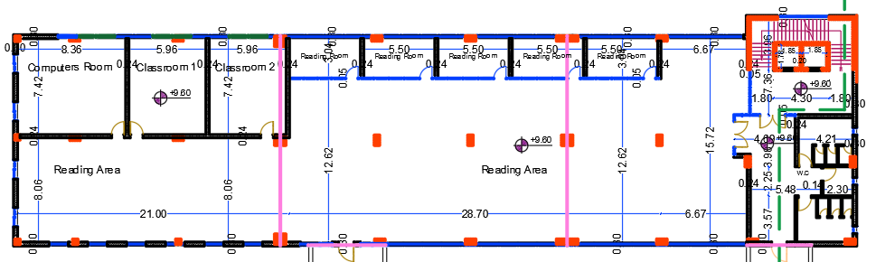
Architectural Design
Second
floor
10

Slide 11
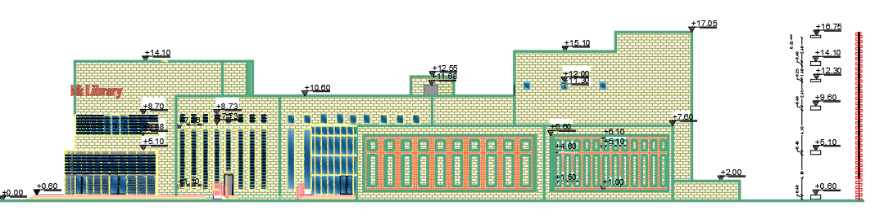
Architectural Design
East Elevation
11

Slide 12
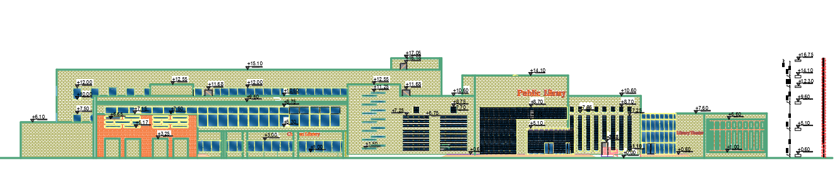
Architectural Design
South Elevation
12

Slide 13
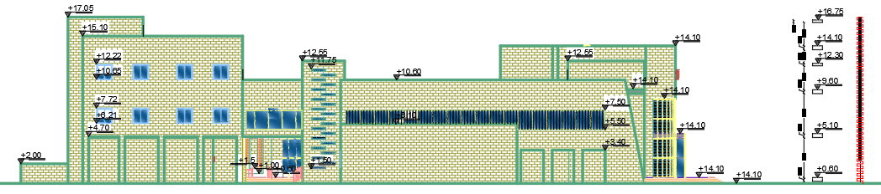
Architectural Design
West Elevation
13

Slide 14
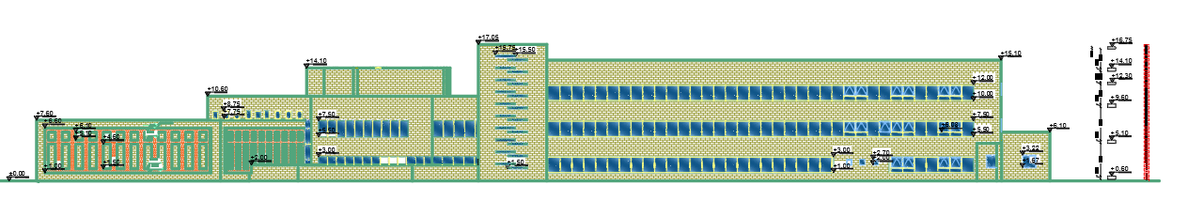
Architectural Design
North Elevation
14

Slide 15
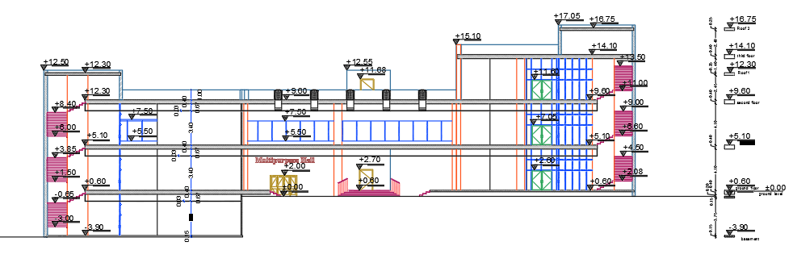
Architectural Design
Section A – A
15

Slide 16
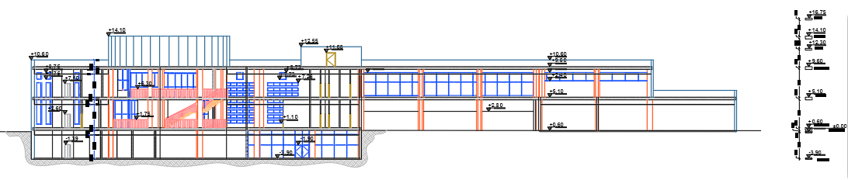
Architectural Design
Section B – B
16

Slide 17
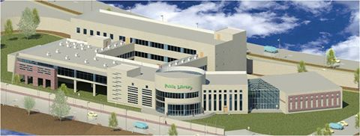
Architectural Design
3D model
17

Slide 18
Environmental Design
18

Slide 19
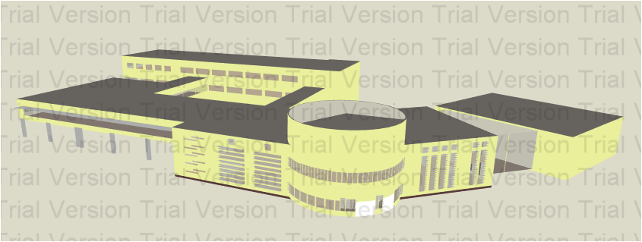
Environmental Design
Shading
Daylight
Thermal Design
Acoustics
Natural Ventilation
19

Slide 20
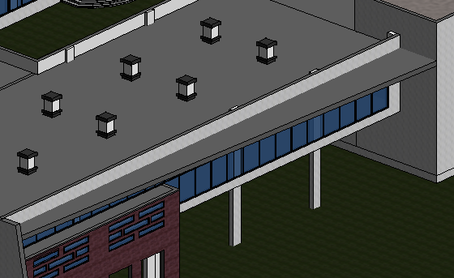
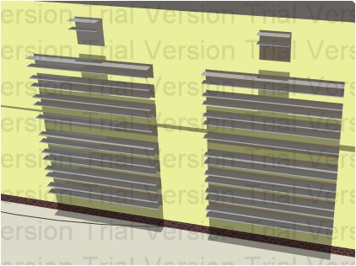
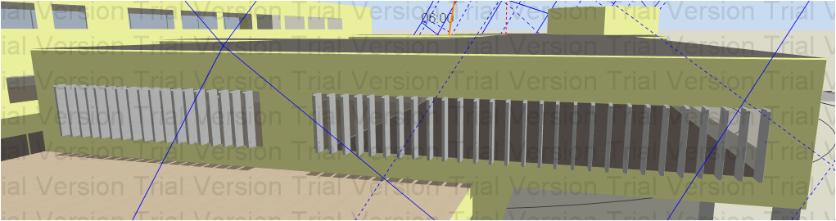
Environmental Design
West windows (vertical shutters)
South windows (horizontal shutters and cantilever)
Shading
20

Slide 21
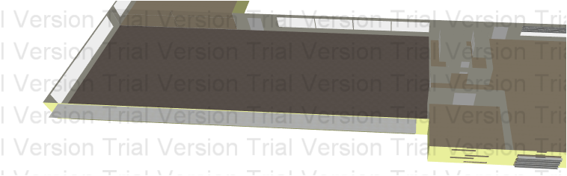
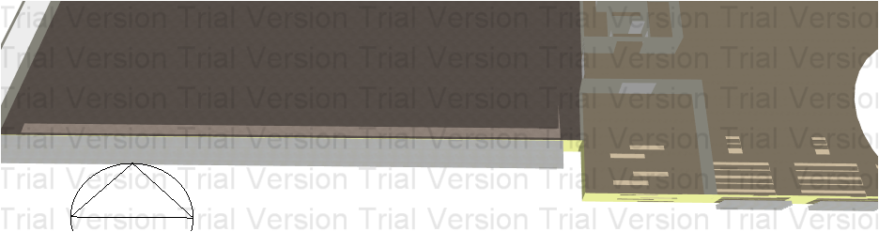
Environmental Design
Shading
South windows
Summer
Winter
21

Slide 22
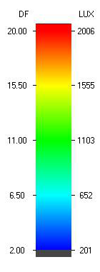
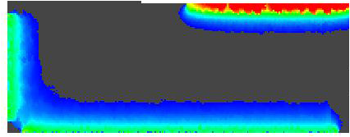
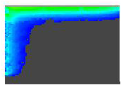
Environmental Design
Daylight
South reading area
Compute room
D.F = 3.04 %
D.F = 2.26 %
22

Slide 23
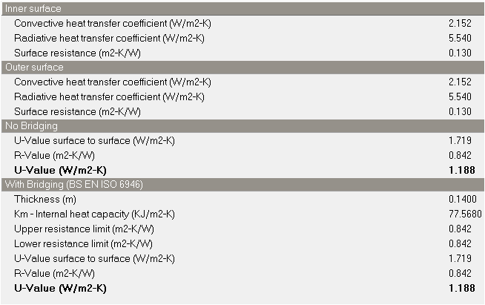
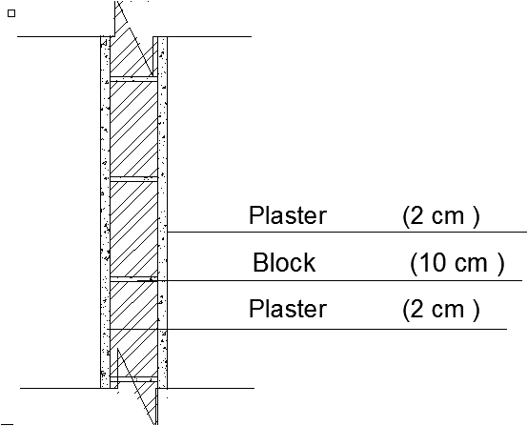
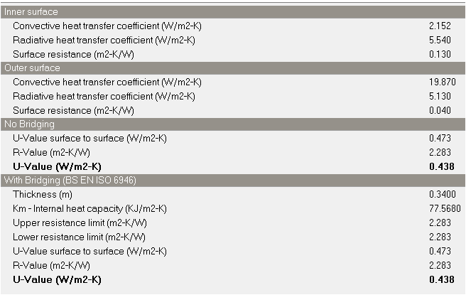
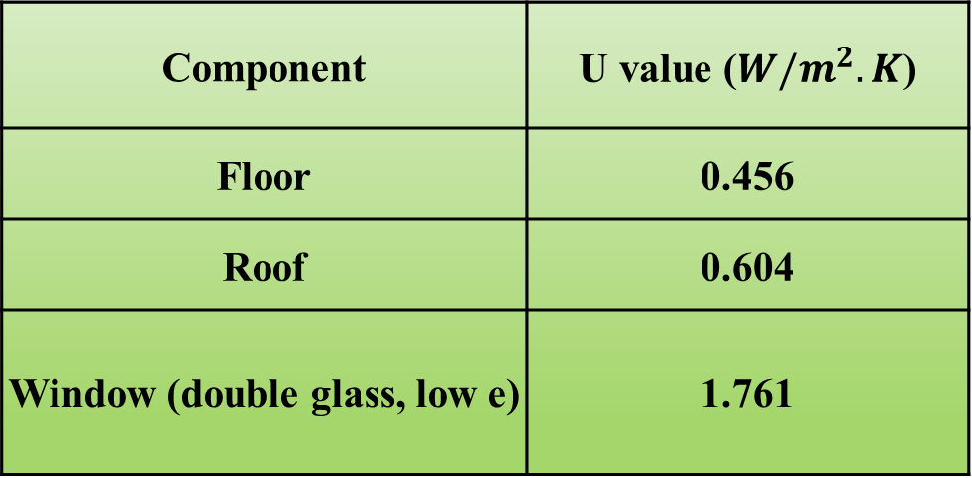
Environmental Design
Thermal Design
U value of other components
Internal wall (U value)
External wall (U value)
Component | U value ($W/m^{2}.K$)
Floor | 0.456
Roof | 0.604
Window (double glass, low e) | 1.761
23

Slide 24
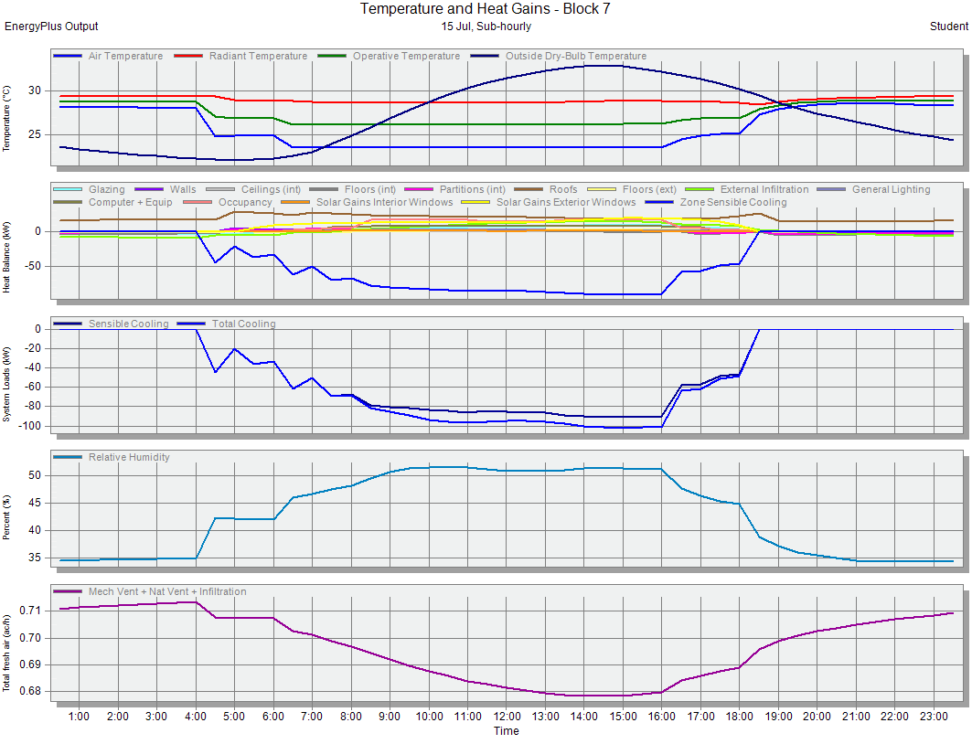
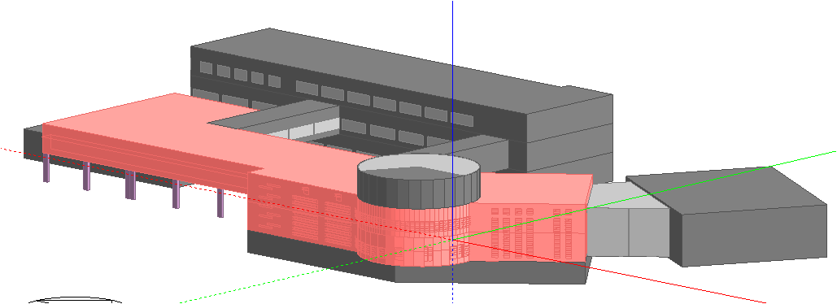
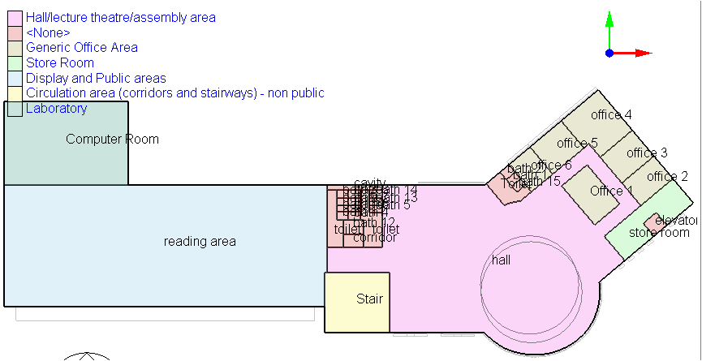
Environmental Design
Thermal Design
Cooling load diagram
Cooling loads
Total cooling load=162.41 kW
24

Slide 25
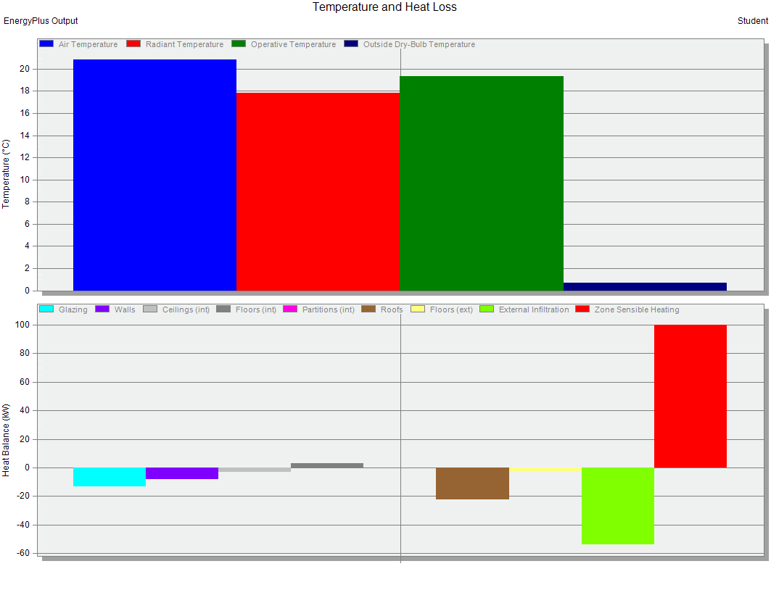
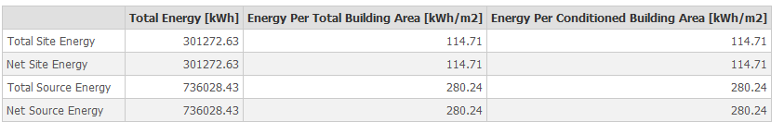
Environmental Design
Thermal Design
Heating load diagram
Energy consumption
Heating loads
Total heating load=124.49 kW
25

Slide 26
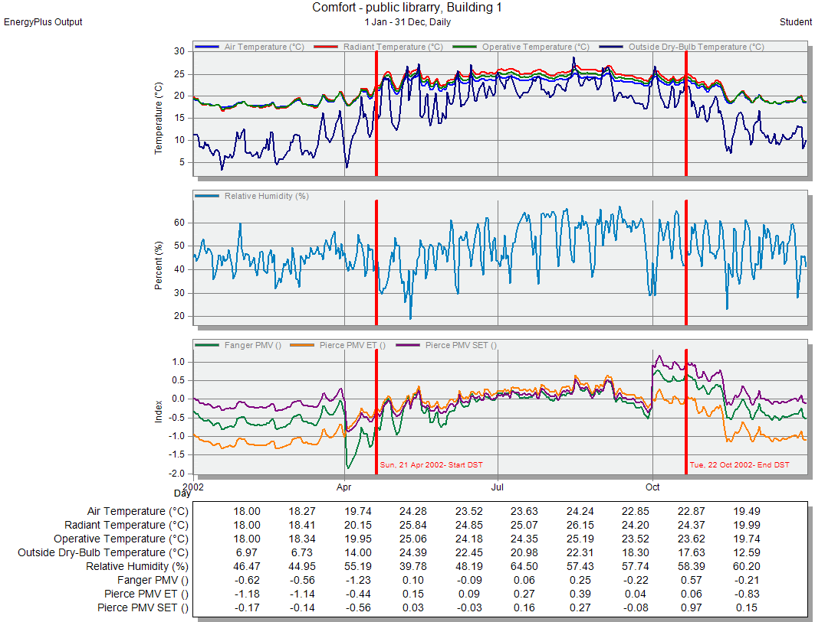
Environmental Design
PPD and PMV
26

Slide 27
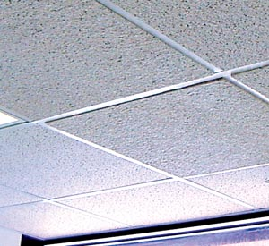

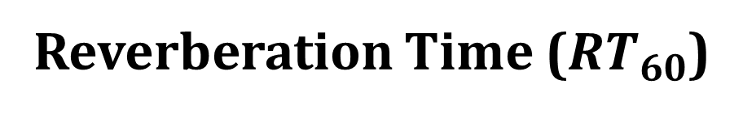
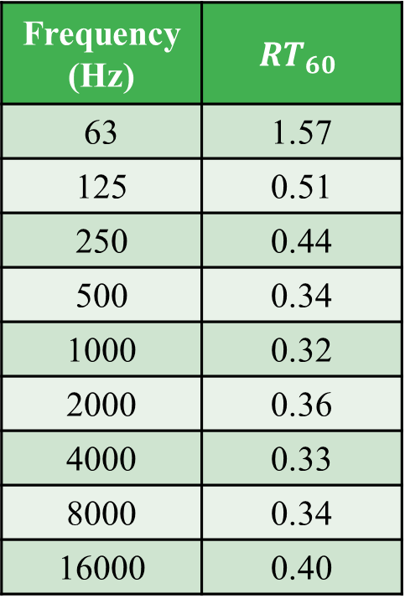
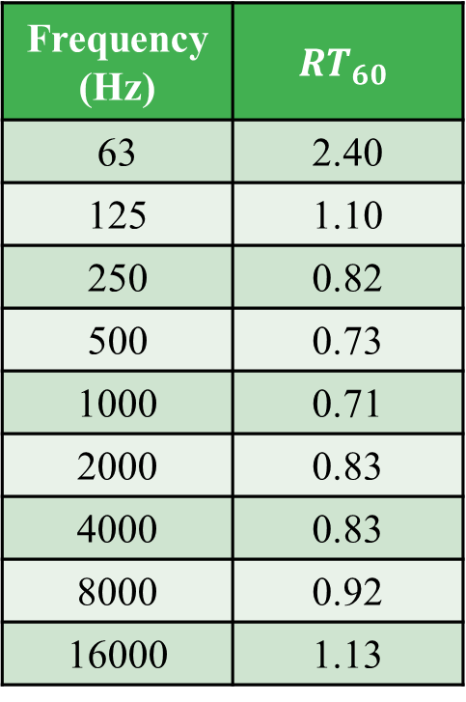
Environmental Design
Acoustics
Reverberation Time ($RT_{60}$)
Reading area
< 1.00
Frequency (Hz) | $$RT_{60}$$
63 | 2.40
125 | 1.10
250 | 0.82
500 | 0.73
1000 | 0.71
2000 | 0.83
4000 | 0.83
8000 | 0.92
16000 | 1.13
Librarian office
< 0.60
Frequency (Hz) | $$RT_{60}$$
63 | 1.57
125 | 0.51
250 | 0.44
500 | 0.34
1000 | 0.32
2000 | 0.36
4000 | 0.33
8000 | 0.34
16000 | 0.40
Used absorptive material
Acoustical ceiling tiles
27

Slide 28
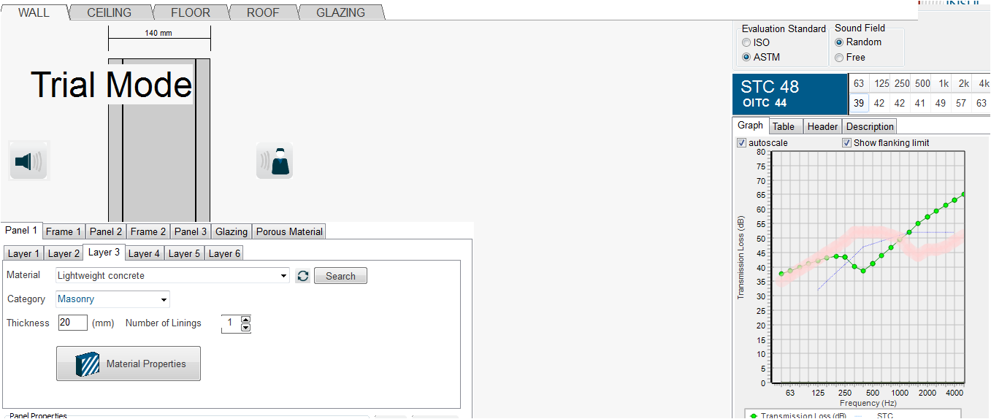
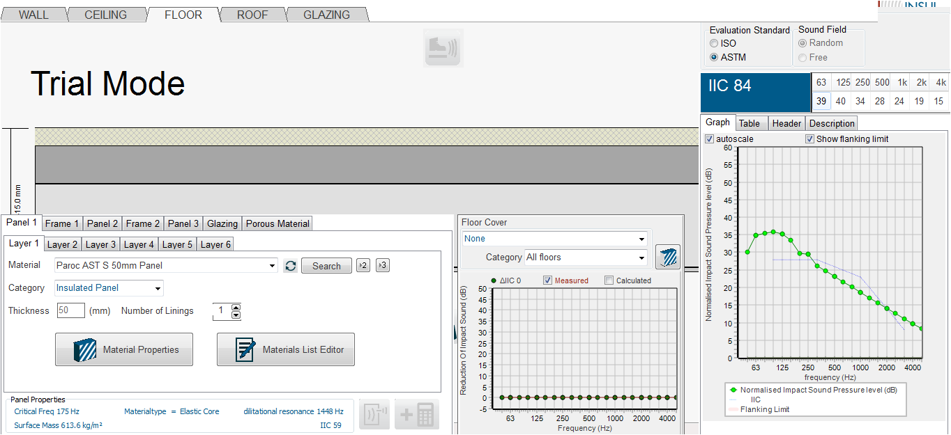
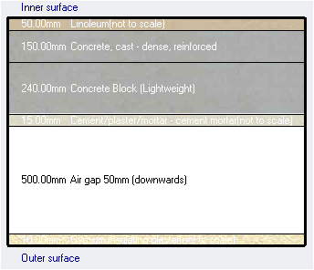
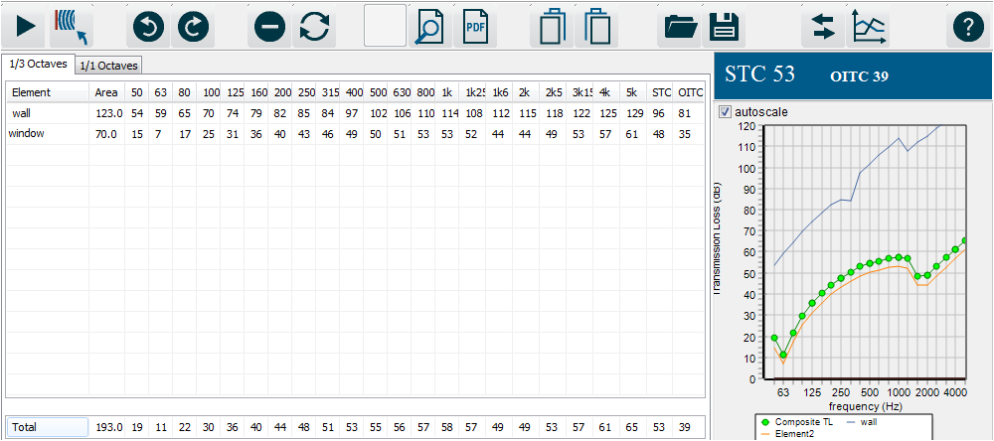
Environmental Design
Acoustics
STC and IIC
STC = 48 dB
TL composite =53 dB
External wall
IIC = 84 dB
Internal wall
Floor
28

Slide 29

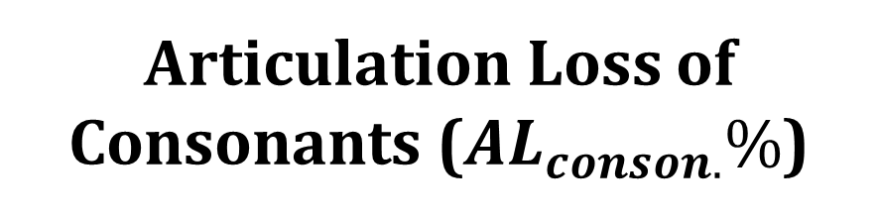
Environmental Design
Acoustics
Articulation Loss of Consonants ($AL_{conson.}\%$)
For classroom = 14.30 %
29

Slide 30
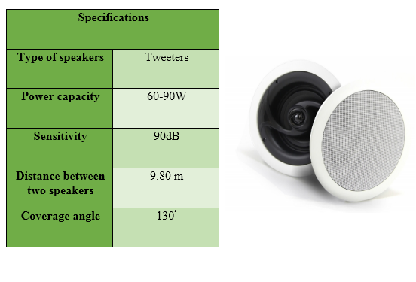
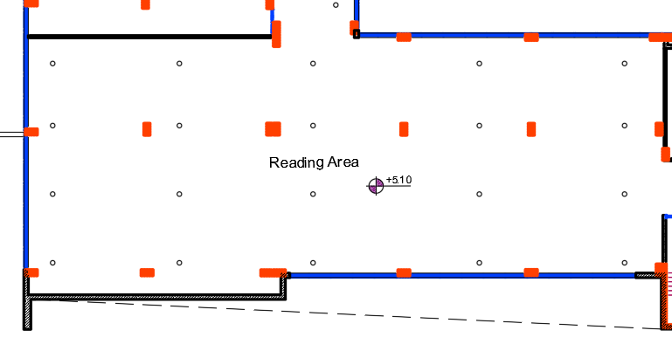
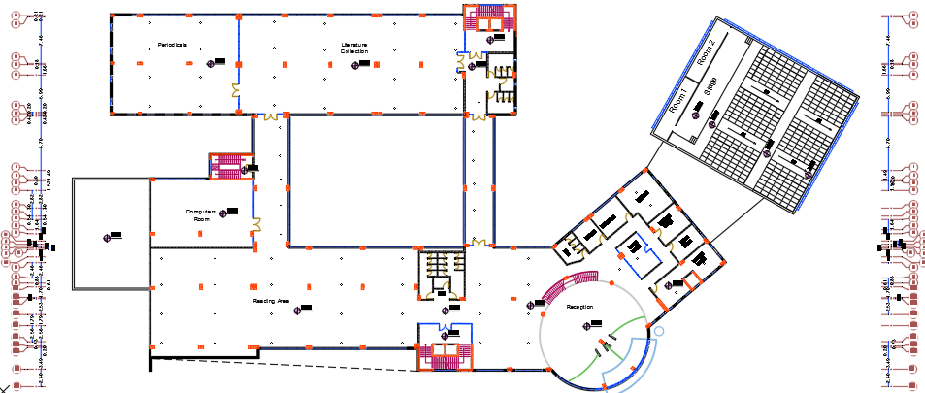
Environmental Design
Acoustics
Sound reinforcing system
31

Slide 31
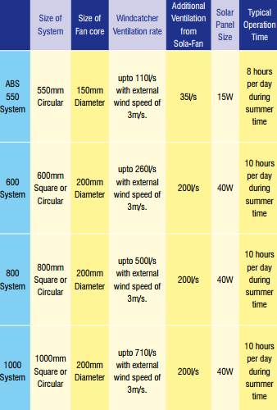
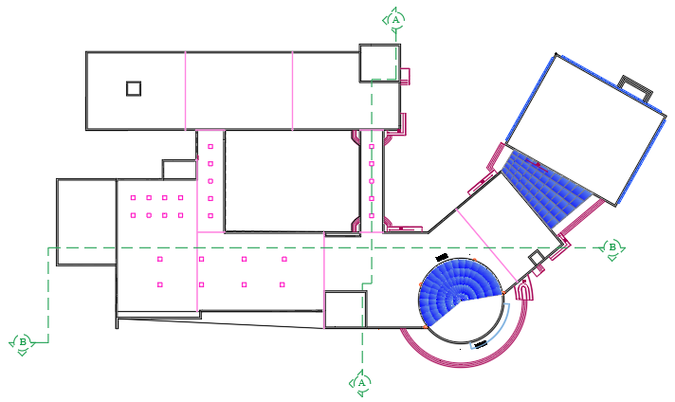
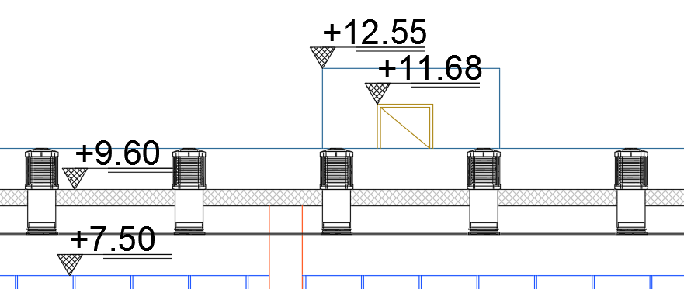

Environmental Design
Natural Ventilation
Sola-Boost windcatchers
32

Slide 32
Structural Design
33

Slide 33
Structural Design
Codes
(ACI 318-14) for RC Structures Design
(ACI 350.3-06) for Water Tank Seismic Loads
(UBC 97) for Earthquake Loads
(ASCE 7 2010) for loads computations
34

Slide 34

Structural Design
Loads
Live Load = $4 KN/m^{2}$
SID= $5.65 KN/m^{2}$
EQ Loads (UBC97):
I= 1.25 Cv=0.4
R= 5.5 Ca=0.28
Z= 0.2 (2B) Ct= 0.0488
35

Slide 35

Structural Design
Material
Concrete B350
Steel Fy = 420MPa
Final Design Sections
Slabs thickness 0.4 m
Columns(rectangular) (0.8$×$0.4),(0.8$×$0.8 m)
Column(circular) 0.30 m (radius)
Beams (0.45$×$0.35),(0.50$×$0.35 ),(0.60$×$0.50)m
Walls thicknesses 0.2 & 0.3 m
Structural system
Two way ribbed slab
36

Slide 36


Structural Design
3D model
Selected
Block
37

Slide 37


Structural Design
Compatibility Check
38

Slide 38

Structural Design
Load | Manual calculations (KN) | Calculations from ETABS (KN) | Difference (%)
Dead load | 20785 | 20474 | 1.50
Live load | 7423 | 7423 | 0.00
Superimposed dead load | 13268 | 13551 | 2.00
C1
Equilibrium Check
Internal Forces Check
Element | Hand calculations | Calculations from ETABS | Difference (%)
Column 1 | 1273 KN.m | 1370 KN.m | 7.08
Beam 3 | 172 KN.m | 129 KN.m | 25.00
Slab 2 | 250 KN | 218 KN | 12.80
39

Slide 39

Structural Design
Deflection
Limit = 11300/240
= 47 mm
(According to
ACI 318-11)
40

Slide 40



Structural Design
Slab:
Two-Way Ribbed Slab
41

Slide 41



Structural Design
Beam Design
42

Slide 42



Structural Design
Column | Section (mm) | reinforcement |  | STIRRUPS
 |  |  | Zone A | Zone B
C (1,4,6,14,15,2,7,5,17,16) | 800*400 | 14$∅$18 | 2$∅10/150mm$ | 2$∅10/300mm$
C (3,8) | 800*400 | 1$4∅$18 | 2$∅10/150mm$ | $$2∅10/300mm$$
C(9) | 800*400 | 14$∅$20 | 3$∅10/150mm$ | $$3∅10/300mm$$
C(10,11,12,13) | 800*800 | 20$∅$18 | $$3∅10/150mm$$ | $$3∅10/300mm$$
 | D600 | 14$∅$16 | $$∅10/120mm$$ | $$∅10/250mm$$
C(18) | 400*800 | 18$∅$20 | 2$∅10/150mm$ | $$2∅10/300mm$$
Column Design
43

Slide 43

Structural Design
Footing Design
44

Slide 44



Structural Design
Footing Design
Section in footing (F1)
Plan of footing (F1)
45

Slide 45


Structural Design
Shear wall Design
46

Slide 46



Structural Design
Water Tank Design
47

Slide 47

Structural Design
Stair Design
48

Slide 48
Electrical Design
49

Slide 49















Electrical Design
Light scenes
Artificial lighting:
In reading room: ceiling lamps are on and table lamps are off.
In the other spaces: all lamps are on
Calculation results
Required uniformity
(>0.60)
(>0.60)
(>0.40)
c
c
Required illuminance
(300-500 lx)
Required uniformity
(>0.60)
Max 15.6 at 330̊
50

Slide 50


Electrical Design
Light scenes
2. Artificial lighting:
In reading room: ceiling lamps are on and table lamps are dimmed by 50% )
51

Slide 51


Electrical Design
Light scenes
3. Artificial and daylighting:
52

Slide 52
Electrical Design
Summary
Total load from light scene (1) = 5401.2 W
Total load from light scene (2) = 5744.6 W
Total load from light scene (3) = 4848.0 W
52

Slide 53
Mechanical Design
53

Slide 54



Mechanical Design
Water Supply System
Library water demand = 65 $m^{3}$
54

Slide 55


Mechanical Design
Drainage System
55

Slide 56


Mechanical Design
Rain Water Drainage
56

Slide 57





Mechanical Design
HVAC system
VAV (Variable Air Volume) system
Ceiling Diffuser
(525$×$525 mm)
Air flow 689 L/s
Noise level 37 dBA
Fan coil unit
(42 NH)
(3.7– 12.6 kW) cooling
(5.1– 17.5 kW) heating
Carrier company
Chiller
(16LJ 01-82)
(80 – 4000 kW)
Carrier company
57

Slide 58


Mechanical Design
HVAC system (GF floor)
58

Slide 59


Mechanical Design
HVAC system (1st floor)
59

Slide 60







Mechanical Design
Emergency Egress System
Emergency
Fire Protection System
`
60

Slide 61
Quantity Surveying & Cost Estimation
61

Slide 62

Quantity Surveying and Cost Estimation
Total Cost for finishings and Structural Design
= 12,401,045 NIS
Total Cost for Mechanical Design = 1,656,315 NIS
Total Cost for Electrical Design including elevators
= 595,725 NIS
Total Cost for Project =14,653,085 NIS (1,519 NIS/$m^{2}$)
62

Slide 63

Thank You
63

