Slide 1

.
An-Najah National University
Faculty of Engineering and Information Technology
Department of Mechanical and Mechatronics Engineering
Graduation Project 2:
Geothermal Energy In Palestine: Current Situation (Hardee's Restaurant).
Supervisor:
Dr. Ramez khaldi.
Group members:
Nour Yaseen.
Obaida Rahhal.
Dec-2021

Slide 2
Abstract
The Palestinians are now paying the highest prices for energy and a clear increase in the number of people and equipment, so it is necessary to use alternative natural energy sources, including the heating and adaptation system using geothermal energy.
Geothermal energy is useful and environmentally friendly, as heat is transferred from the ground.
In this project, we will compare the advantages and disadvantages of geothermal energy with other types of energy in terms of (cost, maintenance and most effective).

Slide 3
Contents:
CHAPTER 1: INTRODUCTION.
CHAPTER 2: LITERATURE REVIEW.
CHAPTER 3:GEOTHERMAL ENERGY IN PALESTINE.
CHAPTER 4: METHDOLOGY.
CHAPTER 5: RESULTS AND DISCUSSION(COST ANALYSIS).
CHAPTER 6: CONCLUSIONS AND RECOMMENDATIONS.

Slide 4
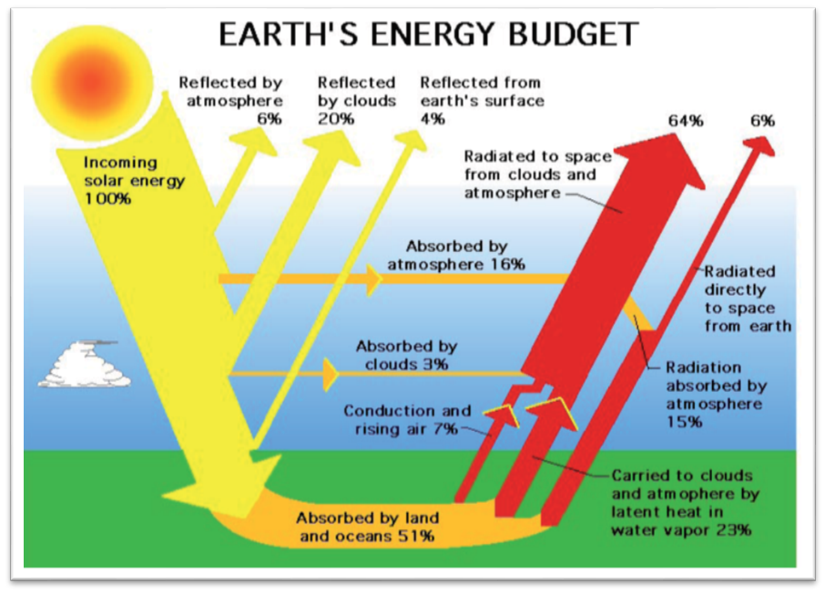
Chapter 1:Introduction
The word “Geothermal" has its origins in Greek roots ("geo" means earth and "thermo" means heat).
Geothermal conversion: The basic idea behind employing geothermal energy is to use the temperature differential between the Earth and the building to raise or lower its temperature, or even to create electricity.
Figure (1): Earth’s energy budget

Slide 5
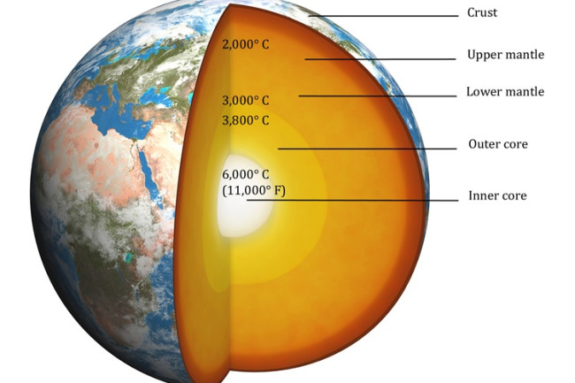
Layers of earth:
The crust: is the outer solid shell of a rocky planet, ranges from 5 to 70 km.
The mantle: constitutes 84% of the total size of the earth, the thickness of the mantle is about 2900 km, The temperature of the mantle varies greatly, from 1000 to 3700 Celsius.
Earth’s core: 2,900 kilometers below the surface of the earth, temperature is between 4500 and 5500 ° C.
Figure (2): The earth's crust and its temperature

Slide 6
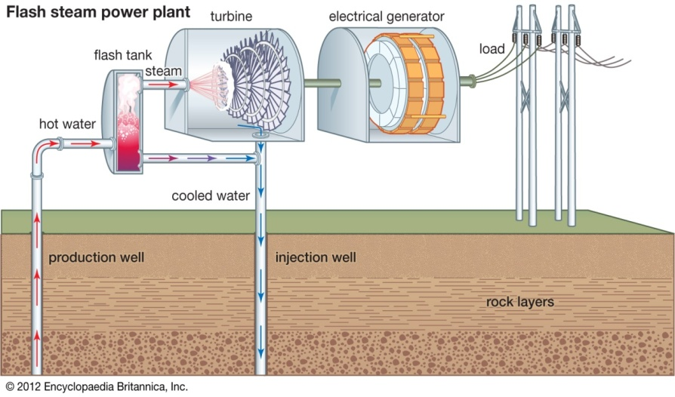
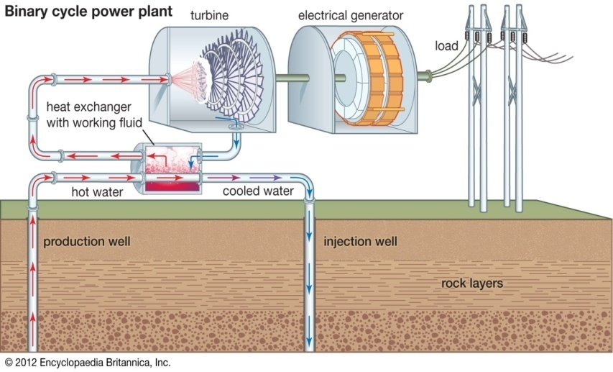
Extraction and uses of geothermal energy:
1 Direct use and district heating systems
2 Geothermal Power plants
Dry Steam Power Plants flash steam power plant
Dual cycle (Binary Cycle)
3 Geothermal heat pumps
Figure (3): flash steam power plant
Figure (4): Binary cycle power plant.

Slide 7
Type of geothermal heat pump system:
1 Open-loop geothermal systems:They primarily employ groundwater as a coolant for thermodynamic energy transfer.
2 Closed-loop geothermal systems:They vary from open-loop geothermal systems in that they transmit heat using water that travels via subterranean pipes rather than groundwater.
Closed-loop geothermal systems are classified into three types:
Horizontally loops.
Vertical loops.
Pond or lake loops.
3Hybrid systems: Hybrid system is a blend of geothermal heat pump, and air source heat pumps to offer a cost-effective and highly efficient system.

Slide 8
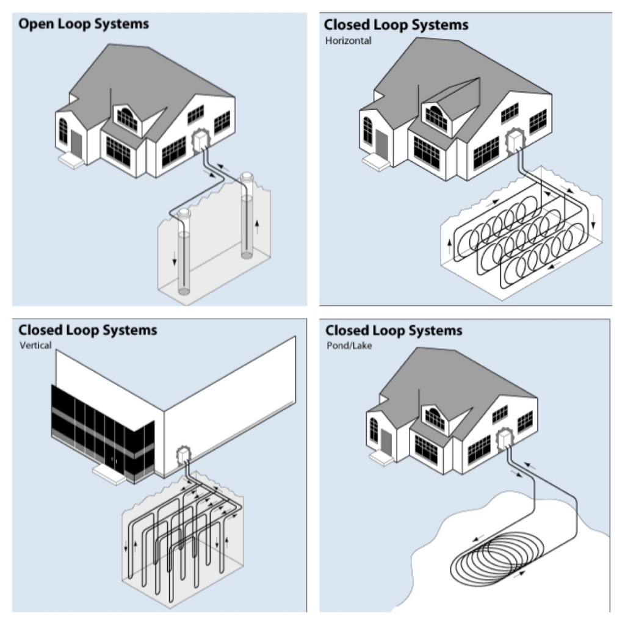
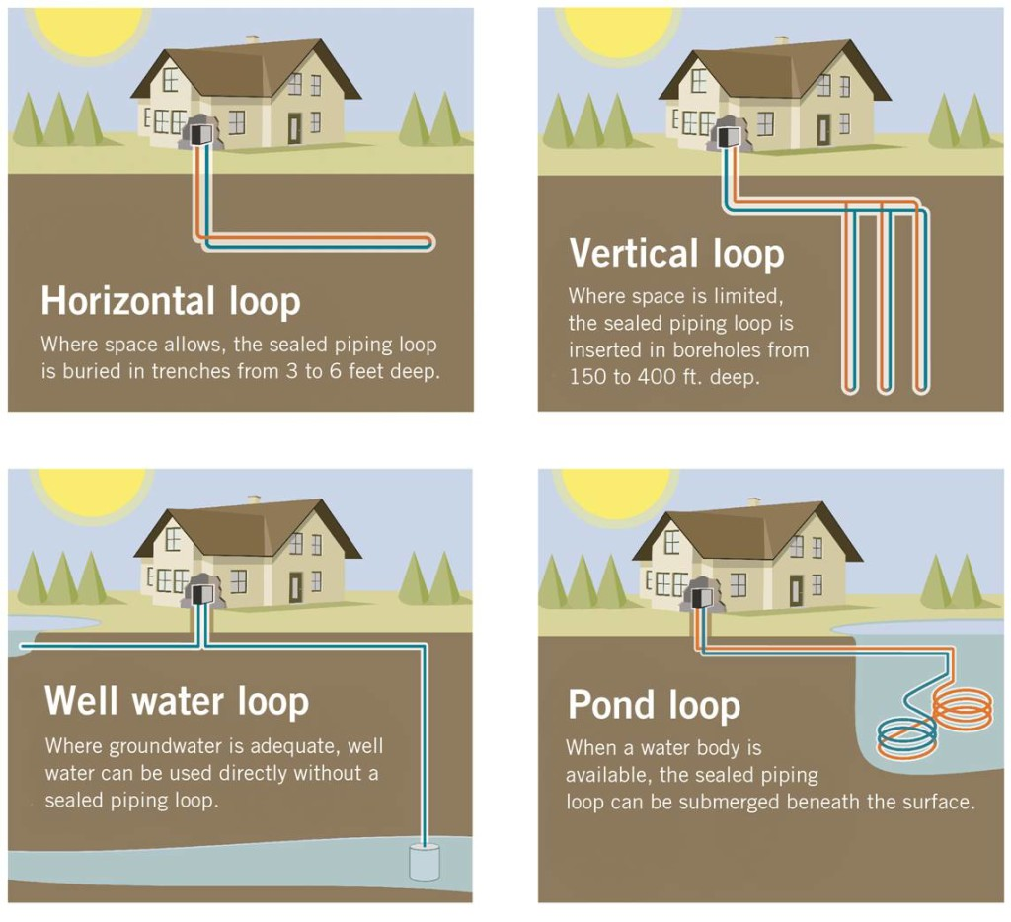
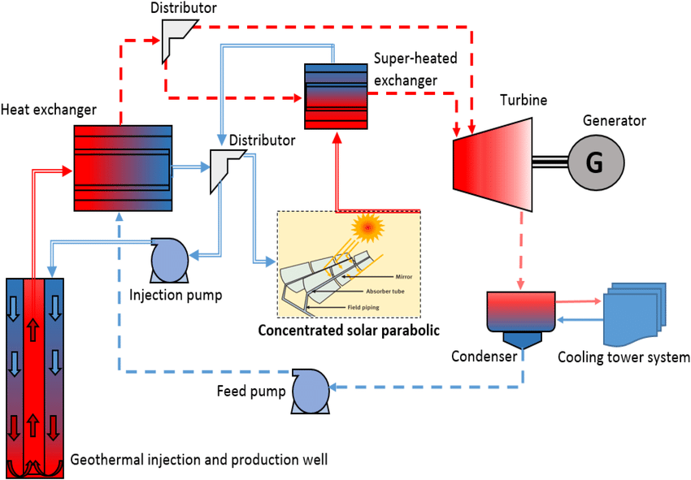
.
Figure (5):Type of geothermal heat pump system
Figure (6):Types of closed loop geothermal systems
Figure (7):Hybrid-geothermal and CST power cycle

Slide 9
Advantages and Disadvantages of geothermal system:
Advantages of geothermal system
1. Environmentally Friendly
2. Renewable
3. Huge Potential
4. Sustainable / Stable
5. Heating and Cooling
6. Reliable
7. No Fuel Required
8. Rapid Evolution
Disadvantages of geothermal system
1. Location Restricted
2. Environmental Side Effects
3. Earthquakes
4. High Costs
5. Sustainability

Slide 10
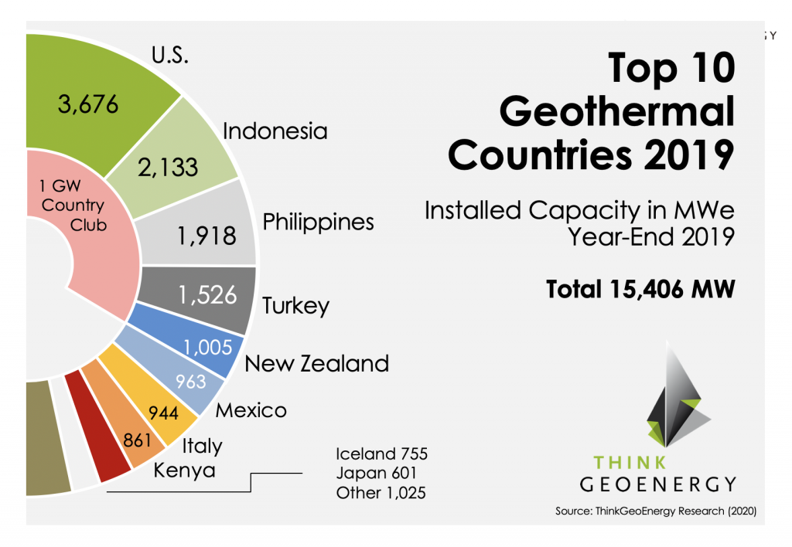
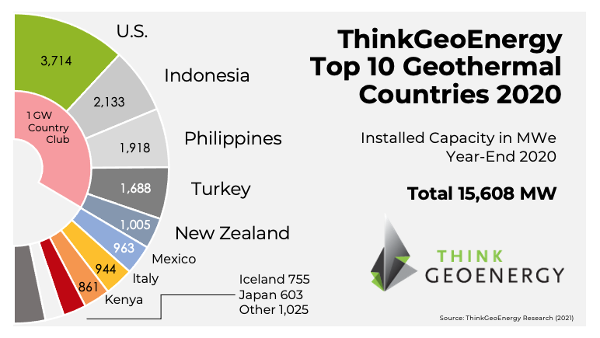
CHAPTER 2: Literature review.
Top 10 countries in geothermal energy (end2019):
Top 10 countries in geothermal energy (end 2020):
Figure (8): Countries that produce the most heat energy in the world in Year-End 2019.
Figure (9): Countries that produce the most heat energy in the world in the end of 2020.

Slide 11
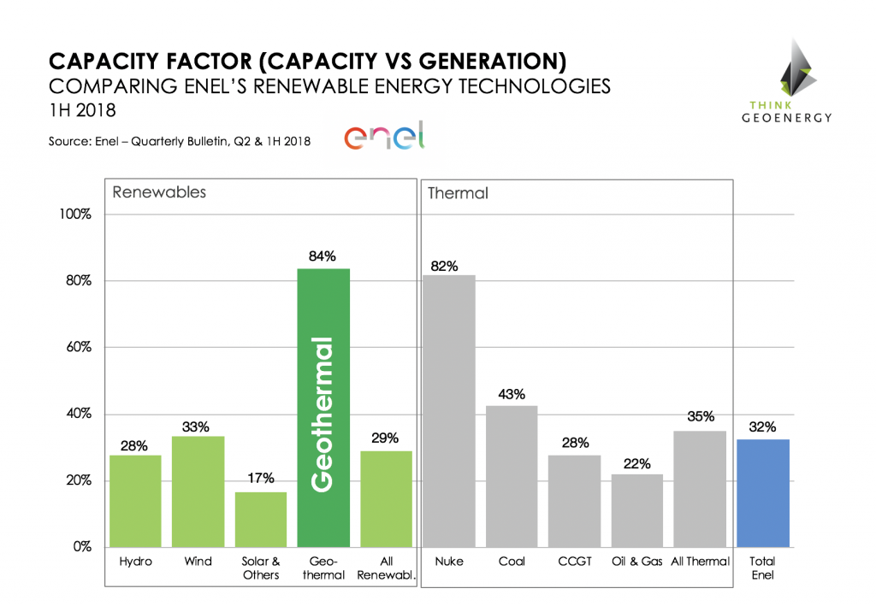
Renewable energy consumption:
Other countries represent an installed power generation capacity of 925 MW, bringing the total installed geothermal power generation capacity at the end of the year 2020 to 15,608 MW.
European countries generate more than 4000 from geothermal sources predominantly in Italy, Iceland, Turkey and Russia .
Figure (10): Ratios of renewable energy sources.

Slide 12
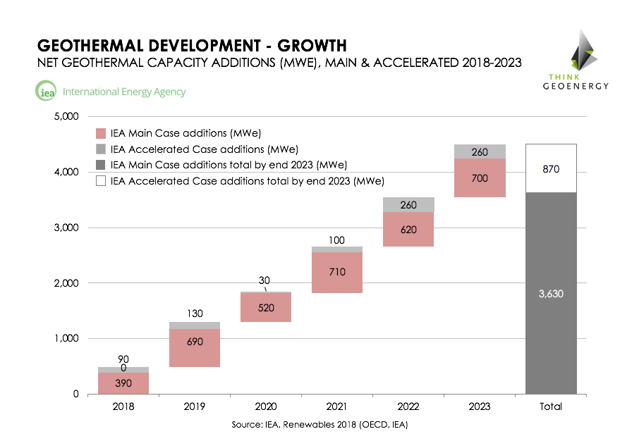
Geothermal growth worldwide:
Figure (11): The growth in the geothermal energy worldwide.

Slide 13
CHAPTER 3: Geothermal in Palestine.
Energy prices in Palestine:
Locations of Geothermal Sources in Palestine:
Table (3.1): The prices of energy in Palestine
0.128 – 0.22 $/kWh | Price of electricity
1.6 $/liter | Price of gasoline
2.1 $/liter | Price of diesel
1.44 $ /Kg | Price of gas
1.3 $/liter | Price of kerosene
195-334 $ /ton | Price of firewood
Figure (12): shows the temperature of the earth at depth of 6 km.

Slide 14

Geothermal energy companies in Palestine:
There are just a few firms in our nation "Palestine" that work in the field of geothermal energy; one of these companies is "MENA GEOTHERMAL" in Ramallah. It has a number of successful initiatives in Palestine and Jordan, including:
Figure (13): Geothermal system of the villa in Etihad subdivision.
Figure (14): UCI headquarter building in Ramallah

Slide 15
Constraint:
We encountered many difficulties in this project because it is unusual for local energy producing companies, in addition to the habitual access to energy from the Zionist occupation, and geothermal energy is not well-known in developing countries and is used infrequently, but the situation may change in the future.
Initially, there are various ways, which are: vertical hole drilling, horizontal hole drilling, and diagonal hole drilling. We use one of these methods based on the available area of the project, in addition to the cheaper hole drilling costs than other methods.
Second, how to make this project cost-effective with rapid efficiency and repayment, so that the geothermal installation may operate 24 hours a day, seven days a week. Finally, we have an issue in our nation with investor ideas since they do not believe in investing in clean energy concepts.
Stander code:
We have used many of the standard code in this project including ASHRAE code, Palestinian heat code, British code, mechanic system code, and ASTM code
Earlier course:
We have benefited greatly from the courses we studied previously, and we have implemented a part of our project, this courses is mechanics of fluid (67320), HVACs (67440), Thermodynamic 1&2 (67220, 67329) and Building systems (67529).

Slide 16
CHAPTER 4: Methodology
Procedure:
Calculate the cooling and heating loads.
Select heat pump.
Select the ground loop.
Select pipe for ground loop:the plastic pipes have been foundto be the most cost effective.
Calculate length of ground loop.
Choose fluid in ground loop: accordion to application.
Select circulating pump or pumps.

Slide 17
Estimation of natural heat flow:
The heat flow is estimated by determining the quantity of heat transferred by convection and conduction, as well as the conductivity of the natural heat flow from the ground to the surface.
The conductive heat flux is estimated by multiplying the thermal conductivity constant of the rocks near the surface by a temperature gradient underneath. Geothermal conductivity and subterranean thermal gradient are calculated using temperature readings, samples, and laboratory testing.

Slide 18


.
Heat flow by conduction estimated by:
. (4.1)
Where:
H: Conductive heat flow, Watt.
A: Surface area, m².
C:Rock thermal conductivity, Watt/m°. C.
:Geothermal gradient, °C/m.
: Bottom whole temperature, °C.
: Mean ambient temperature, °C.
Z:Depth, m.
Heat flow by conviction estimated by:
(4.2)
Where:
:Convective heat flow, kW.
F : Mass flow rate of thermal spring, kg/s.
m:Heat capacity of fluid, kJ/kg. °C.
: Fluid discharge temperature, °C.
: Mean ambient temperature, °C.
Total heat is equal summation of

Slide 19
Heating load calculation:
This is accomplished by modifying the thermal load for application via: loss via walls and ceilings, as well as infiltration and ventilation losses:
Transmission heat losses calculation:This is accomplished by calculating the area to be heated or cooled and calculating the overall heat transfer coefficient through surfaces, windows, doors, and the floor, as well as fixing the inside and outside design temperatures, and then calculating the transmission heat loss using the following formula:
(4.3)
Where:
:The amount of heat losses through walls and roof ( ).
:Allover heat transfer coefficient ( ).
: Surface area ( ).
: Inside designcondition temperature.( ).
:Outside design condition temperature.( )

Slide 20
.
Infiltration heat loss calculation:
This approach is based on the hourly air change coefficient (ACH), which occurs when the air within the room is replaced by cold air from the outside and vice versa, causing the internal temperature to rise . The calculation of infiltration heat loss is done using the following formula:
(4.4)
Where:
: Infiltration heat losses ( ).
: Volume of building( ).
: Air change per hour.
: Specific heat capacity of air ( )
: Density of air( ).
:Inside designcondition temperature ).
:Outside design condition temperature ).
Find the total load using addition transmission with infiltration, and the equation is as follows:
(4.5)

Slide 21
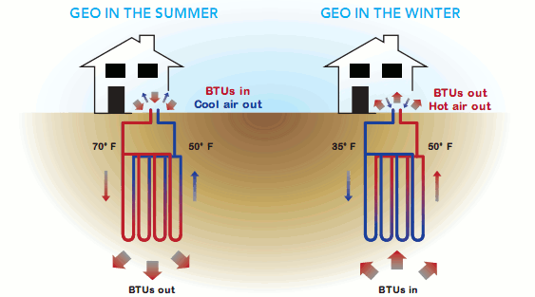
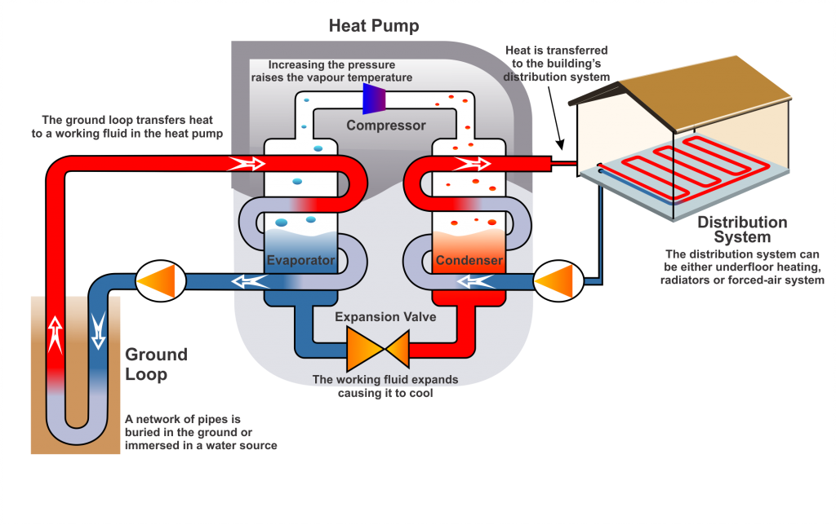
Geothermal heat pump:
To begin, we must understand how heat pumps function. Heat pumps, in simple terms, transport energy from one location to another
How the ground source heat pumps system works?
The fluid flows through the pipes at a low temperature, and the heat is absorbed from the earth. The fluid next enters the compressor, where the temperature and pressure are raised and either transferred to the area for heating or utilized to heat the water. The earth, which causes heat absorption when a liquid is passed beneath it.
Figure (15): heat pump cycle.
Figure (16): geothermal heating and cooling in summer and winter.

Slide 22
Heat pump selection:
To choose the heat pump, we need to know the following coordinates:
• System configuration (open, close, etc.).
• The building's burden (the load).
• A performance coefficient is necessary (COP).
• Pump specifications (such as reversible or not, water to air, water to water).
The technology employed in this project is a closed vertical system with water to air heat pump.
Given the following heat pump type:
Table (4.1): EKW Reversible pump data. [29]
Heating: |  |  | Source Liquid Flow (L/s) | Load Liquid Flow (L/s) | Cooling: |  |  | Source Liquid Flow (L/s) | Load Liquid Flow (L/s) | Model:
LLT= 35°C LST= -3°C |  |  |  |  | LLT=18°C LST=35°C
COP |  | Capacity KW |  |  | COP | Capacity KW
4.9 | 202 |  | 5.70 | 4.30 | 5.4 |  | 156 | 4.30 | 5.70 | EW540

Slide 23
Choosing the right geothermal system:
Information to be monitored for geothermal energy extraction:
1-Geological survey: This covers the study of the earth's outer layer (the crust) at a certain depth, as well as the rock, its composition, age, and groundwater.
2-Thermal gradient measurements: It entails drilling into the earth at a depth of 50-100 meters, recording temperatures along the way, and estimating the thermal conductivity of rocks.
3-Drilling and testing for deep exploration.
Factors that uses in choosing:
The following elements influence the sort of system that should be installed:
1- Weather conditions (location).
2- Soil conditions and constituents
3- The initial drilling expense.
4-The system's available area or space.
These elements govern the selection of the right type. As a result of the aforementioned considerations, we decided the vertical ring system to employ in Hardees resturant, and this is what our project will discuss

Slide 24
Vertical-loop system in Hardee's Restaurant:
Considerations about vertical closed loop:
Because ground temperatures are more consistent at depths of 6 meters or deeper, vertical loops require fewer feet of piping than horizontal loops.
Vertical boreholes generally have a diameter of 13 to 18 cm and are placed 3 to 6 meters apart.
A pair of 2 to 3 centimeter pipes are put into the borehole and joined at the bottom by a U-bend assembly. The pipes in each borehole are connected in a trench 1 to 2 meters below grade.
Because pipe length might range from 91 to 183 meters per ton of heat production, proper design is critical.
Prior to system installation, your contractor may drill a test borehole to verify soil conditions and check loop length and design.

Slide 25
Parallel system:
Advantages:
1. The tubes are reasonably priced and functional.
2. It requires very little freezing.
3. The installation fee is rather affordable.
Disadvantages:
1. Make an effort to guarantee proper air discharge.
2. Maintain balanced flow at balanced speeds, within 5% or less, on each parallel lane.
Because of the cheaper cost and accessible area, we picked a parallel system for our project.

Slide 26
Types of pipes:
According to the International Association of Geothermal Pumps, the best types of pipes are PVC pipes made of polyethylene or butylene, and they are chosen as follows:
1. Polyethylene: When tested on ASTM 3350, the acceptable grade is PE355434C or PE355434C.
2. Polybutylene: Butylene tube is made in accordance with ASTM D-2581.
Pipe (parallel loop):
Parallel installation necessitates a great deal of care, but it also necessitates smaller pipe diameters and lowers pressure. The polyethylene or polyethylene pipes have a 1-1/2 inch diameter. In parallel systems, one loop is employed for every ton (12,000 BTU/h) of heat pump capability.
The International Ground Source Heat Pump Association (IGSHPA) has provided the following dimensions:
Pipe size about: 3/4" and 1".
Bore lengths about: 100 to 200.
Pipe lengths about: 200 to 400.
Length between loops about: 10 to 15.

Slide 27
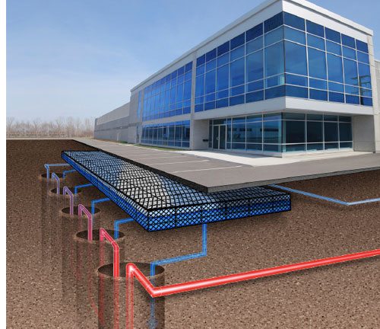
Geothermal system for Hardee’s Restaurant:
The traditional HVAC system employed in Hardee’s Restaurant In Nablusconsists of one chillers, has a power of 140 kilowatts, which explains how much the system costs. Furthermore, the system consists of one boilers (160 kw) for heating (one of which is standby),
Due to the high operating costs, we decided to employ the geothermal system Hardee’s Restaurant In Nablus to reduce costs.
Figure (17): vertical loop system.

Slide 28


Thermal test:
Knowledge of subterranean thermal characteristics is essential for designing a borehole heat exchanger (BHE) for a ground source heat pump (GSHP) or underground thermal energy storage (UTES). Thermal conductivity should be tested on-site for bigger plants (commercial GSHP or UTES). A great technique for this is the reaction test. A specified heat load is injected into BHE
for a thermal response test, and the ensuing temperature variations of the circulating fluid are monitored.
Evolution thermal response:
(4.6)
Where:
K: inclination of the curve of the temperature versus logarithmic time.
Q= heat injection / extraction.
H= length of borehole heat exchanger.
=Effective thermal conductivity.[34]
To calculate thermal conductivity, the formula has to be transformed:
(4.7)

Slide 29

Borehole Thermal Resistance:
The following formula may be used to calculate thermal resistance ( ):
(4.8)
Where:
Q: heat injection (w).
H: borehole depth (m).
T0: initial ground temperature(c).
λ:thermal conductivity.
α: thermal diffusivity. R0: borehole radius(m).
When employing parameter estimate approaches, the various elements of (e.g., thermal conductivity of the grout) are often discovered, and may be determined. The overall thermal resistance determined by the test for this project is 4 M2 Co/W. (this value was given from previous test in Ramallah city form). The average ground temperature was discovered to be 19Co, and the test has a hole depth of 100 m.

Slide 30

Pipe sizing:
Ground heat exchanger(GHX) sizing (Pipe lengthestimation):
Ground heat exchanger size is primarily concerned with determining heat exchanger length. To determine the length, two approaches will be used:
Method (1):
The required GHX length () based on heating requirement is:
(4.9)
Where:
q heat : the load liquid flow for the heating
cop h : the design heating coefficient of performance(COP) of the heat pump system.
Rp :the pipe thermal resistance.
Rs :the soil/field thermal resistance.
Fh :the GHX part load factor for heating.
Tg , min:the minimum undisturbed ground temperature.
Tewt . min:the minimum design entering water temperature(EWT) at the heat pump.

Slide 31

.
A similar equation can be used to calculate the required GHX length (Lc) based on cooling requirements:
(4.10)
Where:
q cooling: the load liquid flow for the cooling.
Cop c: the design cooling coefficient of performance (COP) of the heat pump system.
Rp:the pipe thermal resistance.
Rs:the soil/field thermal resistance.
Fc:the part load factor for cooling.
Tg.max: the maximum undisturbed ground temperature.
Tewt.max: the maximum design entering water temperature at the heat pump. [36]
Method (2):
For horizontal and vertical systems given the following:
Vertical, all configurations: L= 21m / KW (73m / ton).
Note: KW or ton is the heating load.
Horizontal, single pipe: L=37m / KW (130m / ton).
Horizontal, tow pipes per length: L= 44m / KW (155.5m / ton). Horizontal, four pipes per length: L= 54m / KW (180.5m / ton).

Slide 32

Part LoadFactor(F):
Using the preceding calculations to get the GHX length necessitates the evaluation of the GHX component load factor. The component load factor (F) is the percentage of equivalent full load hours during the design month to the load number of hours in the month, as shown on the GHX (Kavanaugh and Rafferty, 1997) . It may be calculated as follows:
(4.11)
Where:
q avg: average load for the month.
q max: peak load for the month.
The component load factor (F) is calculated for the design cooling and heating months, which are generally July and January in the northern hemisphere, resulting in the values and utilized in equations. When utilizing peak load calculations, portion load equals one (maximum load).

Slide 33
Estimation of pipe length:
From the thermal test, we have:
Tg= 19
Tewt, min = - 6.7 .
Tewt.max = 92.2 .
Rp =.4/W.
Rs = 1/W.
From the heat pump, we have:
For heating:COP = 4.9 andFlow rate = 4.3L/s.
For cooling:COP = 5.4 andFlow rate = 5.7L/s.
By using (method 2) which is the most sustained and effective, we have the following:
Note: The design on the heating load. (160 kw).
Sample calculation:
Lc= 21(m/KW) ×160=(KW) =3360 m.
So,
The Number of holes: depth/length =3360/100 =34 holes.

Slide 34
Considerations:
Because of the high expected operating costs for heating and cooling, we planned to establish a geothermal power station in our project where a building has been chosen and it is a Hardee's Restaurant in the city of Nablus where we will calculate the loads that the building consumes and calculate its cost and on the other side we will calculate the cost of the new system and how long we need to recover the capital where.

Slide 35
Chapter 5:Results and Analysis
(Cost Analysis)
Estimation of the normal system cost:
Normal system has a boiler used for heating, and one chillers used for cooling.
1 Initial cost:
The first item to consider is the expense of heating and cooling (material cost). The mechanical room (which comprises the boiler and pumps) required for heating the Hardee’s Restaurant In Nablus have cost = 2000 $, as well as the chiller required for coolingIn addition to the cost of installation have cost = 8,000 $.
Initial cost = (10000) $= 31000 NIS
2 Running cost:
The running cost is the amount of fuel used to heat the building in the winter and the amount of electricity used to power the chillers. The running cost will be calculated using the daily average approach.

Slide 36

.
Daily average method:
It's a formula for calculating the mass of fuel required for heating, and the general formula is as follows:
(5.1)
(5.2)
Where:
mf= mass of fuel consumed.
Q= required heating load Kwh.
DD= degree-day for estimated period.
Cd= empirical correction factor for heating effect versus degree.
Cv= calorific value for fuel used for (diesel 39000 KJ/Kg).
Ta = mean monthtemperature.
eff = efficiency for (fuel80%).
The values of Cd are given by:
0-1000DD | for | 0.8
1000-2000DD | for | 0.75
2000-3000DD | for | 0.7

Slide 37



.
From the previous equation, the values of DD for each month are listed in table 5.2 below:
Table (5.2): DD value of each month.
Note that when the value of the DD is negative, it must be replaced with zero. From table 5.2, the sum of DD is 909.
So, from the equation (6.1), the fuel mass will be:
And to determine the volume of fuelwe use the following relationship:
Where : volume of fuel (m³).
Where the cost liter of fuel equal to 6.3 So,
Cost=11600* 6.3=73080NIS.
The running cost for cooling operation estimated as following:
one chiller at (Hardee’s Restaurant):operated 12 hours as full load with power of 140 kw. So,
Electricity needed for chiller at 6 months= 140∗12∗30∗6=302400kw. With 0.6 for
every kw.Cost=3024000.6=181440NIS.
12 | 11 | 10 | 5 | 4 | 3 | 2 | 1 | Month
12.7 | 17.7 | 21.3 | 20.7 | 17 | 11.7 | 10.4 | 10.2 | Mean temp
174 | 18 | 0 | 0 | 40 | 205 | 221 | 251 | DD value

Slide 38


Estimation of geothermal system cost:
Initial cost:
The cost of finishing one borehole (drilling and labor cost, and the pipe installation) will be about 1500$. The number of boreholes is shown in chapter 4 (34 holes).
The price of the water to air heatpump for (Hardee’s Restaurant)isabout45,000 $. So, the initial cost will be about (45,000) + (1500∗34) =96,000$ =96,000*3.1=297600 NIS
Running cost:
, the operating cost of heating in a geothermal system with (cop)=4.9 is as follows:
The coefficient of performance (Cop) for heating in a normal system is 3.5, hence the ratio of cop in geothermal to cop in a normal system is 1.4
So. The running cost for heating in geothermal = =52200 NIS.
Calculate the running cost of a geothermal cooling system in the same way. The coefficient of performance for a normal system is 3.5, whereas the coefficient of performance for a geothermal system is 5.4. As a result, the ratio is 1.54
Therefore,The running cost of cooling = =117818 NIS.

Slide 39

Cost Analysis:
High initial cost for the geothermalsystem(297600 NIS).
Low initial cost for the normal system (31000 NIS).
The running cost for normal system will be about (73080+181440) =254520 NIS.
The running cost for geothermal system is about (52200+117818) =170018 NIS.
The geothermal system's operating costs are nearly 66% lower than those of a conventional system.( *100%)
The space required for geothermal system:
The 34 holes needed for a vertical system can be drilled in many forms.With 5 inches (0.127m) in diameter for every hole, and 2 m between ever two holes. So,
the land required = (0.12734+ 233) =70.3 m2

Slide 40


Payback:
When compared to normal heating and air conditioning systems, the return period (payback) with geothermal systems typically ranges between 3 and 7 years.
The performance coefficient (COP) is more than 4.1 years in heating and 14.5EER (Energy Efficiency Classification) in refrigeration, which implies that for every electricity unit used to power geothermal pumps, the system saves 4.1 units of heating energy, making it less efficient at 410 percent.
Payback Analysis:
(5.4)
Where:
PBP = Payback Period (years).
SC = Difference in Start-up Cost ($).
AOC = Difference in Annual Operating Cost ($/year).
To convert this value to number of months we multiply by 12.

Slide 41
Discussion:
There are numerous advantages to using geothermal energy, the most important of which is the creation of an independent energy source for the Palestinian people, as it reduces the cost of fuel used in air conditioning and creates a comfortable environment for humans without harming the environment, as gases emitted from the ground are not harmful.
With all of these benefits, we propose using geothermal energy in sites that run daily and 24 hours a day, as well as in regions that have enough room for drilling.
Hospitals, universities, and retail malls are examples of successful areas that employ geothermal energy.
We picked Hardee's Restaurant in Nablus, where it operates every day, 12 hours a day, so the rehabilitation period will usually be short, around 3.2 year.

Slide 42
Conclusion and Recommendation:
In conclusion, geothermal heating has several advantages and disadvantages, so if we can bear the high costs of installation and the return over a long period of time, the advantages will outweigh the disadvantages; they have excellent thermal efficiency compared to other systems, as well as long durability and low maintenance costs.
The following factors should be considered in order to maximize the efficiency and efficacy of the geothermal energy system:
1. Make sure there is enough room for drilling holes.
2. Considering the surrounding environment and the type of land
3. The air conditioning system's maximum operating hours.
Because the HVAC system on Hardee's restaurant operates 12 hours a day and has an average running duration, the recovery period may be short, and therefore the geothermal system may be more effective.

Slide 43

.
Figure (18): Hardee’s Restaurant In Nablus.

Slide 44
THANK YOU

