Slide 1

DrinkCraft
This project envisions the future of automated drink preparation in large-scale coffee shops and production facilities. It will help create a more efficient and high-quality procedure.
Presented by Zahi Abu Salbak and Hadi Irshaid
Supervised by Dr. Anas Toma and Dr. Ashraf Armoush
A graduation project that took place at An-Najah National University

Slide 2






WHAT
1
2
3
4
5
6
Main idea
Hardware Components
WILL WE
COVER
Features
Constraints
Future Work
Q&A
0-1

Slide 3

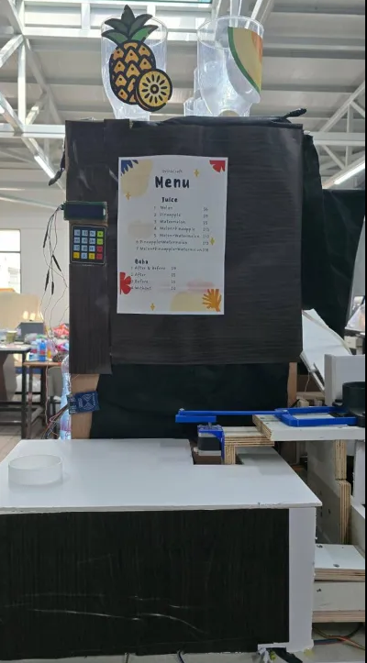
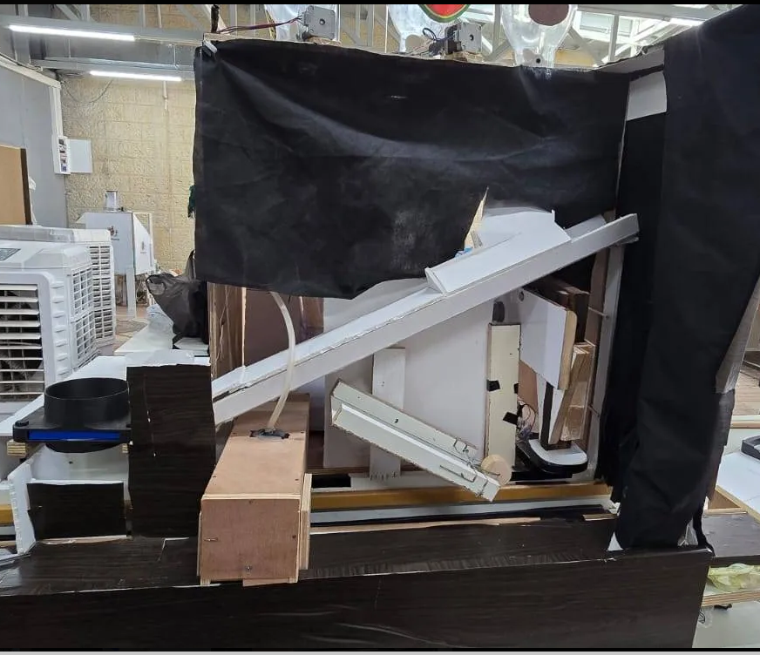
Our Project
1-1

Slide 4
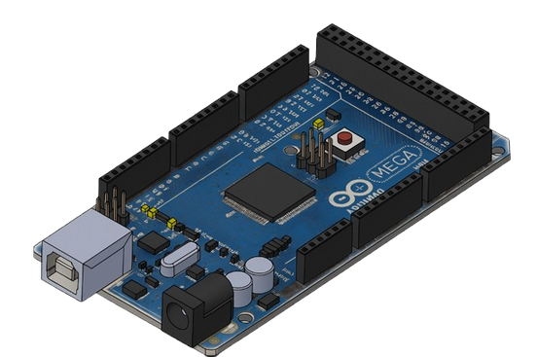
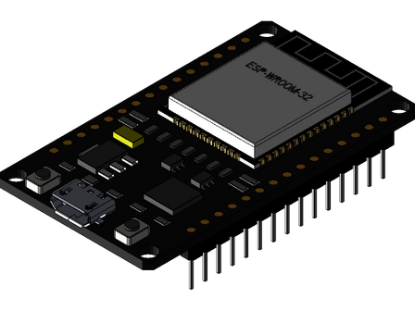

Hardware Components
Control Units
Arduino Mega 2560
ESP-WROOM-32
Arduino IDE
2-1

Slide 5
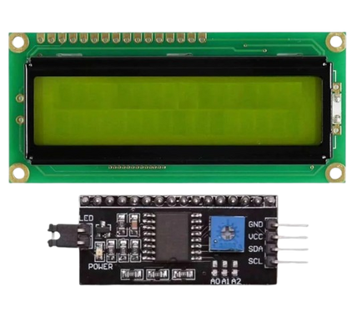
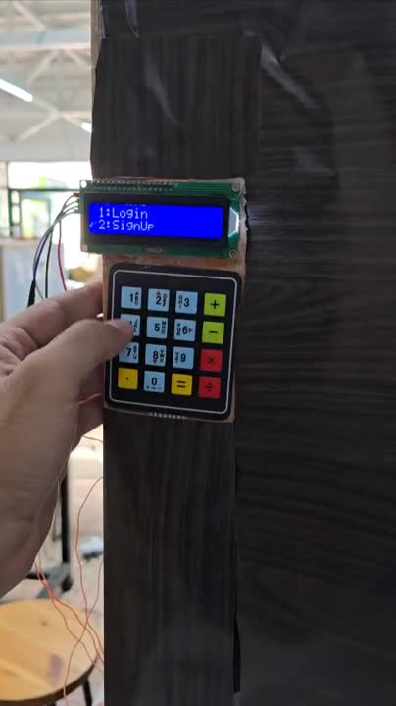
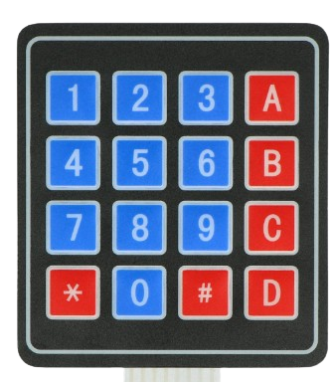
LCD 2X16
Keypad 4x4
2-2

Slide 6

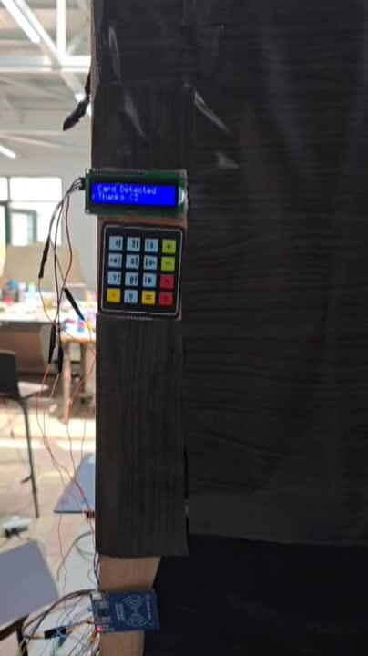
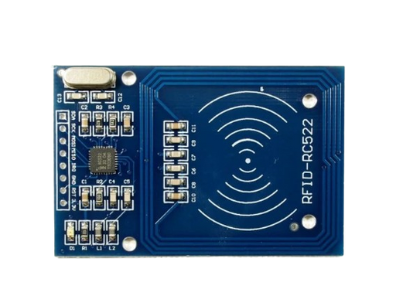

RFID
Customer Card
2-3

Slide 7

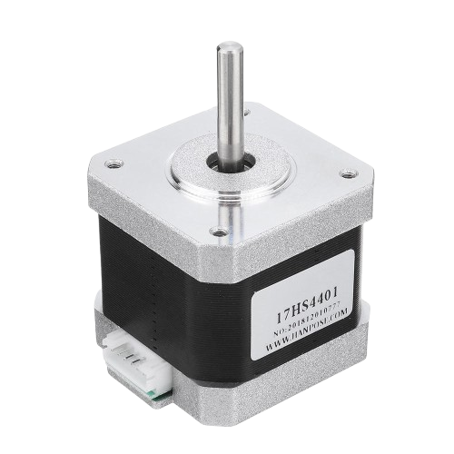
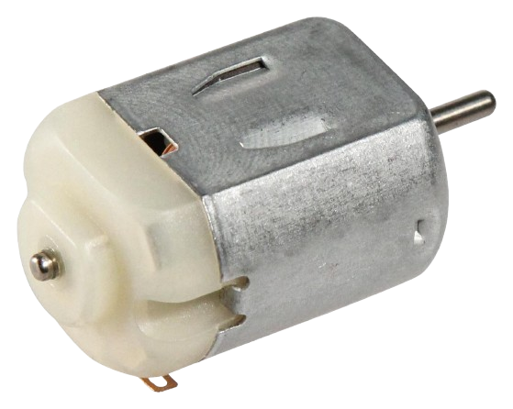
Motors
DC Motor
Stepper Motor Nema 17
2-4

Slide 8

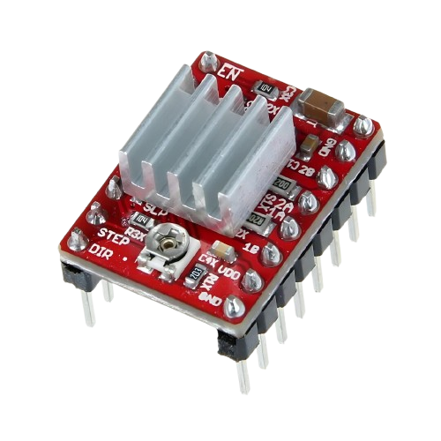
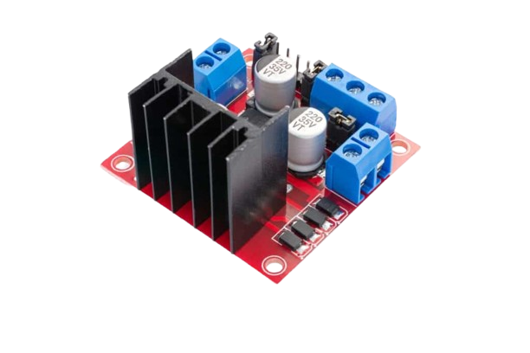



A4988 Stepper Motor Driver‏
L298N Dual H-Bridge Driver Module‏
See more
2-5

Slide 9
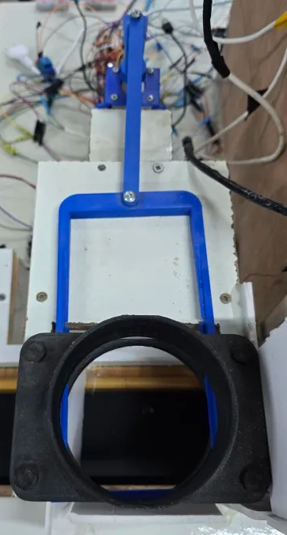

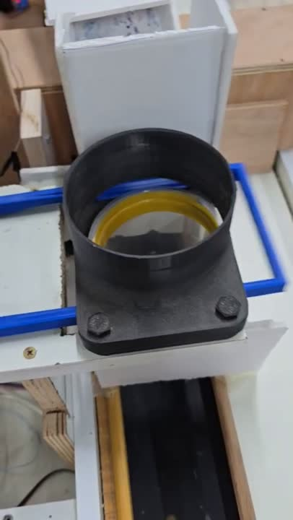
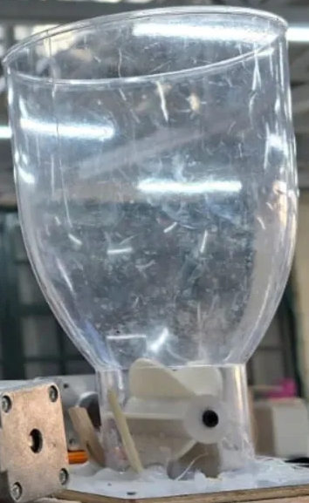
Cup
Dispenser
Fruit
Dispenser
2-6

Slide 10
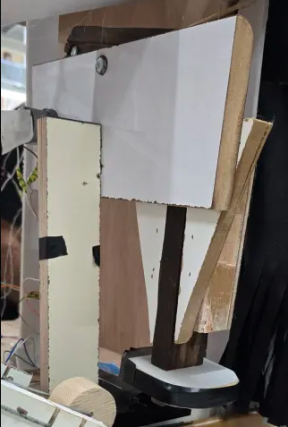
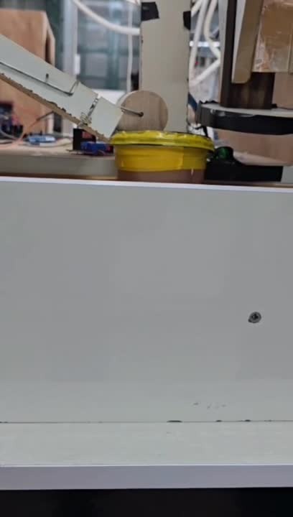
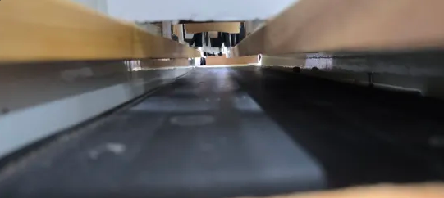
Cup Cover
Presser
Conveyor Belt
2-7

Slide 11

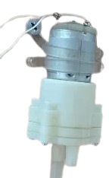
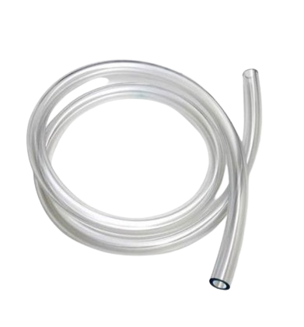
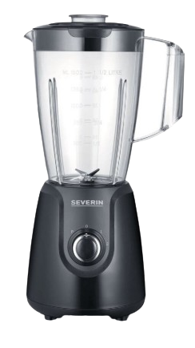
Pump
Pipes
Mixer
2-8

Slide 12
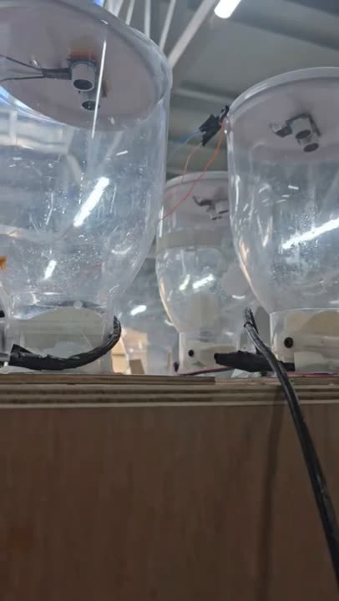
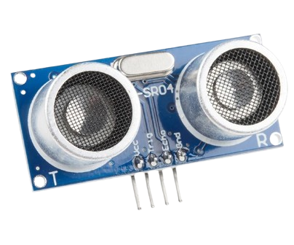
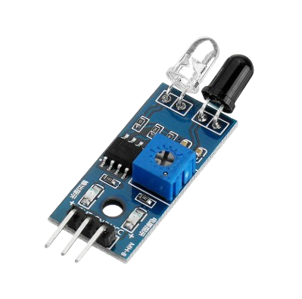
Sensors
Ultrasonic
IR
2-9

Slide 13

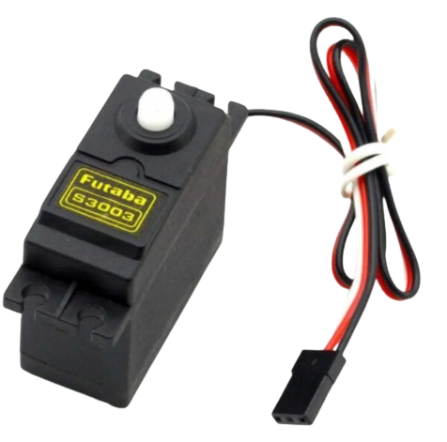
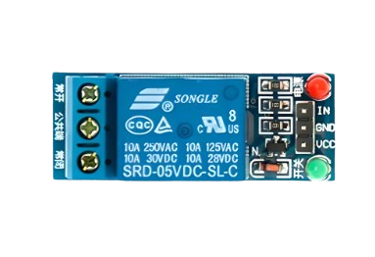
One Channel 5V Relay Module
S3003 Standard
Servo Motor
2-10

Slide 14

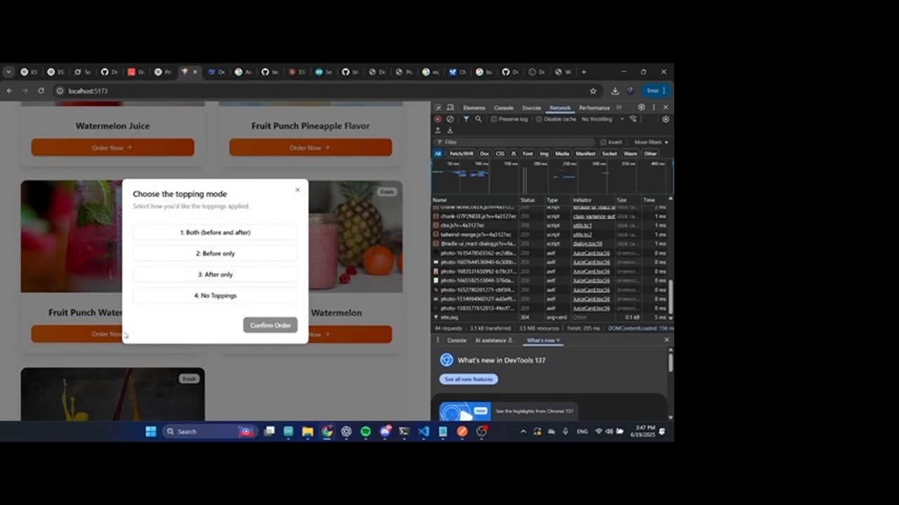

Features
VS Code
React
3-1

Slide 15
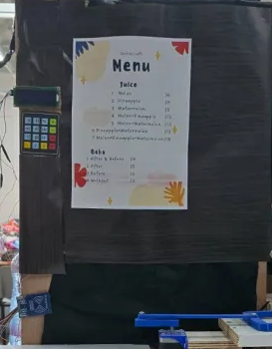
Payment System
3-2

Slide 16

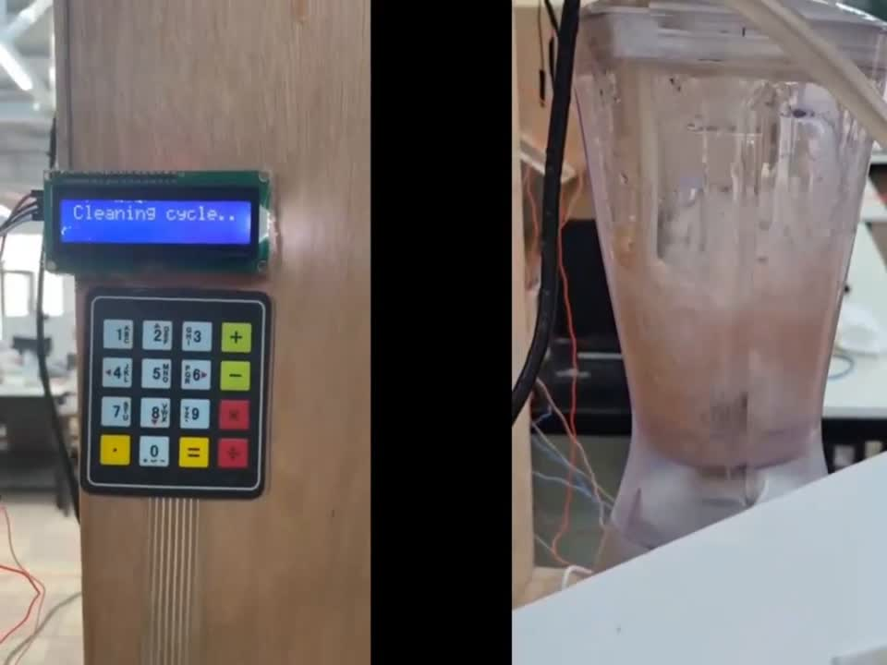
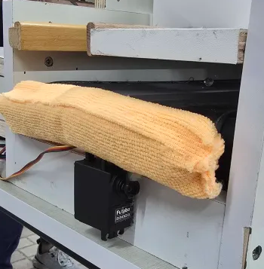
Automated Cleaning
3-3

Slide 17

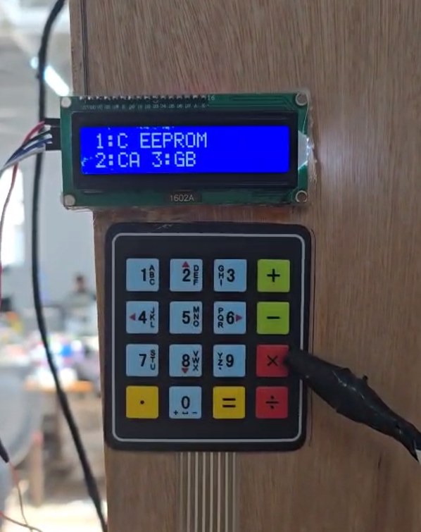
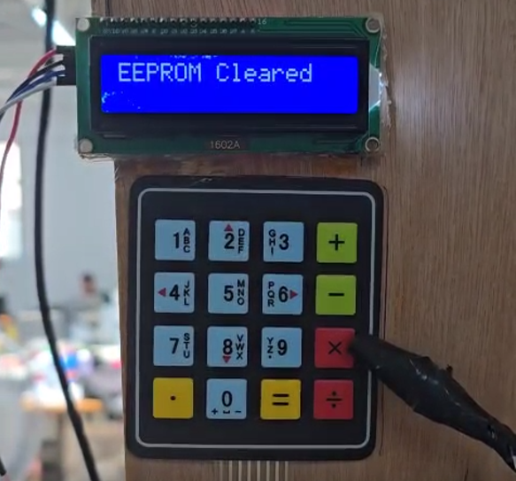
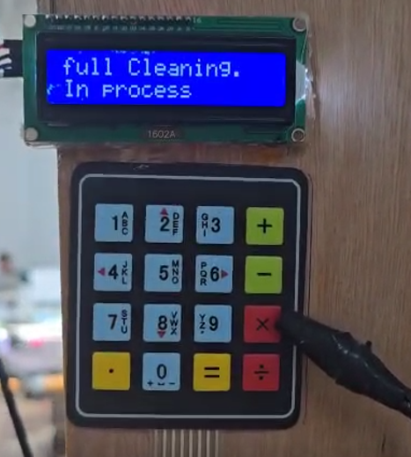
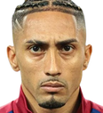
Admin Mode
3-4

Slide 18
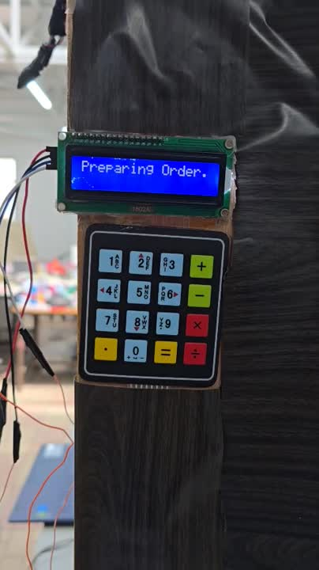
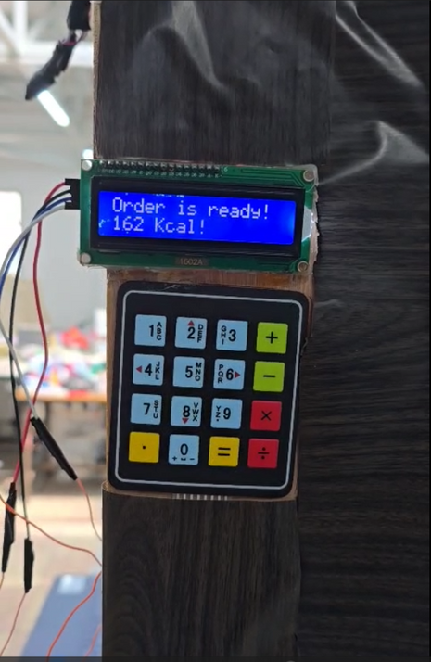
Built-in Calorie Estimator
3-5

Slide 19
Constraints
1- Short Development Timeline
2- Fruit Selection Limitation
3- Low Quality Components In The Market
4-1

Slide 20
Future Work
1
Expand Topping And Fruit Variety
2
Add A Touchscreen For Better UI/UX
Introduce Cooling Control For Ingredients
3
5-1

Slide 21
Improve Liquid Measurement Using Flow Sensors
4
Upgrade The System To Dispense Multiple Cups Per Order And Support Additional Mixes To Increase Productivity.
5
5-2

Slide 22


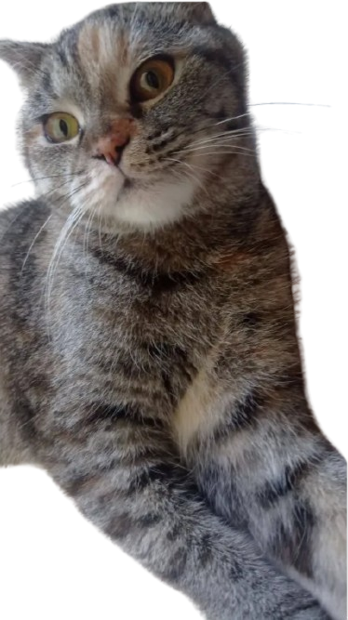
Thanks For Your Attention
Any
Questions ?

