Slide 1
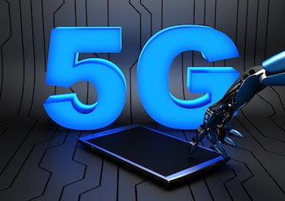
Prepared by
Ghada Salahat
Wejdan Hatim
Mena Omar

Slide 2
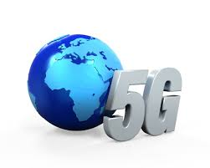
  Outline
Explain some technologies to improve 5G network.
Two-tier Architectures.
CRN Based Architectures.
D-D Communication Architectures.
Energy-Efficient Architectures.
5G is the combination between those Architectures.

Slide 3
  Motivations
The main motivation of going toward the fifth generation is to:
Support more than one hundred billion connections.
Increasing the capacity a thousand times.
Increasing the data rate up to 10Gbit/s speeds.
Make the latency less than 1ms.

Slide 4
Review Of Project 1
Technology Evolution.
Challenges and Application Of 5G Network.
Communication Concepts.
MATLAB Simulation.

Slide 5
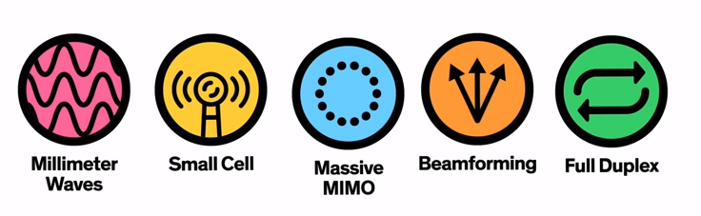
5G Enabling Technologies

Slide 6
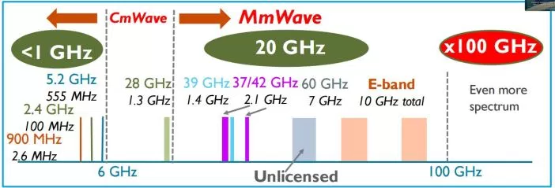
Why Millimeter Waves ?!
Frequency (30 GHz-300 GHz).
Wavelength (1-10 mm) .
f=c/λ
More bandwidth is available
Higher data rate
Security and privacy is better at mm waves.

Slide 7

Why Small cells ?!
Small form factor (<6 ft³ )
Targeted coverage area
( < 10,000 ft² )
“ Plug ’ n ‘ Play “
Operation
Limited capacity
( < 128 users )
Low power output
( < 2 W )
Low power consumption
( < 30 W )

Slide 8
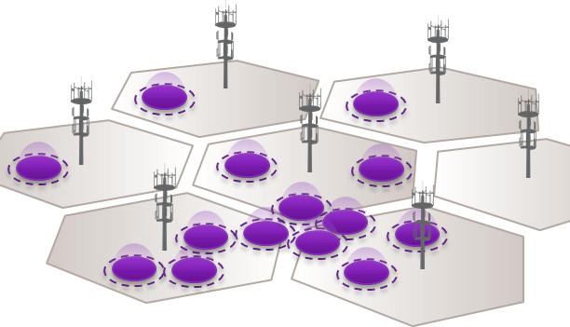
Why we need small cells ??
More mobile users, devices, data required, more capacity and coverage.
Increasing towers, allocate more spectrum, and use new technology are not enough.
Solutions is small cells
Adding more low power antennas in the field with lower footprint (coverage).
Similar to adding more towers idea
but with less power consumption, less users,
less interference.
Results : cheaper and more efficient network.

Slide 9
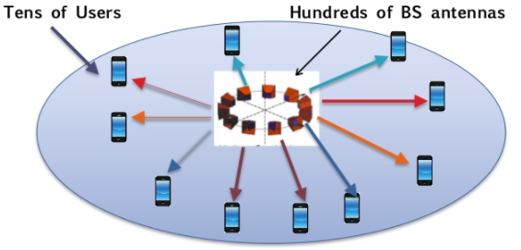
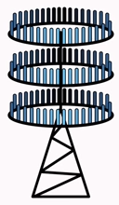
Why Massive MIMO ?!
Essentially multi user MIMO with lots of base station antennas.
A very large antenna array at each BS.
A large number of users are serves simultaneously.
Massive (very large).
Large transmitters/receivers.
High data rate, reduces latency, link reliability.
Equipment price increased, increases the capacity due to spatial multiplexing.

Slide 10
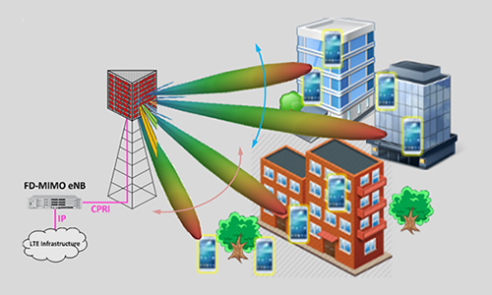
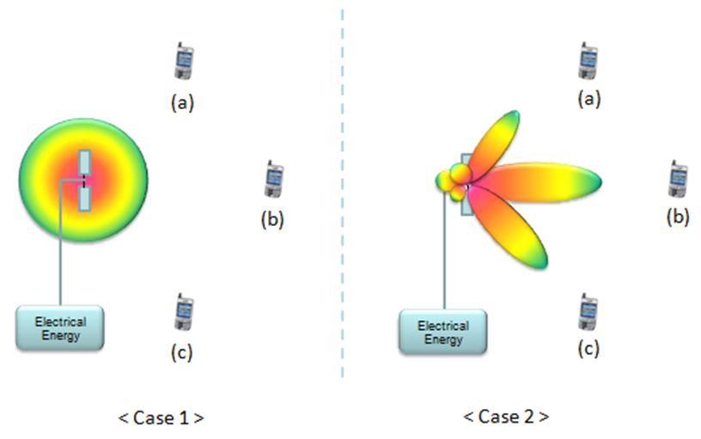
Why Beamforming ?!
Focusing the transmitted energy into a specific direction.
Increase energy to a specific user.
Reduce interference.
Beamforming in 5G

Slide 11

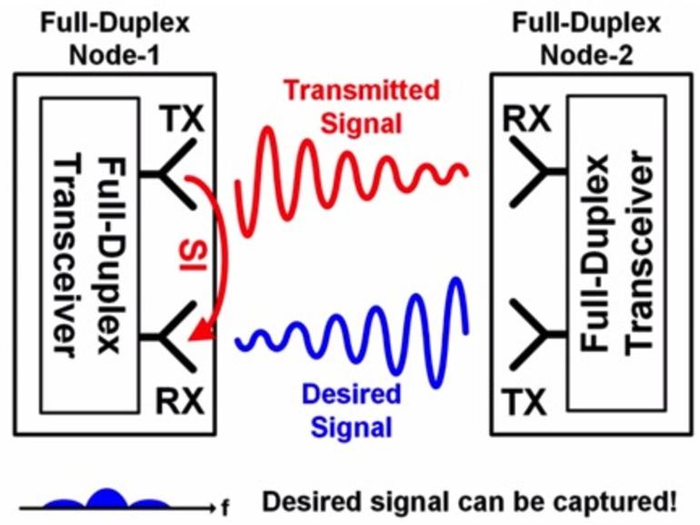
Why Full duplex ?!
Single channel for transmitting and receiving signals at identical time and frequency
Increases link capacity, saves the spectrum, and cost.
Full duplex radio receives signals from another radio and receives interference signals by its own transmission, resulting in self-interference.
Full duplex radio has to implement techniques to cancel self-interference (SIC techniques).

Slide 12
Architectures for the future 5G
Proposed Architectures for 5G:
Tow-tire Architecture .
Cognitive Radio Network based Architectures .
Device-to-Device Communication Architectures .
Energy-Efficient Architectures for 5G Networks .

Slide 13
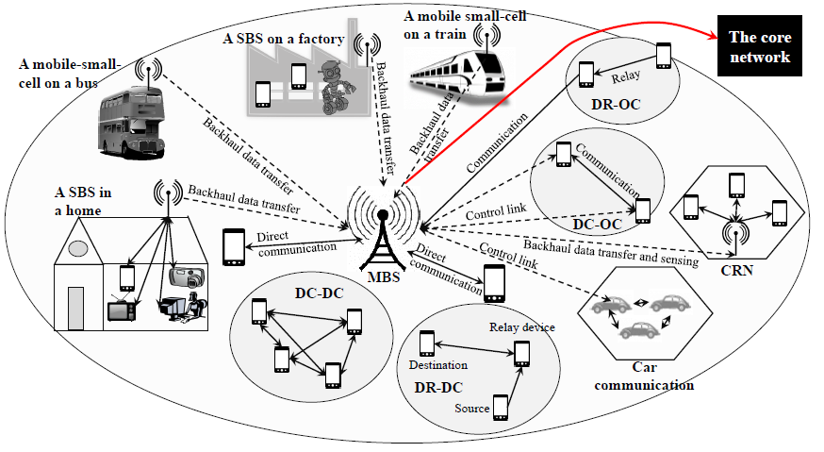
5G network Architecture

Slide 14
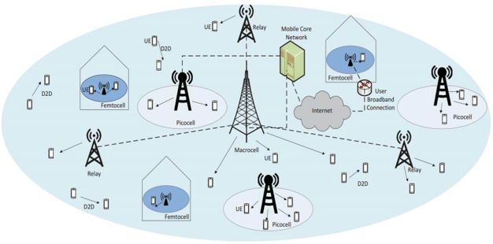
Tow-tier Architecture
The basic idea of two-tier architecture

Slide 15
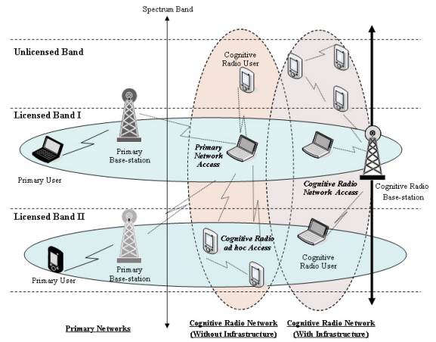
Cognitive Radio Network based Architectures
The basic idea of cognitive radio network

Slide 16
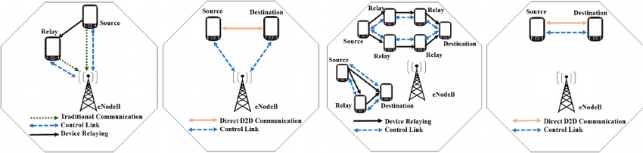
Device-to-Device Communication Architectures
DR-OC
DC-OC
DR-DC
DC-DC
Four types to perform D2D communication

Slide 17
Energy-Efficient Architectures
How to save energy ?
User centric 5G Network
Decoupling of signaling and data
UE connected to SBS
Energy harvesting device
Interference Management

Slide 18
5G network Architecture

Slide 19
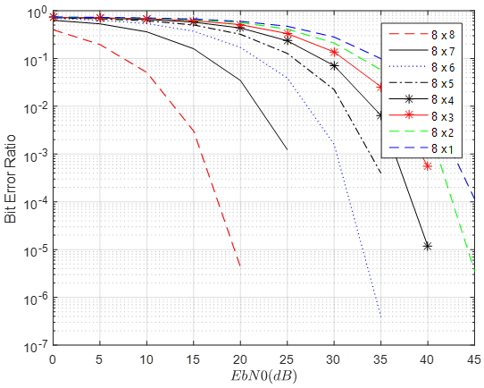
Matlab Simulation “MIMO 8X8”

Slide 20
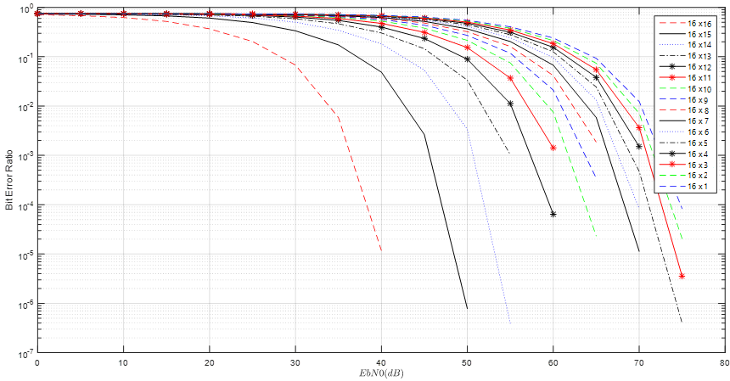
Matlab Simulation “MIMO 16X16”

Slide 21


