Slide 1

Restaurant IOS application
Prepared By : Supervisor:
Ghadeer Joma. Dr. Aladdin Masri.
Shatha Rabai’a.

Slide 2
Contents :
What is Restaurant Application?
Why Restaurant Application .
Languages and Tools.
Implementation.
Problems.
Future work

Slide 3
What is Restaurant Application?
It is a smart phone IOS application
Provides all restaurant services to users.
Provides services in large area ,so it provides several choices for user to select best suitable restaurant.

Slide 4
Why Restaurant Application .
Most of people deals with restaurant .
To search for the restaurant in the local area.
Book your order at the best possible price.
The user gets all the services provided by restaurants in easy way.

Slide 5






Languages and Tools.

Slide 6




Languages and Tools.

Slide 7
Application Parts
Our application contains four parts:
1. Database and Server side.
2. API (web service).
3. IOS Application.
4.ASP.NET Website

Slide 8
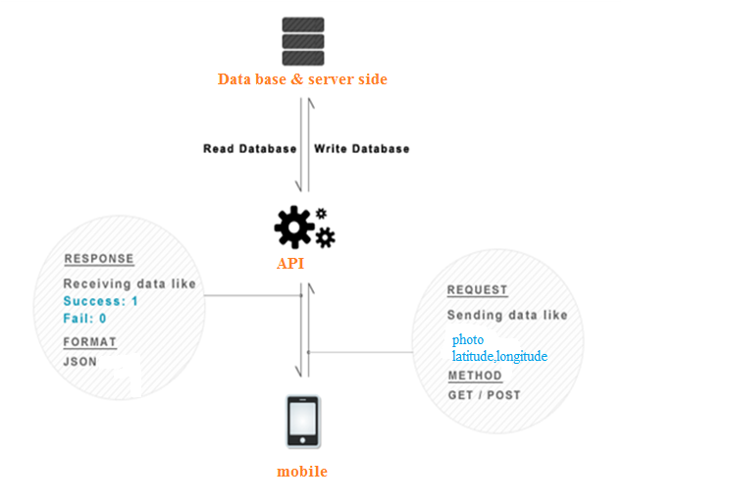
Application Parts

Slide 9
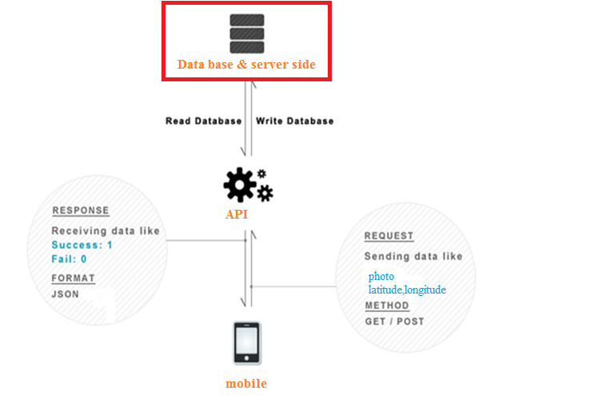
Application Parts

Slide 10
Database
Our database is SQL.
it contains several tables :
Restaurant Table.
Orders Table.
Reservation Table
Categories Tables…..ets.

Slide 11
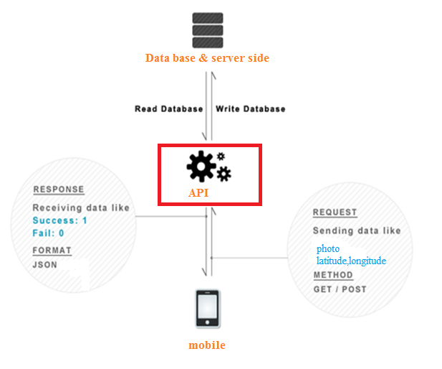
Application Parts

Slide 12
Server and API
We use ASP server
We stored data and retrieved it by using
web services.
The response from server is JSON.

Slide 13
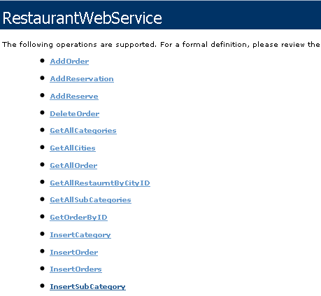
API

Slide 14
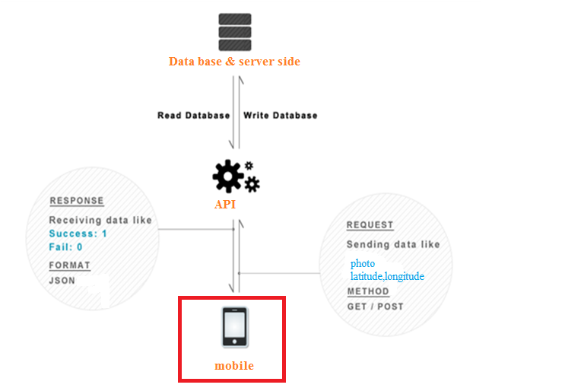
Application Parts

Slide 15
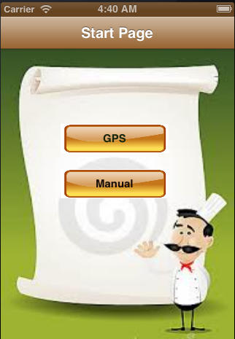
First view

Slide 16
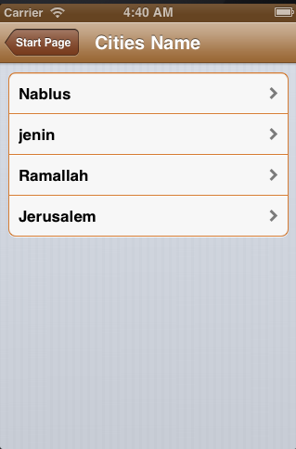
List of cities

Slide 17
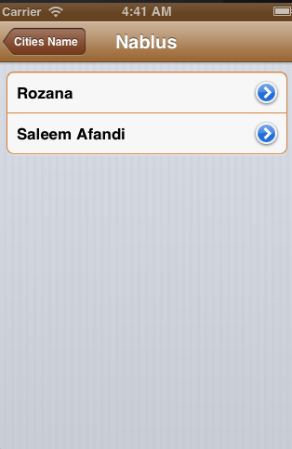
List of restaurant in a city

Slide 18
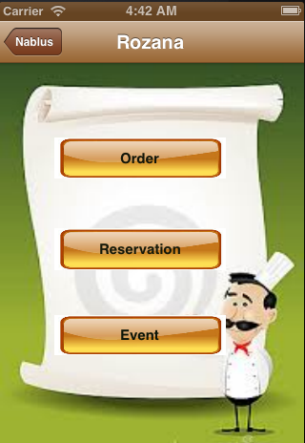
Services :

Slide 19
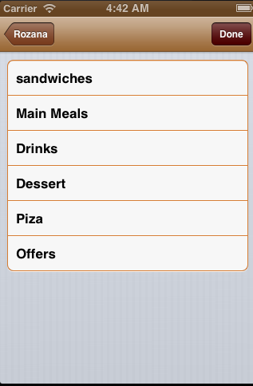
List Of Categories

Slide 20
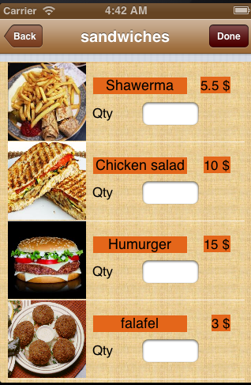
Subcategories of Sandwiches :

Slide 21
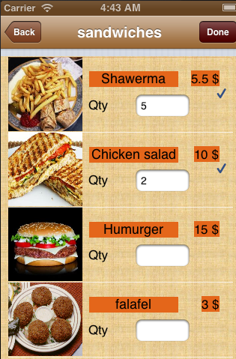
Select order

Slide 22
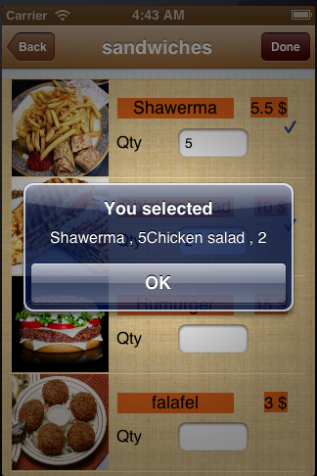
Alert message

Slide 23
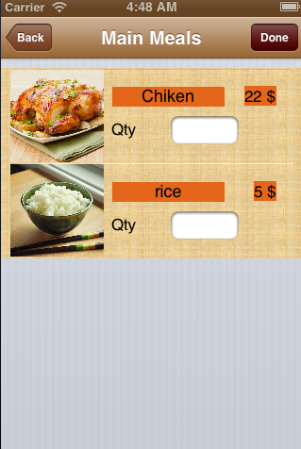
Another Subcategories

Slide 24
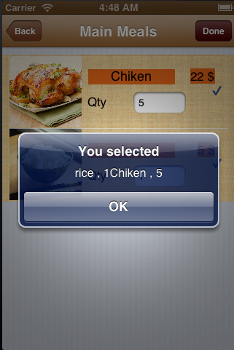
Alert message

Slide 25
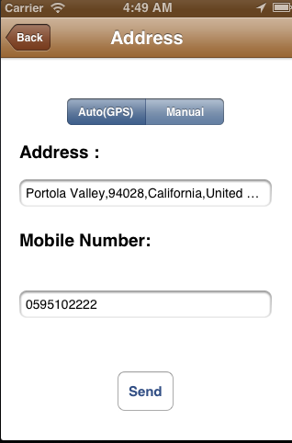
Address :

Slide 26
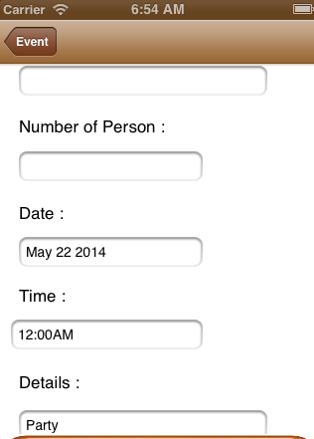
Reservation

Slide 27
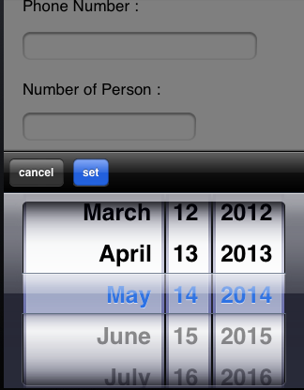
Reservation :

Slide 28
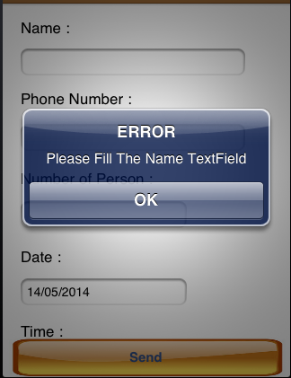
Alert message

Slide 29
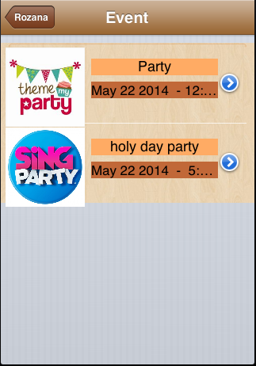
Event :

Slide 30
Reservation the Event :

Slide 31
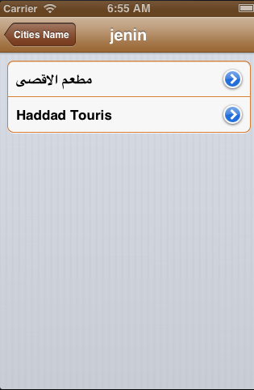
Another City :

Slide 32
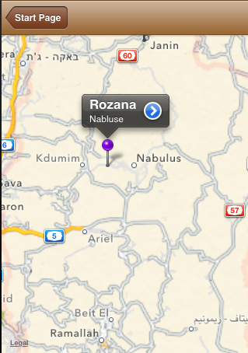
Using GPS :

Slide 33
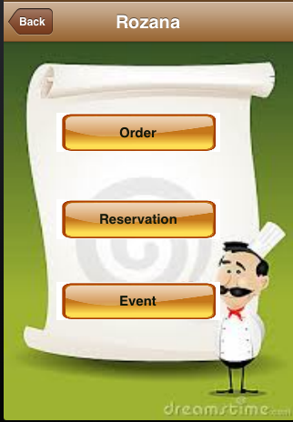
Next Page :

Slide 34
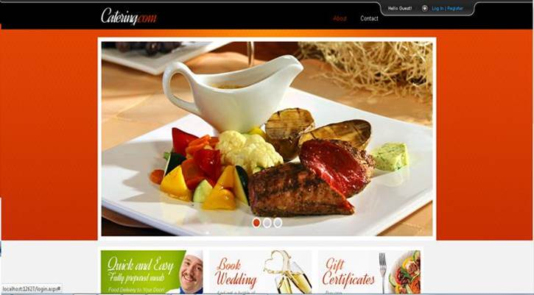
Restaurant side

Slide 35
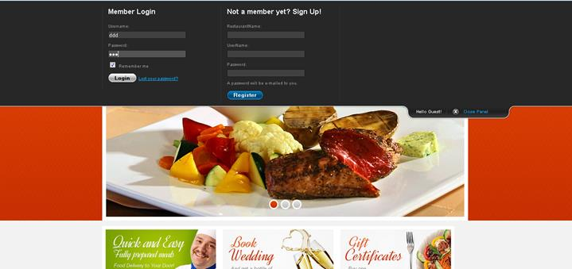
Login and registration

Slide 36
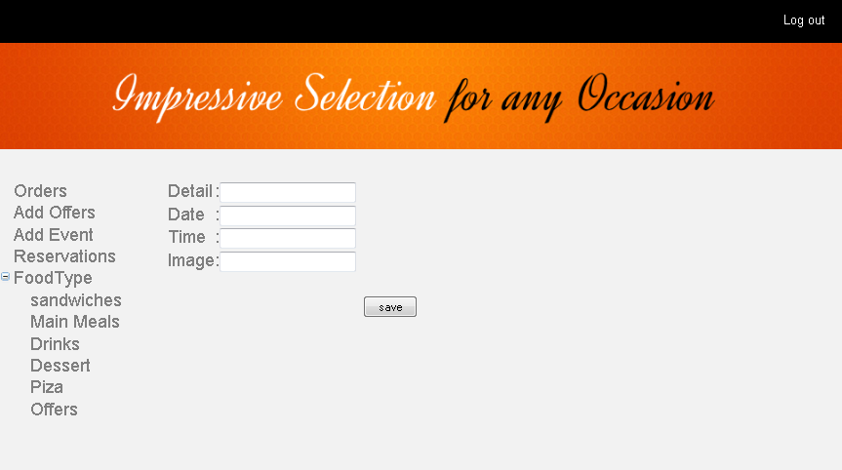
Add event

Slide 37
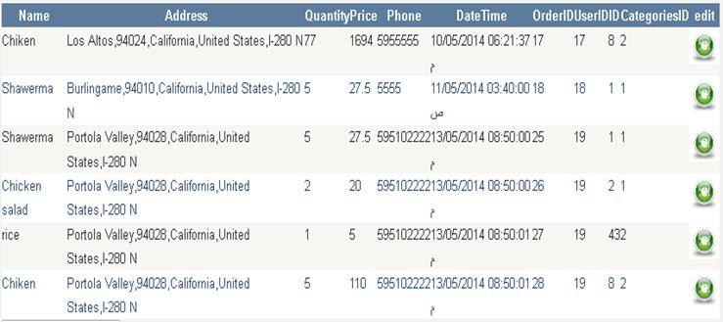
Order page

Slide 38
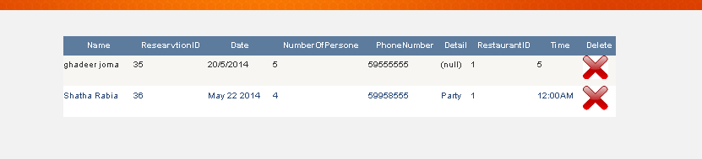
Reservation

Slide 39
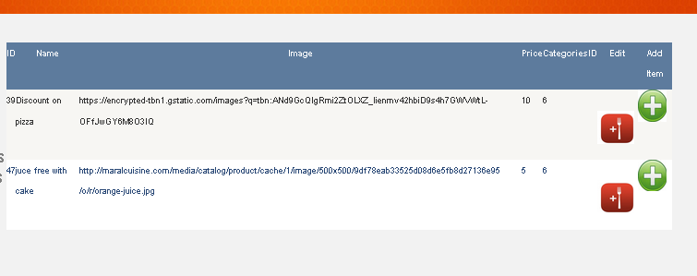
Restaurant menu

Slide 40
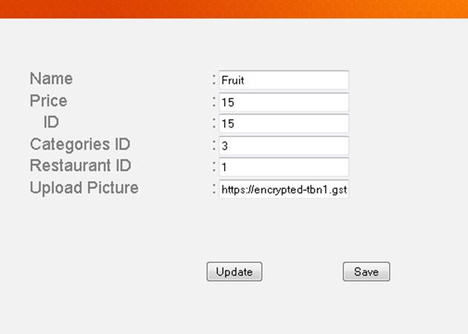
Edit menu

Slide 41
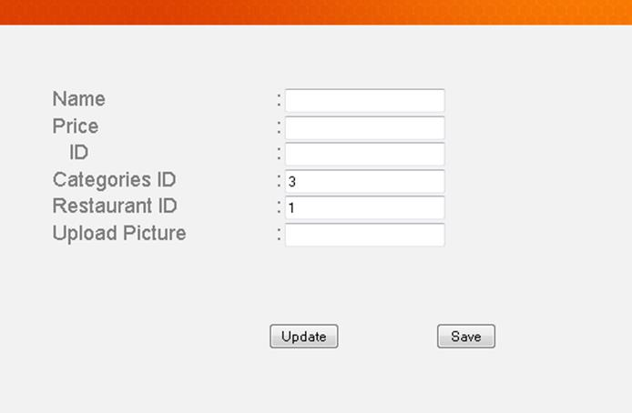
Add new item to the menu

Slide 42
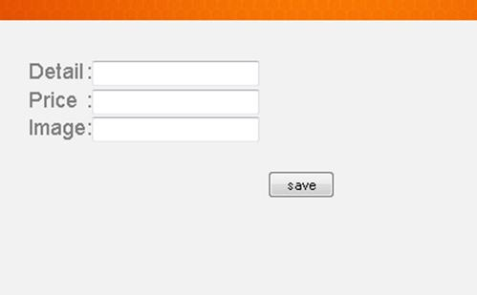
Add Offer

Slide 43
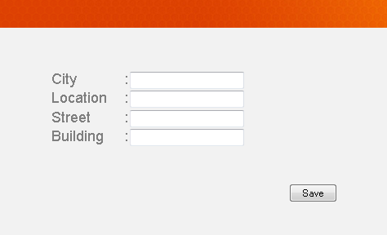
Registration

Slide 44
Problems
This was the first time that we learn C# and objective c.
Limited devices, which are used for programming the IOS so we use a virtual machine.
load a web hosting server to be visible for IOS side.

Slide 45
Future work
Improve GPS using in our project by using Open Street maps .
Improve our design .
We want to add admin for our website .

