Slide 1

Colors Mixer Machine

Slide 2



Team
project supervisor:
Dr.Ashraf Armoush​
Mohee Qawareeq
Amjad Kayed

Slide 3


What is the problem?
Traditionally, craftsmen have relied on manual color mixing techniques, which can be
time-consuming, imprecise, and result in inconsistencies. This not only hampers their
productivity but also hinders their ability to deliver high-quality work that meets their
clients' expectations.

Slide 4
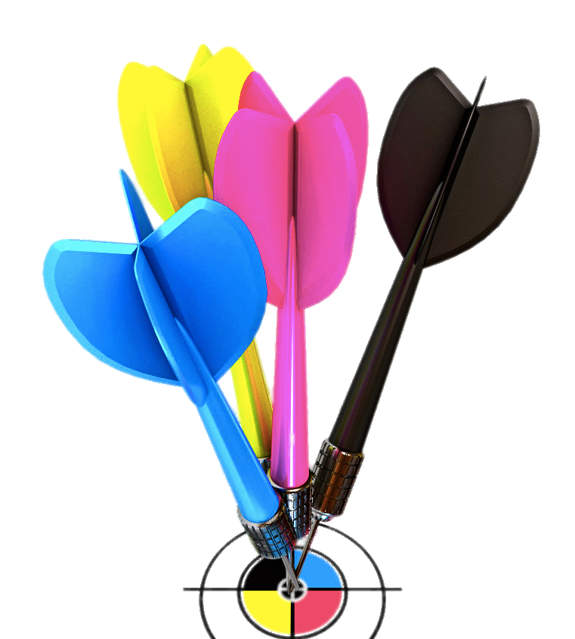
Our solution
empowers craftsmen with a mobile application and a corresponding machine, the Colors Mixer. This system allows craftsmen to easily select the desired color through the mobile application, and the machine automatically mixes the appropriate quantities of pigments to produce the exact color required.

Slide 5

Features

Slide 6
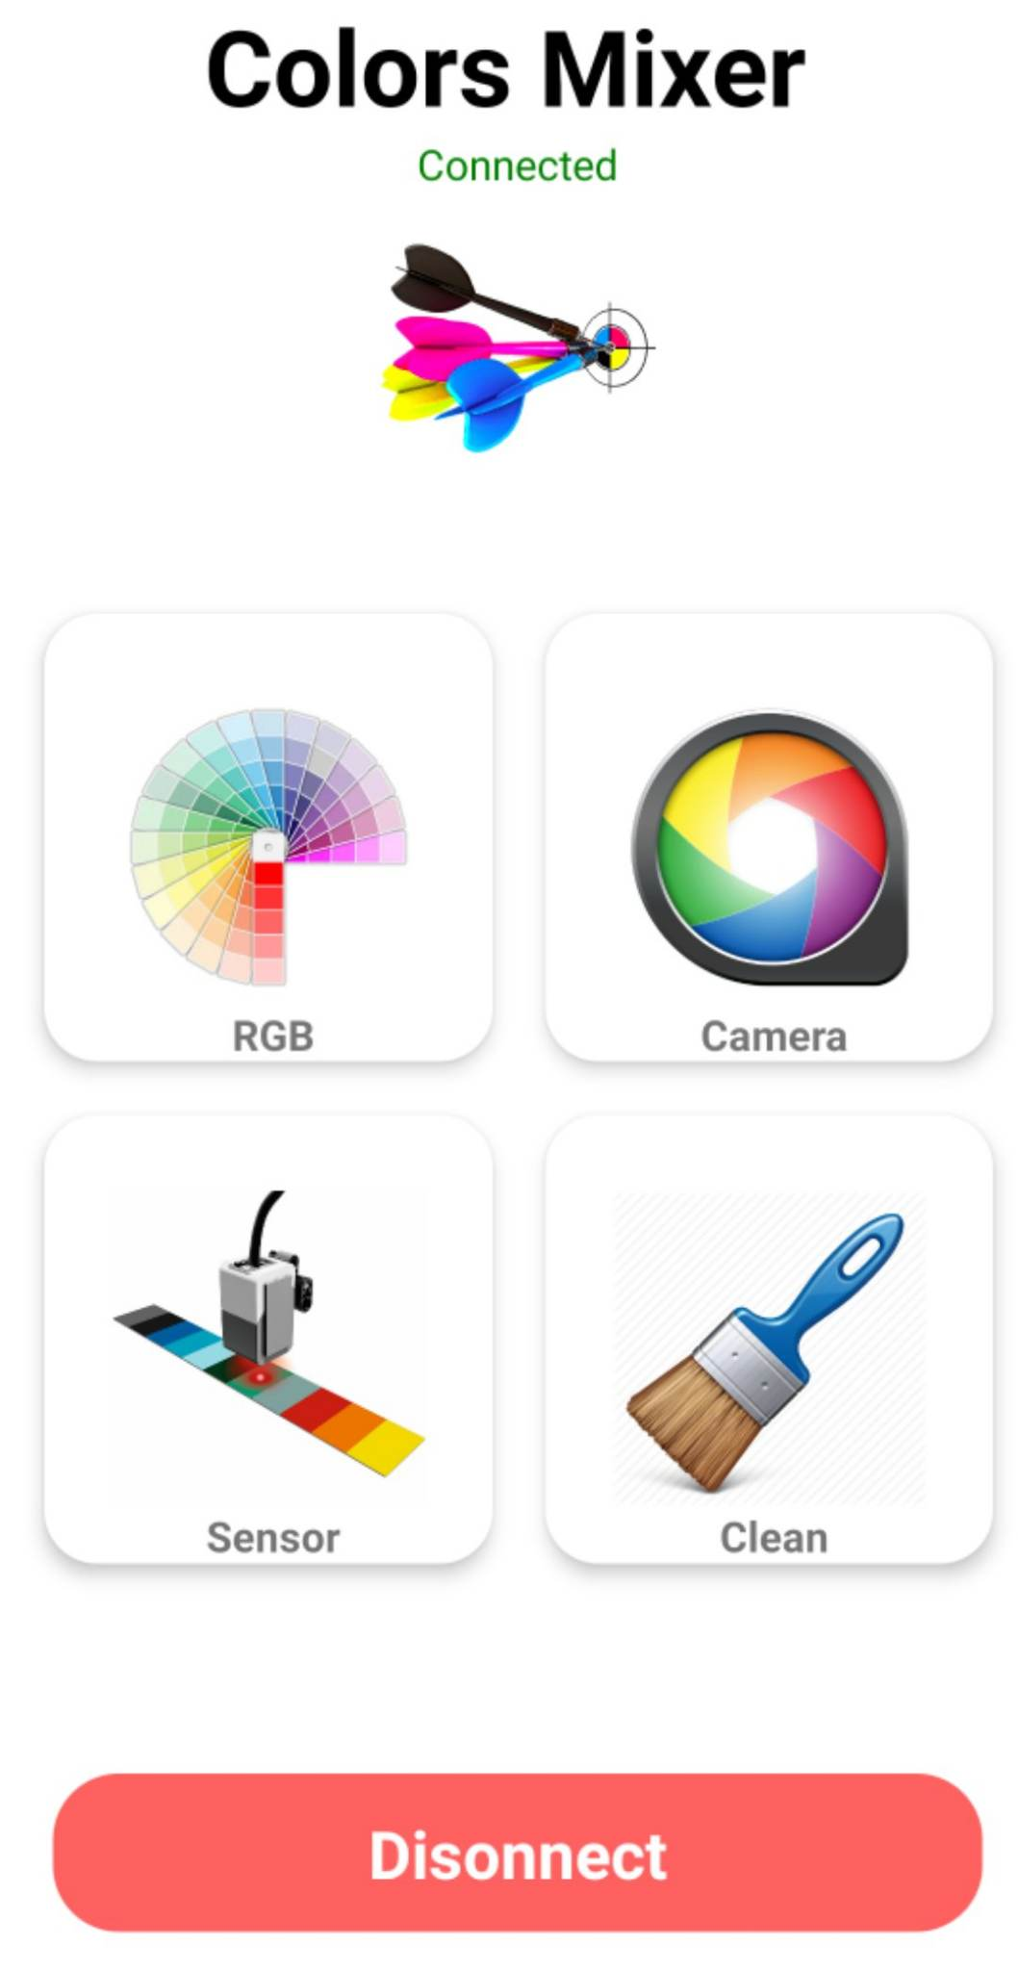
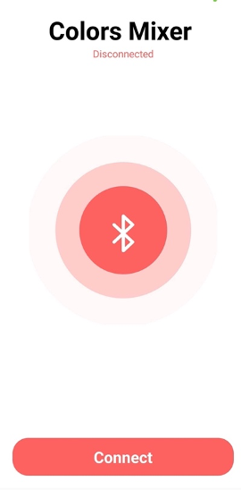
Features
-Mixing Color
-Cleaning the machine after the mixing process
-Mobile Application using React Native with Bluetooth Connectivity

Slide 7
color model

Slide 8
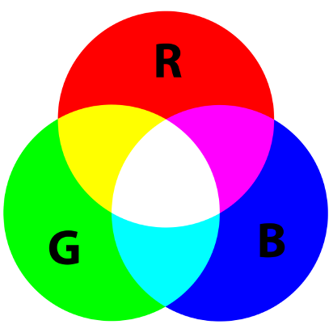
The RGB model

Slide 9
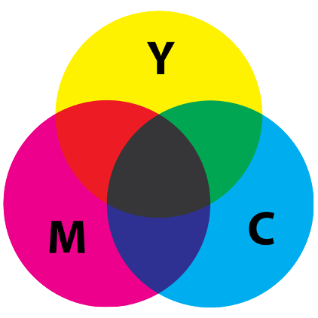
The CMY model
convert RGB to CMY
C = 1 - (R / 255)
M = 1 - (G / 255)
Y = 1 - (B / 255)

Slide 10
Constraints

Slide 11
Constraints
-Effects of High Viscosity of paint
-The liquid nature of the paint
-We did not find the required color grades

Slide 12
Hardware component

Slide 13
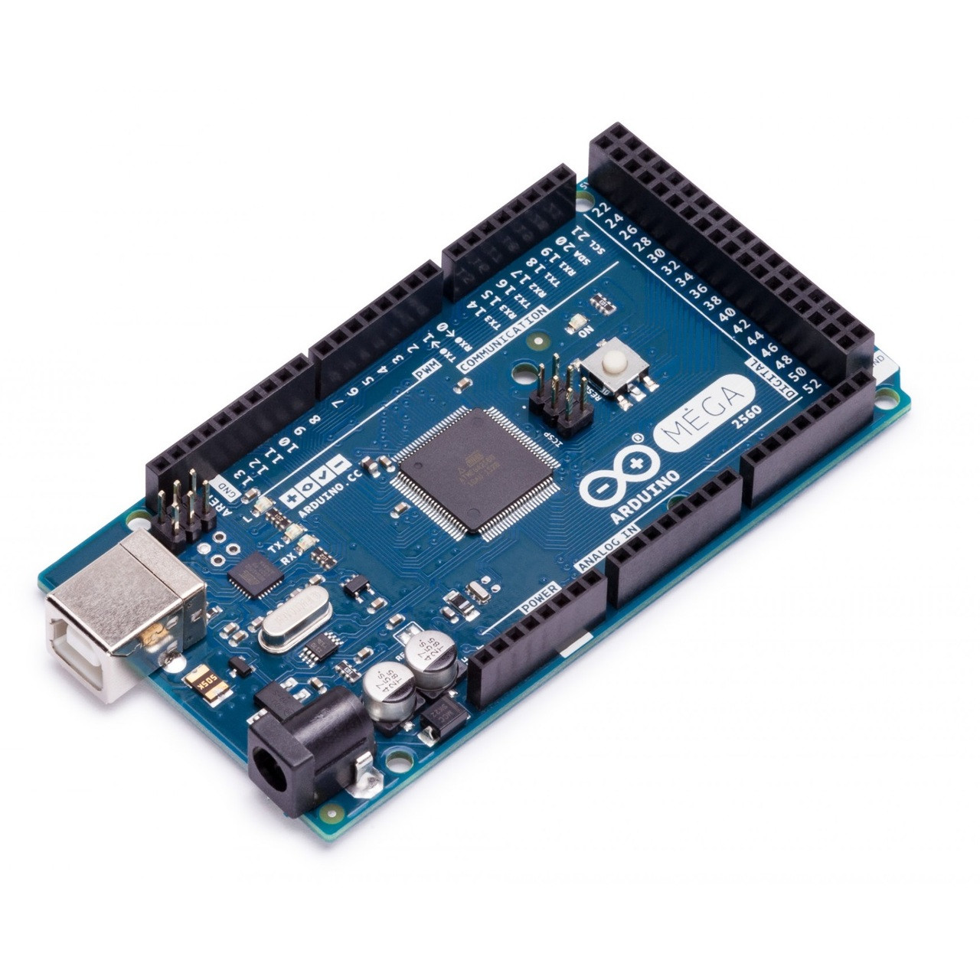
Arduino Mega
Main controller board for overall system functionality.

Slide 14
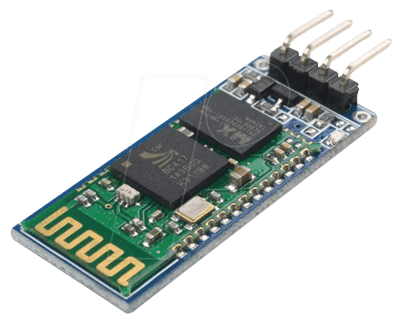
HC-06 Bluetooth Module
Used for wireless communication between the Color Mixer machine and the mobile application.

Slide 15
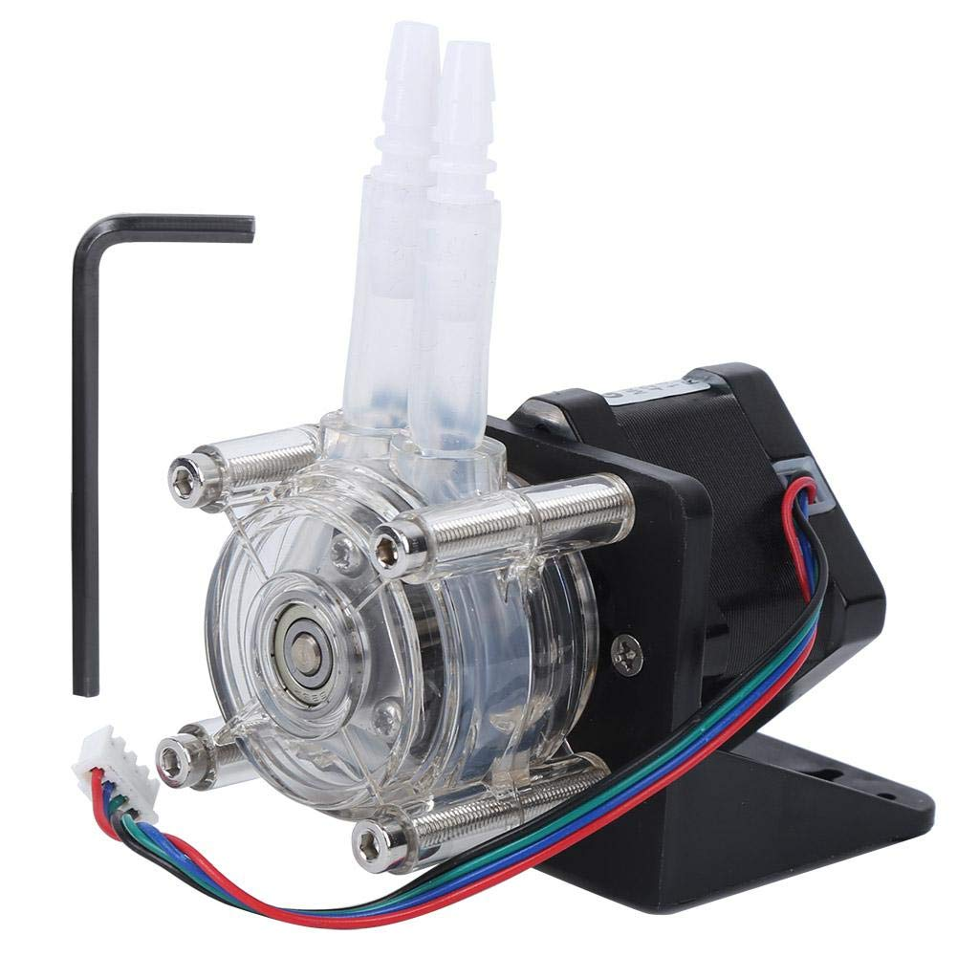
Peristaltic pump
Controls the precise flow of color components during mixing.

Slide 16
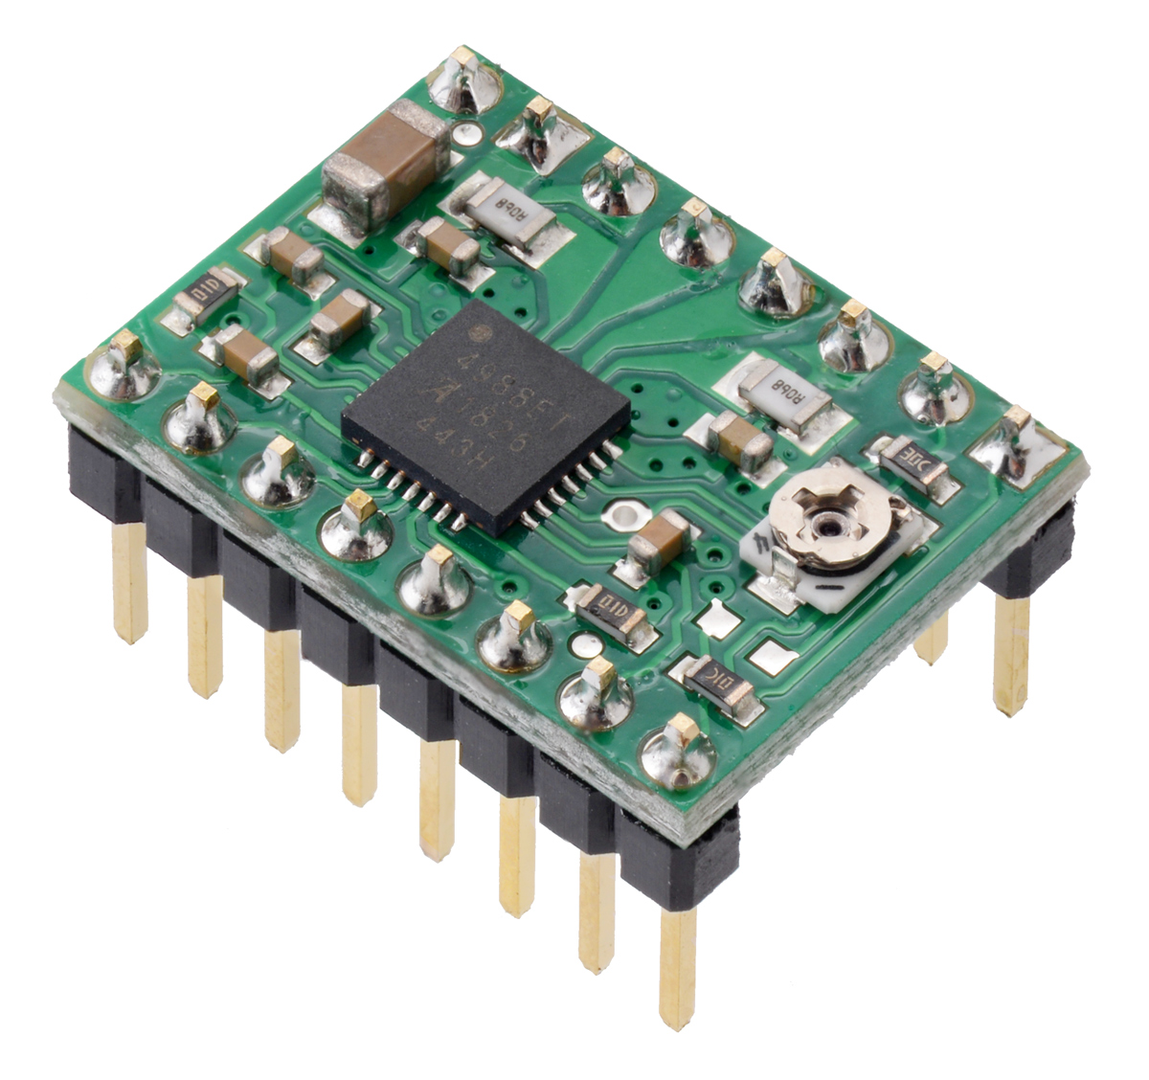
A4988 Stepper Motor Driver Carrier
Drives the stepper motor responsible for precise movement in the system.

Slide 17
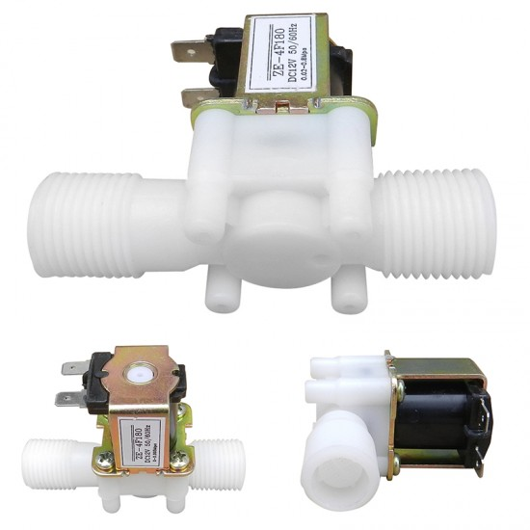
Solenoid valve (½ inch)
Controls the flow of liquids in the system

Slide 18
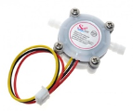
Flow Sensor
Monitors the flow of liquid to check if the thinner is being cleaned or not

Slide 19
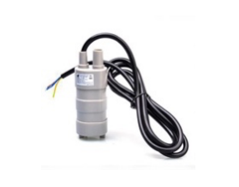
Pump
Pumps the cleaning solvent or thinner in the system to clean the components.

Slide 20
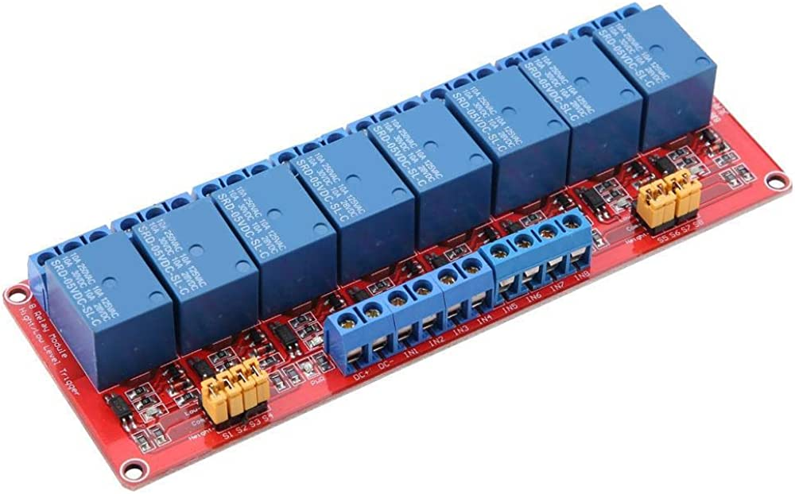
8-Channel 12V Relay Module High/Low
Controls the activation of the 8 solenoid valves for various system operations

Slide 21
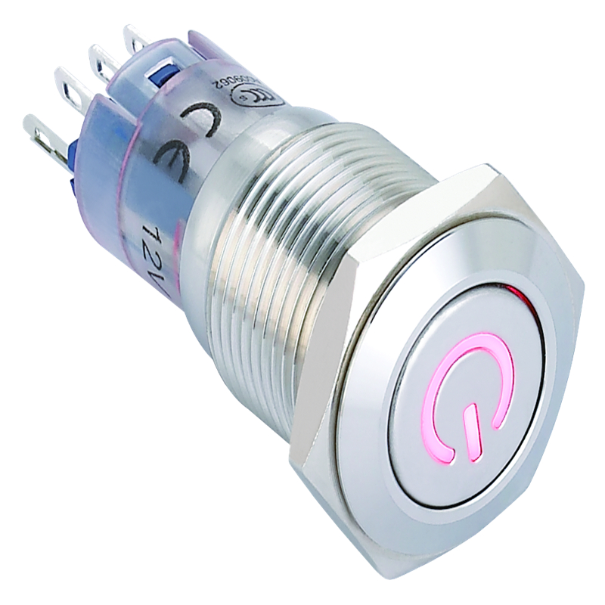
12V 16mm Metal Push Button Switch
Serves as an on/off switch for the entire system, allowing easy control of the system's power.

Slide 22
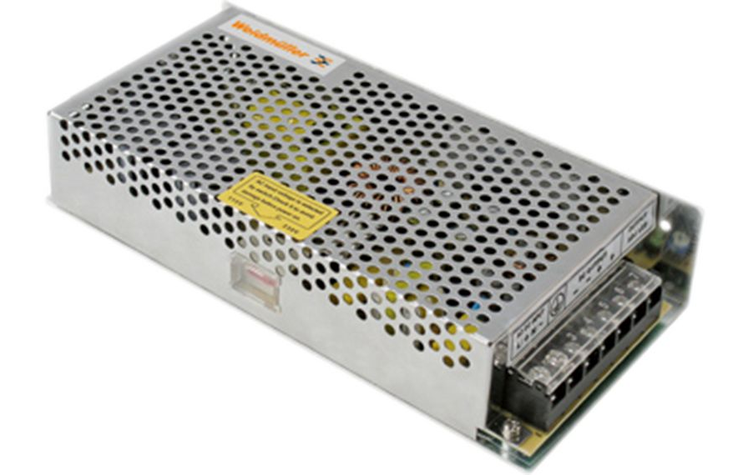
12V 12.5A Power Supply
Supplies the required power to the system, ensuring proper functioning of the components.

Slide 23
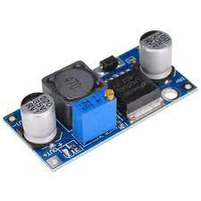
LM2596 Adjustable Step Down Buck Converter
Provides a regulated 5V output to power several components in the system. Generates a stable 6.7V supply voltage to power the Arduino board and ensure its operation.

Slide 24
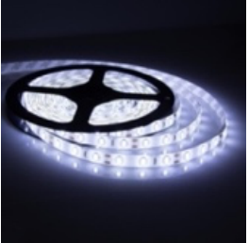
1M 12VDC White LED
To provide lighting in the system

Slide 25
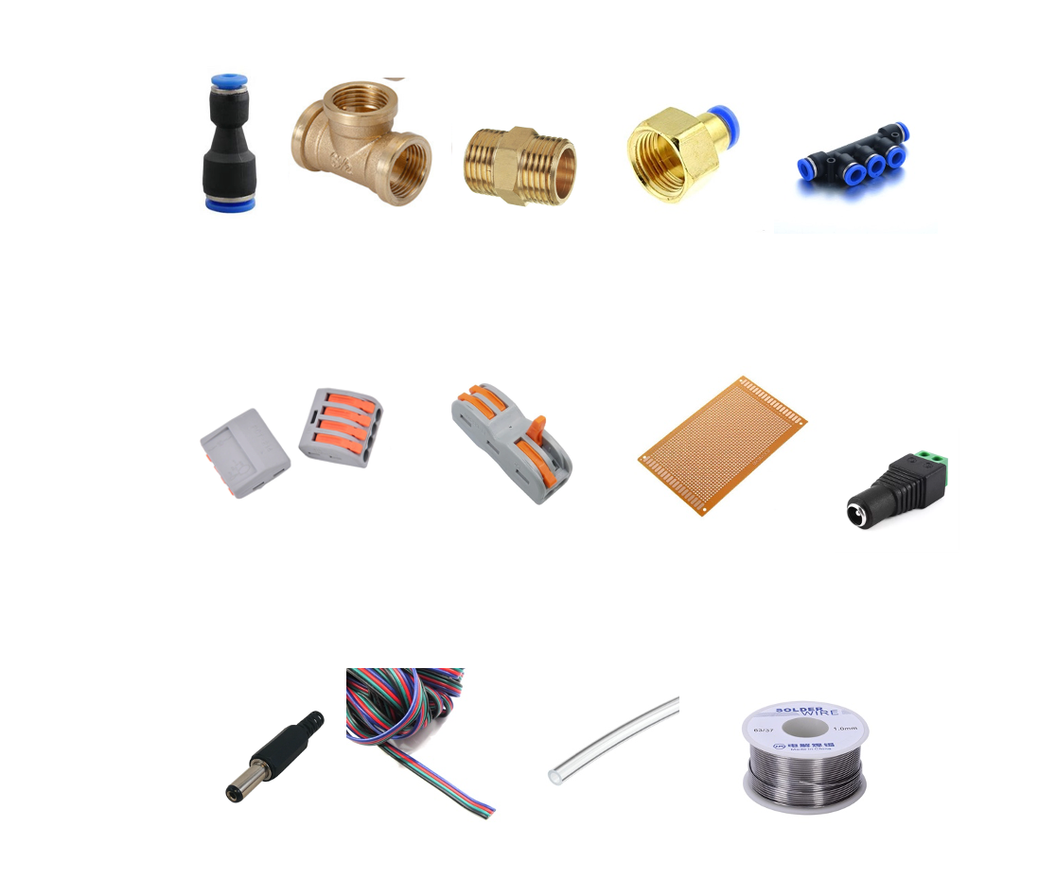
Secondary Components

Slide 26
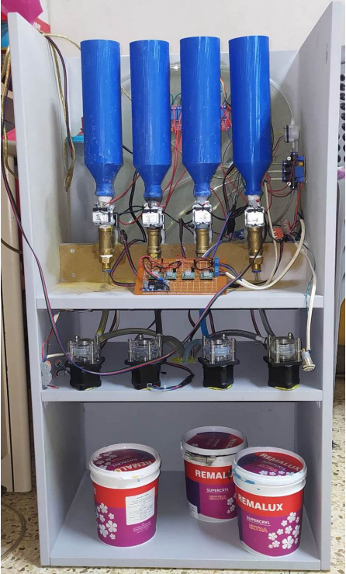
Final design of machine
02

Slide 27
Future work
- Choose a color using the phone's camera and sensor
-Adding a keyboard and screen to the machine where it is used manually
-Adding a paint flow sensor to increase accuracy

Slide 28
Thank you.

