Slide 1


Florenca Online Store and advanced cyber security system in the cloud
Presented by:
Noor Hawari
Mohammad Jamhour
Supervised by:
Dr. Maher Y. Arafat

Slide 2
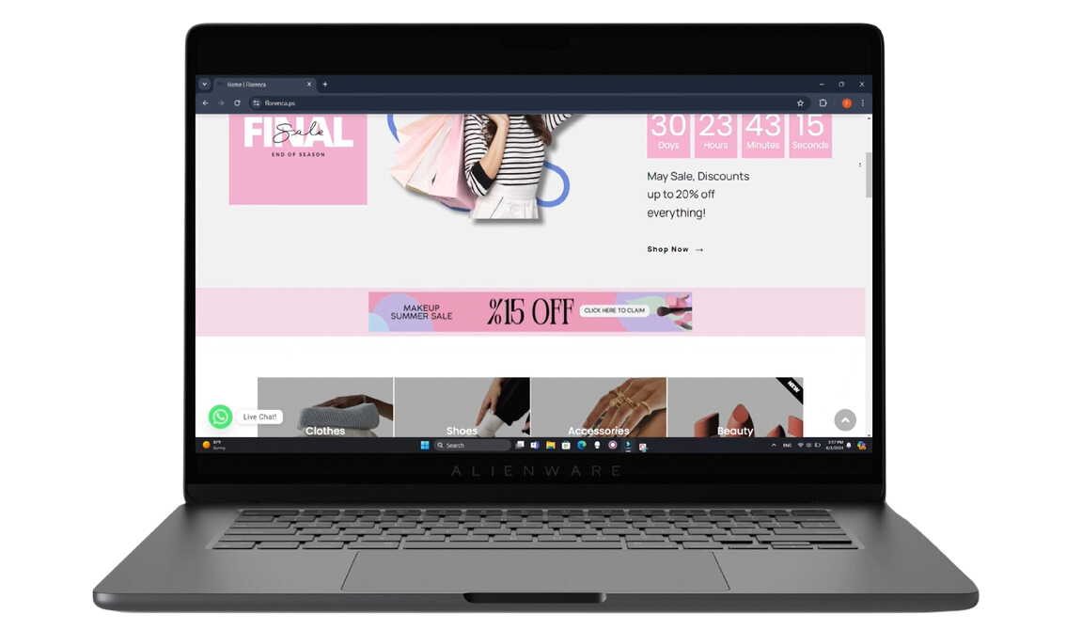

Promo Video

Slide 3
Table of Contents
Introduction
Promo Video
Problem Statement
Survey
Infrastructure and Technology Strategy
Hardware & Software
Website Features
Admin Panel
SIEM
RTIS and Security Levels
Project Infrastructure Blueprint

Slide 4
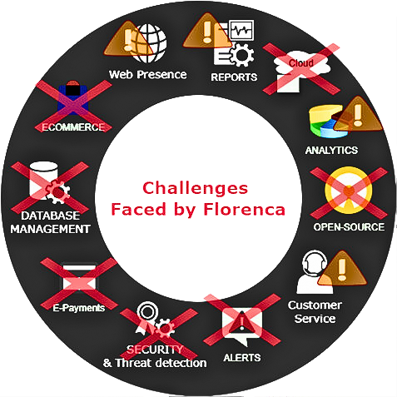

Problem Statement

Slide 5

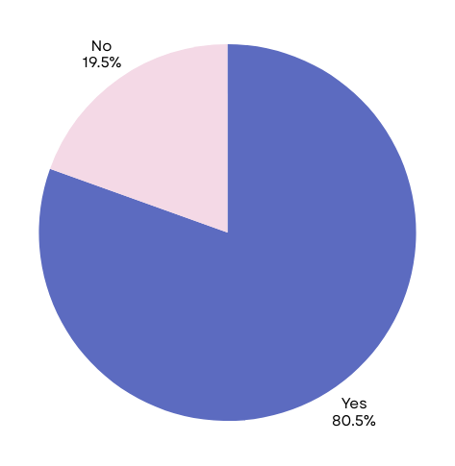




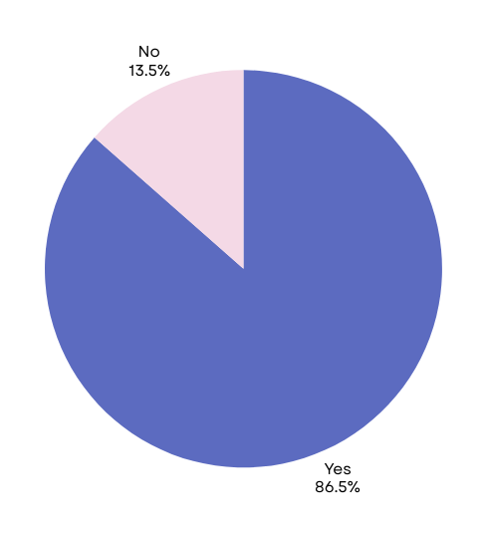

204
Survey Results
80.5% Majority prefer guest checkout with an email to keep track of orders
72.0% of younger respondents (18-34) find WhatsApp Live chat essential.
Guest
70.0% of younger respondents (18-34) view cryptocurrency payments positively.
86.5% of all respondents view cryptocurrency payments positively.

Slide 6








Infrastructure and Technology Strategy
Cloud Based Solutions
Cost Effective Options
Open-Source Technologies

Slide 7
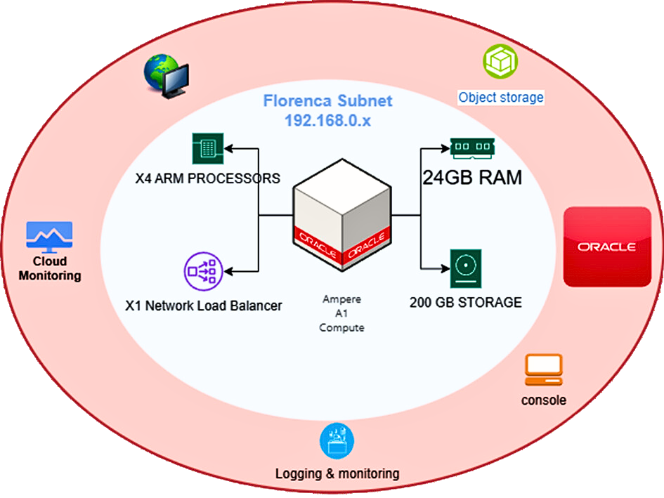
Hardware
Ampere A1 Compute Instance
4 ARM processors, 24GB of RAM, and 200GB of storage
network load balancer

Slide 8
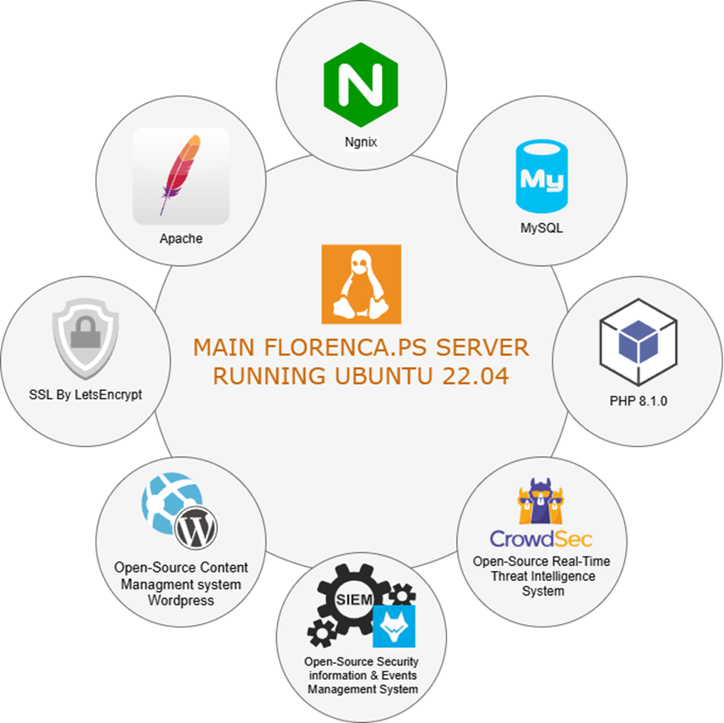
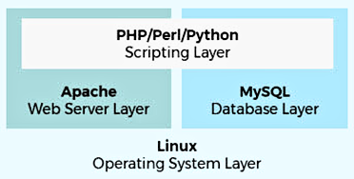

Software

Slide 9







Project Components
Part | Open-Source Software | Programming Lang. | Purpose or Type
www.Florenca.ps | WordPress |  | Content management system (CMS)
www.Admin.Florenca.ps | aaPanel |  | Web hosting Admin control panel (WHCP)
www.SIEM.Florenca.ps | WAZUH |  | Security Information and Event Management System (SIEM)

Slide 10

Logo Design
Old
New

Slide 11



WWW.FLORENCA.PS
WWW.ADMIN.FLORENCA.PS
WWW.SIEM.FLORENCA.PS

Slide 12






Website Security Features
Anti-DDoS

Slide 13

















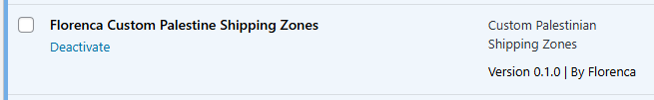
Additional Website Features
Automatic Shipping Calculation
Official E-Payment Gateway
Crypto Payment Integration
CRM & SEO
Data Export & Sales Analytics
Our Plug-in

Slide 14
Additional Website Features
Automatic Shipping Calculation
Official E-Payment Gateway
Crypto Payment Integration
CRM & SEO
Data Export & Sales Analytics
Our Plug-in

Slide 15
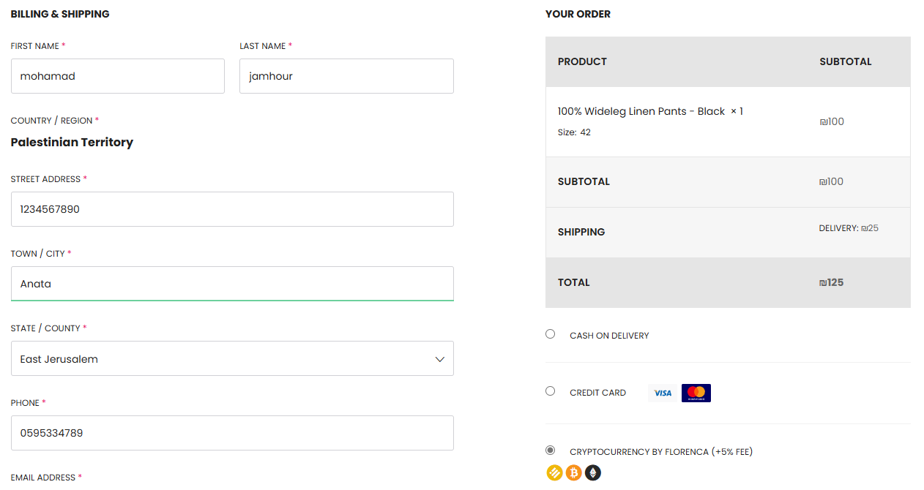

Automatic Shipping Calculator

Slide 16
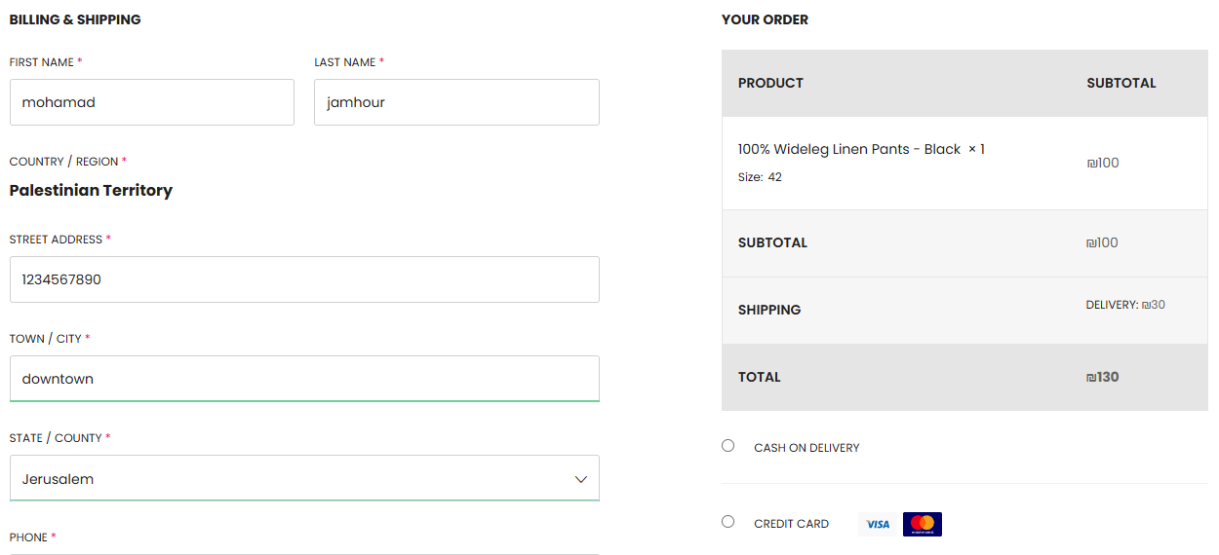
Automatic Shipping Calculator

Slide 17
Additional Website Features
Automatic Shipping Calculation
Official E-Payment Gateway
Crypto Payment Integration
CRM & SEO
Data Export & Sales Analytics
Our Plug-in

Slide 18
E-PAY Video
Official E-Payment Gateway

Slide 19
Additional Website Features
Automatic Shipping Calculation
Official E-Payment Gateway
Crypto Payment Integration
CRM & SEO
Data Export & Sales Analytics
Our Plug-in

Slide 20
Crypto-Pay Video
Crypto Payment Integration

Slide 21
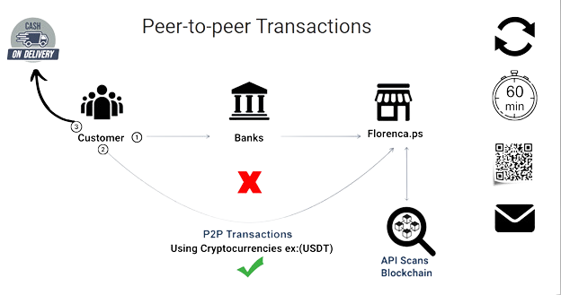
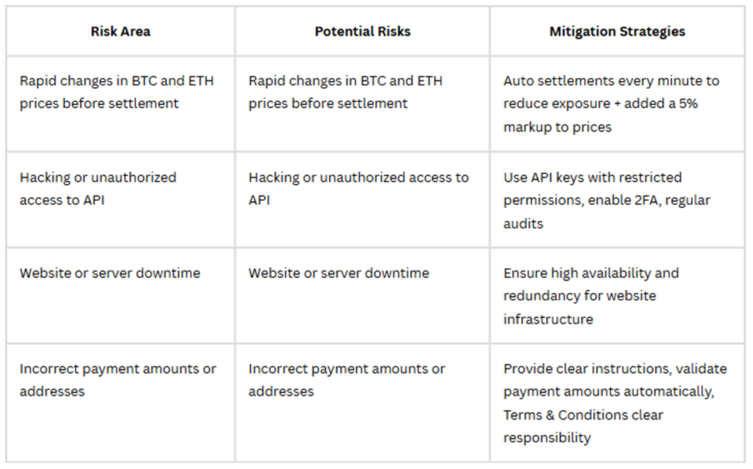






Crypto Payment Integration
“The probability of price fluctuation”
Remedy
Auto Settlement Script
Refreshes every 60 seconds
Runs when paying with:
Or
Prices, Wallet & Auto-settelment Enabled by
5% Markup/Order

Slide 22
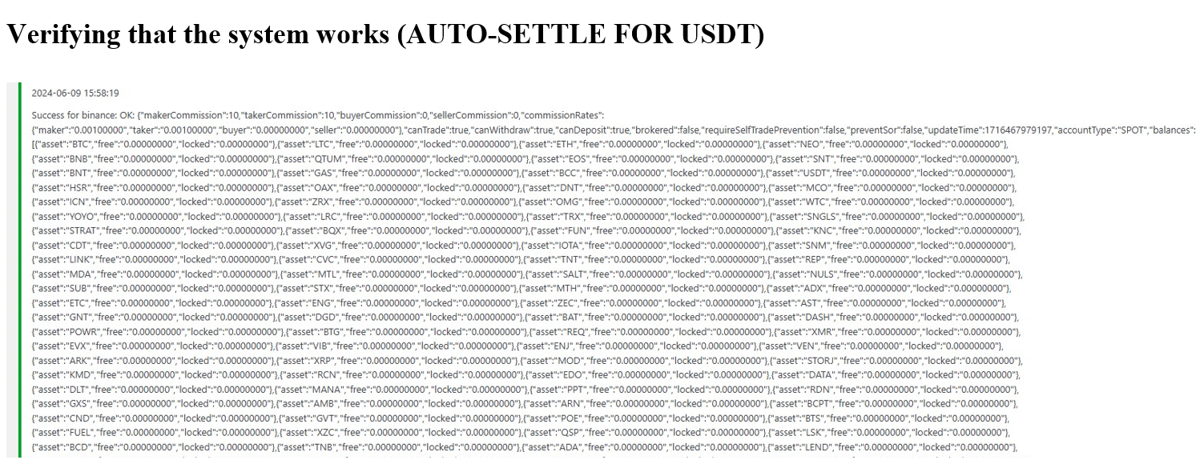
Auto Settlement Script Run

Slide 23
Additional Website Features
Automatic Shipping Calculation
Official E-Payment Gateway
Crypto Payment Integration
CRM & SEO
Data Export & Sales Analytics
Our Plug-in

Slide 24
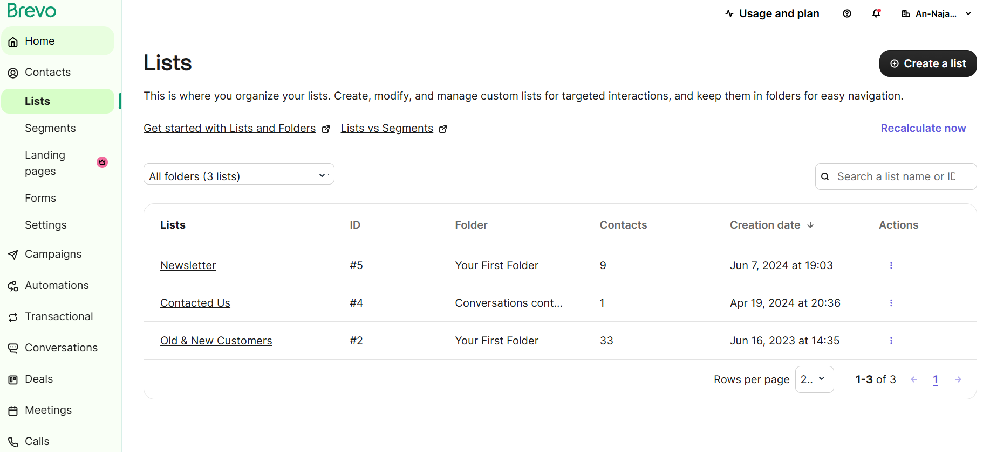
CRM & SEO

Slide 25
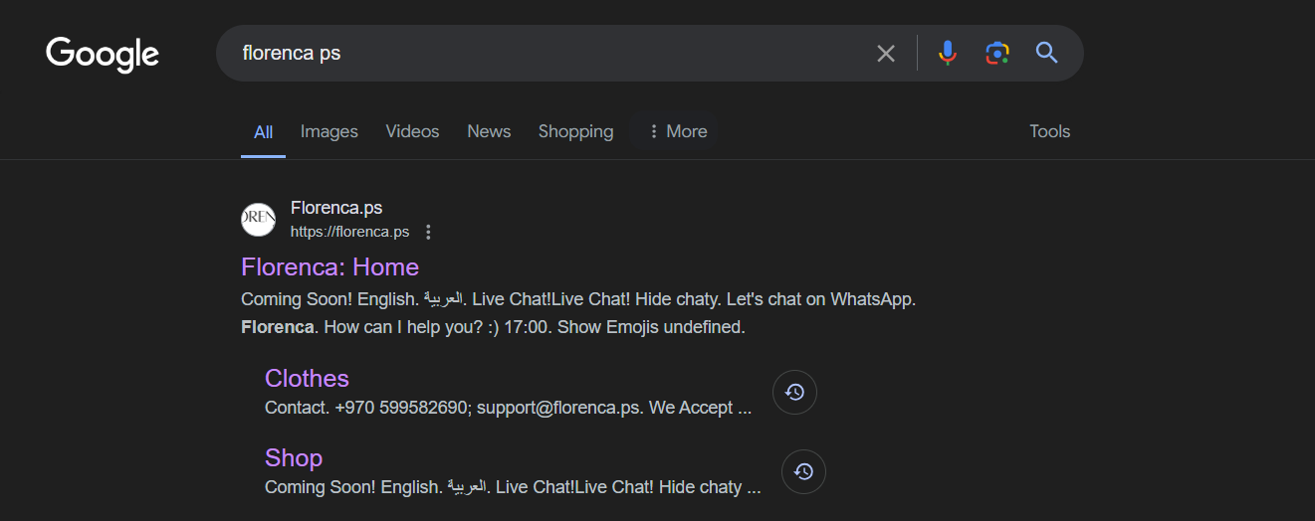
CRM & SEO
Florenca Ps
Florenca Shop

Slide 26
Additional Website Features
Automatic Shipping Calculation
Official E-Payment Gateway
Crypto Payment Integration
CRM & SEO
Data Export & Sales Analytics
Our Plug-in

Slide 27
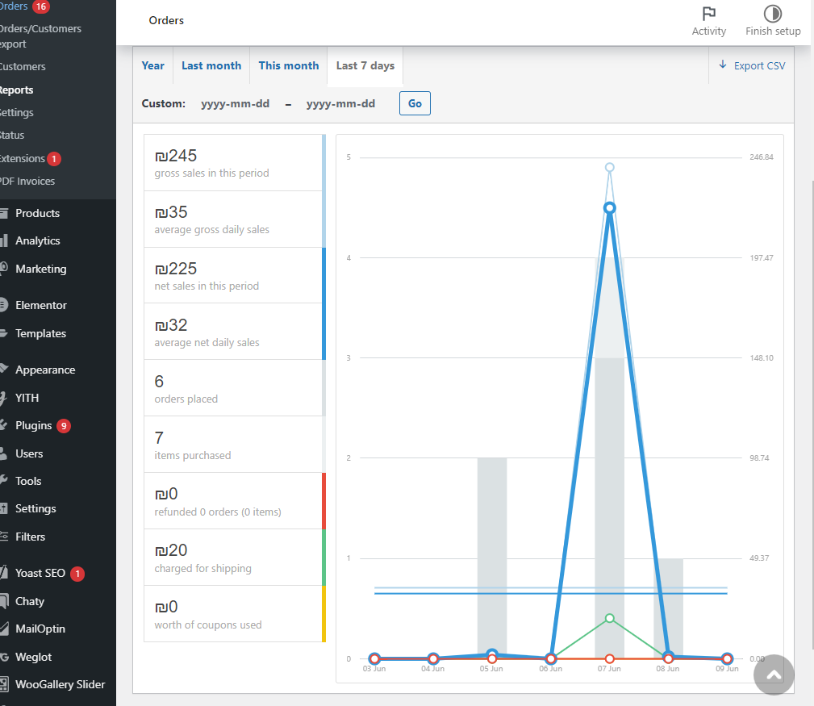
Data Export & Sales Analytics

Slide 28
WWW.FLORENCA.PS
WWW.ADMIN.FLORENCA.PS
WWW.SIEM.FLORENCA.PS

Slide 29

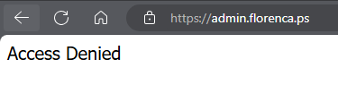



Access Control
WWW.ADMIN.FLORENCA.PS
HTTPS://WWW.ADMIN.FLORENCA.PS/PORT/SECURITY-PHRASE
Example: SMjh78@#
Example: 7002

Slide 30
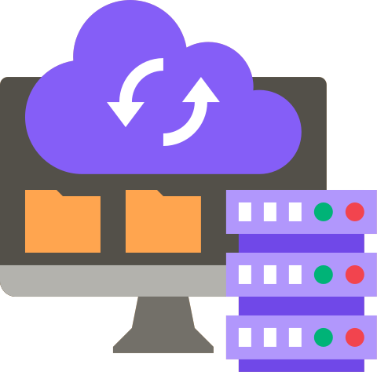


Admin Panel Features
DBMS
Resource monitoring
Back ups

Slide 31
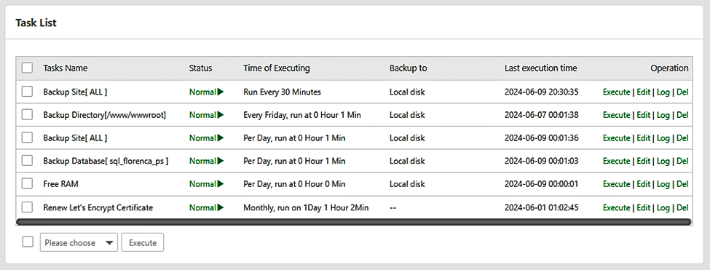



Back Ups
/ 30minutes (keep last 24 copies)
/ Day (keep last 24 copies)
/ Week (keep last 7 copies)

Slide 32

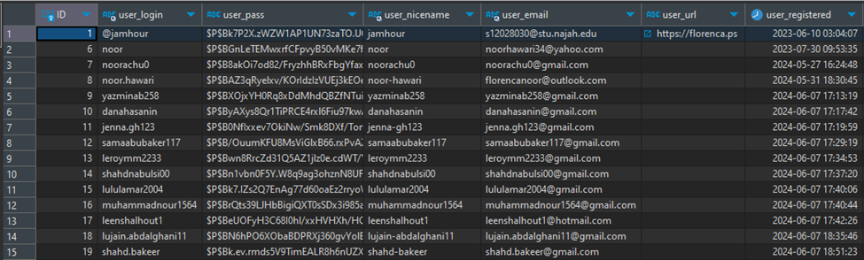
DBMS
wp_hash_password() function = hashed version of the password

Slide 33
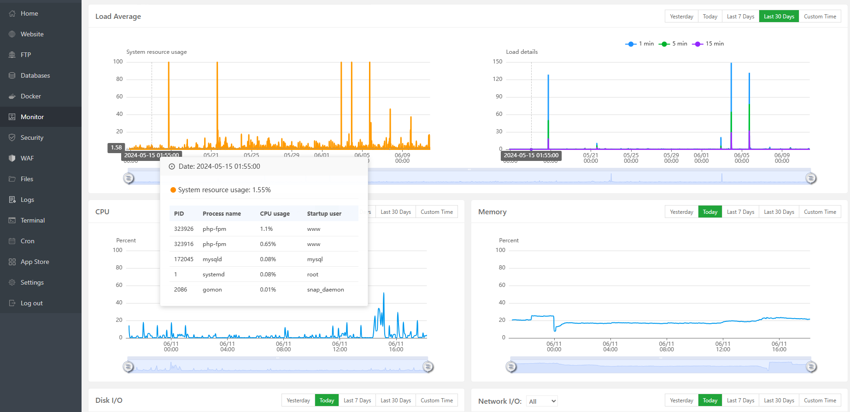
Resource Monitoring

Slide 34
WWW.FLORENCA.PS
WWW.ADMIN.FLORENCA.PS
WWW.SIEM.FLORENCA.PS

Slide 35





SIEM Features
Real time detection
(logs, integrity, aleting)
Compliance
Audit

Slide 36
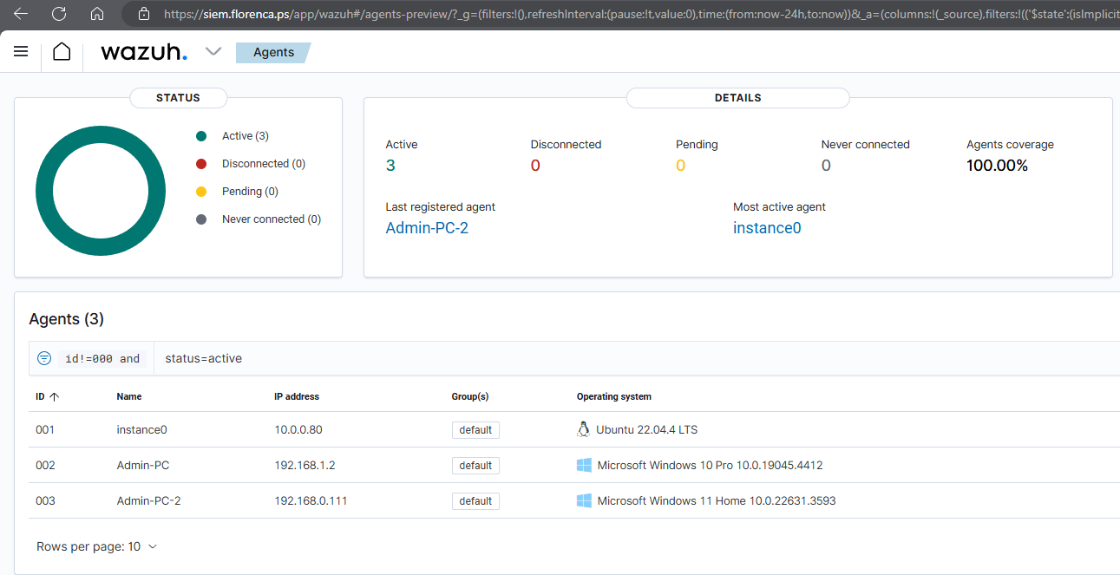
Agents

Slide 37
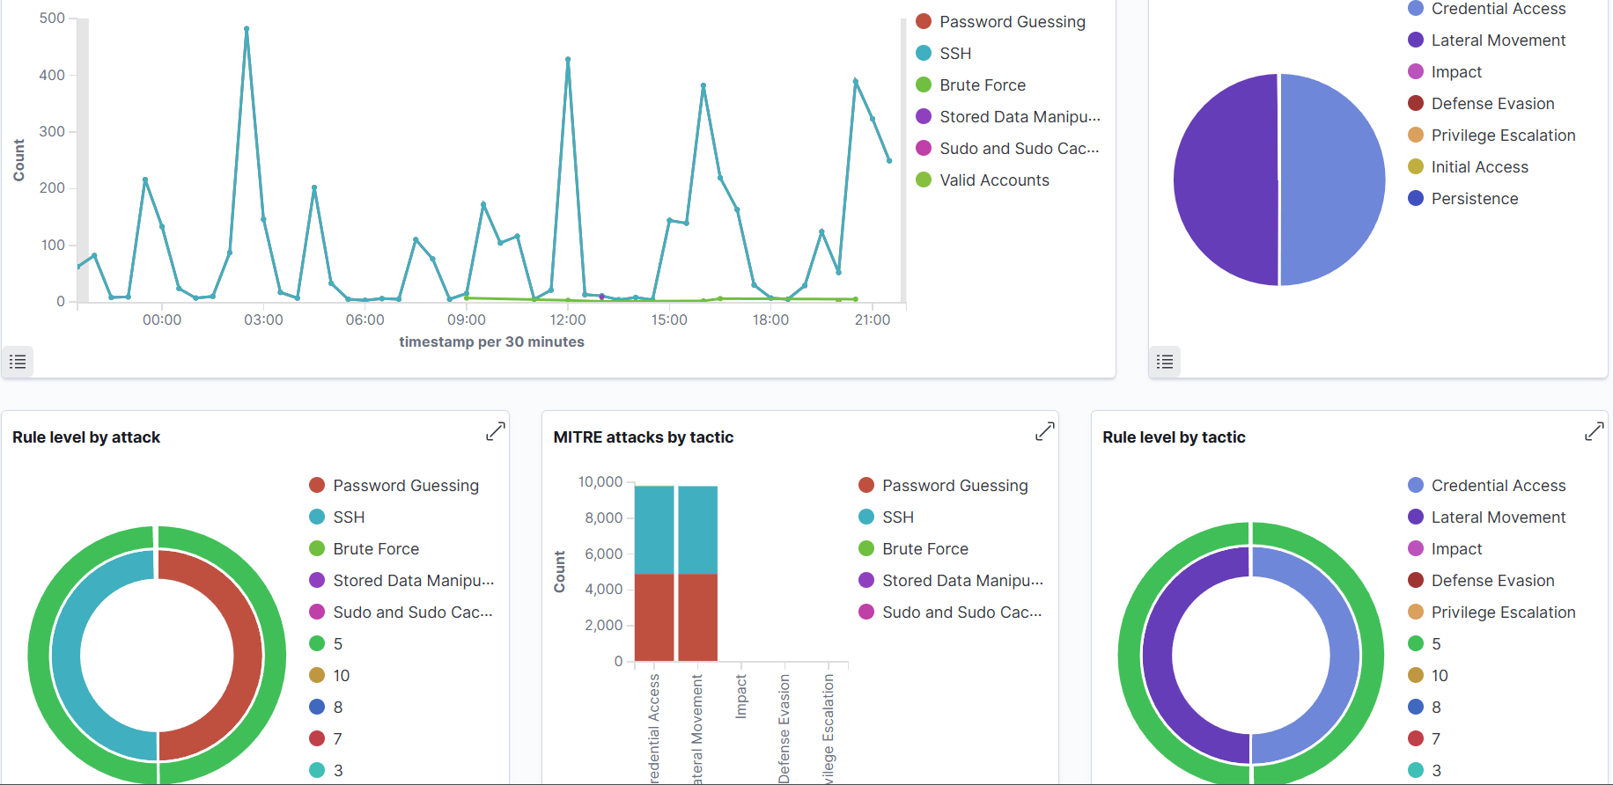
Attack Analysis

Slide 38
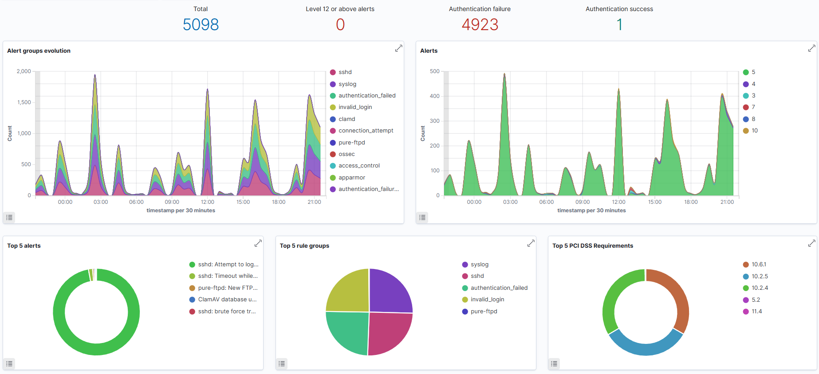
Security Events

Slide 39
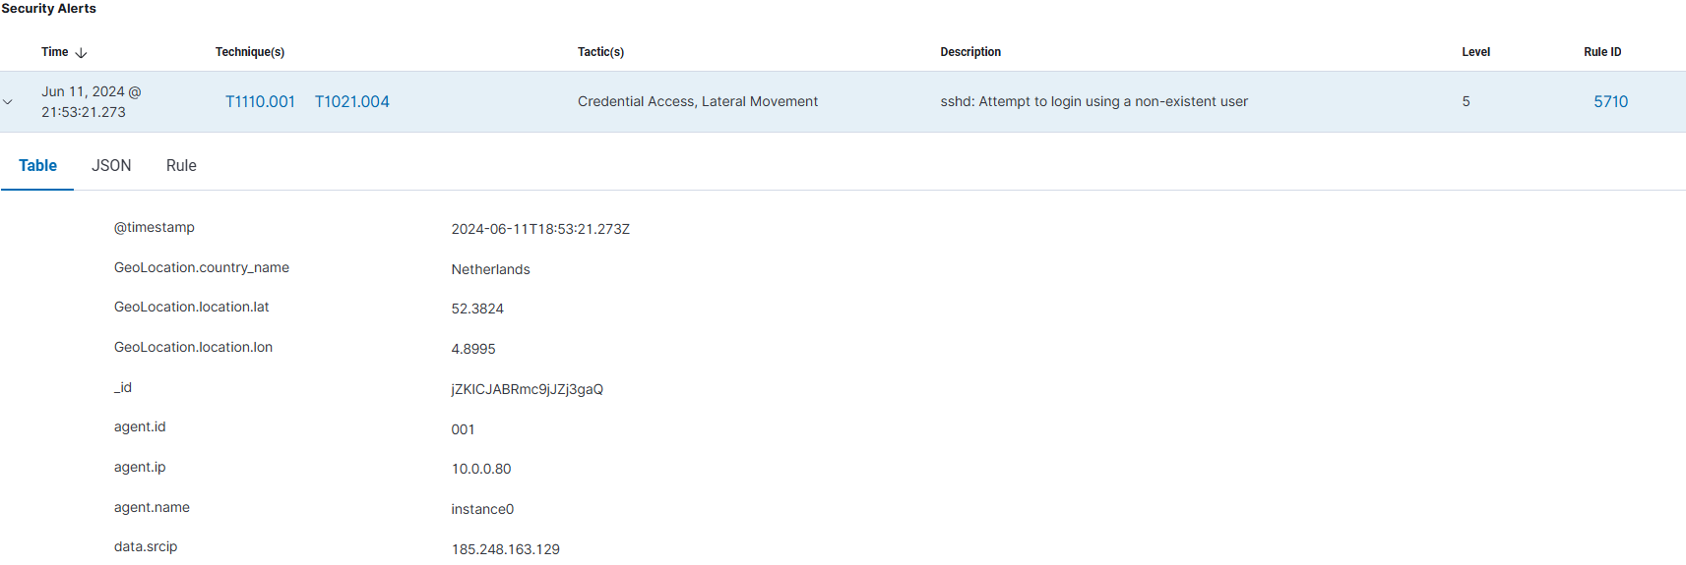
View Event Details

Slide 40
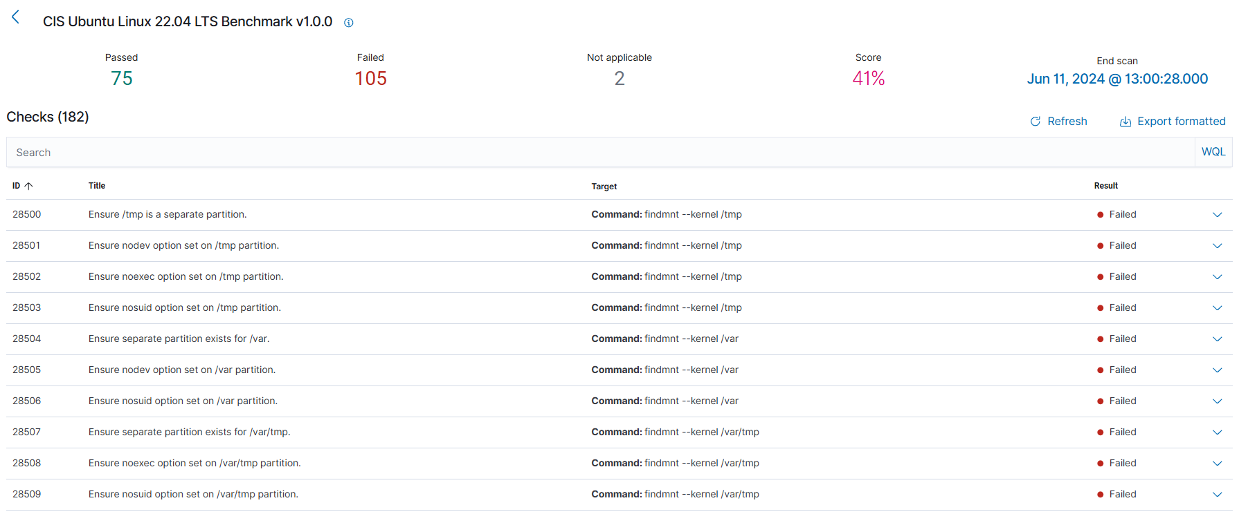
Full Audit + Remidiation

Slide 41

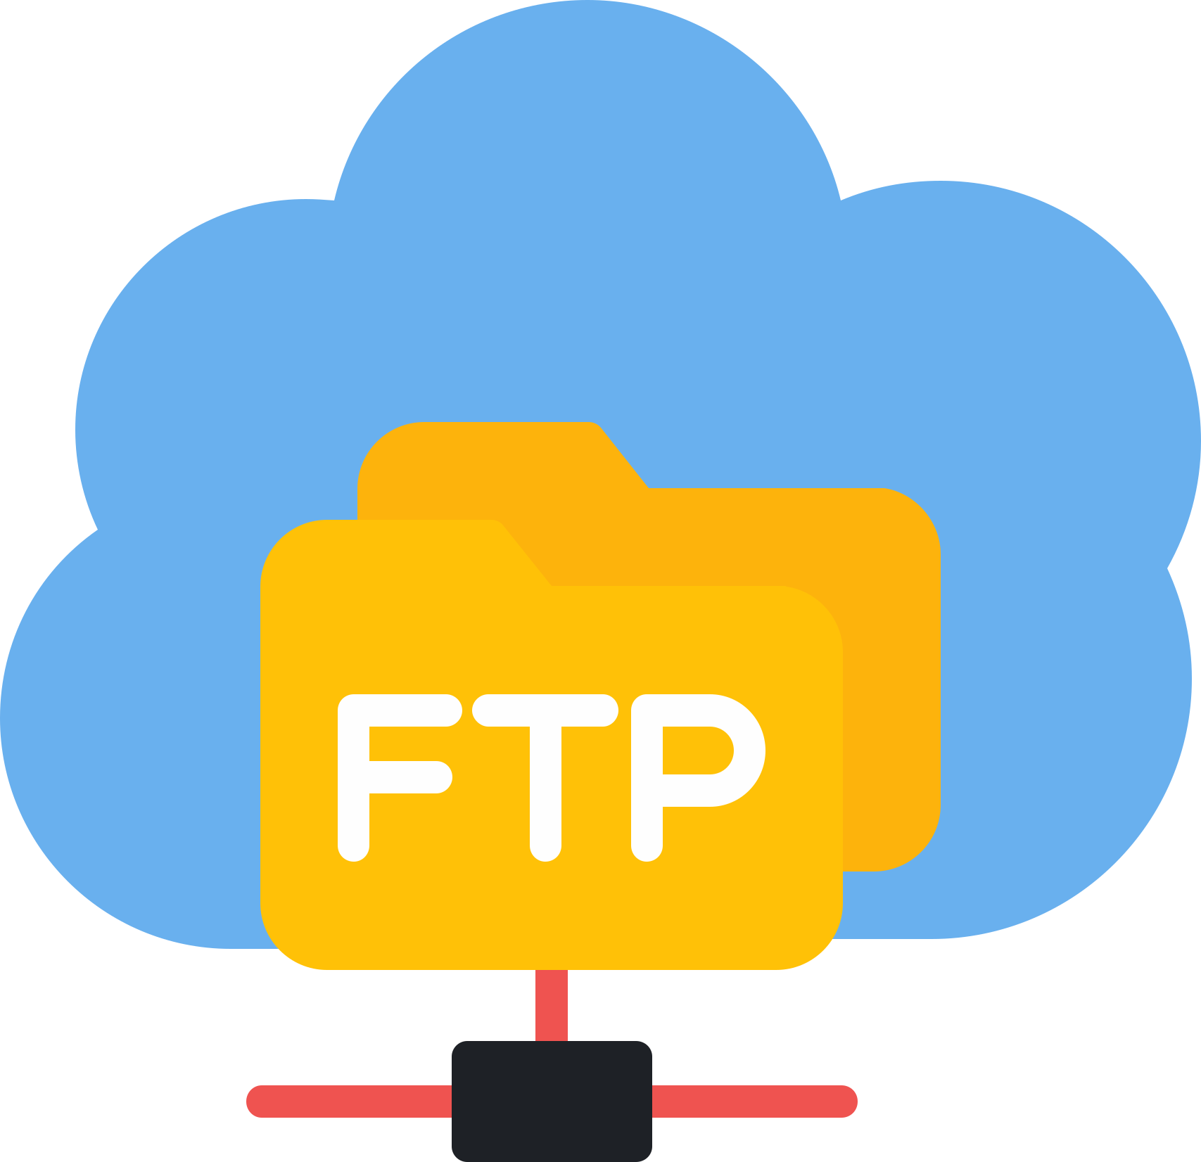





SIEM Results
Key Security Enhancements
Root User Security
FTP Permissions
Core Dumps Restriction
SSH Login Security
Privilege Escalation Prevention
CLI Session Timeout
Sudo Security
PHP Error Handling
TCP SYN Cookies

Slide 42
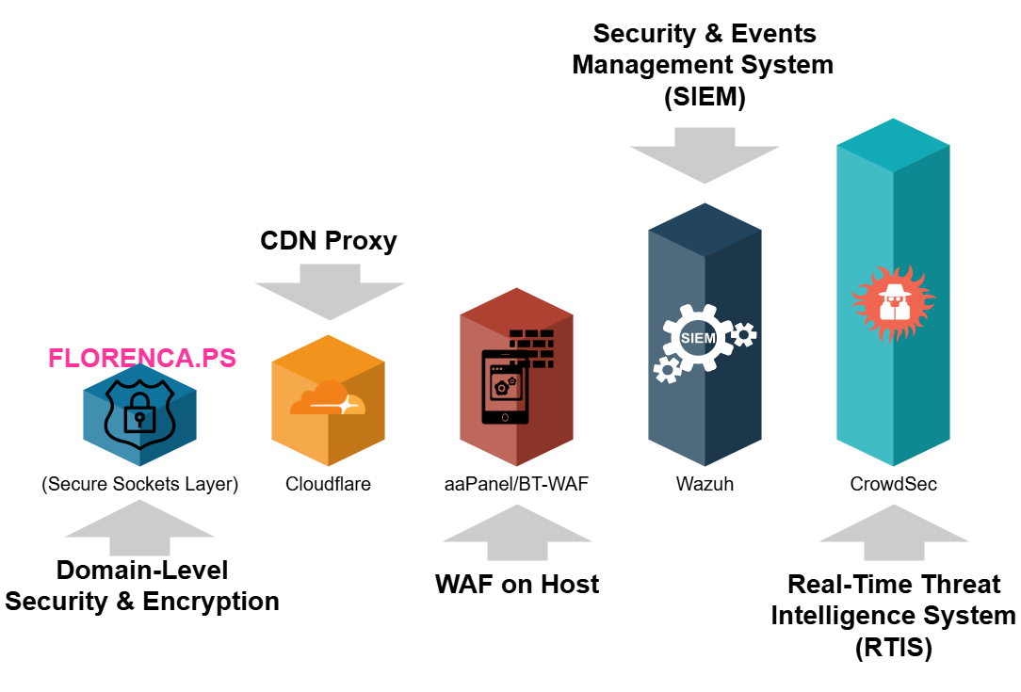
RTIS and Security Levels

Slide 43
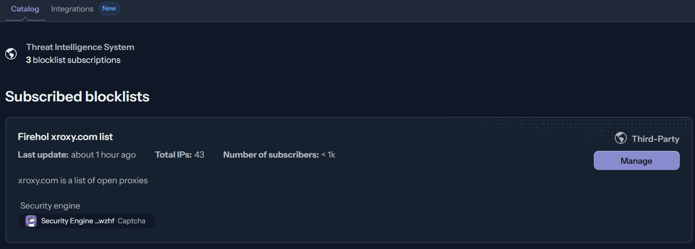
Threat Intel system
Community Blocklists

Slide 44
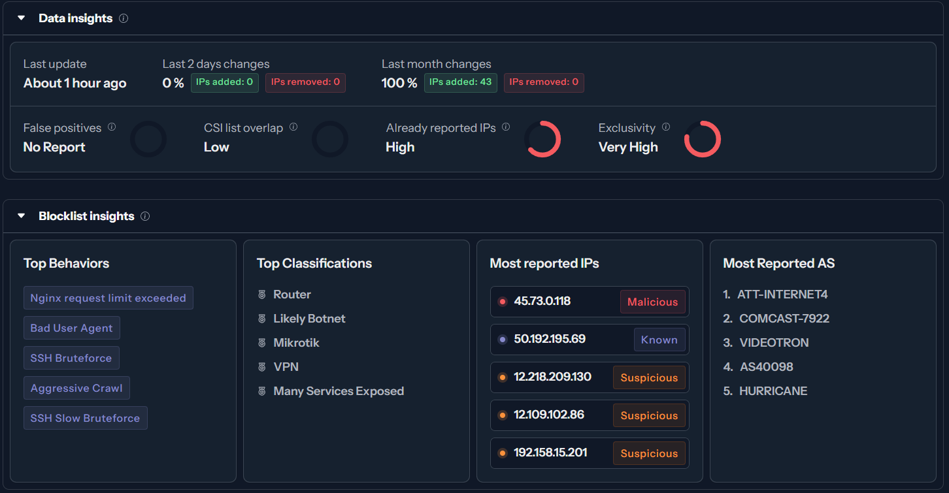
Insights for each added Blocklist

Slide 45
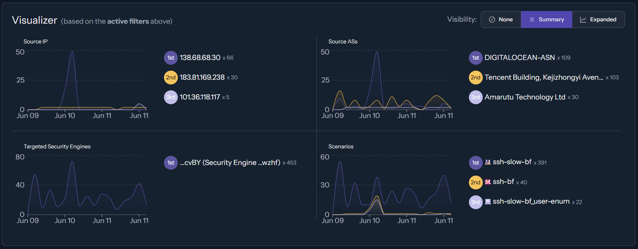
Results / Summary of Blocked Connections

Slide 46
Project Infrastructure Blueprint

Slide 47
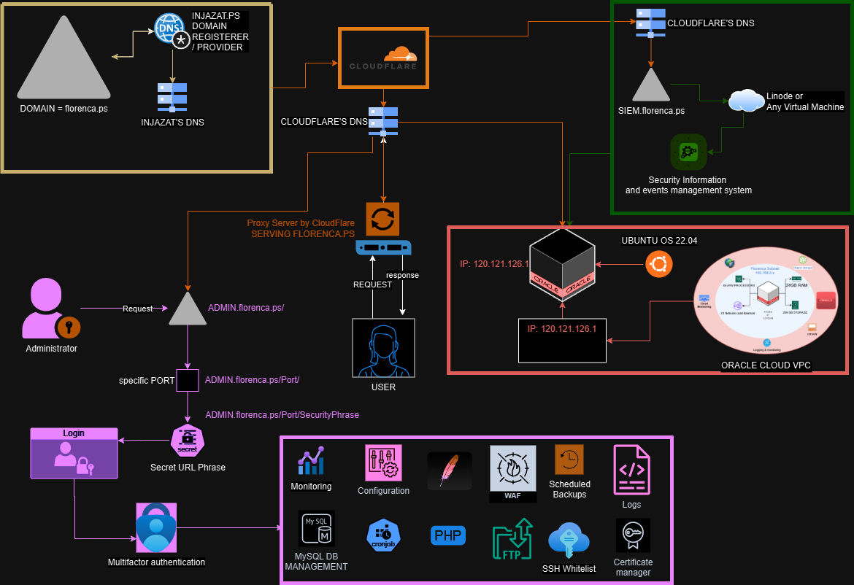
CrowdSec Threat Intelligence

Slide 48
Thank you for your time and attention today.
Presented by:
Noor Hawari
Mohammad Jamhour
Supervised by:
Dr. Maher Y. Arafat

Slide 49


Any
Questions or further clarification

