Slide 1
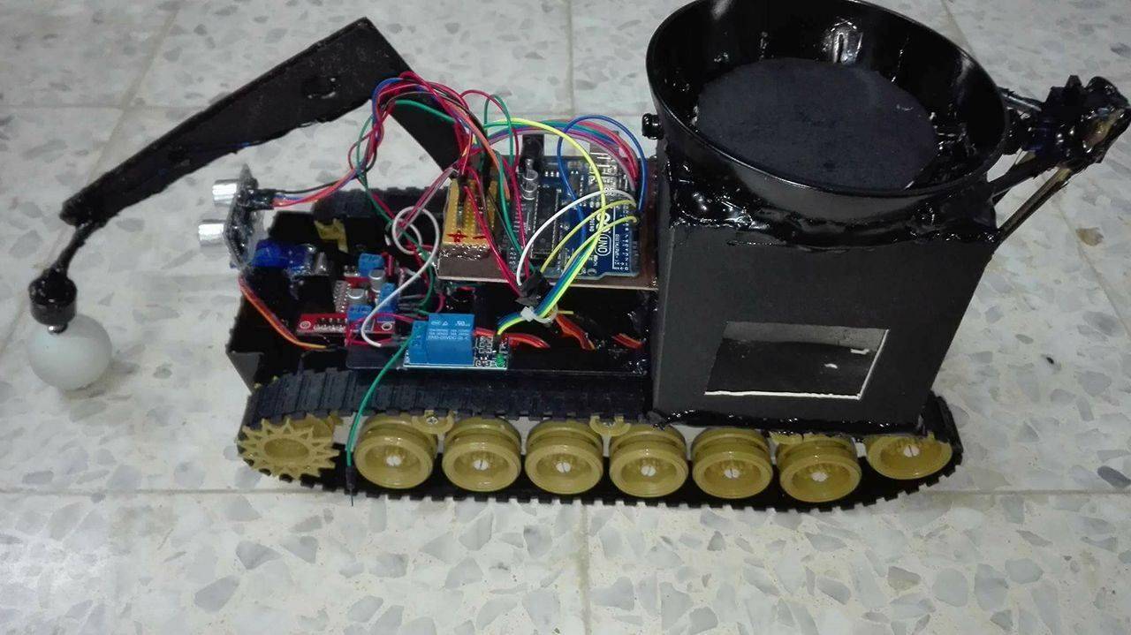
Ball Tracking &Collecting Robot
By: Razan Kiwan
Sumaya Al-khateeb
Supervisor:
Dr. Emad Natsheh

Slide 2
Outline
What is Ball Tracking & Collecting Robot?
Overview
Where to be used?
Hardware part
Software part
Previous Work
Constrains
Demo

Slide 3
What is Ball Tracking & Collecting Robot?
A robot that analyse the surrounding area looking for balls, detect them, collect them and separate them in a basket on its top depending on their colour.

Slide 4
Overview
It consists of two main parts:
Controlling robotic car movement and sensors operation using Arduino Uno microcontroller.
Image processing using Raspberry Pi 2 board and Raspberry Pi camera module.

Slide 5
Where to be used?
In many sports’ fields such as table tennis and Golf since it’s kind of exhausting, distracting and boring to keep collecting them by ourselves.

Slide 6
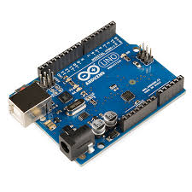
Hardware part
Arduino Uno Microcontroller

Slide 7
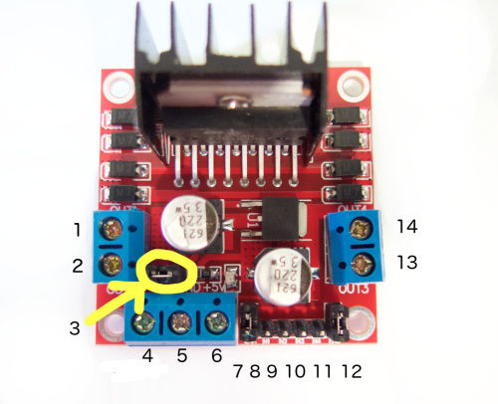
    H-bridge module

Slide 8
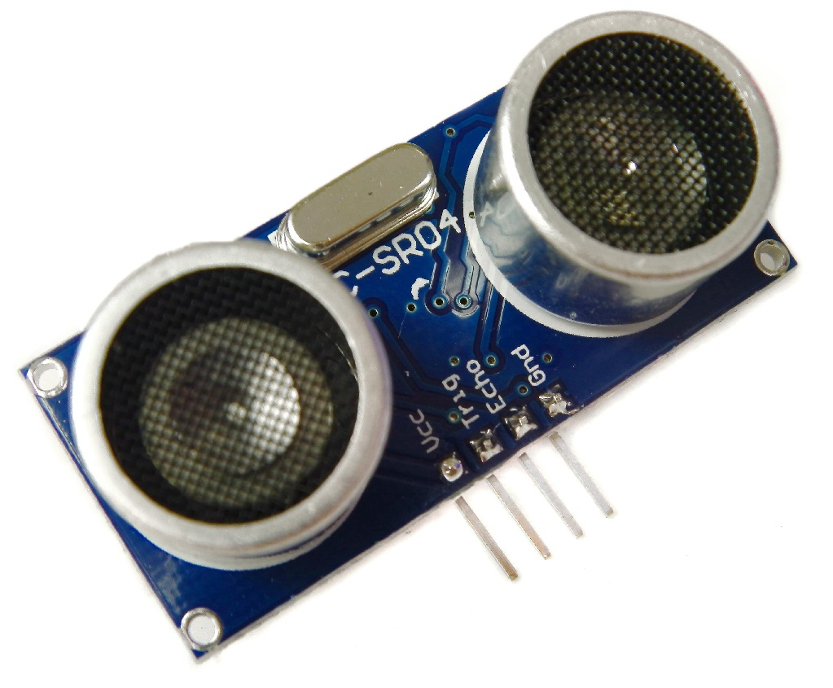
Ultrasonic Sensor

Slide 9
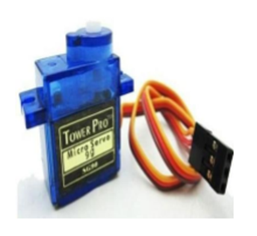
Servo Motors

Slide 10
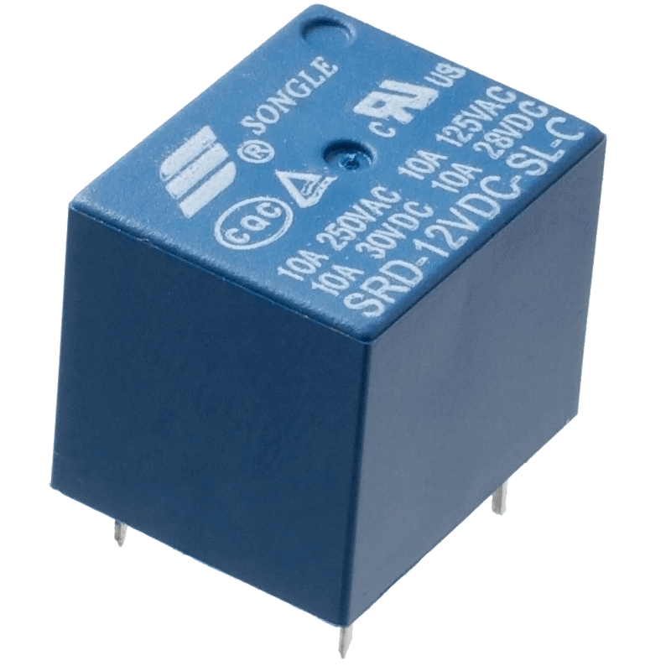
Relay

Slide 11
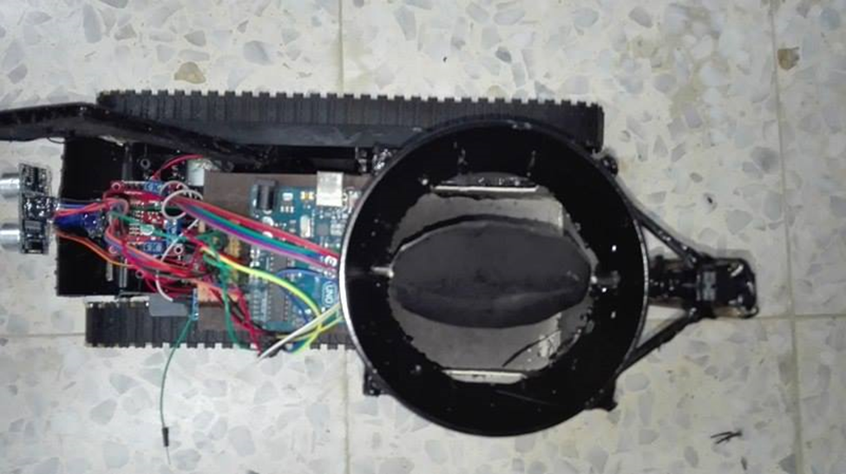
Basket/Box

Slide 12
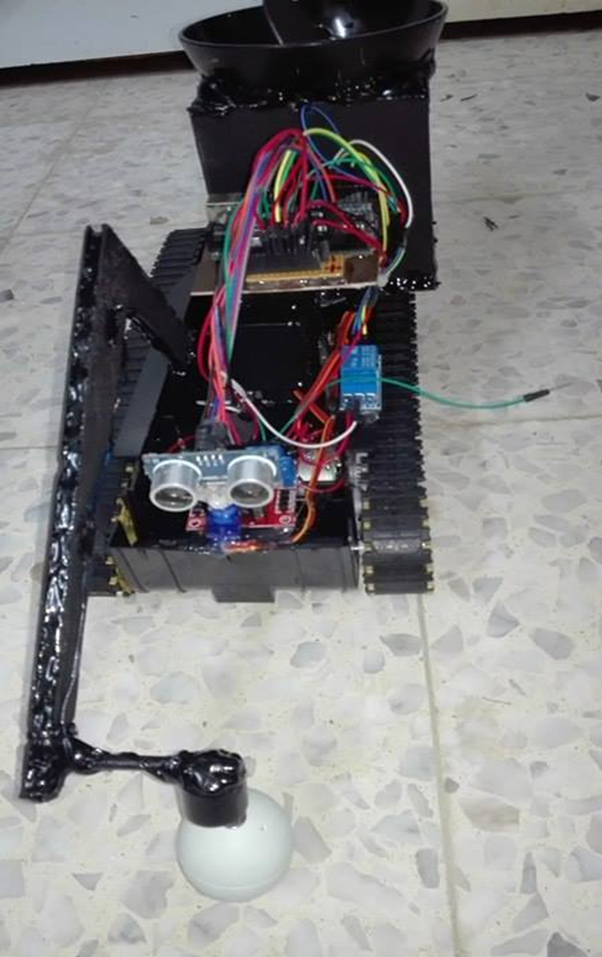
Arm components.

Slide 13
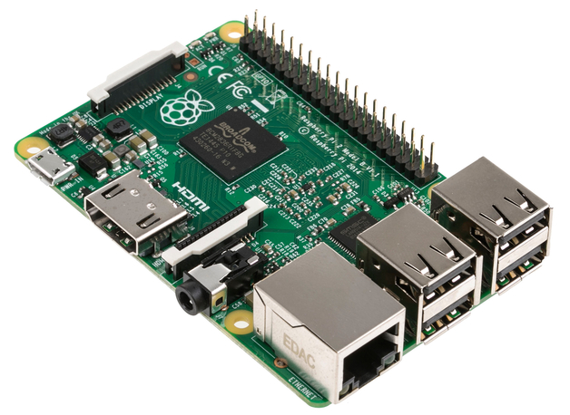
Software Part
Raspberry Pi 2 Module B+

Slide 14
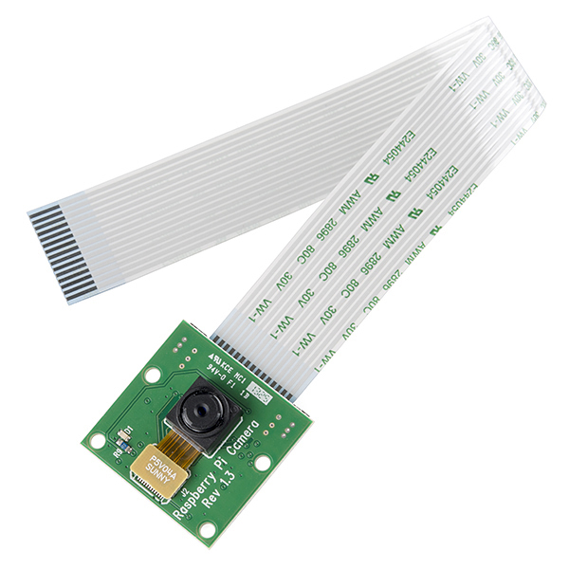
Raspberry Pi Camera Module

Slide 15
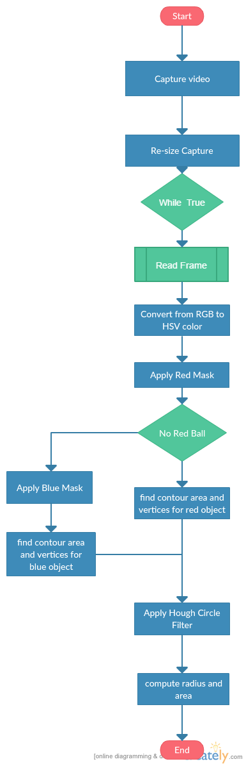

Slide 16
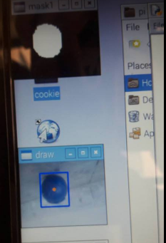
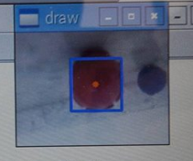

Slide 17
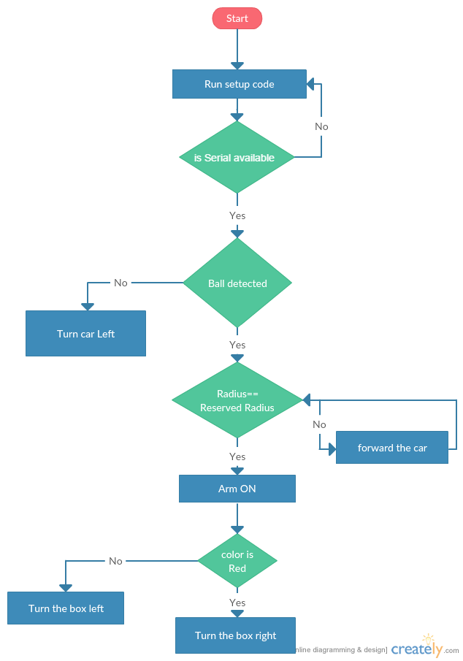

Slide 18
Previous work
A ball collecting robot have been made by students from this department on 2015.
They have used one color, but we used two and we make a methodology to separate between them.
They have forward the ball into a hall , but we have designed a special box to hold the balls and separate them.
In case of more than one ball we have designed our robot to pick the nearest one.

Slide 19
Constraints
    power supply.
    The arm we have made need an exact calculations for the ball position. We may change it as future work
    The camera is fixed. We can add a servo motor to control the movement of the camera when it’s looking for the ball instead of moving the car.

Slide 20
DEMO

