Slide 1
Design of Waste Water Collection Network for Kufr AL-Deek Village
Prepared by :
Adham Shawahnih
Mohammad Hamad
Jehad Hussein
Instructor : Eng. Lubna Haj Hamad
2012/2013

Slide 2
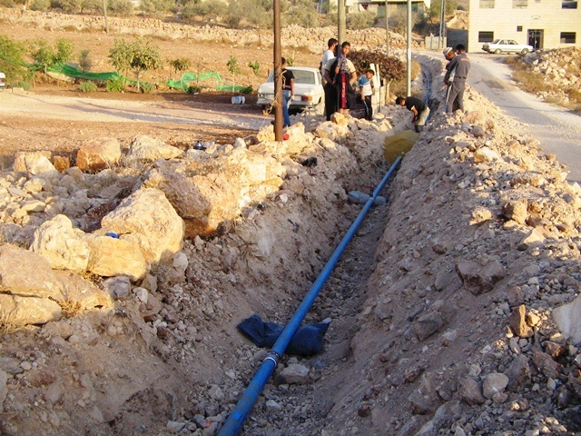
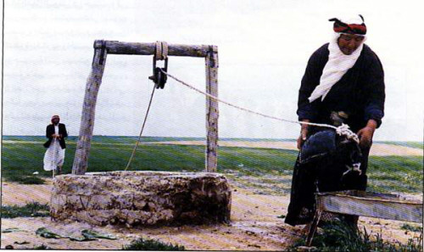
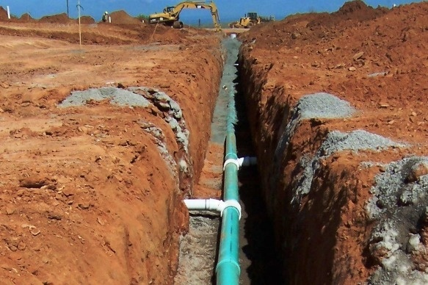
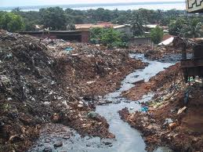

Slide 3
Out Line
Objectives of the project.
Methodology.
Study Area.
Design stage and Results.
Cost Estimation.

Slide 4
Objectives of the project
1) Design a wastewater collection network for
Kufr AL-Deek village.
2) Estimate the total cost for the whole project.

Slide 5
Methodology
Study Area
Data Collection
Start using Sewer CAD software
Start the design stage
Inter and save input
Run
Get results
Cost evaluation
Break down components
Calculate the total cost of the project

Slide 6
Study Area
General information.
Justifications for selection.

Slide 7
General Information
Location : it’s a village in Salfit governorate 36 km S-W away from Nablus .
Topography : mountainous region, 311 m AMSL, has an area 1.24 Km².
Climate : hot dry summer and cold rainy winter.

Slide 8
Justifications for Selection
* Available and accessible.
* Provide some thing new and useful.
* Eliminate the negative impacts of septic tanks.
* Healthy out let.

Slide 9
Design Stage
Requirements.
Design considerations.

Slide 10
Requirements for SWC
Contour map.
Buildings map.
Roads map.
As DXF files.

Slide 11
Design Considerations
Manning’s equation | V=1/n(R^{2/3})*S^{1/2}
velocity | 0.6-3 m/s
slope | 1-12 %
Section size | more than or equal 200 mm
cover | 0.8 m - 4 m
Start build up the NW
spacing between manholes | Max 50 m
Water demand | 152 L/c.d
Design period | 25 yrs (2012-2037)
Calculate and insert sanitary loads on manholes
*

Slide 12
Results
Length of 8” pipes | 20295.5 m
Length of 10” pipes | 1489.5 m
Total length of NW | 21785 m
Total flow | 49.95 L/s
Depth of manholes | 1 m - 3.99 m
Slope | 0.52 % - 16.64 %
Conduit Cover | 0.8 m – 3.7 m
Average depth | 1.7 m
Notes:
Flow/AVG dpth/length/MH/diameter/

Slide 15
Cost Estimation
A detailed cost estimation of the several components of the project is determined based on the current construction prices of Palestine.

Slide 16
Item | Quantity |  | Unit price $ |  | cost $
Excavation/m.l | 21785 m | 683MH | 15 |  | 339,069
Pipes/m.l | 20295.5 (8”) | 1489.5 (10”) | 13 | 15 | 301,079
Manholes/m.d | 683 MH |  | 600 |  | 696,660
Covers/MH | 683 MH |  | 200 |  | 136,600
Basement concrete/CM | 134 CM |  | 75 |  | 10,040
Sand/m.l | 21785 m |  | 10 |  | 217,850
Base coarse/CM | 3050 CM |  | 5 |  | 15,249
Asphalt/SM | 15245 SM |  | 12 |  | 182,994
Total cost |  |  |  |  | 2,010,000

Slide 17
Conclusion
That was a conceptual design of a waste water collection network for Kufr AL-Deek village using sewer cad software, with an estimated cost, and results which help us to establish the network.

Slide 18
Thank you

