Slide 1
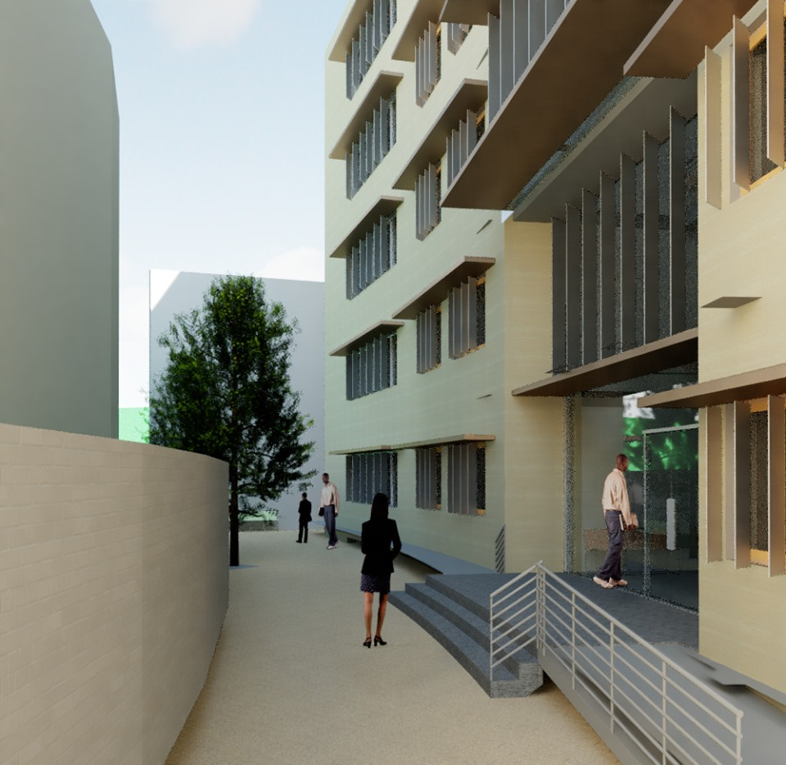

Integrated Redesign of the Administrative and Economic Sciences Faculty
Graduation Project II
An-Najah National University
Engineering College
Building Engineering Department
Preparad by: Danial Halabi
Muna Tuffaha
Tamara Samaro
Supervisor : Eng. Fadi Fatayer

Slide 2
Project Outline
Objectives
Architectural Aspect
Environmental Aspect
Structural Aspect
Electro-Mechanical Aspect
Site Analysis
Quantity survey

Slide 3
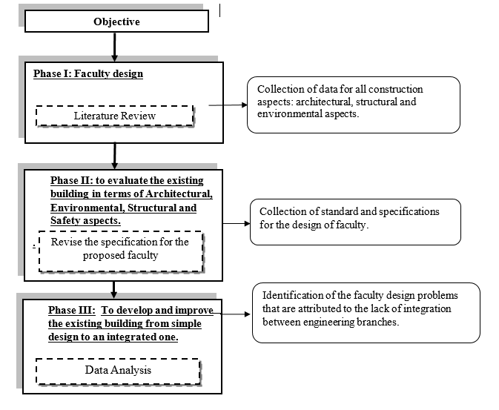
Objectives and methodology

Slide 4
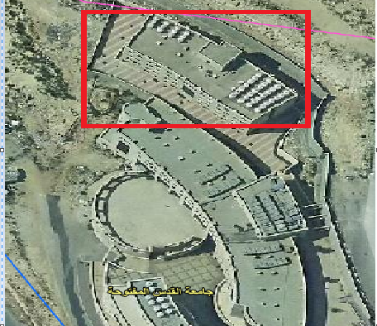
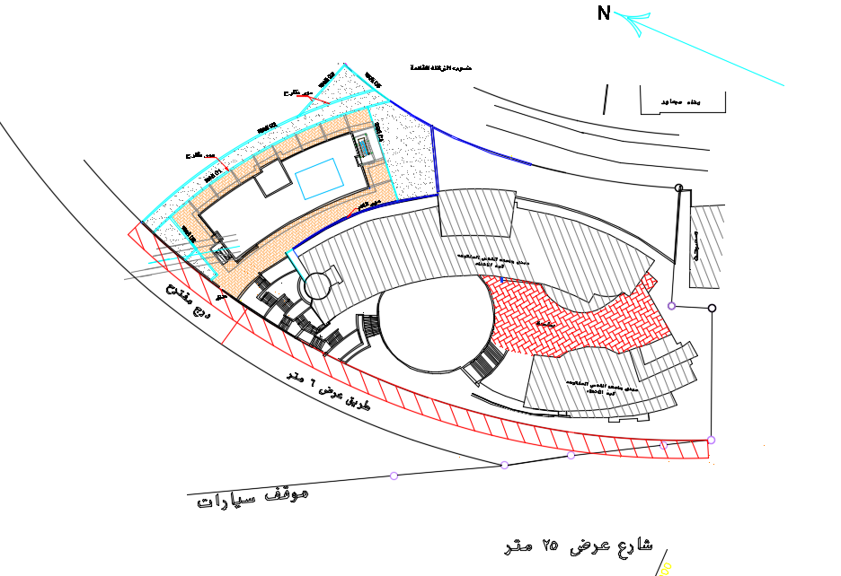
Site analysis
Location:
The land on which the faculty is located at Ghassan al-shaka’a street, near Al-Ma’ajeen Neighborhood, in the north-west part of Nablus city.
The faculty is based on an area of 2000 m²

Slide 5
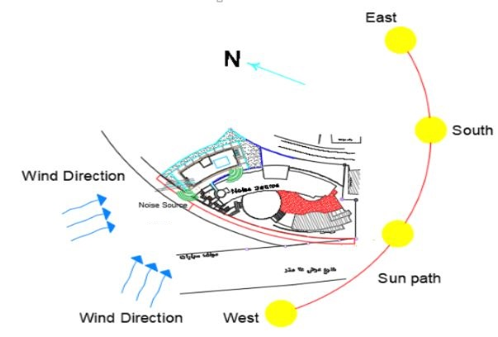
Noise, Sun path and wind analysis:

Slide 6
General Information
Faculty contains five stories (Ground, first , second , third and fourth floor) .
Each floor has an area of 546 $m^{2}.$
Each floor has an area of 546 𝑚^2.
Faculty has three entrances, two of them have emergency stairs.

Slide 7
Architectural Aspect

Slide 8
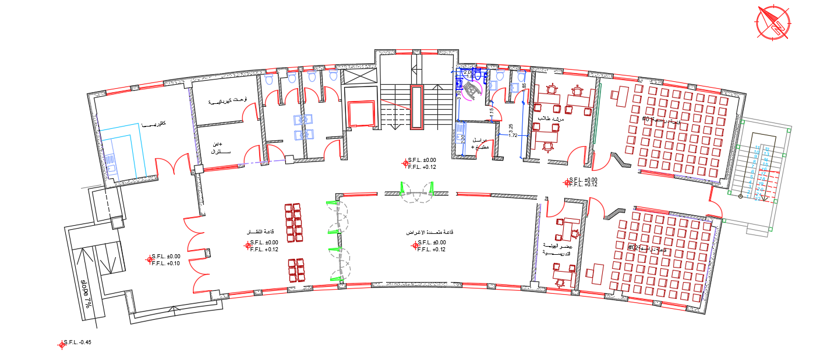
Project’s Plans
Ground floor ( Before)

Slide 9
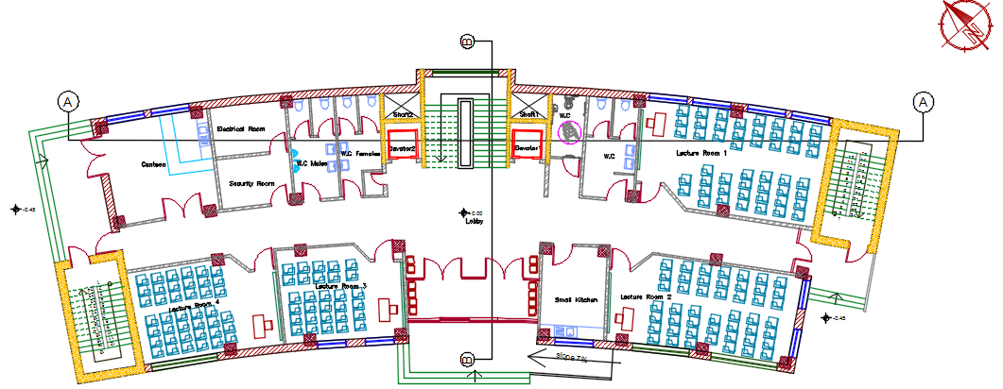
Project’s Plans
Ground floor (After)

Slide 10
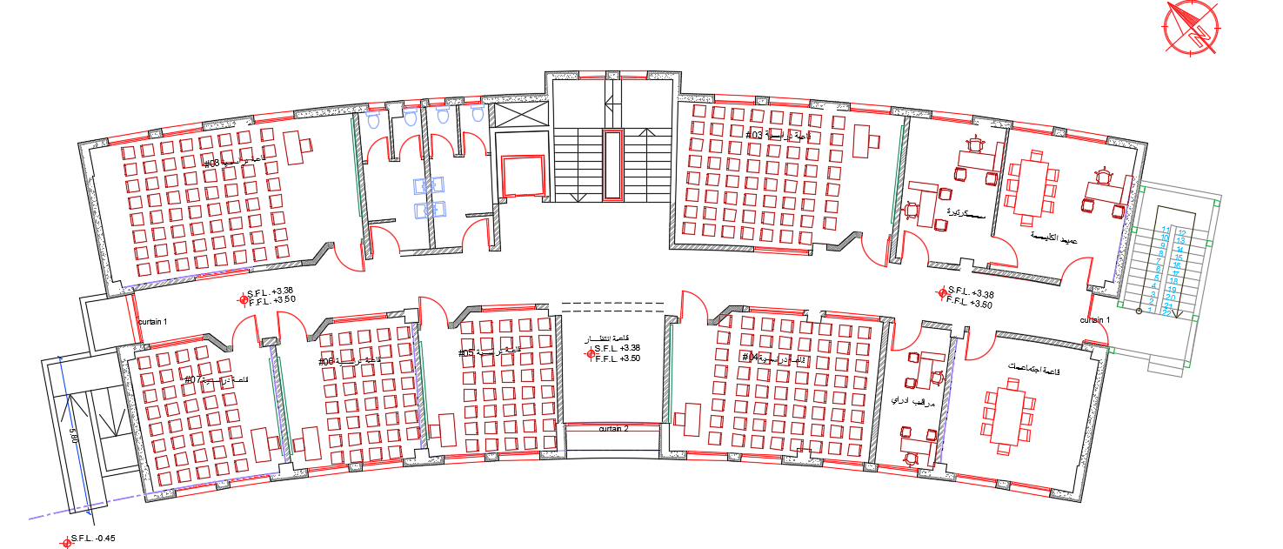
Project’s Plans
First floor ( Before)

Slide 11
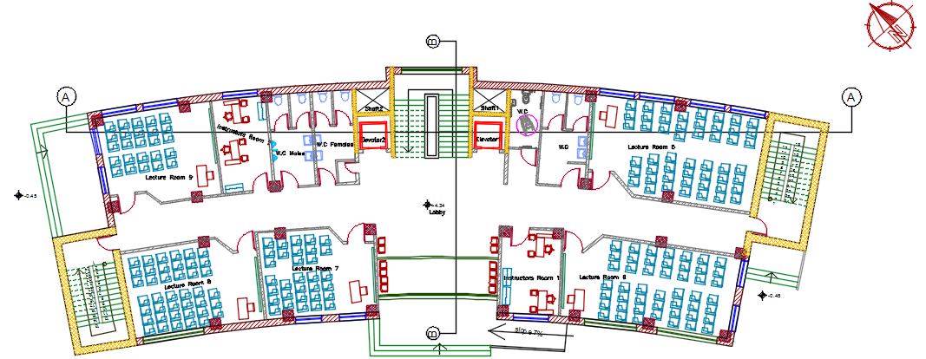
Project’s Plans
First floor ( After)

Slide 12
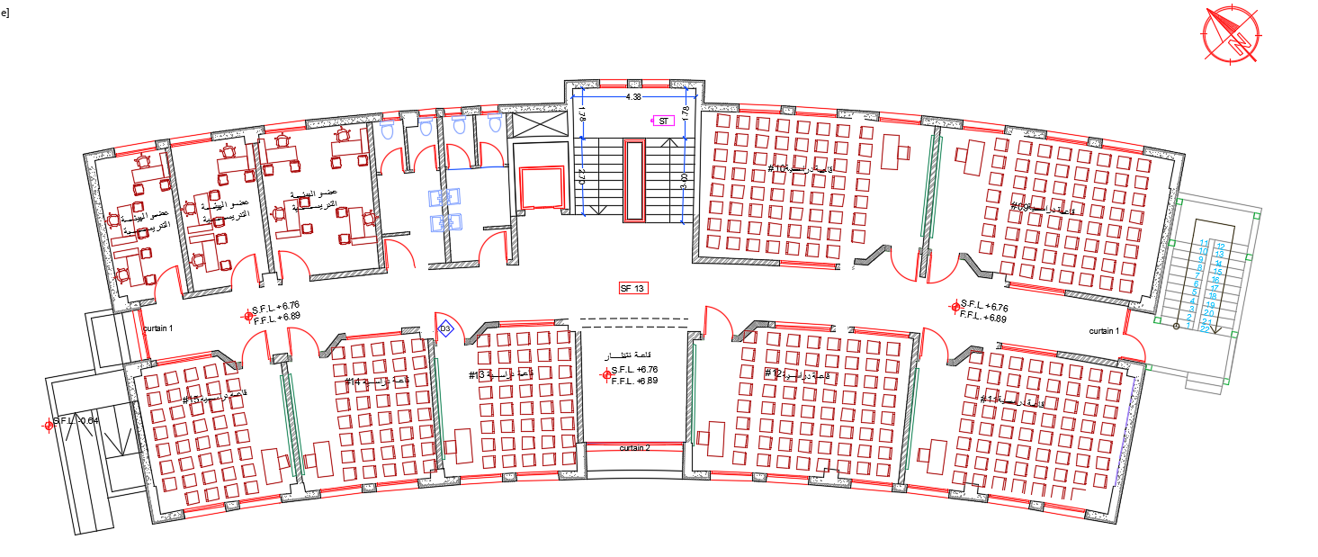
Project’s Plans
Second floor ( Before)

Slide 13
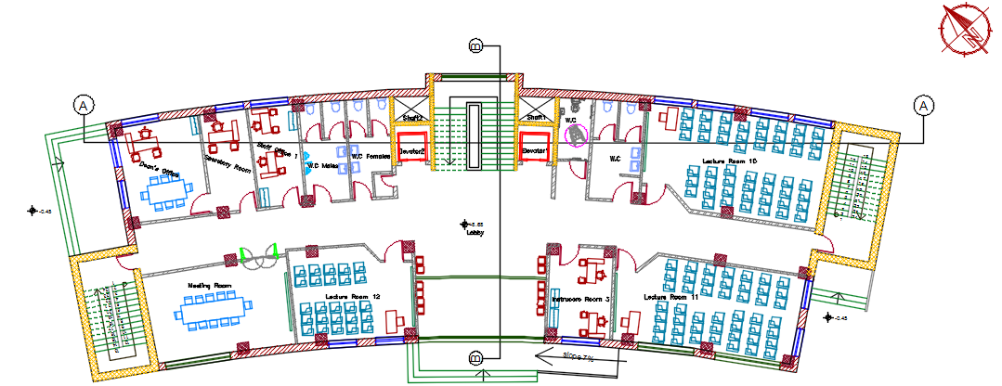
Project’s Plans
Second floor ( After)

Slide 14
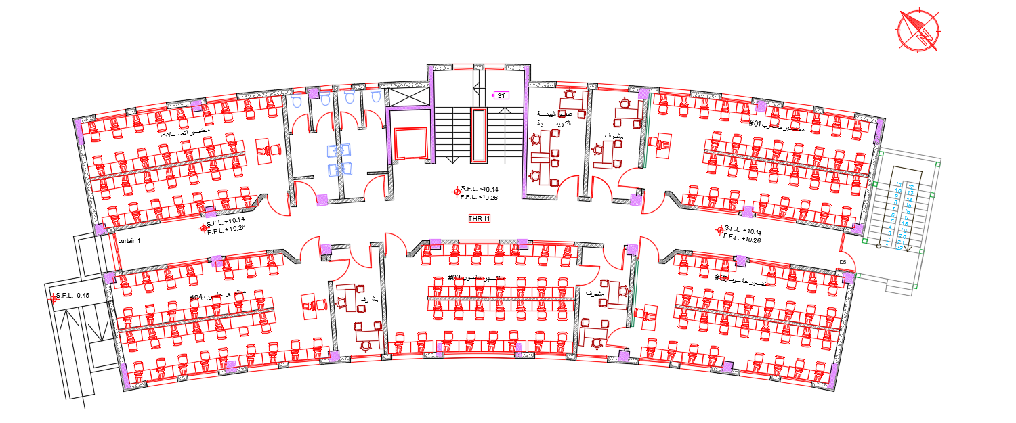
Project’s Plans
Third floor ( Before)

Slide 15
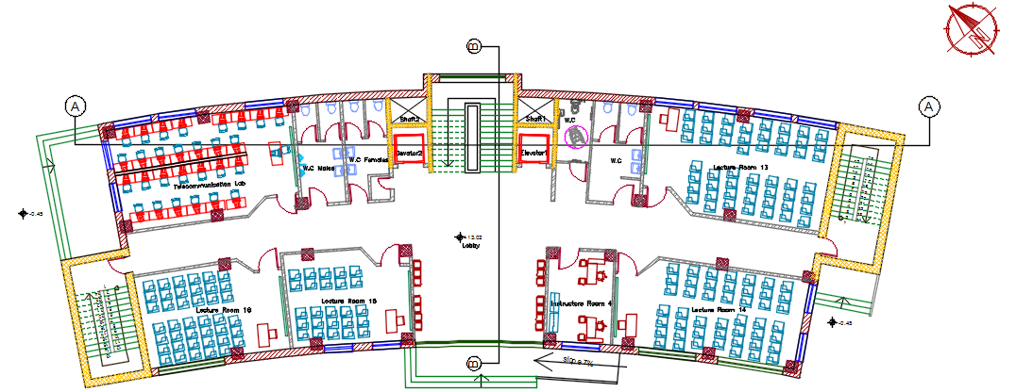
Project’s Plans
Third floor ( After)

Slide 16
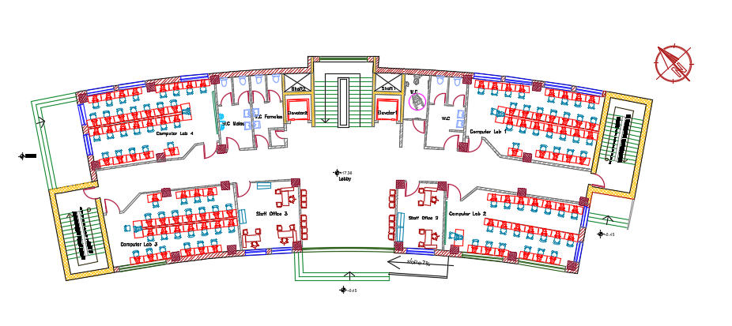
Project’s Plans
Fourth floor (Additional)

Slide 17
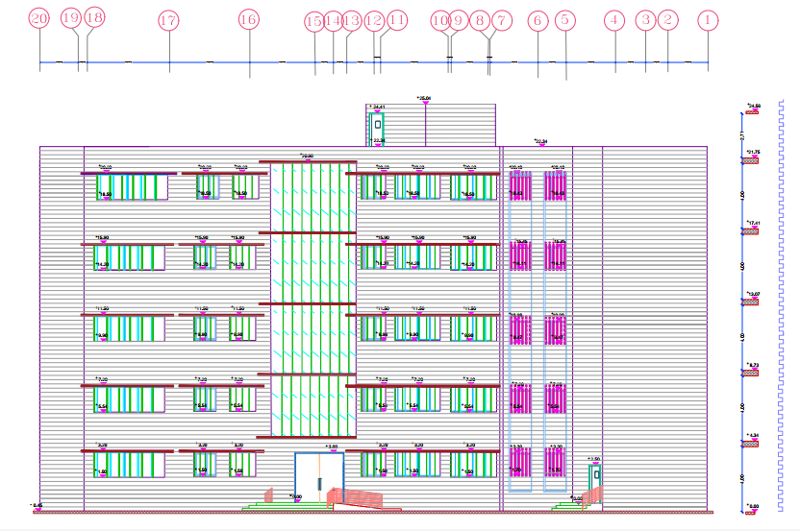
South-west elevation

Slide 18
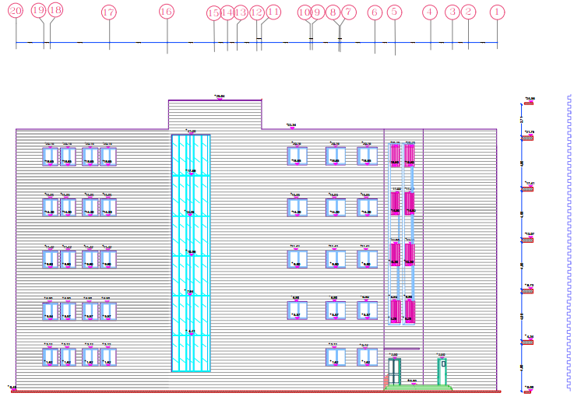
North-east elevation

Slide 19
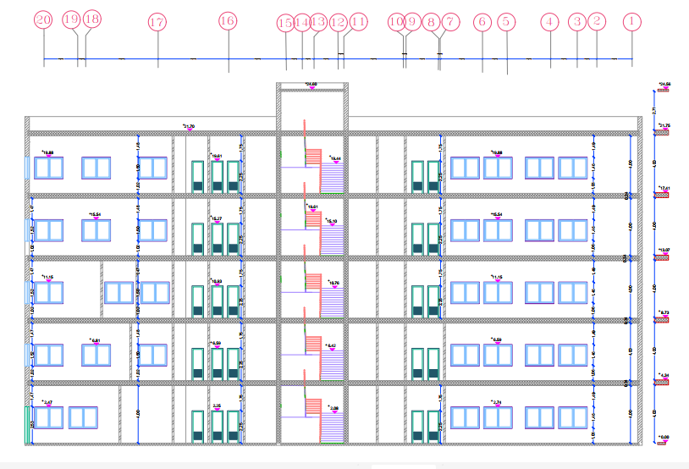
Section A-A

Slide 20
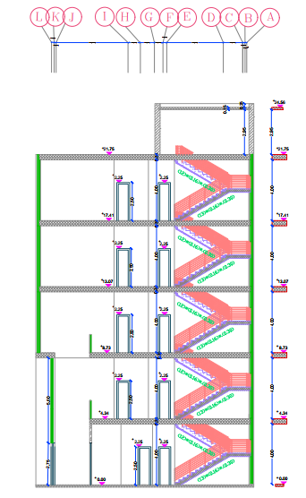
Section B-B

Slide 21
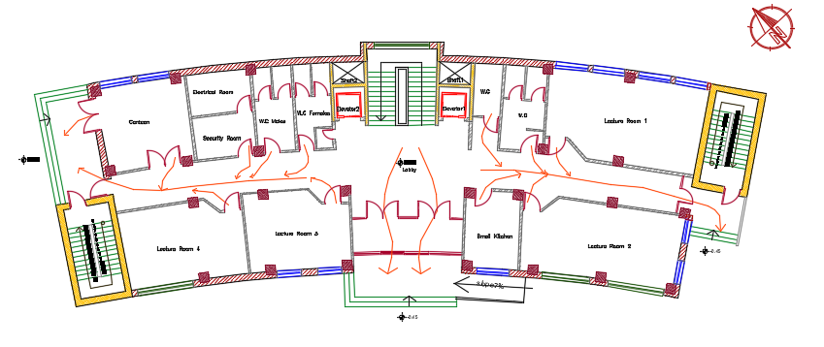
Escape Plans
Escape plan through ground floor

Slide 22
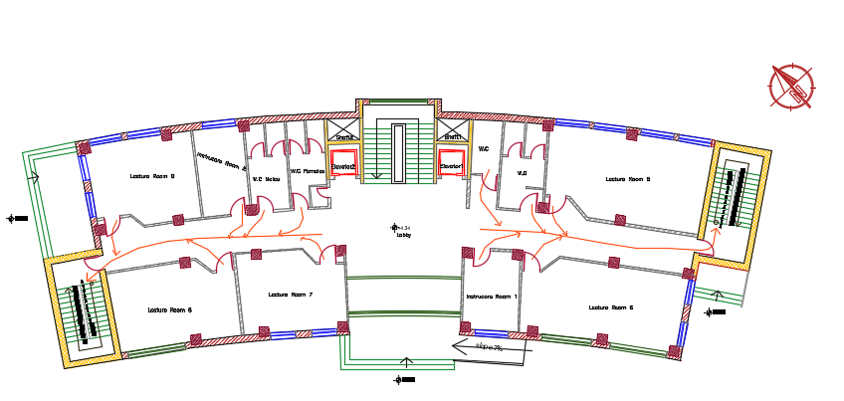
Escape Plans
Escape plan through other floors

Slide 23
Structural Aspect

Slide 24
Structural Design
This structural design is done by using the following codes:
ACI 318-11 for the design of reinforced concrete
ASCE 7 2010 for load combinations
UBC – 97 for earthquake design

Slide 25
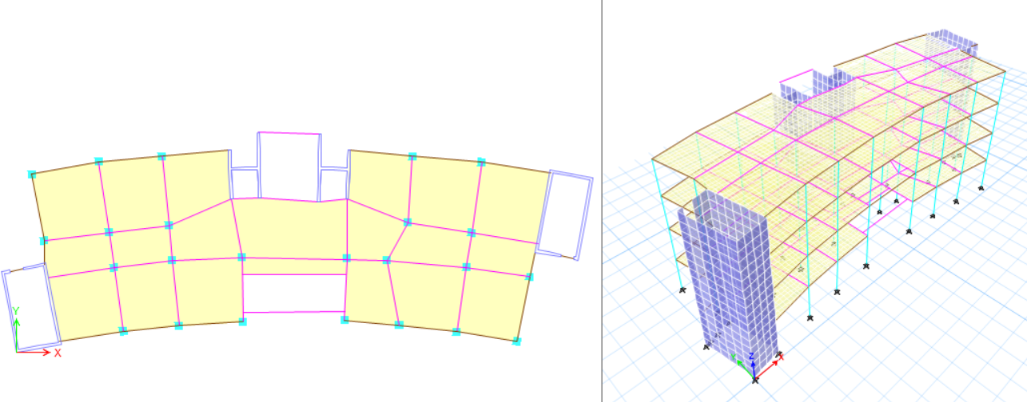
Structural Design
The structural design system used for this building is a two way ribbed slab system, single footings, combined footings, and mat footings.

Slide 26
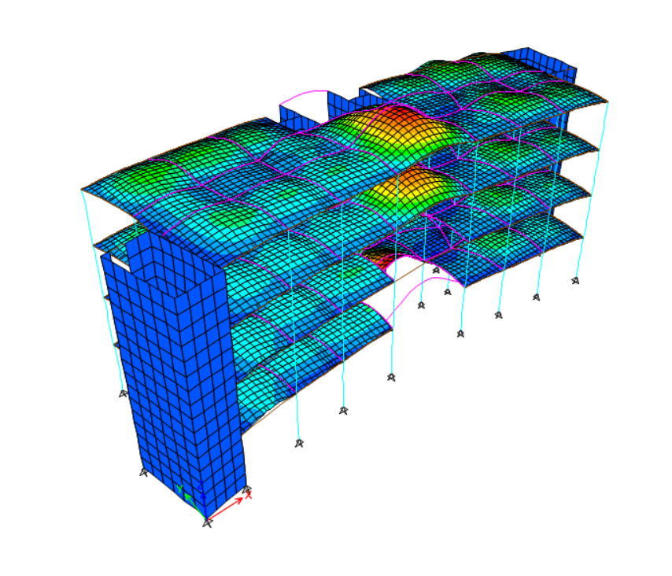
Structural Design
ETABS checks:
1- Compatibility check
Check is OK

Slide 27
Structural Design
ETABS checks:
2- Equilibrium check
Check is OK
Load type | Manual | ETABS | Error | < 5%
Dead | 24494.79 | 24310.2 | 0.75 | OK
Live | 8377.3 | 8376.9 | 0.00 | OK
SID | 16265.89 | 16483.04 | 1.34 | OK

Slide 28
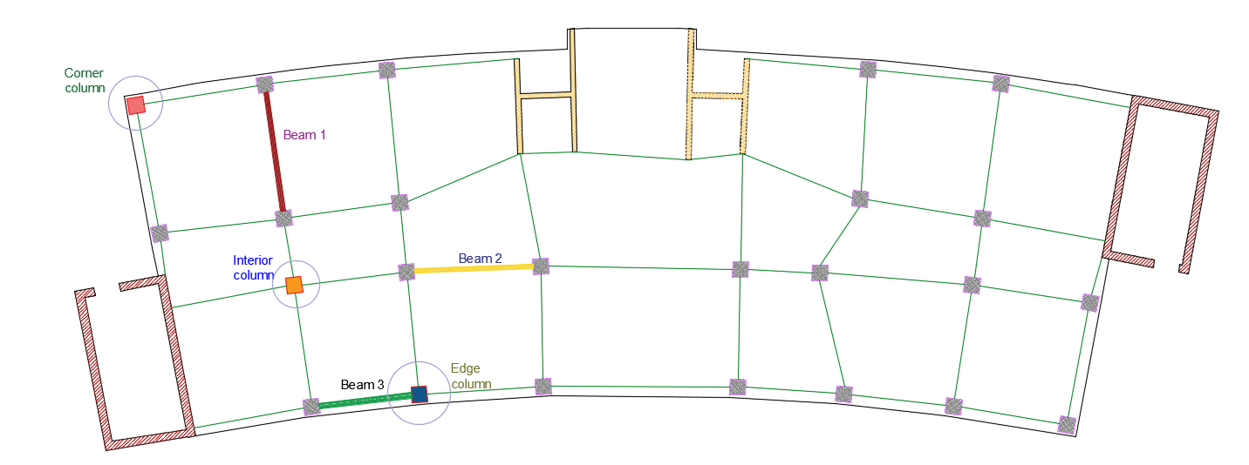
Structural Design
ETABS checks:
3- Stress strain check
Check is OK
Load type | Manual | ETABS | Error | < 10%
Edge column | 1860.14 | 1838.03 | 1.19 | OK
Corner column | 1506.01 | 1573.89 | 4.51 | OK
Interior column | 1837.22 | 1829.35 | 0.43 | OK
Beam 1 | 146.86 | 139.24 | 5.46 | OK
Beam 2 | 130.35 | 128.45 | 1.46 | OK
Beam 3 | 98.38 | 92.17 | 6.32 | OK

Slide 29
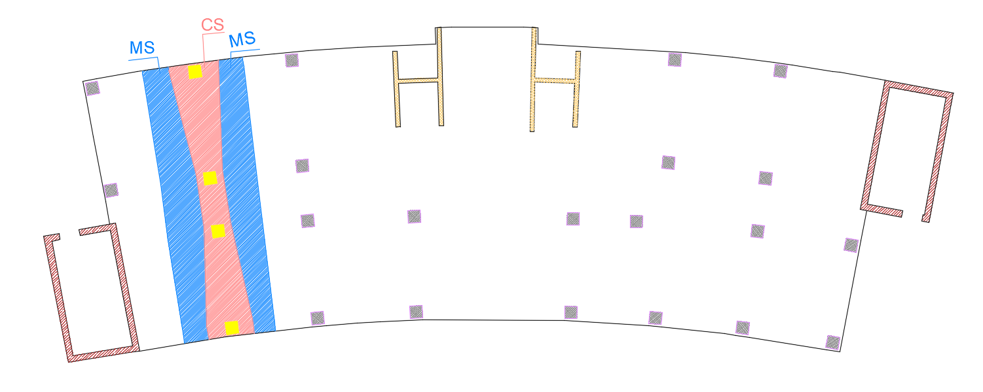
Structural Design
Frame
Manual Results |  |  | ETABS Results
Manual Moment | Frame length | Moment/m | ETABS moment | Length of Section Cut | Moment | Error %
40.5 | 4.9 | 8.27 | 38.54 | 4.9 | 7.87 | 4.84
144.32 | 4.9 | 29.45 | 143.9 | 4.9 | 29.37 | 0.29
177.24 | 4.9 | 36.17 | 168 | 4.9 | 34.29 | 5.21
ETABS checks:
3- Stress strain check
Check is OK
Middle Strip
Manual Results |  |  | ETABS moment
Manual Moment | Frame length | Moment | ETABS moment | Length of Section Cut | Moment | Error %
4.05 | 1.29 | 3.14 | 4.04 | 1.29 | 3.13 | 0.25
36.08 | 1.51 | 23.89 | 31.7 | 1.51 | 20.99 | 12.14
44.34 | 1.73 | 25.63 | 46.35 | 1.73 | 26.79 | 4.53
Column Strip
Manual Results |  |  | ETABS moment
Manual Moment | Frame length | Moment | ETABS moment | Length of Section Cut | Moment | Error %
36.45 | 2.3 | 15.85 | 34.5 | 2.3 | 15.00 | 5.35
108.24 | 1.9 | 56.97 | 112.2 | 1.9 | 59.05 | 3.66
132.9 | 1.32 | 100.68 | 121.65 | 1.32 | 92.16 | 8.47

Slide 30
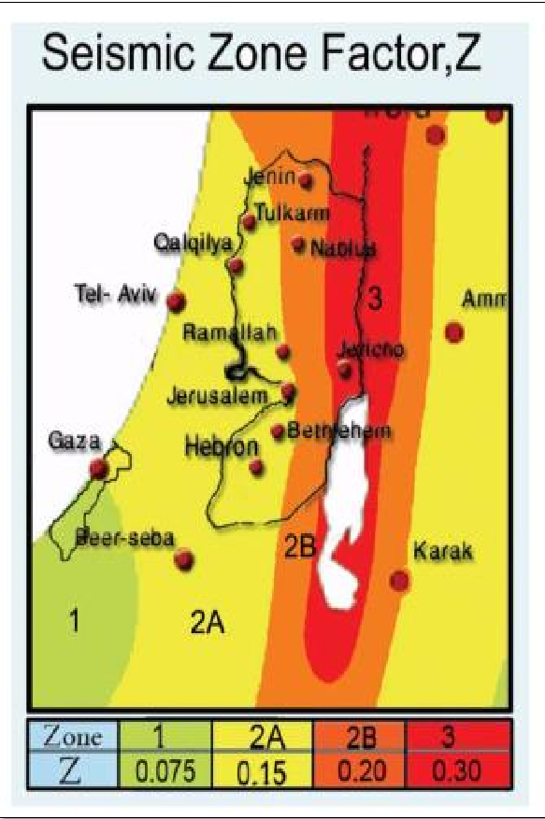
Structural Design
ETABS checks:
4- Time period check
From the 1st mode, Check is OK
T=0.541 seconds
T=0.0488(16) 3/4= 0.39 sec.
T from ETABS < 40% from method “A”
0.541 < 1.4*0.39=0.55 sec

Slide 31
Structural Design
ETABS checks:
5- Base shear check
Check is OK
Load Case/Combo | FX | FY | FZ
 | kN | kN | kN
Dead | 0 | 0 | 24073.22
Live | 0 | 0 | 8377.159
SID | 0 | 0 | 16269.68
EQx 1 | -4608.88 | 0 | 0
EQx 2 | -4608.88 | 0 | 0
Direction | T | V manual | V ETABS | Error%
X | 0.498 | 4615.85 | 4608.875 | 0.15
Y | 0.33 | 4615.85 | 4608.875 | 0.15

Slide 32
Structural Design
ETABS checks:
5- Drift check
Check is OK
Story | Height (mm) | Dis-x | Dis-y | Drift-x (ΔS) | Drift-y (ΔS) | Delta-x (Δm) | Delta-y (Δm) | Delta limit
0 | 4000 | 0 | 0
1 | 4000 | 1.3 | 0.33 | 1.3 | 0.33 | 5.01 | 1.27 | 100
2 | 4000 | 3.4 | 0.89 | 4.7 | 1.22 | 18.10 | 4.70 | 100
3 | 4000 | 5.8 | 1.57 | 10.5 | 2.79 | 40.43 | 10.74 | 100
4 | 4000 | 8.2 | 2.3 | 18.7 | 5.09 | 72.00 | 19.60 | 100

Slide 33
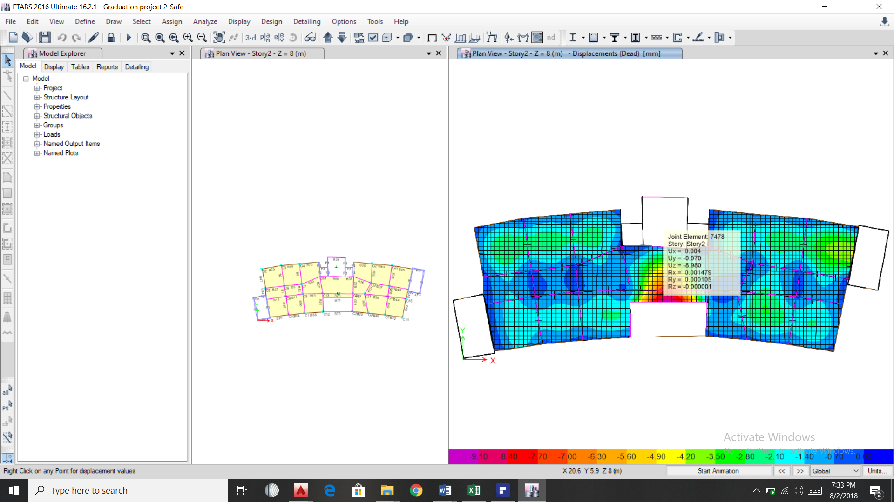
Structural Elements Design
Deflection check
The maximum deflection for span = 32.2mm
the critical deflection in the project which occur for cantilever and equal 8.9 mm. So, check is ok

Slide 34
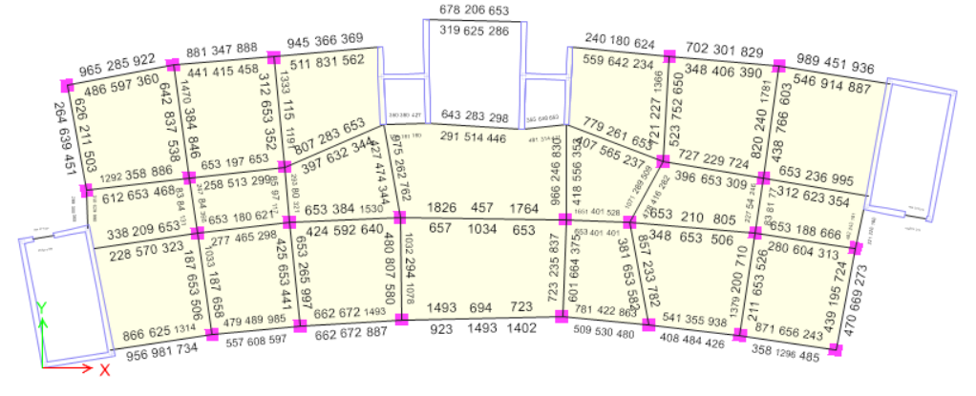
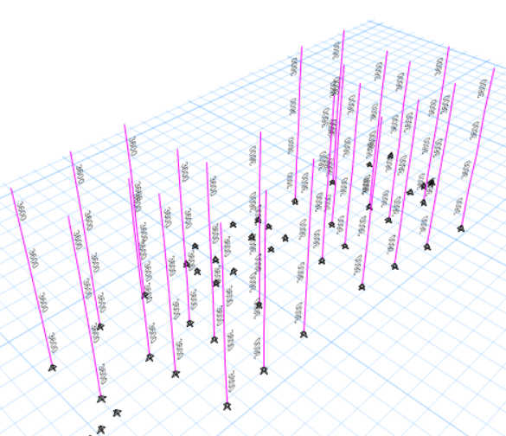
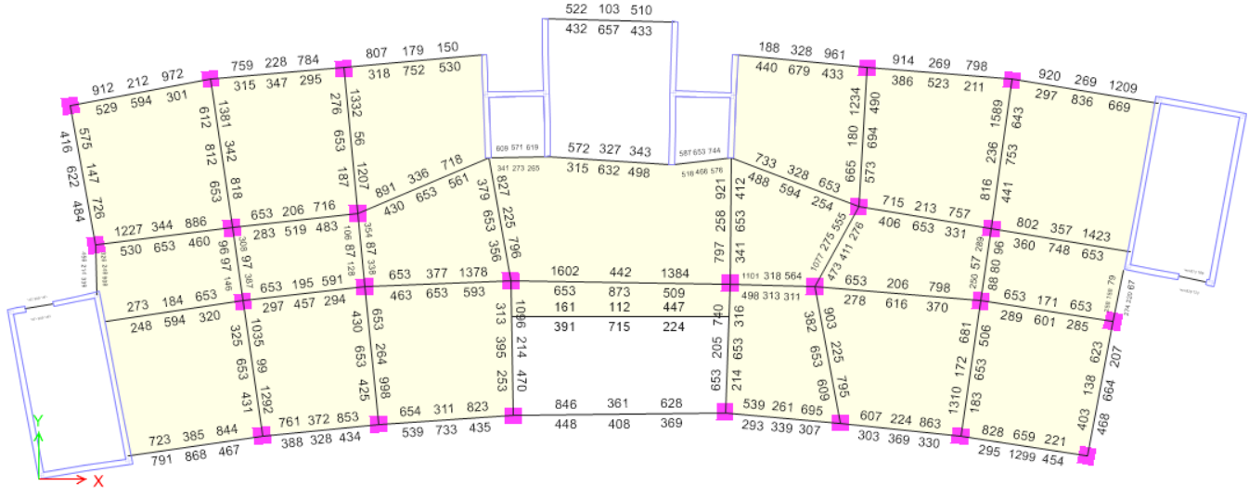
Structural Elements Design
Checking design members

Slide 35
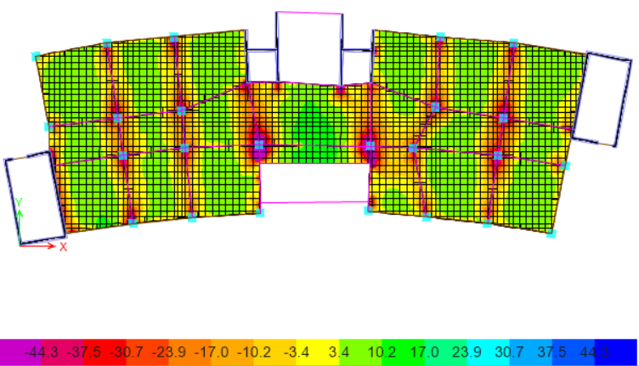

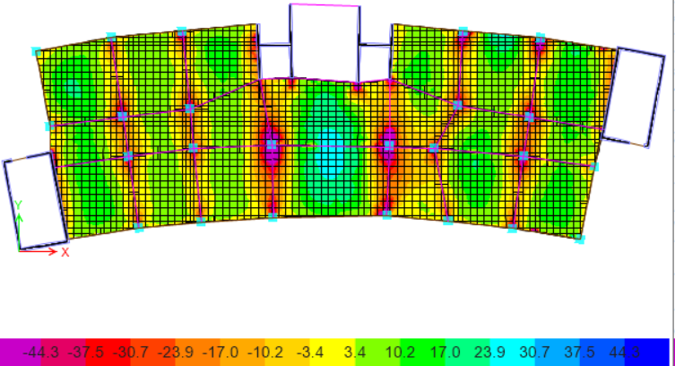
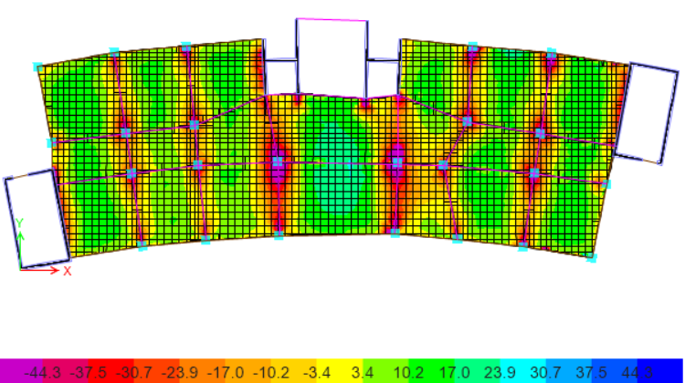
Structural Design
Slabs
The used system in structural design is two way ribbed slab
M11 max for all stories

Slide 36
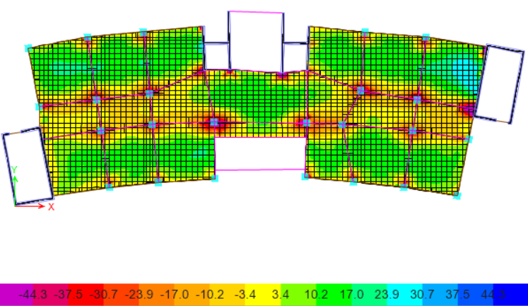
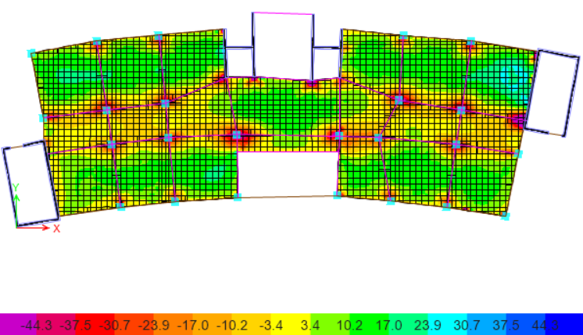
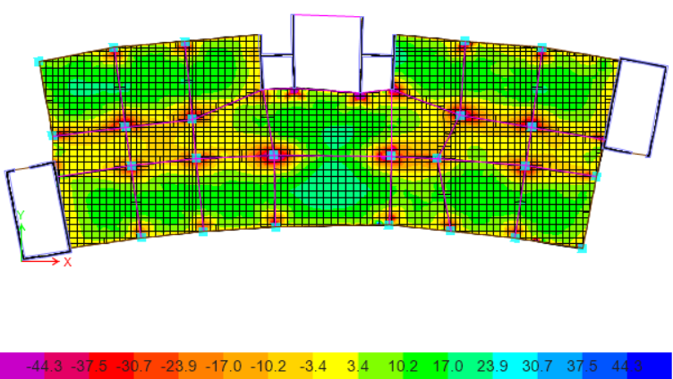
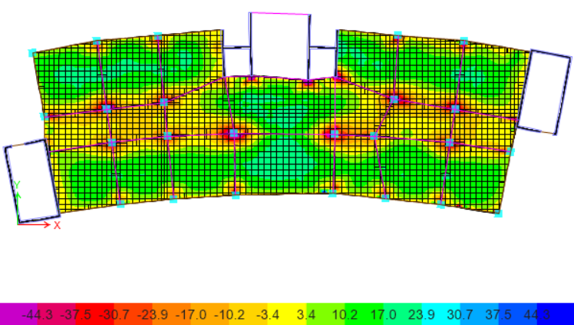
Structural Design
Slabs
The used system in structural design is two way ribbed slab
M22 max for all stories

Slide 37
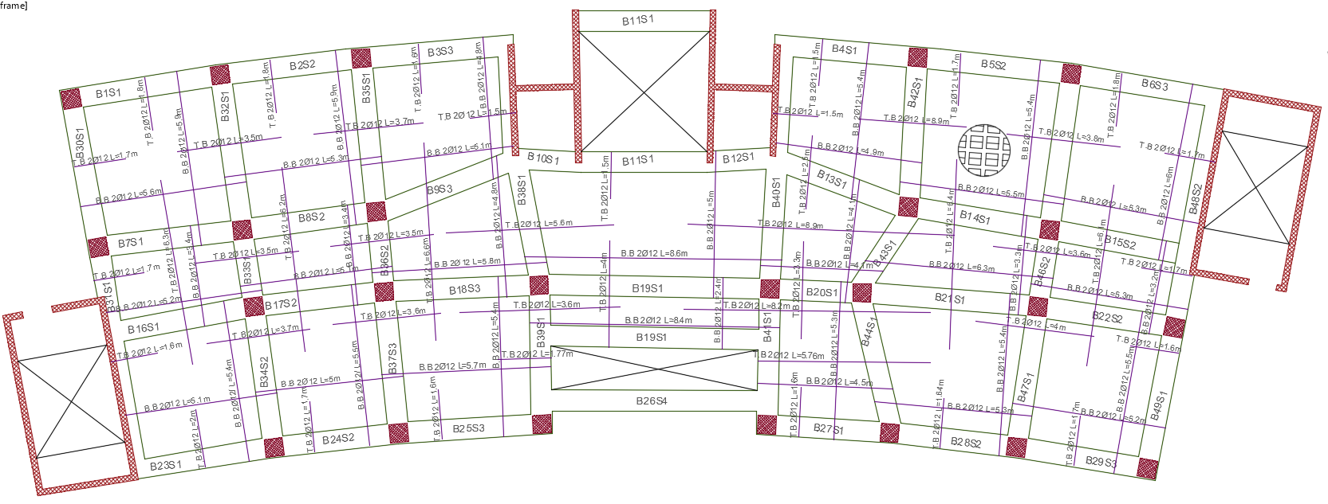
Structural Design
Slabs
For ground floor slab

Slide 38
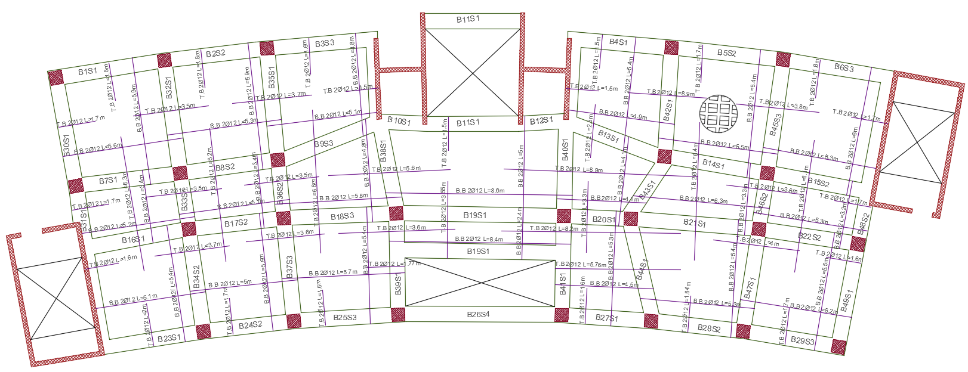
Structural Design
Slabs
For first floor slab

Slide 39
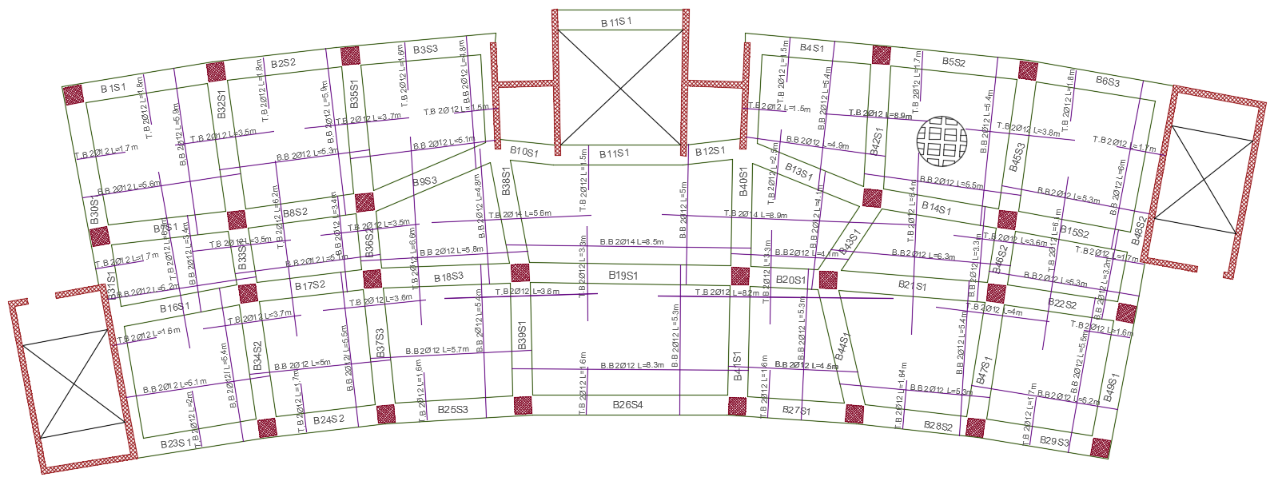
Structural Design
Slabs
For second, third, and fourth slab

Slide 40
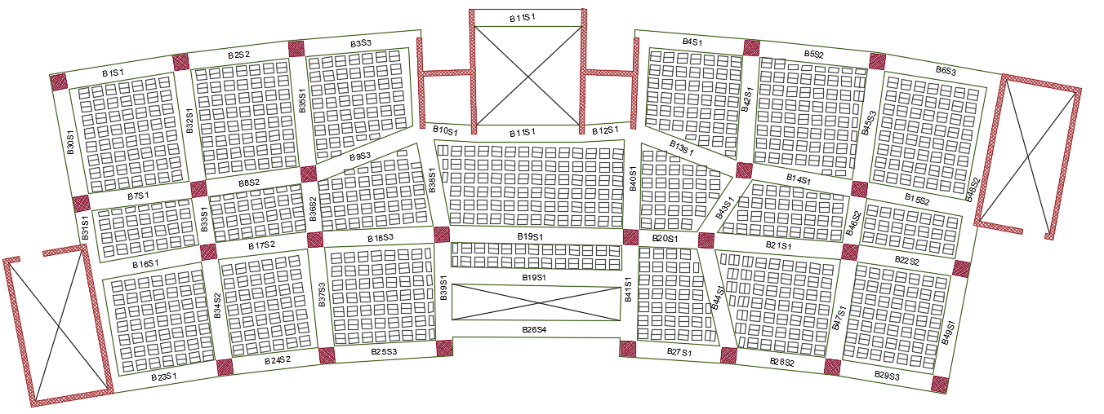
Structural Design
Beams

Slide 41
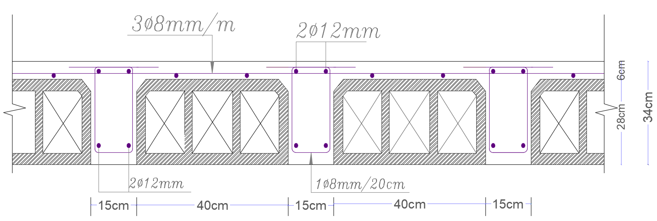
Structural Design
Slabs

Slide 42
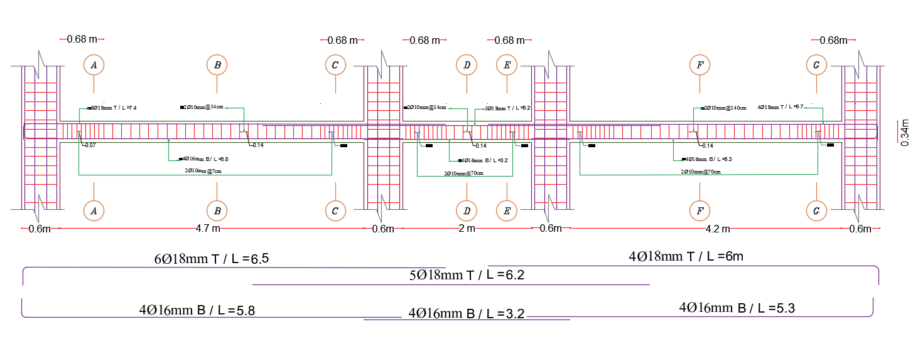
Structural Design
Beams
Cross section in B32, B33, B34

Slide 43
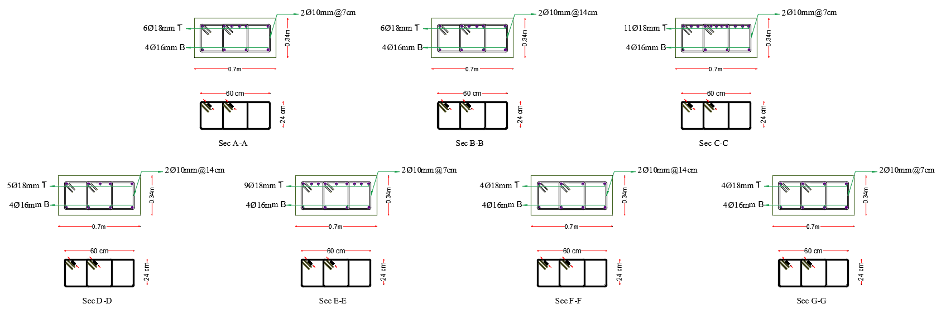
Structural Design
Beams
Detailing of Beams

Slide 44
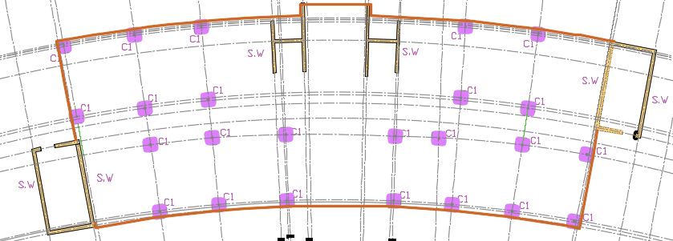
Structural Design
Columns
Columns Centre lines plan

Slide 45
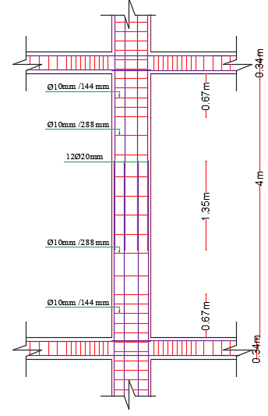
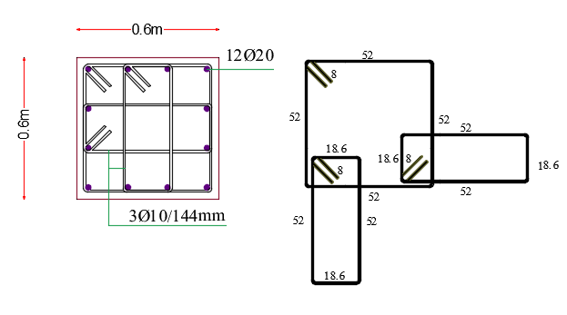
Structural Design
Columns
Column | Width (cm) | Depth (cm) | Longitudinal steel | Stirrups L1 | Stirrups L2
C1 | 60 | 60 | 12Ø20 | Ø10 @144mm | Ø10 @288 mm

Slide 46
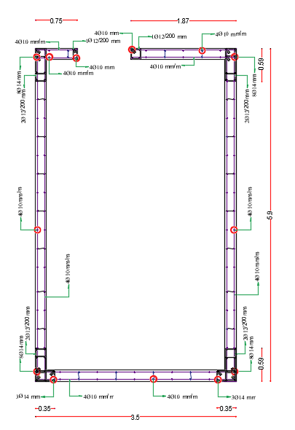
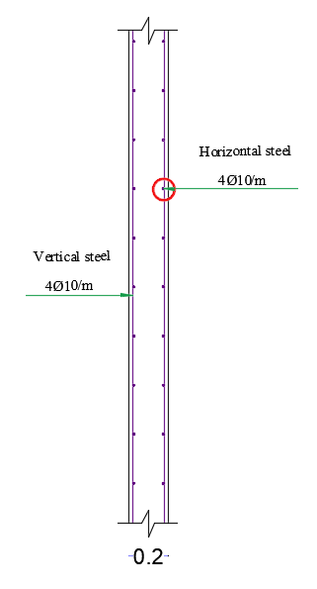
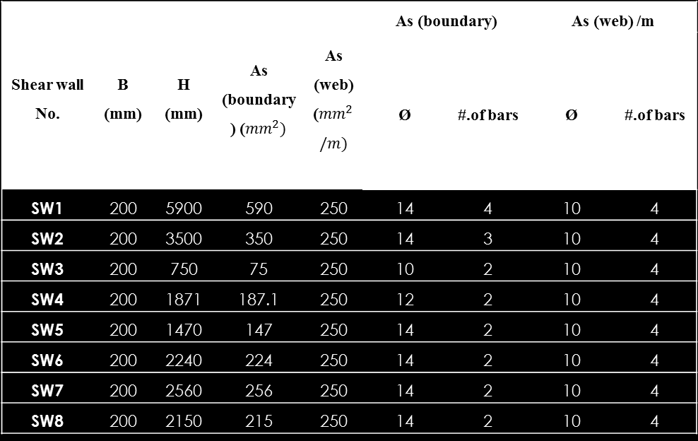
Structural Design
Shear walls
Shear wall No. | B (mm) | H (mm) | As (boundary) (${mm}^{2})$ | As (web) (${mm}^{2}/m)$ | As (boundary) |  | As (web) /m
 |  |  |  |  | Ø | #.of bars | Ø | #.of bars
SW1 | 200 | 5900 | 590 | 250 | 14 | 4 | 10 | 4
SW2 | 200 | 3500 | 350 | 250 | 14 | 3 | 10 | 4
SW3 | 200 | 750 | 75 | 250 | 10 | 2 | 10 | 4
SW4 | 200 | 1871 | 187.1 | 250 | 12 | 2 | 10 | 4
SW5 | 200 | 1470 | 147 | 250 | 14 | 2 | 10 | 4
SW6 | 200 | 2240 | 224 | 250 | 14 | 2 | 10 | 4
SW7 | 200 | 2560 | 256 | 250 | 14 | 2 | 10 | 4
SW8 | 200 | 2150 | 215 | 250 | 14 | 2 | 10 | 4

Slide 47
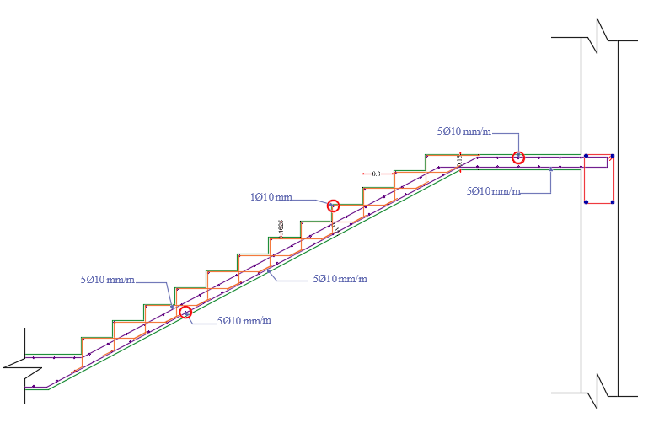

Structural Design
Stair

Slide 48

Structural Design
Footings
Layout of footings

Slide 49


Structural Design
Footings
Isolated footings
Footing NO. | Mu (KN.m) | 𝜌 | As_{req} (${mm}^{2}$/m) | As_{min} (${mm}^{2}$/m) | As (used) (${mm}^{2}$/m) | Ø | #. Of Bars | Spacing (mm) | Available length(L) (m) | Development Length ( L_{d} ) (m)
F1 | 99 | 0.00231 | 786.19 | 720 | 786 | 12 | 7 | 167 | 0.69 | 0.6
F2 | 155 | 0.00277 | 1078.79 | 810 | 1079 | 12 | 10 | 112 | 0.91 | 0.57
F3 | 158 | 0.00282 | 1101.32 | 810 | 1101 | 12 | 10 | 112 | 0.93 | 0.58
F4 | 159 | 0.00284 | 1106.18 | 810 | 1106 | 12 | 10 | 112 | 0.93 | 0.59
F5 | 167 | 0.00234 | 1027.70 | 900 | 1028 | 12 | 10 | 112 | 0.94 | 0.55
F8 | 156 | 0.00280 | 1090.08 | 810 | 1090 | 12 | 10 | 112 | 0.91 | 0.58
F10 | 238 | 0.00220 | 1190.55 | 1080 | 1191 | 14 | 8 | 100 | 1.15 | 0.68
F11 | 186 | 0.00209 | 1023.41 | 990 | 1023 | 14 | 7 | 167 | 1.02 | 0.67
F12 | 111 | 0.00153 | 675.37 | 900 | 900 | 12 | 8 | 143 | 0.76 | 0.6
F13 | 129 | 0.00305 | 1037.82 | 720 | 1038 | 12 | 10 | 112 | 0.82 | 0.55
F14 | 129 | 0.00229 | 892.55 | 810 | 893 | 12 | 8 | 143 | 0.84 | 0.59
F15 | 125 | 0.00222 | 867.13 | 810 | 867 | 12 | 8 | 143 | 0.82 | 0.58
F16 | 101 | 0.00236 | 802.38 | 720 | 802 | 12 | 8 | 143 | 0.72 | 0.53
F17 | 119 | 0.00281 | 954.63 | 720 | 955 | 12 | 9 | 125 | 0.79 | 0.56
F18 | 156 | 0.00371 | 1261.91 | 720 | 1262 | 14 | 12 | 9 | 0.91 | 0.64
F19 | 75 | 0.00132 | 515.55 | 810 | 810 | 12 | 8 | 143 | 0.61 | 0.54

Slide 50




Structural Design
Footings
Combined footings
Footing NO. | Transverse steel
 | Zone1 |  |  |  |  |  |  | Zone2
 | qu (KN/$m^{2}$) | Mu (KN.m) | 𝜌 | As $({mm}^{2}/m$ | Asmin (${mm}^{2}/m$) | Ø | #.of bars | qu (KN/$m^{2}$) | Mu (KN.m) | 𝜌 | As $({mm}^{2}/m$ | Asmin (${mm}^{2}/m$) | Ø | #.of bars
F6 | 872.64 | 369.14 | 0.00690 | 2690.94 | 810.00 | 20 | 9 | 767.65 | 324.73 | 0.00601 | 2344.07 | 810.00 | 20 | 8
F7 | 849.30 | 321.07 | 0.00594 | 2315.85 | 810.00 | 20 | 8 | 790.61 | 298.89 | 0.00550 | 2145.55 | 810.00 | 20 | 7
F9 | 828.00 | 424.84 | 0.00804 | 3136.73 | 810.00 | 20 | 10 | 815.07 | 418.21 | 0.00791 | 3083.00 | 810.00 | 20 | 10
Footing NO. | Top Longitudinal steel
 | Mu (KN.m) | Asreq (${mm}^{2}$) | Asmin (${mm}^{2}$) | Ø | #.of bars
F6 | 329.6 | 2402.61 | 1976.08 | 14 | 16
F7 | 361.8 | 2638.69 | 1894.64 | 14 | 18
F9 | 213.89 | 1540.97 | 2127.08 | 14 | 14
Footing NO. | Bottom Longitudinal steel
 | Mu (KN.m) | 𝜌 | As req (${mm}^{2}$/m) | As min (${mm}^{2}$/m) | Ø | #.of bars
F6 | 900.114 | 0.00690 | 6561.34 | 1976.08 | 20 | 21
F7 | 868.4 | 0.00694 | 6333.43 | 1894.64 | 20 | 21
F9 | 829.01 | 0.00583 | 5972.59 | 2127.08 | 20 | 20

Slide 51




Structural Design
Footings
Mat foundation
F21 Reinforcement
F20 Reinforcement

Slide 52




Structural Design
Footings
Mat foundation
F23 Reinforcement
F22 Reinforcement

Slide 53

Structural Design
Footings
Mat foundation
Section in F1-1

Slide 54


Structural Design
Tie beams

Slide 55

Water tank Design
Water tank volume is 240 m³ and its dimensions are 6m width, 10m depth and 4m height respectively.

Slide 56

Water tank Design
SAP checks:
1- Compatibility check
Check is OK

Slide 57


Water tank Design
SAP checks:
2- Deflection check
Maximum deflection is less than 10 mm so the check is OK
From water pressure
From soil pressure

Slide 58

Structural Design
Detailing

Slide 59

Structural Design
Section A-A

Slide 60

Structural Design
Section B-B

Slide 61
Environmental Aspect

Slide 62
Environmental aspects include:
Thermal Analysis
Daylighting
Shading

Slide 63


Thermal analysis
U-value for the external wall’s layers = 0.424 (W/m²-K).

Slide 64



Internal walls: U-value = 1.188 (W/m²-K).
Roof: U-value = 0.343 (W/m²-K).
Inner ground’s cross section

Slide 65


PMV graph from Design Builder
Site and source energy table using “Design Builder”

Slide 66

Energy Conservation measure ( ECM)
Shading Devices:
Adjustable vertical louvers
Overhang ( Cantilever )

Slide 67


Environmental Modifications on facades
South-west elevation (Before)
South-west elevation (After)

Slide 68

Environmental Modifications on facades
North-east elevation (Before)
North-east elevation (After)

Slide 69


Environmental Modifications on facades
South-east elevation (Before)
South-east elevation (After)

Slide 70


Environmental Modifications on facades
North-west elevation (Before)
North-west elevation (After)

Slide 71



Daylighting Analysis
Daylight factor analysis for First floor by Revit
Before modification
After modification
New Evaluation | old Evaluation | New design D.F | Old design D.F | Min D.F | Avg D.F | Space
Good | Fair | 2 | 1 | 1 | 2 | Staff office
Good | Poor | 2.5 | 1 | 2 | 5 | Classroom

Slide 72
Electro-Mechanical Aspect

Slide 73
Electro-Mechanical Design
Artificial Lighting Design.
Branches and Circuit Breakers Design.
Acoustical Design.
Water Supply Design.
Drainage System Design.
HVAC Design.
Firefighting and Fire safety Systems Design.

Slide 74
Artificial Lighting Design

Slide 75
Artificial Lighting Design by DIAlux.evo
Recommended Values
Main Spaces | Minimum Recommended Illuminance Level (Lux) | Glare (UGR) | Uniformity
Classroom | 300 | 19 | 0.50
Meeting room | 500 | 19 | 0.40
Instructor’s office | 500 | 19 | 0.60
Canteen | 200 | 22 | 0.40
Computer room | 300 | 19 | 0.50
Design Results
Main Spaces | Designed Illuminance Level (Lux) | Designed Glare (UGR) | Designed Uniformity
Classroom | 380 | 15.8 | 0.49
Meeting room | 512 | 17.9 | 0.47
Instructor’s office | 534 | 14.8 | 0.67
Canteen | 306 | 13.9 | 0.57
Computer room | 407 | 17.6 | 0.66

Slide 76





Types of used luminaires in each space:
Computer laboratory
Classroom room
Space | Luminaire type | Manufacturer | Connected load (Watt)
Classroom | Recessed Directional light | Philips | 61 W 16 W
Meeting room | surface- mounted Recessed spot light | Schmitz-Leuchten Simon China | 47 W 7 W
Instructors office | Recessed | Philips | 23 W
Computer room | Recessed Directional light | Philips | 61 W 16 W
Canteen | Recessed | Philips | 33 W
Instructors office
Meeting room
Canteen

Slide 77





Classroom Artificial Lighting Design
Luminaires layout
Classroom Simulation results from DIALux evo:

Slide 78




Instructors Office Artificial Lighting Design
Luminaires layout
Instructors office Simulation results from DIALux evo:

Slide 79



Meeting room 3D View
Instructors office room 3D View
Canteen 3D View

Slide 80



Classroom 3D View
Computer room 3D View
Luminaires layout for Ground Floor

Slide 81
Acoustical Design

Slide 82
Acoustical Design
Spaces that were designed acoustically in the faculty:
Lecture room
2
Computer room
3
Instructors office
1
4
Meeting room

Slide 83

Reverberation time ( RT₆₀ )

Slide 84


Classroom Acoustical Design
Optimum (RT₆₀) for classroom ranges between (0.6-0.8) sec.
The absorption coefficients (α) for the finished materials at different frequencies:
Lecture room RT₆₀
Element |  | Finishing material | Frequency (Hz)
 |  |  | 63 | 125 | 250 | 500 | 1 K | 2 K | 4 K | 8 K
Walls | Plaster |  | 0.12 | 0.09 | 0.07 | 0.01 | 0.01 | 0.02 | 0.01 | 0.02
Floor | Terrazzo |  | 0.01 | 0.01 | 0.01 | 0.01 | 0.02 | 0.03 | 0.07 | 0.09
Ceiling | Acoustical tiles |  | 0.25 | 0.25 | 0.49 | 0.69 | 0.78 | 0.61 | 0.54 | 0.58
Window | Double glazing |  | 0.12 | 0.10 | 0.06 | 0.04 | 0.03 | 0.03 | 0.04 | 0.04
Seats | Wood |  | 0.08 | 0.08 | 0.14 | 0.12 | 0.19 | 0.18 | 0.17 | 0.20
Door | Plywood |  | 0.44 | 0.41 | 0.35 | 0.20 | 0.15 | 0.14 | 0.14 | 0.12
Articulation loss

Slide 85


Meeting room acoustical design
Finishing materials for the meeting room
Surface | Material
Ceiling | Acoustical Suspended Ceiling
Walls | Concrete Block Plaster
Floor | Thin carpet on concrete
Door | Hollow Core Plywood
Other wall | Fabric Acoustical Panel
Windows | Double glazed aluminum frame
Seats | Covered with leather
Meeting room RT₆₀
Articulation loss

Slide 86


RT₆₀ for meeting room
RT₆₀ for instructors office
RT₆₀ for computer room
RT₆₀ optimum ranges (0.4-0.6 ) sec
RT₆₀ optimum ranges (0.6-0.8 ) sec
RT₆₀ optimum ranges (0.6-0.8 ) sec
RT₆₀ results → OK
RT₆₀ results → OK
RT₆₀ results → OK

Slide 87



Sound Transmission Class (STC ) Design
STC for classroom adjacent to corridor.
Element | STC (dB)
Wall | STC 53 (dB)
Door | STC 44 (dB)
Composite STC | STC 50 (dB)

Slide 88
Summary of designed STC for each designed space
Considered room | Adjacent space | STC Normal | STC Calculated
Meeting room | Corridor | STC 40 dB | 45
Meeting room | Classroom | STC 45 dB | 53
Meeting room | Outdoor | OITC 40 dB | 51
Considered room | Adjacent space | STC Normal | STC Calculated
Office | Corridor | STC 45 dB | 48
Office | Classroom | STC 45 dB | 50
Office | Outdoor | OITC 40 dB | 51
Office | Office | 50 STC dB | 53
Considered room | Adjacent space | STC Normal | STC Calculated
computer laboratory | Corridor | STC 45 dB | 50
computer laboratory | computer laboratory | STC 50 dB | 53
computer laboratory | Outdoor | OITC 50 dB | 53
Considered Room | Adjacent space | STC Normal | STC Calculated
Classroom | Corridor | STC 45 dB | 50
Classroom | Classroom | STC 50 dB | 53
Classroom | Outdoor | OITC 50 dB | 50
Classroom | Toilet and restroom areas | STC 53 dB | 53

Slide 89


The OITC for the external walls = 65 dB more than the recommended = 50 dB, so the design of the external wall is ok
OITC of composite classroom’s external wall
Element | STC (dB)
Wall | STC 85 (dB)
Window | STC 55 (dB)
Composite STC | OITC 50(dB)

Slide 90



Impact Insulation Class (IIC)
floor construction layers by using INSUL software.
The minimum IIC ratings for floor-ceiling assemblies above core learning spaces should be IIC-45. IIC value by using INSUL software is calculated to be 67 dB more than required value = 45 dB so, the design of the floor-ceiling layers is adequate.

Slide 91


Electro-acoustics and Loud speakers design
Two types of loud speakers were used for designing the sound system of the faculty
Type | Space | Sensitivity dB | Coverage angle
PC-671R/RV | Corridor | 90 dB | 65▫
PL 8X | Lobby | 93 dB | 80▫
Loud speakers distribution for the ground floor
Loud speakers coverage area for the ground floor

Slide 92
  Heating, ventilation, and air conditions system design (HVAC)

Slide 93

The system used for HVAC design is “ VRF system ” Variable refrigerant flow .
Main components of VRF system are :
Out door unit (for cooling and heating).
Controller.
Fan coil unit.
Ducts.
Diffusers.

Slide 94


results from Design Builder program:
Heating load capacity =155.52 KW
Cooling load capacity= 162.09 KW
Outdoor unit
Fan coil Unit
From TOSHIBA
From TOSHIBA

Slide 95



Air distributing system (Diffuser)
Cassette Unit
From GRADA
From DAIKAIN
Controller

Slide 96


HVAC system layout for fourth floor

Slide 97
Branches and Circuit Breakers Design.

Slide 98


Sockets Layout for Ground floor

Slide 99

Sockets Layout for Fourth floor

Slide 100

Main distribution board

Slide 101
Water Supply System

Slide 102


Water supply Plan for G.F

Slide 103
Sewage and Drainage System

Slide 104



Drainage system types:
Black water: which comes from urinals, W.C’s.
Gray water: which comes from kitchen sinks and lavatories.
Storm water: which comes from the rain.
Strom water drain layout for the faculty

Slide 105




Drainage system layout for G.F
Storm water tank location

Slide 106
Firefighting and Fire safety systems

Slide 107







Firefighting and Protection systems used in the faculty
Fire extinguishers
Hose station
Sprinklers
Flame detector
Smoke sensors
Heat alarms
Fire break glass units

Slide 108






distribution of used fire protection systems at the GF
Smoke and flame detectors distribution at the (GF) ground floor

Slide 109


Fire break glass alarm distribution at the ground floor
    The Emergency Egress System (EES):
Emergency exist sign

Slide 110

The locations of the emergency exits in the faculty

Slide 111

Integration design

Slide 112
Quantity Survey and Cost Estimation

Slide 113
Summery of each work total cost
The estimated cost per unit area for the project is equal to 1,707.44 NIS/m2
Type of work | Total cost of work (NIS)
Architectural work | 484,363.00
Structural work | 921,520.00
Finishing work | 1,845,939.00
Electro-Mechanical work | 1,016,768.00
Total project cost | 4,268,590

Slide 114





3D Revit

Slide 115


