Slide 1

PAL Guide
Supervisor:
Haya sama’neh
By :
Muath Abu jalboosh
Khalid Jarrad

Slide 2
Outline:
Why ?
What is PAL Guide
How it works
PAL Guide, business wise
Technologies and implementation
Constraints
Future work

Slide 3
Why ?
Guide for Palestine
Easy search
Share information

Slide 4
What is PAL Guide ?
Mobile app
Searching .
Information about places
Tends to relate places with time, memories and events.
Provides useful rating and review service.
Read news and find jobs

Slide 5

How Does it work …
Relies basically on location, maps , and data.
Ability to view different kind of places on map.
Ability to view information about places .
Supports memo’s sharing among people .

Slide 6
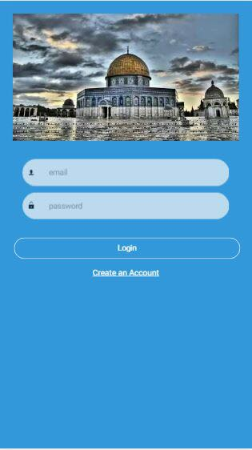
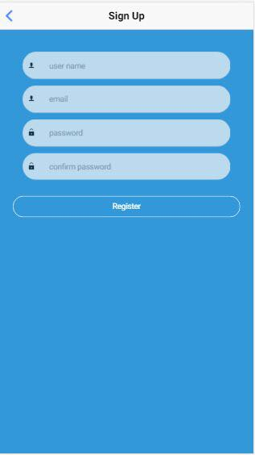
Login & signup
Login page.
Signup page.

Slide 7
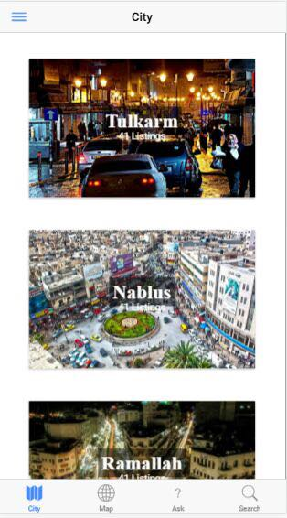
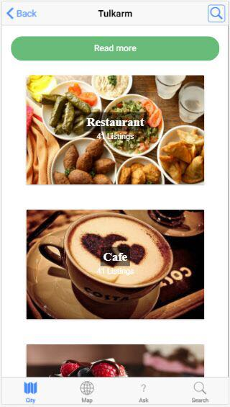
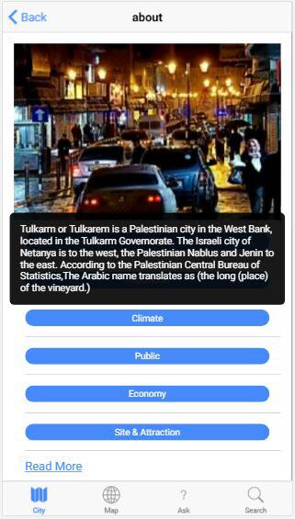
Cities

Slide 8
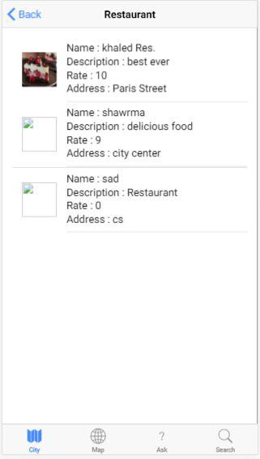
Categories

Slide 9
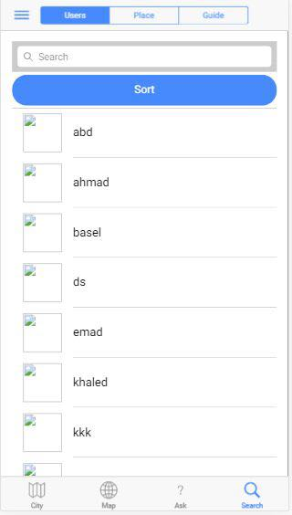
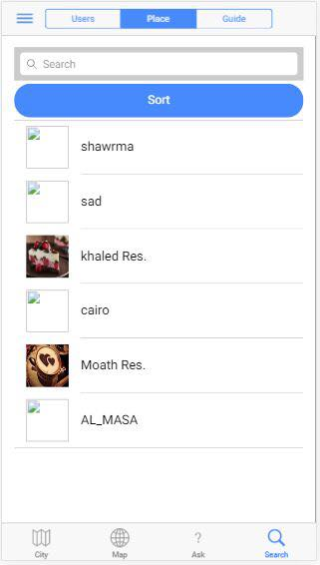
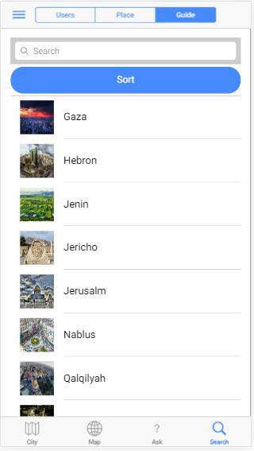
Search

Slide 10
Places information
This is a focused feature in Pal Guide
Know more about places before trying it
Confident decisions.
Includes: Rating , People opinions , Reviews & Map viewing .

Slide 11
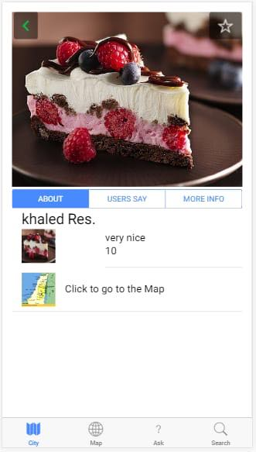
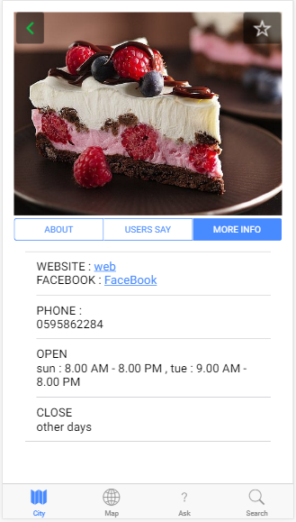
Place

Slide 12
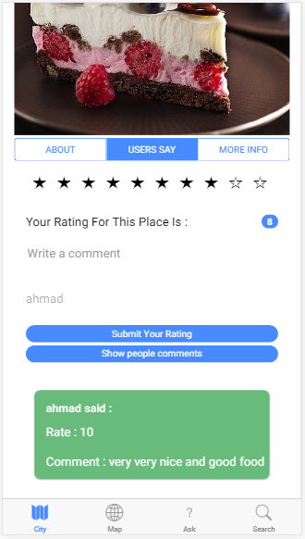
Rating & Reviews
Provide regular & irregular rating of the place.
View others feedback comments in the place page.
User can take decision upon peoples’ experience.

Slide 13
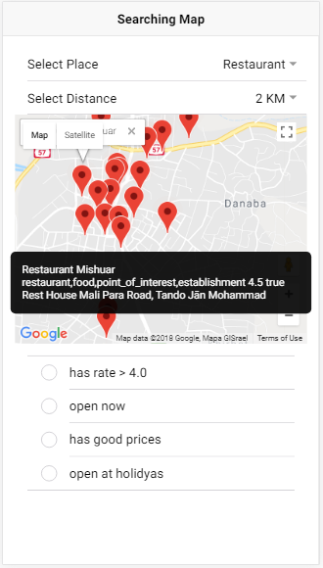
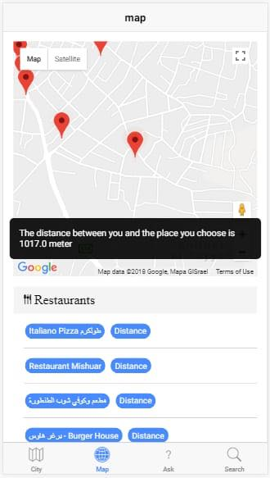
Map

Slide 14
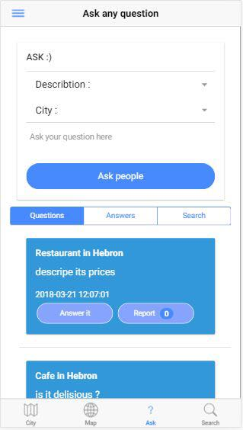
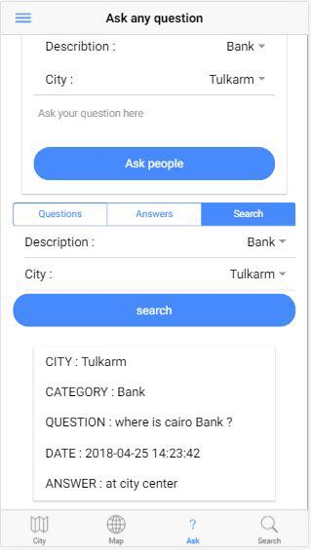
Questions

Slide 15
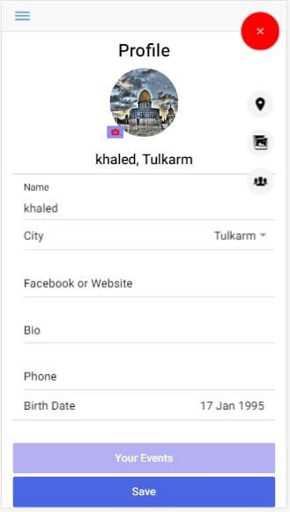
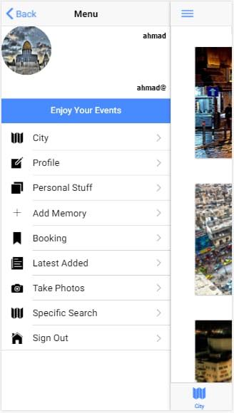
Profile

Slide 16
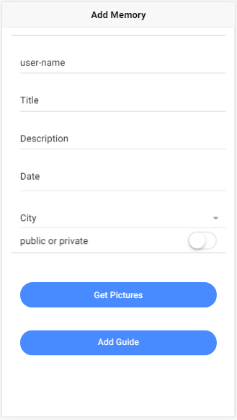
Memo’s
Publish public memo’s easily
& make other users be able to see it.
User can easy back to his memo’s.

Slide 17
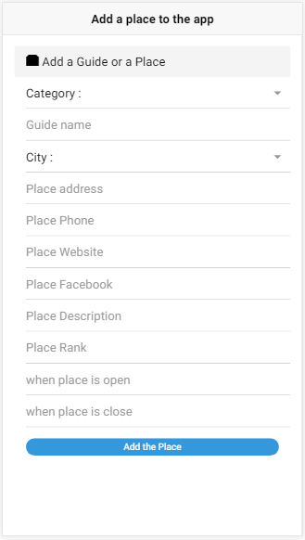
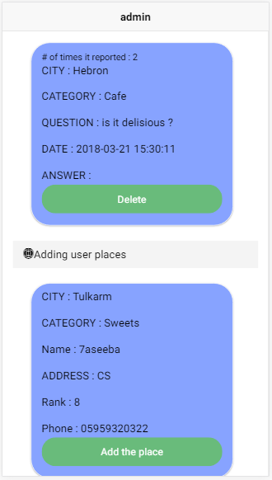
How to add a place from user to app

Slide 18
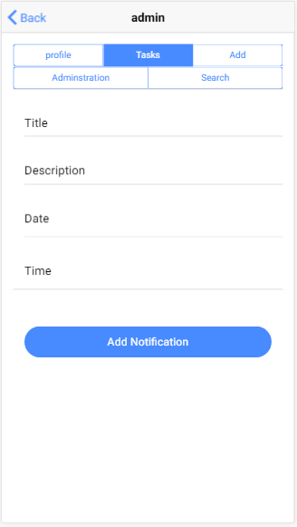
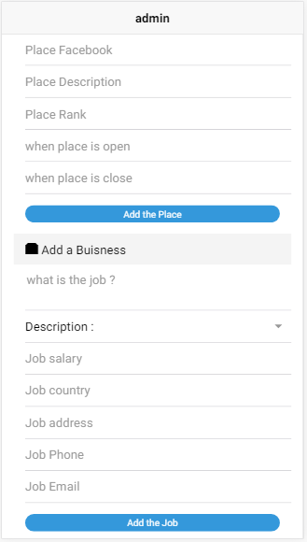

Admin

Slide 19
PAL Guide Business wise:
Can make revenue by adding simple fees to show a specific place at application.
Apply small fees on users to advertise events & general advertisement.

Slide 20





Technologies and implementation
Mobile application
Server

Slide 21
Challenges & Constraints:
Internet connection
Too many data
Time of work on app

Slide 22
Future work
Voice guide with map.
Improve owner capabilities on app
More specific search (tags search).

Slide 23
Thanks

