Slide 1


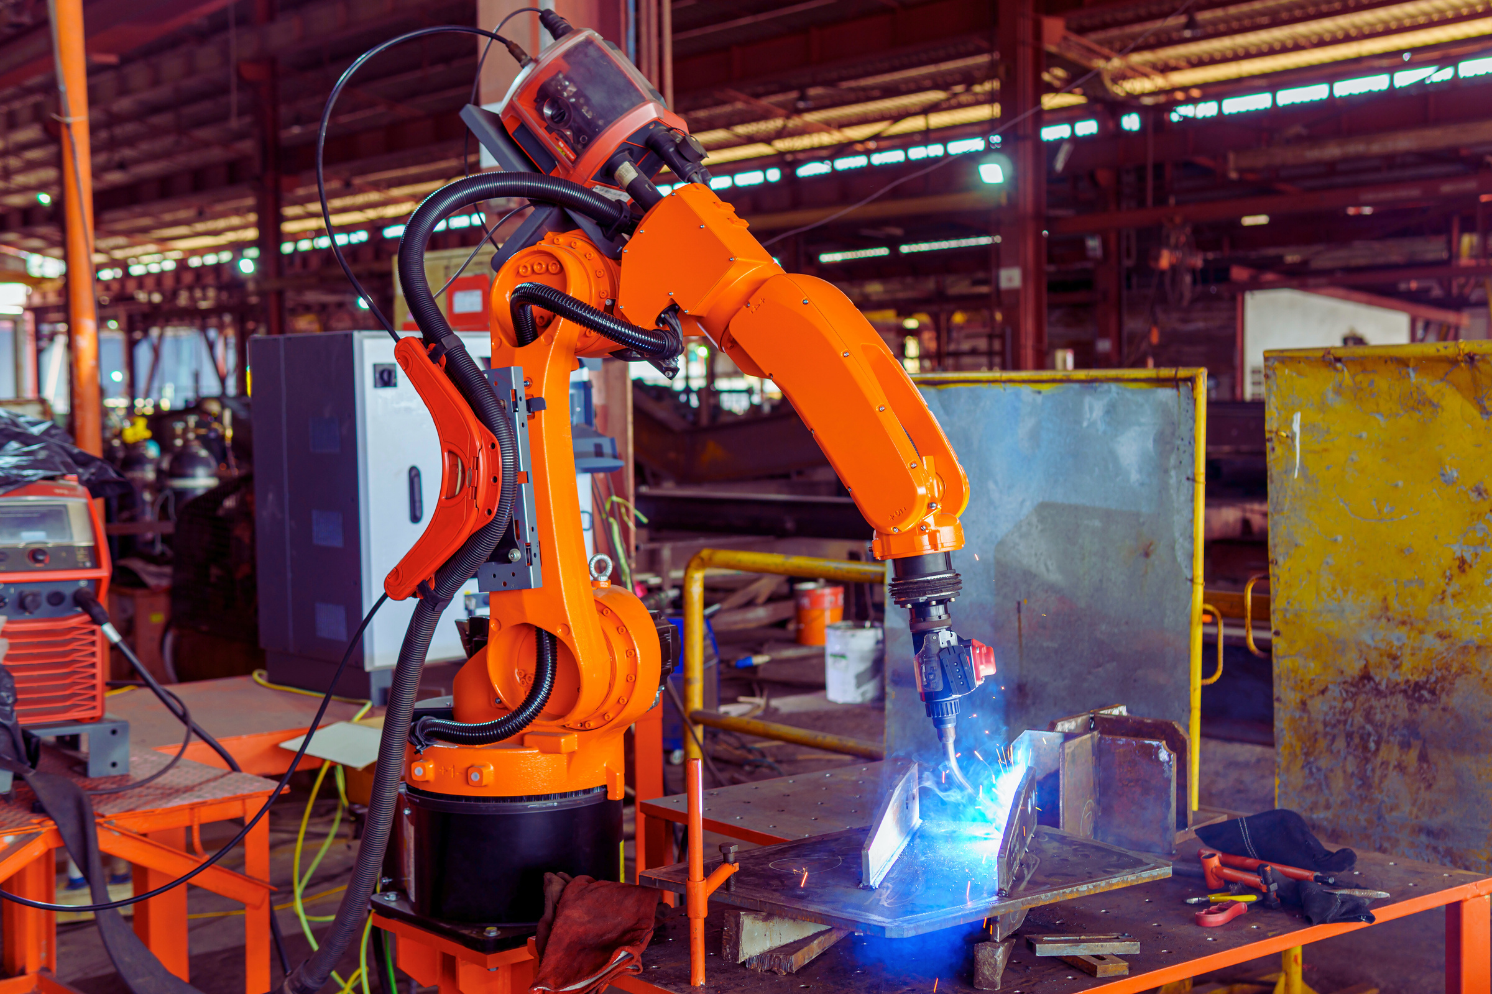

Hardware Project
PROGRAMMABLE
ROBOTIC
ARM
NASRALLAH & KAREEM

Slide 2



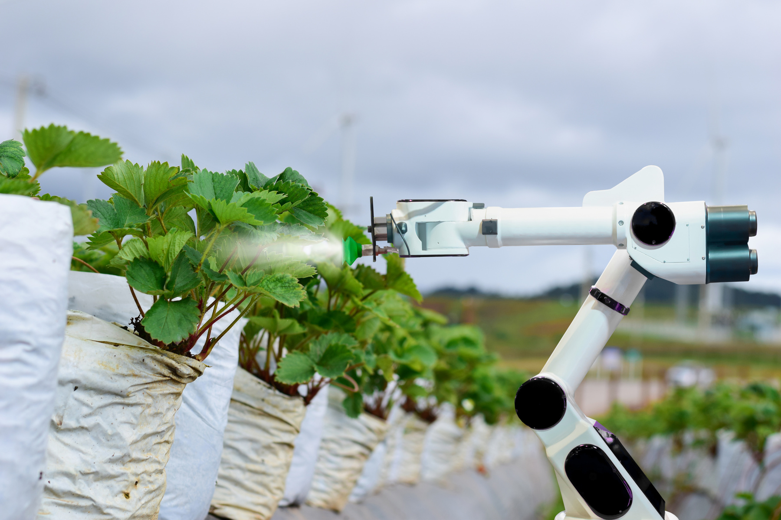
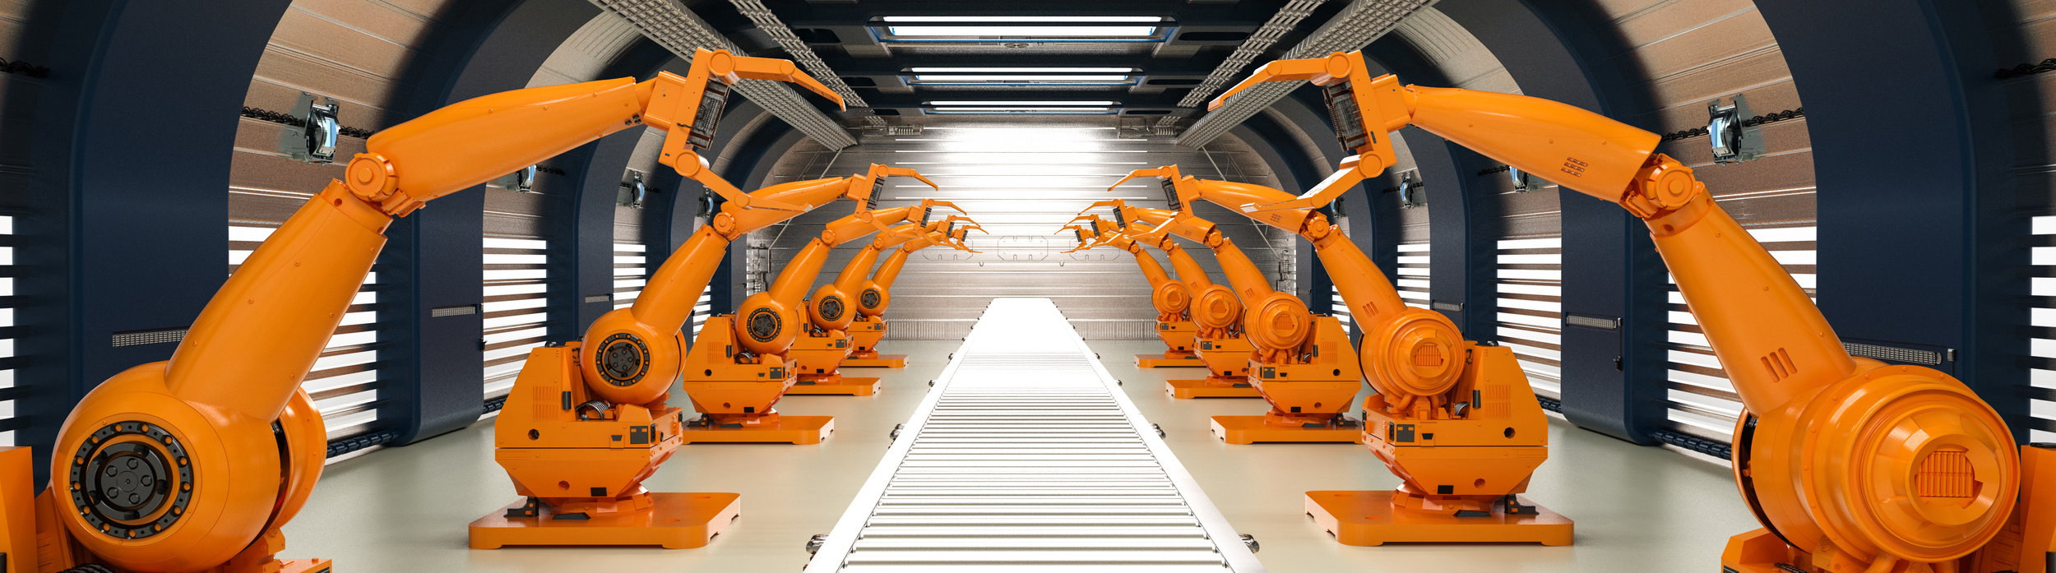


Robotics Arm in Action
Manufacturing and Assembly
Healthcare and Medical Devices
Agriculture
Construction and Infrastructure

Slide 3

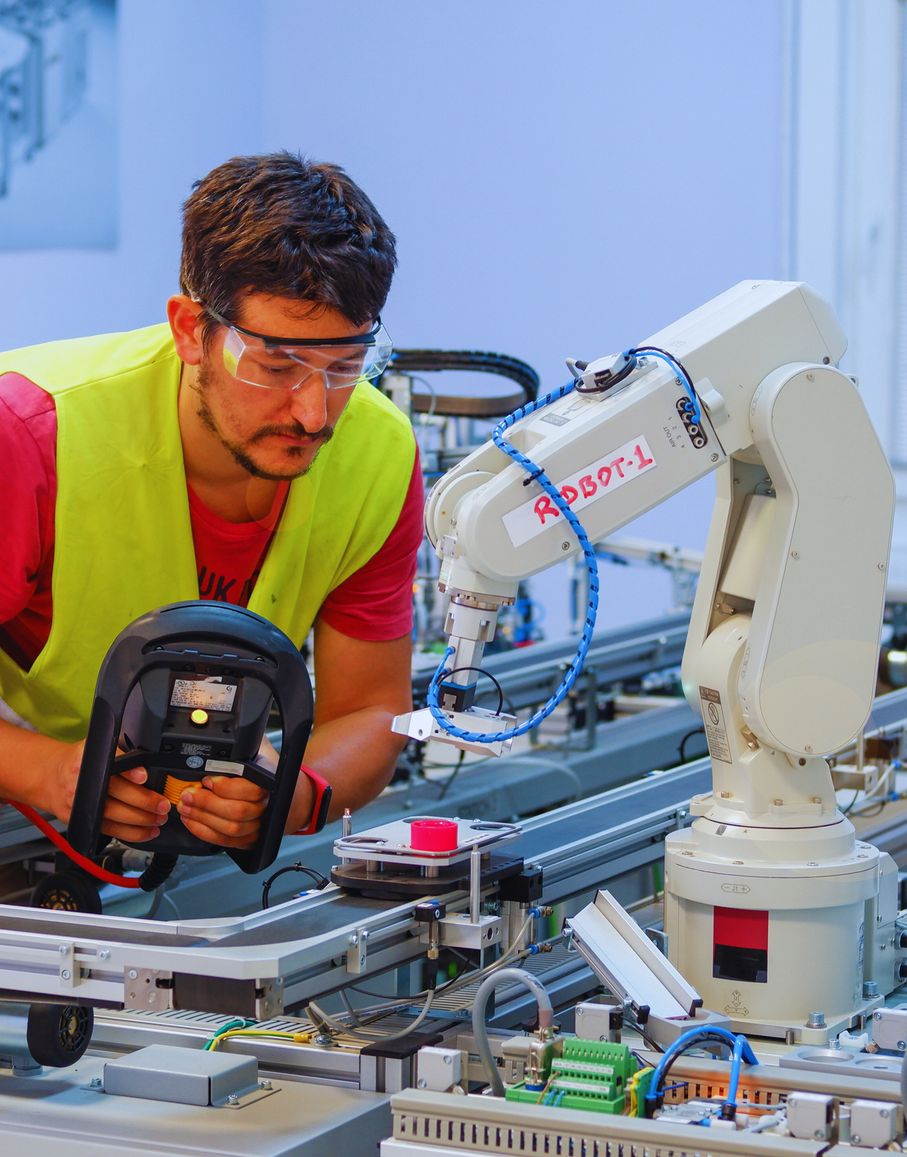

Challenges with Traditional Robotic Arms
Need of a specialist
On-site configuration
Offline programming
Specific Tasks

Slide 4


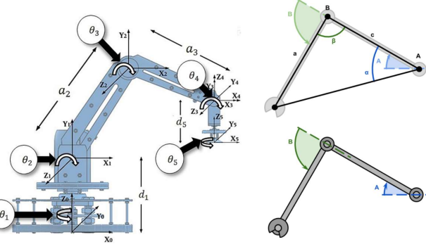

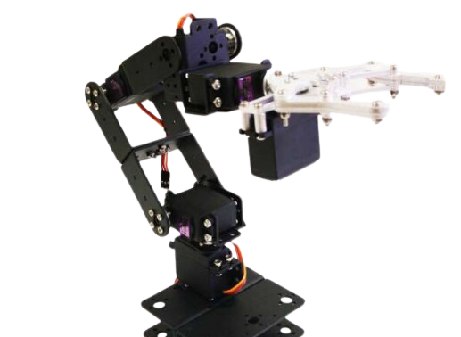
Revolutionary Prototype
The mechanical design of our robotic arm prototype was carefully crafted to ensure it meets the needs of a wide range of industrial tasks.
6 Degree of Freedom (DOF)
Aluminum Material
Joints and Gripper Design
Obstacle Detection and Safe Design
Solid Base and Platform
Inverse Kinematics for Smooth Motion

Slide 5
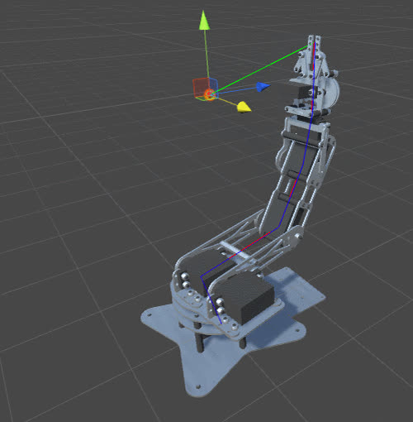




Key Features:
Inverse Kinematics
What is Inverse Kinematics?
Importance of Inverse Kinematics
Challenges with Inverse Kinematics

Slide 6
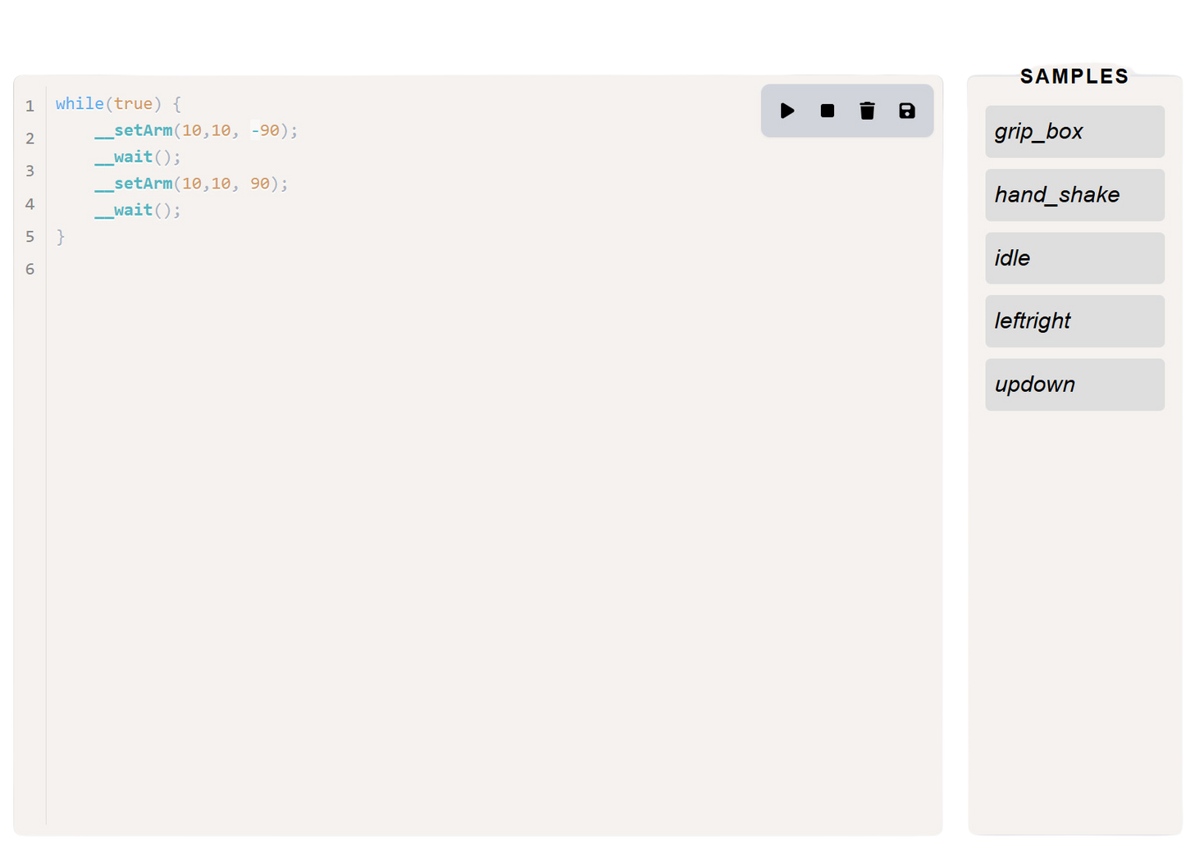



Key Features:
Custom Compiler
Robotic Arm Compiler
Simple & descriptive
Language
On-fly Configurations
Auto Save on
Flash
Option for online
programming

Slide 7
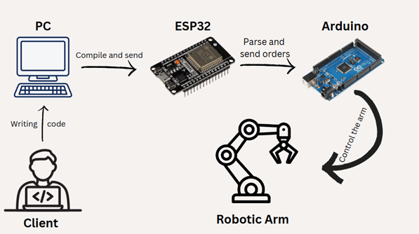


Key Features:
Custom Compiler
How it
works?

Slide 8
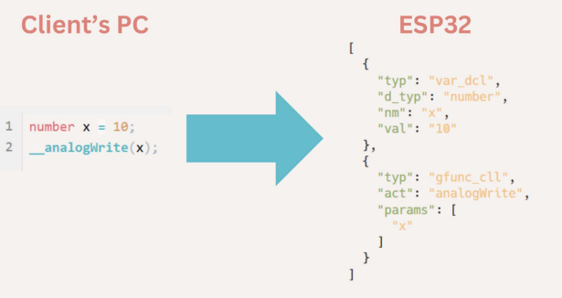
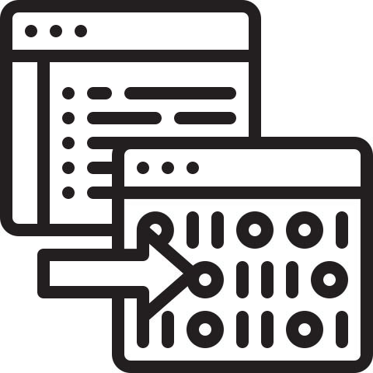



Key Features:
Custom Compiler

Slide 9

Key Features:
Custom Compiler
gripObject()
autoWrist()
setArm(x, y, z)
other control
functions
wait()

Slide 10
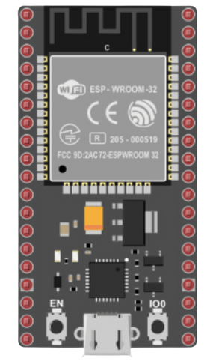


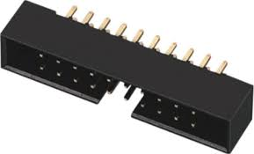


Key Features:
Sensor Expansion
Plug & Play
Compiler
Compatible
Scalable

Slide 11

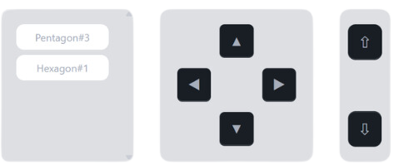





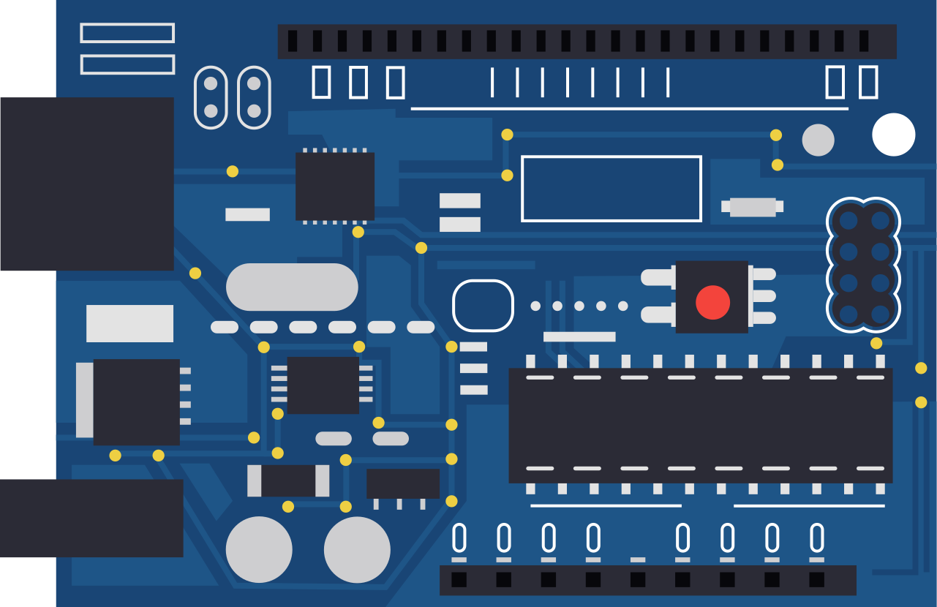

Key Features:
Manual Control
Mobile /
Computer
Serial /
Wi-Fi
Live Feedback

Slide 12
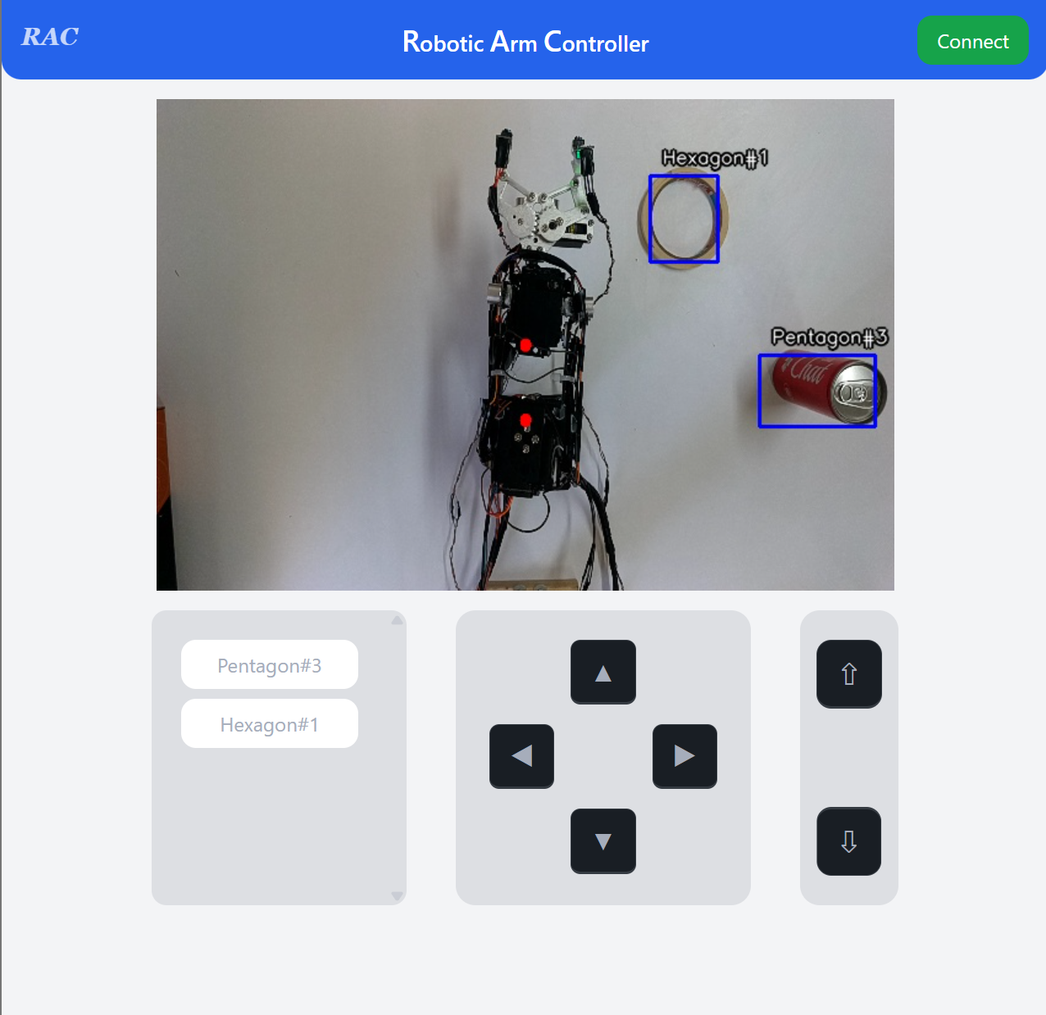



Key Features:
Object Detection
Object Spatial Calculations
Object
Classifier
Clickable
Objects

Slide 13


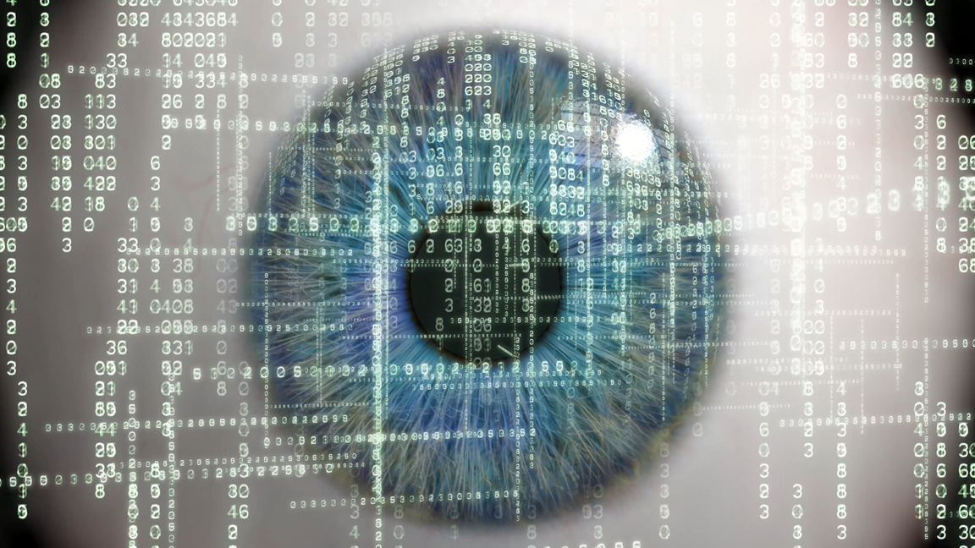
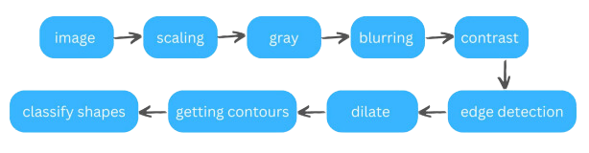
Image Processing
Chain

Slide 14
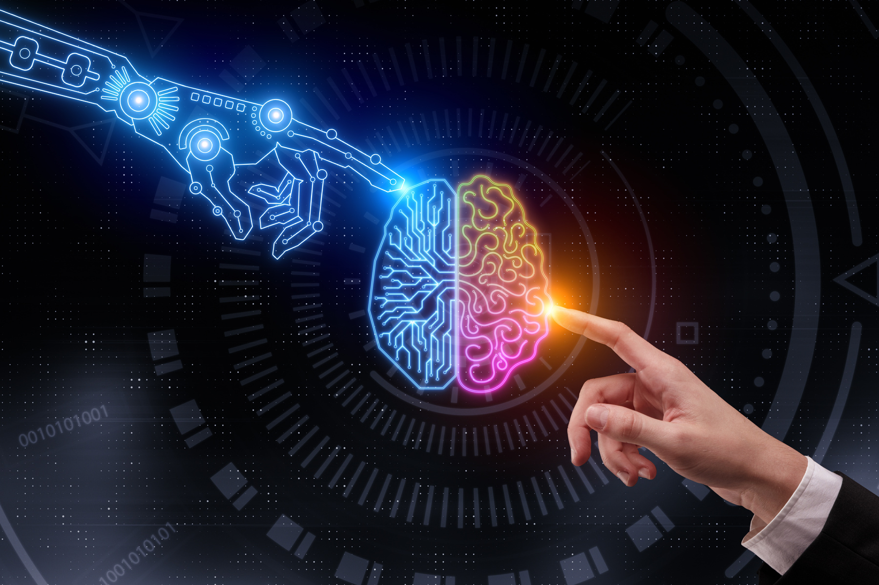


Key Features:
Arm Intelligence
Adaptive Gripping
Range Detection
Object Size Sensing
Auto
Gripping

Slide 15

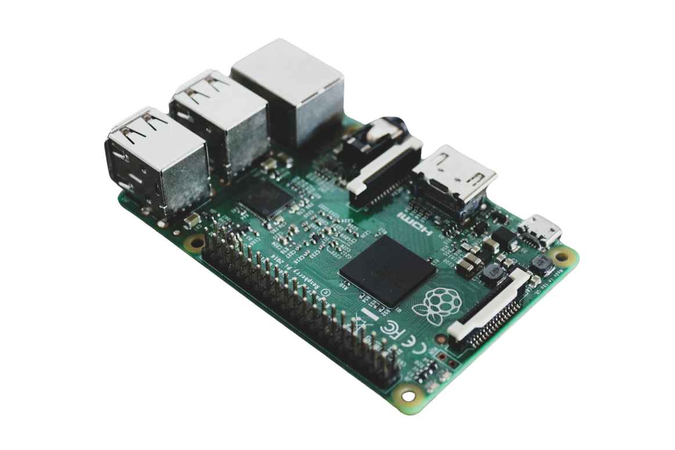

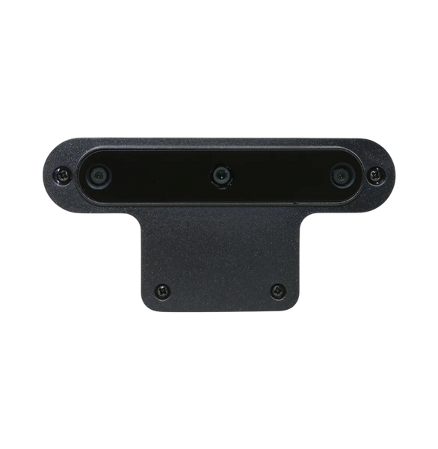
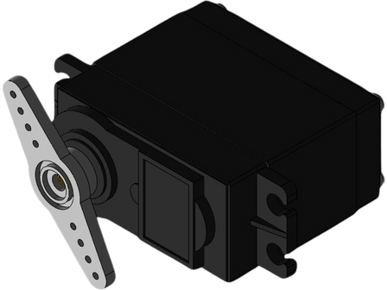

Hardware Components
Arduino Mega
Raspberry Pi 5
ESP32
OAK-D Camera
MG996R Servo
LCD

Slide 16
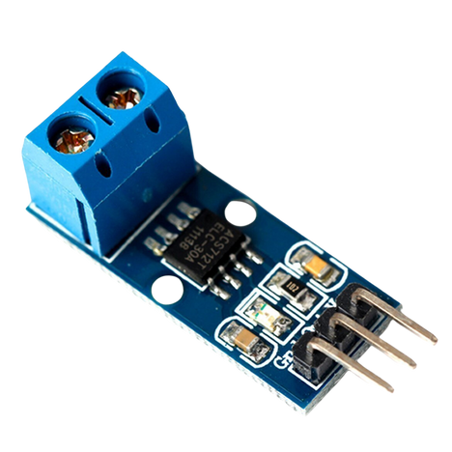
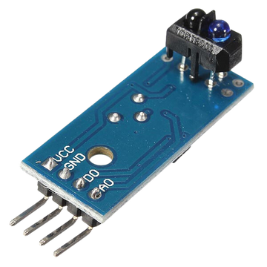
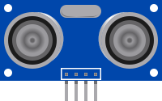
Hardware Components
Curre
Current Sensor
IR Sensor
Ultrasonic Sensor

Slide 17
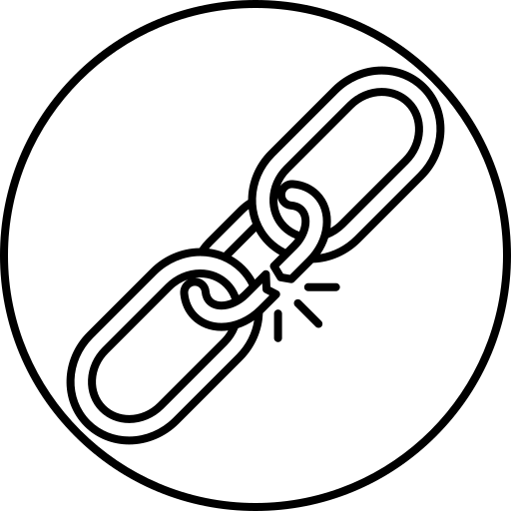





Constraints
Lack of Time
Limited components
Learning new Concepts

Slide 18


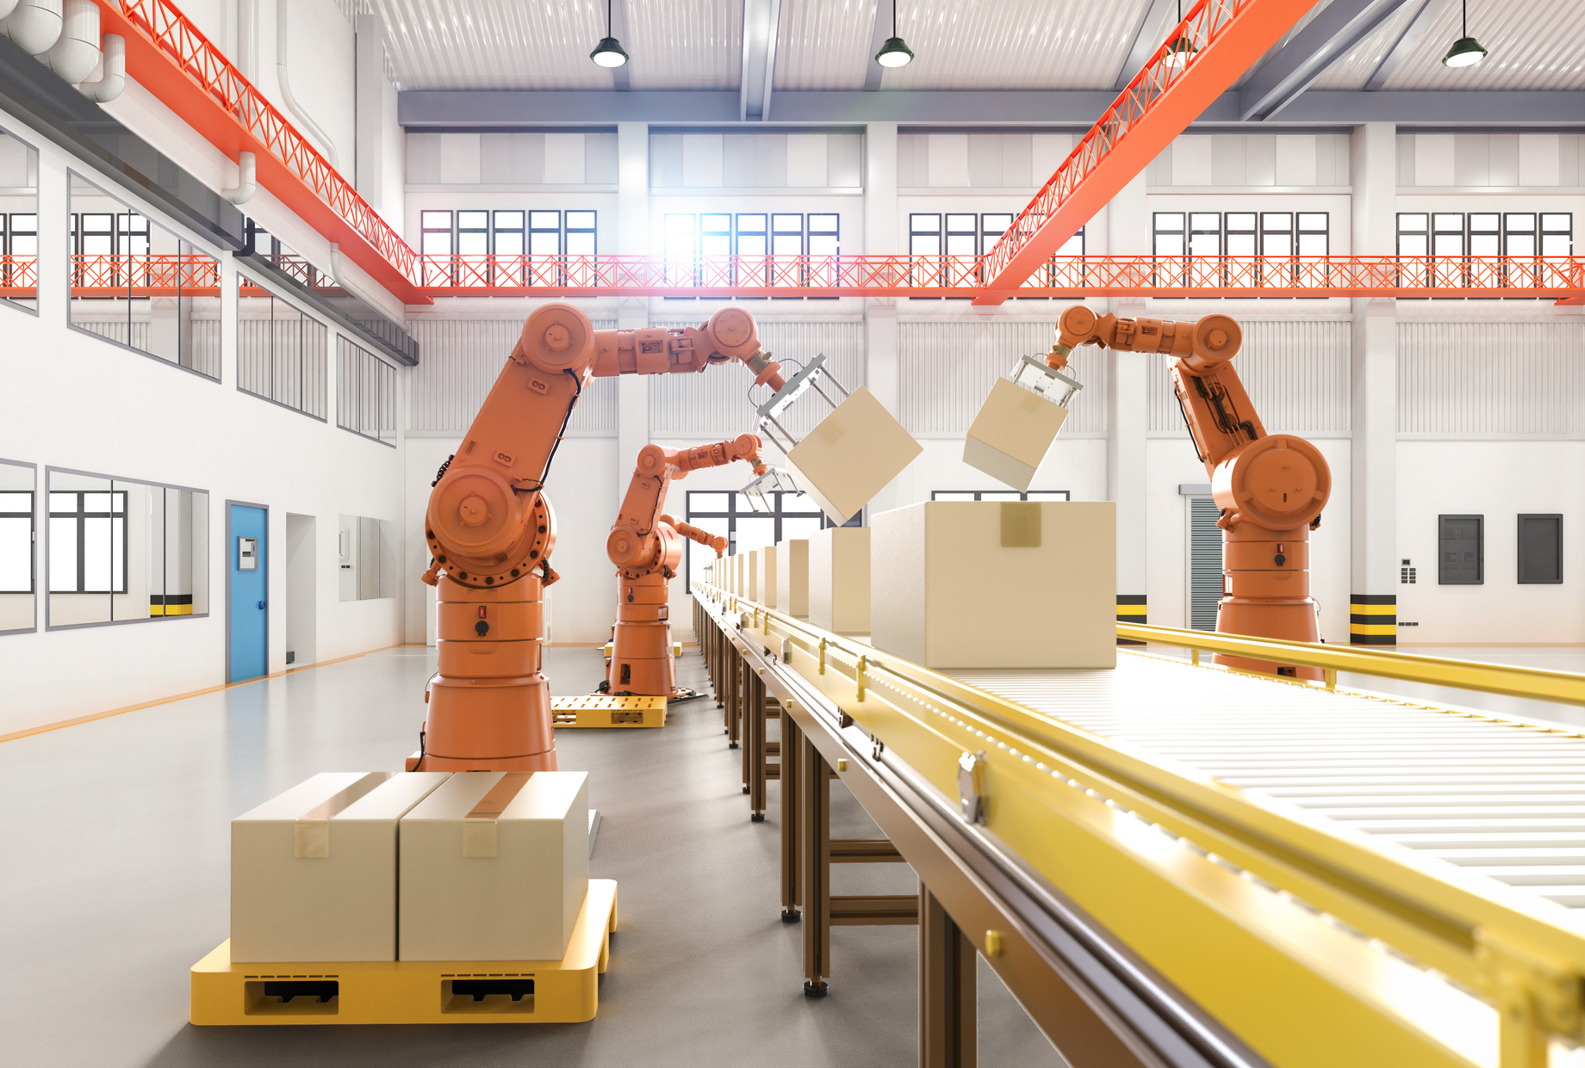



Future Evolution
Co-operative complex tasks
Custom Object Recognition
Compiler Debugger
Standard Language Integration

Slide 19


Thank you
for your
Attention
Any Questions?
chatgpt it

Slide 20


