Slide 1

Chemical Engineering Program 2024-2023
Preparation, Characterization and Applications of Zinc Oxide/Carbon Nanodots Hybrid

Slide 2
Contents
Overview
Objectives
Materials and methodology
Result
Application
Conclusion

Slide 3
Overview
Nano Particles
Carbon Nanodots
The hybrid
Photodegradation

Slide 4
Objectives
MICROWAVE SYNTHESIS METHOD:
Develop a rapid microwave-based synthesis for high-yield ZnO NPs and CNDs.
Investigate a one-pot approach for simultaneous ZnO-CNDs hybrid synthesis.
PHOTODEGRADATION APPLICATION:
Explore ZnO and ZnO-CNDs hybrid electrodes for methylene blue photodegradation.
Emphasize effectiveness, degradation efficiency, and stability through multiple cycles.

Slide 5
Objectives
WATER PURIFICATION APPLICATIONS:
Assess ZnO/CND hybrids as electrodes for practical water purification.
Focus on diverse pollutant removal, particularly dyes, via a photocatalytic process
MATERIAL CHARACTERIZATION:
Utilize UV–vis spectrophotometry to analyze optical properties.
Identify chemical functional groups through FT-IR spectroscopy.
Examine surface topography with SEM and AFM.

Slide 6
MATERIALS AND METHODOLOGY
MATERIALS USED
SYNTHESIS PROCEDURES
CHARACTERIZATION TECHNIQUES

Slide 7
Materials Used
Distilled Water
Isopropanol
Sodium Hydroxide
Ammonia Hydroxide
Zinc Salt
D-Glucose

Slide 8
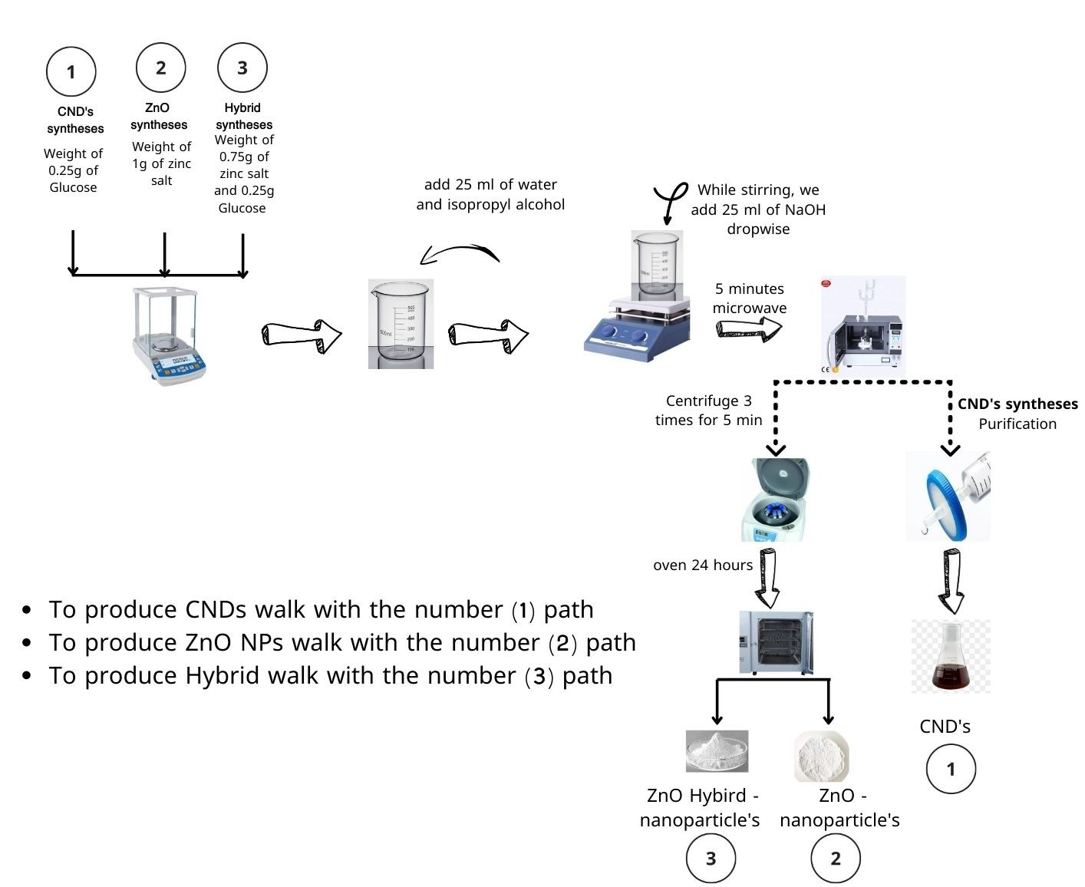
THE PROCESS OF MANUFACTURING

Slide 9
CHARACTERIZATION TECHNIQUES
UV-vis Absorption spectra
Fourier Transform Infrared (FT-IR)
Photolinmineneacence
Scanning electron Microscopy (SEM)
Atomic Force Microscopy (AFM)

Slide 10
RESULTS
Synthesis
Characterization Results

Slide 11
Synthesis Results
 | Without NH4OH | With NH4OH
Zinc Oxide (ZnO Nps) | 17.3% | 27.7%
Carbon Nanodots (CNDs) | 9.5% | 17.5%
ZnO-CNDs Hybrid | 13.5% | 24.4%

Slide 12
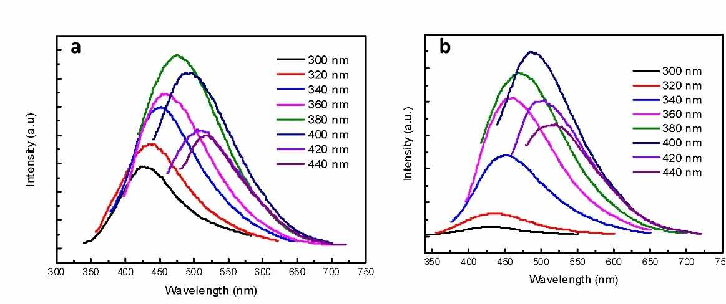
FLUORESCENCE MEASUREMENTS

Slide 13
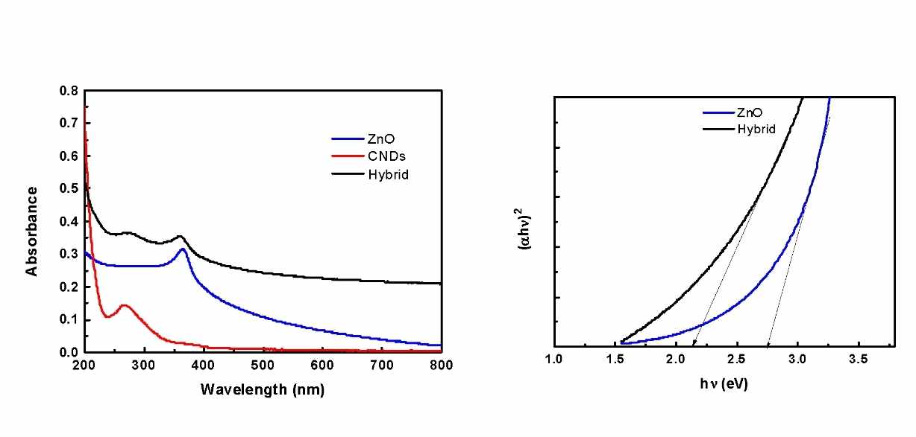
UV-VIS SPECTROSCOPY

Slide 14
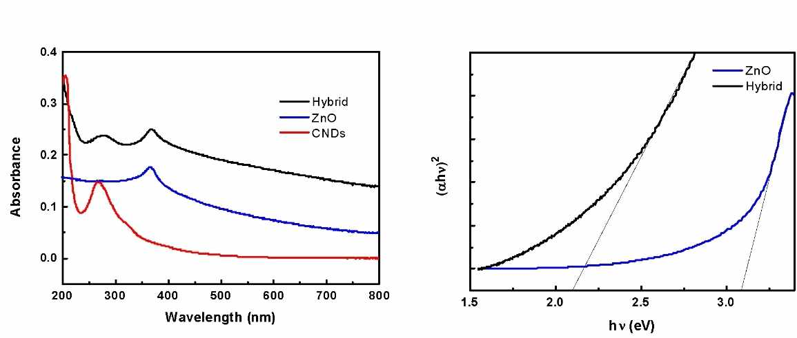
UV-VIS SPECTROSCOPY

Slide 15
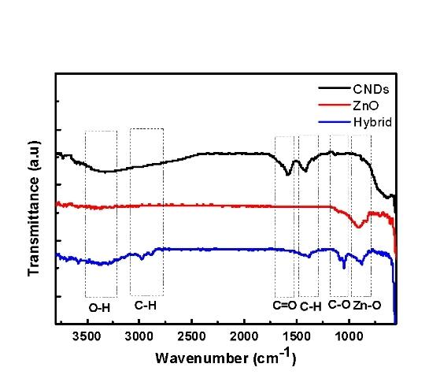
FT-IR SPECTRA

Slide 16
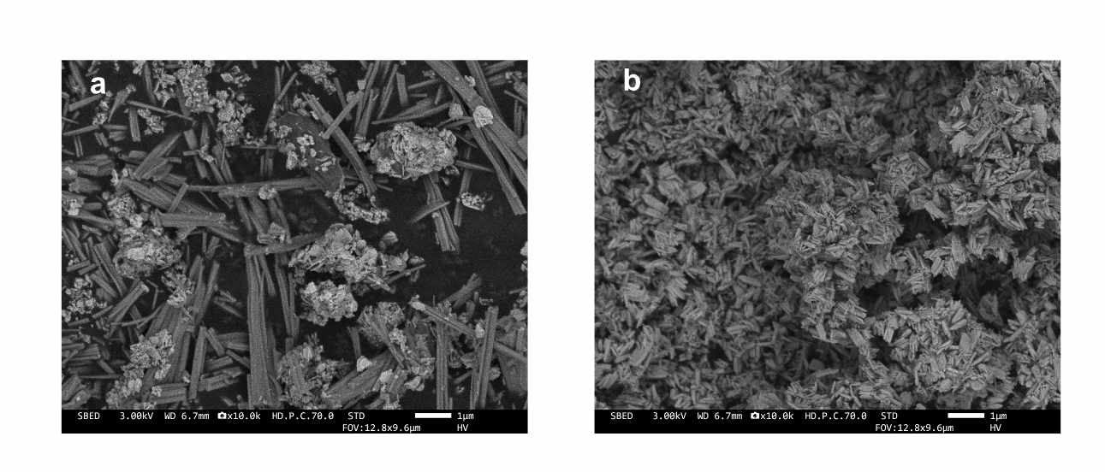
SEM MICROSCOPY

Slide 17
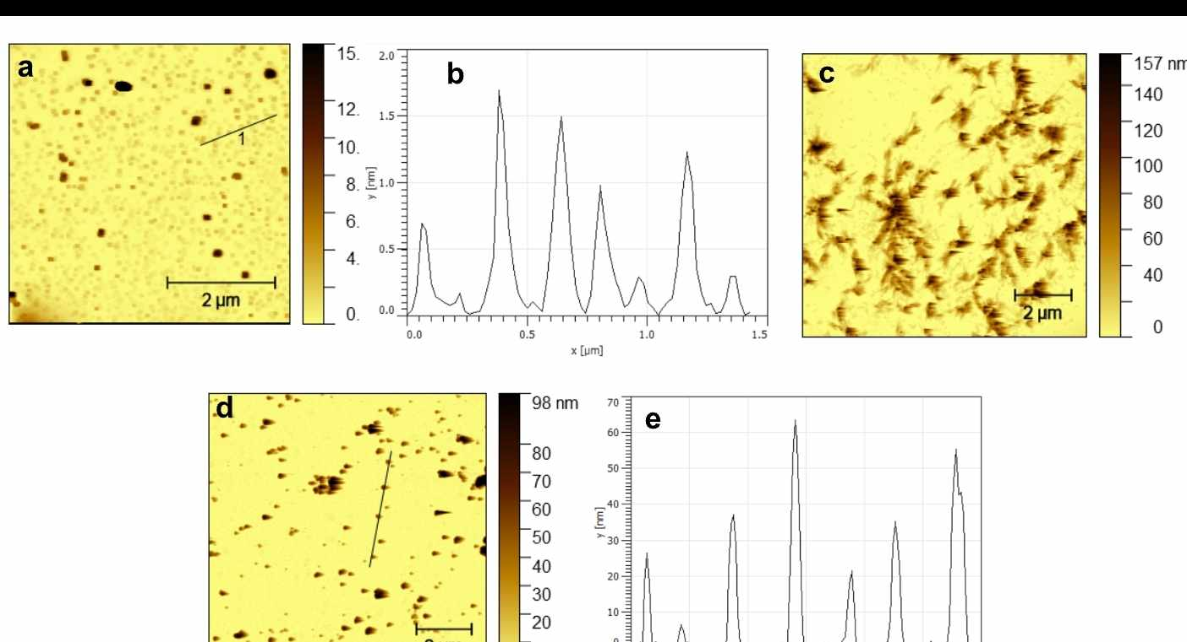
AFM MICROSCOPY

Slide 18
APPLICATION
PHOTODEGRADATION
Photocatalyst

Slide 19
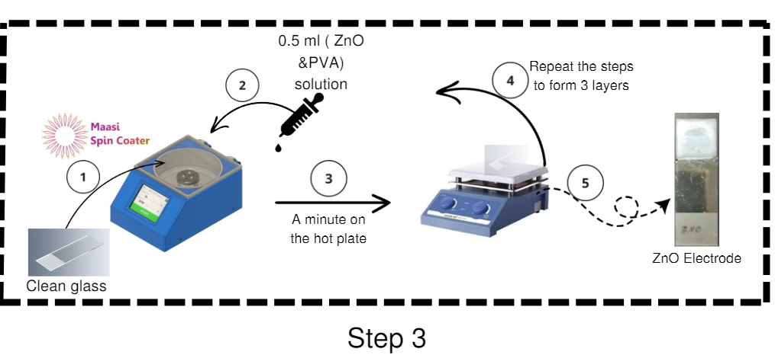
ELECTRODE MANUFACTURING METHOD

Slide 20
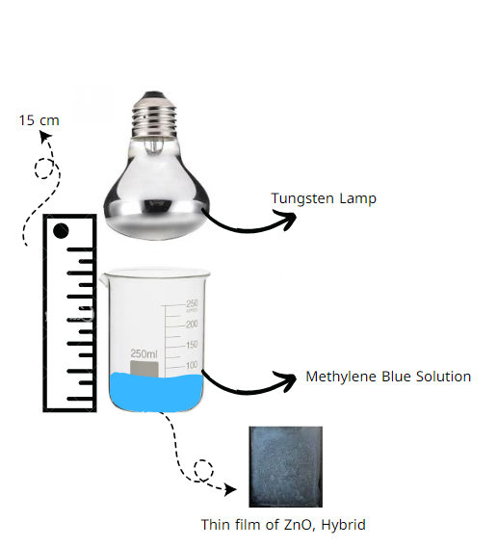
PHOTODEGRADATION OF DYE USING ELECTRODE

Slide 21
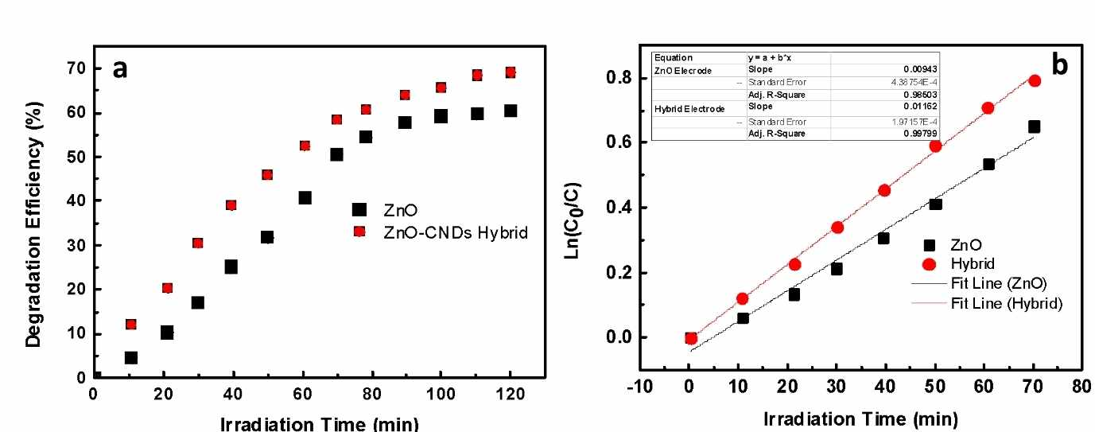
ANALYSES OF THE METHYLENE BLUE DEGRADATION

Slide 22
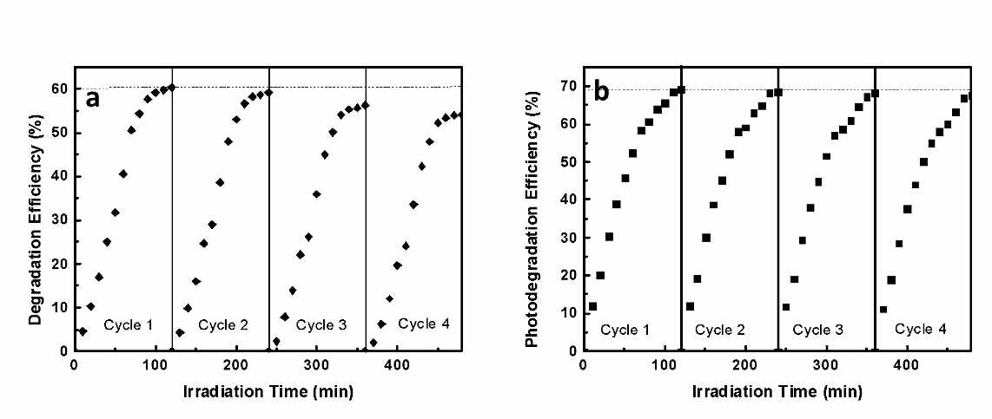
ELECTRODE STABILITIES

Slide 23
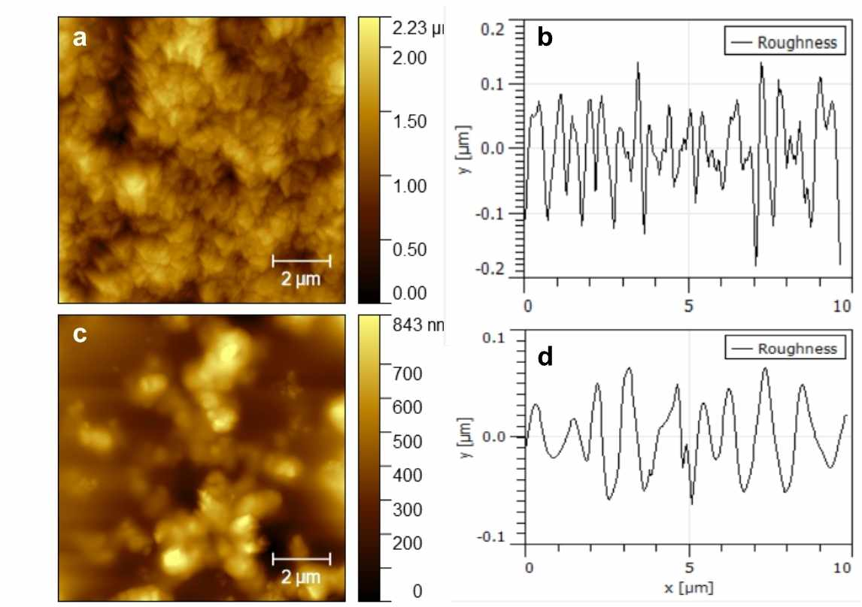
AFM MICROSCOPY

Slide 24
Conclusions
Microwave Method
Potential of Ammonia as Reducing Agent
Thin Film Stability
Characterization Analysis
Application in Photodegradation
Successful Hybridization

Slide 25
Thank You
Do You Have Any Questions ?

