Slide 1
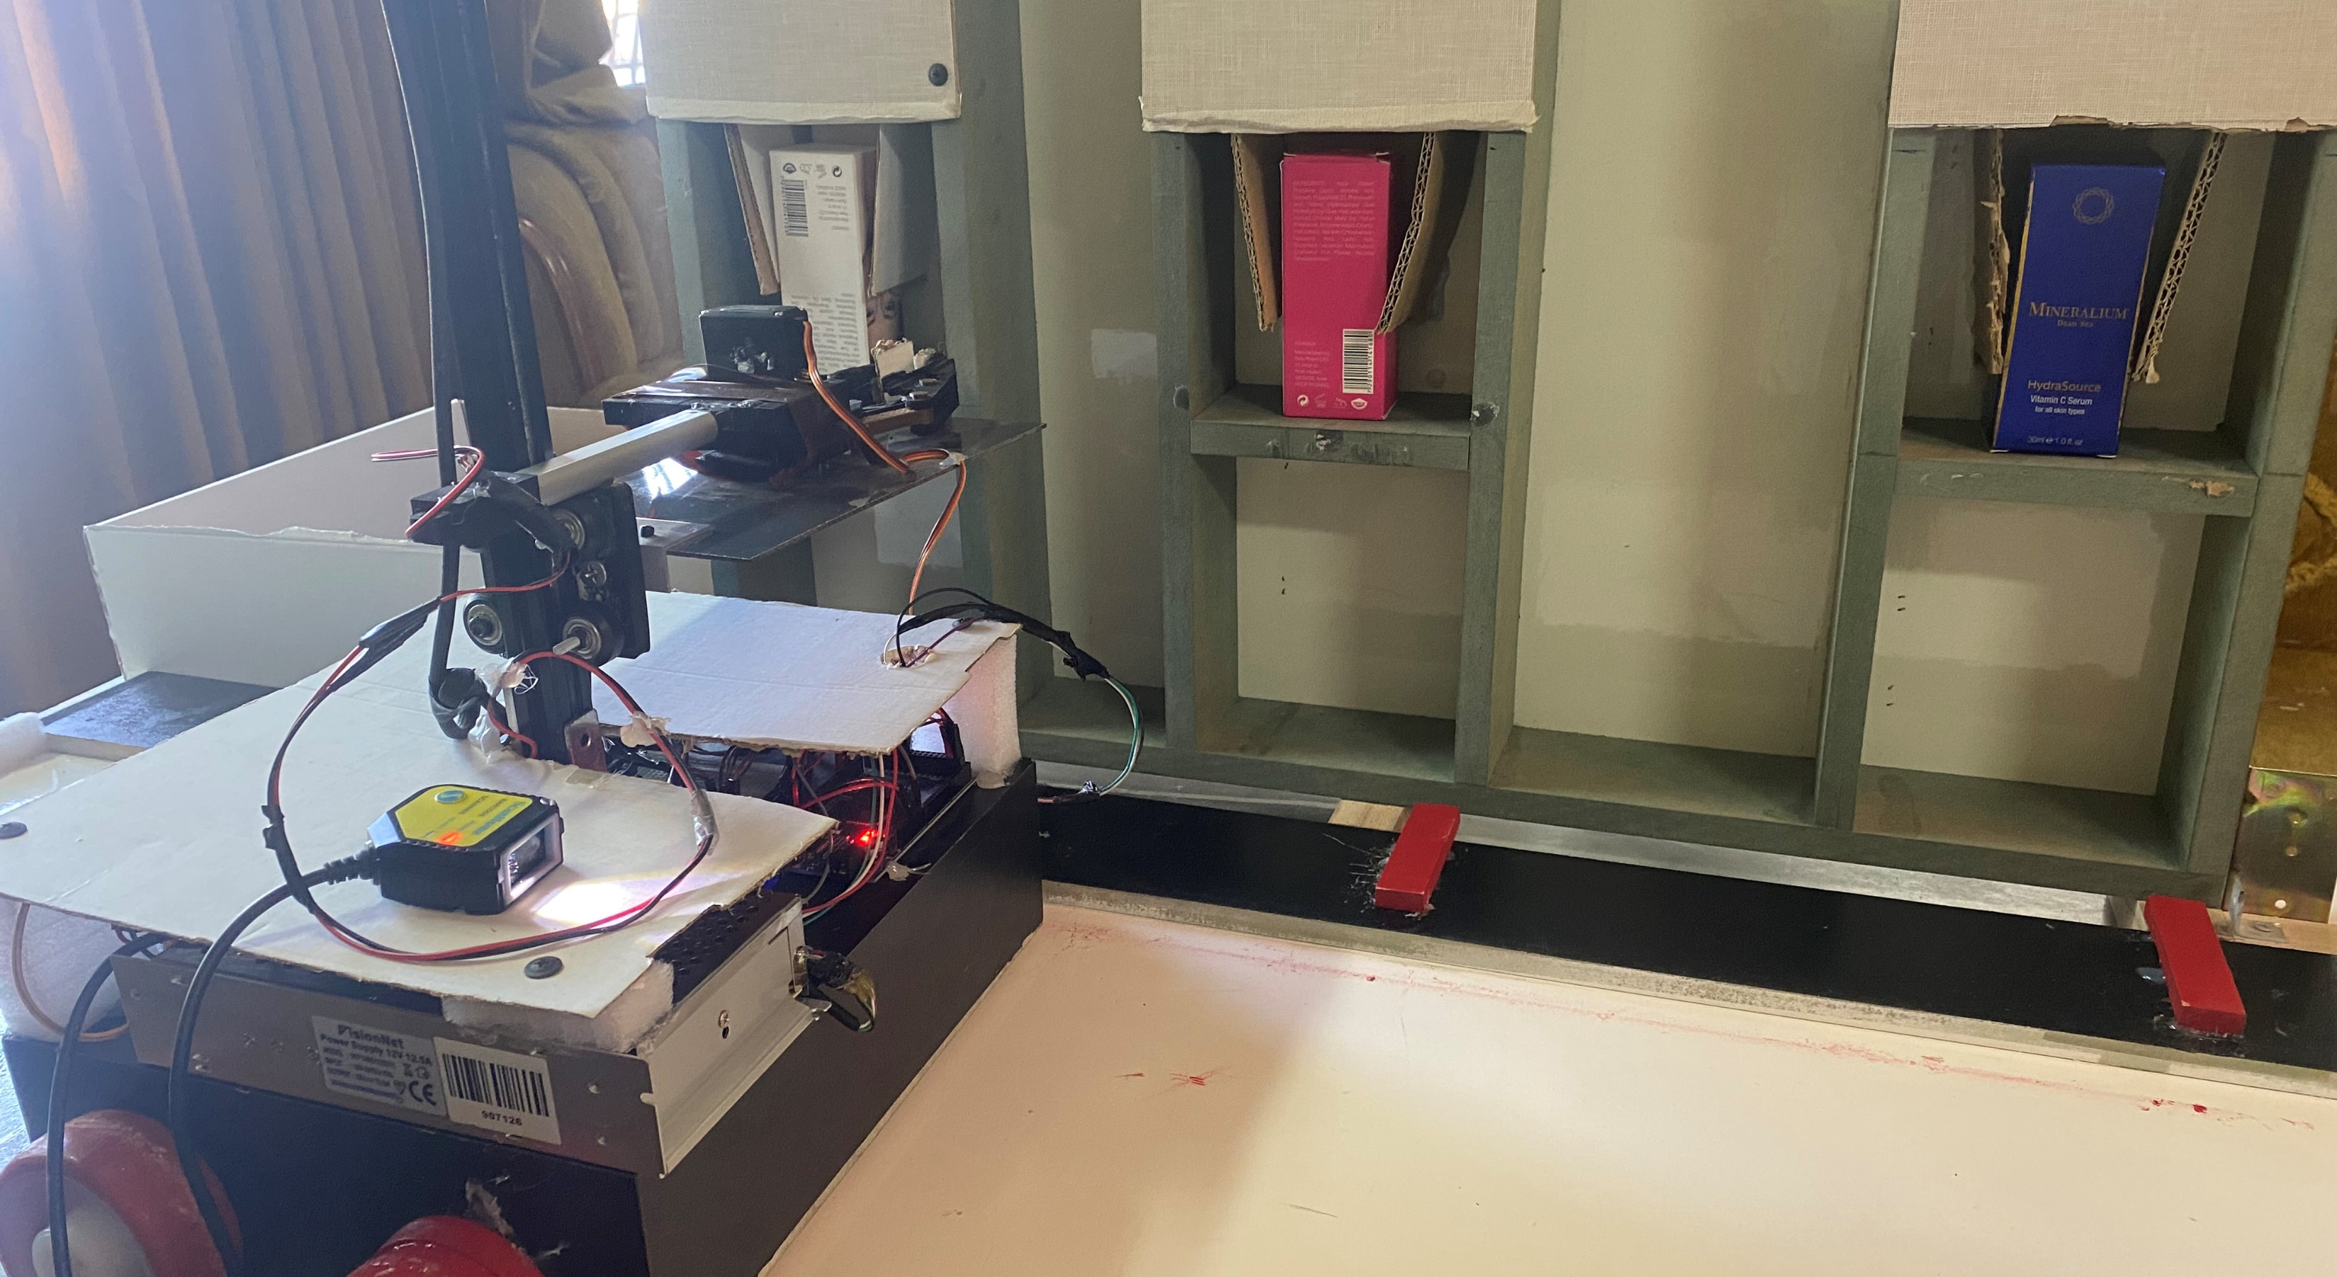
Pharmabot
By: Yazan Diab and Osaid Jabaji
Supervisor: Dr. Luai Malhis

Slide 2
Outlines
Problem Statement
What’s Pharmabot and how it works
Tools
Constraints
Future Work

Slide 3
Problem Statement
Most pharmacies face problems in storing or fetching medicines, as they arrange the medicines manually, and this takes a lot of time and effort.
There is also the possibility of error, and sometimes the shelves are so high that it is difficult to place medications on them.

Slide 4
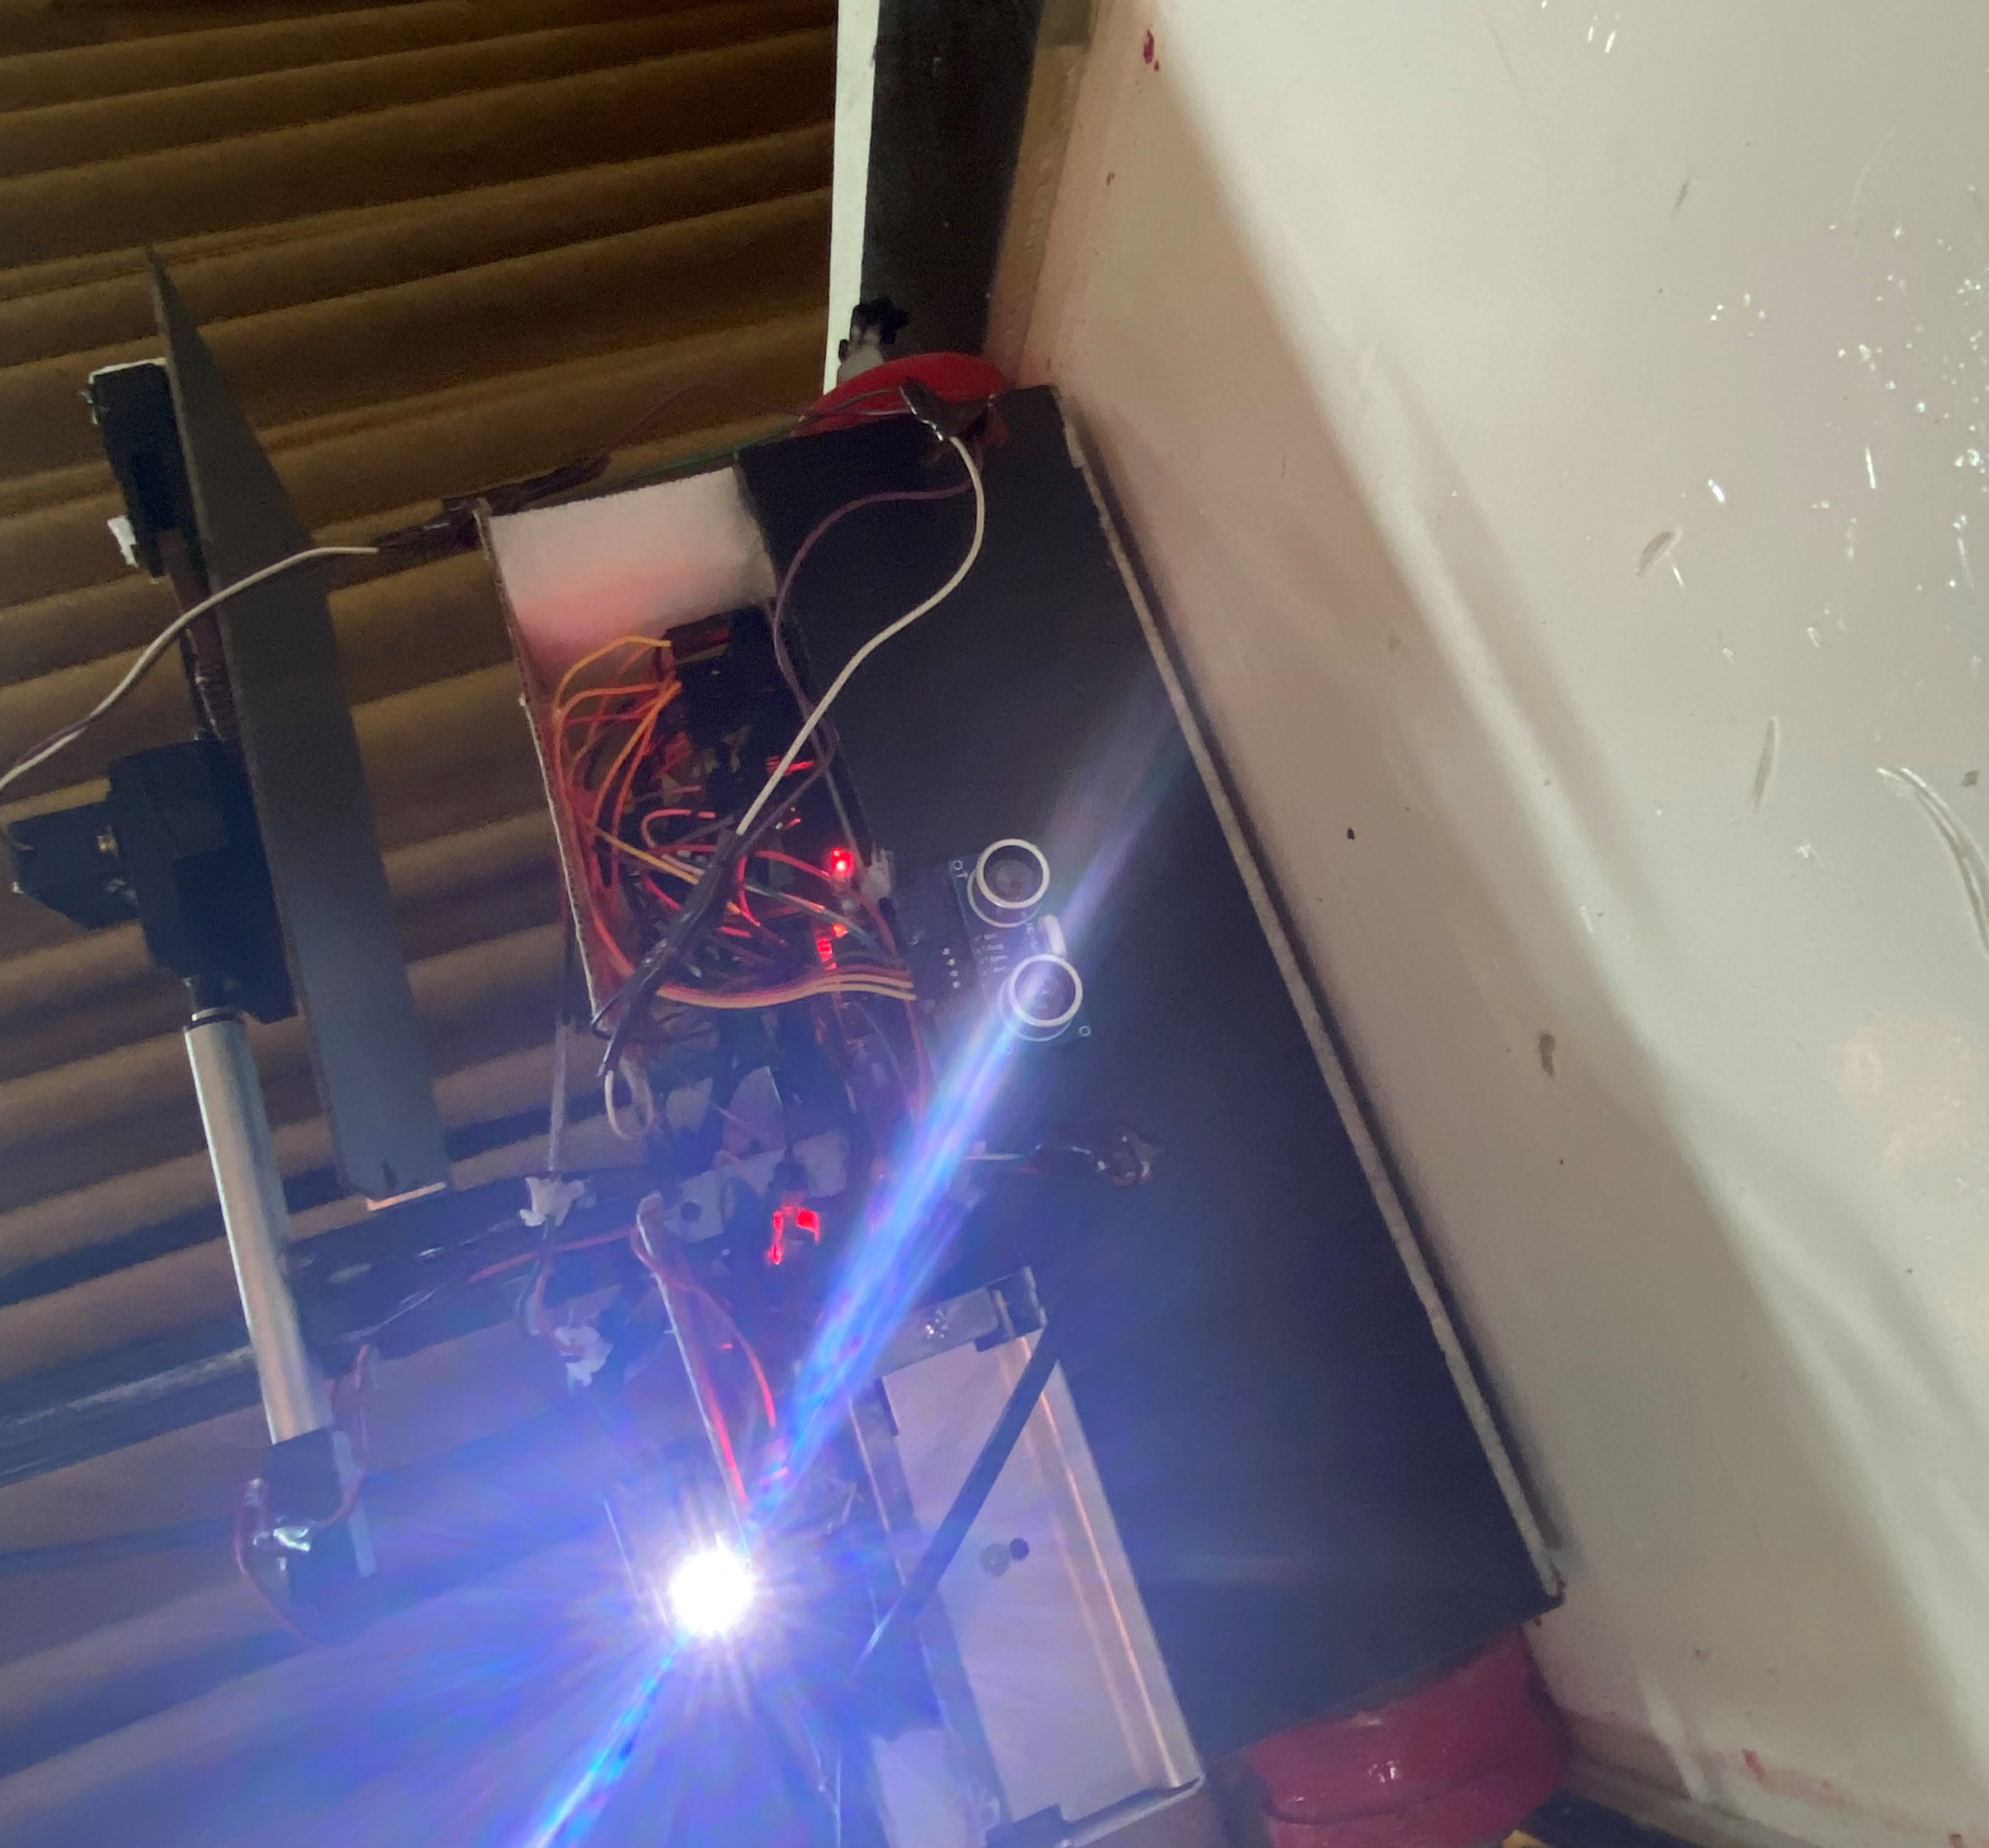

What’s Pharmabot

Slide 5
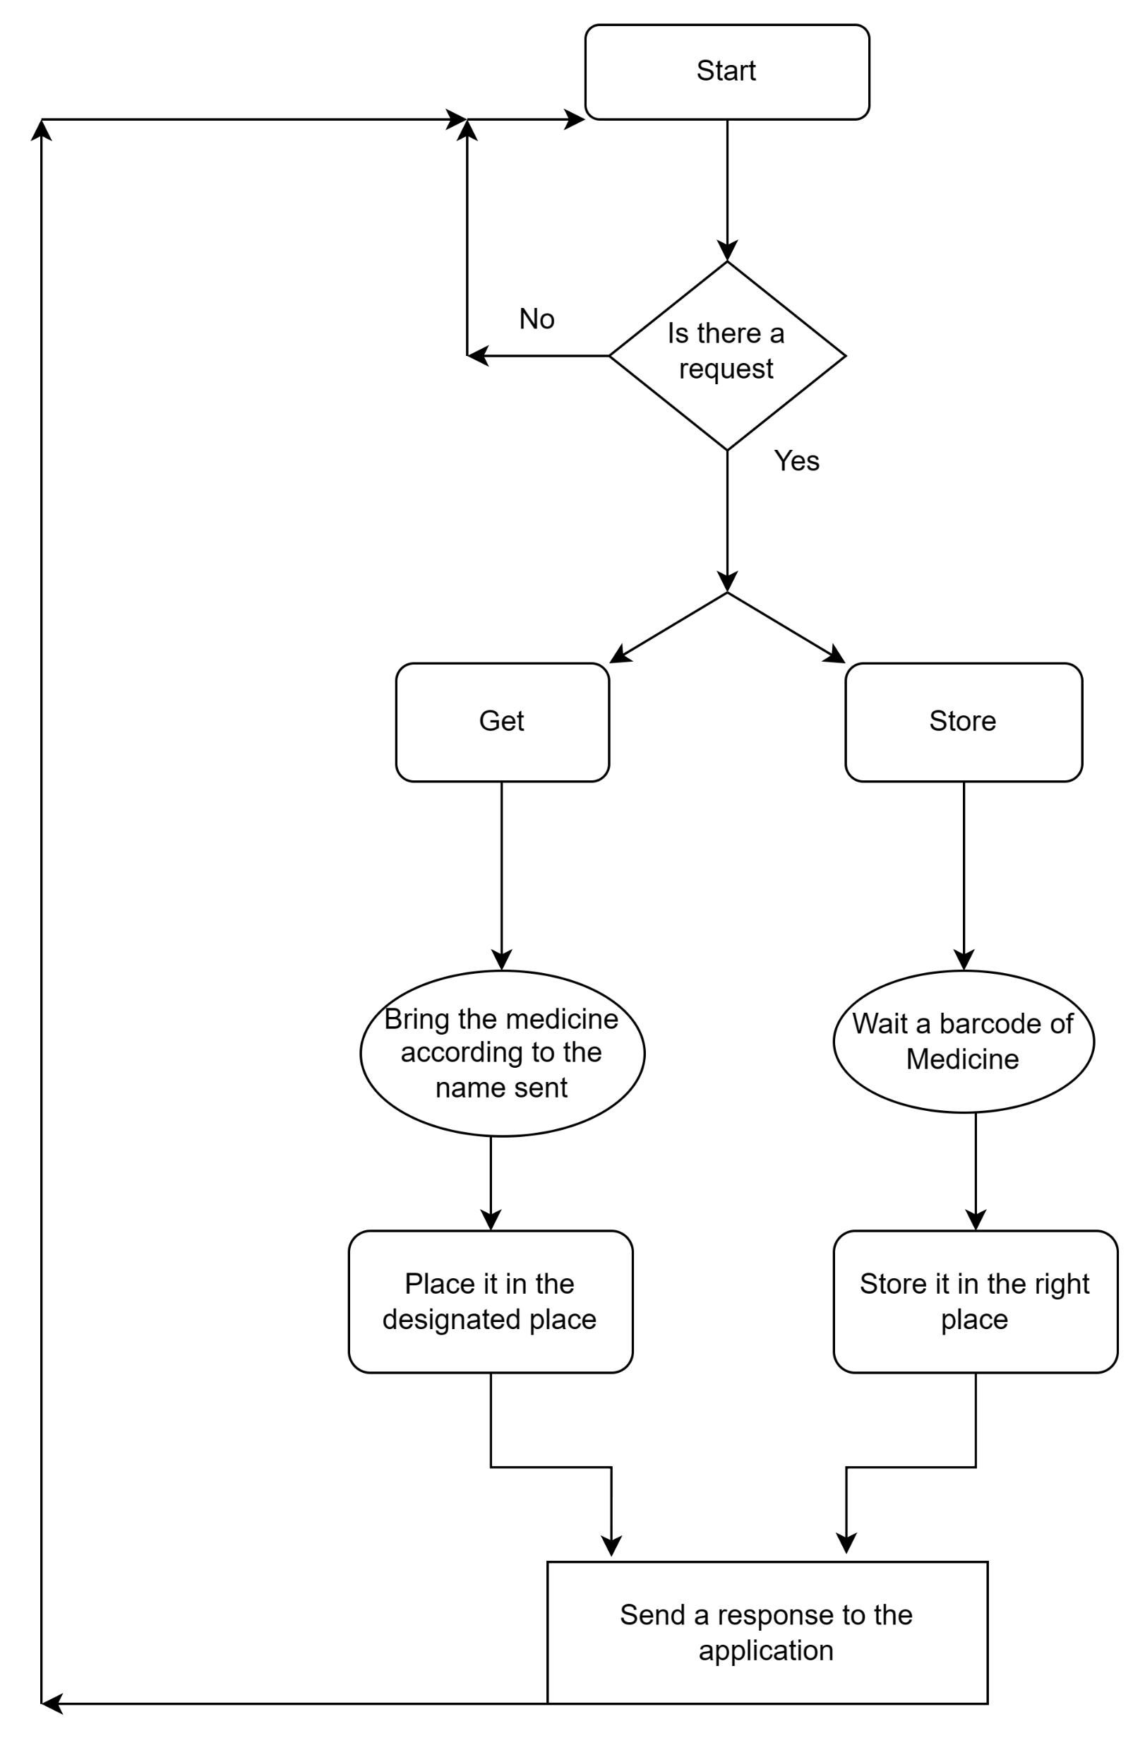
How it works

Slide 6
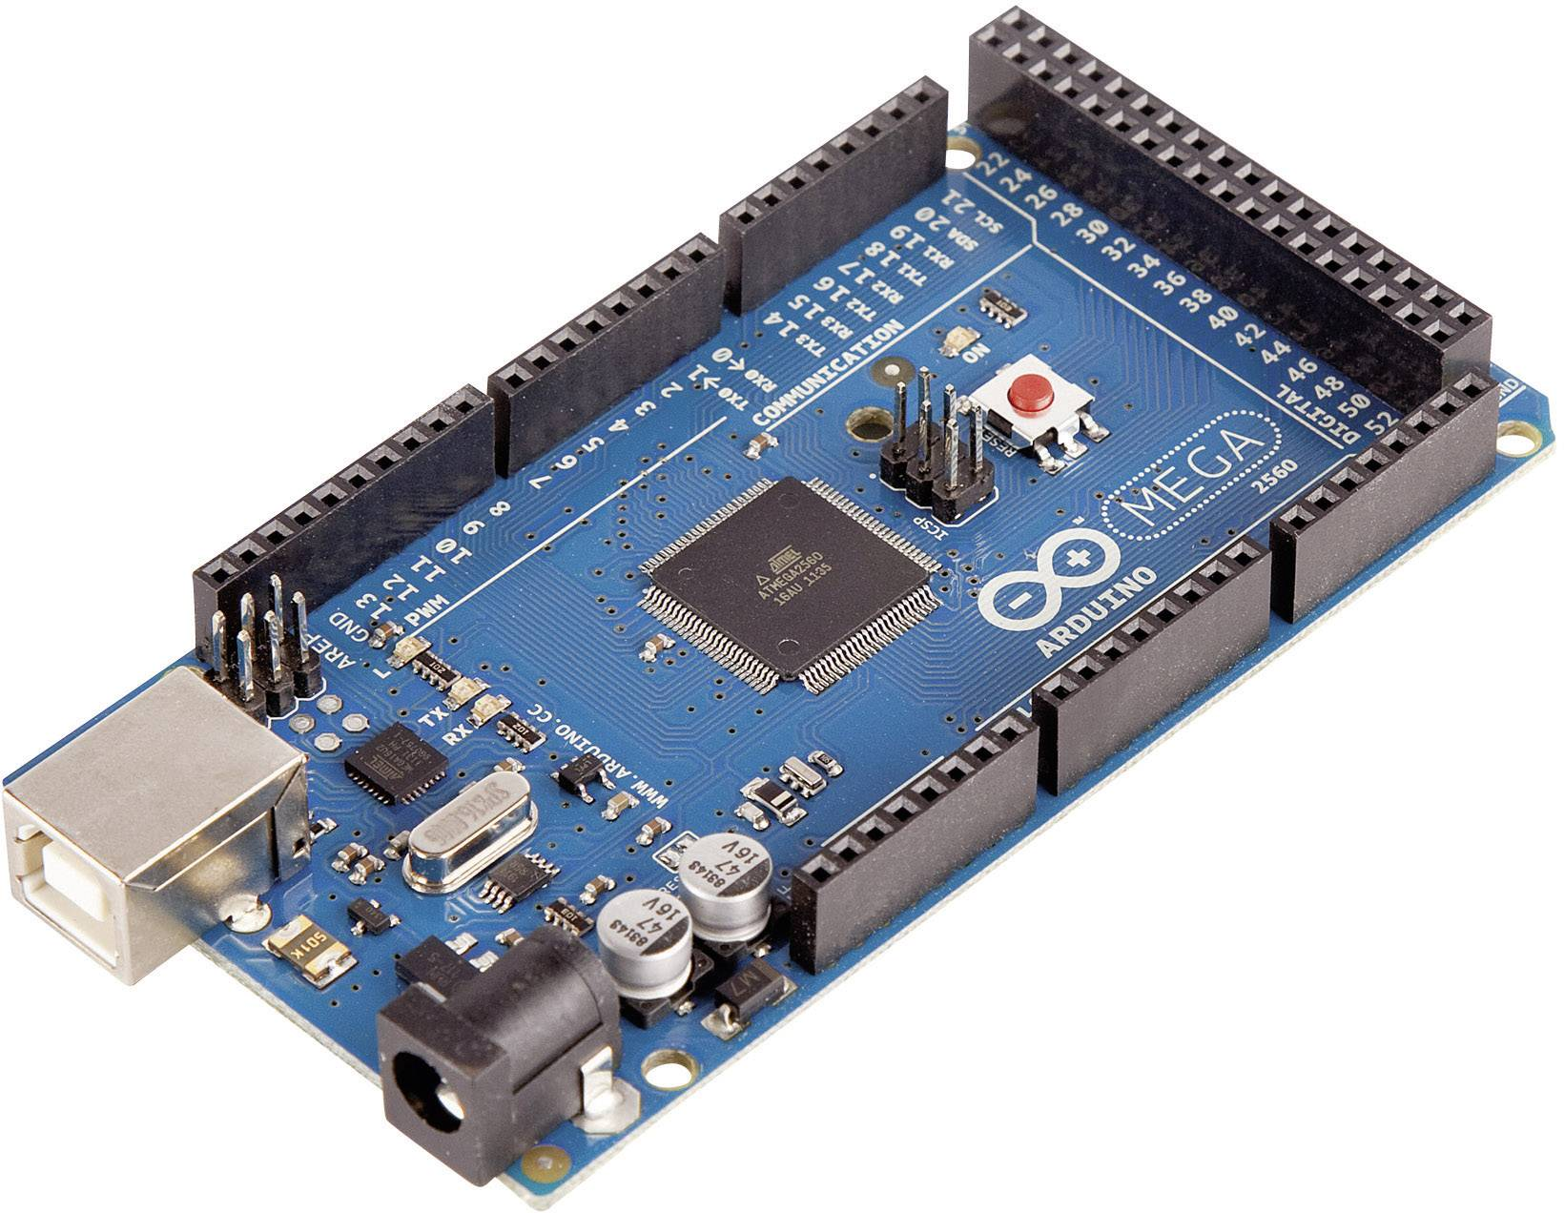
Tools
The main controller of the project.
It controls stepper,Dc and servo motors.
Arduino Mega 2560
It reads sensors data and process them.
It reads barcode scanner data and process it.
25
It send and receive data to Bluetooth.
Average value

Slide 7
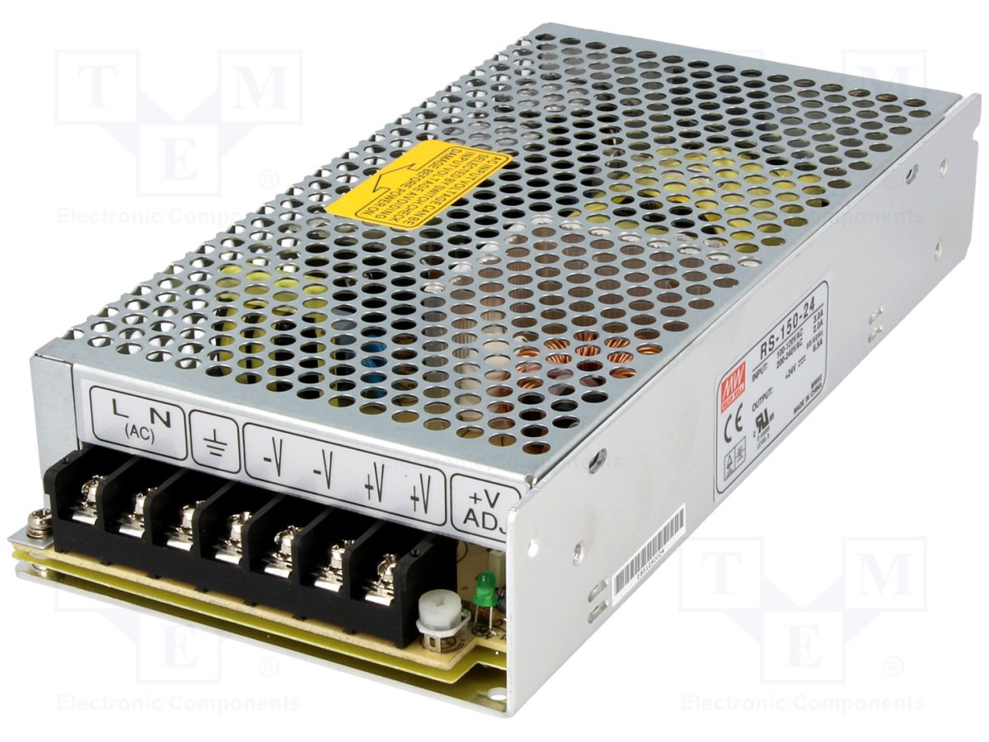
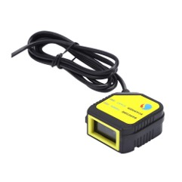
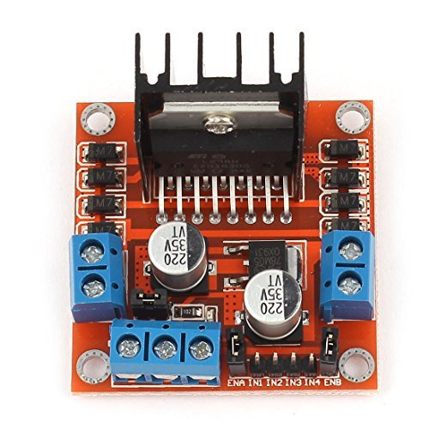
Tools (cont)
Power Supply 12V, 12.5 A
Barcode Scanner
L298N Dual H-Bridge Motor Drive

Slide 8
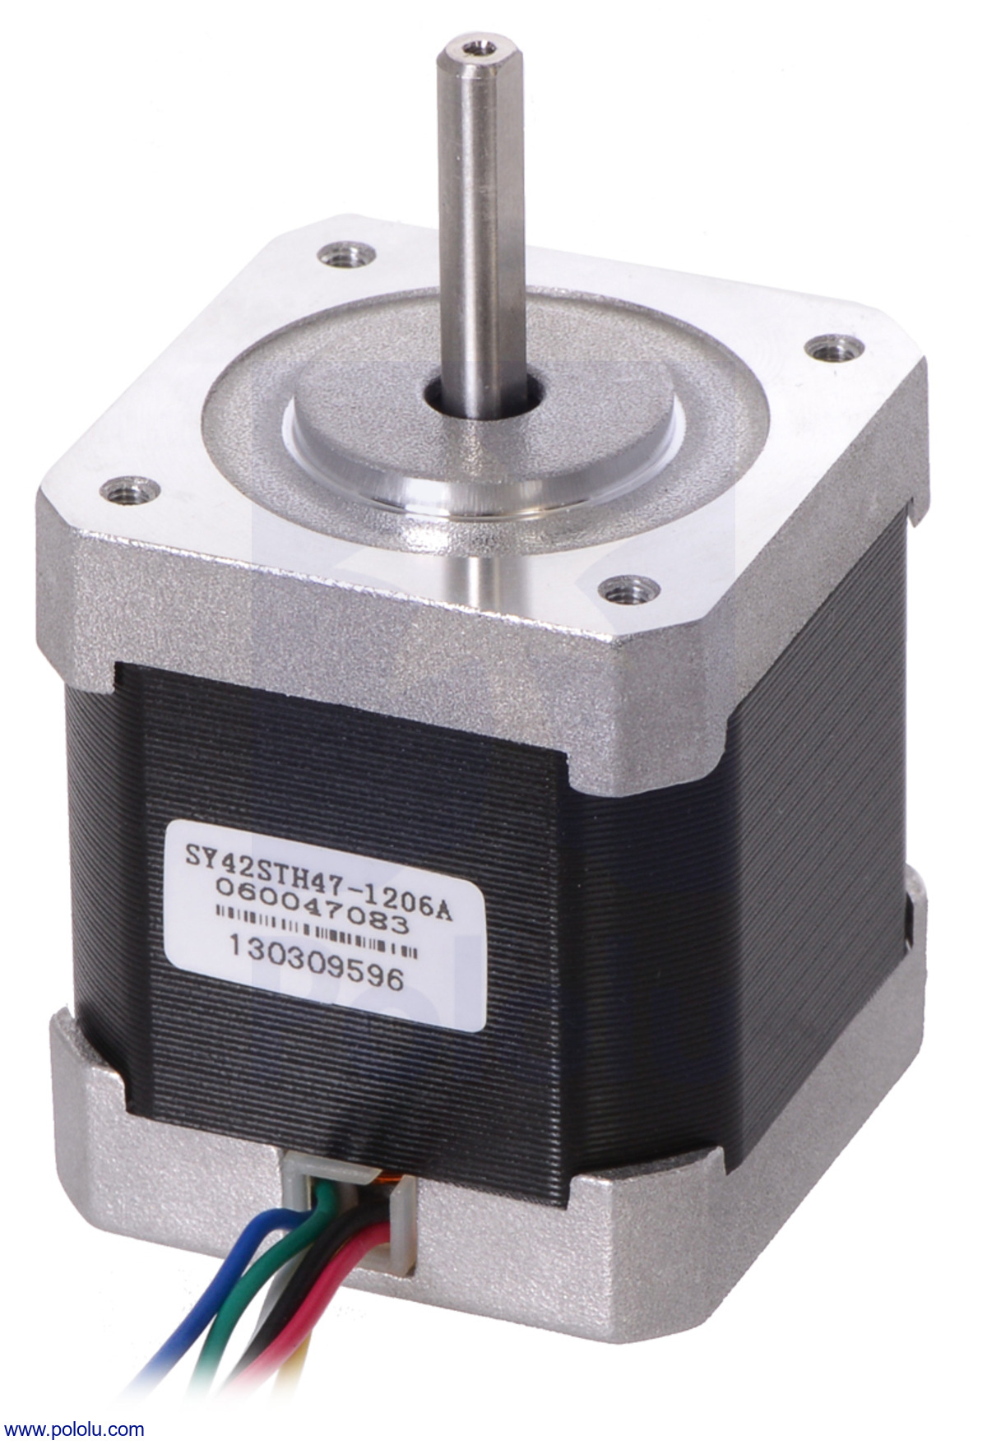
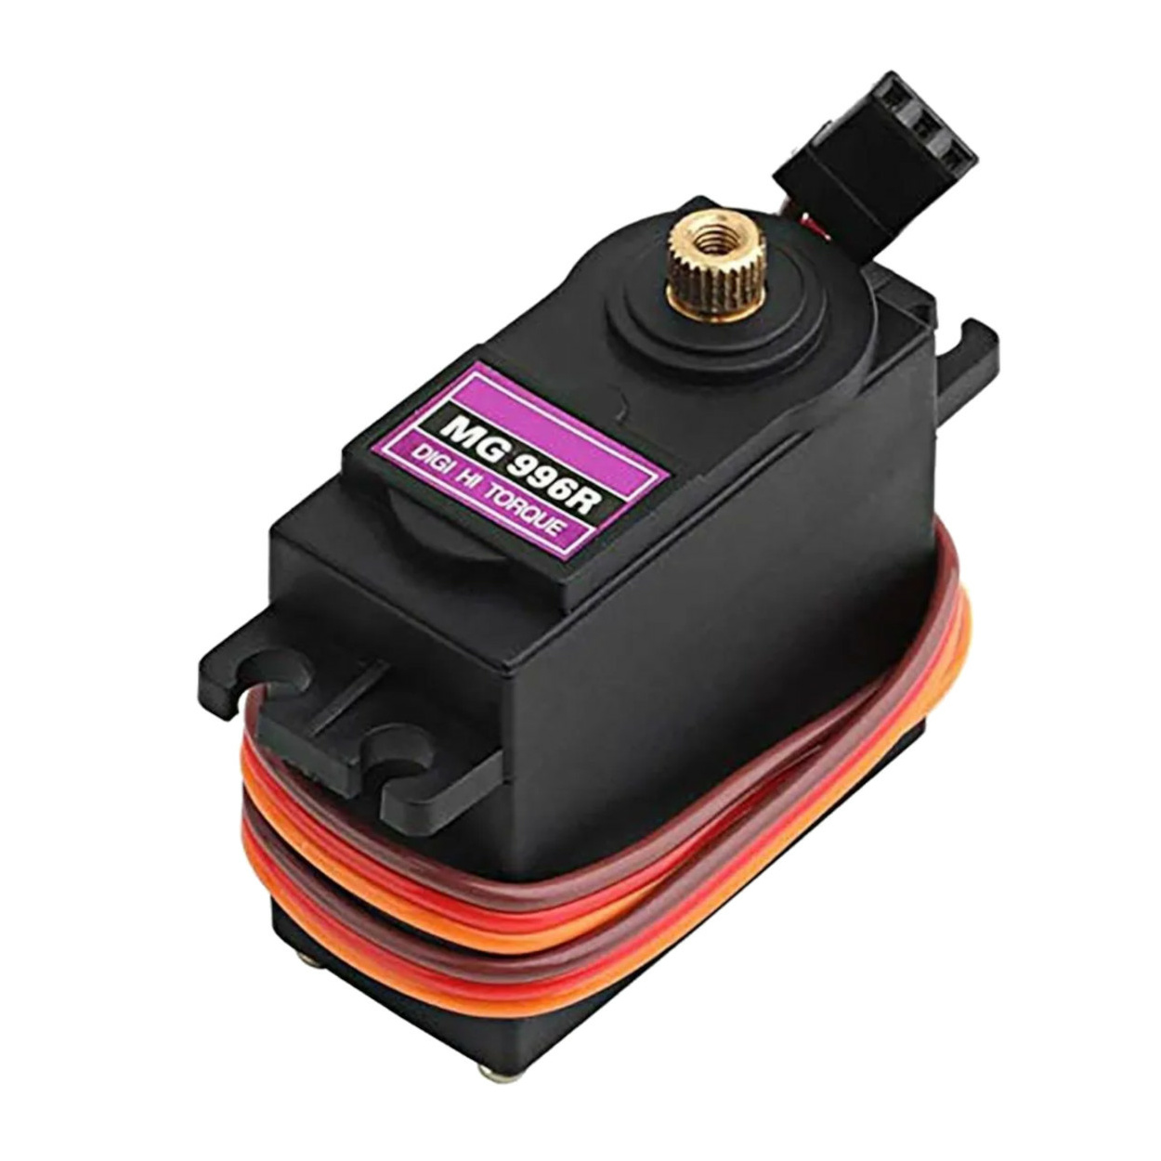
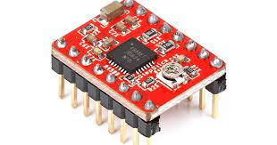
Tools (cont)
Stepper motor
Servo motor MG996R
A4988 stepper driver

Slide 9
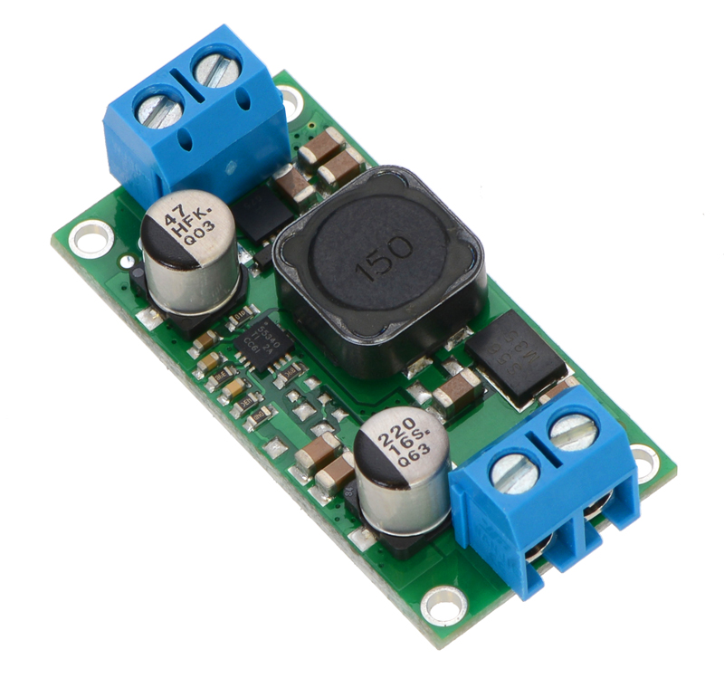
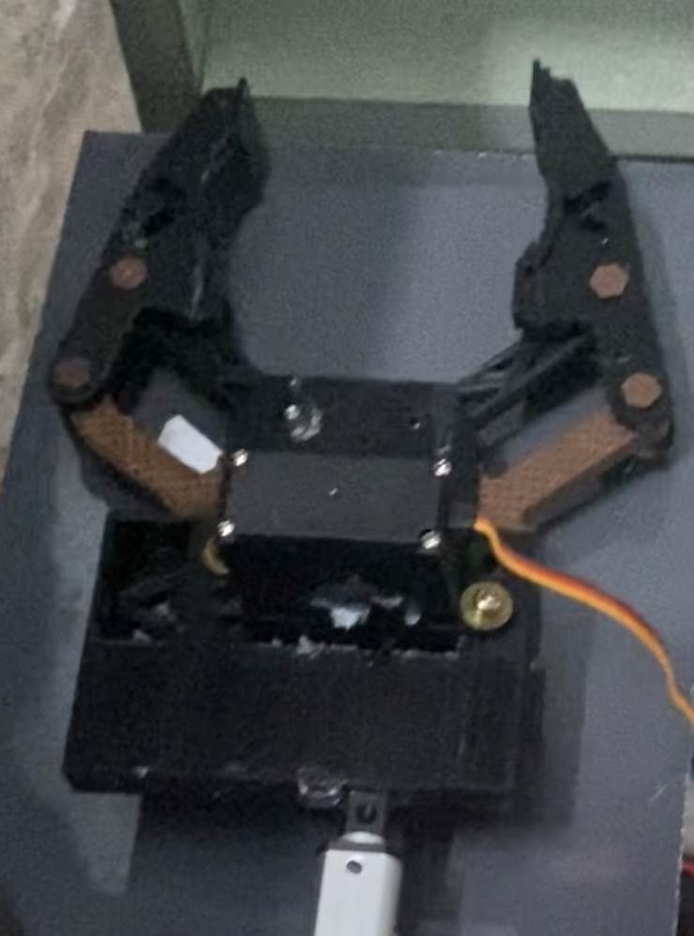
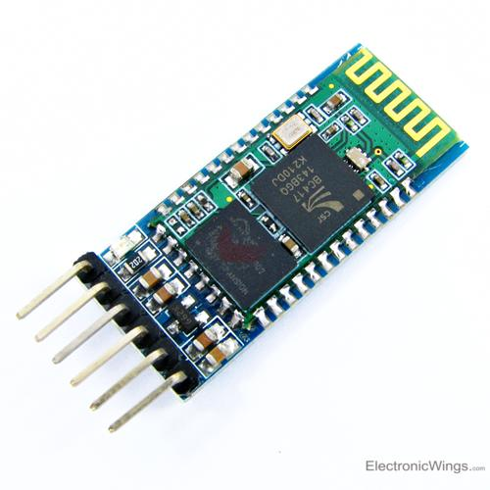
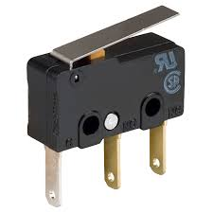
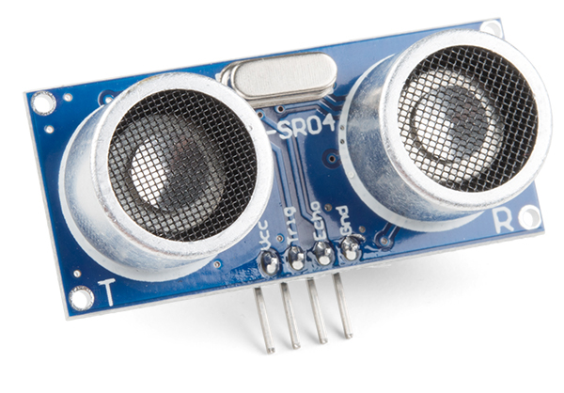
Tools (cont)
LM2596 Regulator
Printed Arm
Linear actuator 10mm
HC-05 Bluetooth
Limit switch
Ultrasonic Distance Sensor

Slide 10
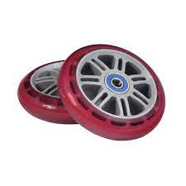
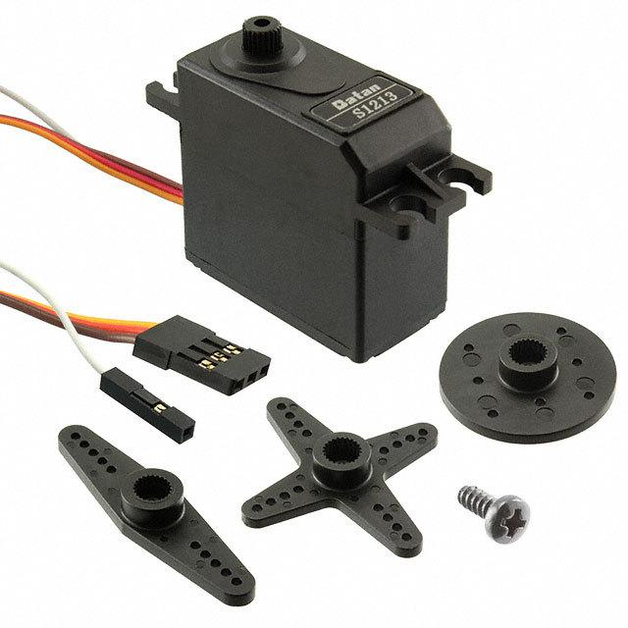

Constraints
Wheels accuracy Problem
Servo motor Problem
Linear actuator speed

Slide 11
Future work
Create a basket so that the robot brings more than one medicine in the same process
The speed of the robot has increased in general, so that it can add and bring medicines in a quick and practical way

Slide 12
Thank you for your attention
Questions?!!

