Slide 1

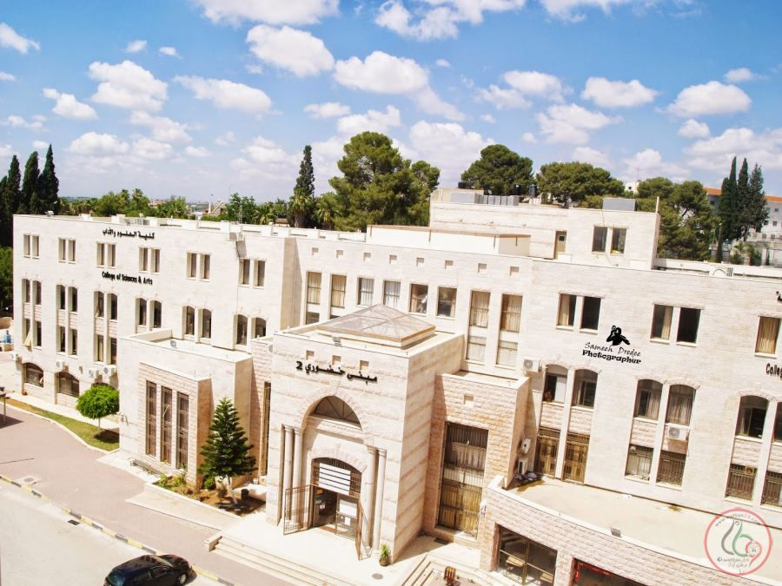
An-Najah National University
Faculty of Engineering
Civil Engineering Department
Graduation Project II
Structural Analysis and Design of Technical collage- Technical University of Palestine.

Slide 2
Structural Analysis and Design of Technical collage- Technical University of Palestine – Al-Khudoury
Prepared by:
Haneen Abu Madi
Nareman Rabaya’
Rawan Abu Safiya
Fatima Atrash
Supervisor:
Dr. Mohammed Samaaneh
Date:
26-12-2019

Slide 3
Outline
1
General Description
2
Preliminary Design
3
Three-Dimensional Modeling and Analysis
4
Design Results

Slide 4
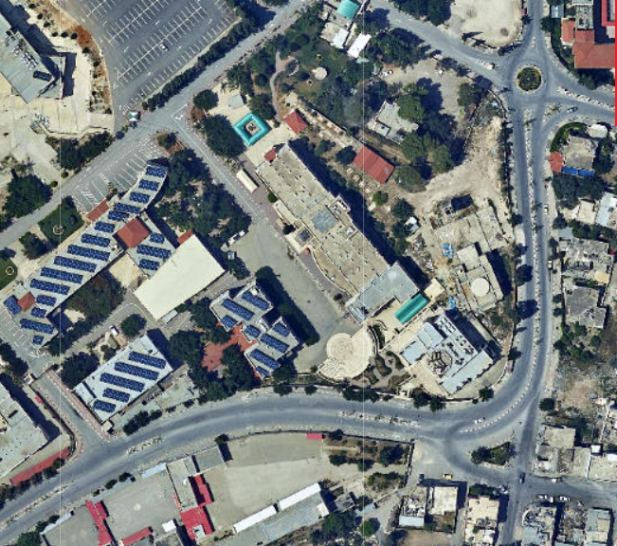
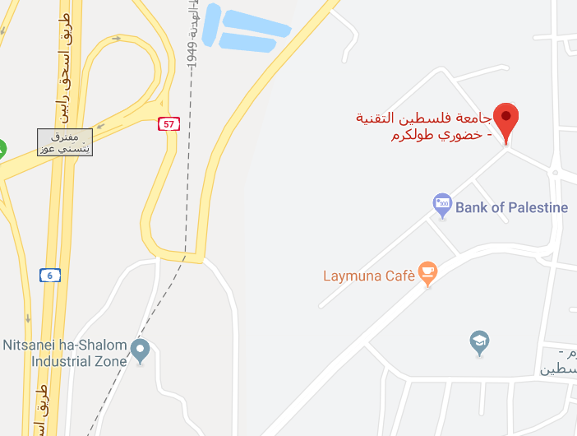
General Description
● Location.
Location from Geomolg.
Location on google map.

Slide 5
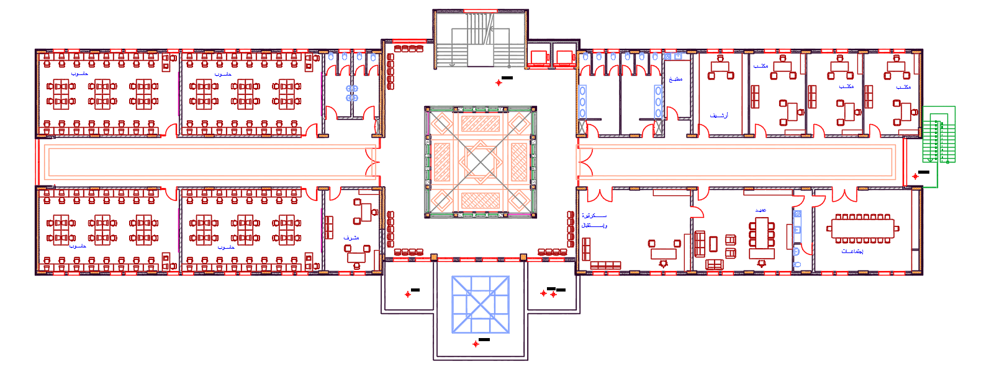
General Description
● Architectural Plans.
First , second and third Floor.

Slide 6
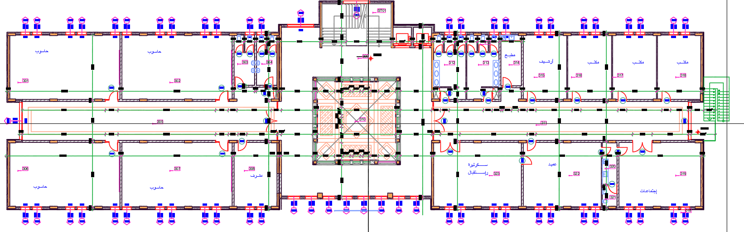
General Description
● Architectural Plans.
Forth Floor.

Slide 7
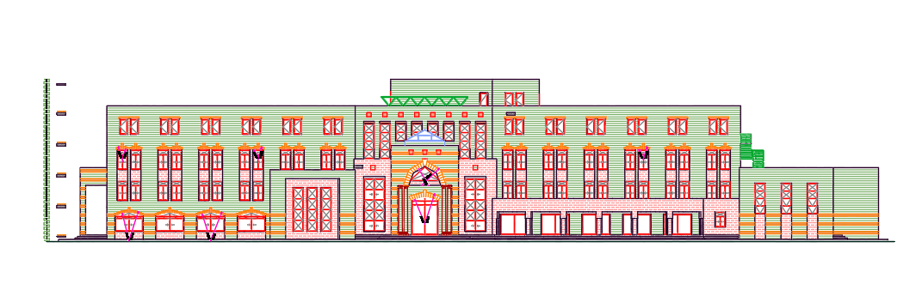
General Description
● Architectural Plans.
South Elevation.

Slide 8
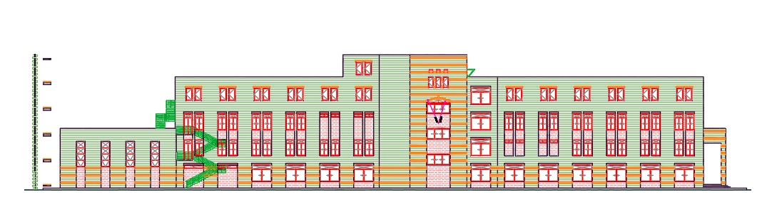
General Description
● Architectural Plans.
North Elevation.

Slide 9
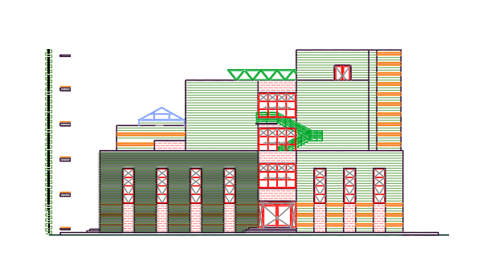
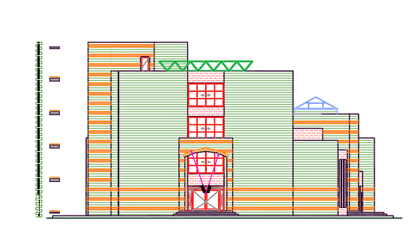
General Description
● Architectural Plans.
East and West Elevation.

Slide 10
General Description
● Height and Area for each block.
Block number | Height (m) | Area for each story (m²) | Number of floor
Block one | 14 | 483.3 | 4
Block two | 17.75 | 740.4 | 4
Block three | 3.5 | 237.0 | 1
 | Total Area | 5131.8

Slide 11
General Description
● Codes and Standards.
1) American Concrete Institute Code (ACI 318-14).
2) American Society Of Civil Engineers (ASCE 7-10).
3) International Building Code (IBC-2014).

Slide 12
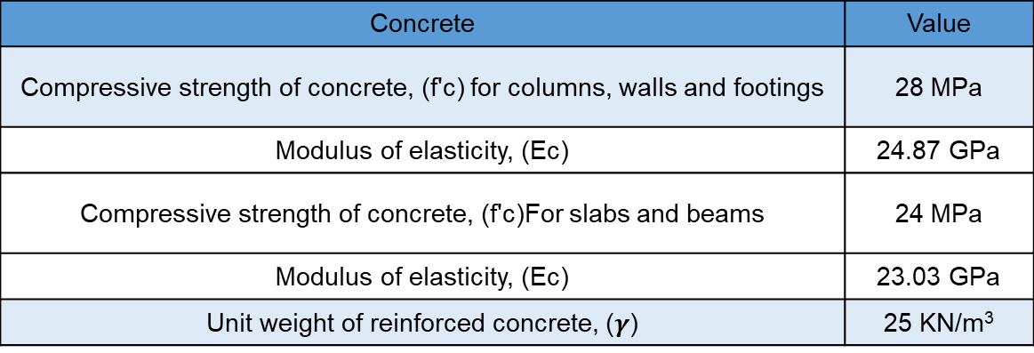
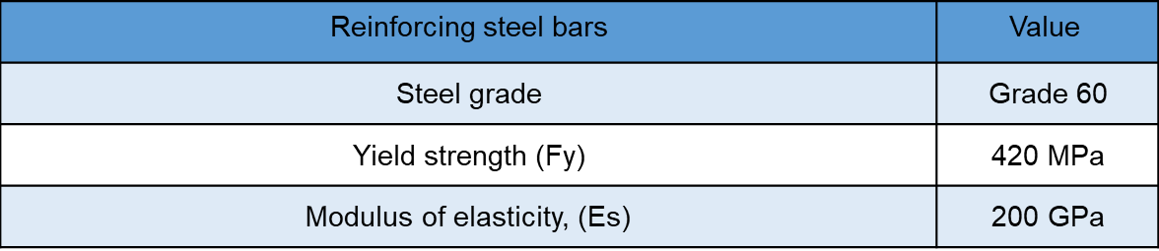
General Description
● Construction Materials.
1- Strctural Elements.

Slide 13
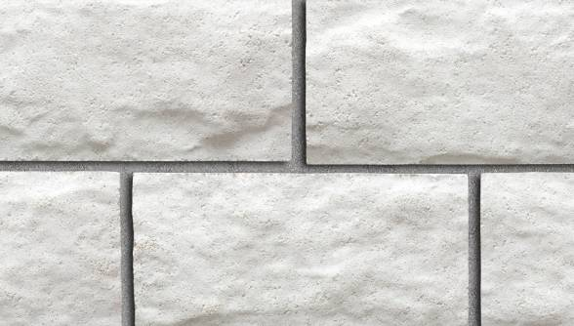
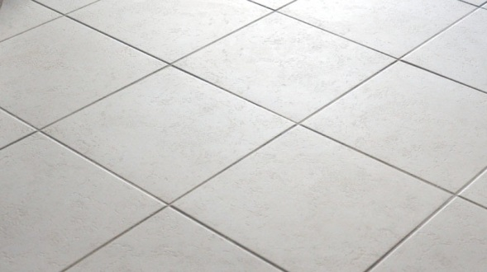

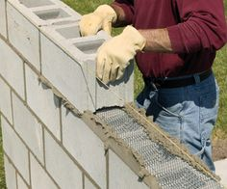
General Description
2- Non-Strctural Elements.
Material | Density ( KN/ m³)
Blocks | 12
Plastering | 20
Mortar | 23
Aggregate | 18
Insulation | 0.4
Stone | 27
Tiles | 26
Marble | 26

Slide 14
General Description
Loads
Gravity
Dead
Live
Lateral
Earth quick
Snow
Super Dead

Slide 15
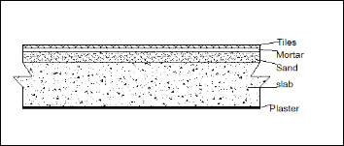
General Description
● Gravity Loads.
1- Superimposed dead load:
The floor layers:
Finishing materials weight = Σ (thickness of layer * unit weight for each layer
W tiles = 3.77 kN/m²
Element | Thickness ( cm ) | Unit weight ( KN/m³)
Filling | 10 | 20
Mortar | 3 | 23
Tiles | 3 | 26
Plaster | 1.5 | 20

Slide 16
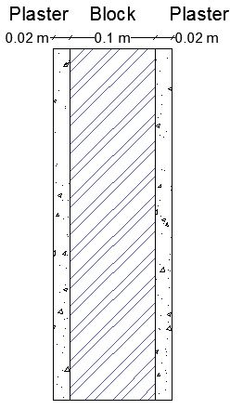
General Description
The internal partitions (hollow blocks):
Weight of block = 0.1×6=0.6 KNm2
Wight of plastering =0.02×20×2=0.8 KNm2
Total weight =0.8 + 0.6=1.5 KN\m².
Weight of internal partition = 1.5 KN/m².

Slide 17
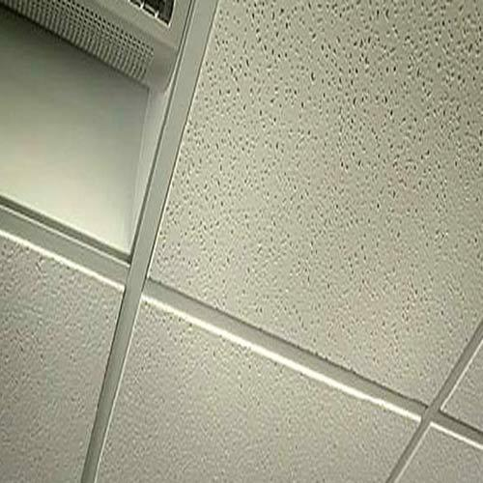
General Description
False Ceiling:
Suspended ceiling load=0.6 KNm2 (This value includes the weight of mechanical ducts and other service equipment).
The overall superimposed dead load = 3.77 + 0.8 + 1.5 = 5.9 kN/m².

Slide 18
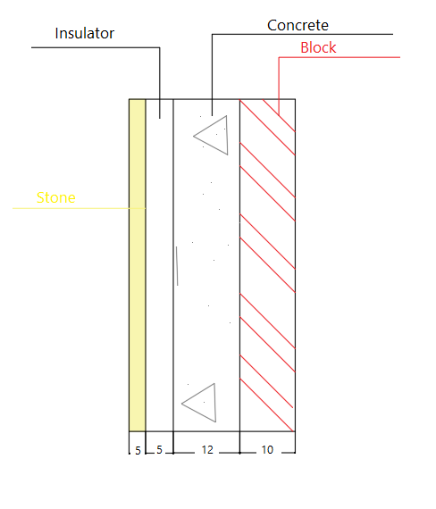
General Description
External Wall Weight:
Element | Thickness ( cm ) | Unit weight ( KN/ m³)
block | 10 | 12
Stone | 5 | 27
Concrete | 12 | 23
W.S.D = (0.1*12) + (0.05*27) + (0.12*23) = 5.31 kN/m².
Height of floor = 3.5 m.
Load on parameter = 5.31 x 3.5 = 18.585 kN/m.

Slide 19
General Description
● Gravity Loads.
2- Live load: 5 kN/m² is used for both blocks.
Occupancy (Intended Function) | Live Load (KN/m²)
Classroom | 1.92
Offices | 2
Corridors above first floor | 3.83
First floor corridor | 4.79
Stairs and exit ways | 4.79

Slide 20
General Description
● Gravity Loads.
3- Snow load: 0.785 kN/m² is used for both blocks.

Slide 21
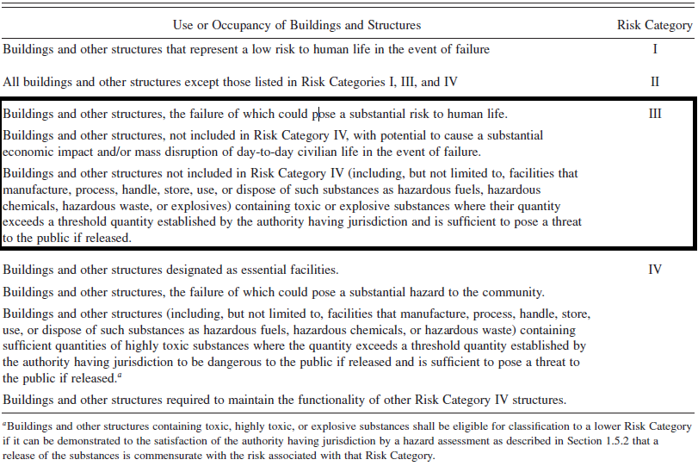
General Description
● Lateral Loads.
According to ASCE 7-10 code to seismic analysis for this structure:
1- Risk category:
Risk category of building and other structures for flood, wind, snow, earthquake and ice loads (ASCE 7-10 Table 1.5-1)

Slide 22
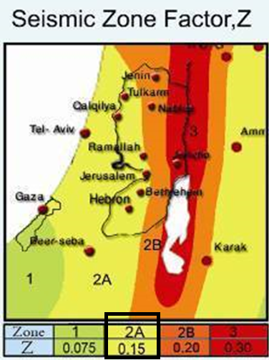
General Description
2- Importance factor (Z):
Seismic zone factor, Z (Earthquake Center at An-Najah National University)

Slide 23
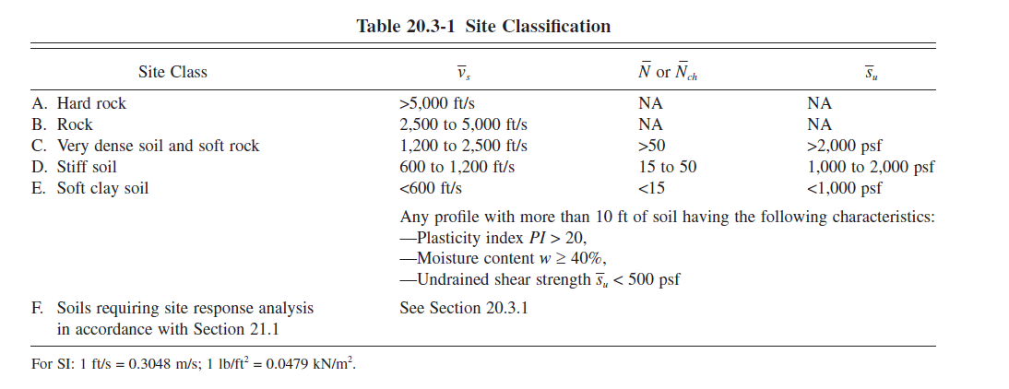
General Description
3- Site class:

Slide 24
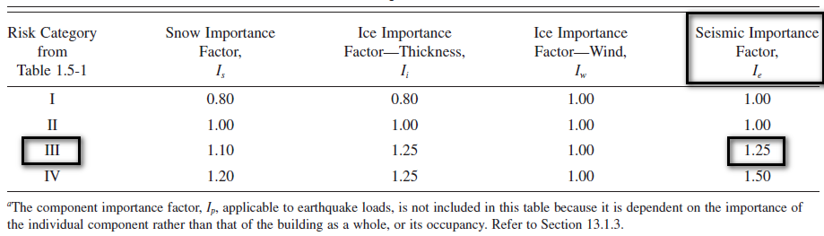
General Description
4- Importance Factor ( Ie):
Importance Factors by Risk Category of Buildings and Other Structures for Earthquake Loads (ASCE 7-10 Table 1.5-2)

Slide 25
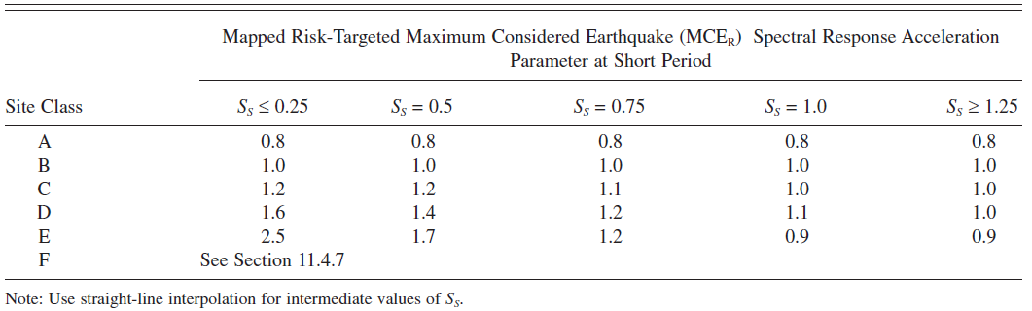
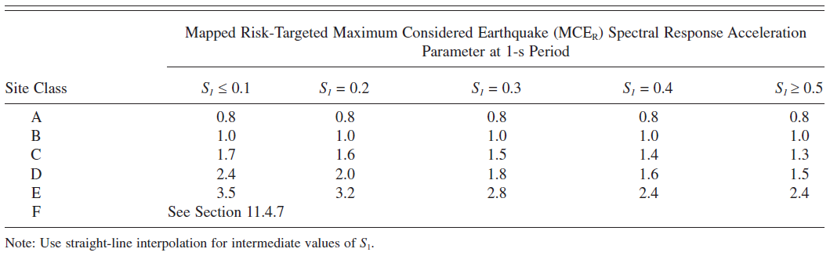

General Description
5- Design Spectral Acceleration Parameter ($S_{Ds}$ and $S_{D1}$ )
$$S_{s}=0.375$$
$$S_{1}=0.1875$$
$$S_{DS}={\frac{2}{3} F}_{a}= 0.3$$
$$S_{D1}={\frac{2}{3} F}_{v}= 0.21$$

Slide 26
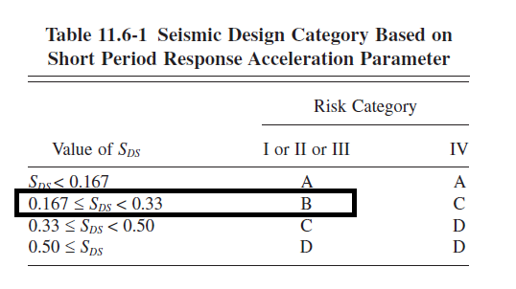
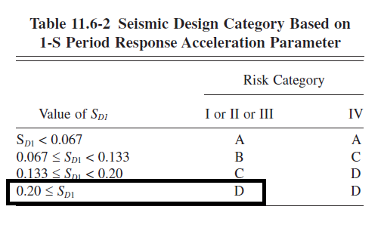
General Description
6- Siesmic Design Category ( SDC):
Seismic design category (SDC): D

Slide 27
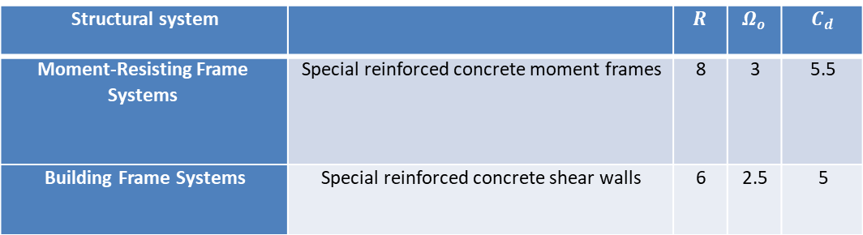
General Description
There are two systems to resist seismic load on X & Y-direction:
1- In X-direction → Moment Resisting Frame System ( special reinforced concrete frame).
2- In Y-direction → Building Frame System ( special shear wall system ).
Structural system |  | $$R$$ | $$Ω_{o}$$ | $$C_{d}$$
Moment-Resisting Frame Systems | Special reinforced concrete moment frames | 8 | 3 | 5.5
Building Frame Systems | Special reinforced concrete shear walls | 6 | 2.5 | 5

Slide 28


Computer Program

Slide 29
Preliminary Design

Slide 30
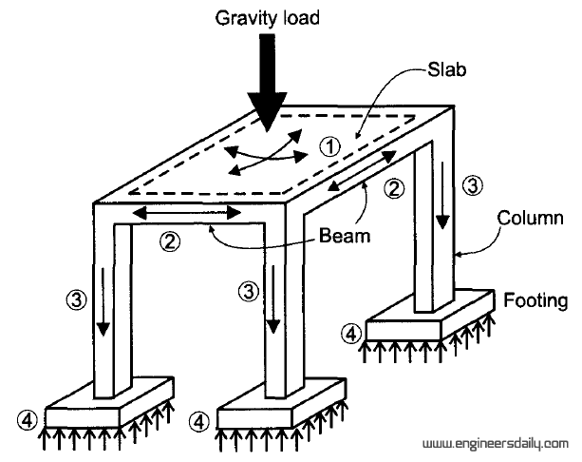
Preliminary Design
Structural system to analysis and design:
1. Slab system.
2. Beam system.
3. Column system.

Slide 31
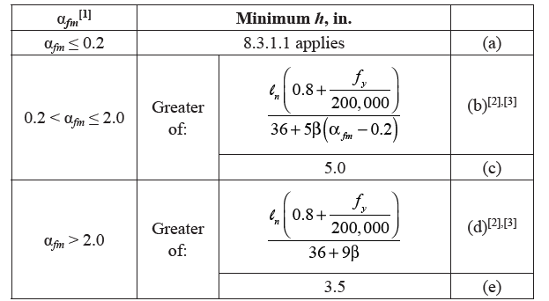
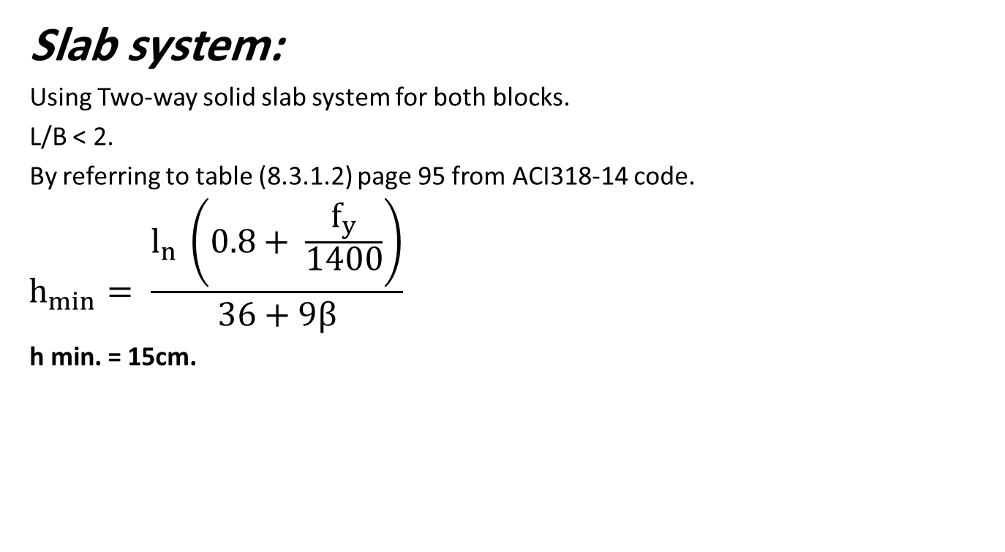
Preliminary Design
Slab system:
Using Two-way solid slab system for both blocks.
L/B < 2.
By referring to table (8.3.1.2) page 95 from ACI318-14 code.
$$h_{min}= \frac{l_{n }\left(0.8+ \frac{f_{y}}{1400}\right)}{36+9β}$$
h min. = 15cm.

Slide 32
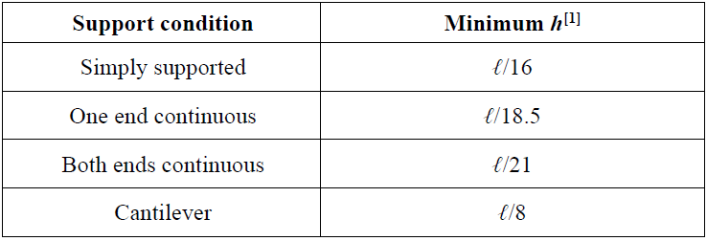

Preliminary Design
Beam system:
Preliminary Dimensions of Beams …
Width ${(b}_{w})=\frac{l}{20}$
Depth (h)

Slide 33
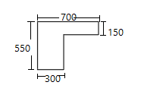
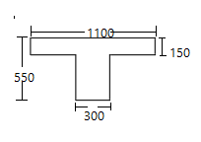
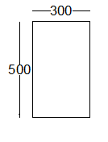
Preliminary Design
Beam system:
Width (mm) | Depth (mm) | Beam name | Beam
300 | 550 | L-section | 1
300 | 550 | T-section | 2
300 | 500 | Tie beam | 3

Slide 34
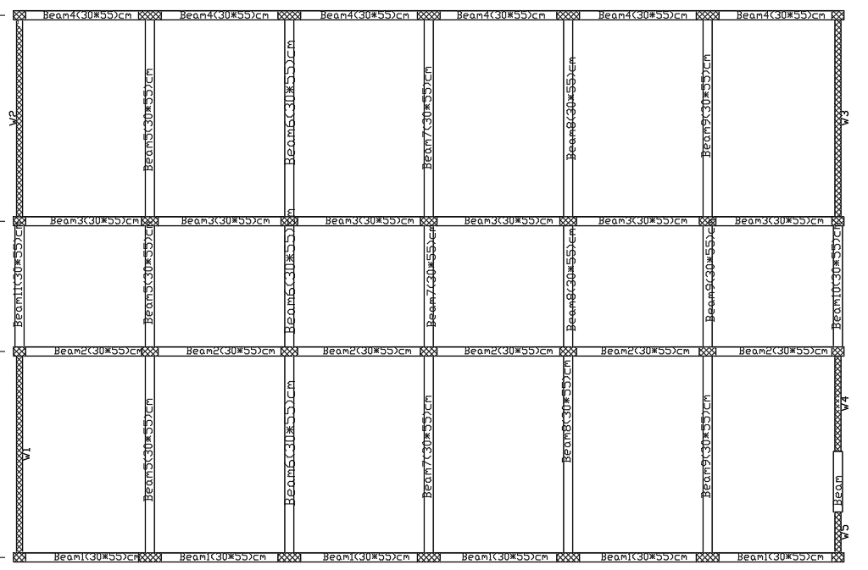
Preliminary Design
Beam layout for block one:

Slide 35
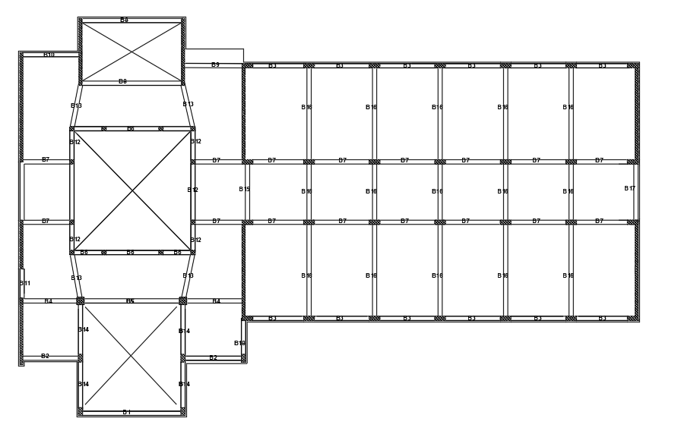
Preliminary Design
Beam layout for block two:

Slide 36
Preliminary Design
Column System:
Types for all columns on block one & two:
Column Size (cm) | Column Group
30 x 40 | C1
30 x 55 | C2
30 x 75 | C3
20 x 40 | C4
50 x 50 | C5

Slide 37
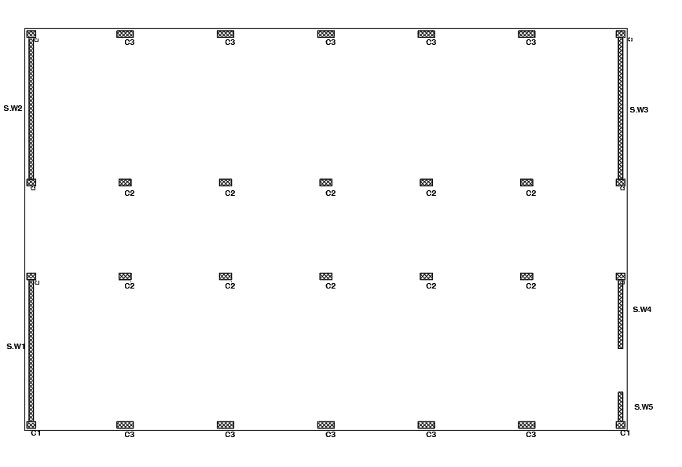
Preliminary Design
Column layout on block one:

Slide 38
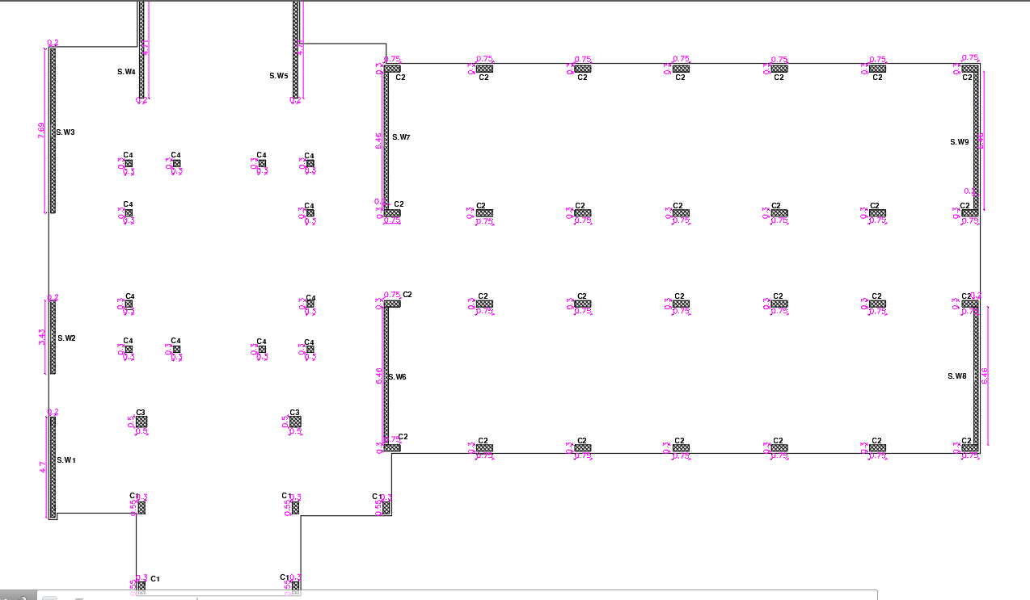
Preliminary Design
Column layout on block two:

Slide 39
3D-Modeling and Analysis

Slide 40
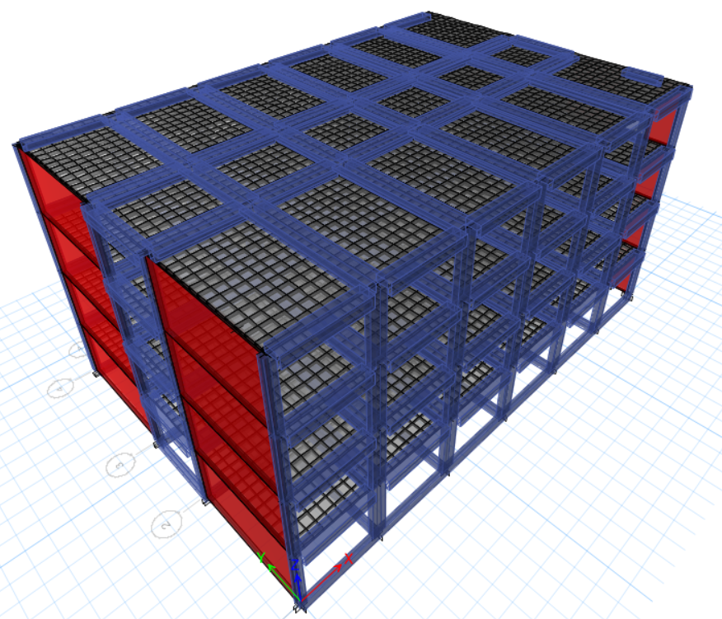
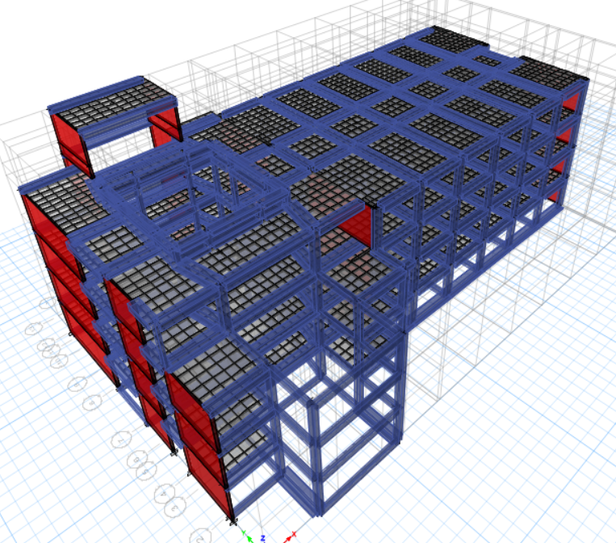
3D-Modeling and Analysis
Block One
Block Two

Slide 41
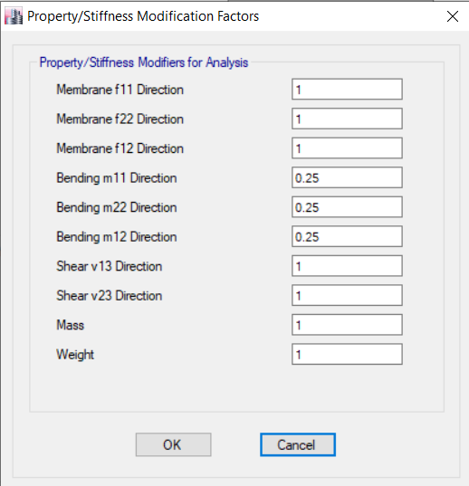
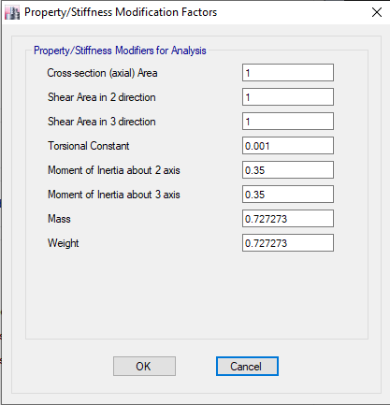
3D-Modeling and Analysis
Modifier for structural elements:

Slide 42
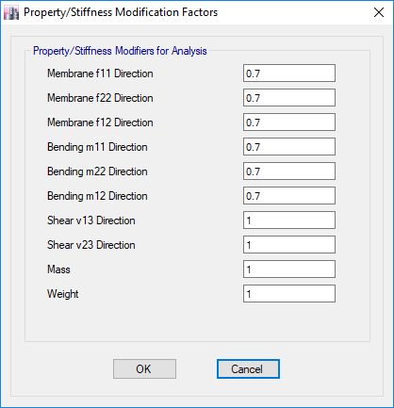
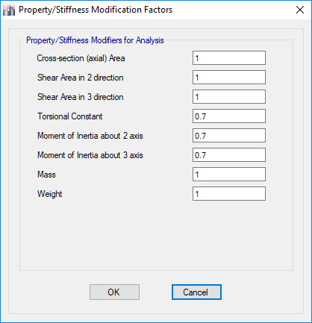

Slide 43
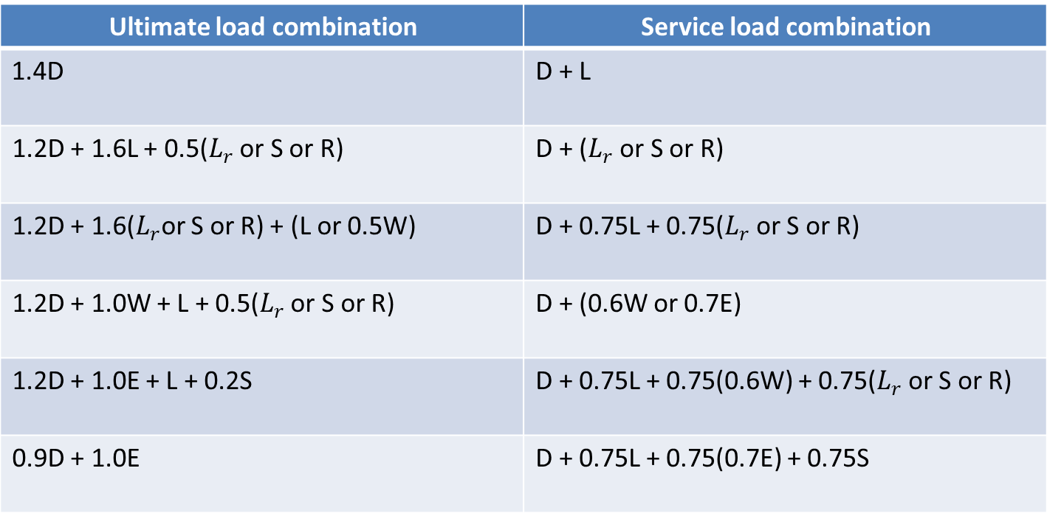
3D-Modeling and Analysis
Load combinations:
Service load combination | Ultimate load combination
D + L | 1.4D
D + ($L_{r}$ or S or R) | 1.2D + 1.6L + 0.5($L_{r}$ or S or R)
D + 0.75L + 0.75($L_{r}$ or S or R) | 1.2D + 1.6($L_{r}$or S or R) + (L or 0.5W)
D + (0.6W or 0.7E) | 1.2D + 1.0W + L + 0.5($L_{r}$ or S or R)
D + 0.75L + 0.75(0.6W) + 0.75($L_{r}$ or S or R) | 1.2D + 1.0E + L + 0.2S
D + 0.75L + 0.75(0.7E) + 0.75S | 0.9D + 1.0E

Slide 44
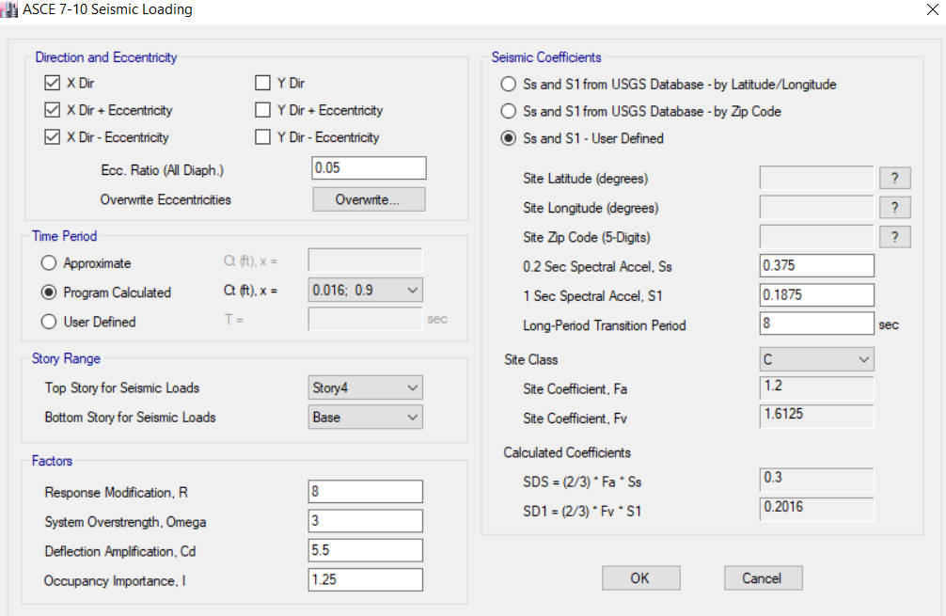
3D-Modeling and Analysis
→ Seismic Analysis Methods:
  1- Equivalent lateral force method (ELF).
Definition of ELF in ETABS for both blocks :
Seismic loading (ESM) in X-direction

Slide 45
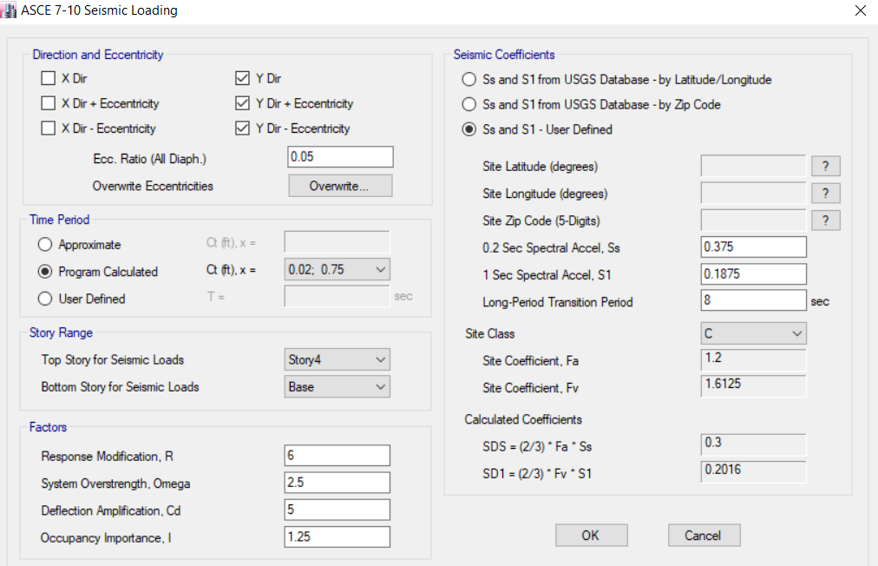
3D-Modeling and Analysis
Seismic loading (ESM) in Y-direction

Slide 46
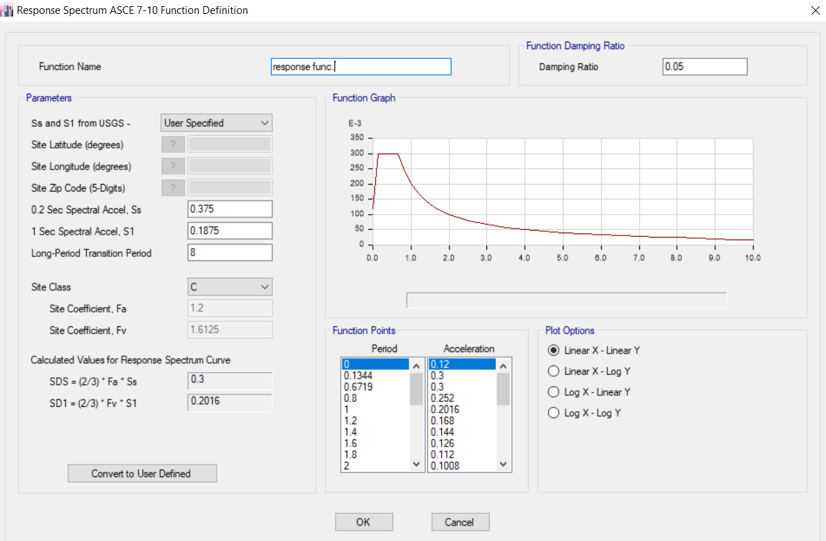
3D-Modeling and Analysis
  2- Modal response spectrum method (MRS).
→ Definition of RS function in ETABS:

Slide 47



3D-Modeling and Analysis
→ Mass case for block one & two:
In X-direction → Scale factor = $\frac{9810∗1.25}{8}=1532.81$
In Y-direction → Scale factor = $\frac{9810∗1.25}{6}=$2436.15

Slide 48
3D-Modeling and Analysis
Checks
Analysis check
Compatibility
Equilibrium
Design check
Deflection
Internal forces
Wide beam shear
Punching

Slide 49


3D-Modeling and Analysis
Analysis Checks:
- Compatibility check:
Compatibility for block-1
Compatibility for block-2

Slide 50


3D-Modeling and Analysis
- Equilibrium Check for gravity load:
Block one:
%error | ETABS Result (KN) | Manual Result (KN) | Load type
0.56% | $$15072.83$$ | $$14988.2$$ | Dead
0.0% | $$16208.244$$ | $$16208.244$$ | Superimposed
0.0% | 9666 | 9666 | Live
0.0% | 379.39 | 379.39 | snow
Block two:
%error | ETABS Result (KN) | Manual Result (KN) | Load type
1.089% | $$24601.6$$ | $$24872.49$$ | Dead
0.644% | $$25108.81$$ | $$25271.65$$ | Superimposed
0.069% | $$13972.92$$ | $$13982.65$$ | Live
0.077% | $$553.3971$$ | $$553.8254$$ | snow

Slide 51
3D-Modeling and Analysis
- Internal forces check:
  To ensure that the load will be distributed in an expected way to structural elements such as slabs, beams and columns.
  1- Slab check.
  2- Beam check.
  3- Column check.

Slide 52


3D-Modeling and Analysis
1- Slab ckeck:
For block one and frame in Y-direction:
Manual result:

Slide 53

3D-Modeling and Analysis
ETABS result:

Slide 54


3D-Modeling and Analysis
2- Beam check:
  The beam in y-direction is selected for check:
$Wu$ = $442.7753$KN/m.
$Mu$ (manual)= $373.5917 KN.m$
$Mu$ (ETABS)= $410.6 KN.m$
%diff. = 9.9% < 10%.

Slide 55



3D-Modeling and Analysis
3- Column check:

Slide 56

3D-Modeling and Analysis
Design checks:
- Deflection check:
From ACI 318 Table 9.5(b) maximum permissible deflections.

Slide 57


3D-Modeling and Analysis
- Deflection check:
1- Immediate deflection:
Allowable deflection in X-direction → $\frac{L}{360 }=\frac{4600}{360 } =12.78mm$
Allowable deflection in Y-direction → $\frac{L}{360 }=\frac{6800}{360 } =18.89mm$
Avg =$\frac{0.591+0.637+1.030+1.133}{4}=0.86025$ mm
0.86025 – 7.934 = 7.07375 mm < allowable in both direction.

Slide 58


3D-Modeling and Analysis
2- Long-term deflection:
Allowable deflection in X-direction → $\frac{L}{240 }=\frac{4600}{240 } =19.167 mm$
Allowable deflection in Y-direction → $\frac{L}{240 }=\frac{6800}{240 } =28.33 mm$
Avg =$\frac{20.66+30+30.3+26.45}{4}=26.85 mm$
45.122 – 26.85 = 18.3 mm < allowable in both direction.

Slide 59

3D-Modeling and Analysis
- Wide beam shear for slab:
- Punching Check:
There is no punching shear because there is slab with beams.

Slide 60

3D-Modeling and Analysis
    Verification of seismic analysis:
1- Equivalent Static Method:
- Mass participation ratio for modal analysis
Block one

Slide 61

3D-Modeling and Analysis
    - Mass participation ratio for modal analysis
Block two

Slide 62

3D-Modeling and Analysis
- Period:
By comparing the vale of period from ETABS with manual calculation for block one and two:

Slide 63

3D-Modeling and Analysis
- Check equilibrium for base shear

Slide 64

3D-Modeling and Analysis

Slide 65

3D-Modeling and Analysis

Slide 66

3D-Modeling and Analysis

Slide 67

3D-Modeling and Analysis
2- Response Spectrum Method:
- Base shear:
For block-1:
$V_{x}$ = $650.15 KN$
$V_{D,x}$ = $546.524 KN$
Ratio in X-direction = $\frac{V_{D,x}}{V_{x}}=0.84$
$\frac{0.85Vx}{VD,x}=1.011$ → need to multiple the scale factor in X-direction by value of 1.011 .
$V_{y}$ = $866.87KN$
$V_{D,y}$ =$618.37 KN$
Ratio in Y-direction = $\frac{V_{D,y}}{V_{y}}=0.713$
$\frac{0.85Vy}{VD,y}=1.19$ → need to multiple the scale factor in Y-direction by value of 1.19.

Slide 68

3D-Modeling and Analysis
For block-2:
$V_{x}$ = $1780.709 KN$
$V_{D,x}$ = $1451.401KN$
Ratio in X-direction = $\frac{V_{D,x}}{V_{x}}=0.815$
$\frac{0.85Vx}{VD,x}=1.05$→ need to multiple the scale factor in X-direction by value of 1.05
$V_{y}$ =$3285.994KN$
$V_{D,y}$ =$2286.065KN$
Ratio in Y-direction = $\frac{V_{D,y}}{V_{y}}=0.7$
$\frac{0.85Vy}{VD,y}=1.23$→ need to multiple the scale factor in Y-direction by value of 1.23.

Slide 69

3D-Modeling and Analysis
- Drift check:

Slide 70

3D-Modeling and Analysis

Slide 71

3D-Modeling and Analysis
- P-Delta check:
→ Block-1:

Slide 72

3D-Modeling and Analysis

Slide 73

3D-Modeling and Analysis
→ Block-2 :

Slide 74

3D-Modeling and Analysis

Slide 75
Design Results

Slide 76
Design Results
  The structural system: Building frame with special reinforced concrete shear walls and special frames.
  The structural members that were designed are:
      Slab.
      Beams.
      Columns.
      Stairs.
      Foundations.
      Shear walls.

Slide 77

Design of Slab
Slab design:
Check slab thickness for shear:
∅ Vc = 61.24 KN.

Slide 78
Design of Slab
  ETABS results for V13 & V23:
      All values of V_{u} < ØV_{c} = 61.24 KN → OK

Slide 79
Design of Slab
Design for flexure: (based on envelope u)
For load transfer in X-direction:
There are two zones:
For M=16.953 kN.m → Use 3Ø12
  For M=23.24 kN.m → Use 4Ø12
  For load transfer in Y-direction:
  There are two zones:
  For M=12.254 kN.m → Use 3Ø12
  For M=23.426 kN.m → Use 4Ø12

Slide 80

Design of Beam
Design for flexure:
Maximum values of negative and positive moments from ETABS:

Slide 81

Design of Beam
  Hand calculations:

Slide 82

Design of Beam
  ETABS results:

Slide 83



Design of Beam
Design for shear in y-direction:

Slide 84


Design of Beam
Design for shear in X-direction:
$V_{e}=\frac{{(M}_{pr1}+M_{pr2} )}{L_{n}}+V_{gravity}$

Slide 85


S₁ = 100mm
S₂=255mm

Slide 86

Design of columns
Longitudinal steel:

Slide 87


Design of columns

Slide 88
Design of shear wall
Pier labels in ETABS:
W1 in fourth floor is selected for sample design:
W1

Slide 89

Design of shear wall
The dimensions of shear wall are:
ℓ_{w} = 6.8 m.
h_{w} = 3.5 m.
b_{w} = 0.2 m.
Aspect ratios:
h_{w} / ℓ_{w} = 0.515 < 2
ℓ_{w} / b_{w} = 17.5 > 6
So the pier is considered to be designed as a wall and there is no
need to satisfy specified column design requirements.

Slide 90


Design of shear wall
Design for shear:
Check for shear in X-direction:
Vux = 37.987 KN
φVc =$0.75×\frac{1}{6}×\sqrt{28}×160×3500×{10}^{−3}=370.4 KN$ > Vux → OK
Design for shear in Y direction:
Ø𝐕𝐜= 𝟎.𝟕𝟓×(𝟎.𝟐𝟕√𝟐𝟖×𝟐𝟎𝟎×𝟓𝟒𝟒𝟎+𝟖𝟑𝟓.𝟓𝟐×𝟏𝟎𝟑×𝟓𝟒𝟒𝟎𝟒×𝟔𝟖𝟎𝟎)=𝟏𝟐𝟗𝟏.𝟏𝟓𝟐 𝑲𝑵

Slide 91




Slide 92



Using the interaction diagram, the following values for steel ratio and area of steel are obtained:
$ρ=$ 0.0033
$A_{s}=2310 {\text{mm}}^{\text{2}}$ → 1155 mm² on each side

Slide 93

Design of shear wall
The total area of steel required 2310 + 2x579.81 = 3469.62 mm²
Vertical rebar area (A_{L}) = 3469.62 mm²
Horizontal rebar area (A_{T}) = 500 mm²

Slide 94

Design of shear wall
Shear walls reinforcement:

Slide 95

Design of stairs
Design of stairs:
  Dimensions of stairs:
  Landing width = 2.5m
  Landing length = 1.50m
  Step width = 2.5m
  Going = 0.3m
  Assume rise = 0.175m
  Span length = 4.6m

Slide 96


Design of stairs

Slide 97


Design of stairs
  Check for shear:

Slide 98

Design of stairs
Design for flexure:
For main reinforcement use 1Ф16\250mm
For shrinkage steel, use 1 Ф14\400 mm

Slide 99
Design of Footing
  Check type of footing:
    Total service load = 51608.7 kN
    → 206.4 < 0.5*Area of building = 0.5*483.4 = 241.7
    → The type of footing is single footing
Area of footing=total service load /allowable bearing capacity
= 51608.7/250= 206.4 m²

Slide 100

Design of Footing
Footing Dimention:
P_{u} = 1892.2 KN
P_{s} = 1470.4 KN
Area:
  $$A_{f}=\frac{p_{service}}{q_{all}}=\frac{1470.4}{250}=5.88 m^{2}$$
$B=L=\sqrt{5.88}=2.42m$
Assume $L=3m and B=2m$ where the columns are$300∗750 mm$.
Determine the footing effective depth, depending on wide beam shear in critical dimension.

Slide 101

Design of Footing
Wide beam shear:
$$q_{u}=\frac{p_{u}}{A}=\frac{1892.2}{3∗2}=315.4 kN/m^{2}$$
$$v_{u}=q_{u}\left(l_{1}−d\right)=315.4\left(\frac{3−0.75}{2}−d\right)$$
$$∅v_{c}=\frac{0.75}{6}\sqrt{28}∗1000∗\frac{d∗1000}{1000}$$
$$∅v_{c}= v_{u} SO we have value of d=0.37 m$$
h= d + cover = 0.37+ 0.08 = 0.45 m

Slide 102
Design of Footing
Punching shear check:
All the ratios of punching shear Vu<ΦVcp, so it is ok

Slide 103

Design of Footing
Design For Flexure:
$$M_{u}=\frac{q_{u}∗l_{1}^{2}}{2}=\frac{315.4∗{1.125}^{2}}{2}=200 KN.m$$
$$ρ=\frac{0.85f_{c}^{′}}{f_{y}}\left[1−\sqrt{1−\frac{2.61M_{u}}{bd^{2}f_{c}^{′}}}\right]=\frac{0.85∗28}{420}\left[1−\sqrt{1−\frac{2.61∗200∗{10}^{6}}{(1000)({370)}^{2}(28)}}\right]=0.004$$
$A=ρ∗b_{w}∗d=0.004∗1000∗370=1480 {mm}^{2}$ $8∅16(1∅16/125mm)$
$A_{sh}=ρ∗b_{w}∗h=0.0018∗1000∗450=810 {mm}^{2}$ $5∅16(1∅16/200mm)$
Check L_{dt} = $\frac{0.48∗ 420}{\sqrt{28}}$ * 16 = 660 mm
1150 – 80 = 1070 > 660 no need to have hook.

Slide 104

Design of Footing

Slide 105
THANK YOU ☺

