Slide 1


An-Najah National University
Faculty of Engineering & Information Technology
Department of Building Engineering
Integrated redesign of Al-Istiqlal University Library.
By
Zeina Mahamdah
Hanan Abdo
Tasneem Riyad
Under the supervision of Eng. Fadi fatayer

Slide 2
Contents of the project
01
04
Introduction
Structural Aspect
02
05
Architectural Aspect
Electro-mechanical Aspects
03
06
Environmental Aspect
Quantity surveying & cost estimate

Slide 3
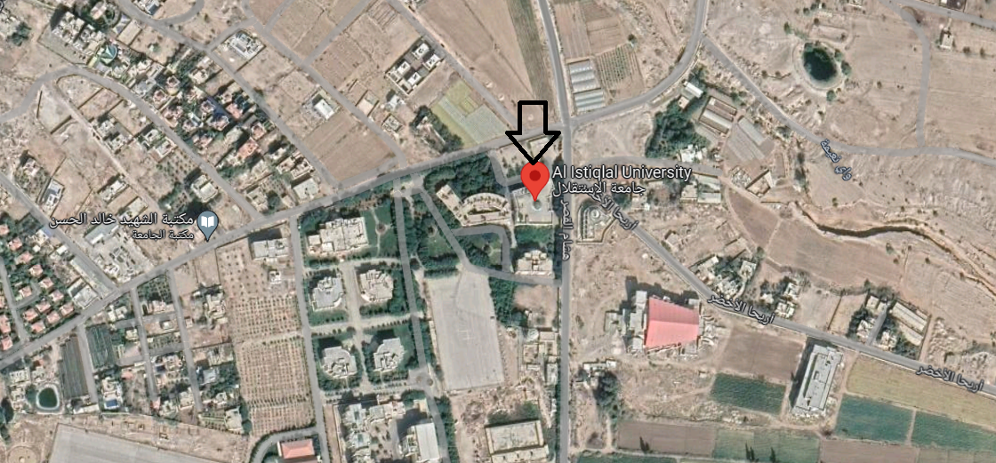
Introduction
The location of the building
In Jericho – Al-Istiqlal University.
It contains 3 floors.
It has a total area of 5900 SM.

Slide 4
Architectural Aspects

Slide 5
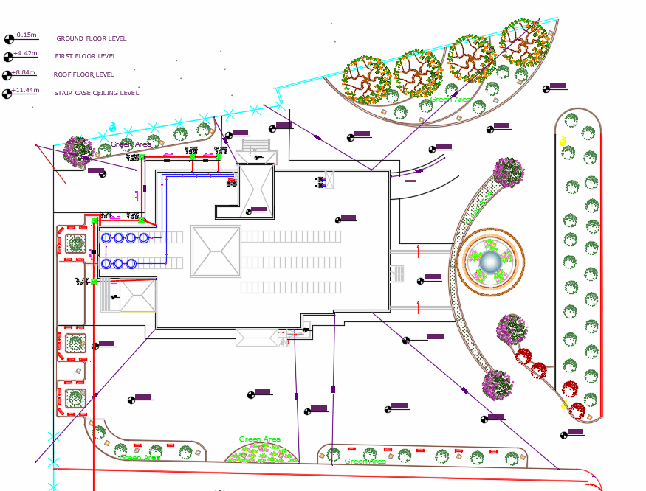
Site analysis

Slide 6
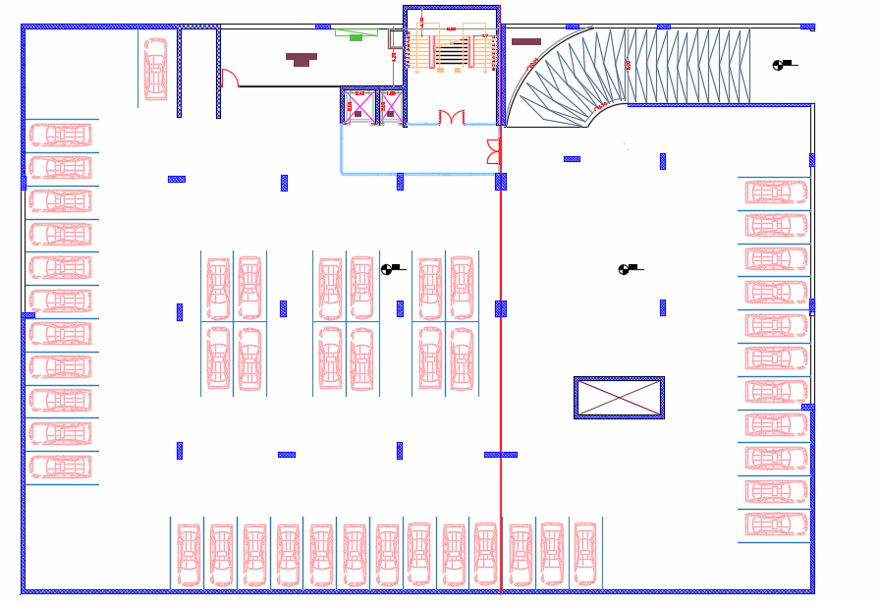
Basement

Slide 7
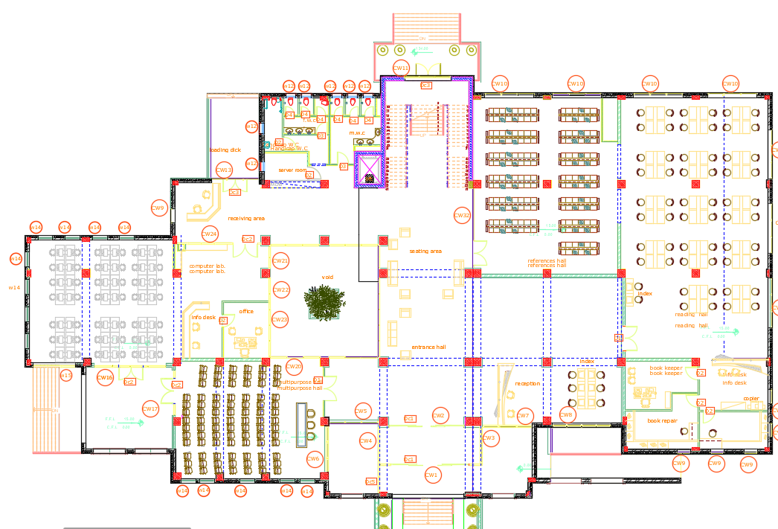
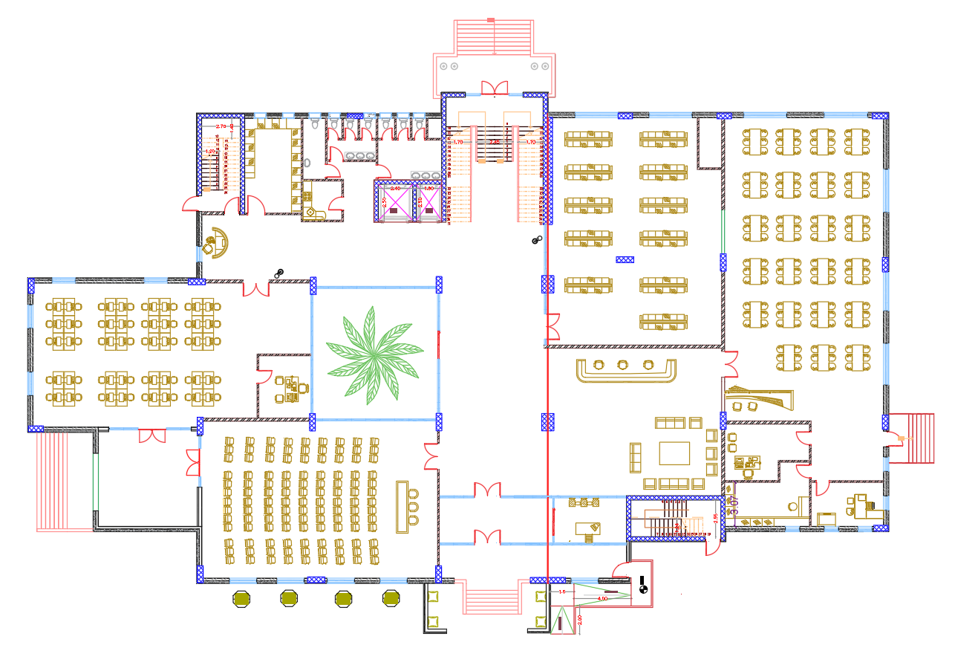
Ground floor
Before
After

Slide 8
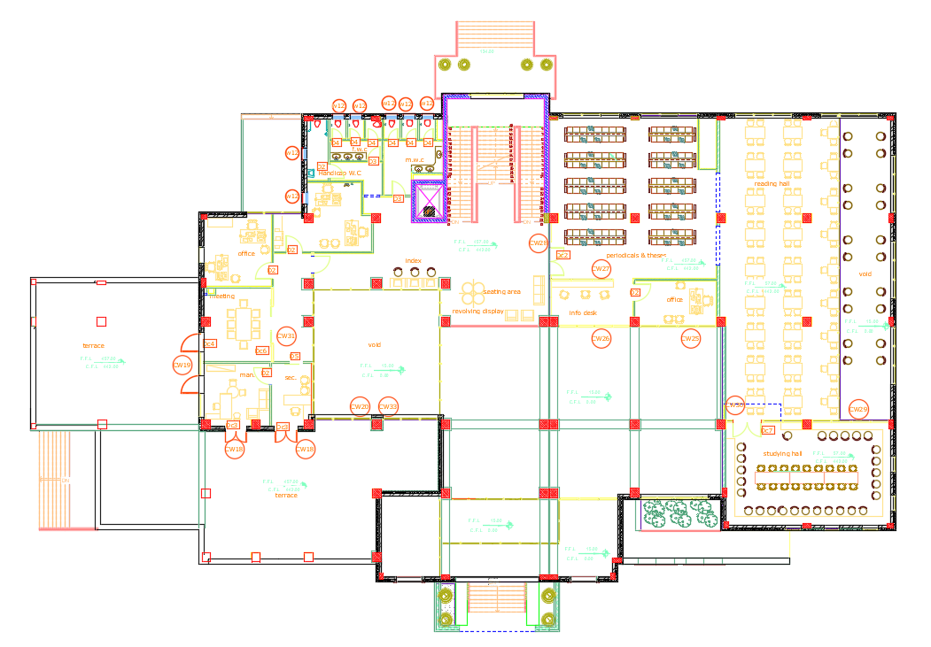
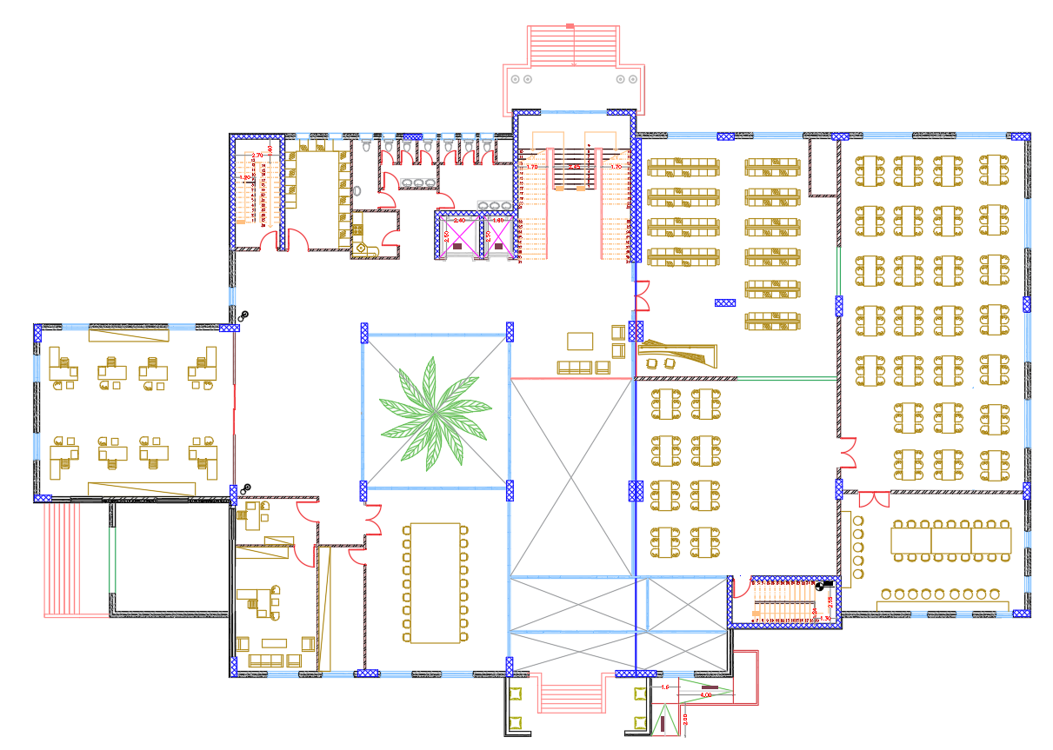
First floor
Before
After

Slide 9
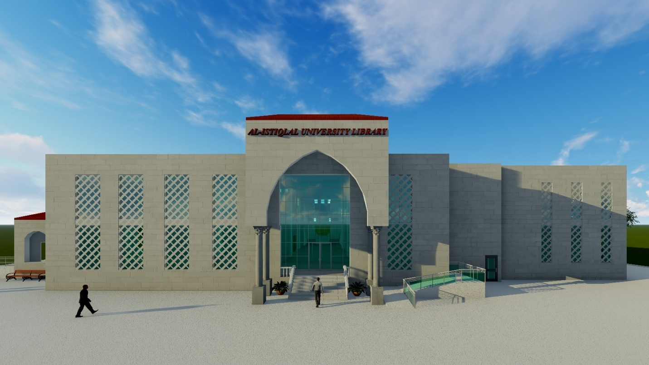
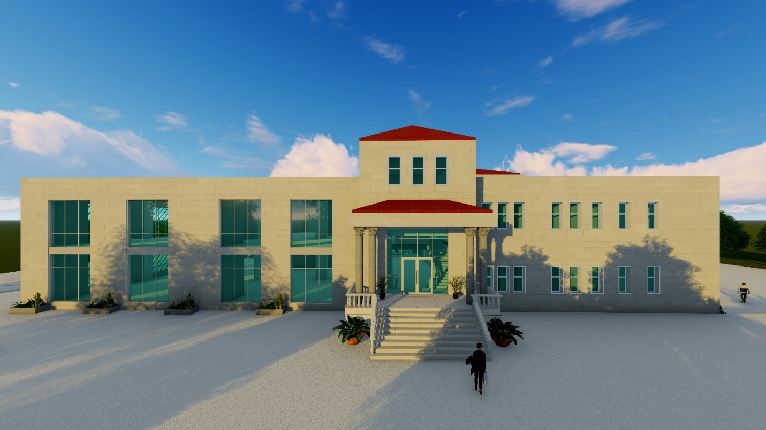
Elevations
South Elevations
North Elevations

Slide 10
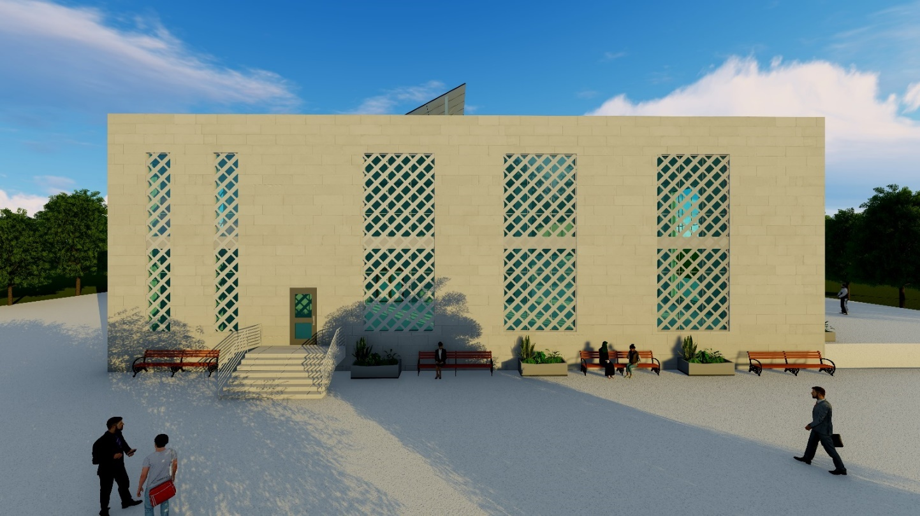
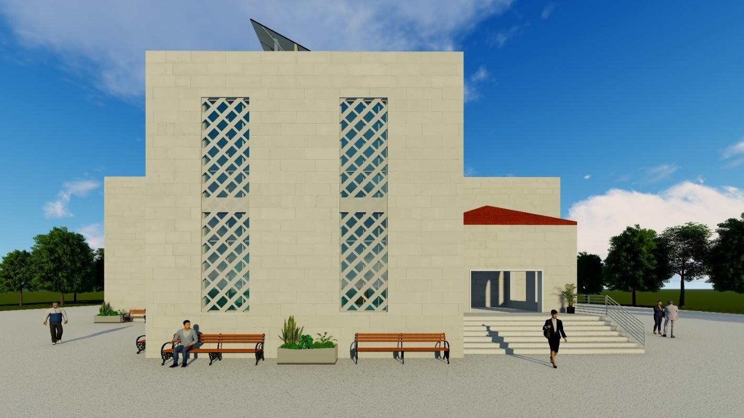
Elevations
East Elevations
West Elevations

Slide 11
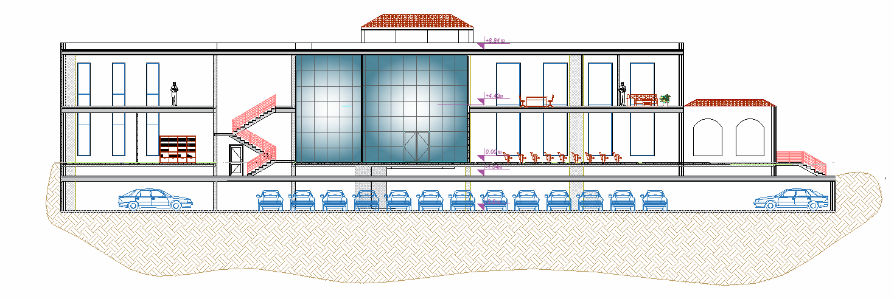
Sections
Section A-A

Slide 12
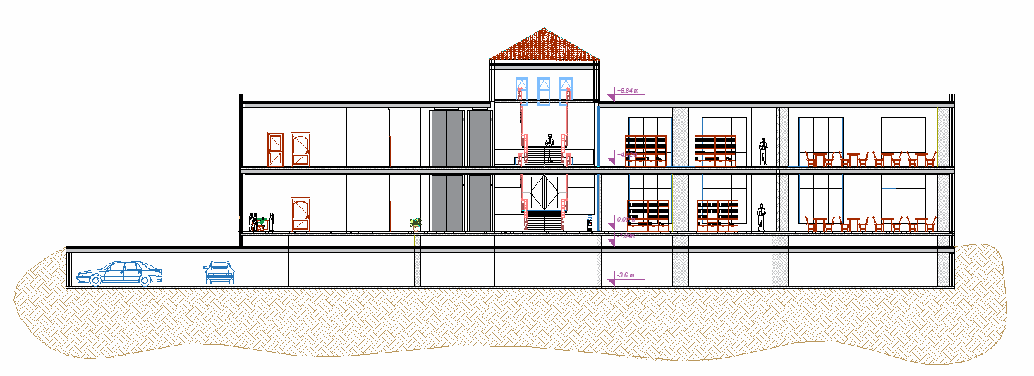
Sections
Section B-B

Slide 13
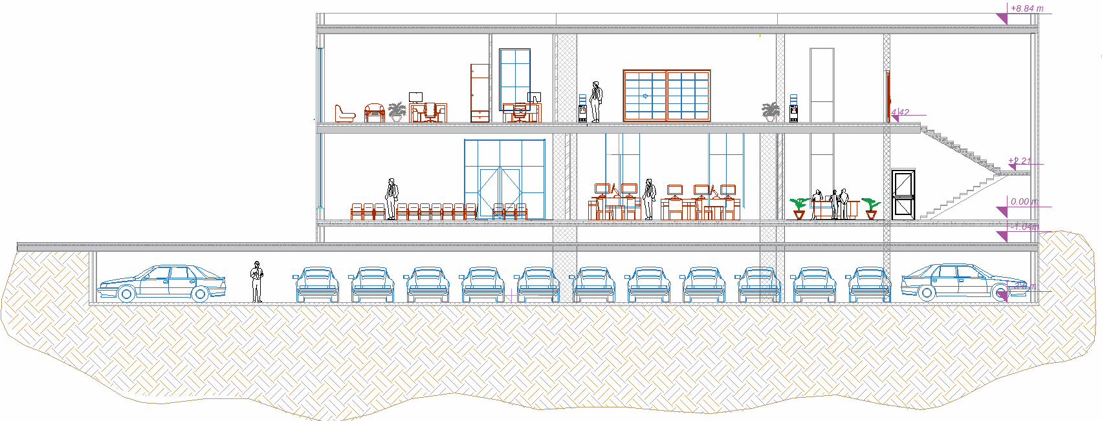
Sections
Section 1-1

Slide 14
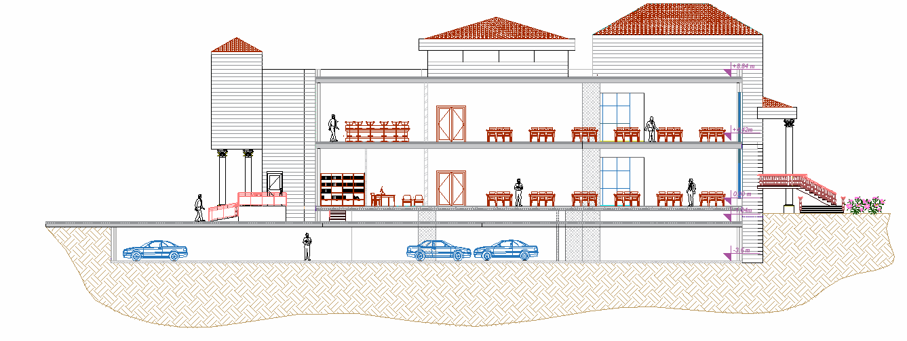
Sections
Section 2-2

Slide 15
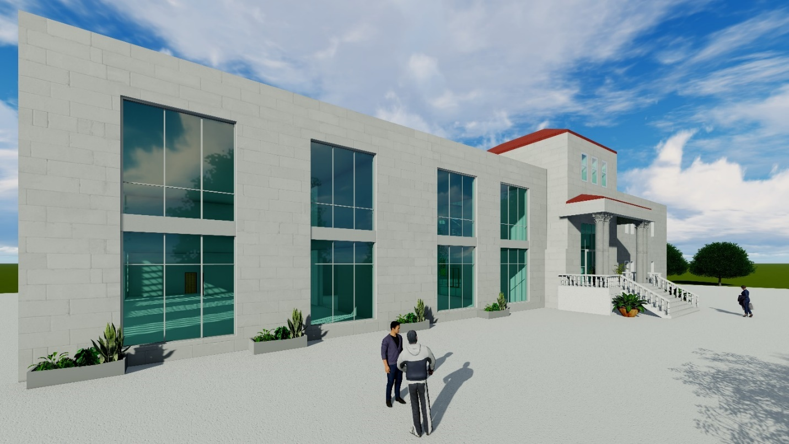
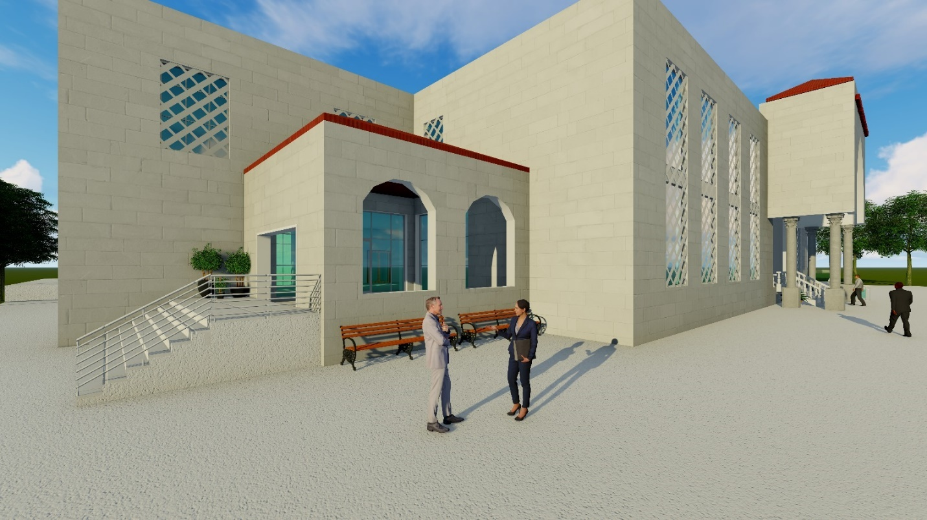
3 D Modeling

Slide 16
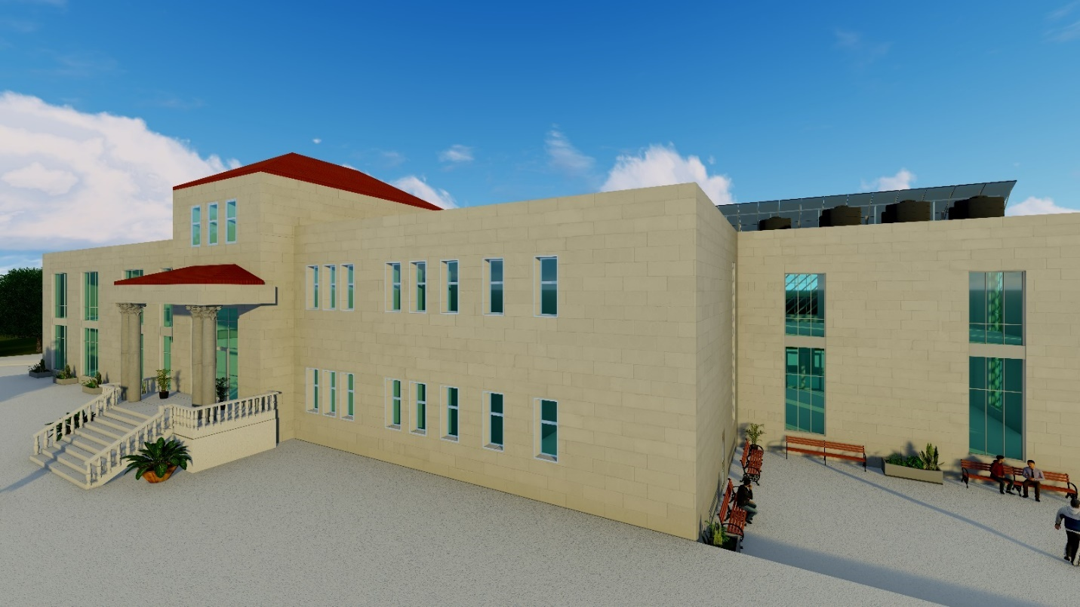
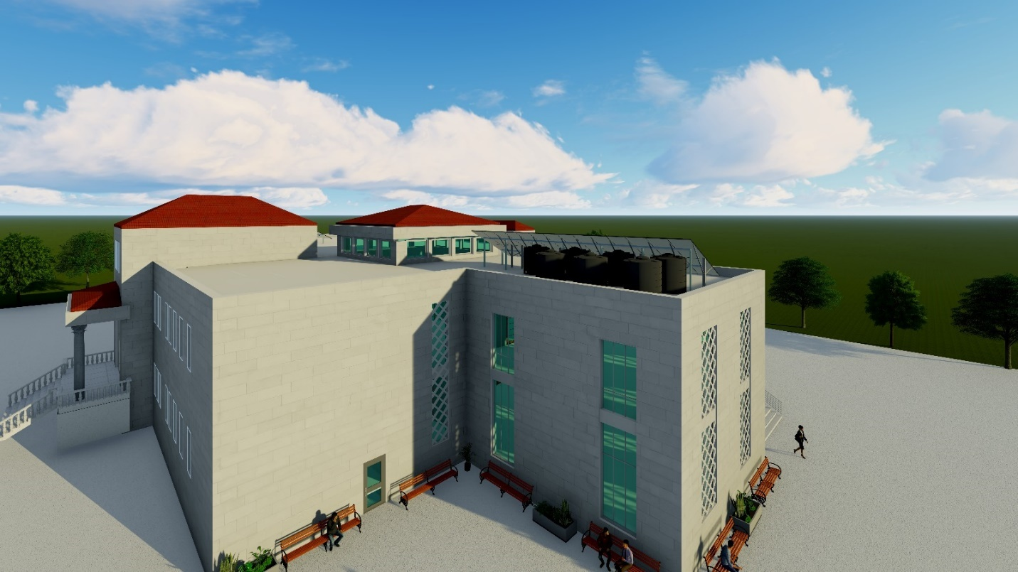
3 D Modeling

Slide 17
Environmental Aspects

Slide 18
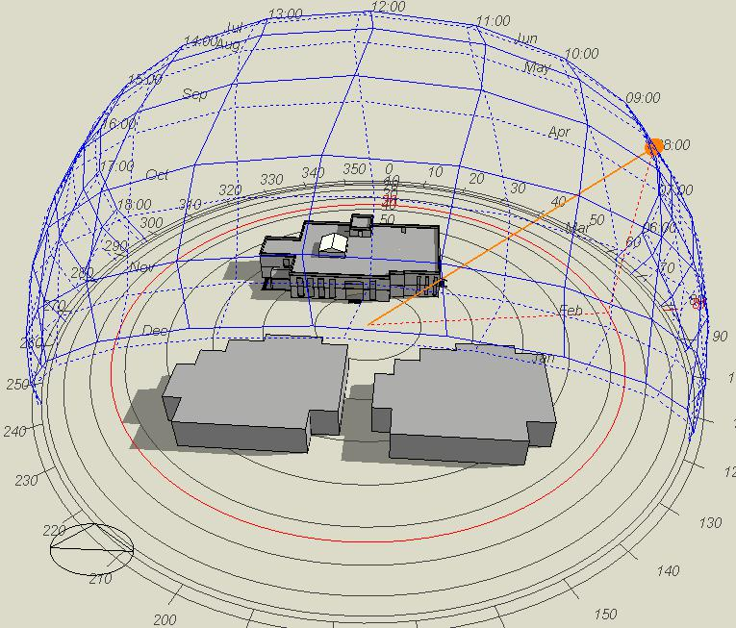
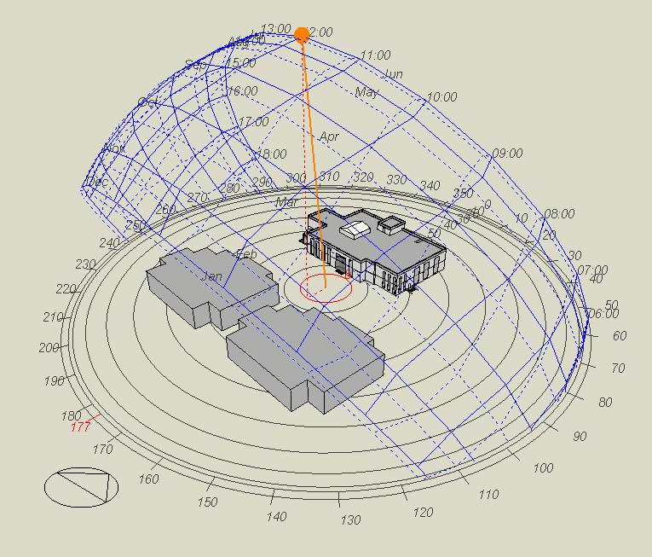
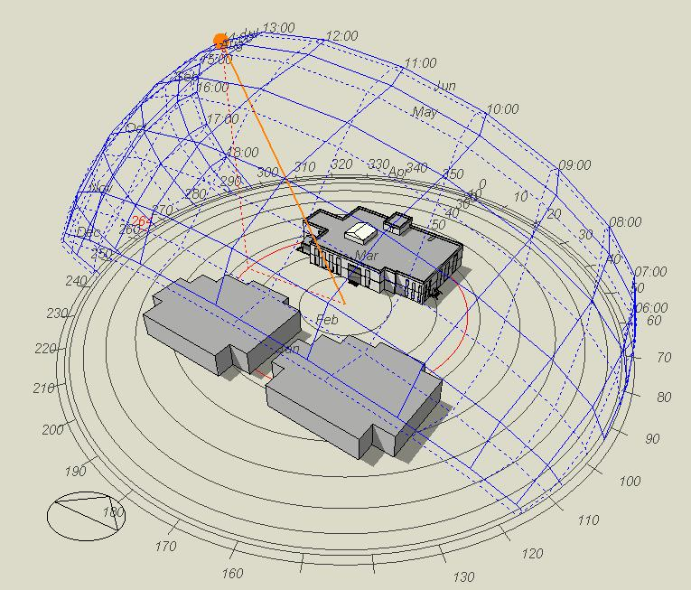
Shading analysis
Summer 21 June
At 8 am
At 2 pm
At 12 pm

Slide 19
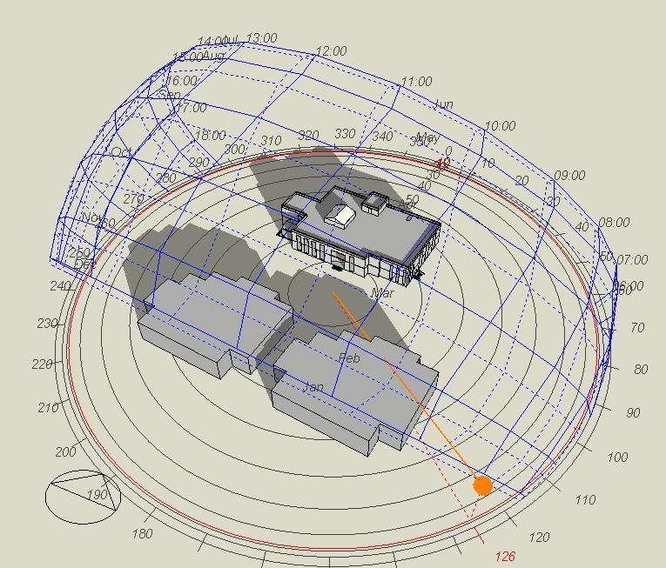
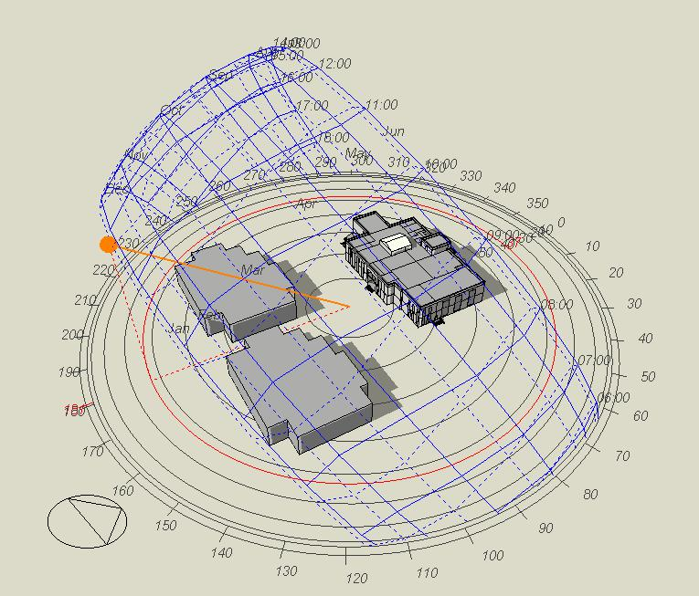
Shading analysis
Winter 21 December
At 8 am
At 12 pm

Slide 20
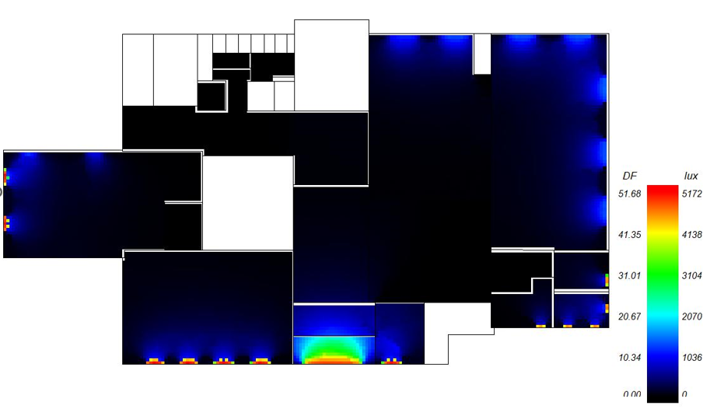
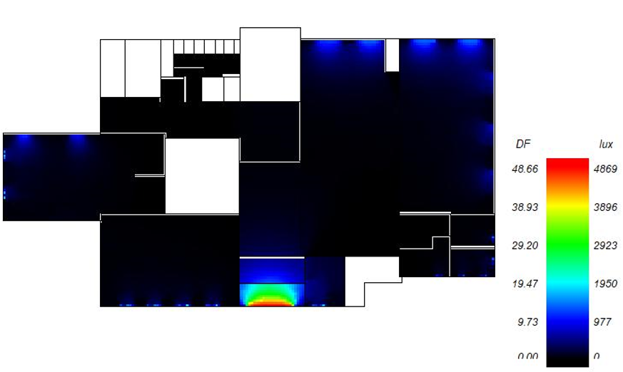
Daylight analysis
For ground floor
Before
After

Slide 21
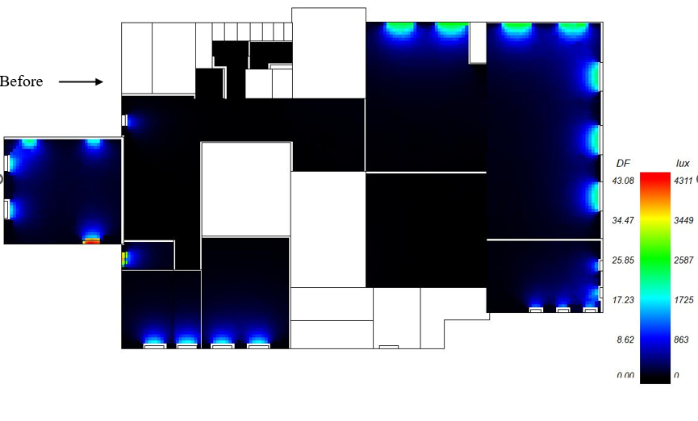
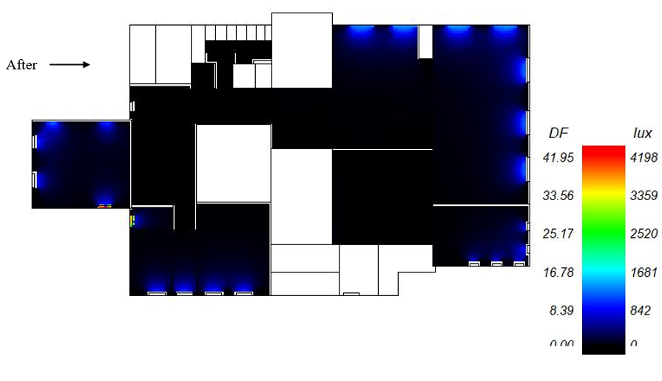
Daylight analysis
For first floor

Slide 22
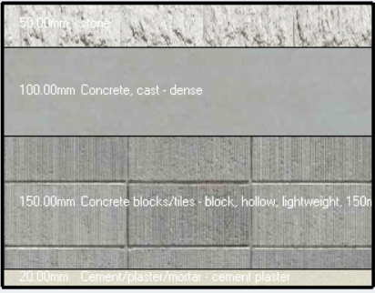
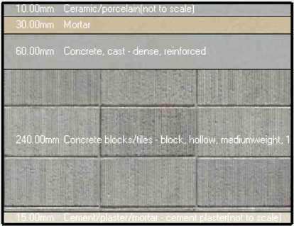
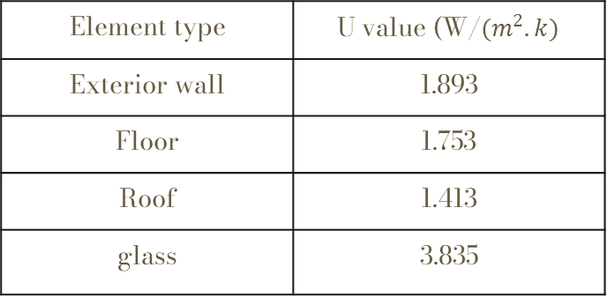
Heating and cooling load
Heat transfer coefficient (U value) before treatment for the element in the building :
Element type | U value (W/$(m^{2}.k)$
Exterior wall | 1.893
Floor | 1.753
Roof | 1.413
glass | 3.835

Slide 23
Heating and cooling capacity (before all treatments )
Zone | Design Capacity (kW) | Design Capacity (W/m2)
first-floor design heating capacity=62.4 W
office 1 | 7.89 | 61.0367
secretary | 1.25 | 79.1594
Main office | 2.86 | 69.7134
documentation | 1.3 | 57.834
meeting room | 5.7 | 56.677
Reading room 2 | 7.47 | 53.3253
study room | 5.46 | 62.9904
server | 0.27 | 32.1282
M.W.C | 0.22 | 38.7563
reading room | 14.08 | 55.815
references hall | 6.16 | 35.3289
F.W.C | 0.37 | 33.4694
lobby | 9.37 | 40.8875
ground floor design heating capacity =59.880 W
office | 0.67 | 38.3422
computer lap | 11.62 | 62.1027
entrance 1 | 0.77 | 28.7915
police room | 1.34 | 45.4227
multipurpose hall | 10.93 | 57.3048
M.W.C | 0.17 | 29.365
server | 0.24 | 27.8159
F.W.C | 0.3 | 26.7732
entrance hall | 2.12 | 24.1311
LOBBY | 5.03 | 35.4753
info desk | 1.68 | 87.7609
book repair | 1.62 | 63.8066
lobby | 1.36 | 60.6369
bookkeeper | 1.2 | 53.0729
receptions | 3.67 | 29.7169
references hall | 6.21 | 32.5175
reading room | 10.95 | 43.8662
total heating design capacity =112.280 W
Zone | Design Capacity (kW) | Design Flow Rate (m3/s) | Total Cooling Load (kW) | Design Cooling Load Per Floor Area(W/m2) | Glazing Gains (kW) | Wall Gains (kW) | Floor Gains (kW) | Roof and Ceiling Gains (kW)
office 1 | 14.04 | 0.9669 | 12.2 | 108.6 | 1.215 | 1.265 | -1.516 | 1.185
secretary | 2.1 | 0.1447 | 1.83 | 132.7 | 0.3 | -0.171 | -0.428 | 0.144
Main office | 4.25 | 0.2931 | 3.7 | 103.9 | 0.185 | 0.921 | 0.162 | 0.566
documentation | 2.37 | 0.1633 | 2.06 | 105.7 | 0.193 | 0.23 | 0.121 | 0.331
meeting room | 10.73 | 0.7391 | 9.33 | 106.6 | 0.385 | 0.473 | 0.378 | 1.299
Reading room 2 | 16.18 | 1.1149 | 14.07 | 115.5 | 0 | 0.568 | -0.152 | 1.901
study room | 11.41 | 0.7864 | 9.93 | 131.7 | 0.565 | 1.589 | 0.168 | 1.262
server | 0.53 | 0.0363 | 0.46 | 61.7 | 0 | 0.15 | 0.009 | 0.137
M.W.C | 0.6 | 0.0383 | 0.53 | 105.3 | 0 | 0.067 | -0.004 | 0.091
reading room | 30.95 | 2.1321 | 26.91 | 122.6 | 1.393 | 2.188 | 3.766 | 3.266
references hall | 15.08 | 1.0386 | 13.11 | 86.5 | 0.616 | 0.538 | -0.023 | 2.544
F.W.C | 0.91 | 0.0581 | 0.79 | 83.4 | 0 | -0.002 | -0.017 | 0.162
lobby | 24.84 | 1.5375 | 21.6 | 108.4 | 0.42 | 0.571 | -0.323 | 3.081
office | 1.55 | 0.1068 | 1.35 | 88.7 | 0 | 0.391 | 0.034 | 0
computer lap | 23.85 | 1.6431 | 20.74 | 127.5 | 1.975 | 0.834 | -1.42 | 0.01
entrance 1 | 1.9 | 0.1264 | 1.65 | 70.8 | 0.125 | 0.141 | 0.023 | 0
police room | 2.62 | 0.1802 | 2.27 | 88.5 | 0.26 | 0.204 | -0.047 | 0.006
multipurpose hall | 20.24 | 1.3942 | 17.6 | 106.1 | 1.363 | 1.425 | 0.567 | 0.035
M.W.C | 0.4 | 0.0269 | 0.35 | 69.4 | 0 | 0.098 | 0.006 | 0
server | 0.61 | 0.042 | 0.53 | 72 | 0 | 0.14 | 0.01 | 0
F.W.C | 0.63 | 0.0417 | 0.55 | 56.6 | 0 | 0.066 | 0.007 | 0
entrance hall | 4.76 | 0.328 | 4.14 | 54.1 | 0.061 | 0.146 | 0.04 | 0
LOBBY | 13.1 | 0.8085 | 11.39 | 92.4 | 0.463 | 0.248 | -0.558 | 0.005
info desk | 3.31 | 0.2277 | 2.87 | 172.4 | 0.335 | 0.352 | 0.003 | 0.002
book repair | 2.92 | 0.2011 | 2.54 | 114.7 | 0.118 | 0.575 | 0.062 | 0.004
lobby | 3.44 | 0.2172 | 2.99 | 153.7 | 0.097 | 0.544 | 0.4 | 0.005
book keeper | 2.81 | 0.1939 | 2.45 | 124.4 | 0 | 0.476 | 0.046 | 0
receptions | 8.56 | 0.5899 | 7.45 | 69.3 | 0 | 0.53 | 0.153 | 0
references hall | 14.42 | 0.9932 | 12.54 | 75.5 | 0.752 | 0.823 | 0.469 | 0
reading room | 27.93 | 1.9243 | 24.29 | 111.9 | 2.222 | 1.127 | -0.406 | 0.023
Totals | 267.04 | 18.0945 | 232.21 | 103.6 | 13.042 | 16.505 | 1.529 | 16.061

Slide 24
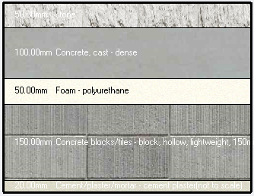
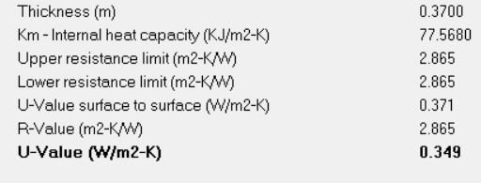
U value for external wall after adding insulation

Slide 25
Heating and cooling capacity after adding external wall insulation
Zone | Design Capacity (kW) | Design Capacity (W/m2)
first-floor heating load =51.330
office 1 | 5.35 | 41.3975
secretary | 1.01 | 63.6387
Main office | 1.81 | 44.2567
documentation | 1.01 | 45.2525
meeting room | 4.55 | 45.1679
Reading room 2 | 7.35 | 52.4308
study room | 3.9 | 45.0229
server | 0.25 | 29.7539
M.W.C | 0.21 | 36.6893
reading room | 11.8 | 46.7581
references hall | 5.53 | 31.7337
F.W.C | 0.36 | 32.9037
lobby | 8.2 | 35.808
ground floor heating load=49.410
office | 0.58 | 33.1085
computer lap | 9.1 | 48.6597
entrance 1 | 0.73 | 27.2664
police room | 0.98 | 33.0677
multipurpose hall | 8.88 | 46.5608
M.W.C | 0.16 | 27.6251
server | 0.22 | 25.7873
F.W.C | 0.29 | 26.2807
entrance hall | 2.07 | 23.5814
LOBBY | 4.49 | 31.658
info desk | 0.95 | 49.5334
book repair | 1.05 | 41.1894
lobby | 0.95 | 42.4458
bookkeeper | 1.05 | 46.3657
receptions | 3.56 | 28.8505
references hall | 5.6 | 29.3248
reading room | 8.75 | 35.0366
total heating load =100.740
Zone | Design Capacity (kW) | Design Flow Rate (m3/s) | Total Cooling Load (kW) | Design Cooling Load Per Floor Area(W/m2) | Glazing Gains (kW) | Wall Gains (kW) | Floor Gains (kW) | Roof and Ceiling Gains (kW)
office 1 | 11.3 | 0.7786 | 9.83 | 87.4 | 1.242 | -0.244 | -1.507 | 1.225
secretary | 1.72 | 0.1182 | 1.49 | 108.4 | 0.303 | -0.373 | -0.446 | 0.144
Main office | 3.07 | 0.2113 | 2.67 | 74.9 | 0.193 | 0.198 | 0.148 | 0.564
documentation | 1.9 | 0.1309 | 1.65 | 84.8 | 0.195 | 0.025 | 0.093 | 0.332
meeting room | 9.07 | 0.6245 | 7.88 | 90.1 | 0.394 | -0.073 | 0.221 | 1.294
Reading room 2 | 15.1 | 1.0404 | 13.13 | 107.8 | 0 | 0.53 | -0.041 | 1.938
study room | 9.52 | 0.6556 | 8.27 | 109.8 | 0.612 | 0.503 | 0.11 | 1.286
server | 0.48 | 0.0327 | 0.41 | 55.6 | 0 | 0.106 | 0.008 | 0.137
M.W.C | 0.54 | 0.0337 | 0.47 | 93.2 | 0 | 0.049 | -0.002 | 0.091
reading room | 29.54 | 2.0348 | 25.68 | 117.1 | 1.217 | 0.626 | 2.754 | 3.752
references hall | 13.41 | 0.9237 | 11.66 | 76.9 | 0.593 | 0.265 | 0.066 | 2.569
F.W.C | 0.82 | 0.0519 | 0.71 | 74.9 | 0 | -0.004 | -0.011 | 0.162
lobby | 21.82 | 1.3406 | 18.97 | 95.2 | 0.409 | -0.222 | -0.334 | 3.107
office | 1.39 | 0.096 | 1.21 | 79.7 | 0 | 0.281 | 0.026 | 0
computer lap | 21.7 | 1.4952 | 18.87 | 116 | 2.026 | -0.443 | -1.775 | 0.004
entrance 1 | 1.84 | 0.1215 | 1.6 | 68.4 | 0.118 | 0.099 | 0.017 | 0
police room | 2.3 | 0.1587 | 2 | 78 | 0.275 | -0.013 | -0.082 | 0.002
multipurpose hall | 18.3 | 1.2607 | 15.91 | 95.9 | 1.406 | 0.277 | 0.224 | 0.019
M.W.C | 0.38 | 0.0254 | 0.33 | 65.5 | 0 | 0.081 | 0.005 | 0
server | 0.57 | 0.0393 | 0.5 | 67.4 | 0 | 0.11 | 0.008 | 0
F.W.C | 0.61 | 0.0405 | 0.53 | 54.9 | 0 | 0.057 | 0.006 | 0
entrance hall | 4.68 | 0.3222 | 4.07 | 53.2 | 0.057 | 0.1 | 0.028 | 0
LOBBY | 12.33 | 0.7584 | 10.72 | 87 | 0.469 | -0.17 | -0.626 | 0.003
info desk | 2.61 | 0.1801 | 2.27 | 136.4 | 0.347 | -0.048 | 0.059 | 0.001
book repair | 2.44 | 0.168 | 2.12 | 95.9 | 0.121 | 0.228 | 0.028 | 0.002
lobby | 2.95 | 0.184 | 2.57 | 131.8 | 0.101 | 0.213 | 0.349 | 0.002
bookkeeper | 2.59 | 0.1787 | 2.26 | 114.7 | 0 | 0.356 | 0.028 | 0
receptions | 8.31 | 0.5724 | 7.23 | 67.3 | 0 | 0.422 | 0.135 | 0
references hall | 13.68 | 0.9425 | 11.9 | 71.6 | 0.759 | 0.455 | 0.358 | 0
reading room | 24.61 | 1.6954 | 21.4 | 98.6 | 1.882 | 0.572 | 3.605 | 0.016
Totals | 239.56 | 16.2159 | 208.32 | 93 | 12.718 | 3.961 | 3.451 | 16.651

Slide 26
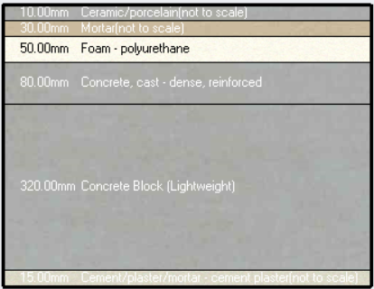
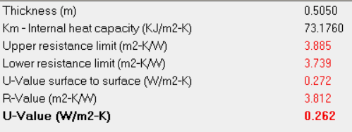
U value for Roof after adding insulation

Slide 27
Heating and cooling capacity after adding a Roof and external wall insulation
Zone | Design Capacity (kW) | Design Capacity (W/m2)
first-floor heating load =47.56
office 1 | 5.44 | 42.0627
secretary | 1.02 | 64.5172
Main office | 1.84 | 44.9809
documentation | 1.03 | 46.0947
meeting room | 4.62 | 45.8741
Reading room 2 | 7.44 | 53.1274
study room | 3.96 | 45.7272
server | 0.26 | 30.6886
M.W.C | 0.22 | 37.6683
reading room | 11.96 | 47.4086
references hall | 5.65 | 32.4208
F.W.C | 0.37 | 33.7327
lobby | 8.37 | 36.5278
ground floor heating load=47.26
office | 0.58 | 33.301
computer lap | 9.13 | 48.8192
entrance 1 | 0.73 | 27.2864
police room | 0.98 | 33.1056
multipurpose hall | 8.91 | 46.6949
M.W.C | 0.16 | 27.7915
server | 0.22 | 25.9686
F.W.C | 0.29 | 26.4123
entrance hall | 2.07 | 23.5909
LOBBY | 4.51 | 31.8148
info desk | 0.95 | 49.6971
book repair | 1.05 | 41.3598
lobby | 0.95 | 42.5994
bookkeeper | 1.05 | 46.5595
receptions | 3.59 | 29.0423
references hall | 5.64 | 29.5169
reading room | 8.79 | 35.2223
total heating load =95.256
Zone | Design Capacity (kW) | Design Flow Rate (m3/s) | Total Cooling Load (kW) | Design Cooling Load Per Floor Area(W/m2) | Glazing Gains (kW) | Wall Gains (kW) | Floor Gains (kW) | Roof and Ceiling Gains (kW)
office 1 | 10.44 | 0.7191 | 9.08 | 80.7 | 1.269 | -0.089 | -1.236 | 0.019
secretary | 1.6 | 0.1104 | 1.39 | 101.3 | 0.305 | -0.329 | -0.429 | -0.018
Main office | 2.83 | 0.1952 | 2.46 | 69.2 | 0.197 | 0.331 | 0.218 | 0.154
documentation | 1.77 | 0.1216 | 1.54 | 78.8 | 0.2 | 0.112 | 0.12 | 0.08
meeting room | 8.66 | 0.5968 | 7.53 | 86.1 | 0.4 | 0.288 | 0.436 | 0.355
Reading room 2 | 14.49 | 0.9984 | 12.6 | 103.4 | 0 | 0.919 | 0.328 | 0.65
study room | 8.98 | 0.6188 | 7.81 | 103.7 | 0.61 | 0.724 | 0.356 | 0.418
server | 0.43 | 0.0297 | 0.37 | 50.4 | 0 | 0.159 | 0.018 | 0.04
M.W.C | 0.5 | 0.0315 | 0.44 | 87.3 | 0 | 0.082 | 0.003 | 0.025
reading room | 28.59 | 1.9699 | 24.86 | 113.3 | 1.473 | 0.946 | 3.192 | 1.136
references hall | 12.29 | 0.8468 | 10.69 | 70.5 | 0.623 | 0.582 | 0.592 | 0.716
F.W.C | 0.77 | 0.0486 | 0.67 | 70.2 | 0 | 0.061 | 0.001 | 0.043
lobby | 20.25 | 1.24 | 17.61 | 88.4 | 0.406 | 0.411 | 0.142 | 0.733
office | 1.39 | 0.0955 | 1.21 | 79.4 | 0 | 0.277 | 0.025 | 0
computer lap | 21.65 | 1.4912 | 18.82 | 115.7 | 2.028 | -0.426 | -1.751 | 0.004
entrance 1 | 1.83 | 0.1213 | 1.59 | 68.3 | 0.117 | 0.097 | 0.016 | 0
police room | 2.3 | 0.1582 | 2 | 77.7 | 0.275 | -0.017 | -0.083 | 0.002
multipurpose hall | 18.23 | 1.2561 | 15.85 | 95.6 | 1.408 | 0.284 | 0.238 | 0.019
M.W.C | 0.38 | 0.0252 | 0.33 | 65 | 0 | 0.08 | 0.005 | 0
server | 0.57 | 0.039 | 0.49 | 66.8 | 0 | 0.107 | 0.008 | 0
F.W.C | 0.61 | 0.0403 | 0.53 | 54.6 | 0 | 0.055 | 0.006 | 0
entrance hall | 4.67 | 0.3219 | 4.06 | 53.1 | 0.056 | 0.099 | 0.027 | 0
LOBBY | 12.25 | 0.7533 | 10.65 | 86.4 | 0.467 | -0.148 | -0.611 | 0.003
info desk | 2.61 | 0.1796 | 2.27 | 136 | 0.347 | -0.056 | 0.056 | 0.001
book repair | 2.42 | 0.1669 | 2.11 | 95.3 | 0.121 | 0.228 | 0.029 | 0.002
lobby | 2.95 | 0.1835 | 2.56 | 131.4 | 0.101 | 0.21 | 0.347 | 0.002
bookkeeper | 2.58 | 0.1776 | 2.24 | 113.9 | 0 | 0.354 | 0.028 | 0
receptions | 8.22 | 0.5664 | 7.15 | 66.6 | 0.001 | 0.437 | 0.153 | 0
references hall | 13.56 | 0.9341 | 11.79 | 71 | 0.763 | 0.461 | 0.375 | 0
reading room | 24.55 | 1.6915 | 21.35 | 98.3 | 1.883 | 0.537 | 3.557 | 0.016
Totals | 232.37 | 15.7284 | 202.06 | 90.2 | 13.05 | 6.777 | 6.166 | 4.403

Slide 28
Heating and cooling capacity after all treatments
Zone | Design Capacity (kW) | Design Capacity (W/m2)
first-floor heating load =33.600
office 1 | 3.97 | 30.6691
secretary | 0.5 | 31.9093
Main office | 1.31 | 31.9097
documentation | 0.73 | 32.5363
meeting room | 3.15 | 31.3002
Reading room 2 | 4.78 | 34.1555
study room | 2.99 | 34.5164
server | 0.17 | 19.8961
M.W.C | 0.13 | 21.9144
reading room | 7.07 | 28.0106
references hall | 3.67 | 21.0486
F.W.C | 0.21 | 19.6739
lobby | 4.92 | 21.4688
ground floor heating load=33.290
office | 0.39 | 22.1651
computer lap | 6.96 | 37.1985
entrance 1 | 0.44 | 16.4319
police room | 0.64 | 21.6476
multipurpose hall | 6.72 | 35.2483
M.W.C | 0.1 | 17.0038
server | 0.13 | 15.1669
F.W.C | 0.17 | 15.703
entrance hall | 1.13 | 12.8384
LOBBY | 2.5 | 17.6203
info desk | 0.7 | 36.5465
book repair | 0.71 | 27.8976
lobby | 0.55 | 24.5327
bookkeeper | 0.52 | 22.7888
receptions | 2.25 | 18.2454
references hall | 3.48 | 18.2442
reading room | 5.9 | 23.6303
total heating load =66.890
Zone | Design Capacity (kW) | Design Flow Rate (m3/s) | Total Cooling Load (kW) | Design Cooling Load Per Floor Area(W/m2) | Glazing Gains (kW) | Wall Gains (kW) | Floor Gains (kW) | Roof and Ceiling Gains (kW)
office 1 | 7.15 | 0.4923 | 6.21 | 55.3 | 1.147 | 0.433 | 0.011 | 0.385
secretary | 0.95 | 0.0654 | 0.83 | 60 | 0.239 | 0.016 | -0.03 | 0.045
Main office | 2.05 | 0.141 | 1.78 | 50 | 0.22 | 0.349 | 0.141 | 0.166
documentation | 1.26 | 0.0868 | 1.1 | 56.2 | 0.226 | 0.14 | 0.084 | 0.087
meeting room | 6.34 | 0.4369 | 5.51 | 63 | 0.457 | 0.299 | 0.303 | 0.39
Reading room 2 | 10.11 | 0.6962 | 8.79 | 72.1 | 0 | 0.609 | 0.103 | 0.612
study room | 7.09 | 0.4666 | 6.16 | 79.25 | 0.658 | 0.576 | 0.009 | 0.37
server | 0.3 | 0.0209 | 0.26 | 35.5 | 0 | 0.157 | 0.014 | 0.046
M.W.C | 0.32 | 0.02 | 0.28 | 56 | 0 | 0.062 | 0 | 0.024
reading room | 16.93 | 1.1662 | 14.72 | 67.1 | 1.658 | 0.886 | 1.48 | 1.153
references hall | 9.25 | 0.6089 | 8.04 | 53.1 | 0.719 | 0.404 | 0.261 | 0.701
F.W.C | 0.51 | 0.0316 | 0.45 | 46.9 | 0 | 0.042 | -0.002 | 0.043
lobby | 12.73 | 0.7638 | 11.07 | 55.6 | 0.308 | 0.528 | 0.221 | 0.857
office | 0.95 | 0.0657 | 0.83 | 54.6 | 0 | 0.202 | 0.016 | 0
computer lap | 16.48 | 1.1354 | 14.33 | 79.125 | 1.999 | 0.062 | -0.367 | 0.002
entrance 1 | 1.31 | 0.0788 | 1.14 | 48.9 | 0.085 | 0.075 | 0.009 | 0
police room | 1.54 | 0.106 | 1.34 | 52.1 | 0.286 | 0.046 | -0.019 | 0.002
multipurpose hall | 13.64 | 0.9395 | 11.86 | 71.5 | 1.574 | 0.365 | 0.225 | 0.008
M.W.C | 0.28 | 0.0175 | 0.25 | 48.8 | 0 | 0.046 | 0.002 | 0
server | 0.4 | 0.0278 | 0.35 | 47.5 | 0 | 0.051 | 0.002 | 0
F.W.C | 0.46 | 0.0283 | 0.4 | 41.6 | 0 | 0.026 | 0.002 | 0
entrance hall | 3.07 | 0.1907 | 2.67 | 34.9 | 0.035 | 0.08 | 0.013 | 0
LOBBY | 7.13 | 0.4252 | 6.2 | 50.3 | 0.353 | 0.127 | -0.074 | 0.001
info desk | 1.52 | 0.1047 | 1.32 | 79.3 | 0.403 | 0.139 | 0.033 | 0.003
book repair | 1.56 | 0.1077 | 1.36 | 61.4 | 0.134 | 0.19 | 0.024 | 0.001
lobby | 1.35 | 0.0889 | 1.18 | 60.5 | 0.13 | 0.199 | 0.065 | 0.001
bookkeeper | 1.33 | 0.0913 | 1.15 | 58.6 | 0 | 0.268 | 0.029 | 0
receptions | 5.57 | 0.3838 | 4.84 | 45.1 | 0 | 0.3 | 0.114 | 0
references hall | 9.36 | 0.6149 | 8.14 | 49 | 0.826 | 0.359 | 0.301 | 0
reading room | 15.97 | 1.1001 | 13.89 | 64 | 2.129 | 0.659 | 1.395 | 0.011
Totals | 156.92 | 10.5028 | 136.45 | 60.9 | 13.587 | 7.694 | 4.368 | 4.908

Slide 29
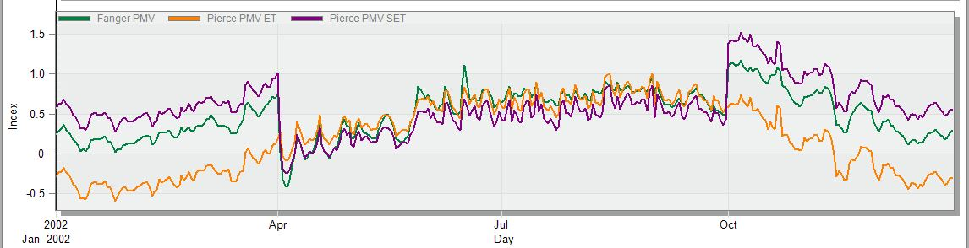
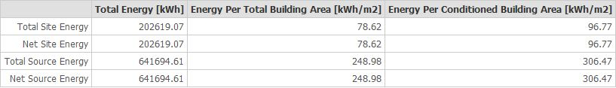
Thermal comfort
PMV between (-0.7-0.7)
The total site energy is=78.62 kwh/m2

Slide 30
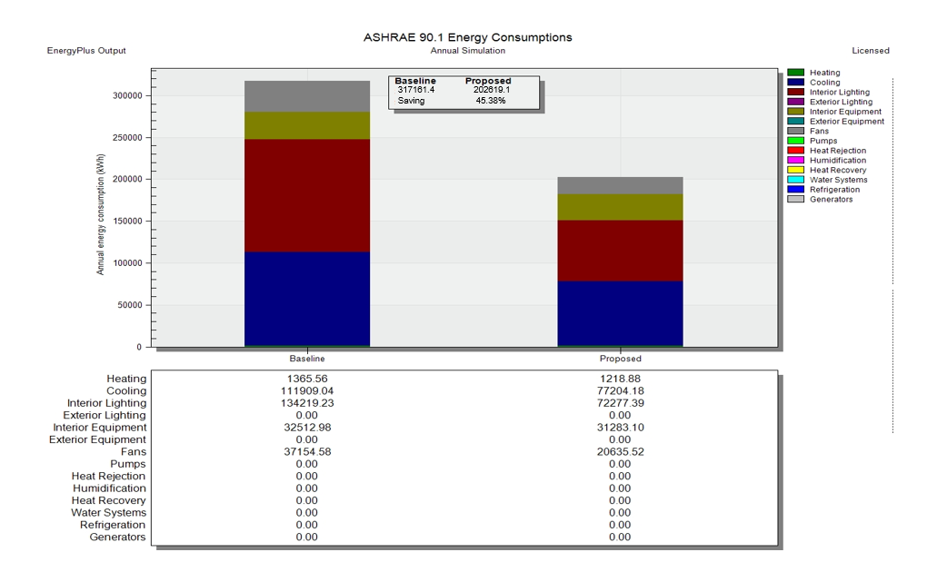
Energy baseline analysis for building

Slide 31
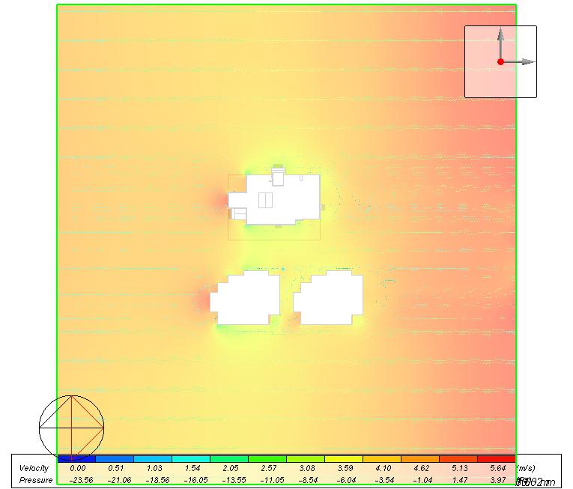
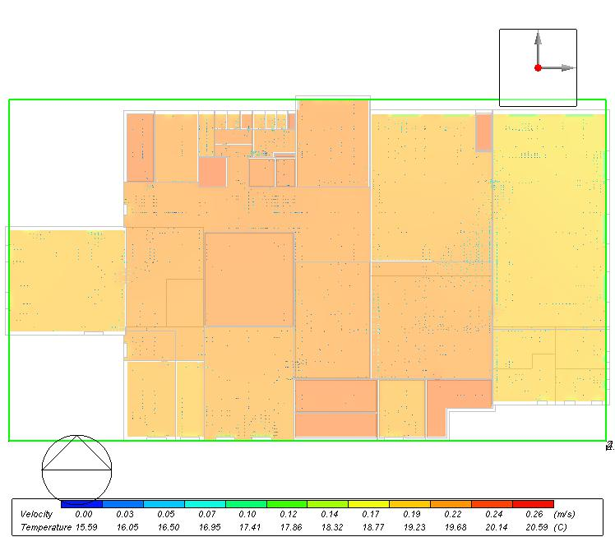
CFD analysis
External CFD
Internal CFD

Slide 32
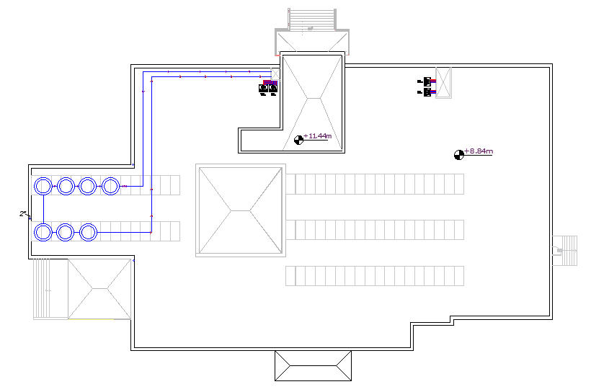
Photovoltaic design

Slide 33
Structural Aspects

Slide 34
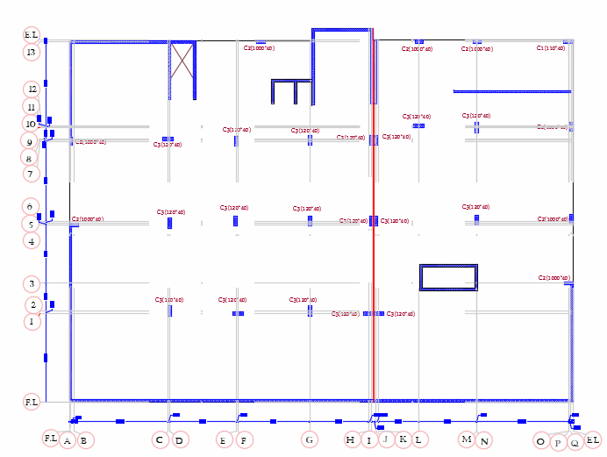
Center of columns

Slide 35
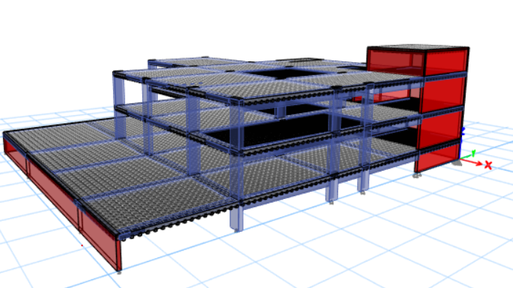
3D Modeling of Al-Istiqlal University Library
Design codes are ACI 319, ASCE, UBC-97.
The slab system is a Two-way Ribbed Slab.
Subjected loads are as follows:
Live load =5 kN/m²
SID = 4.47 kN/m²
Bearing capacity =200 KN/m²
Materials used: f’c concrete for (columns + footing + two way ribbed slab ) f'c=28 Mpa.
Steel fy=420 Mpa.

Slide 36
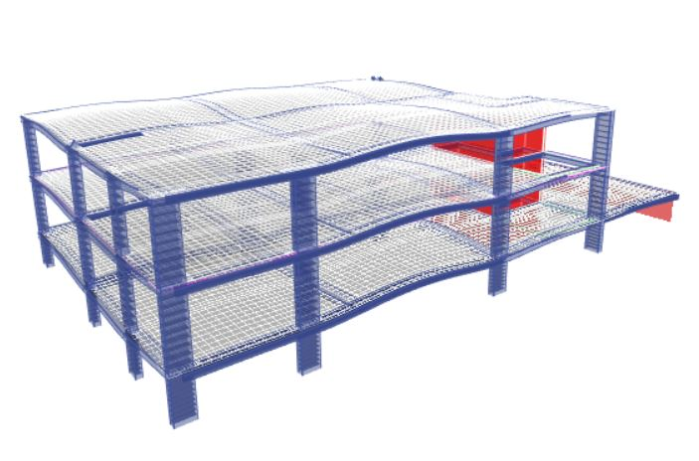
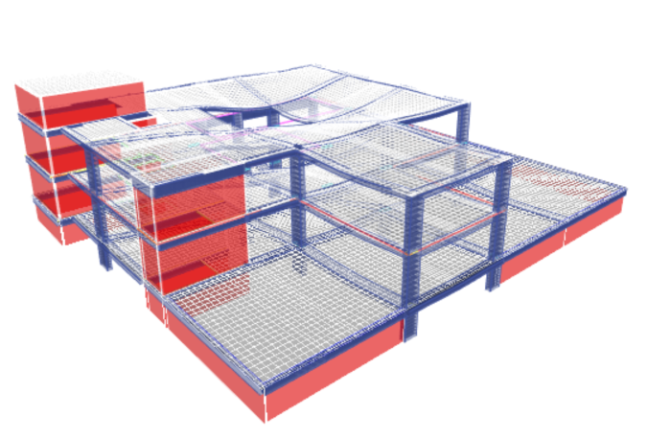
Computability Check
All elements within each area seamlessly integrate, ensuring the absence of any instabilities present in the overall structure

Slide 37
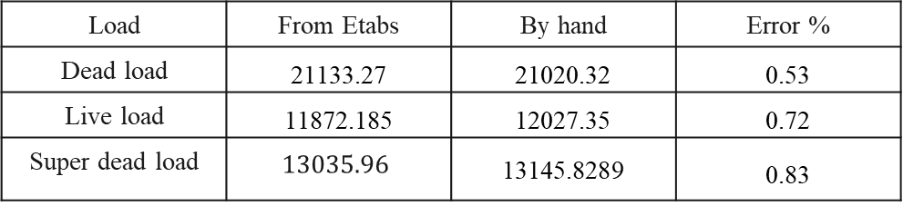
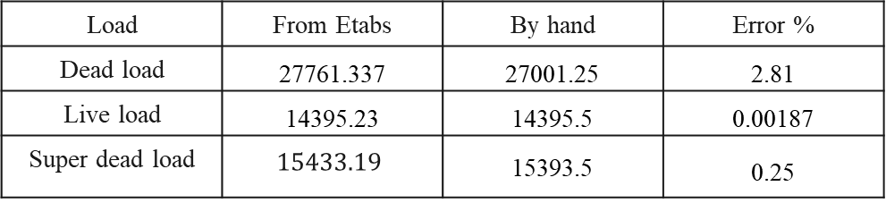
Equilibrium Check (part one )
Load | From Etabs | By hand | Error %
Dead load | 21133.27 | 21020.32 | 0.53
Live load | 11872.185 | 12027.35 | 0.72
Super dead load | $$13035.96$$ | 13145.8289 | 0.83
Equilibrium Check (part two )
Load | From Etabs | By hand | Error %
Dead load | 27761.337 | 27001.25 | 2.81
Live load | 14395.23 | 14395.5 | 0.00187
Super dead load | $$15433.19$$ | 15393.5 | 0.25

Slide 38
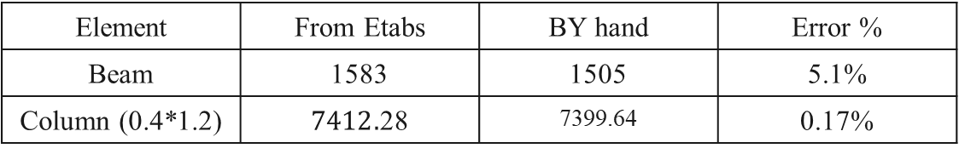
Internal force
Element | From Etabs | BY hand | Error %
Beam | 1583 | 1505 | 5.1%
Column (0.4*1.2) | $7412.$28 | 7399.64 | 0.17%

Slide 39
Seismic design Checks

Slide 40
T-Period check
Part one
  T method A = Ct*(height of building) 3/4
  Then the maximum allowed limit is (1.4* T method A =0.552)
  T period from Etabs =0.544 < 1.4 method A=0.552 → OK
Part two
  T method A = Ct*(height of building) 3/4
  Then the maximum allowed limit is (1.4* T method A =0.582)
  T period from Etabs =0.37 < 1.4 method A=0.582 → OK

Slide 41
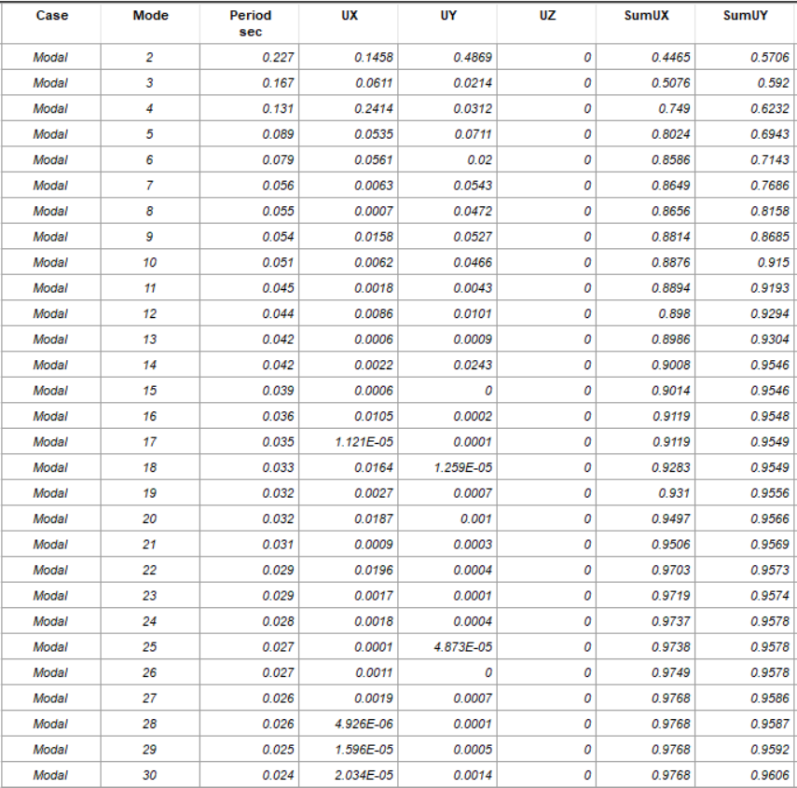
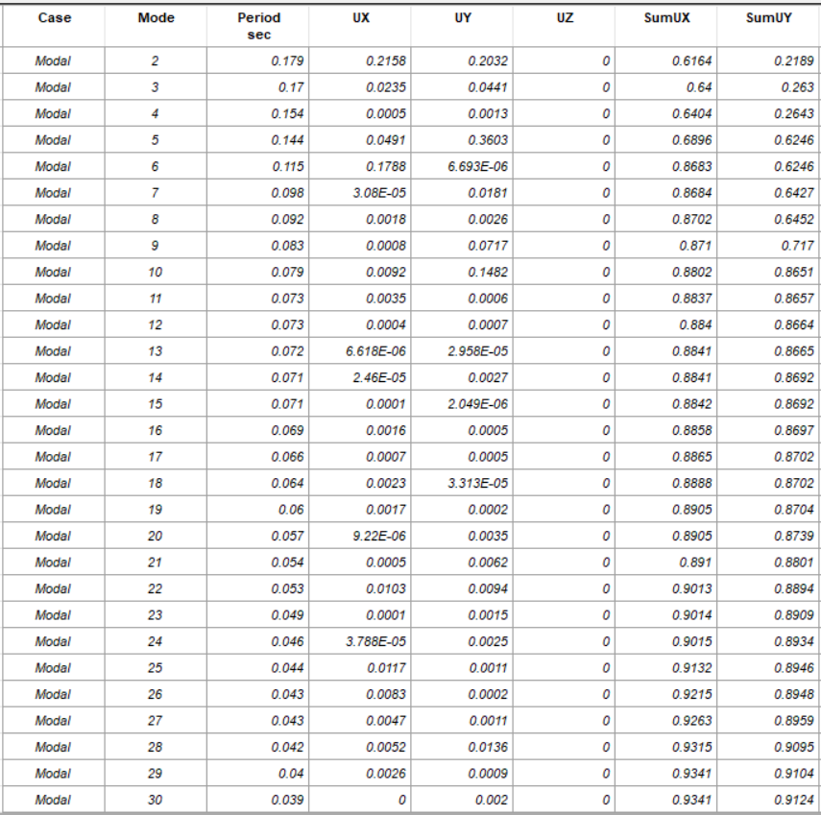
Model Mass Participation Ratio
Part one
Part two
Sum Ux and Uy >0.9 → ok
Sum Ux and Uy >0.9 → ok

Slide 42



Base shear check
Part one
Part two
In this check the base shear of EQx or EQy from response spectrum (ETABS) must be bigger than base shear from the equivalent static(Manual).
$${\text{response} \text{spectrum} base shear from etabs>V}_{manual}EQx → ok$$
$${\text{response} \text{spectrum} base shear from etabs>V}_{manual} EQy→ok$$

Slide 43
Drift check
Part one
story | height | DIS X | DIS Y | DRIFT X | DRIFT Y | Delta X | Delta Y | Limitation
base | 0 | 0 | 0 | 0 | 0 | 0 | 0 | 0
basement | 2550 | 1.35 | 0.52 | 1.35 | 0.52 | 5.197 | 2.002 | 63.75
ground | 4420 | 11.159 | 3.74 | 9.809 | 3.22 | 37.76 | 12.4 | 101.75
first | 4420 | 20.265 | 6.994 | 9.106 | 3.254 | 35.058 | 12.52 | 101.75
Part two
story | height | DIS X | DIS Y | DRIFT X | DRIFT Y | Delta X | Delta Y | Limitation
base | 0 | 0 | 0 | 0 | 0 | 0 | 0 | 0
basement | 2550 | 1.215 | 0.321 | 1.215 | 0.321 | 4.677 | 1.235 | 63.75
ground | 4420 | 4.938 | 1.001 | 3.723 | 0.68 | 14.33 | 2.618 | 101.75
first | 4420 | 9.221 | 1.766 | 4.282 | 0.765 | 16.48 | 2.94 | 101.75
staircase | 2900 | 3.392 | -0.466 | -5.829 | -0.093 | -22.44 | -1.79 | 72.5
$$All (Delta_X, Delta_Y)< Delta_limit → drift check is OK$$

Slide 44


Mat foundation
Section

Slide 45


Water tank
Section

Slide 46

Column
column | dimension | reinforced | ties | # of the column in two parts
C1 | 110*40 | 16ø18 | 2ø10 | 1
C2 | 100*40 | 14ø18 | 2ø10 | 8
C3 | 120*40 | 18ø18 | 3ø10 | 18

Slide 47




Shear wall
Part one
Part two

Slide 48


Beams

Slide 49

Basement slab

Slide 50

Ground floor slab

Slide 51

First floor slab

Slide 52
Electromechanical Aspects

Slide 53
Electromechanical Aspects
07
01
04
Artificial Lighting
Acoustics
Fire
02
05
Power
Water supply
03
06
HVAC
Drainage

Slide 54
Artificial Lighting
Standard Illuminance (Lux), CCT, CRI and UGR for space
Room type | Lux recommendation | UGR | CCT | CRI
reading room | 500 | 19 | 4000 | 80
reference hall | 200 | 19 | 4000 | 80
multipurpose hall | 500 | 19 | 4000 | 80
toilet | 200 | 22 | 4000 | 90
reception area | 300 | 22 | 4000 | 80
parking | 100 | 25 | 4000 | 80
Office | 300 | 19 | 4000 | 80
lobby | 100 | 25 | 4000 | 80

Slide 55



Artificial Lighting
Office

Slide 56
Artificial Lighting
Space | E(lux) | UO | UGR
Office | 312 | 0.58 | 17
Computer lab | 304 | 0.57 | 20
Reading hall | 552 | 0.58 | 20
Reference hall | 204 | 0.5 | 22
Multiparous hall | 515 | 0.47 | 15
lobby | 121 | 0.5 | 21
W.C | 205 | 0.52 | 15
Storage | 204 | 0.52 | 19

Slide 57

Artificial Lighting
Basement floor

Slide 58

Artificial Lighting
ground floor

Slide 59

Artificial Lighting
first floor

Slide 60

power
Basement floor

Slide 61

power
ground floor

Slide 62

power
first floor

Slide 63

power
main distribution board

Slide 64

HVAC design
The system that was used is a VRF system.

Slide 65

HVAC design
The design capacity = 156.92 KW
Outdoor unit:

Slide 66
HVAC design
Outdoor unit:

Slide 67


HVAC design
Fan coil unit

Slide 68

HVAC design
Diffuser selection

Slide 69

HVAC
ground floor

Slide 70

HVAC
first floor

Slide 71

HVAC

Slide 72




Fire fighting design

Slide 73

Fire fighting design
Basement floor

Slide 74

Fire fighting design
ground floor

Slide 75

Fire fighting design
first floor

Slide 76

Fire fighting design
ground floor

Slide 77

Fire fighting design
first floor

Slide 78

Fire fighting design

Slide 79

Integration(lighting, HVAC ,Fire)
Basement floor

Slide 80

Integration(lighting, HVAC ,Fire)
ground floor

Slide 81

Integration(lighting, HVAC ,Fire)
first floor

Slide 82

Acoustical design

Slide 83

Acoustical design
Space | Reverberation time 60
Meeting room | 0.5-1.0
Reading hall | 0.4-1.2
Multipurpose hall | 0.6-1.5

Slide 84
Acoustical design
Reverberation time (RT60) For Meeting room :
When 100% occupancy :
Reverberation Time RT60 (Sec) | 125Hz | 250Hz | 500Hz | 1000Hz | 2000Hz | 4000Hz
 | 0.9 | 0.66 | 0.68 | 0.59 | 0.70 | 0.87
(0.5-1.0) | good | good | good | good | good | good
When 0% occupancy :
Reverberation Time RT60 (Sec) | 125Hz | 250Hz | 500Hz | 1000Hz | 2000Hz | 4000Hz
 | 1.0 | 0.76 | 0.68 | 0.70 | 0.86 | 1.01
(0.5-1.0) | good | good | good | good | good | good

Slide 85

Acoustical design
Material used :
50 mm (2 inches) thick Mineral Wool

Slide 86

Acoustical design
Sound power level (SPL) For Multi-purpose hall :

Slide 87
Acoustical design
Sound power level (SPL) For Multi-purpose hall :
When 100% occupancy :
Point | SPL_{125Hz} | SPL_{250Hz} | SPL_{500Hz} | SPL_{1000Hz} | SPL_{2000Hz} | SPL_{4000Hz}
1 | 74.64 | 75.05 | 75.70 | 75.02 | 75.37 | 75.85
2 | 72.74 | 73.37 | 74.29 | 73.32 | 73.83 | 74.50
3 | 72.34 | 73.02 | 74.01 | 72.97 | 73.52 | 74.24
4 | 72.16 | 72.87 | 73.89 | 72.82 | 73.38 | 74.12
5 | 71.93 | 72.67 | 73.73 | 72.62 | 73.21 | 73.97
6 | 71.64 | 72.43 | 73.55 | 72.37 | 73.00 | 73.80
7 | 71.55 | 72.35 | 73.49 | 72.30 | 72.93 | 73.74
8 | 71.49 | 72.30 | 73.45 | 72.24 | 72.89 | 73.70
9 | 71.47 | 72.29 | 73.44 | 72.23 | 72.87 | 73.69
10 | 71.44 | 72.26 | 73.42 | 72.21 | 72.85 | 73.68

Slide 88
Acoustical design
Sound power level (SPL) For Multi-purpose hall :
When 0% occupancy :
Point | SPL_{125Hz} | SPL_{250Hz} | SPL_{500Hz} | SPL_{1000Hz} | SPL_{2000Hz} | SPL_{4000Hz}
1 | 74.96 | 75.51 | 75.70 | 75.62 | 76.17 | 76.98
2 | 73.23 | 74.03 | 74.29 | 74.18 | 74.93 | 75.97
3 | 72.87 | 73.73 | 74.01 | 73.89 | 74.69 | 75.79
4 | 72.71 | 73.60 | 73.89 | 73.77 | 74.58 | 75.70
5 | 72.51 | 73.44 | 73.73 | 73.61 | 74.45 | 75.60
6 | 72.26 | 73.24 | 73.55 | 73.42 | 74.29 | 75.48
7 | 72.18 | 73.17 | 73.49 | 73.35 | 74.24 | 75.44
8 | 72.12 | 73.13 | 73.45 | 73.31 | 74.21 | 75.42
9 | 72.11 | 73.12 | 73.44 | 73.30 | 74.20 | 75.41
10 | 72.09 | 73.10 | 73.42 | 73.28 | 74.18 | 75.40

Slide 89


Acoustical design
Number of Speakers used for the hall is speakers.

Slide 90

Water supply system
Underground tank
capacity of 35 m3.

Slide 91


Water supply system
Roof Tanks
Water consumption is 33600 liters per day.
Tanks dimension is 1.6 * 2 m
7 Tanks used

Slide 92


Water supply system
For Ground Floor

Slide 93

Water supply system
For First Floor

Slide 94

Water supply system
Roof Tanks

Slide 95

Water supply system

Slide 96

Water drainage system

Slide 97

Water drainage system
For Parking

Slide 98


Water drainage system
Slope | Max DFU | Inch
2% | 21 | 2
1% | 180 | 4
1% | 700 | 6
For Ground Floor

Slide 99

Water drainage system
Slope | Max DFU | Inch
2% | 21 | 2
1% | 180 | 4
1% | 700 | 6
For First Floor

Slide 100

Water drainage system
Manhole in site plan
Slope | Max DFU | Inch
2% | 21 | 2
1% | 180 | 4
1% | 700 | 6
For Site Plan

Slide 101

Water drainage system
For Rainwater

Slide 102
Quantity surveying & cost estimate
ILS | 131,498.4 | Earthwork | 1
ILS | 3,988,718.5 | Structural elements | 2
ILS | 858,365.0 | External works elements | 3
ILS | 291,476.4 | Interior walls | 4
ILS | 2,905,368.2 | Finishes | 5
ILS | 336,796.4 | Electrical work | 6
ILS | 1,708,565.1 | Mechanical work | 7
ILS | 11,818,299.1 | Total Project Cost | 8
Unit cost per m =2007.6 M2/ILS

