Slide 1




Slide 1
NIRVATECHS
Psychological Analyzer
&
Personalities types Classifier

Slide 2
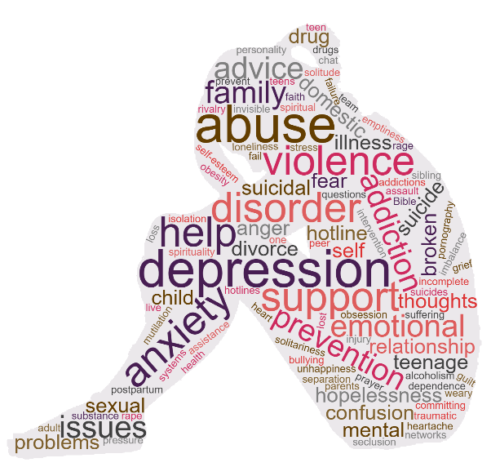

Slide 3
300 million people have been diagnosed with depression

Slide 4
800,000 people die due to suicide every year

Slide 5


How do we make decisions?
Personality Type
Emotional State

Slide 6

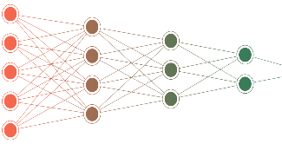








What is NIRVATECHs?
Emotion Detection
Personality Type Classification

Slide 7
1
Research & Data collection
2
Pre-processing & Features engineering
Stages
3
Building models & Training
4
Nirvatechs Application Building

Slide 8
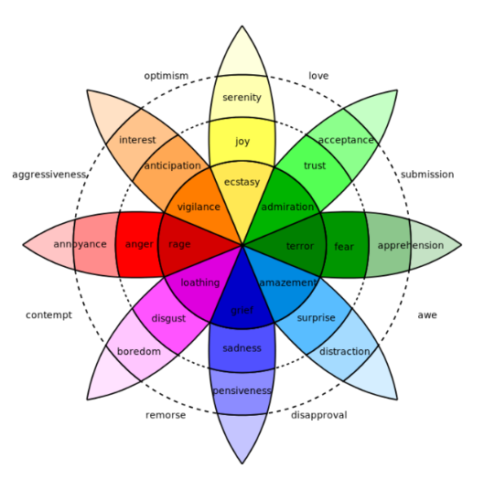
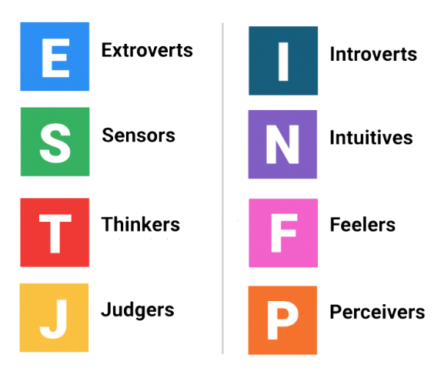
Research & Data Collection

Slide 9


Emotion detection datasets - labeled
Here we should put data samples example

Slide 10
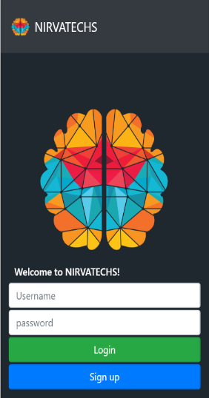
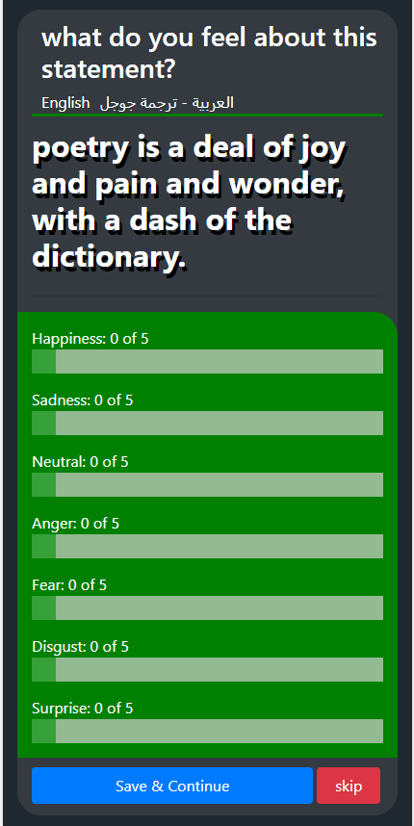
Emotion detection datasets - unlabeled

Slide 11
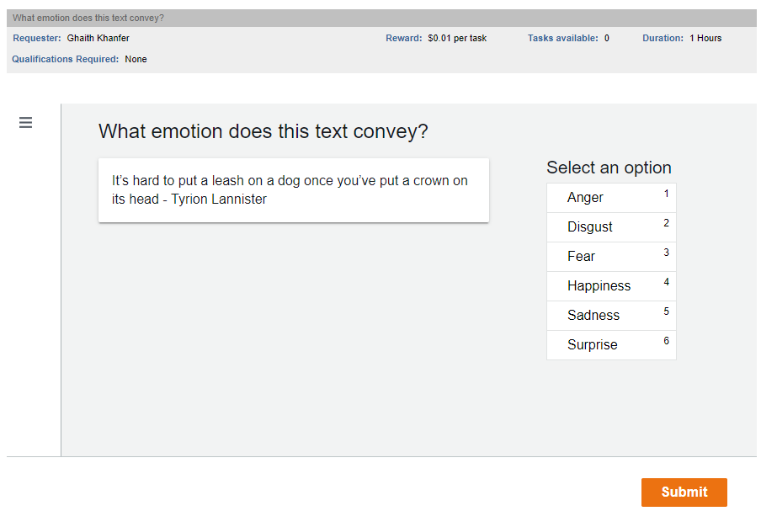
Emotion detection datasets - validation
1
Average vector of more than one labeling record
2
AWS Mechanical Turks

Slide 12
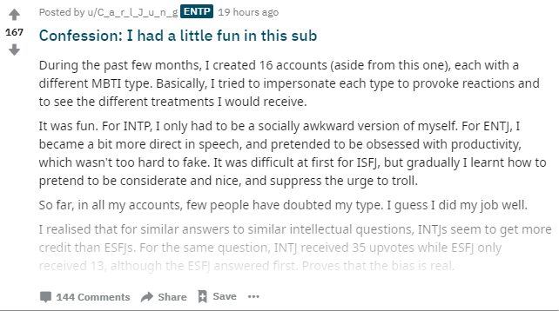

Personality type datasets - labeled

Slide 13
Emotion detection datasets - Results
Emotion Detection
416,000 Labeled record
Personality Types
10,000,000 Labeled record

Slide 14
Pre-processing & features engineering
1
Numbers & symbols elimination
2
Punctuation marks removal
3
Stop words removal
4
Spelling error correction

Slide 15
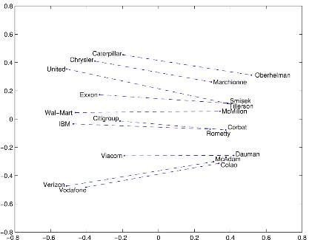
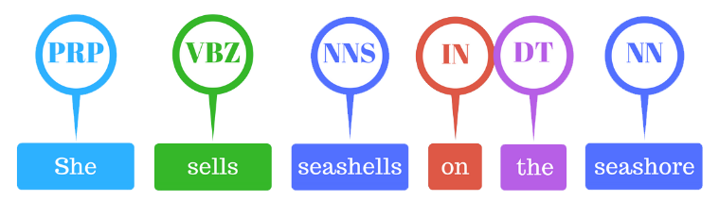

Pre-processing & features engineering
50
3
2
# words
# Links
# Videos

Slide 16
Pre-processing & features engineering
Feature | description | Feature | Description
CC | coordinating conjunction | RB | adverb
CD | cardinal digit | VB | verb
DT | determiner | COUNT_W | words per sequence
EX | existential there like: “there is” | COUNT_L | links per sequence
FW | foreign word | COUNT_P | photos per sequence
IN | preposition | COUNT_V | videos per sequence
JJ | adjective ‘big’
MD | modal ‘could’
NN | noun
PRP | personal pronoun

Slide 17
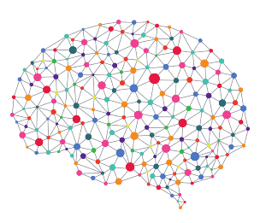

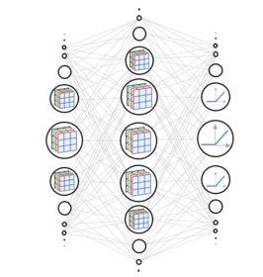

Building Models & Training

Slide 18
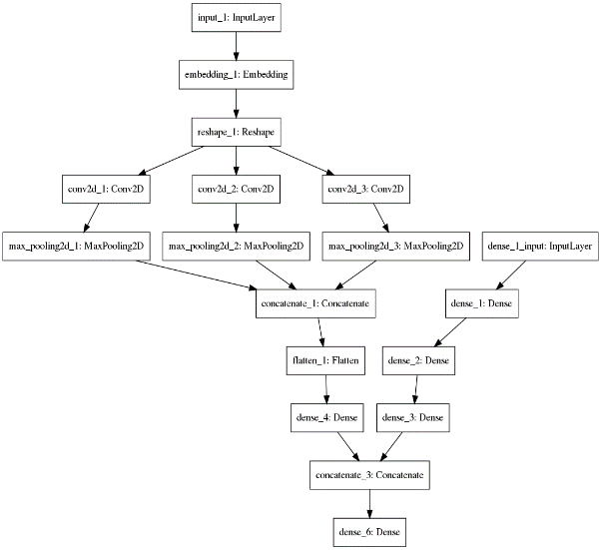
Building Models - structure

Slide 19
Building Models - structure
Introversion (I) – Extroversion (E)
Intuition (N) – Sensing (S)
Thinking (T) – Feeling (F)
Judging (J) – Perceiving (P)

Slide 20



Building Models & Training
Emotion detection – 94% for >150 words text sequence
MBTI classifier – 79% for > 2000 words text sequence

Slide 21
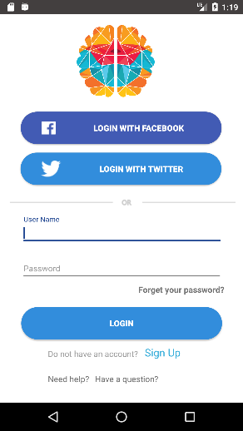
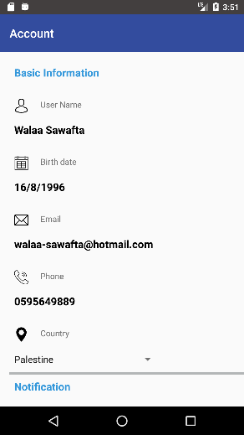

Nirvatechs mobile Application

Slide 22

Where are We?
Second model
AWS
MBTI analysis
Mechanical turks
4
The application
Web platform
2
First model
Alpha version
Collecting data
Emotion detection
5
1
3

Slide 23
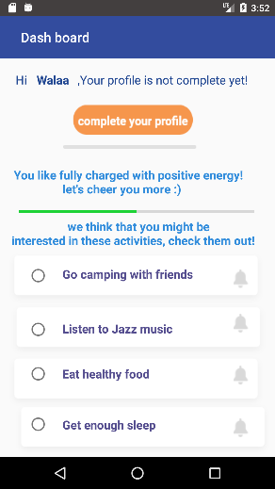
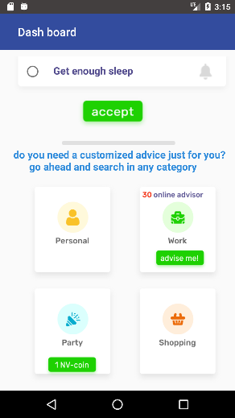
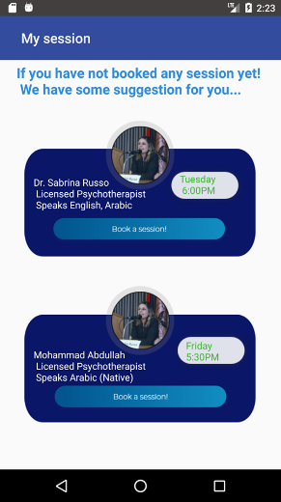

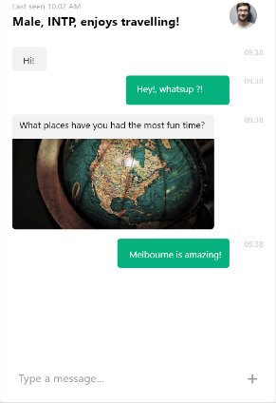

Future work

Slide 24

Future work

Slide 25
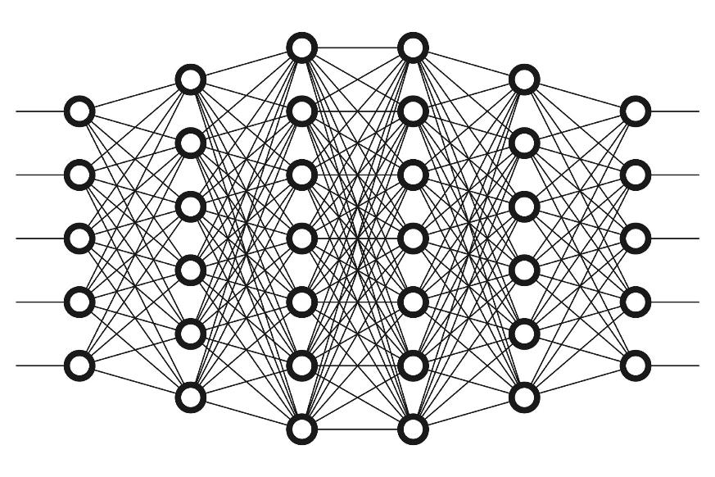
Future work

Slide 26

Slide 1
THANK YOU

Slide 27




Competitive advantage
The use of
Deep Machine
Learning
Locality & Customization
Of Language
Instant.
accurate
Services
Secure.
Private.
Virtual.
Others
Others
Others
Others
Boring, very long questionnaires
Culture and language are not very well considered
Services takes days/weeks to be served
Storing data about users,
and do it in traditional way or non-smart websites

Slide 28
Sales & marketing
How we will make money?
How we will reach customers?
Selling services as packages:
Monitoring and Tracking psychological state: 4$/Month
Live Sessions with Therapists: 70$/Month
Personal Assistant service:10$/Hr
Parent Account subscription: 1$/Month
Advertisements:
Customized Ads depends on the psychological analysis of users, price is based on the area and type of ads.
Affiliate Marketing:
Commission on products offered to users based on interests of users.
Online Advertisements.
Local Booths and events.
Partnerships with Psychiatric Clinics.

Slide 29
competitors
Better Help:
Employees 318(78% female) from 19 to 72
Founded 2013
Rev $10.5m/year
Rev in 2018 reach $ 60 m
Users 1 million
2500 us professionals
35-70 $ per week
7 Cups:
Employees (est.) (Mar 2019) 210 (+4%)
Website Visits (Jan 2019) 1.7 m
total Funding $59 m
Categories Health Care, Information Technology, Psychology, Wellness
Headquarters Regions San Francisco Bay Area, Silicon Valley, West Coast
Founded Date 2013
Founders Glen Moriarty
Operating Status Active
Rev: 7m$/year

Slide 30
competitors
Talk Space:
Employees (est.) (Mar 2019) 466 (+3%)
Website Visits (Jan 2019) 1.1 m
total Funding $59 m
Categories Employee Benefits, Health Care, Wellness
Headquarters Regions San Francisco Bay Area, West Coast,
Western US
Founded Date 2017
Founders Alyson Friedensohn, Erica T. Johnson
Operating Status Active
rev: $5.4M/year
Ginger.io:
Employees (est.) (Mar 2019) 105 (+10%)
Website Visits (Jan 2019) 20.7 k
total Funding $28.2m
Categories Analytics, Big Data, Health Care, mHealth, Mobile
Headquarters Regions San Francisco Bay Area, West Coast, Western US
Founded Date 2011
Founders Alex Pentland, Anmol Madan, Karan Singh, Ryan O'Toole
Operating Status Active
rev: $4M/year

Slide 31
Business model
Value Proposition
Customer Segments
Revenue Streams
monitoring the psychological states
students (smart devices holders)
school students, high school students, university students
Social Media Sources
Advertisements
Google
App's features and services packages
decisions recommendation system
Other DATA Providers
Adults (aged 22+)
Parents
Parents who have children -18 years old
In-App offers
psychological behavioural enhancer
Affiliate Marketing
live sessions for human therapists
Our Employees
Sell smart watches & rings
Personal assistants commission
Proposition system by mood and interests
Hot-Line consultation system

Slide 32
Business model
Key Resources
Key Partners
Cost Structure
Developers, testers, UX designers, etc.
Social Media Sources
Research and Development
Google
Licensed software
Databases and data providers
Other DATA Providers
Marketing expenses
human resources
psychologists, therapists, translators, etc..
Hardware resources
People developing and maintaining software
Hosted building

Slide 33
Around 800,000 person die due to suicide every year !
WHO global health estimates – 2016

Slide 34
Statistics references
300 million people around the world have depression
Depression and Other Common Mental Disorders: Global Health Estimates. Geneva: World Health Organization; 2017.
Around 800,000 person die due to suicide every year !
WHO global health estimates – 2016
Only 1 in 5 people receive treatment consistent with current practice guidelines
Depression and Other Common Mental Disorders: Global Health Estimates. Geneva: World Health Organization; 2017.
74% of People think that we need an APP for psychological health care and analysis.
Our published Questionnaire

