Slide 1


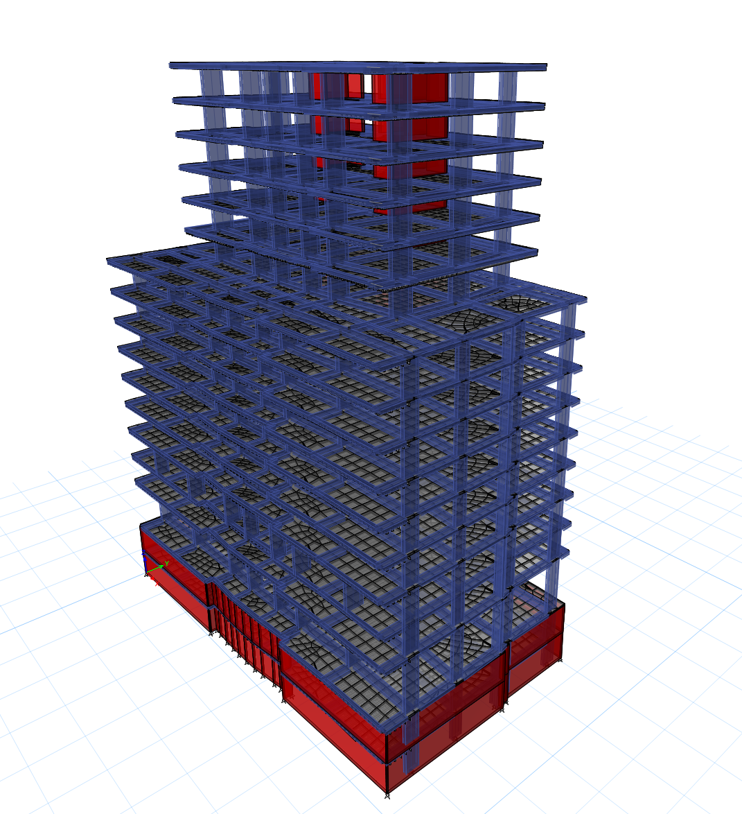
Analysis and Design Foundations of Nablus tower Building
Prepared by:
Firas Sameer Hareez
Omran Omar Said
Wael Rezeq Zeed
Yazan Ahmad khwaireh
Under supervision of: Dr. Mohammad Ghazal.

Slide 2
Content
1- Introduction
2- Type of foundation
3- Site investigation
4- STRUCTURE ANALYSIS
5- Design Piles& Raft & Retaining wall

Slide 3
Project Importance
During the last few decades, the quick growth of cities all over the world led to rapid increase in the number and height of high-rise and super high-rise building, even in unfavorable subsoil conditions.

Slide 4
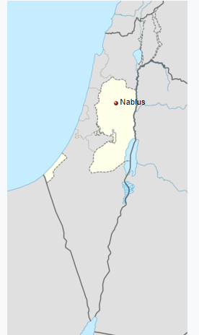
Site Description
Nablus is a city in the northern West Bank and north of Jerusalem, (approximately 63 kilometers), with a population of 126,132 so its decided to take this place due to importance of the city for commercial.

Slide 5
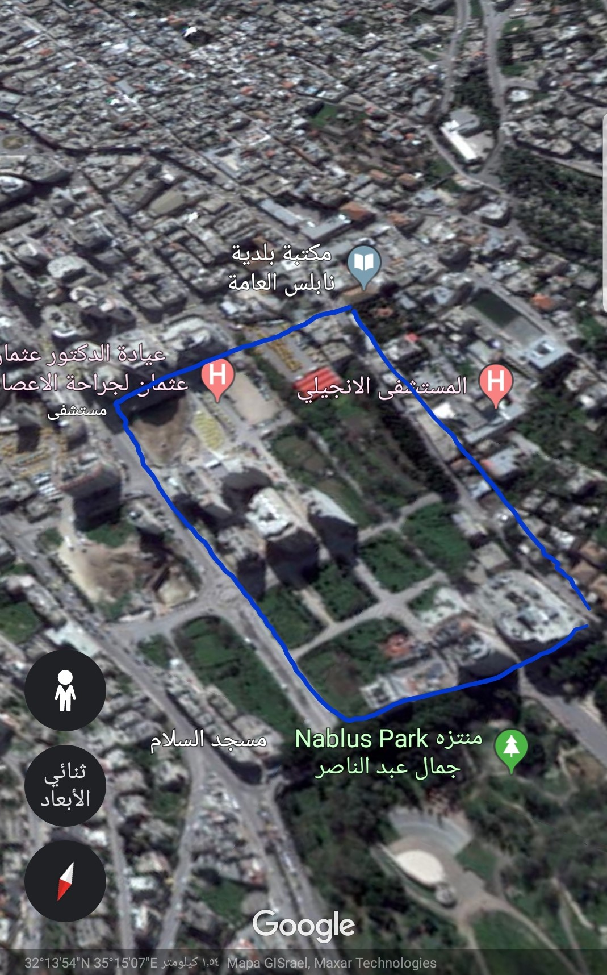
Al-Basatin area is located along the last part of suffian Street in considered an important vital area in Nablus.

Slide 6
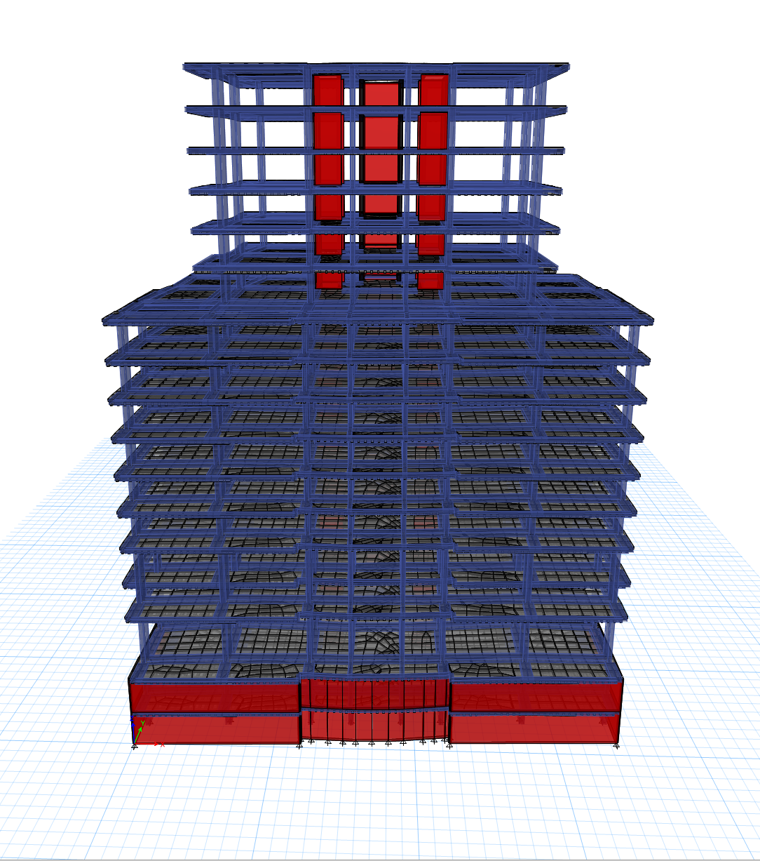
Project Description
The tower is a commercial building with a 15 Stories two of them is under the ground level. shows a model for this building.

Slide 7
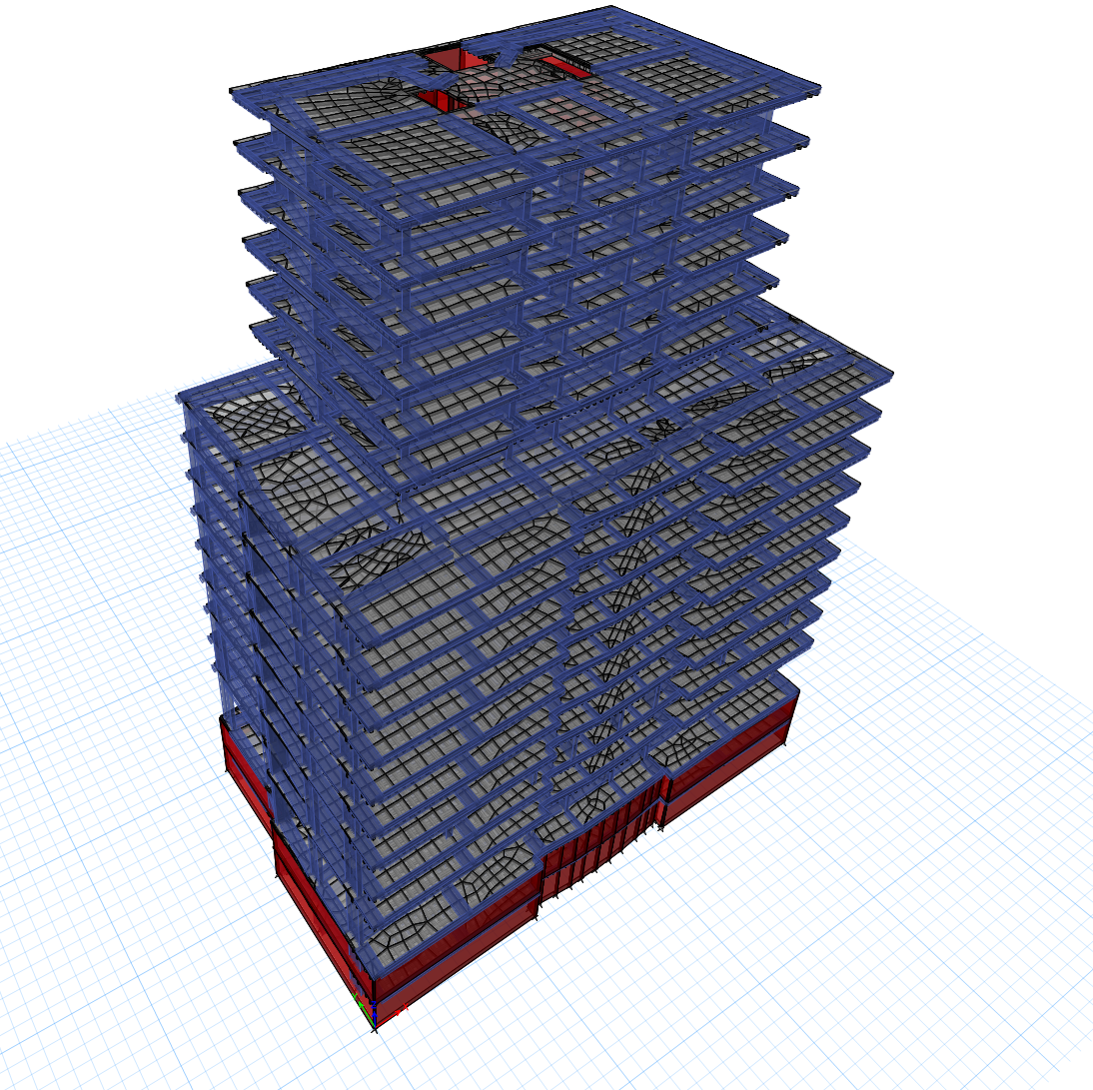
Project Description
The height of the tower is Forty-five meters including fifteen stories. The area of the plan for the first story is 1035 and 8 stories after is 1000 m2 each and in the last 6 stories is 530 m2 each.
The total area of the whole structure is 12241 m2.

Slide 8
Factor affect the selection of foundation
The load exerted by the structure.
The subsoil characteristics
The nature of structure

Slide 9
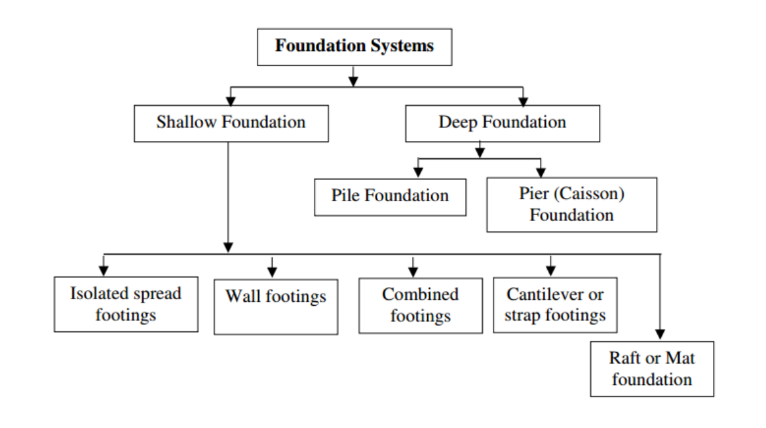
Type of Foundation system

Slide 10
RAFT Foundation
Raft foundation is a large combined thick slab designed to seat and support the whole or a large part of a structure.
A raft is usually used when subsoil is weak, or columns are closely located and with deviated loadings. It also serves as a transfer slab to combine and tie up all the vertical loading elements to the plate-form foundation. By doing so, differential settlement can be avoided.

Slide 11
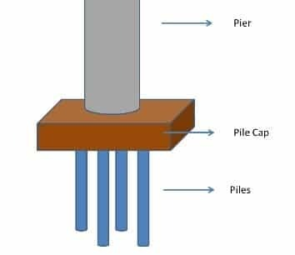
Piled foundation
Piled foundation is a form of foundation using piles to transfer the loads of a structure down to a firm soil stratum with sufficient load-taking capacity.
Piled Foundation can be classified into:
  End Bearing pile or Friction pile (or of combined nature)
  Piles formed by manual or mechanical methods
Percussion Piles (driven by hammer) or Non-percussion Piles

Slide 12
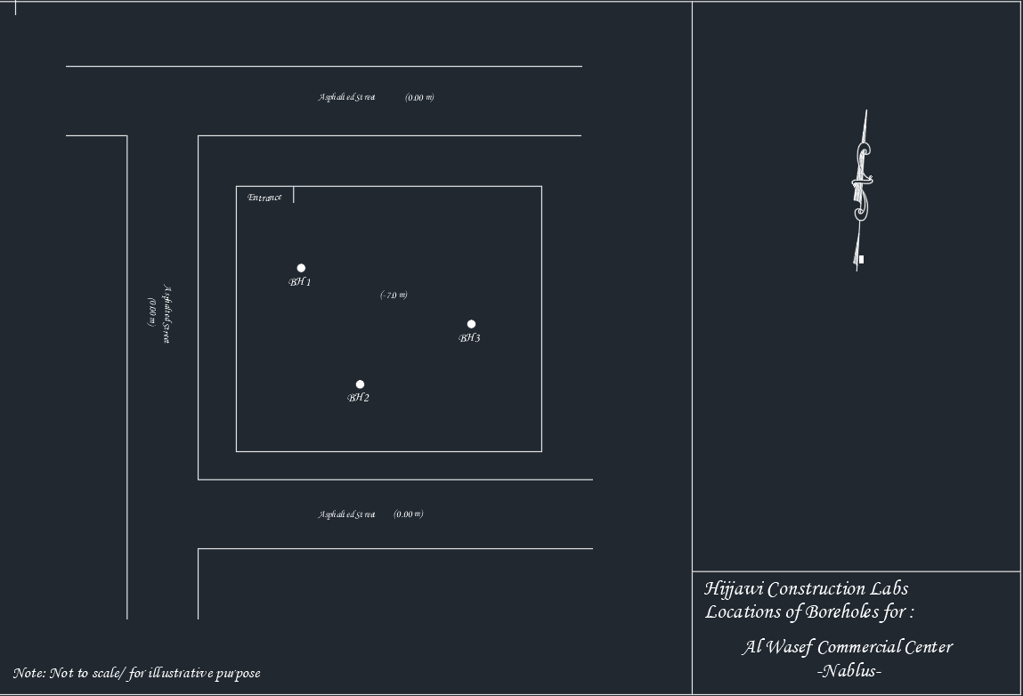

Slide 13
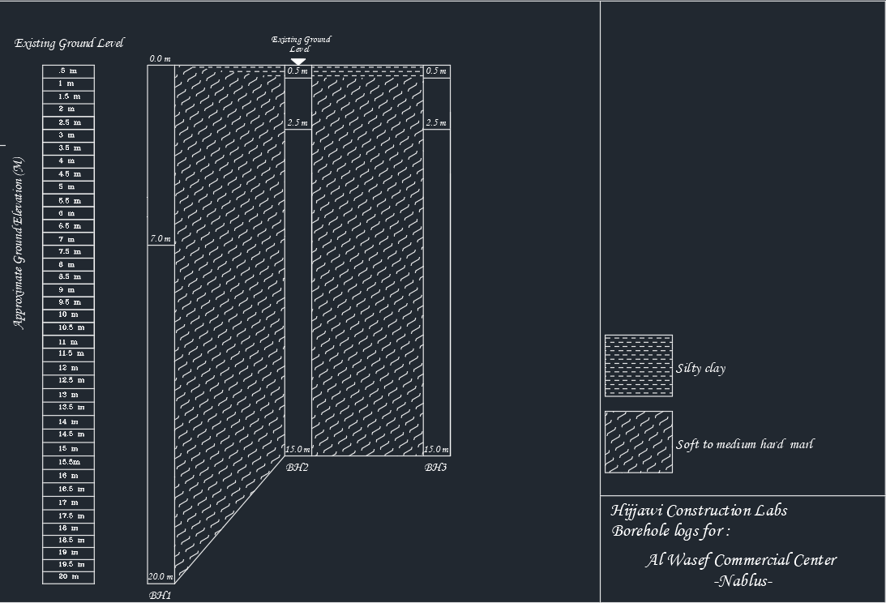

Slide 14
Site investigation
Site Geology
It was found through close Checking of the site and through drilling the sounding boreholes that the site's soil is made of soft, wet poplar and plastic throughout the depths of the excavated holes. In the drilling area number one, at a depth of 7 meters, a dry, medium-hard gray poplar appears. knowing that the excavation took place at a depth of 7 meters from the natural ground level (street level).

Slide 15
Site investigation
Soil bearing capacity:
The soil bearing capacity of the formula reconstituted samples (worst case) can be calculated using the Terzaghi formula to calculate the bearing ability of any base:
qult = CNc + γo DNq + 0.5 γ 1 B N γ
Calculation of base bearing capacity (assumed)
B=10.0 m
L=20.0 m
L/B =1
D= 3.0 m (from the existing ground level at the date of exploration)
C = 10 KN/m²
φ = 15º

Slide 16
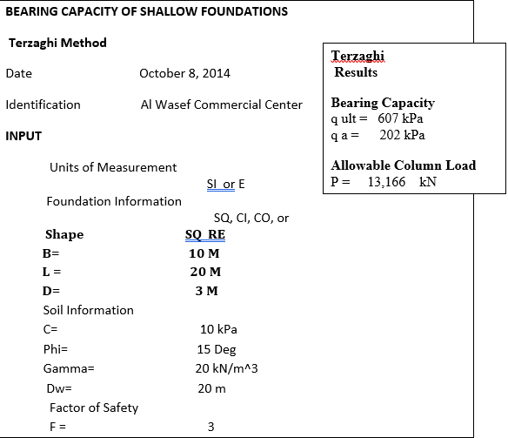
Site investigation

Slide 17
Site investigation
Results and recommendations
It is recommended that the soil bearing capacity does not exceed 2.5 kg / cm^2, assuming that the foundations will be based on the compacted gravel layer as indicated previously for the mat foundation. It is also recommended to do bearing Test check to ensure soil bearing capacity.

Slide 18
Site investigation
The surface layer drilling output cannot be used for backfilling due to its humidity and high the plasticity. In general, suitable materials is any gravel material that does not contain organic matter and plant roots and has a maximum stone size of no more than 15 cm and plasticity coefficient of 0.1

Slide 19
Site investigation
It is recommended to drain the building and protect it from water impacts and prevent water from gathering and entering the foundation area.
It is recommended to construct a not waterproof berth around the building, with a width of 2m outside, in order to protect the foundation soil from the impact of surface water.

Slide 20
STRUCTURE ANALYSIS
The Analysis of Mat foundation of 15 floor building where structural evaluation includes structural analysis for dead, super-imposed, and live loads to determine the forces and then checking the adequate dimensions of the foundation of the building

Slide 21
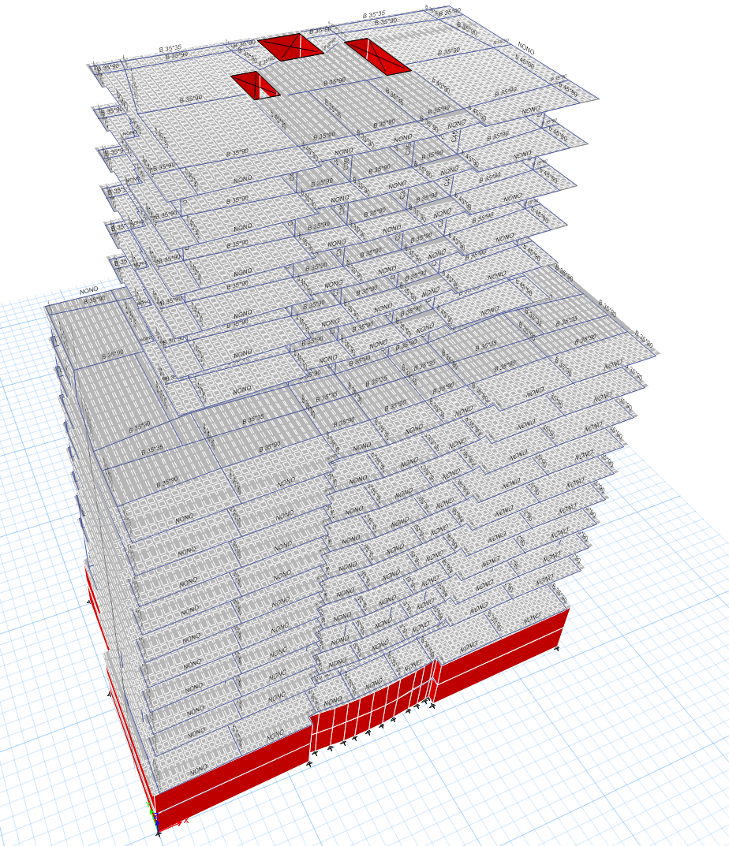
STRUCTURE ANALYSIS
ETABS offers a single user interface to perform: Modeling, Analysis, Design, making all checks needed to verify the program results such as Compatibility, Equilibrium and Stress-strain.

Slide 22
Structural System
Analysis result
Since the Service load combination has a compression reaction this means that the structure is impossible to overturn. ( Etabs result)
column# | Ultimate load | Service load
C1 | 4663.01 | 3730.51
C2 | 16229.44 | 12971.2
C3 | 16881.87 | 13487.38
C4 | 5468.46 | 4363.46
C5 | 4677.48 | 3679.63
C6 | 1485.09 | 1179.07
C7 | 19365.42 | 15287.65
C8 | 18301.11 | 14448.62
C9 | 4993.33 | 3934.41
C10 | 2855.16 | 2268.12
C11 | 6164.62 | 4876.12
C12 | 20272.09 | 16044.65
C13 | 15046.63 | 11891.66
C14 | 9961.42 | 7857.87
C15 | 10210.94 | 8059.3
C16 | 14156.79 | 11195
C17 | 18463 | 14603.76
C18 | 6594.76 | 5228.57
C19 | 6164.62 | 5022.52
C20 | 20272.09 | 9958.03
C21 | 15046.63 | 6605.81
C22 | 9961.42 | 4676.03
C23 | 10210.94 | 4607.06
C24 | 14156.79 | 6482.44
C25 | 12171.86 | 9590
C26 | 6594.76 | 5074.57
C27 | 4593.47 | 3684.05
C28 | 2341.96 | 1896.43
S1 | 2740.07 | 2122.78
S2 | 2123.26 | 1643.54
S3 | 2030.86 | 1592.72
S4 | 2640.68 | 2041.35

Slide 23
Artery method
Column | Dead load (tons) | Live load (tons) | Service Load (tons) | Ultimate loads (tons) | Bearing Capacity Kg/cm2 | Area (m2)
C1 | 370 | 63 | 433 | 545 | 2.00 | 21.65
C2 | 690 | 95 | 785 | 980 | 2.00 | 39.25
C3 | 796 | 92 | 888 | 1102 | 2.00 | 44.40
C4 | 394 | 67 | 461 | 580 | 2.00 | 23.05
C5 | 293 | 66 | 359 | 457 | 2.00 | 17.95
C6 | 228 | 59 | 287 | 368 | 2.00 | 14.35
C7 | 1317 | 107 | 1424 | 1752 | 2.00 | 71.20
C8 | 1066 | 104 | 1170 | 1445 | 2.00 | 58.50
C9 | 170 | 57 | 227 | 295 | 2.00 | 11.35
C10 | 165 | 53 | 218 | 282 | 2.00 | 10.90
C11 | 294 | 67 | 361 | 460 | 2.00 | 18.05
C12 | 826 | 103 | 929 | 1156 | 2.00 | 46.45
C13 | 651 | 88 | 739 | 922 | 2.00 | 36.95
C14 | 463 | 77 | 540 | 679 | 2.00 | 27.00
C15 | 460 | 77 | 537 | 675 | 2.00 | 26.85
C16 | 615 | 88 | 703 | 879 | 2.00 | 35.15
C17 | 850 | 104 | 954 | 1187 | 2.00 | 47.70
C18 | 209 | 70 | 279 | 363 | 2.00 | 13.95
C19 | 384 | 57 | 441 | 552 | 2.00 | 22.05
C20 | 538 | 97 | 635 | 801 | 2.00 | 31.75
C21 | 378 | 82 | 460 | 585 | 2.00 | 23.00
C22 | 249 | 71 | 320 | 413 | 2.00 | 16.00
C23 | 242 | 71 | 313 | 404 | 2.00 | 15.65
C24 | 383 | 80 | 453 | 571 | 2.00 | 22.65
C25 | 507 | 100 | 607 | 768 | 2.00 | 30.35
C26 | 318 | 60 | 378 | 477 | 2.00 | 18.90
C27 | 418 | 50 | 568 | 581 | 2.00 | 28.40
C28 | 351 | 45 | 396 | 493 | 2.00 | 19.80
S1 | 1314 | 113 | 1427 | 1757 | 2.00 | 71.35
S2 | 1262 | 104 | 1366 | 1681 | 2.00 | 68.30
S3 | 309 | 53 | 362 | 393 | 2.00 | 18.10
S4 | 266 | 42 | 308 | 386 | 2.00 | 15.40

Slide 24
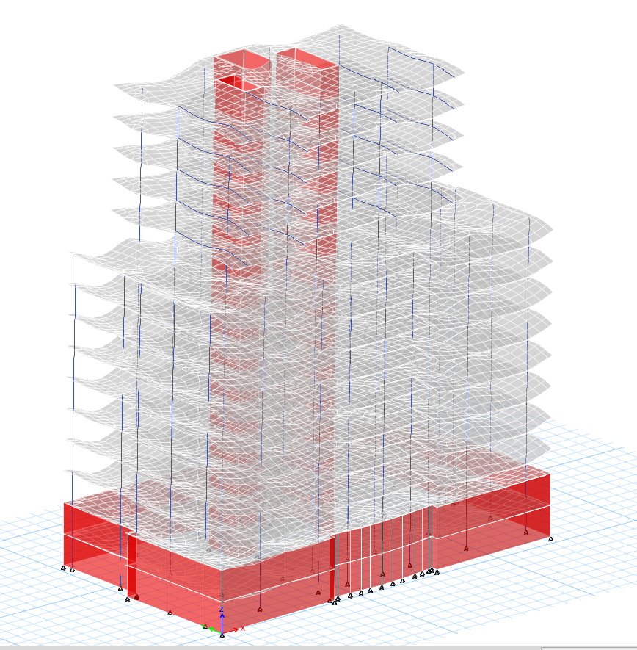
structural system
Verifications of structural Analysis
Compatibility Check

Slide 25
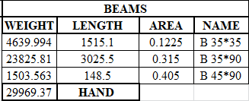
structural system
Equilibrium Check
Calculations of weights by hand:
Dead Loads: Own weight of structural elements:
Beam calculation :
Weight of Beam = length of beam*Section Area*Unit weight of concrete

Slide 26
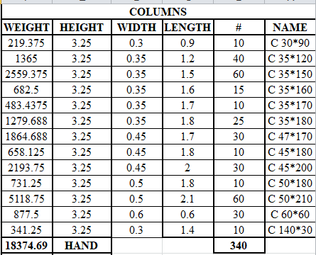
structural system
Columns calculation
Weight of Column =Section Area*Length of column*Unit weight of concrete*# Of column

Slide 27
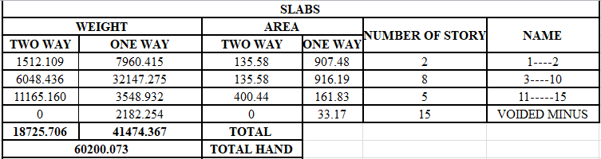
structural system
Slab calculation
Weight of Slab = Area of slab*Slab section*Unit weight of concrete*#of stories

Slide 28
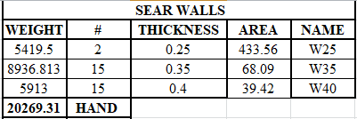
structural system
Shear wall calculation
Weight of Slab = Area of wall*wall section*Unit weight of concrete*# Of Stories

Slide 29

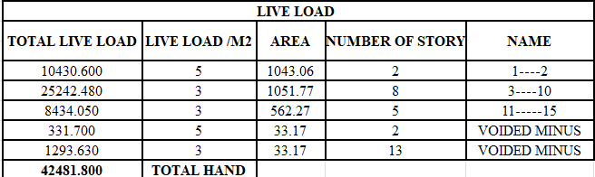
structural system
Total Dead load:
Live Loads:
This load is applied to slabs, then determine areas of slabs and multiply them by the live loads expected.

Slide 30
structural system
Superimposed Loads:
This load is applied to slabs, then determine areas of slabs and multiply them by the SD loads expected.
SID LOAD
NAME | NUMBER OF STORY | AREA | LIVE LOAD /M2 | Super imposed LOAD
1----2 | 2 | 1043.1 | 4 | 8344.480
3----10 | 8 | 1051.8 | 4 | 33656.640
11-----15 | 5 | 562.27 | 4 | 11245.400
VOIDED MINUS | 15 | 33.17 | 4 | 1990.200
 |  |  | TOTAL HAND | 51256.320
 |  |  | TOTAL ETABS | 51228.56

Slide 31
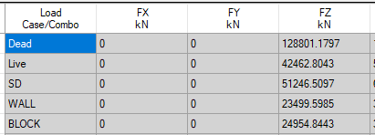
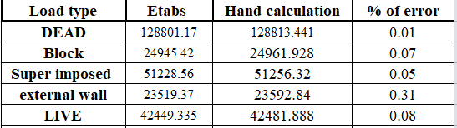

structural system
From ETABS
$Error=\frac{Manual−Etabs}{Manual}∗100\%$
Difference: 0.61%
All of them are less than 5% then okay.

Slide 32
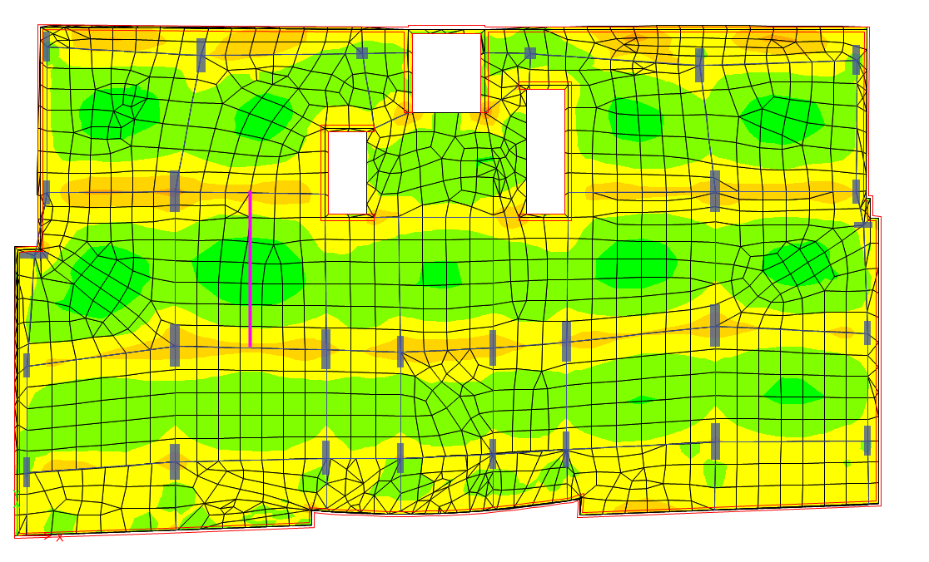
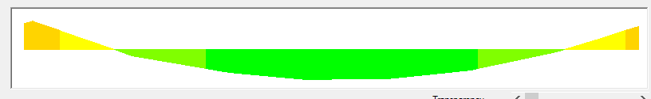
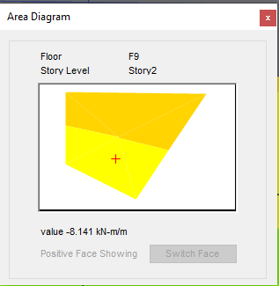
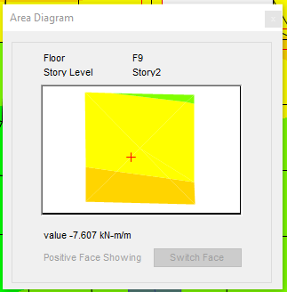
structural system
3- Stress-Strain Check
M22 (-ve) = 7.87KN.m
M22 (+ve) = 15.15KN.m

Slide 33
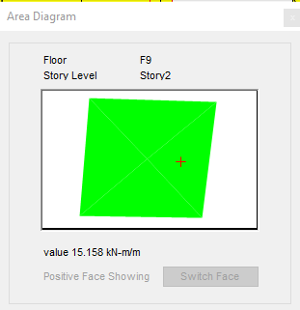

structural system
By ETABS M11 = $\frac{8.14+7.6}{2}+15.16=23.03KN.m$
M22manual $=\frac{wl^{2}}{8}=\frac{3×{7.72}^{2}}{8}=22.35KN.m$
$Error= \frac{23.03−22.35}{22.35}=3.04\%<10\% i$

Slide 34
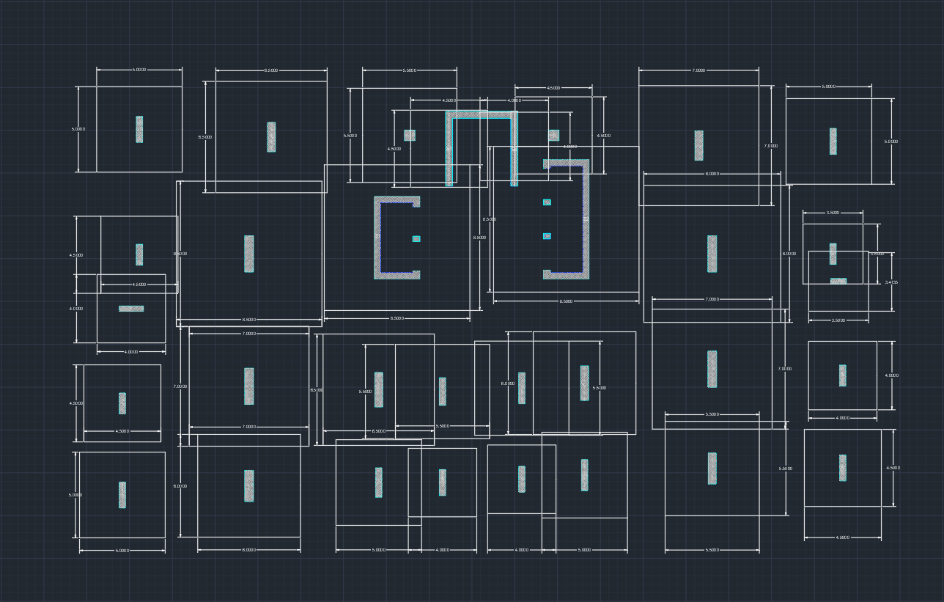

Slide 35
Chapter Four: Pile & Raft/Retaining wall Design
Pile Design
After calculating the loads on each column, we have decided to use pile and mat foundation system due to the heavy loads existed, the soil bearing capacity is low, so this had led us also to use this system.
In this design we made many iterations to achieve the perfect design.
Using one pile or two piles in one cap is not preferred because of the instability in this case, so we have tried to use group piles under raft foundation depending on the loads on each column.
Number of piles in the one cap was restricted by the geometry of the whole system. The over lapping piles was the main reason in this case. The minimum distance between two piles was 2.5 the diameter of the pile.
So, the loads and the minimum distance between two piles were the two main factors in the design. Moreover, the property line was considered in the design.
We tried not to exceed 20m in the length of the pile to achieve the practical design.
Just few piles exceeded this number. The diameter of the pile is 100 cm and it is the same in every pile, also we tried in this case to achieve practical design.

Slide 36
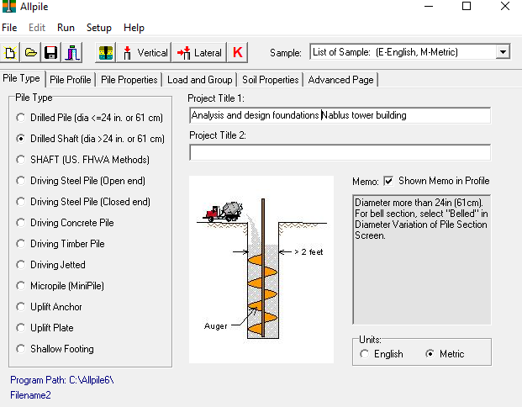
The design of the piles was done by ALL PILE program. Procedure followed in the ALL PILES program

Slide 37
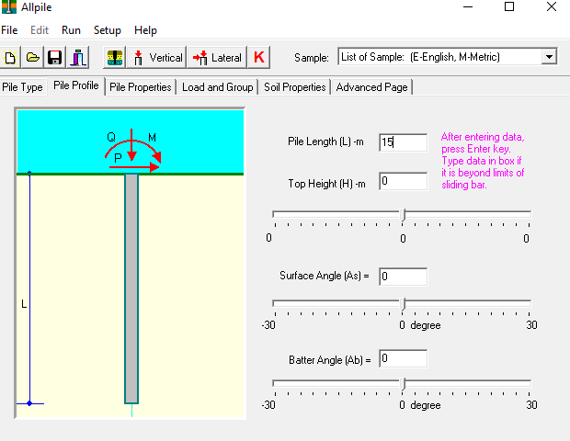

Slide 38
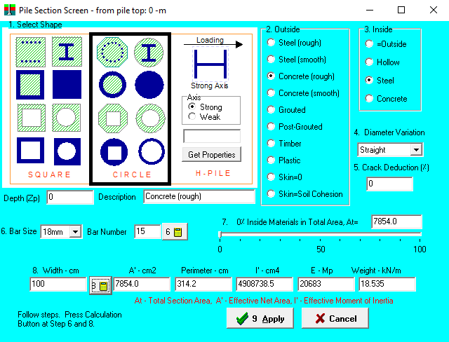

Slide 39
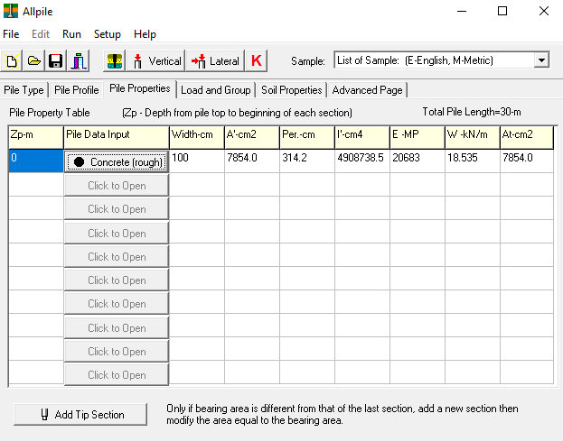

Slide 40
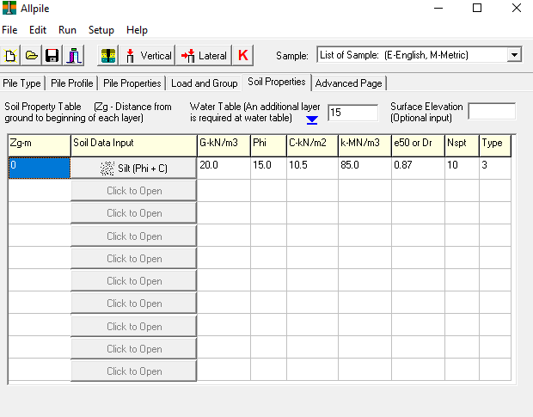

Slide 41
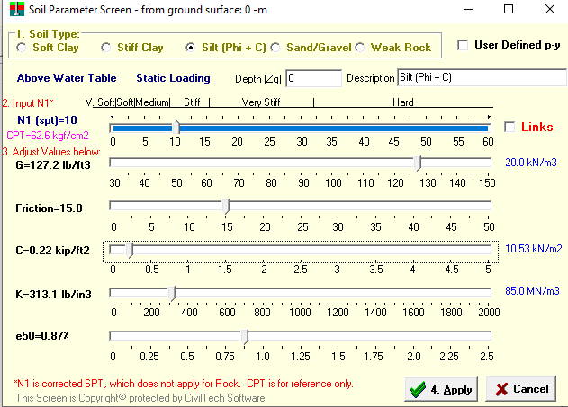

Slide 42
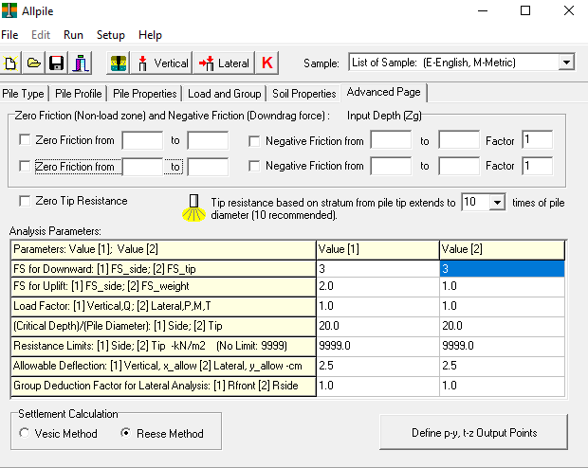

Slide 43
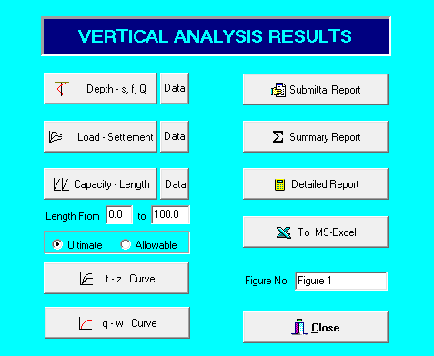

Slide 44
Then we can read the results, we need to read the bearing capacity(service) of each pile (because of different lengths) then by dividing the load (also service) on the bearing capacity we can know the number of piles needed.
Sample: C14 Service load: 540 tons
Capacity: 106.1
540/106.1 = 5.09.
So, use 5 piles.

Slide 46
Design of Reinforcement in the Piles
The diameter of the piles was 100 cm. Due to the high stiffness of the piles & the high lengths of the piles, it was noticed that the reinforcement in each pile was the minimum reinforcement steel.
As = ρ X area = 0.005 (π/4) (1000)2
= 3927 mm 2
Use 15 Ф 18
Perimeter = π D = 314.15 cm
Spacing = 314.15/15 = 20 cm.
S= 20 cm.
It is recommended to use spiral stirrups 1Ф8 mm / 10 cm

Slide 47
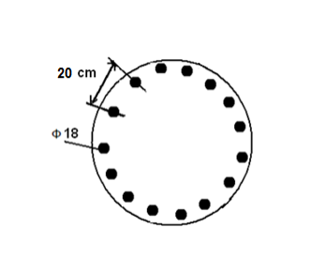

Slide 48
Cost Estimation
In order to estimate the total cost, we have to calculate the concrete cost, the
steel costs, and the cost of drilling the piles.
The sizes of the piles and mat foundation must be
determined, then calculate the cost by multiplying the size by the cost
of one cubic meter of concrete (B 400).

Slide 50
The total size is 2057.7 m 3
The cost of one cubic meter of concrete is 320 NIS.
The total cost of concrete = 2057.7*320 = 658464 NIS .

Slide 51
Cost of drilling the piles
Total length needed to be drilled is 515 m
The cost to drill one-meter length is 50 NIS
Cost of the drilling = 515*50 = 25750 NIS

Slide 52
 | longitudinal reinforcement transverse reinforcement
Type by length |  | No. of piles | no of bars | dia. m | Total length m | weight ton | length of stirrup m | no. of stirrups | dia. m | Spacing cm | Total length m | weight ton
15(m) |  | 104 | 15 | 18 | 24960 | 49.92 | 368 | 1 | 8 | 12 | 38272 | 15.12
20(m) |  | 24 | 15 | 18 | 19080 | 38.16 | 490 | 1 | 8 | 12 | 11760 | 4.64
Total |  |  |  |  |  | 88.08 |  |  |  |  |  | 19.76

Slide 53
Total weight of steel in the piles is 107.84 ton.
The cost of 1 ton of the steel (420 MPa) is 2650 NIS.
Total cost of steel= 2650 * 107.84 = 285800 NIS
Total cost of piles = 658464 + 25750 + 285800 = 970000 NIS.

Slide 54
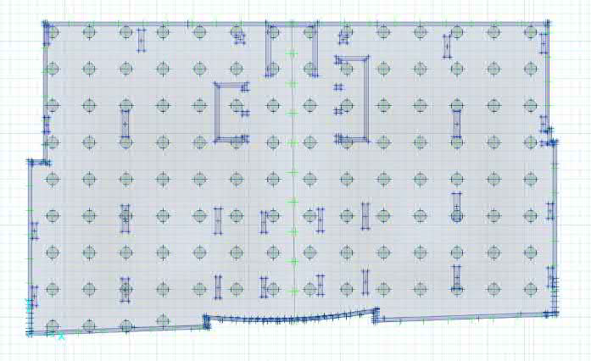
Raft foundation Design
Design of foundation
The type of foundation that is used is raft foundation with piles, the capacity of Pile
950KN, the diameter of it 90 cm, length equals 9m and raft thickness = 1.4m
The foundation is modeled using SAFE 2016 Program, Figure 1-13 shows the layout of
foundation and its modeling on SAFE Program

Slide 55
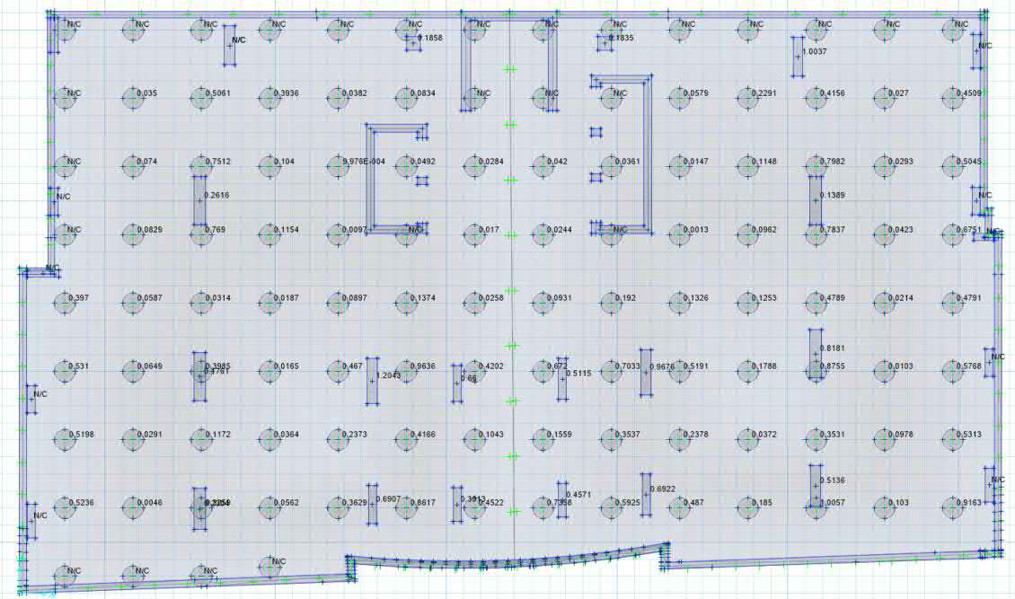
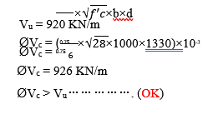
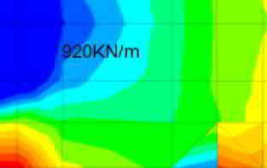
Punching Shear Check
Punching Shear Check
Wide Beam Shear Check

Slide 56
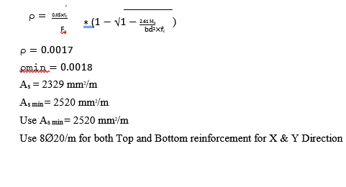
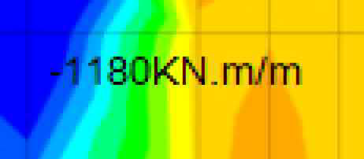
Flexural Design

Slide 57
Cost Estimation for Raft and steel
Estimation of steel reinforcement quantity is a necessary step in calculating cost of RCC structure along with other building materials as per construction drawing,
Accurate calculation of reinforcement in the building plays an important role in
the overall costing of the project
Account quantities for reinforcement concrete Raft thickness = 1.4m
Area of building=1035m2
Area of building X Raft thickness = reinforcement concrete required
1035m2 X 1.4m=1449m3
The price of a concrete cubic=
1449m3X 320 = 463680 INS

Slide 58
Cost Estimation for Raft and steel
We used in this design 8Ø20/m for both Top and Bottom reinforcement for X & Y
Direction
The weight of one longitudinal meter of the twenty rod 2.4 kilogram
We have 8 in X direction and 8 in Y direction, the length of each one of them is 1-meter, total length of 16 meters, the total length is 32, 32x2.4=76.8, the quarter meter contains 76.8 kg, Multiply the area by the base by this weight per square meter you will find the total iron weight.
76.8 Kg X 1035m2 =79488/1000=79.488ton
Multiply 79488 X 1.1=87.436 ton
The price of Top and Bottom reinforcement for X & Y Direction
87.436ton x 2650 per ton =231705 INS

Slide 59
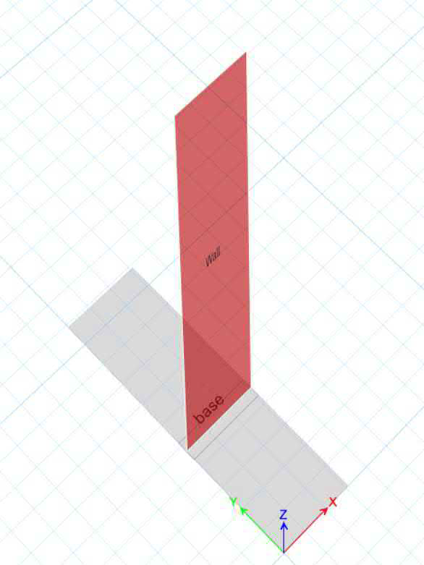
Retaining wall

Slide 60
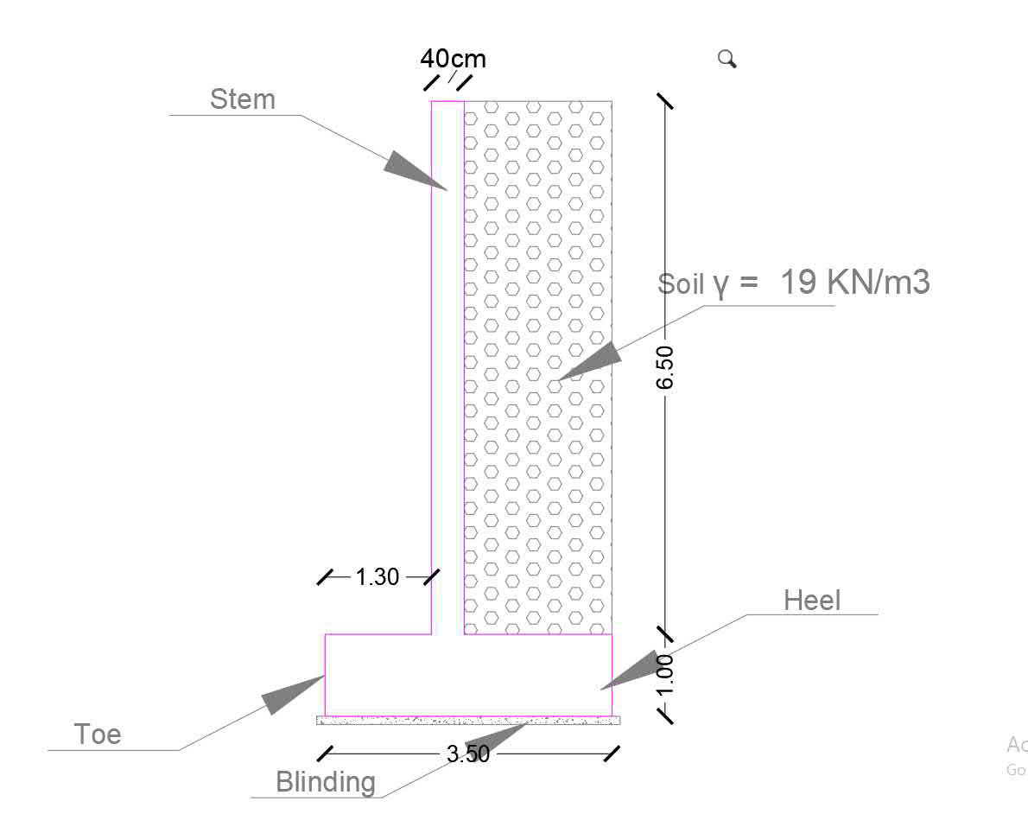
Stem
Stem > 200 mm
So stem = 400 mm.
Base
B=3.5m
Toe = 1.3 m.
Heel = 1.8 m.
And thickness base = 0.1h = 1 m
Dimension

Slide 61

Checks stability
Fc = 24 MPa fy=420MPa
$∅=15$ Qall=202KPa
Ka= ($\frac{1−sin∅}{1−sin∅}$) =0.333
Check over turning
M over turning
Mo = 2.4*162.52=390 Kn.m
F1=6.5*0.4*25= 65 KN
Mf1=F1 * 1.525= 65 *1.525 = 99.125KN.m
F2= 1*3.5*25= 87.5 KN
M2 = 61.25*1.75 = 153.125 KN.m
F3 = 19*1.85*6.5=228.475 KN
M3=228.475*2.575 =588.32 KN.m
M resisting = 850.7 KN.m
FS = 850.7\ 390=2.2 > 2 → OK

Slide 62
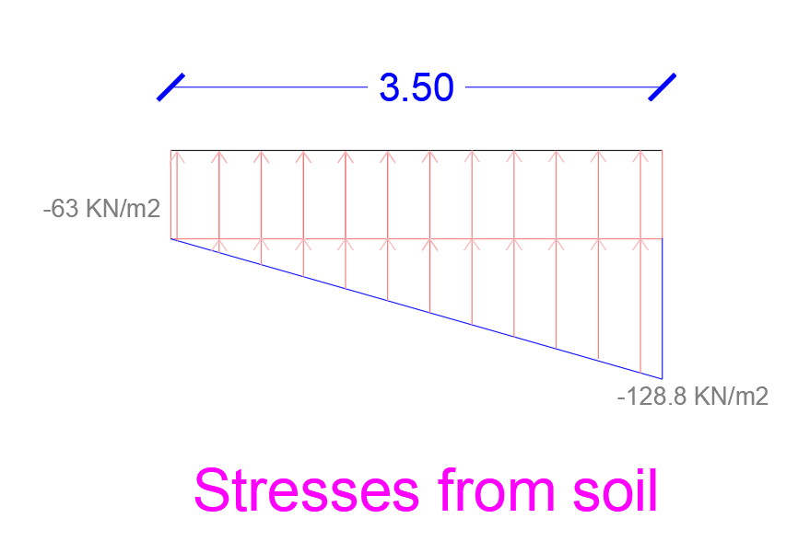
check bearing
Ma = 0
850.5-390= a*381
A = 1.25m
M = 0.3*381=114 KN.m
= -p\A - (Mo\I)
= (-381\3.5) + (114\ ((1/12)*3.1^3)) = -63
= (-381\3.5) - (114\ ((1/12)*3.1^3)) = -155 kPa <202kPa →ok
Max. Stress < 202 KN/m2 OK. And two values are minus so no tension

Slide 63
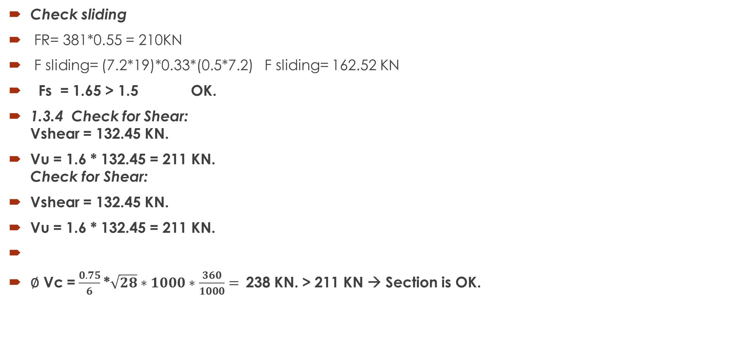
Check sliding
FR= 381*0.55 = 210KN
F sliding= (7.2*19)*0.33*(0.5*7.2) F sliding= 162.52 KN
Fs = 1.65 > 1.5 OK.
1.3.4 Check for Shear:
Vshear = 132.45 KN.
Vu = 1.6 * 132.45 = 211 KN.
Check for Shear:
Vshear = 132.45 KN.
Vu = 1.6 * 132.45 = 211 KN.
∅ Vc =$\frac{0.75}{6}$*$\sqrt{28}∗1000∗\frac{360}{1000}=$238 KN. > 211 KN → Section is OK.

Slide 64
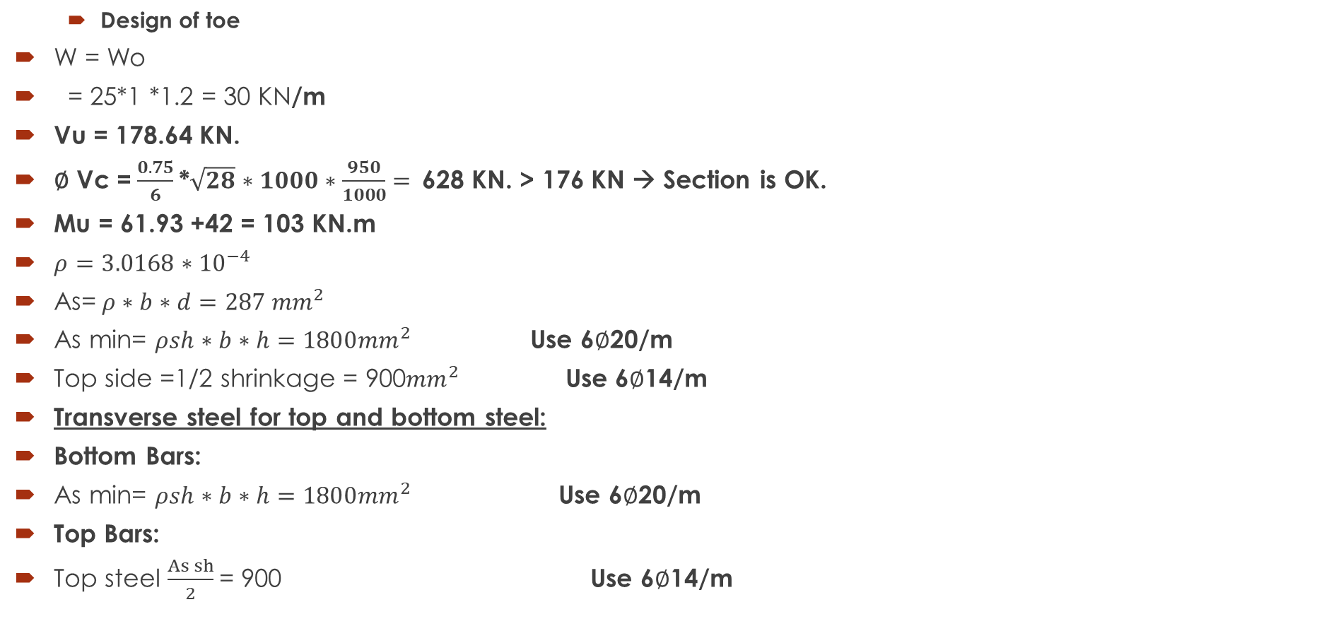
Design for flexure
  Design of toe
W = Wo
= 25*1 *1.2 = 30 KN/m
Vu = 178.64 KN.
∅ Vc =$\frac{0.75}{6}$*$\sqrt{28}∗1000∗\frac{950}{1000}=$628 KN. > 176 KN → Section is OK.
Mu = 61.93 +42 = 103 KN.m
$ρ=3.0168∗{10}^{−4}$
As=$ρ∗b∗d=287{ mm}^{2}$
As min= $ρsh∗b∗h=1800{mm}^{2}$ Use 6$∅$20/m
Top side =1/2 shrinkage = 900${mm}^{2}$ Use 6$∅$14/m
Transverse steel for top and bottom steel:
Bottom Bars:
As min= $ρsh∗b∗h=1800{mm}^{2}$ Use 6$∅$20/m
Top Bars:
Top steel $\frac{As sh}{2}$= 900 Use 6$∅$14/m

Slide 65

  Design of heel
W = Wo + Ws
= 25*1 *1.2 + 6.5*19 *1.2 = 178.2 KN/m
Vu = 69.44 KN.
∅ Vc =$\frac{0.75}{6}$*$\sqrt{28}∗1000∗\frac{950}{1000}=$628 KN. > 69 KN → Section is OK.
Mu = 36.44 KN.m
$ρ=1.068∗{10}^{−4}$
As=$ρ∗b∗d=232{ mm}^{2}$
As min= $ρsh∗b∗h=1800{mm}^{2}$ Use 6$∅$20/m
Top side =1/2 shrinkage = 900${mm}^{2}$ Use 6$∅$14/m
Transverse steel for top and bottom steel:
Bottom Bars:
As min= $ρsh∗b∗h=1800{mm}^{2}$ Use 6$∅$20/m
Top Bars:
Top steel $\frac{As sh}{2}$= 900 Use 6$∅$14/m
Transverse direction:
Mu = 40KN.m → use As min. = 1800 mm2.
Use 6$∅$20
Top face:
Ast = Ashrinkage /2 * b * h = 900mm2.
Use 6$∅$14/m

Slide 66

  Design of stem :
Inner steel:
Mu = 460KN/m
$ρ=0.0104$ As= 3760 ${mm}^{2}$
$ρ s=0.0018 As=720{mm}^{2}$ → Use 8$∅$25/m
Shrinking steel at outer face of stem:
$\frac{.0018}{2}∗b∗h=360{mm}^{2} → Use 6∅12$/m
Horizontal steel
Two faces
$ρ\min{=0.005}→As sh= \frac{0.005}{2}∗b∗h=1000 {mm}^{2} Use 7∅14$/m

Slide 67
Thank you for listening
☺

