Slide 1
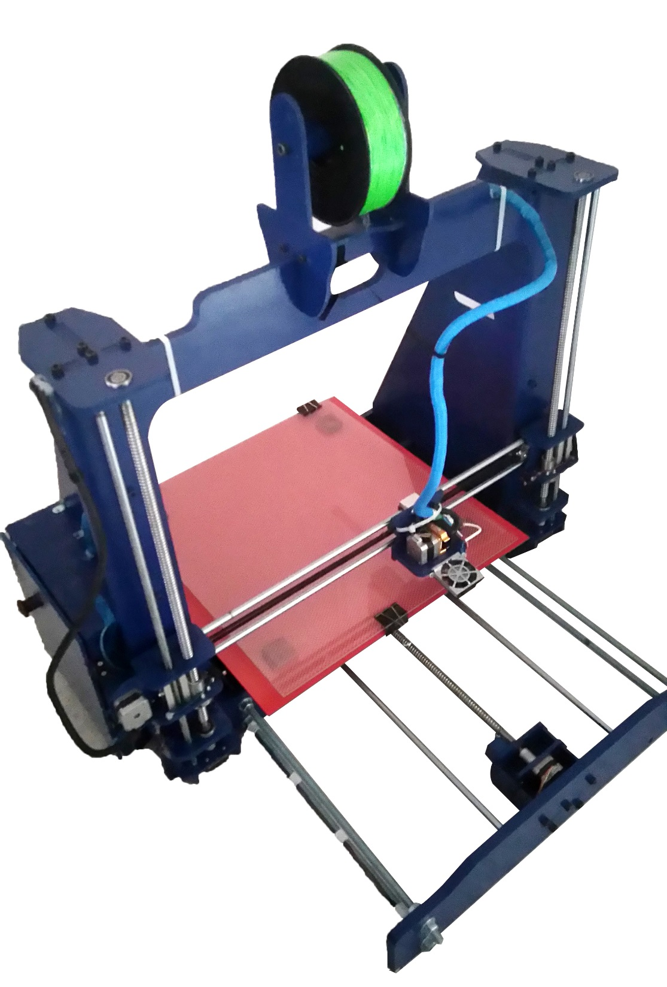
3D-Printer
Ahmad Nofal
Feras Arafat
Said Abdallah
Mohammad Sabri
Bahaa younis
Supervisor: Eng. Salamah abd-Alfatah

Slide 2


Slide 3
Outlines
Introduction
Mechanical part
Electrical part and protection circuit.
Software.
Control loop.
Calibration.
Results.
Conclusions.

Slide 4
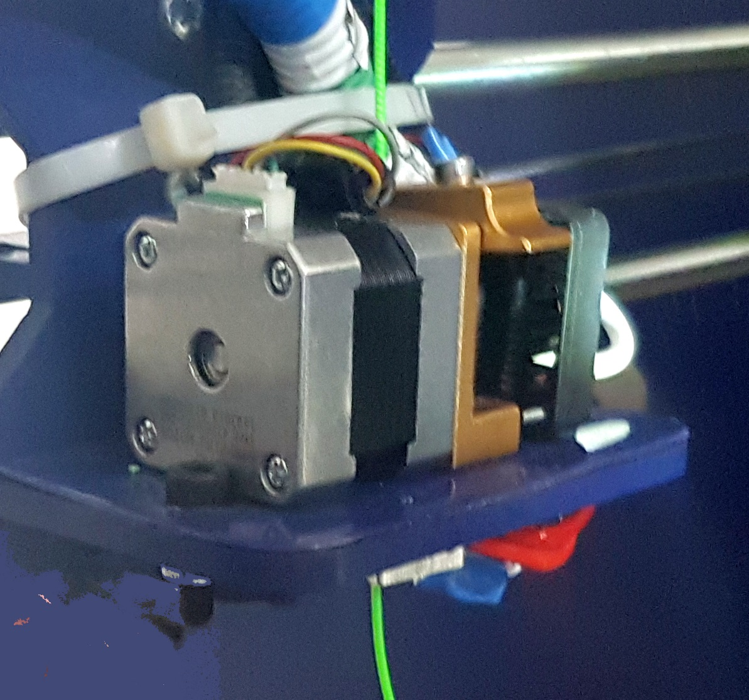
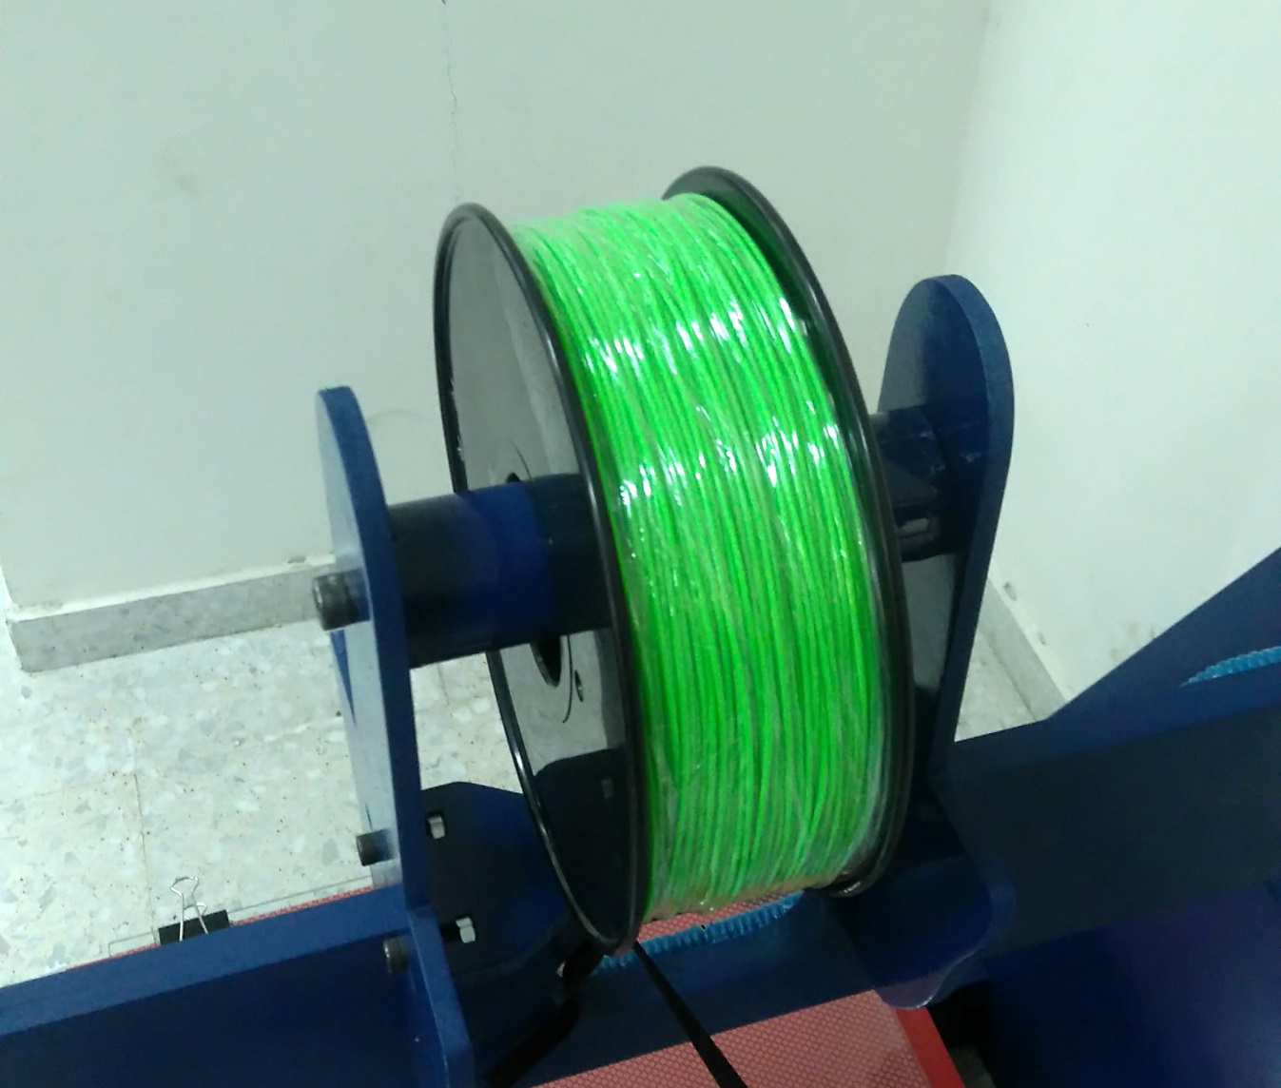
Thermoplastic Extruder and ABS material

Slide 5
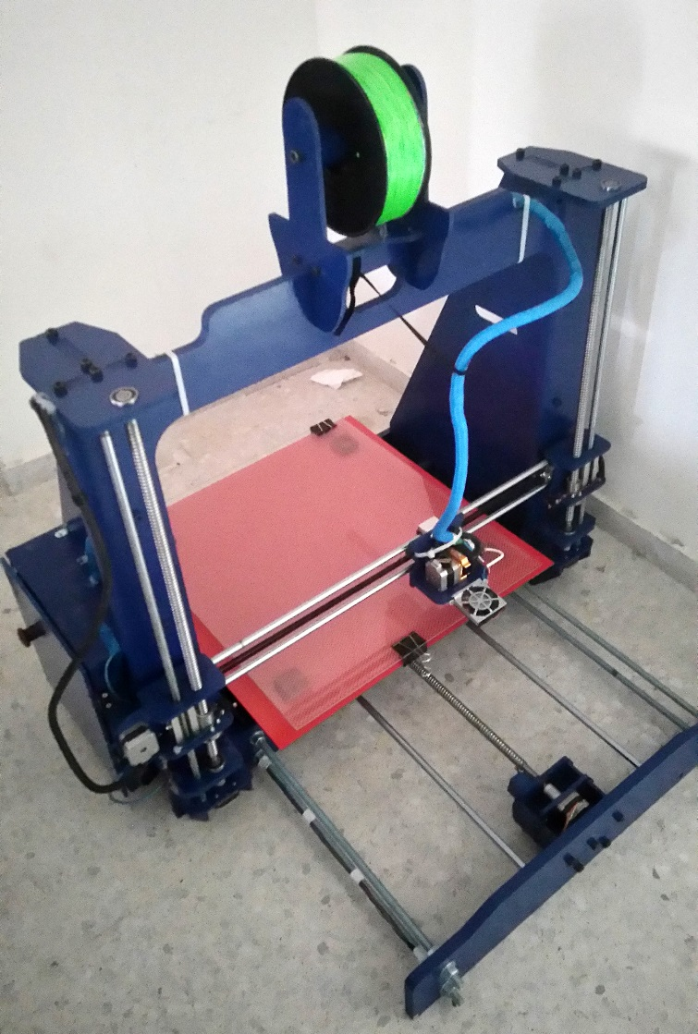
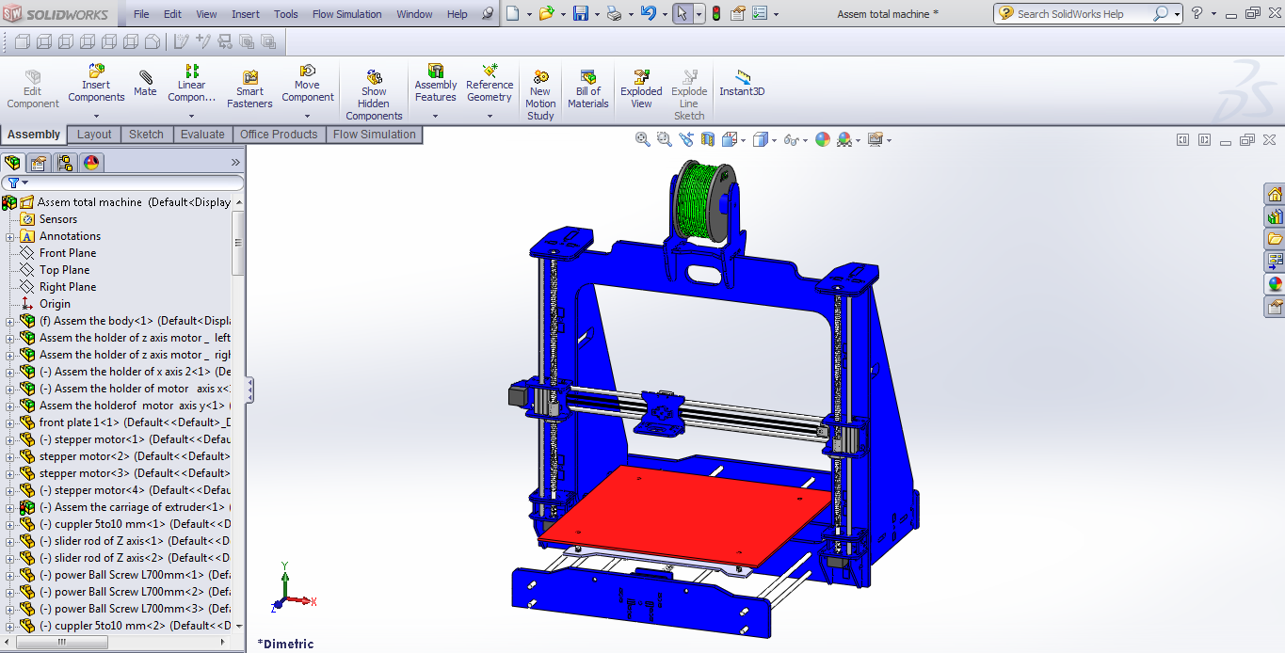
Mechanical design
Frame design
Practical models
3D models

Slide 6
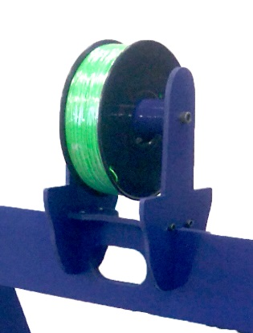
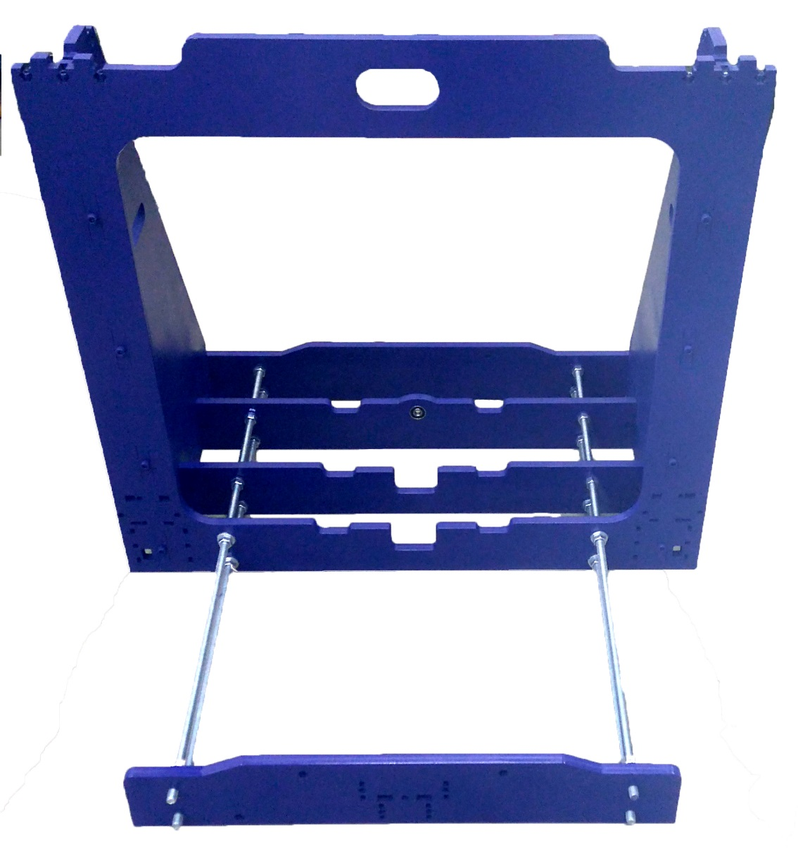
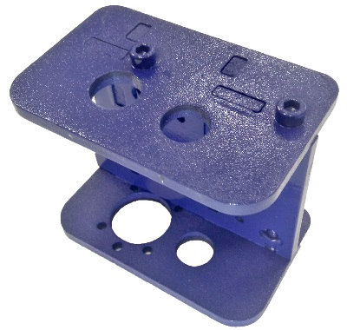
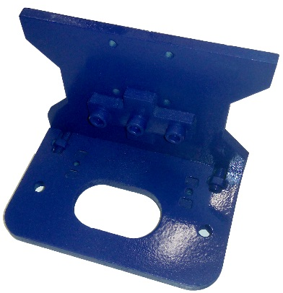
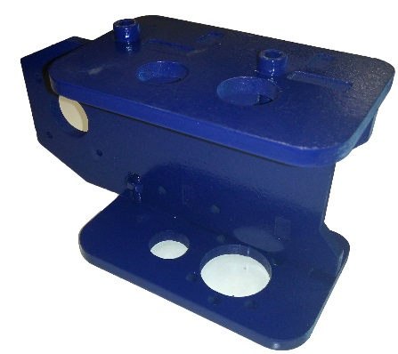
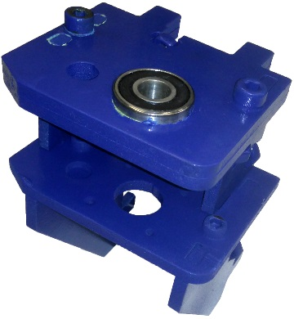
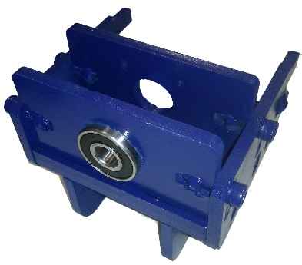
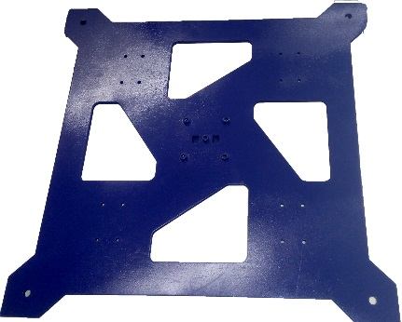
Material and Main body

Slide 7
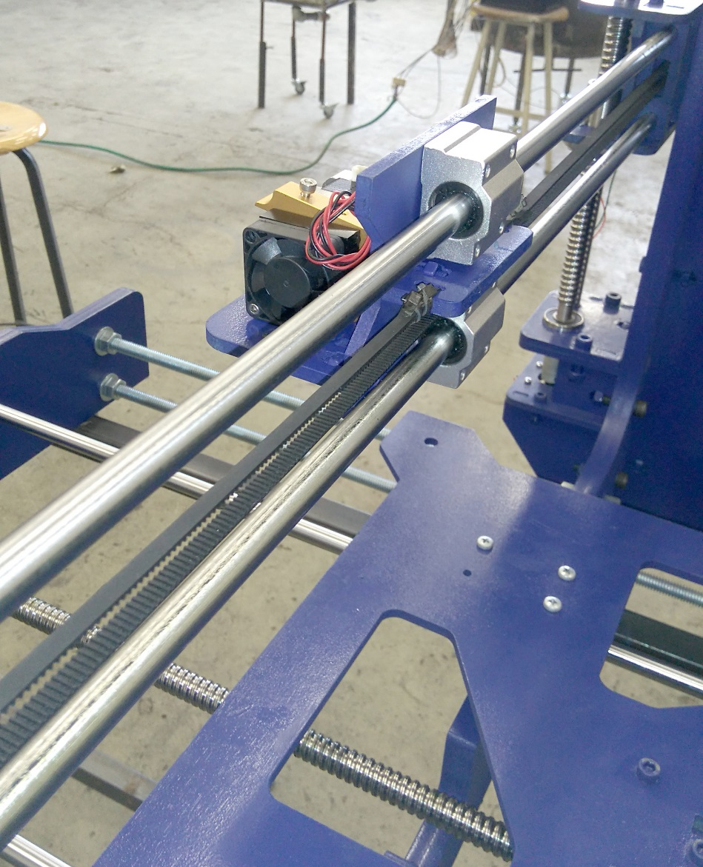
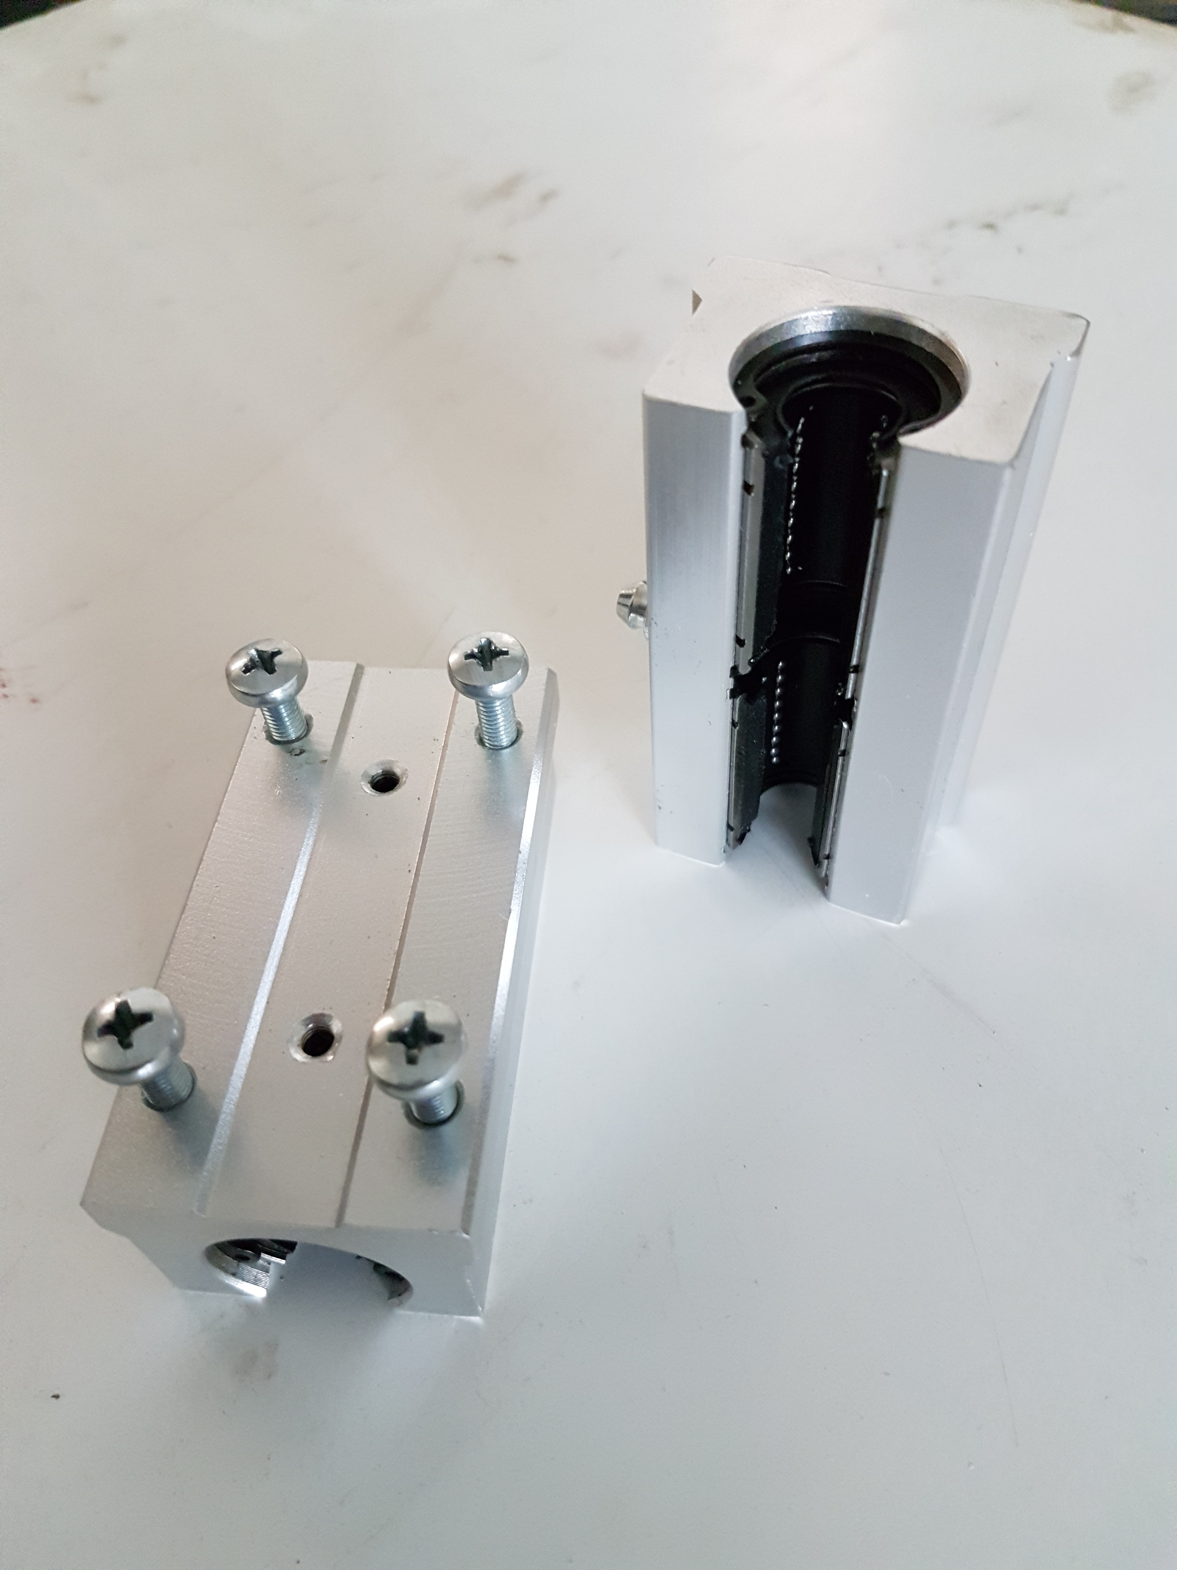
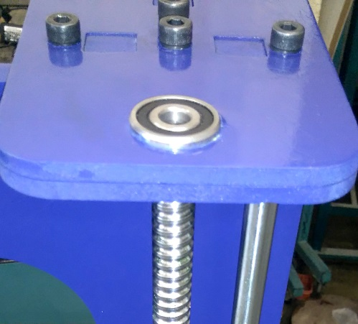
Transmission systems
Rod rails
X axis has 2*85 cm
Y axis has 2*95 cm
Z axis has 2*72cm.
Linear and rotation ball Bearings

Slide 8
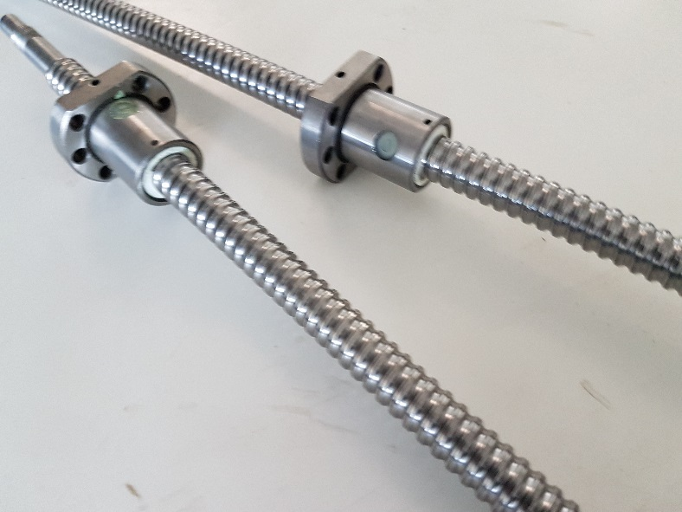
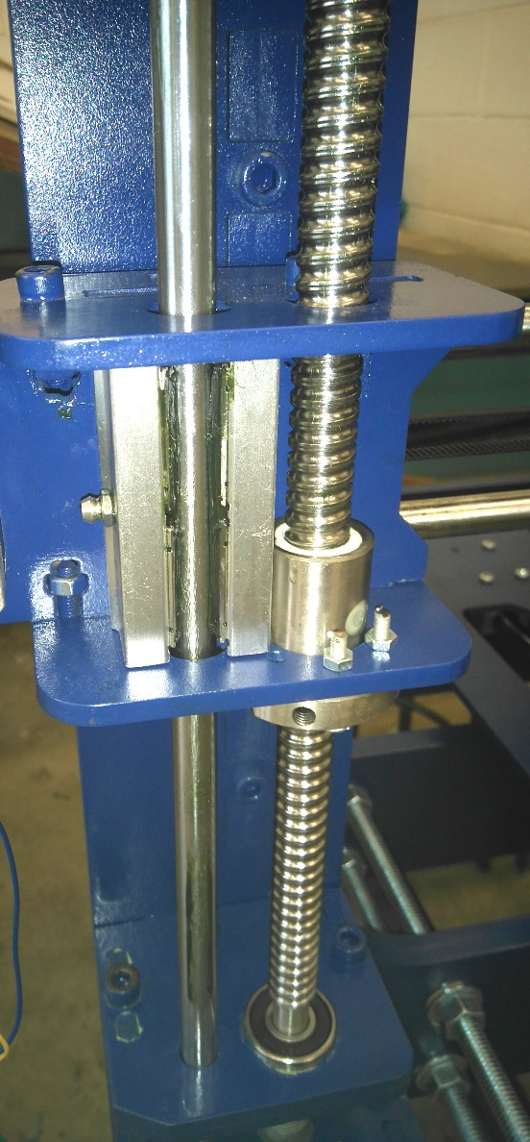
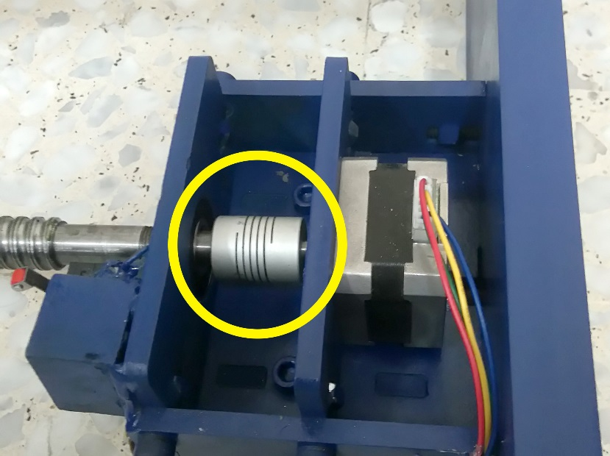
Transmission systems
Power screws and ball nut
For Y and Z -axis
Coupler
It used for join between stepper motor and power screw

Slide 9
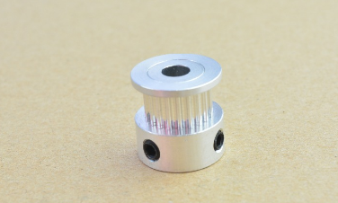
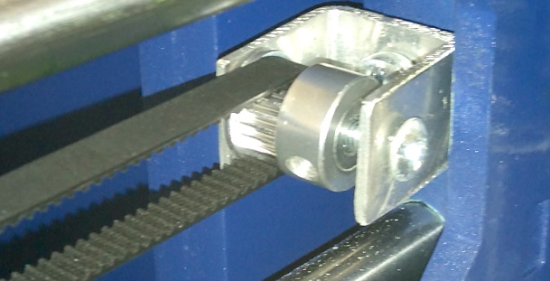
Transmission systems
Timing Belt and pulley
For X-axis

Slide 10
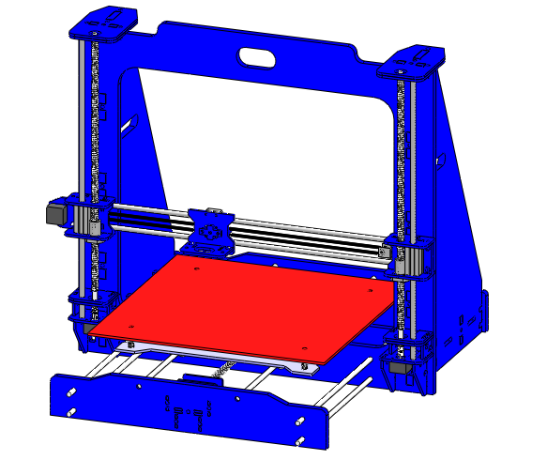
3D-Printer Axes
Z-axis
X- axis
Z
Y- axis
Y
X

Slide 11

X, Y and Z Motor tuning
The screws that used in the project is single start that mean :
For Y and Z axes (lead screw) :-
Lead ($\frac{Distance moved}{number of revolution}$) = Pitch = 5 mm/rev
steps per millimeter = $\frac{200 steps}{rev}×\frac{1}{5}\frac{rev}{mm}$= 40 Steps/mm

Slide 12
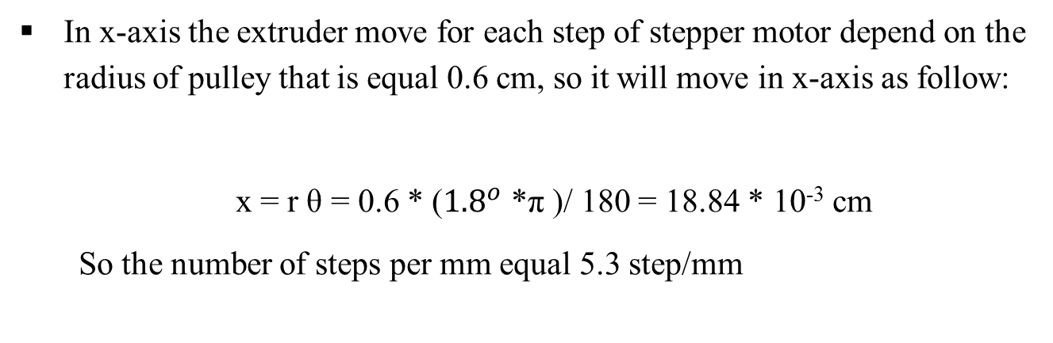
For X axes (Timing belt and pulley ):-
In x-axis the extruder move for each step of stepper motor depend on the radius of pulley that is equal 0.6 cm, so it will move in x-axis as follow:
x = r θ = 0.6 * (${1.8}^{o}$ *π )/ 180 = 18.84 * 10⁻³ cm
So the number of steps per mm equal 5.3 step/mm

Slide 13
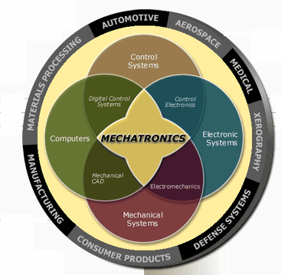
Electrical parts

Slide 14
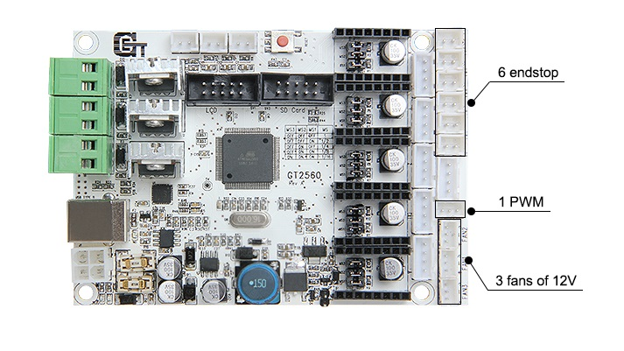
Electrical parts
Protection circuit
GT2560 it’s a integrated board
Of Arduino Mega2560+ ramps 1.4.
GT2560 have a self protection
circuit

Slide 15
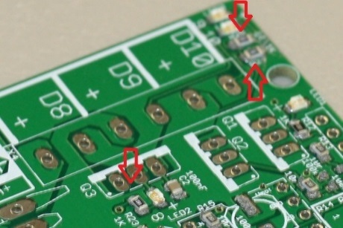
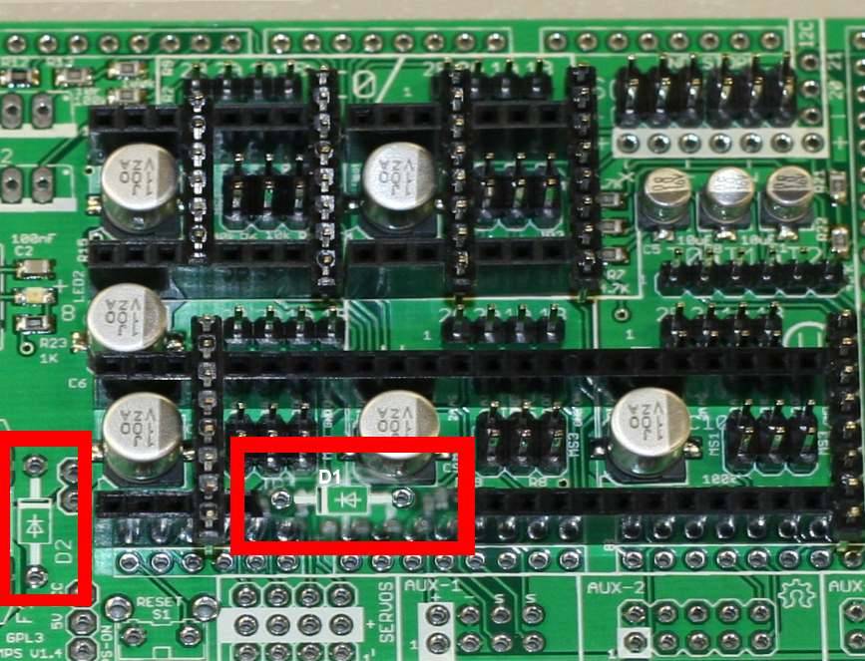
Electrical parts :Protection circuit
1- resistors and diodes .

Slide 16
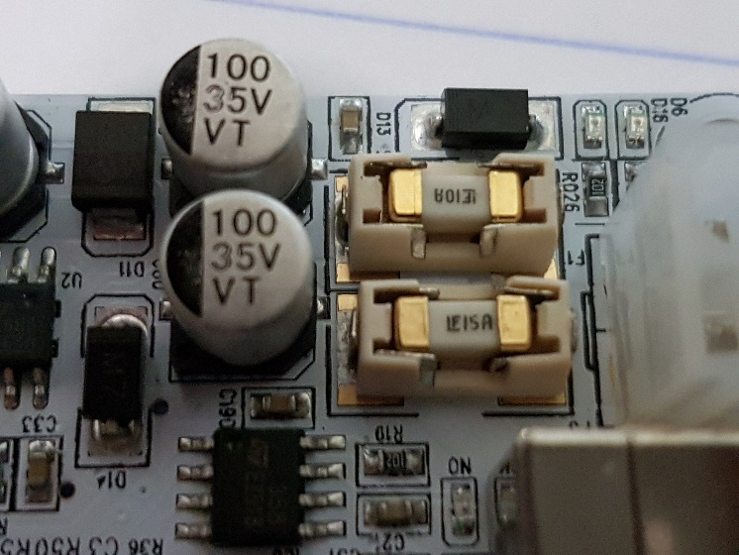
Electrical parts :Protection circuit
2-fuse
A fuse is a type of low
resistance resistor .
Use to provide overcurrent
protection.

Slide 17
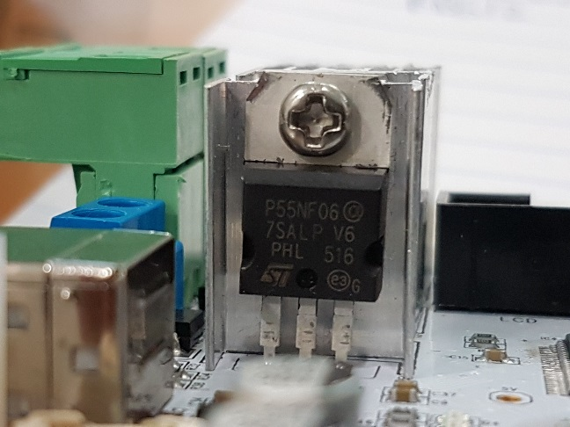
Electrical parts :Protection circuit
3-Power MOSFET.
electronic components that
allows to control high currents.
it use between controller’s
power And outside power that will
feed heater and fans by power.

Slide 18
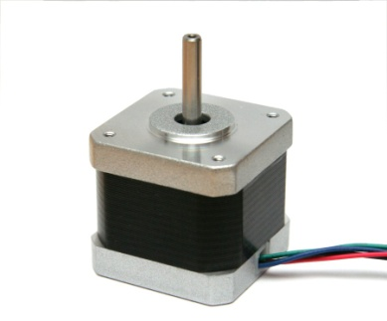
Electrical parts
1- stepper motors .

Slide 19
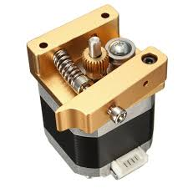
Electrical parts
2-stepper for extruder

Slide 20
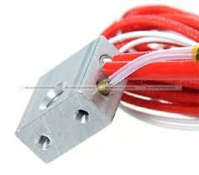
Electrical parts
2-Heater

Slide 21
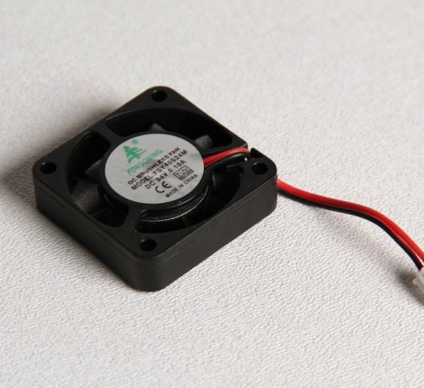
Electrical parts
3-Fans

Slide 22
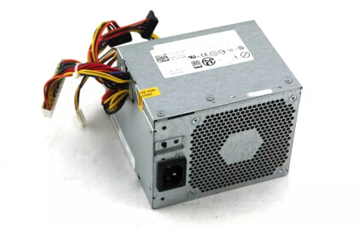
Electrical parts
4- power supply

Slide 23
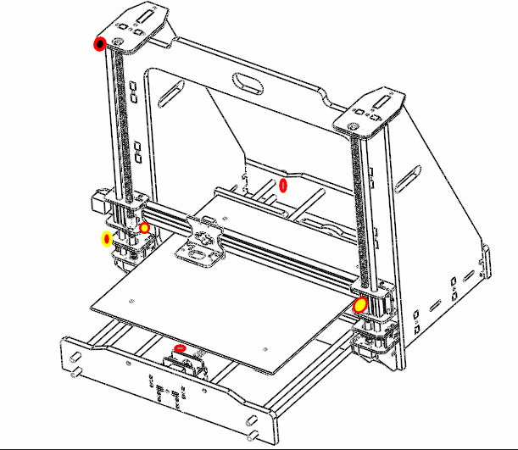
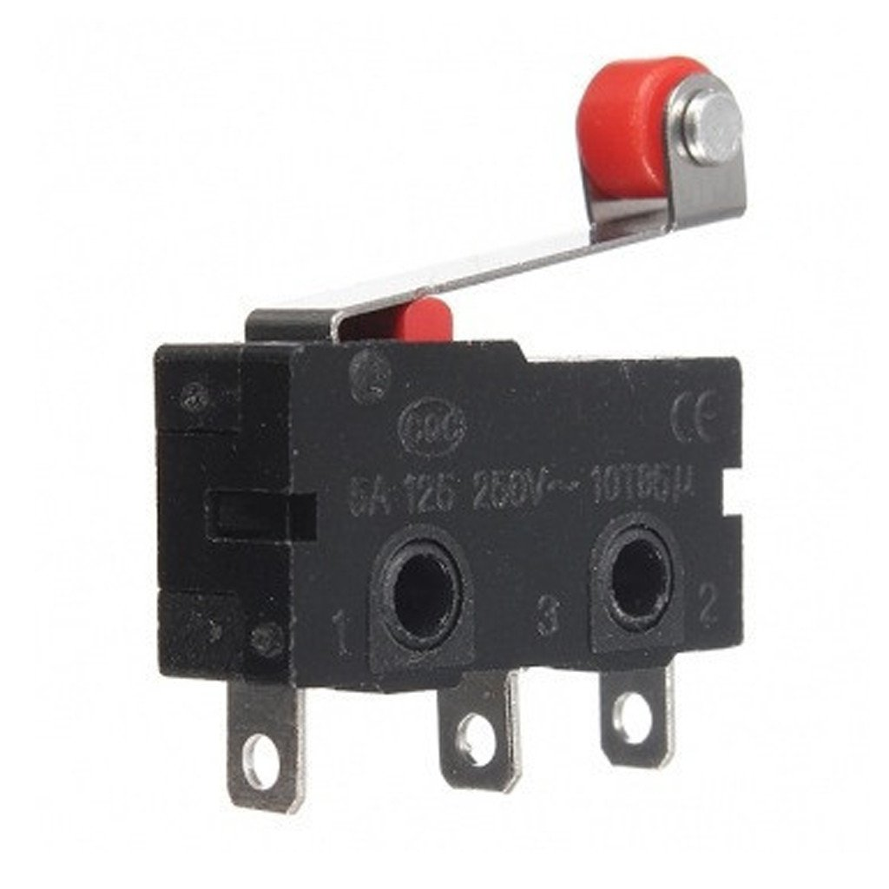
Electrical parts
Z-
5- limit switches
Y -
Z+
X+
X-
Y +

Slide 24
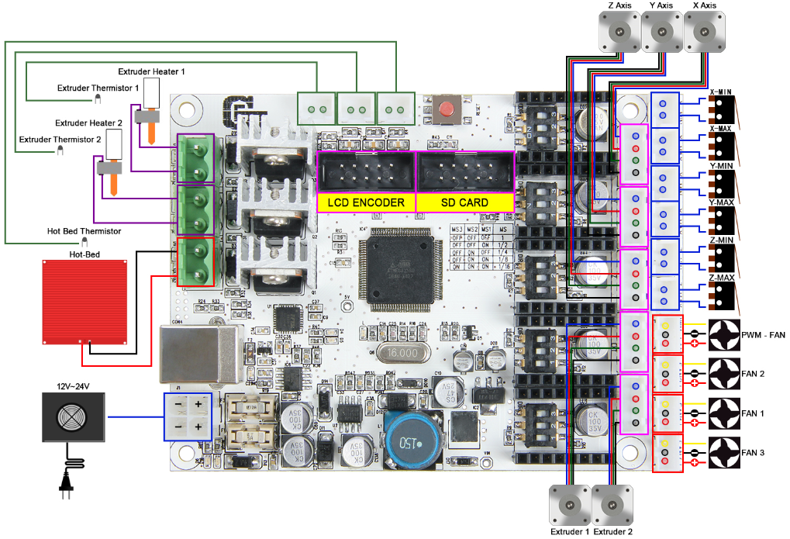
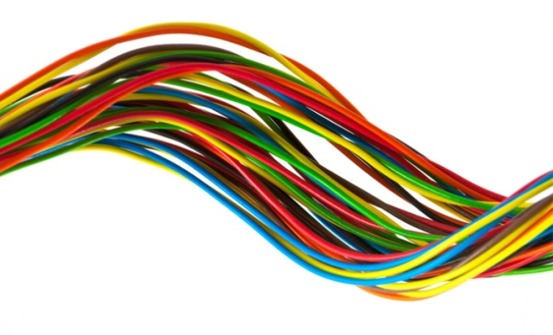
Electrical parts
6- cables

Slide 25
Software

Slide 26
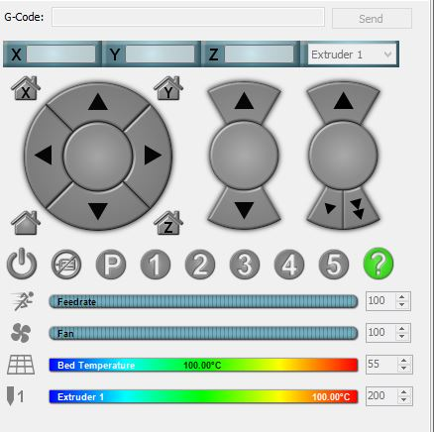
Introduction
The most important job for the software is to process the G-code file and by communicating with the printer’s electronics, it will send these commands to the 3D printer to build our objects layer by layer

Slide 27
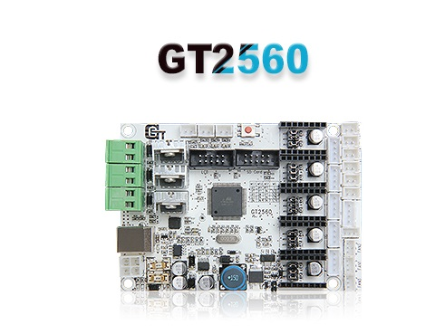
GT2560 microcontroller
GT2560 is a compact board that is integrated with the mighty function of the Arduino Mega2560+Ultimaker and Arduino Mega2560 + ramps 1.4 on respect of both software and hardware and has more premium features

Slide 28
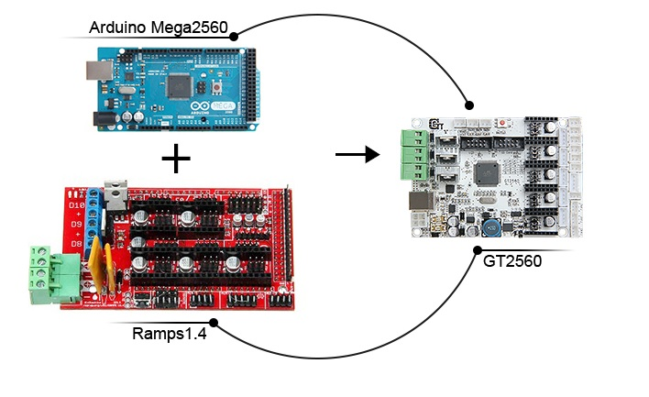

Slide 30
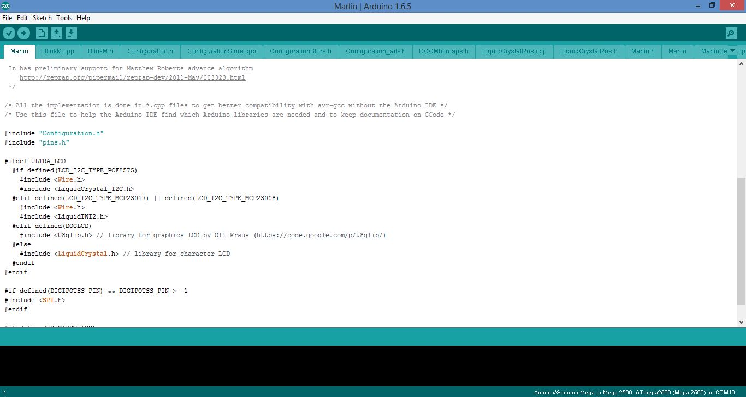
Marlin Firmwaer

Slide 31
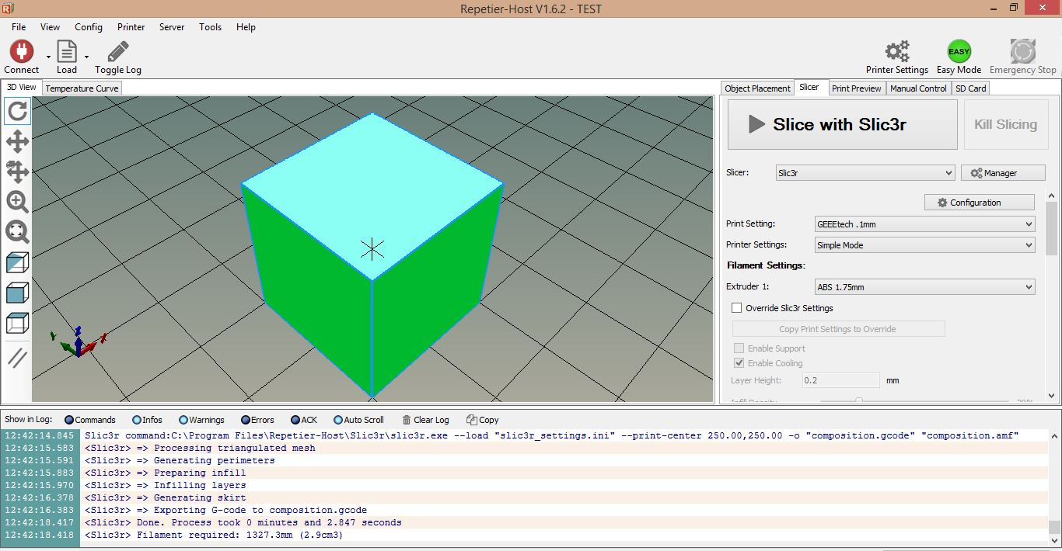
Slicer

Slide 32
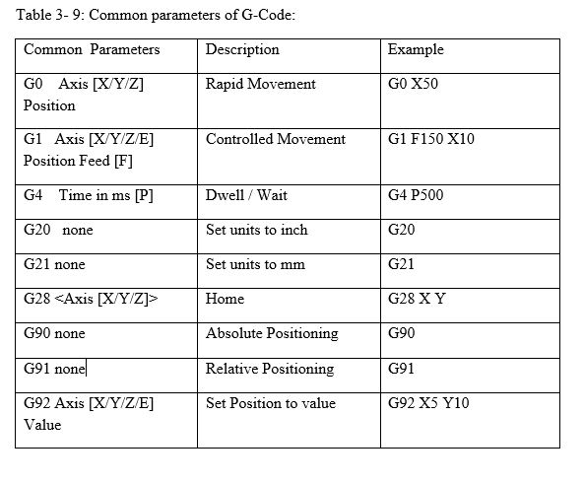
G-code
A programming language for 3d printers. G-Code programming controls " how " and "where" a machine moves, the codes used vary, based on the machine type, make and model.

Slide 33
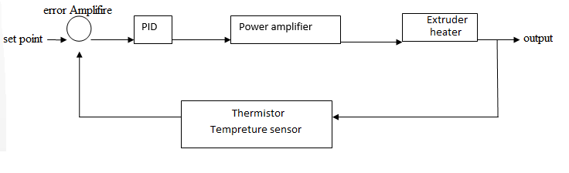
Control loop
Temperature of extruder:
Typically a temperature control algorithm inside the GT2560 reads the temperature from a thermistor, and then drives another pin connected to a MOSFET that connects or disconnects 12 V power to a resistance heater.

Slide 34
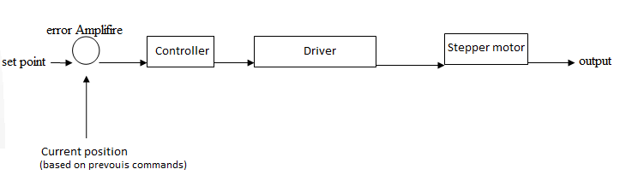
Control loops
Position of extruder:
The extruder it will go to the determined position by the program, and the program depend on the retain position to determine the new position. This because of the accuracy for each step stepper motors.

Slide 35
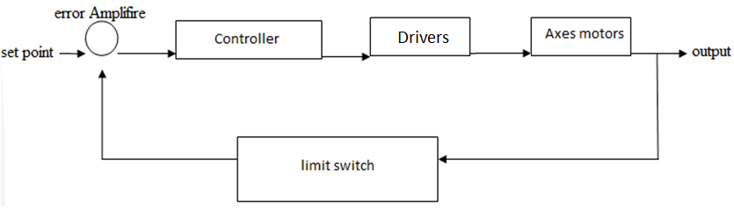
Control loops
Home position:
When the extruder and bed ordered to go home position, they will move to the minimum point of each axis until reach the limit switch to stop, so the program will define the home position.

Slide 36
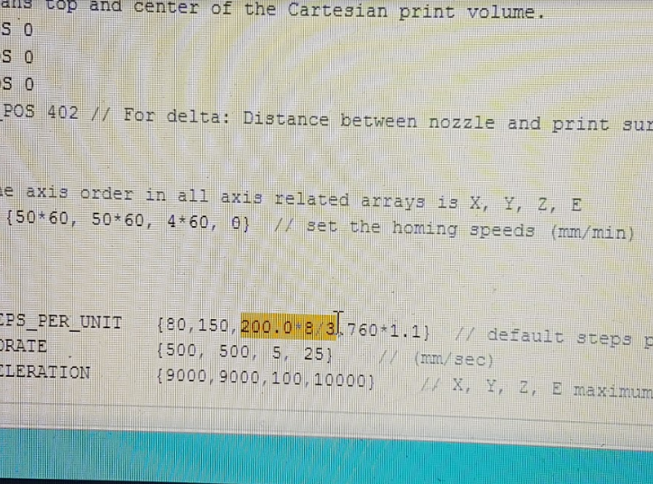
Calibration
Now this time is for take 3D printer and put it to work. We need to prepare it for accurately make prints, this process includes verifying:
Movement of each axis.
Heating the extruder .
Extruding the plastic.
Testing the endstops.
We made a lot of changes in
Program parameters.

Slide 37
Results
The weight of our 3D printer about 45 kg.
We have the print size more than 50*50*50 cm.
We obtained the main frame of 3D printer.
We obtained the movement for three axes.
Heated the extruder.
Extrusion plastic through extruder.

Slide 38
Conclusion
3D printer is a complete mechatronics system, This technology combines mechanical parts that are moved by electrical actuators controlled by some electronic and electrical circuits.
It used to produce product in 3D model with complex shape from different materials much and much easier than the traditional methods of manufacturing.
In the future, for our 3d printer we can use two extruder for 3D printer, and we can use other type of printing material as aluminum rather than plastic filament in addition to increase the printing accuracy.

