Slide 1



Pet Care System
Abeer Hamadneh
Sabeen Khuffash
Supervised by Dr. Luai Malhis

Slide 2

Why?
Nowadays most of us have pets at home. Keeping animals at home is one of the favorite hobbies of the community. One of the animals that are kept a lot is the cat.Cats are one of the cutest animals and very close to humans. In Addition, cats are also able to reduce stress, feelings of anxiety, and the risk of stroke. this pet should be taken care of properly. Their meal time is important because they have become part of the family. however, some people fail
to pay attention to their pets because they are so busy that they cannot afford to feed them on time.

Slide 3
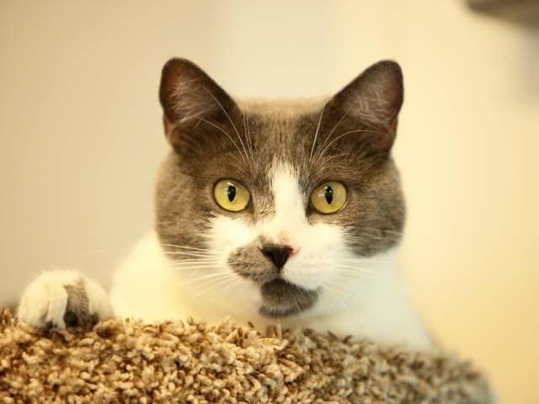
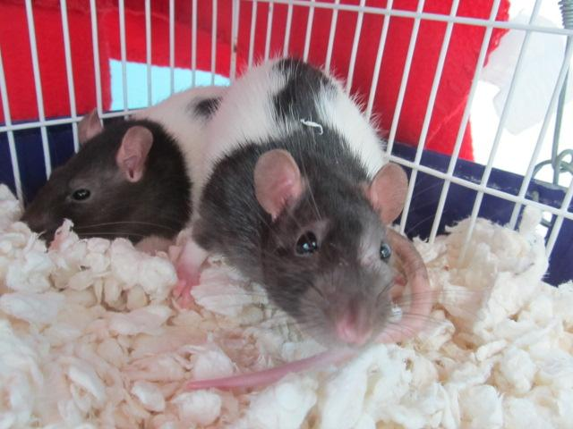
Why?
Pets need a lot of love and attention, and different pets have different needs. We are going to discuss the many things our pets need to be happy and healthy.
\

Slide 4
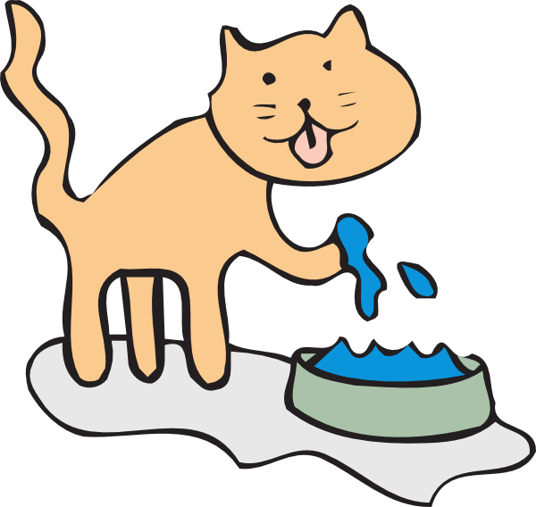
What it is?

Slide 5
Smart Pet System has an auto-generated machine that can feed your pet according to the time and quantity specified and measure the temperature around the pet, lighting, and controlling it with the software. Using this machine, pet owners do not have to be with their pets all the time to provide food or giving them the basic needs.They can also do other work outside without taking care of the pet. Pet dishes are filled in one container by setting the time using the Arduino Mega that has been displayed on the LCD mounted on the pet mediator.

Slide 6

Arduino is an open-source physical computing stage based on a straightforward input/output (I/O) circuit and a create- ment environment that executes the Handling dialect.

Slide 7




What do pets need?
Food
Water
Shelter
To be safe

Slide 8
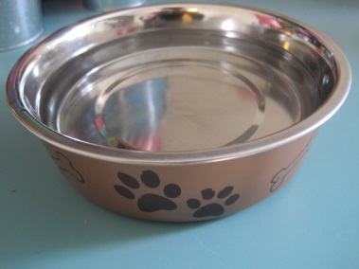
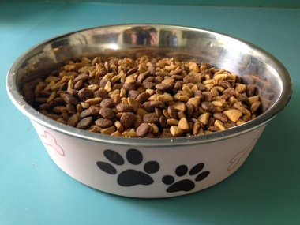
Food
Pets need special food created just for them:
Dogs and cats need dry kibble or wet canned food.
All pets need fresh water everyday.

Slide 9
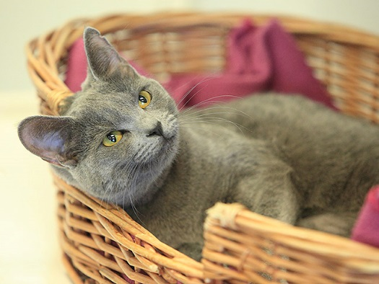
Shelter
Just as pets need their own special food, pets need their own special place to live. The safest place for a cat to live is indoors with you.

Slide 10
Designing the system
We can't just start designing and building the system without first drawing the chart and the block diagram to know how the system works.

Slide 11
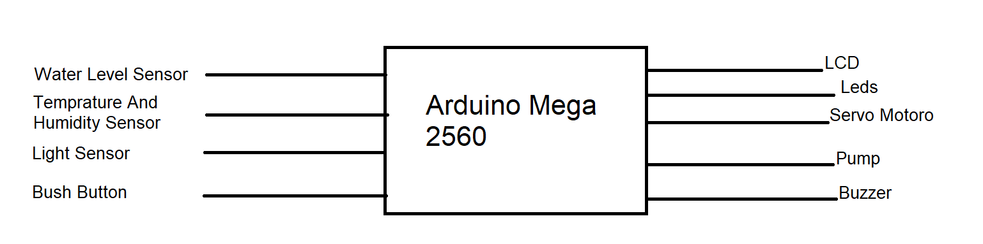
IR Sensor.

Slide 12
Designing the system
For any pet care system, it should contains food during all the day and water. In our research, we tried to add more than these basic needs, such as providing the pet with light, cooler and such many features were added to our design.

Slide 13
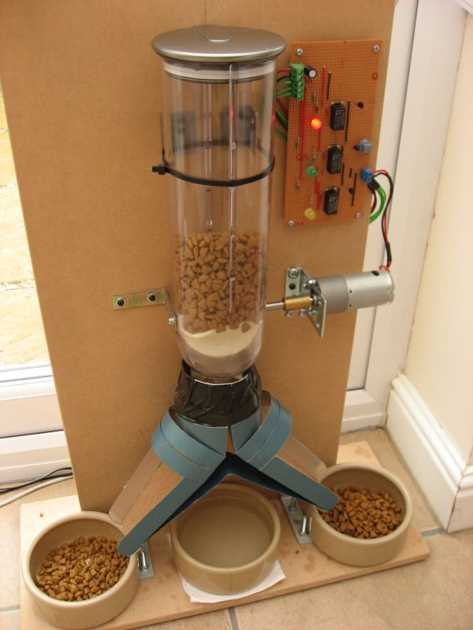
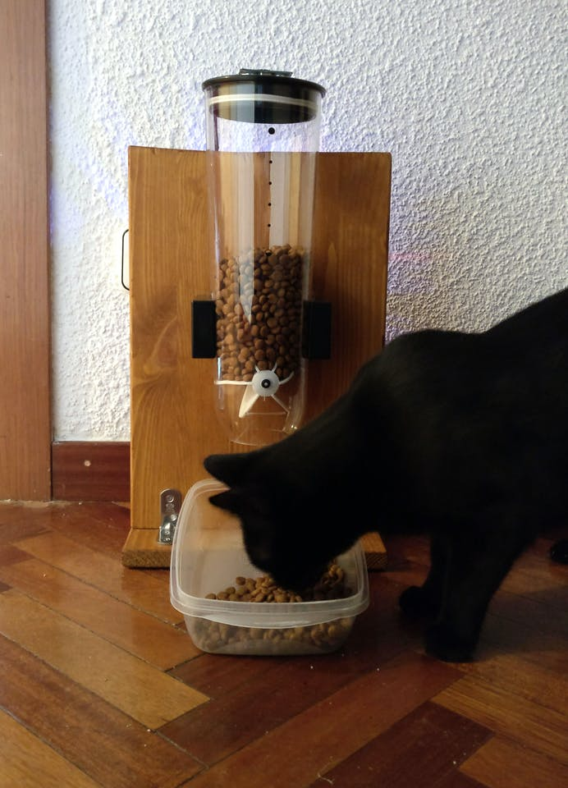

Slide 14
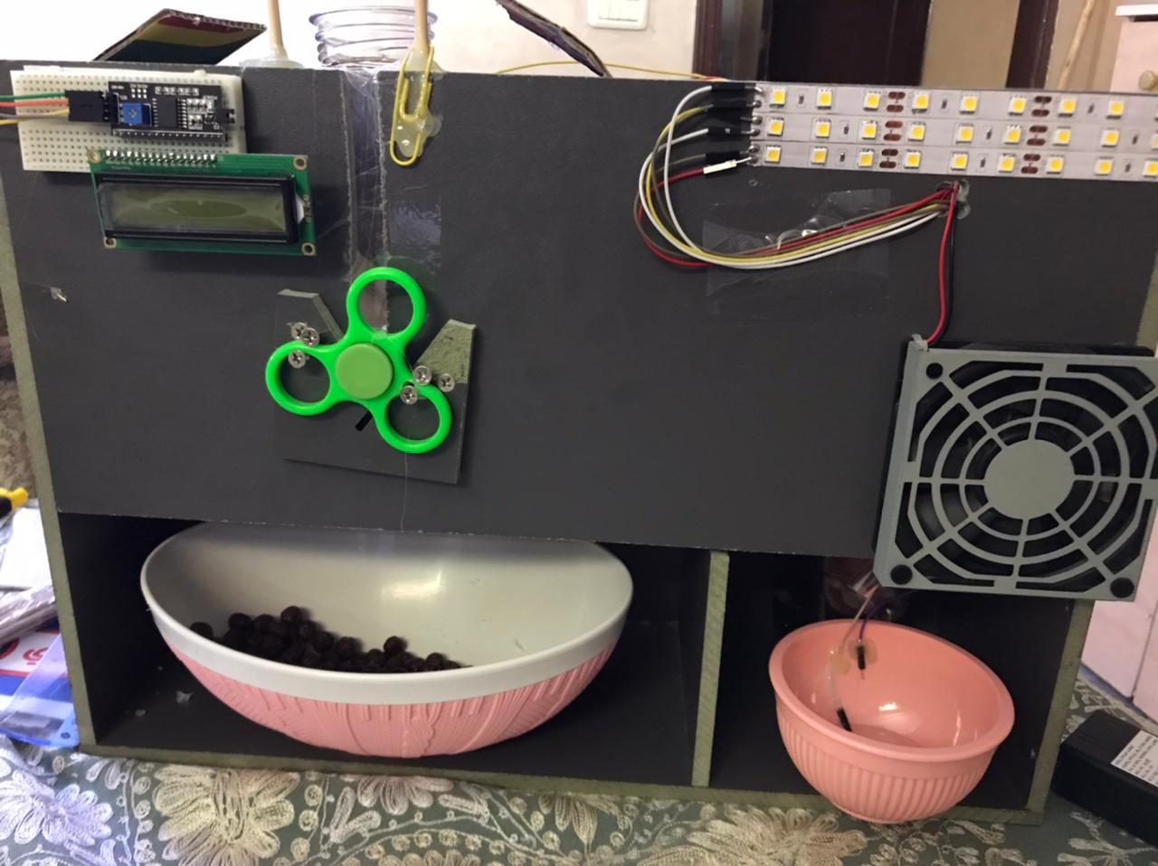

Slide 15

Auto feeding
The servo motor that we're using acts as a lid to the food container. Arduino is a well known and probably the most popular microcontroller which is the brain of this machine. The servo motor will rotate at a certain angle thereby opening and closing the lid.

Slide 16
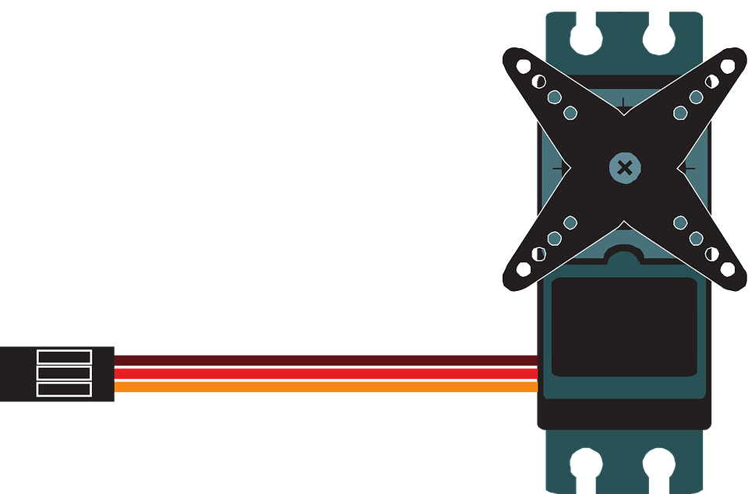
Servos are the easiest way to start making motion with a microcontroller. Even though they don’t turn 360 degrees but only 180, you can use them to create all sorts of periodic or reciprocating motions. Check out some of the mechanisms at Rob Ive’s site for ideas on how to make levers, cams, and other simple machines for making motion.

Slide 17

Auto Drinking
The concept we have used here in our project where the water motor pump is automatically turned on when the water level in the respective tank becomes low with the using of the water level measurement.

Slide 18
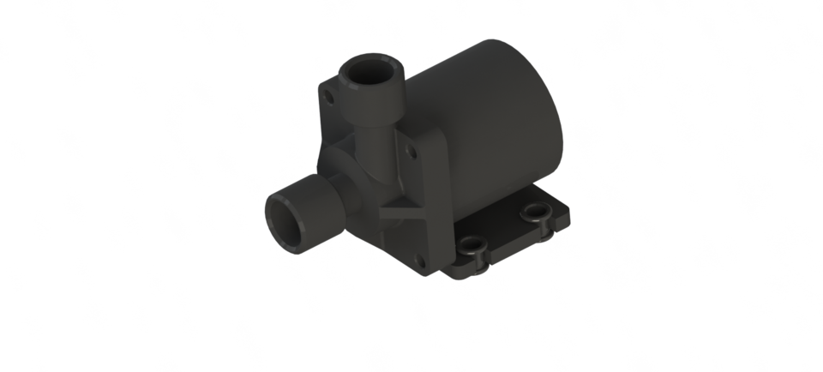
As the Arduino can only provide output voltage of 5V, hence we have to use a relay module for switching operation of the water pump.

Slide 19
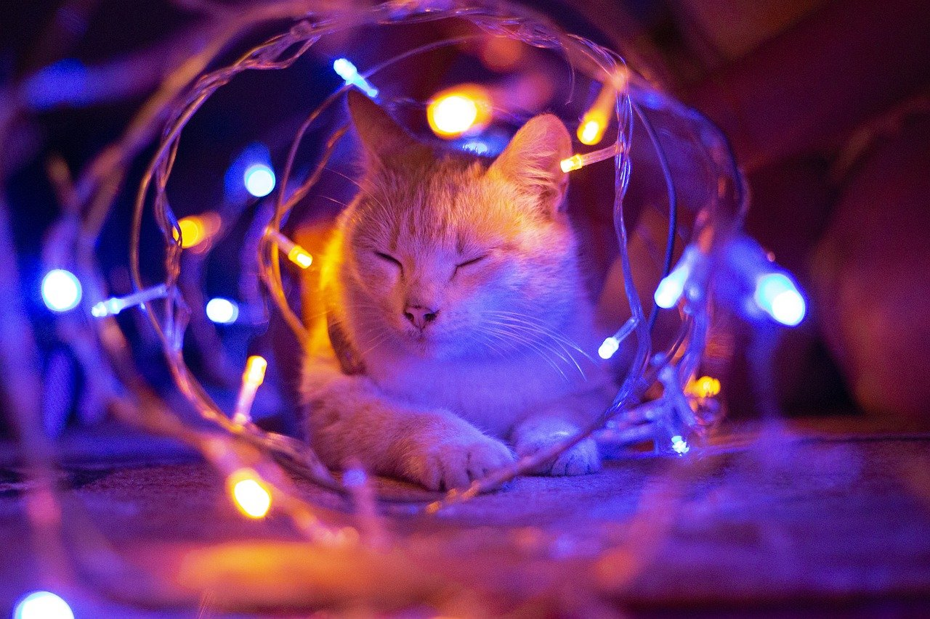
Pets need to be safe

Slide 20
Turn LED On If Surroundings Are Dark With LDR Sensor

Slide 21
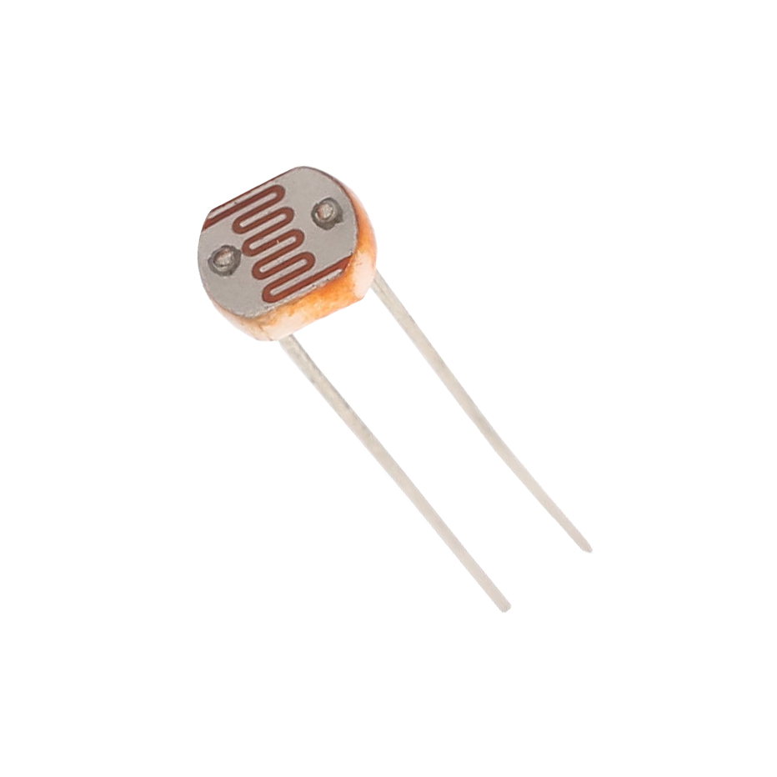
Light Sensor
Compact circuit design.
High precision.
Flexibility in adjusting the sensitivity of the sensor (through the resistor is integrated on the circuit).

Slide 22
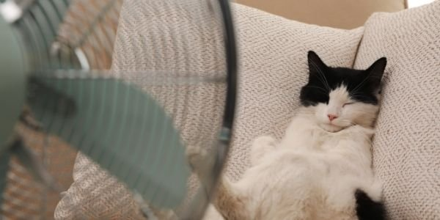
Do Fans Work on Pets?

Slide 23
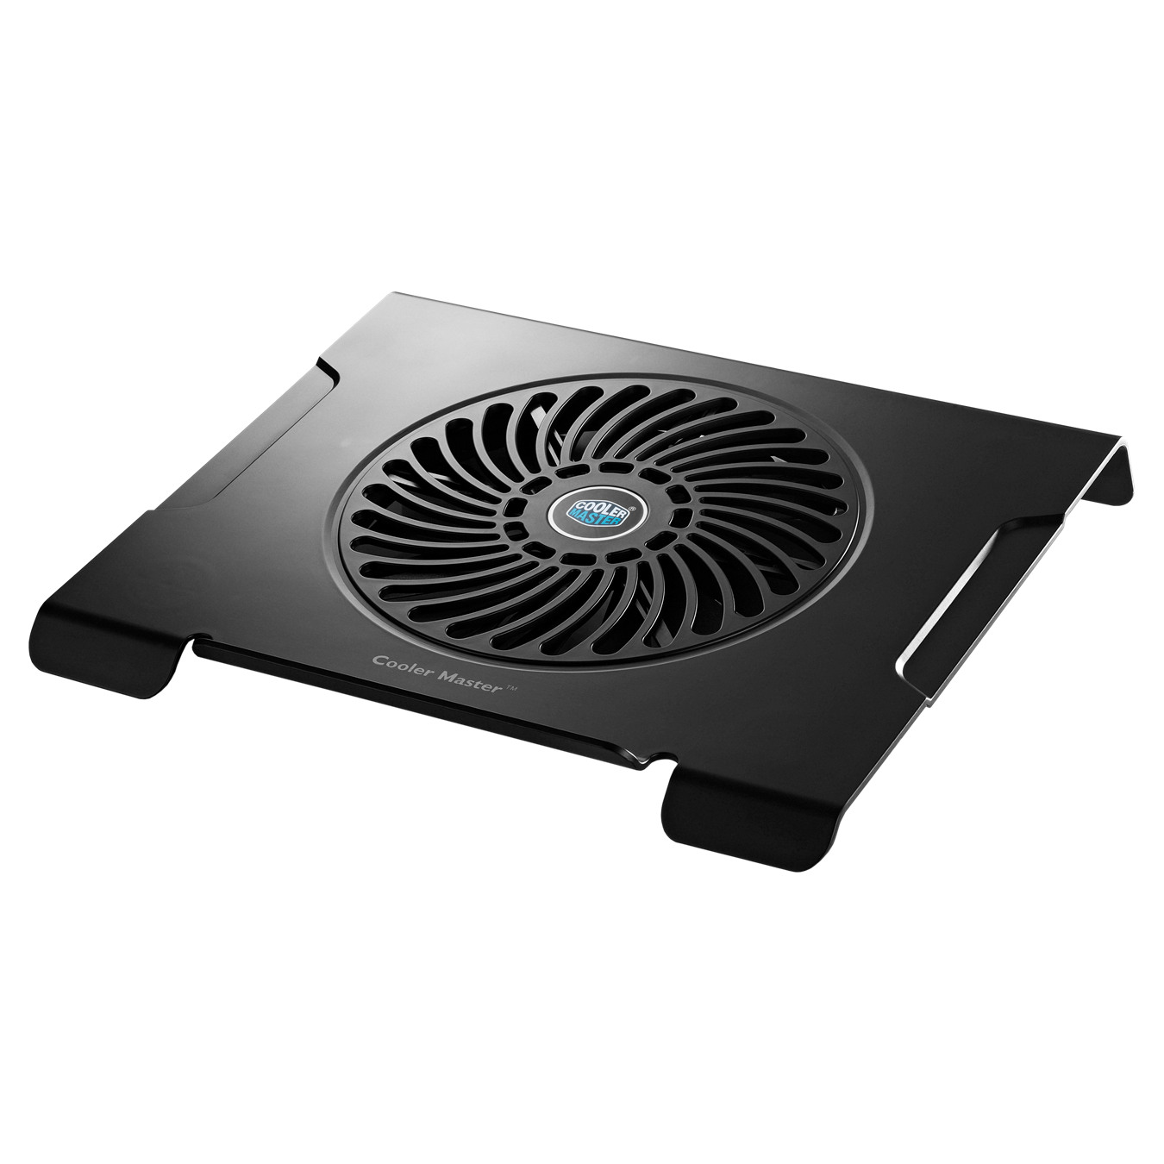
We live in an modern era right now. We want to do everything automatic. So, In this project we designed an automatic fan that will be ON and OFF according to the temperature value.

Slide 24
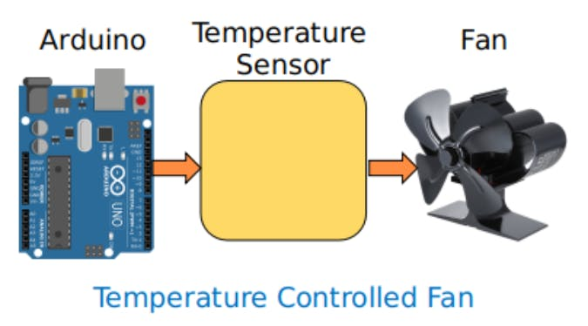
Arduino will connect with a temperature sensor. Then Arduino read the temperature value from the sensor. After that according to the temperature the fan will work.

Slide 25

Infrared sensor
IR sensor is a simple electronic device which emits and detects IR radiation in order to find out certain objects/obstacles in its range. Some of its features are heat and motion sensing. This sensor is used here to detect if the Pet is around the care system or not, according to this the system and its components will work for the pet’s benefit.

Slide 26
According to IR, what signs we receive?
The fan will work with two conditions, the pet is inside its place and the temperature is high.
The lights will be on also if the pet is around the system

Slide 27
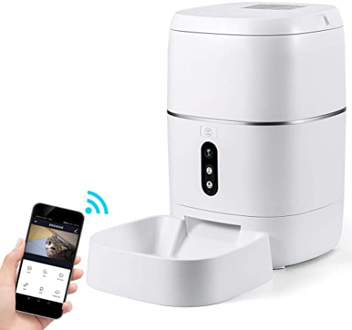
Mobile App Control

Slide 28
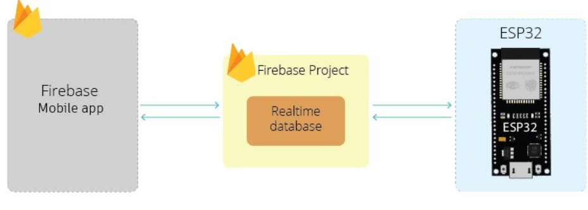

Slide 29
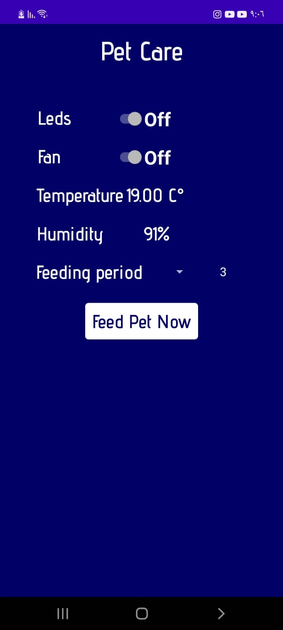
Mobile App Control
The mobile App helps the owners to control the system manually and setting the period time for feeding the pets and receiving the information.

Slide 30

Challenges
ESP8266
Water Level Sensor
The nature of a pet feeder

Slide 31





Future Work
Live Streaming Using Camera
Heater In addition to cooler
Taking care of pet’s health using mobile
Entertainment

Slide 32


Slide 33





