Slide 1
Smart Cash
Prepared by:
Aya Thafer
Shatha Abu Hanish
Supervisor:
Dr. Hanal Abu Zant

Slide 2
Contents
Project overview
Hardware components
Results
Challenges
Future work

Slide 3
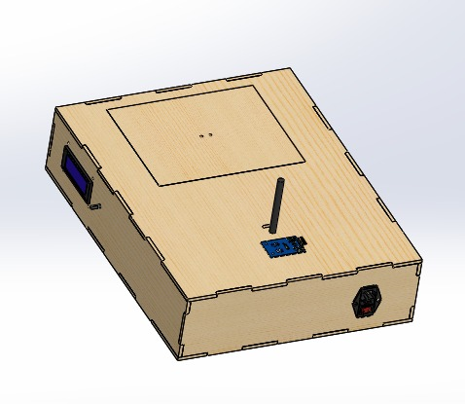
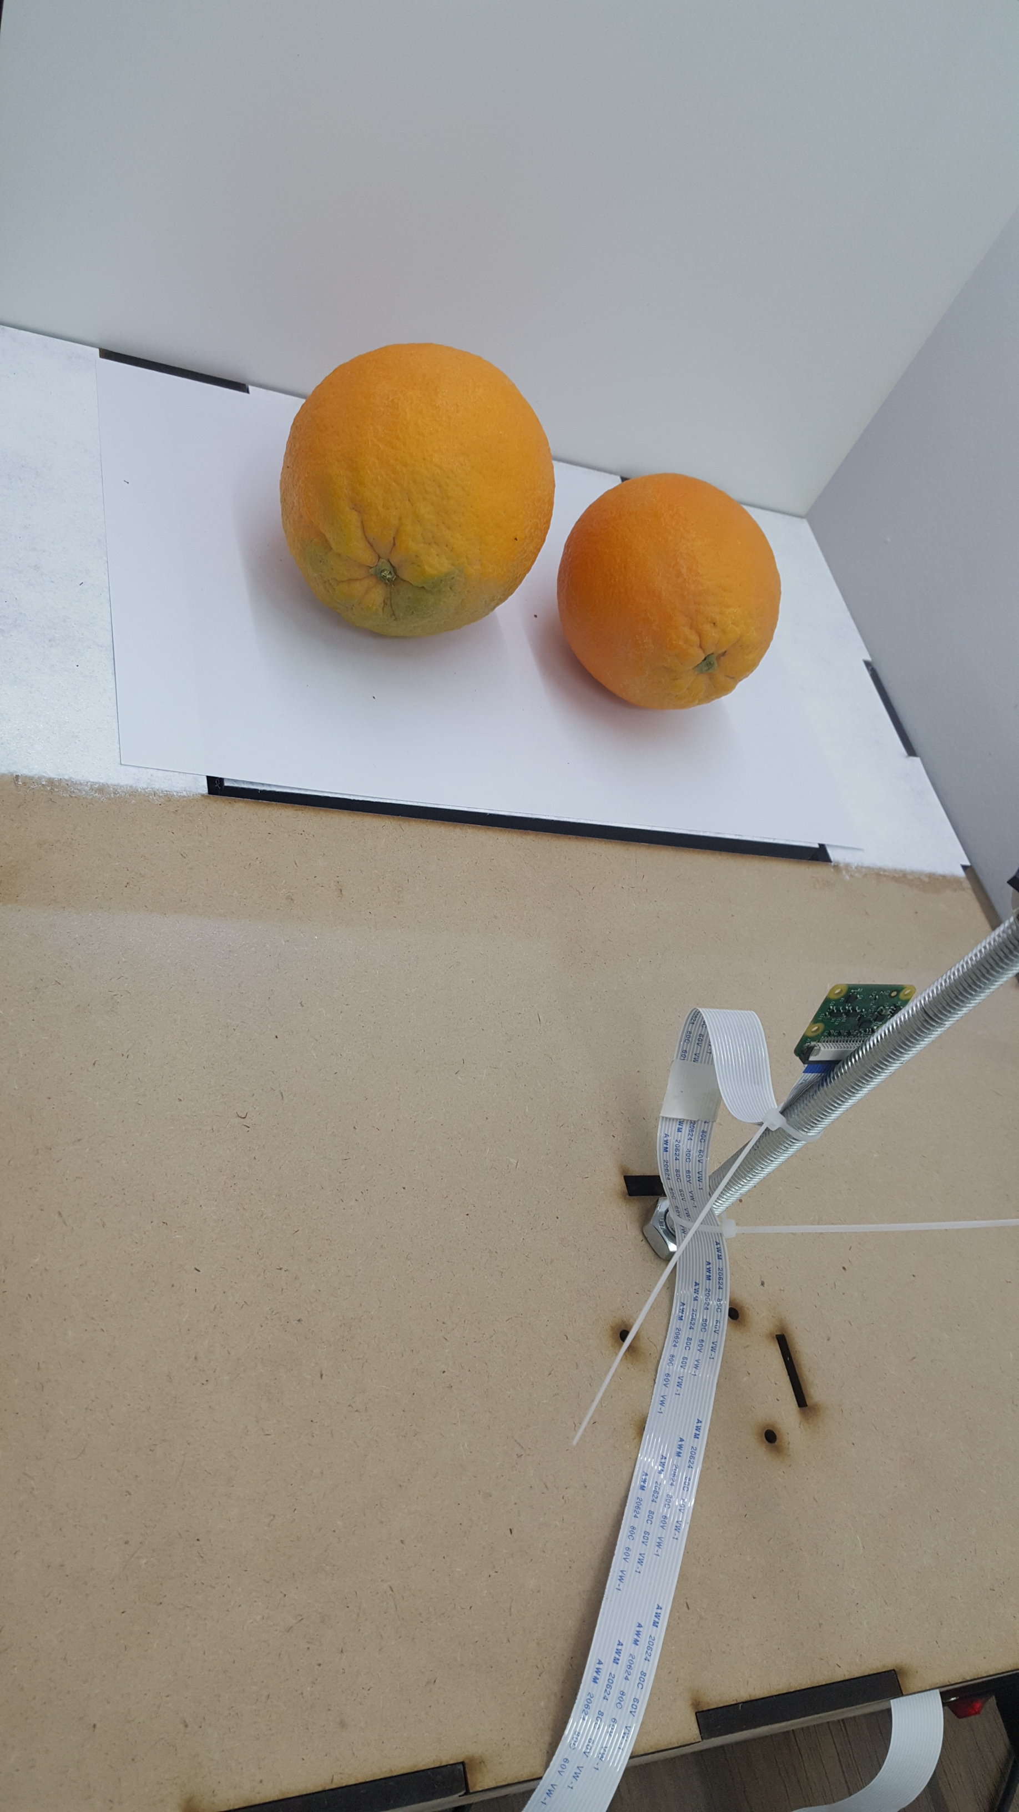
Project Overview
The main controller in Smart Cash System will be the Arduino nano, which will get the name of the detected fruit/vegetable from the Raspberry pi4 and the weight of it from the balance, then display them with the price on the LCD.

Slide 4
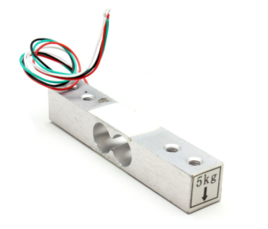
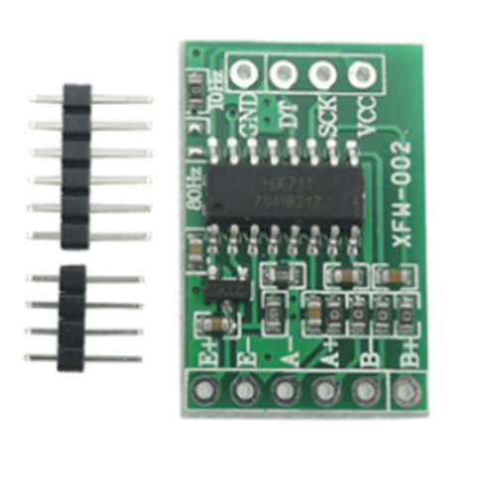
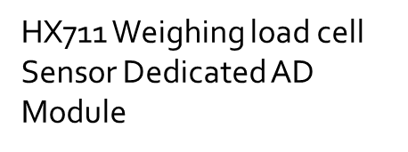
Hardware components
Load cell sensor 5KG

Slide 5
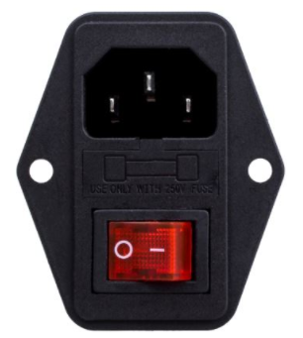
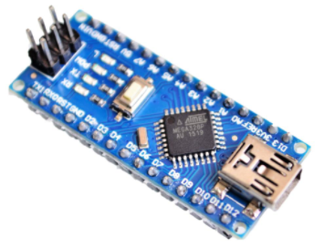
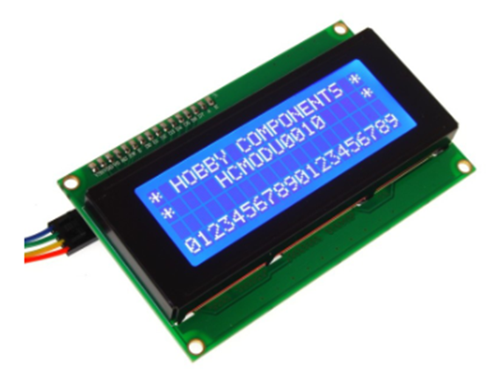

Arduino nano 328P with cable
Power Socket Inlet Module Plug 5A Fuse Switch

Slide 6
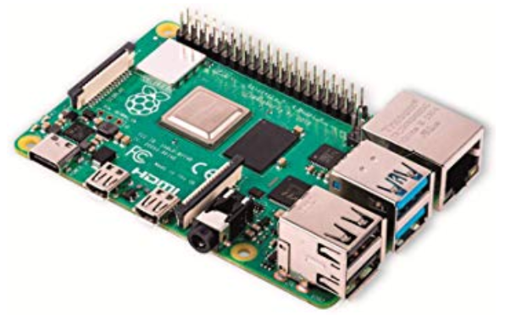
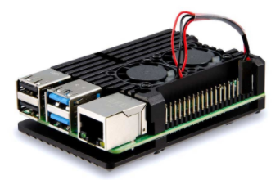
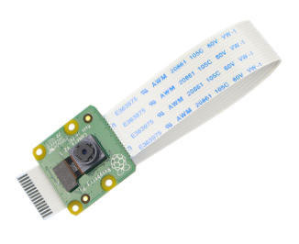
Raspberry Pi 4 Model B 4GB RAM
Dual Fan Aluminium Heatsink Case for Raspberry Pi4
Raspberry pi Camera V2.1 Module 8MP

Slide 7
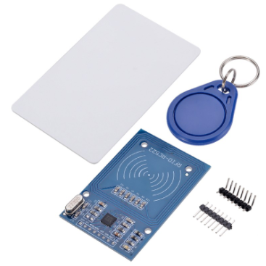
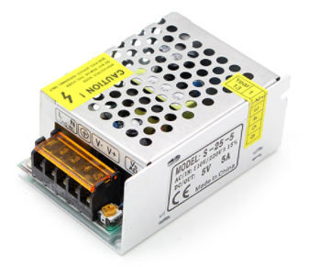
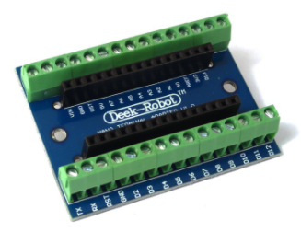
Terminal Adapter for Arduino NANO
RFID card RC522 module KIT 13.56Mhz
5V 5A Power Supply

Slide 8
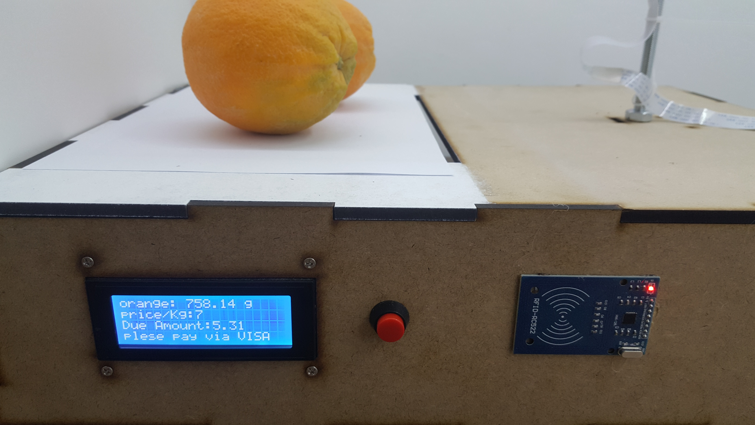
Results
Before Payment

Slide 9
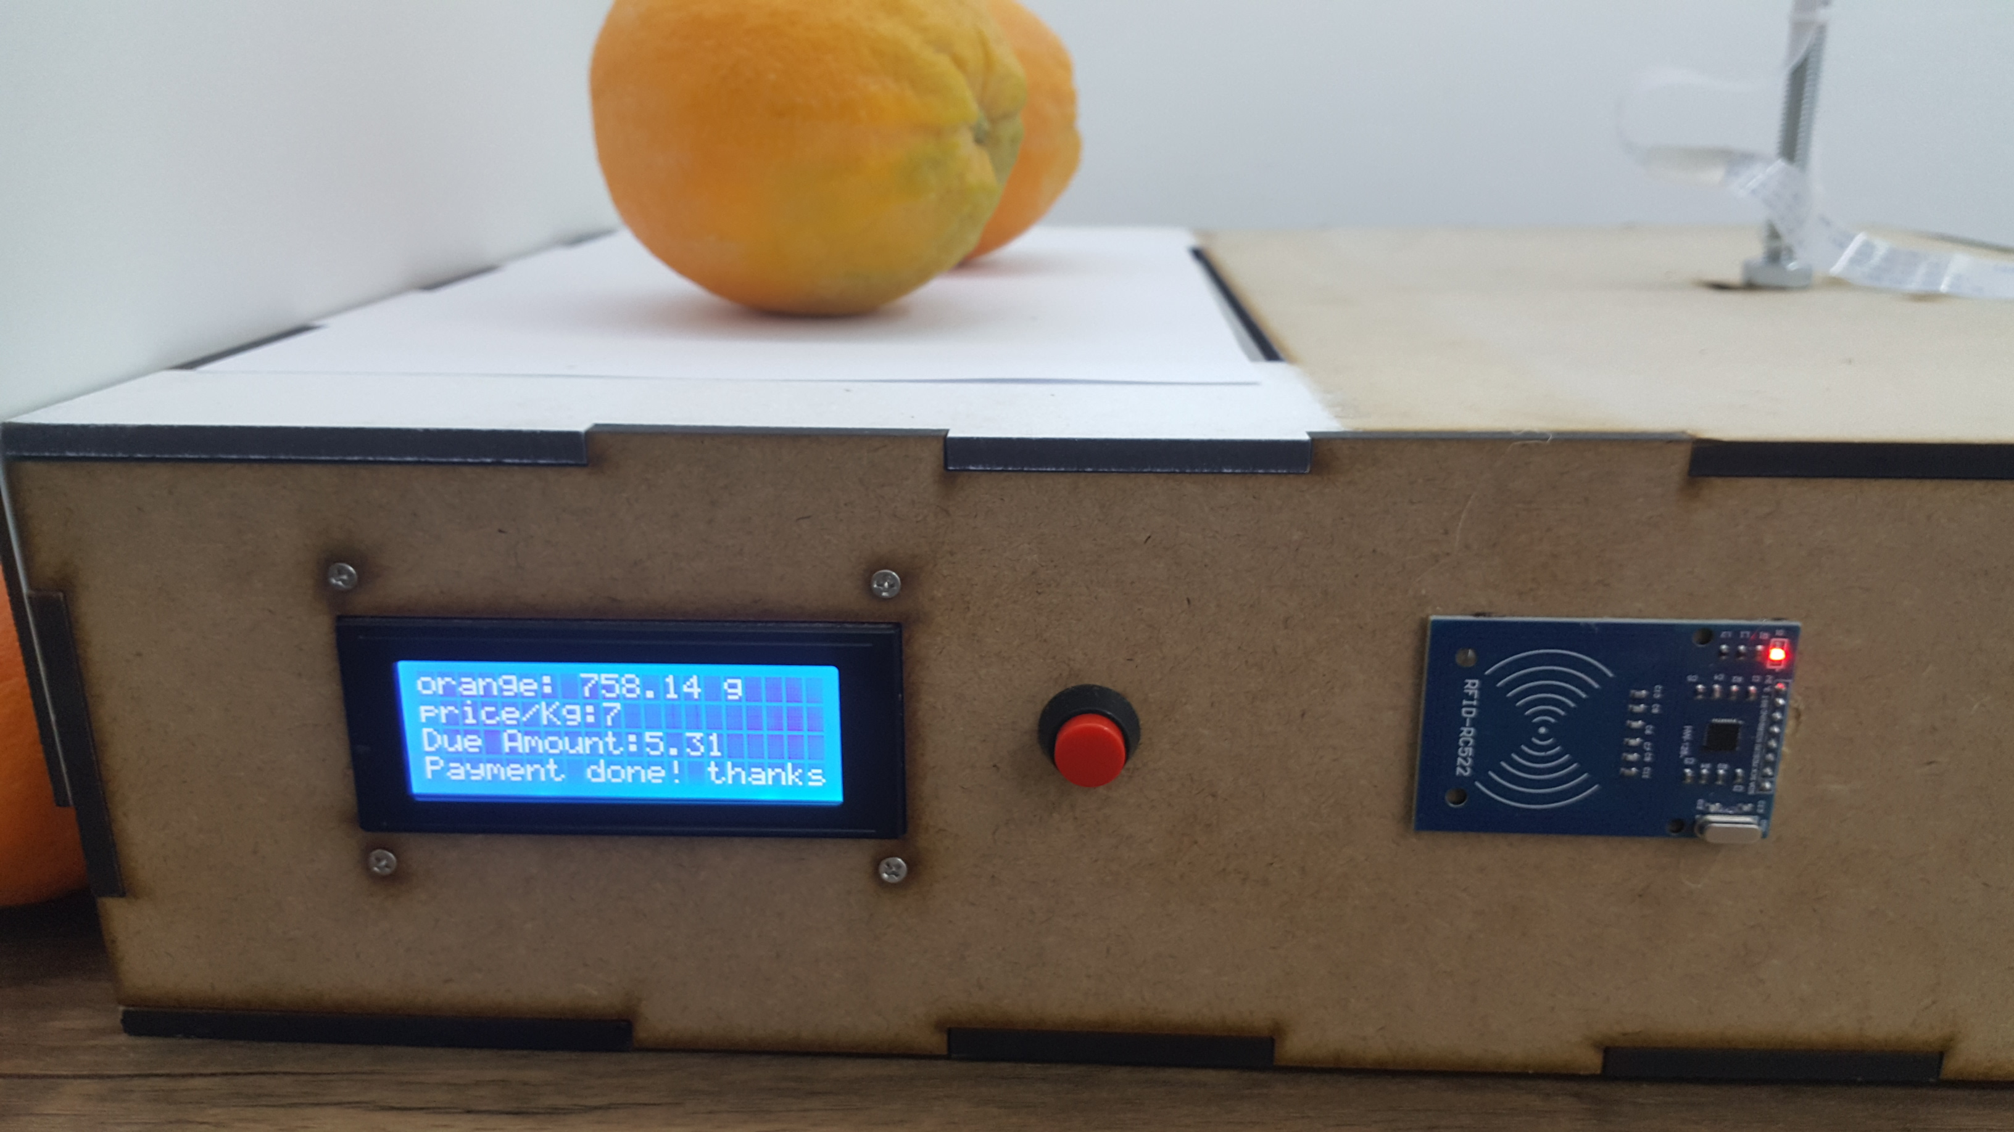
After Payment

Slide 10
Challenges
It took us time to learn how to deal with the hardware components.
We had some difficulties dealing with image processing and detection and the need to provide a proper, consistent lighting and background.

Slide 11
Future work
It can be used as self-service machine in the markets.
Support our project with a printing machine that prints the information displayed on the LCD.
Support the project with a loudspeaker that reads what is displayed on the LCD.
Expand the project to include more products.

Slide 12
Thanks for your Time

