Slide 1

Sallikna
MADE BY: Walaa Dwikat & Ola Hantoli
SUPERVISORS: Eng. Haya Samaaneh &
Dr.Mona Demaidi

Slide 2
Outline:
Introduction
Problem
Project Description
Objectives and Importance
Literature Review
Used Tools
Project Sections
System Management (Website).
End Users (Mobile App).
Service Provider(Mobile App).
Results and Discussion.
Constraints.
Conclusion and Future work.

Slide 3
Problem
With the increase in the number of Vehicles and Drivers the need for faster vehicle services has become more than it was and with increase in number of 3G users we thought to solve this problem by SALLIKNA where the customer is provided with the appropriate provider garage or company and get the service without an effort and save his time. A mechanical or service provider that he is need is sent to the customer to help him anywhere he is.

Slide 4
Project Description
SALLIKNA is a combination of Mobile apps and website, its provides five basic services for vehicles owners:
Battery Charge.
Break Down
Recovery
Refilling Fuel
Repairing And Changing Tyres.

Slide 5
Objectives and Importance
Our project serves the Palestinian drivers category, especially those who have no experience in vehicle breakdowns and maintenance, as we provide light breakdown maintenance, and we are looking to provide the lowest costs to the consumer as well as we aim to facilitate the maintenance cycle for the consumer as we provide transportation and maintenance services only through the application where the consumer provides us his data and location and we reach him wherever and whenever.

Slide 6
Literature Review
After searching we found that our application is the first application in Palestine of car services that aim to connect the customer with a service provider.It is similar to the application of Roadside Assistance, and it is one of the branches of Emirates Transport Company

Slide 7
Used Tools
The Website and Mobile Application are developed using:
React native for Front-End , SQL Database (with php )for Back-End for Mobile Applications .
HTML and CSS for Front-End , SQL Database (with php) for Back-End for Website.

Slide 8
Project Sections
1- System Management(Website):
The system manager can
Update his personal profile.
Add new companies and providers.
Search about specific company, provider or customer.
Remove specific company or provider or block a customer.
Show all companies , all providers and all messages.
Add a new booking and show current bookings.
show customers and services providers on the map.
show total requests (Done and Not Done) for each company.

Slide 9
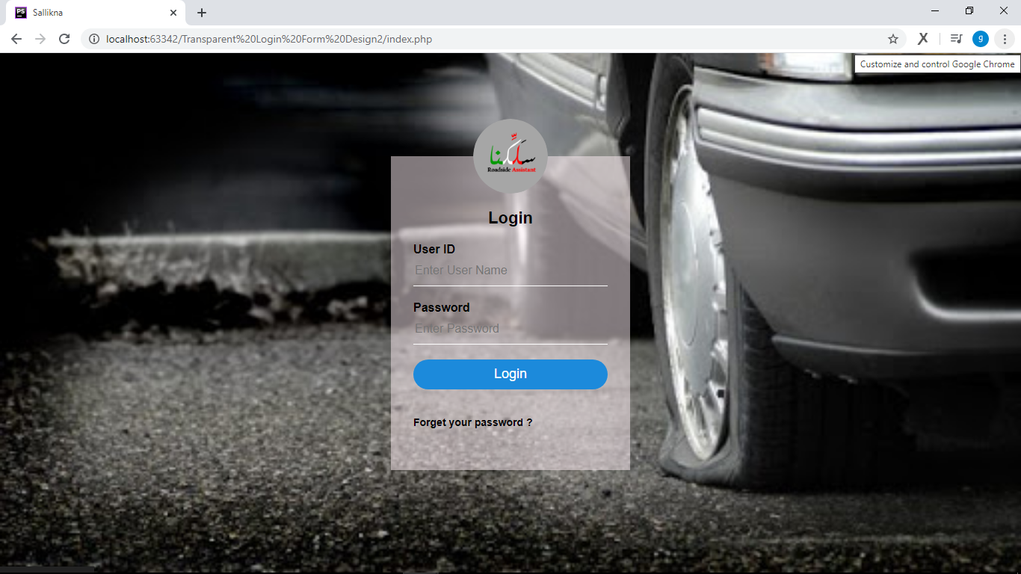

Slide 10
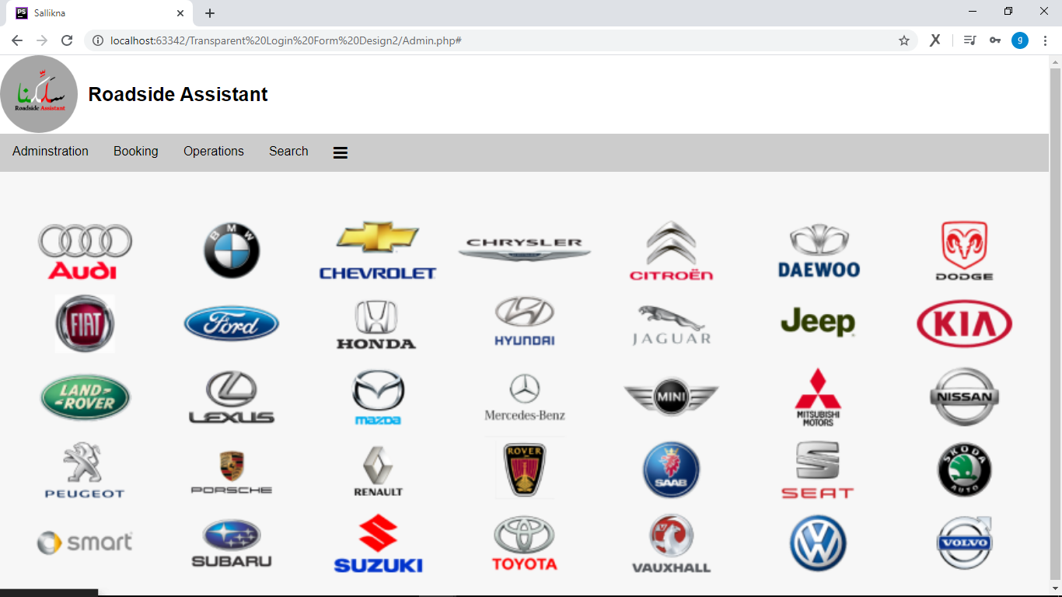

Slide 11
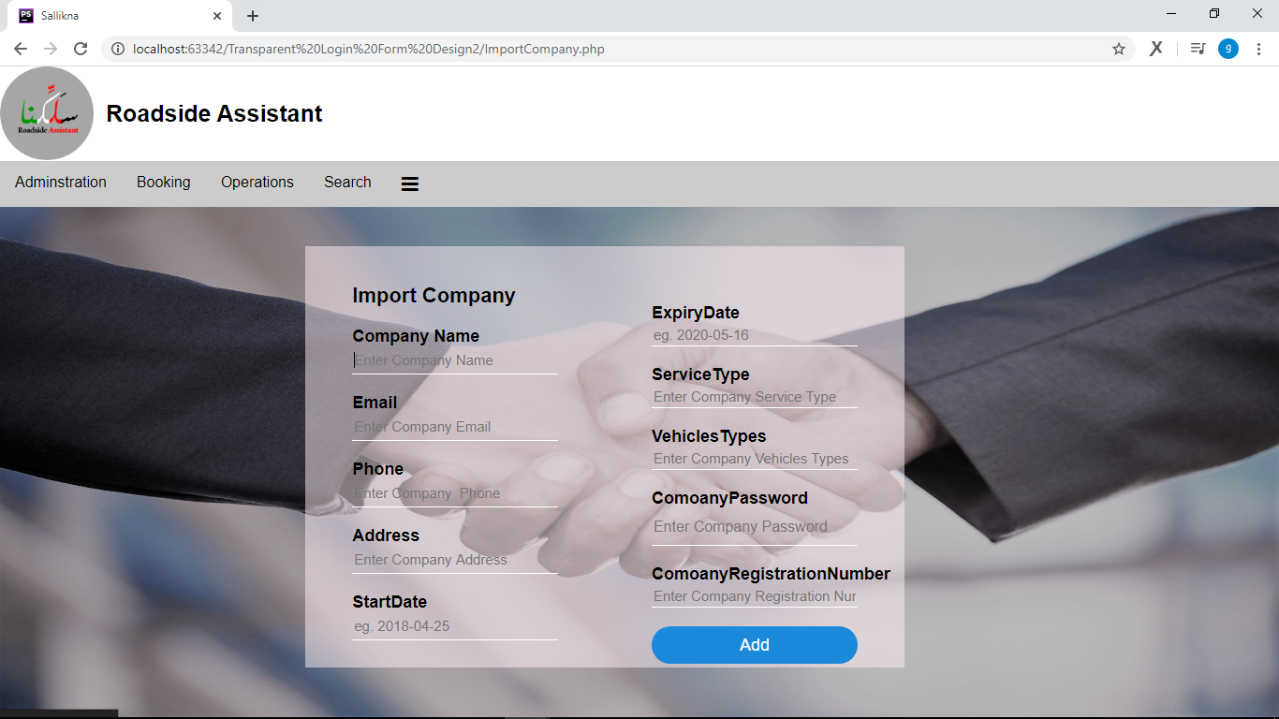

Slide 12
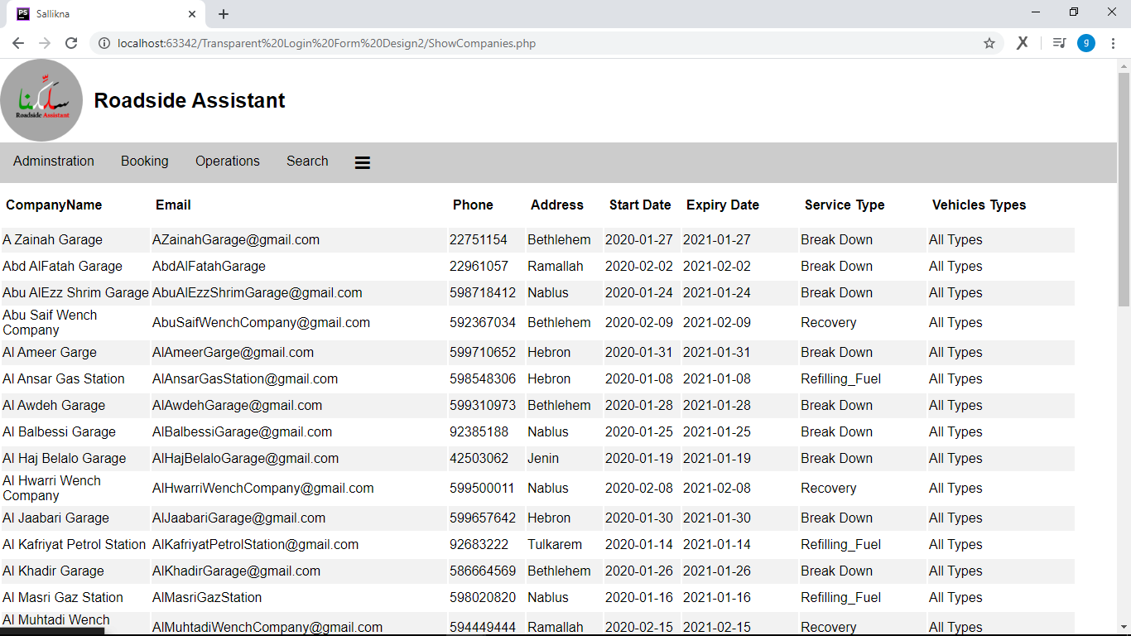

Slide 13
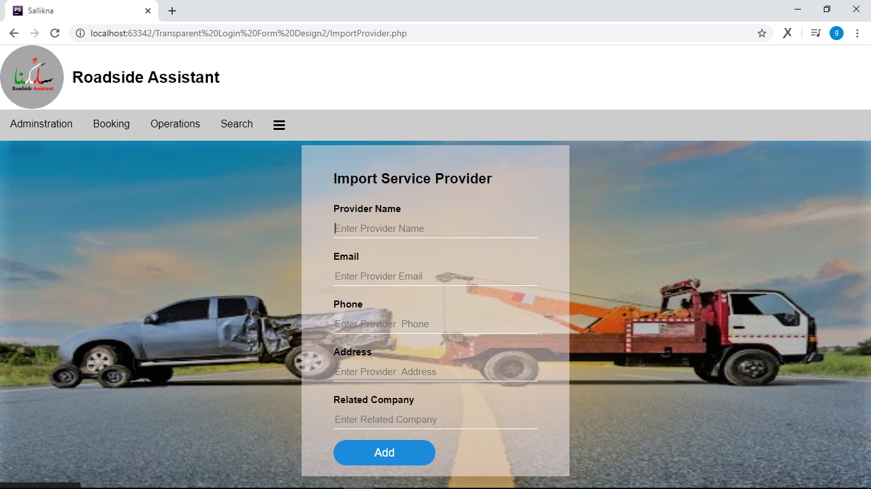

Slide 14
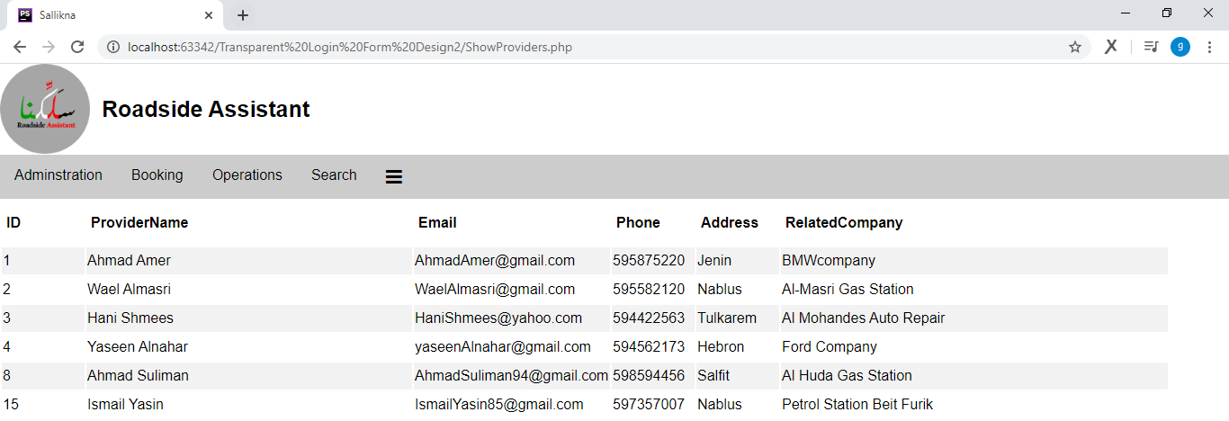

Slide 15
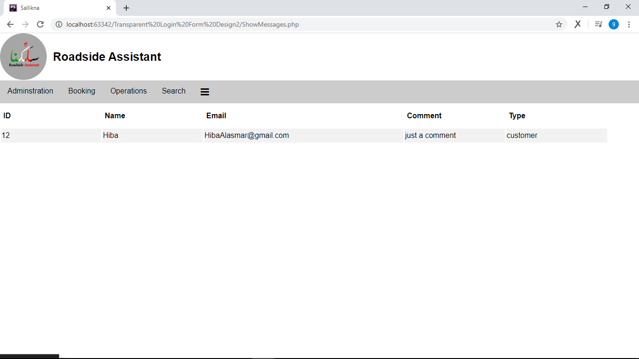

Slide 16
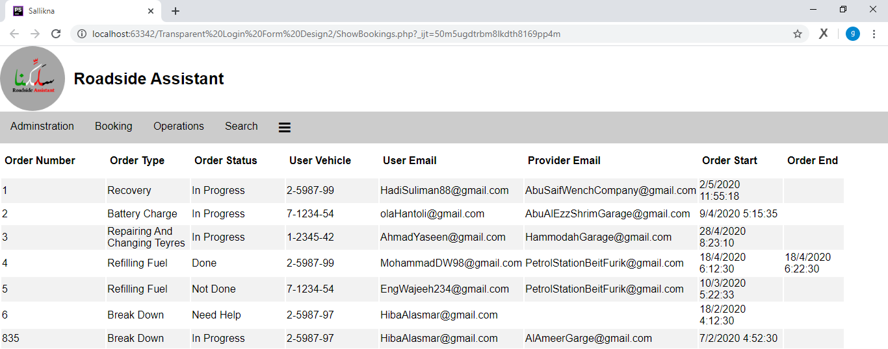

Slide 17
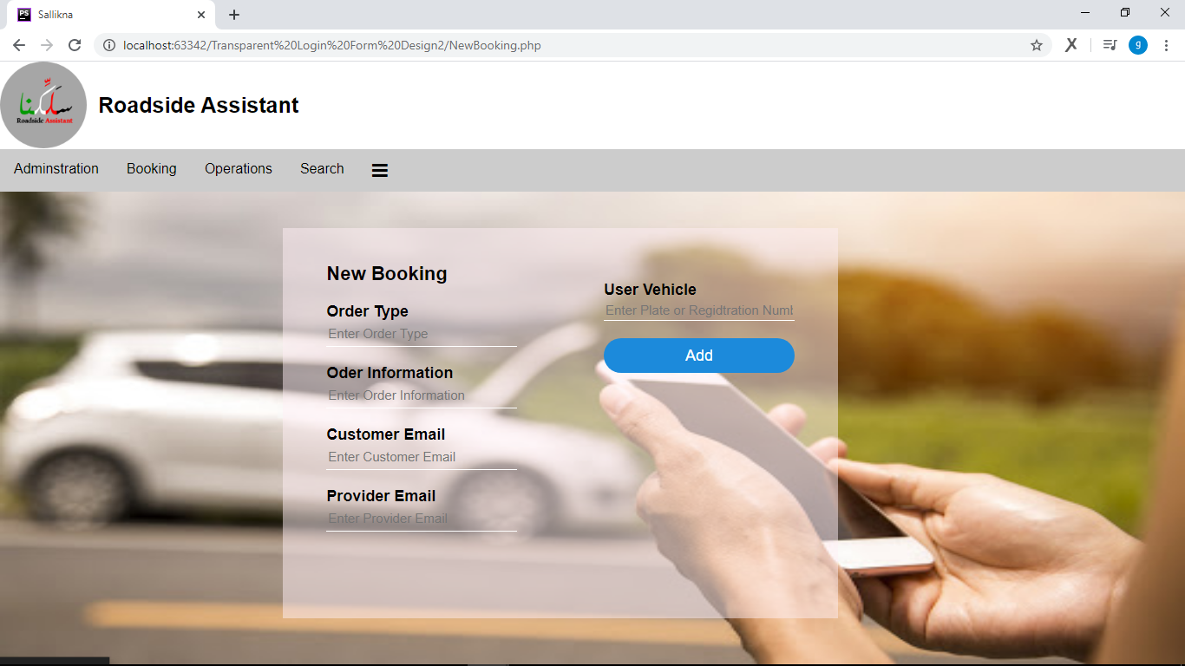

Slide 18
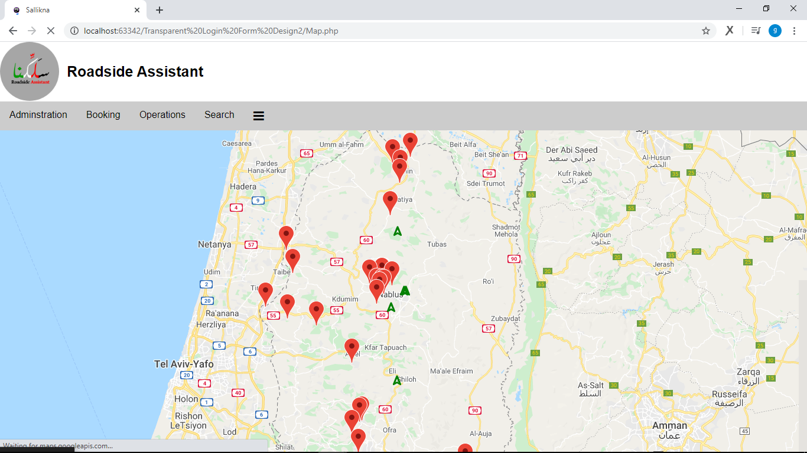

Slide 19
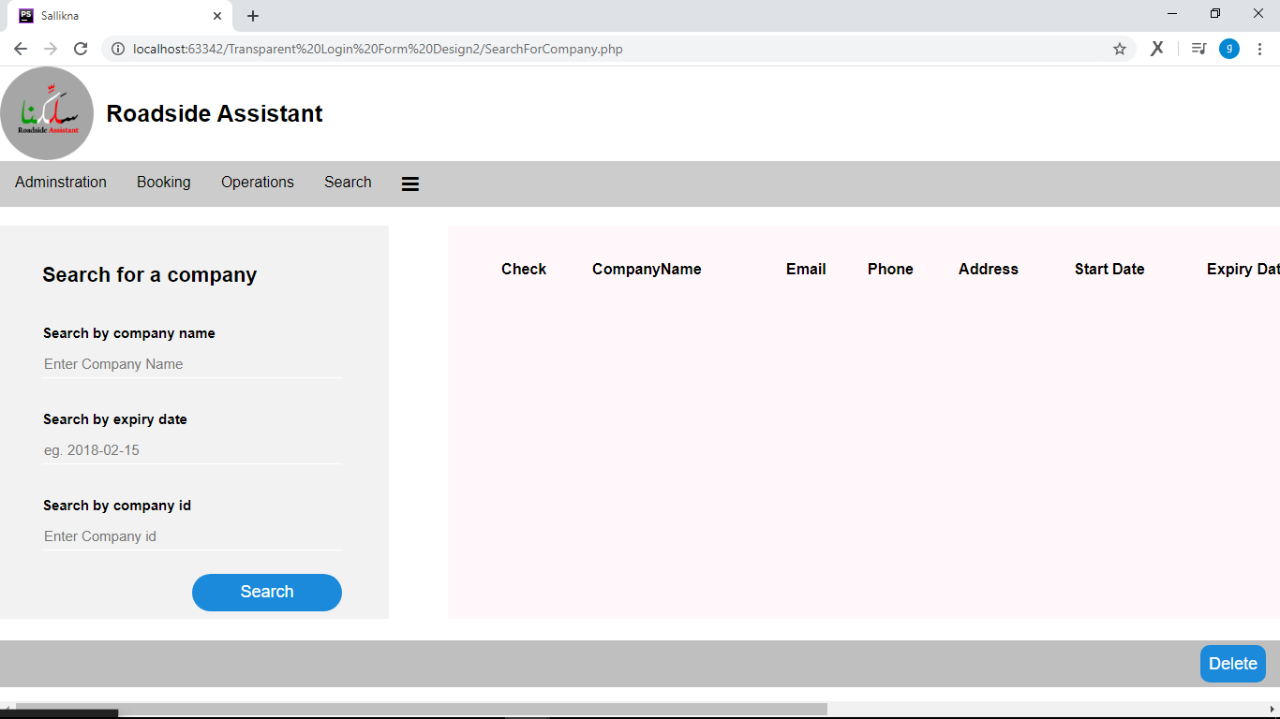

Slide 20
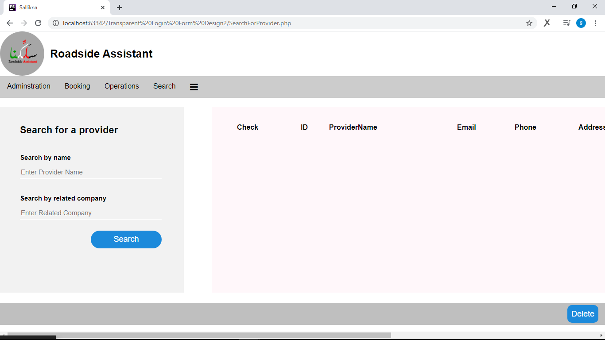

Slide 21
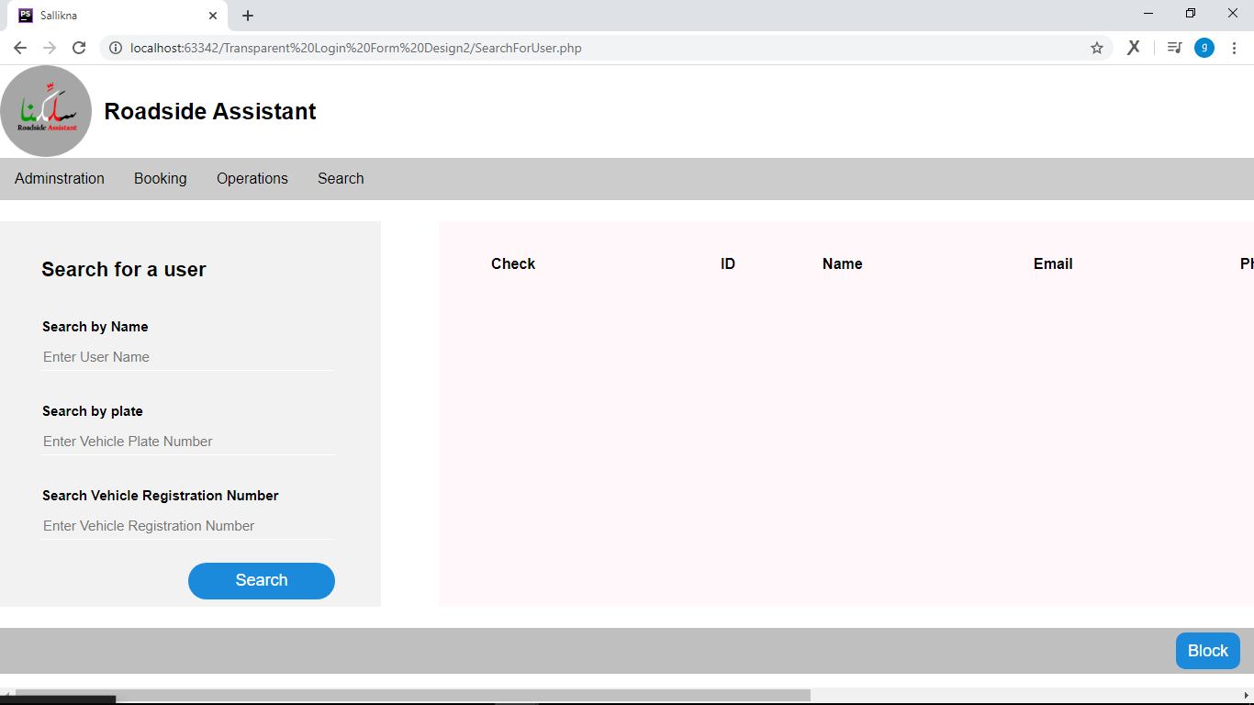

Slide 22
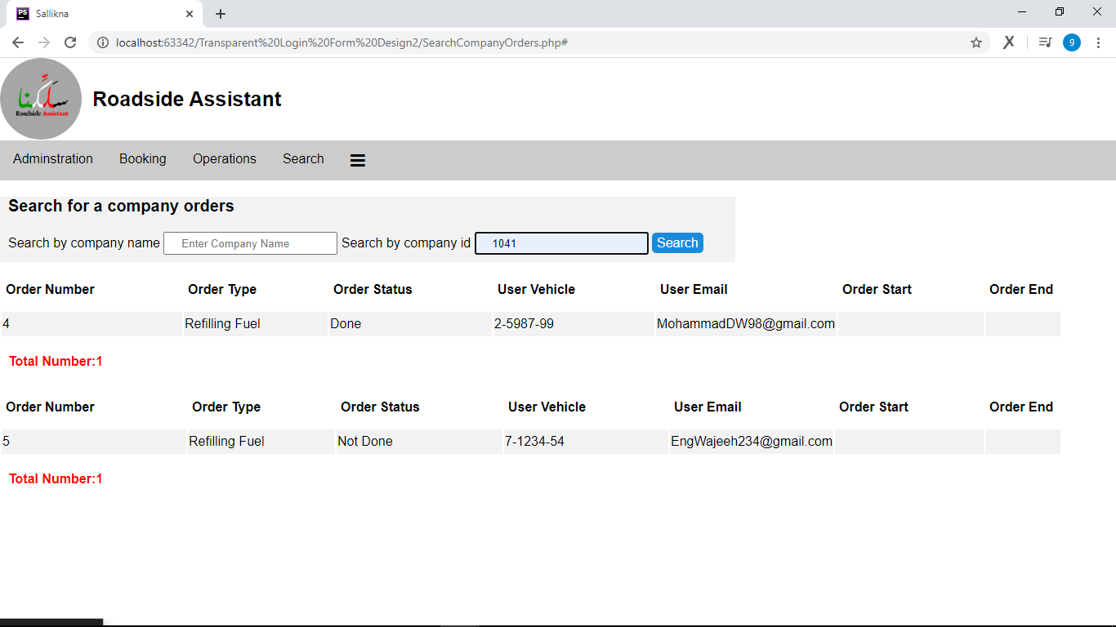

Slide 23
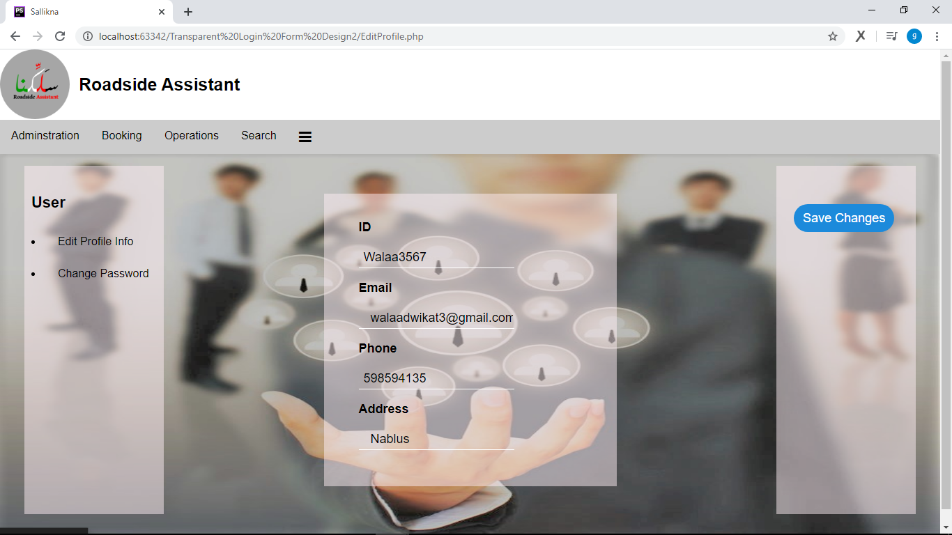

Slide 24
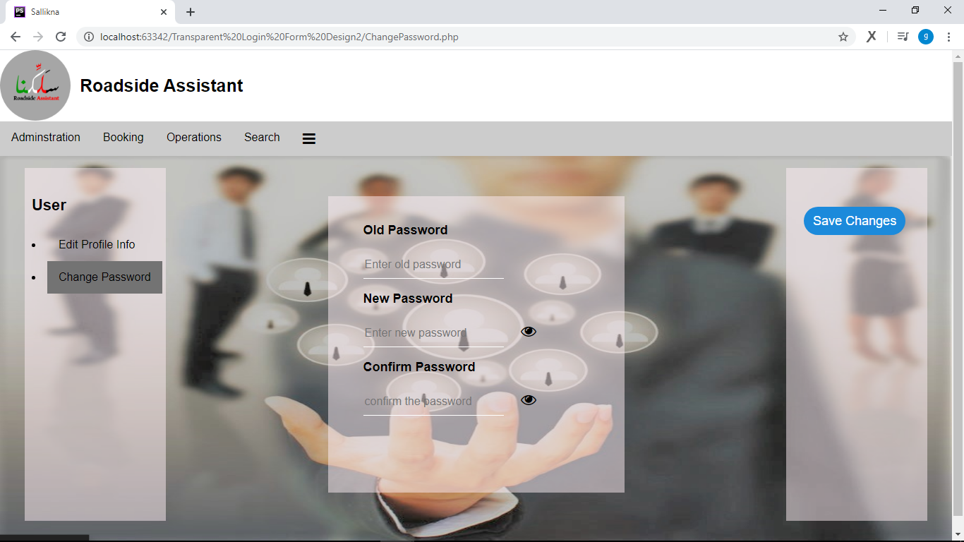

Slide 25
2- End Users (Mobile App)
For the user, he will be able to store his vehicle data that he owns and when needed he will only enter the number of his vehicle plate that has broken down with some information that may be requested from him according to the service he needs in order to explain the image in detail to the service provider.

Slide 26
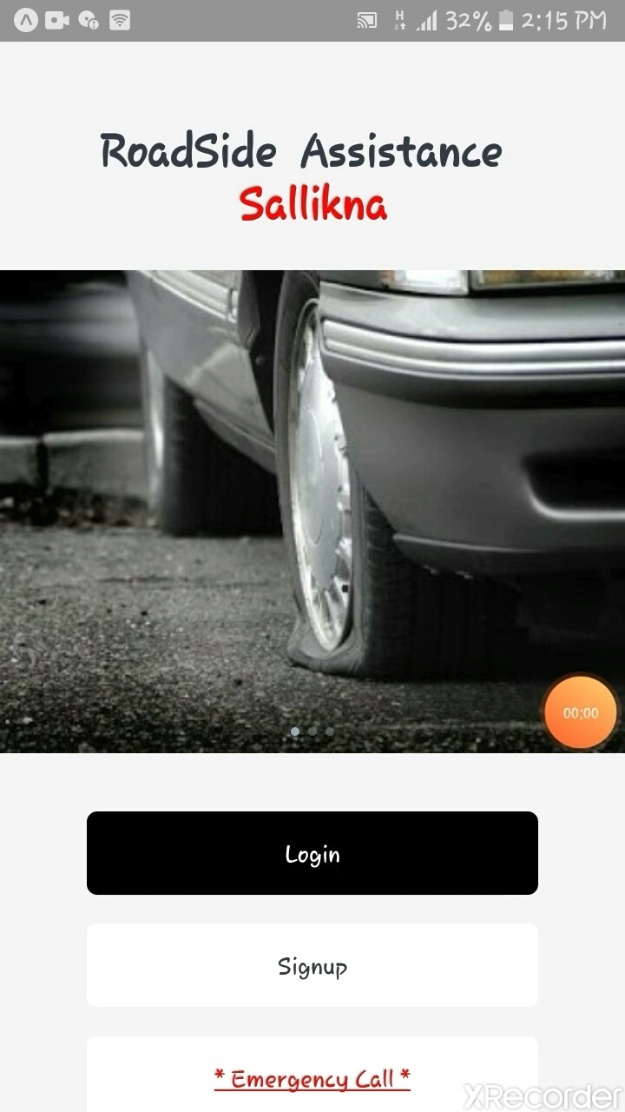

Slide 27
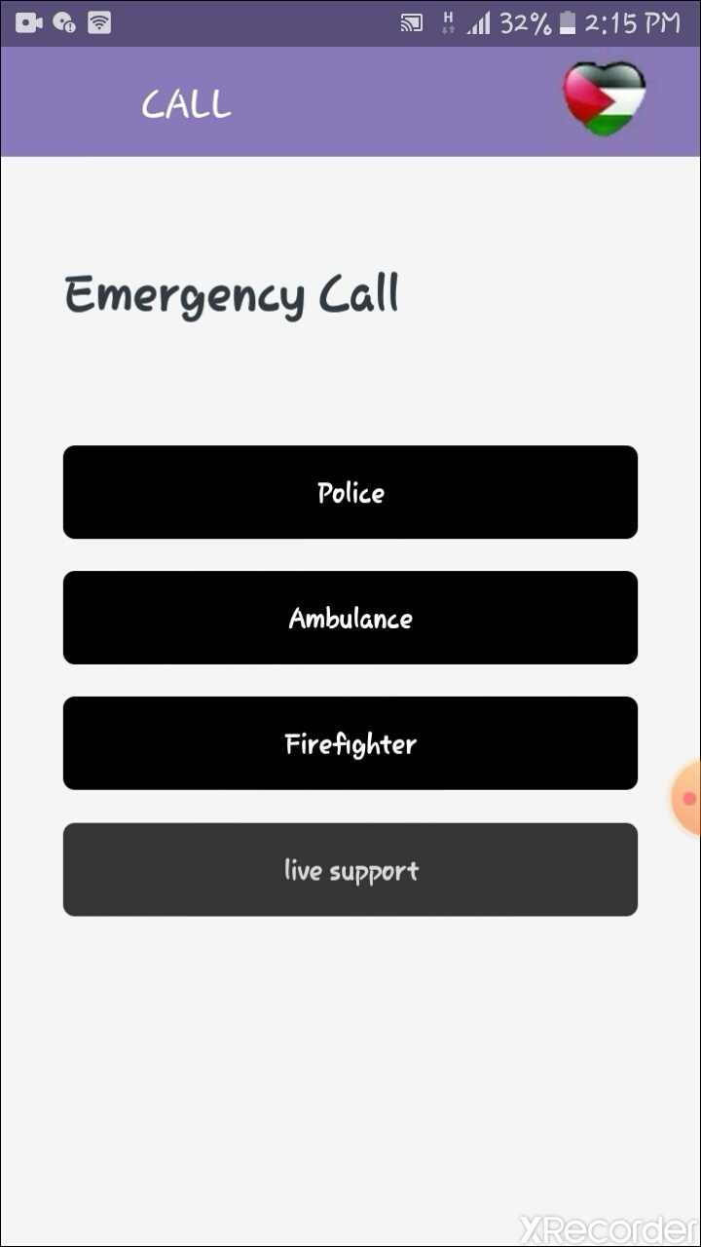
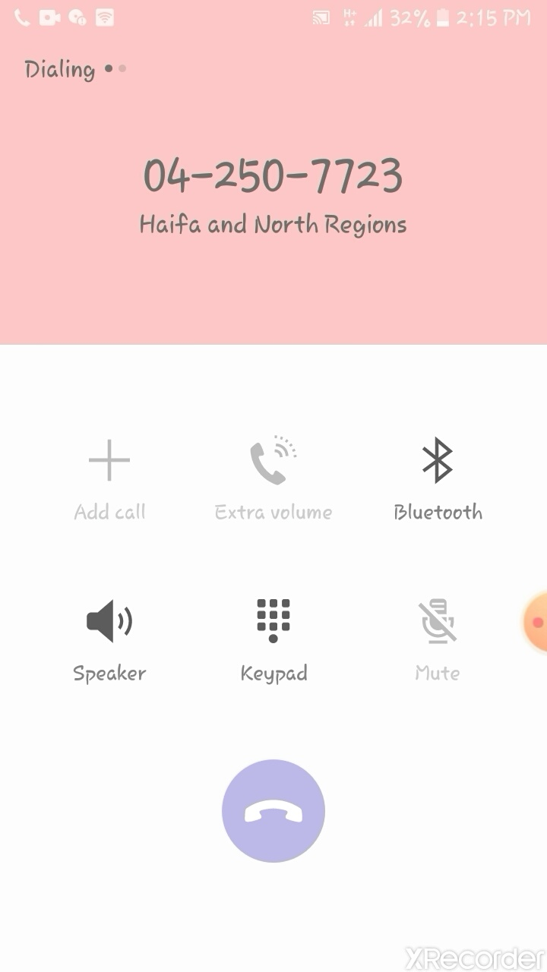

Slide 28
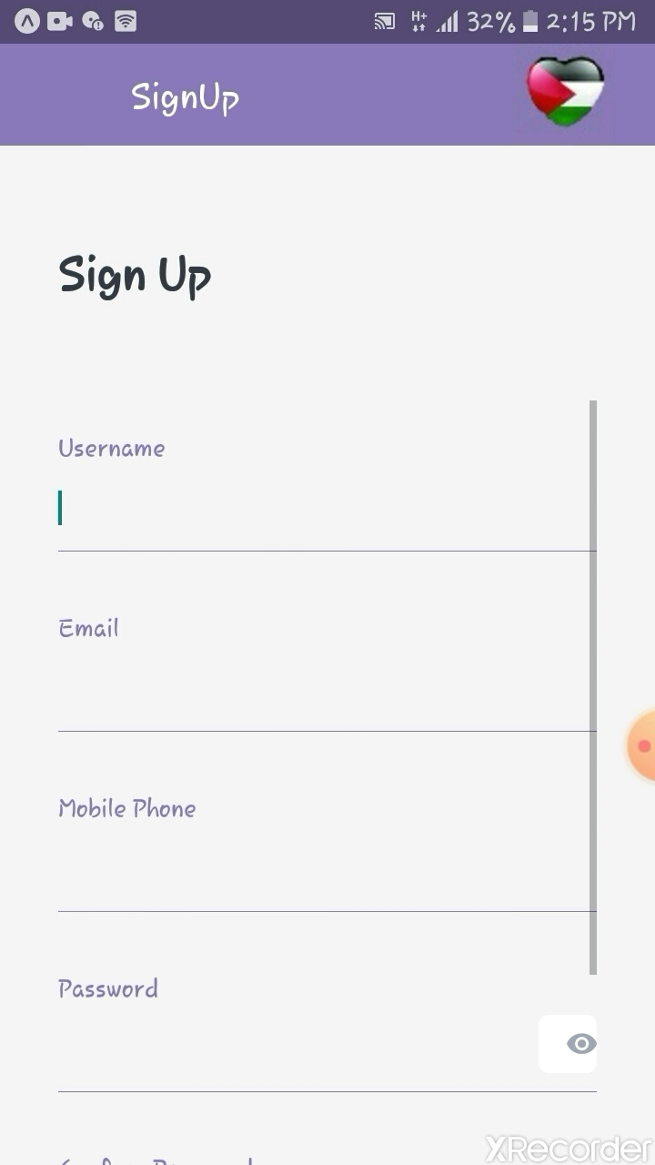
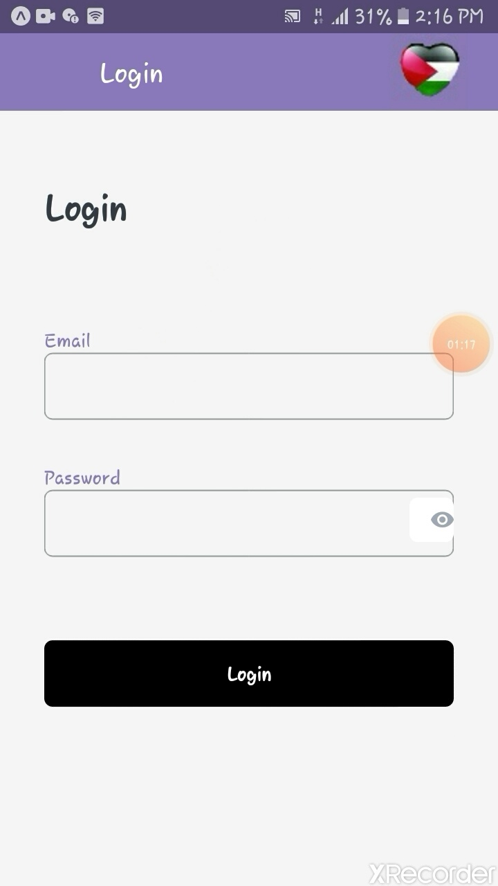

Slide 29
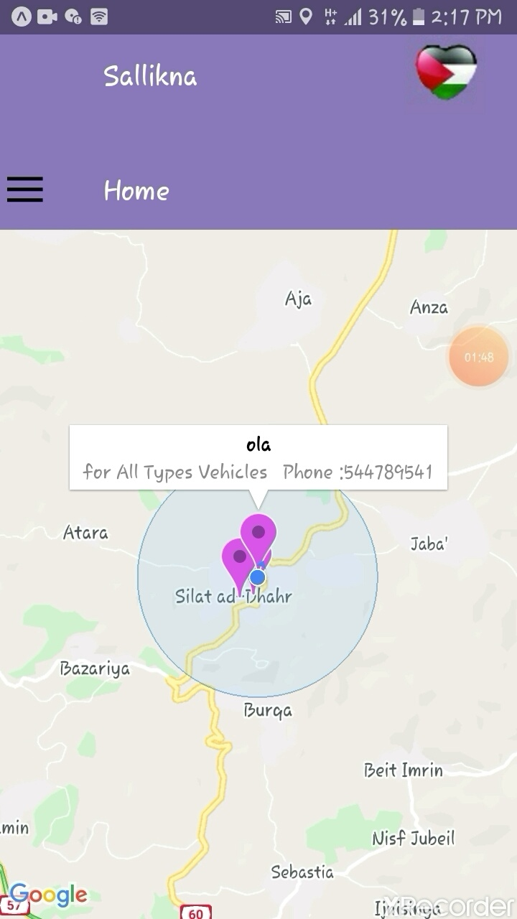
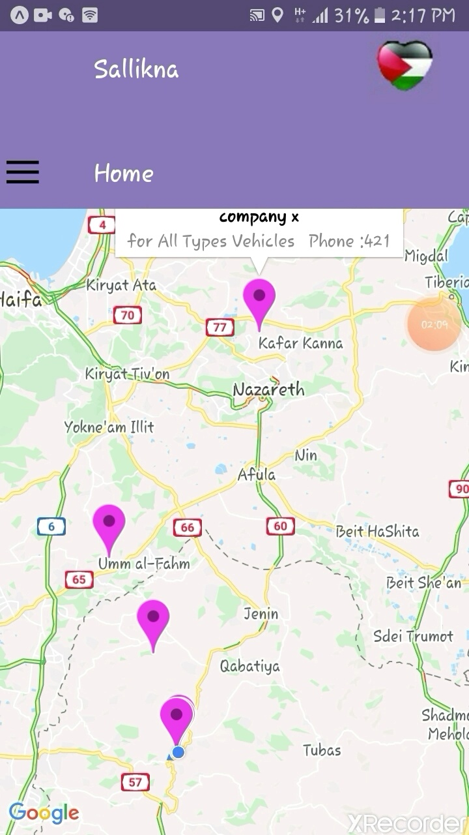

Slide 30
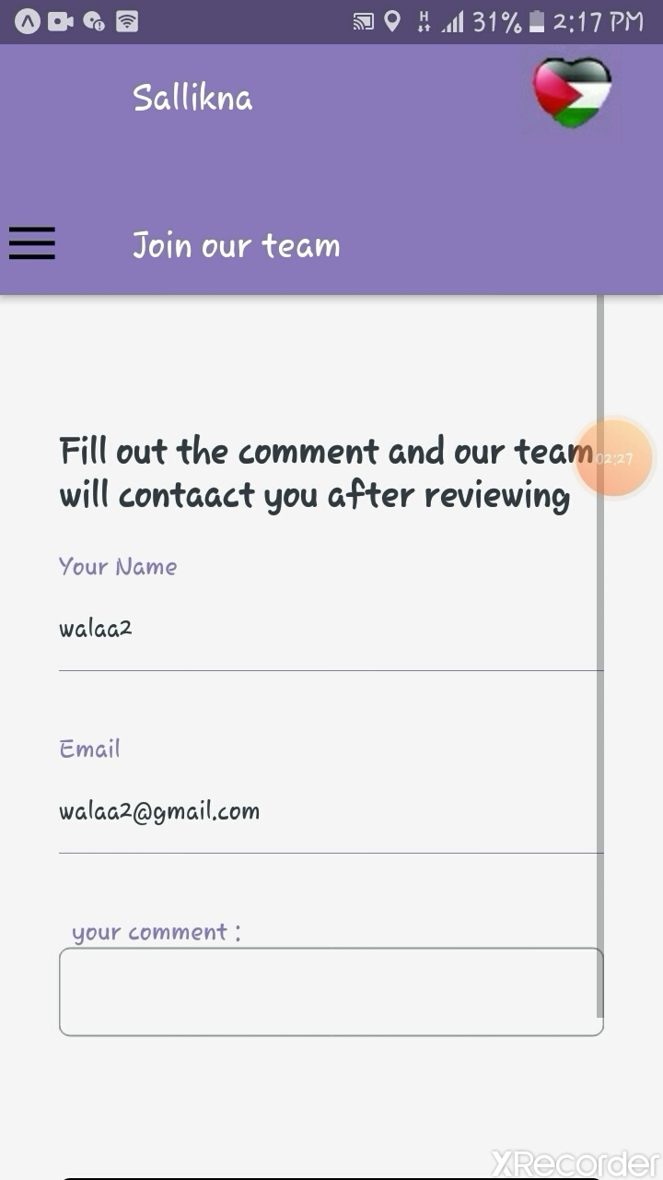
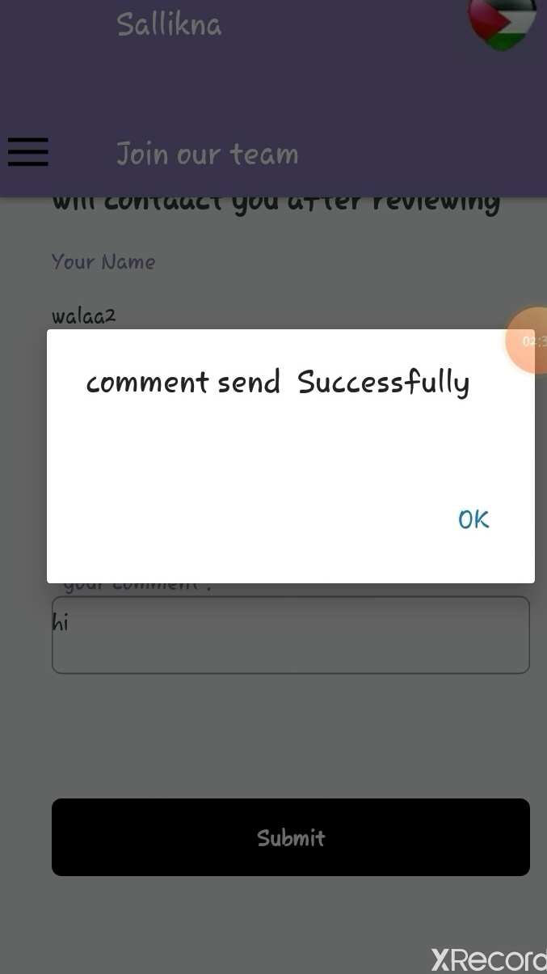

Slide 31
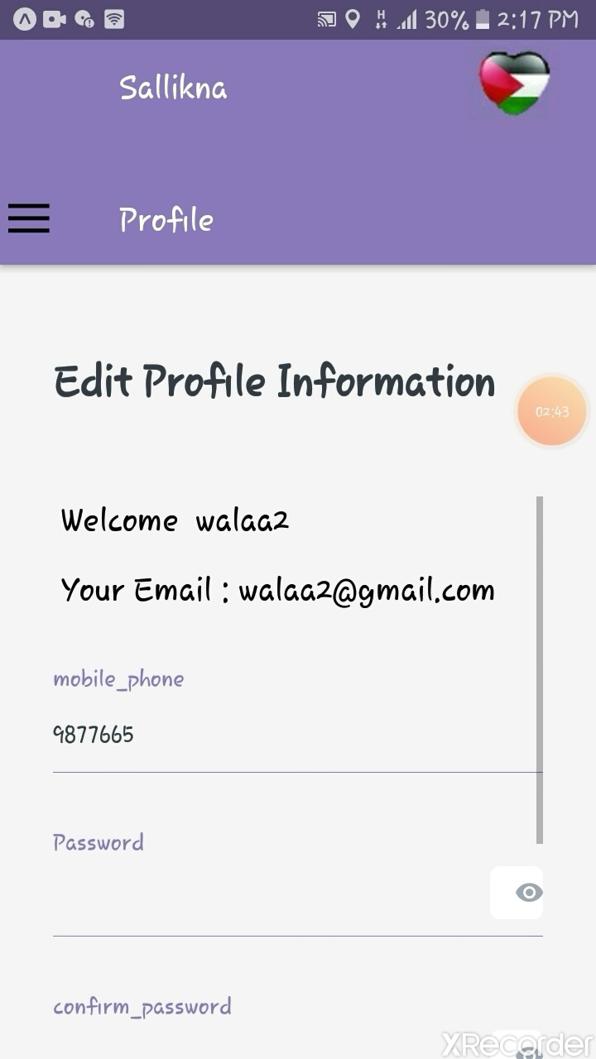

Slide 32
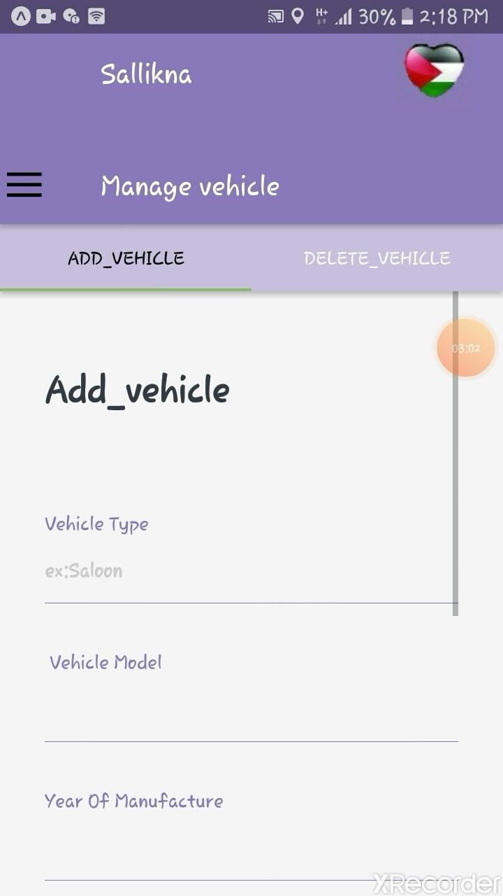
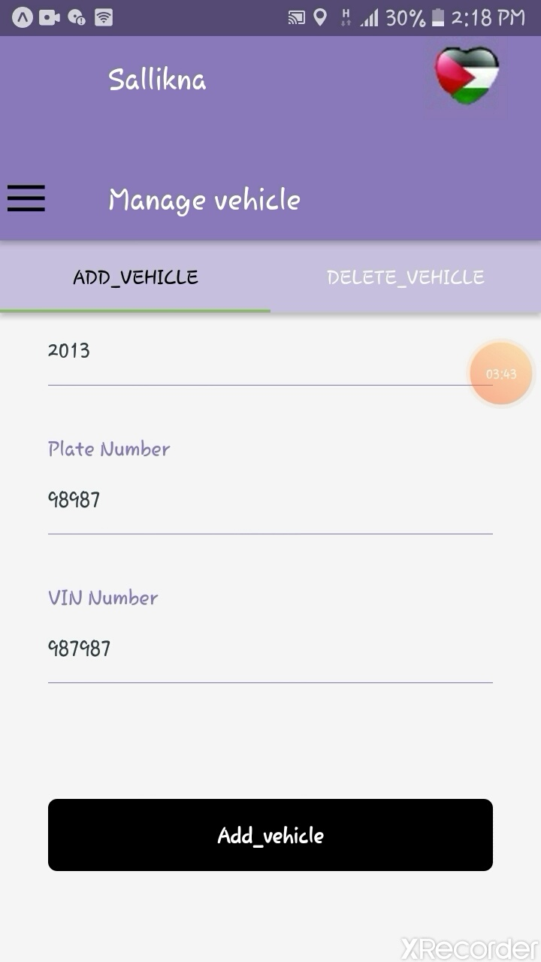

Slide 33
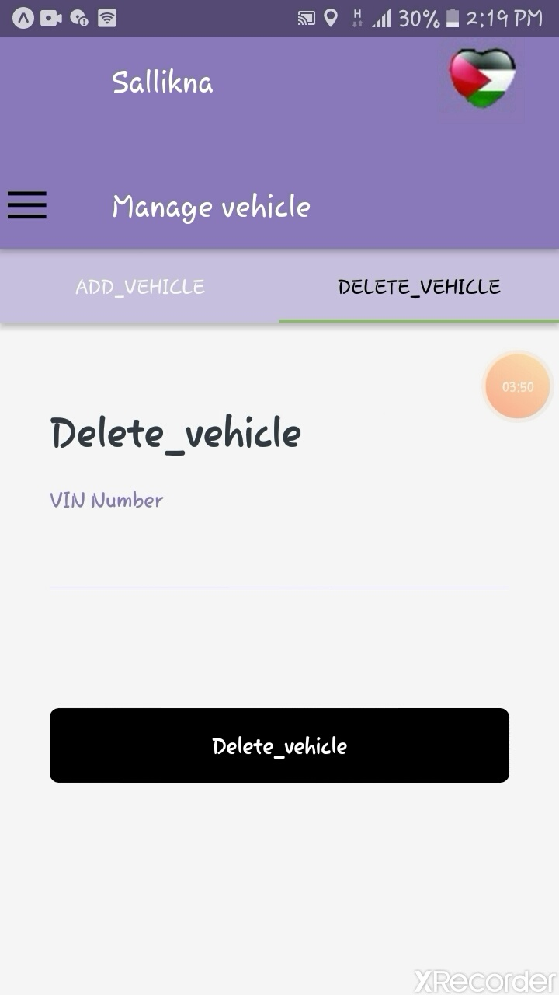

Slide 34
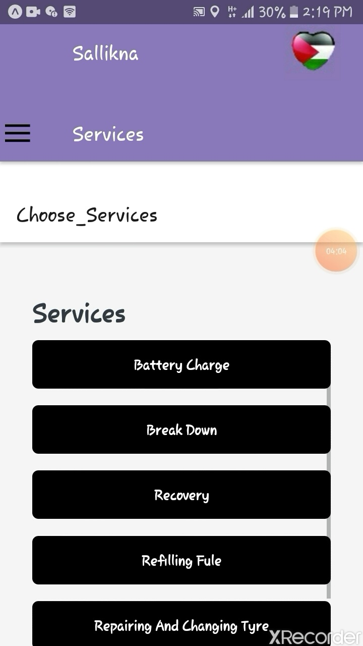
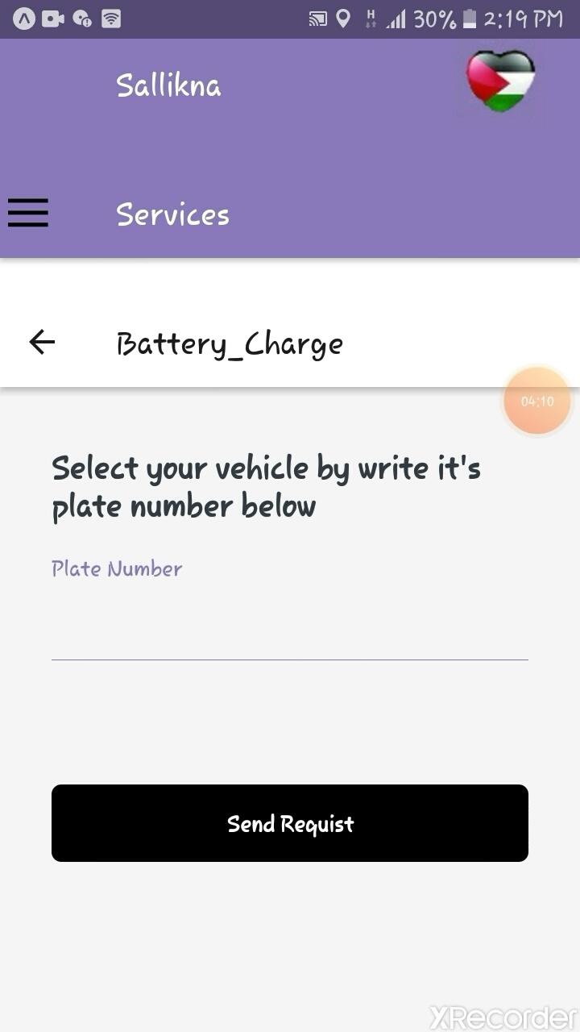

Slide 35
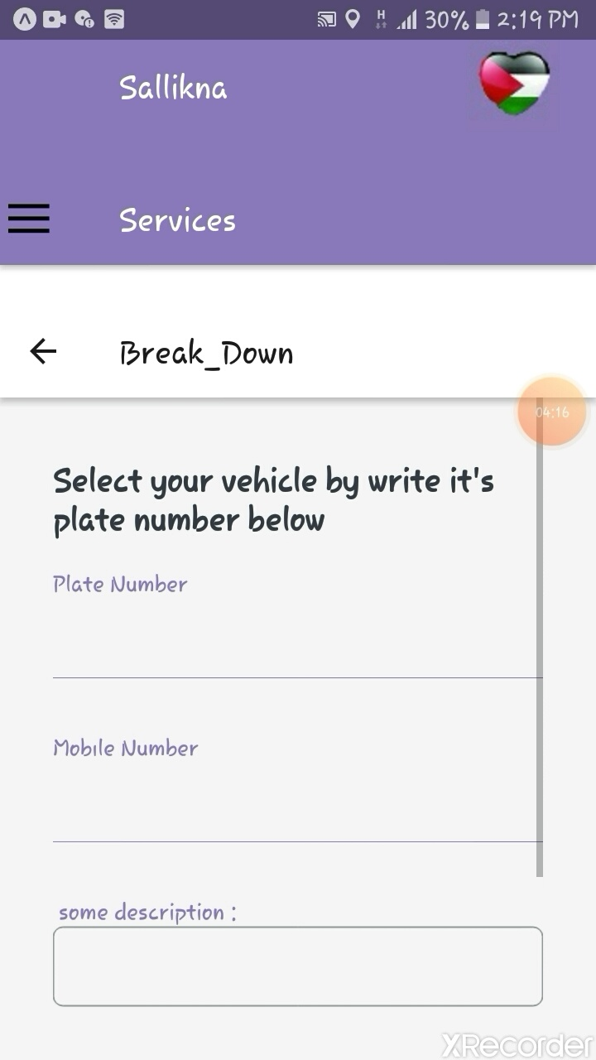
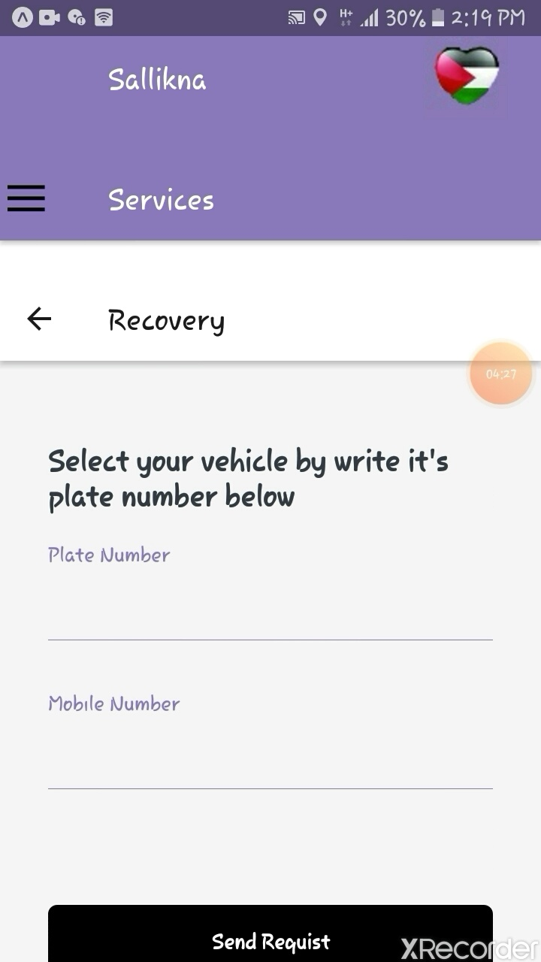

Slide 36
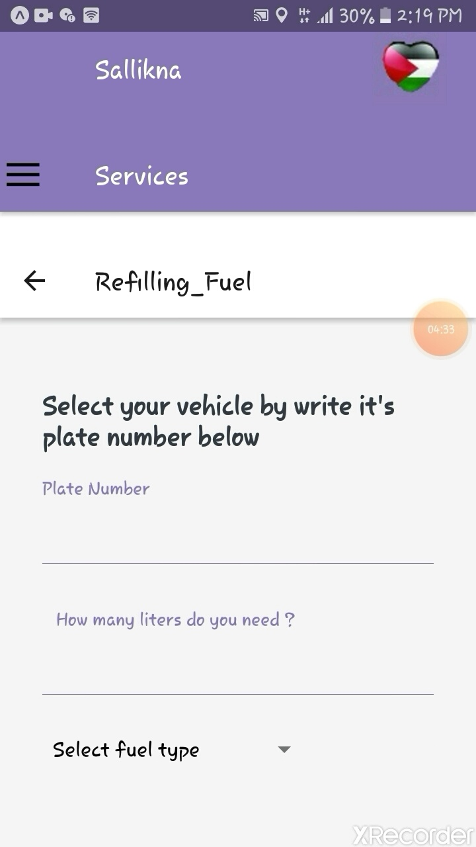
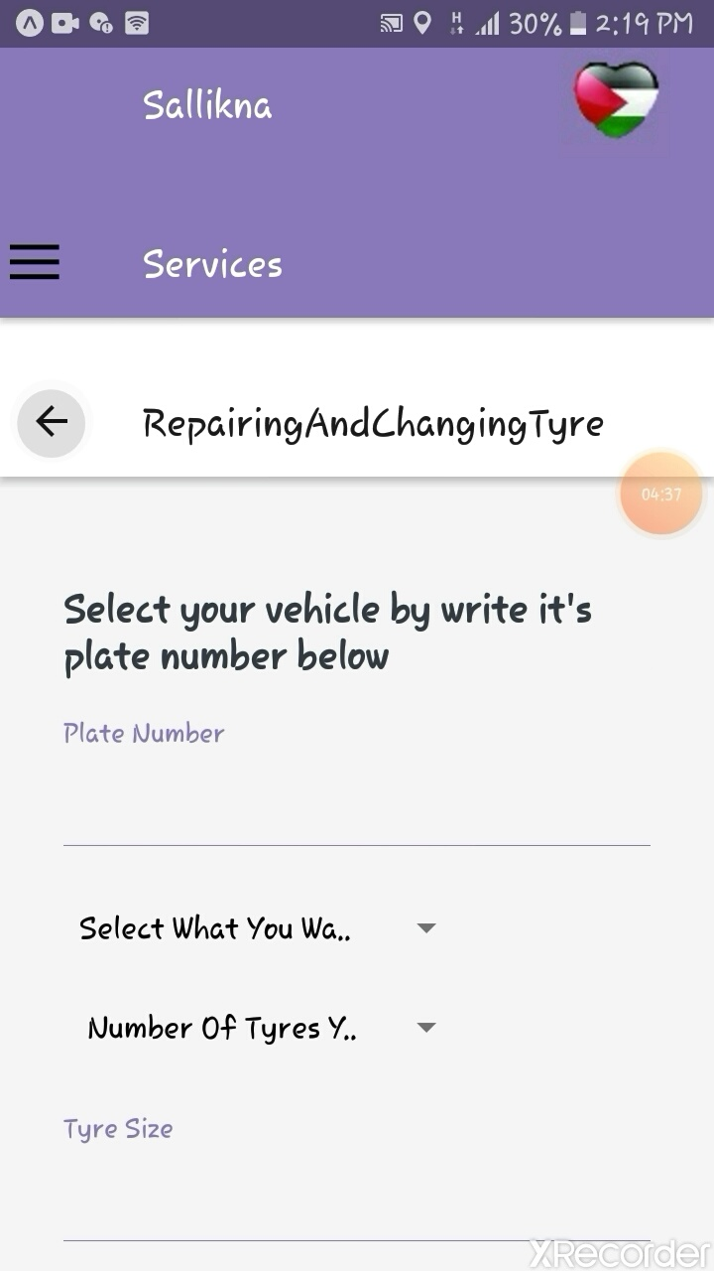

Slide 37
3-Services Provider (Mobile App)
The company has an application through which it can receive requests from customers and the service provider has the option to accept or reject the request depending on the data that received and its capacity to absorb orders.

Slide 38
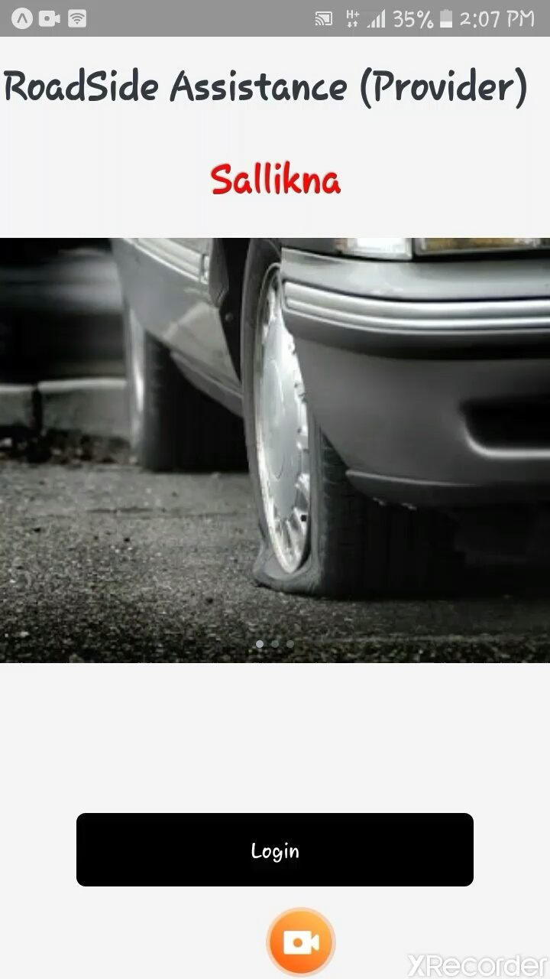
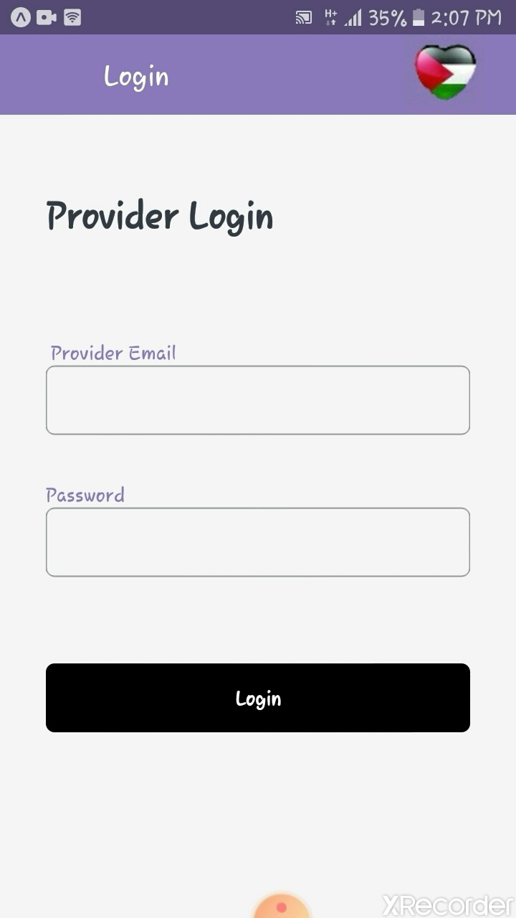

Slide 39
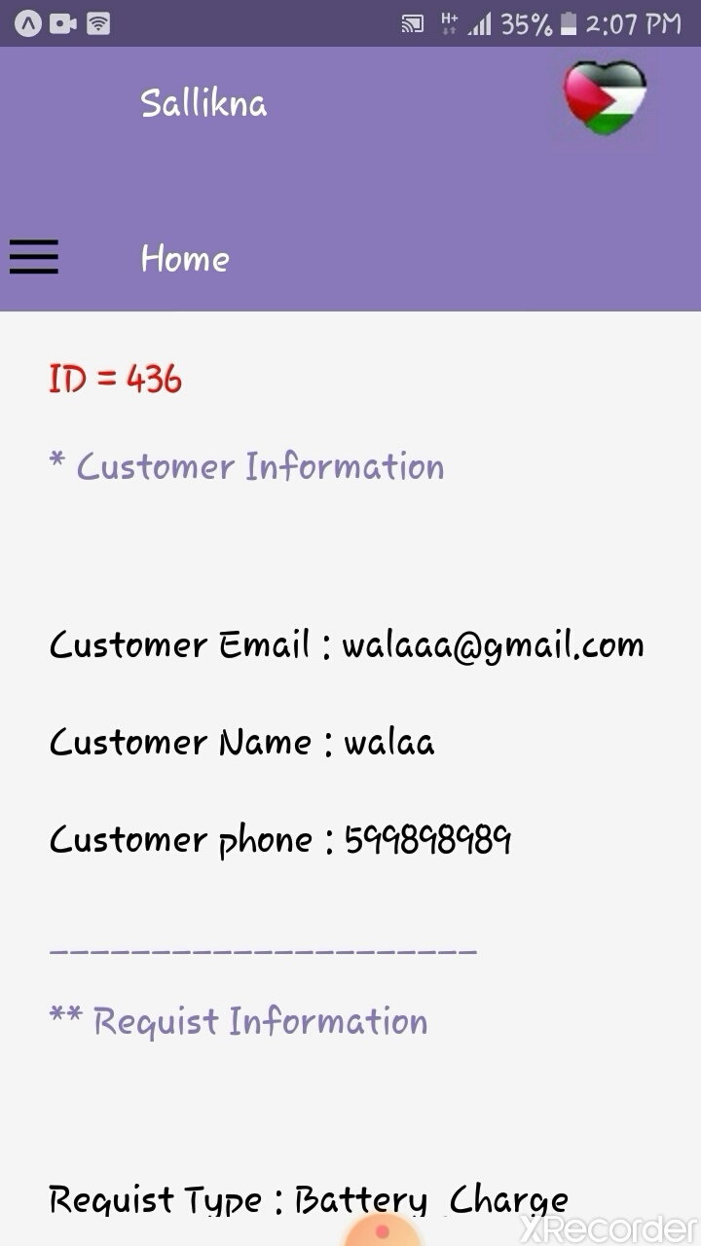
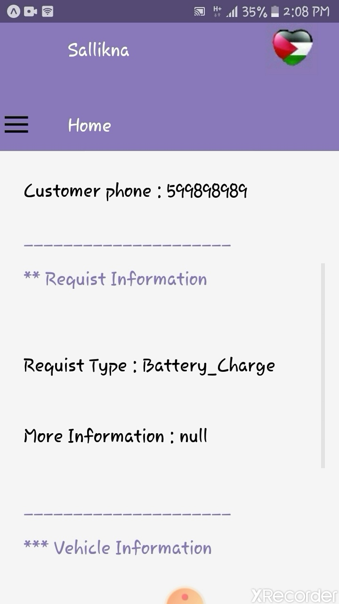
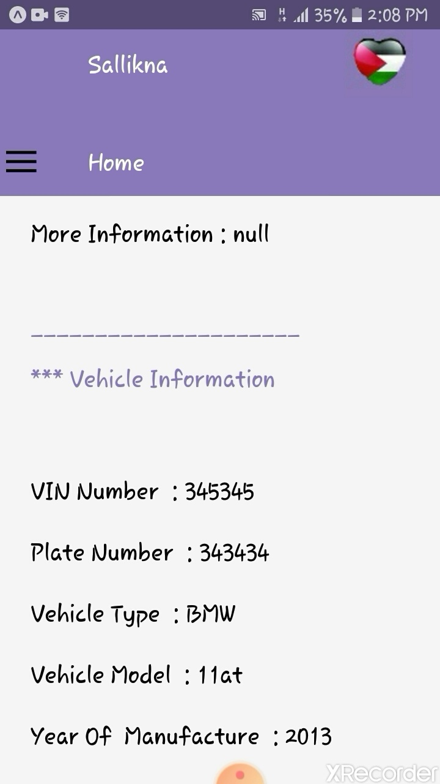

Slide 40
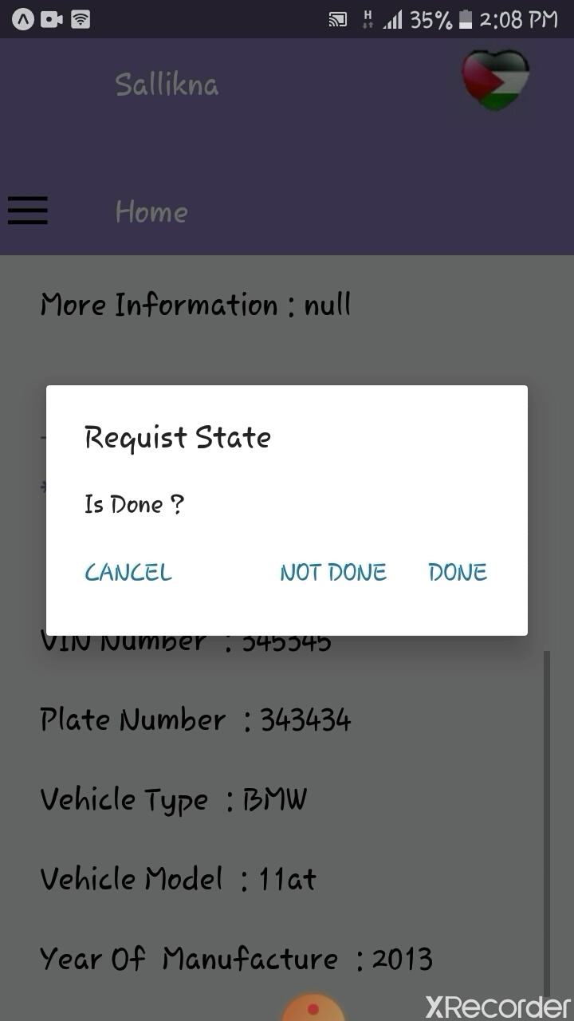

Slide 41
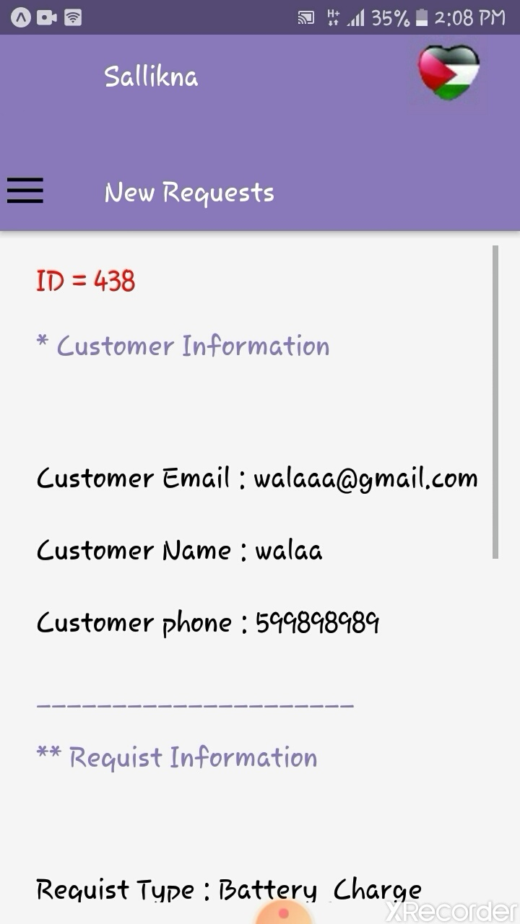
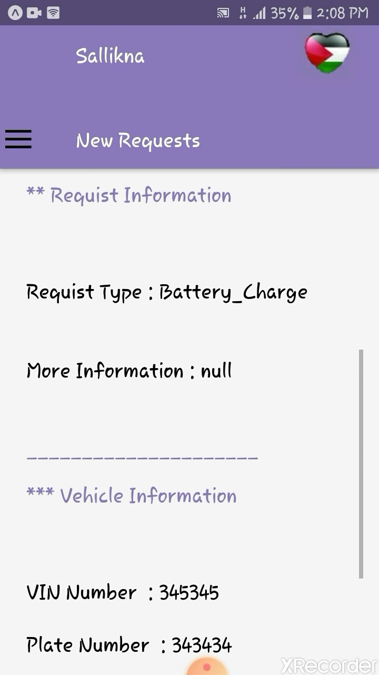
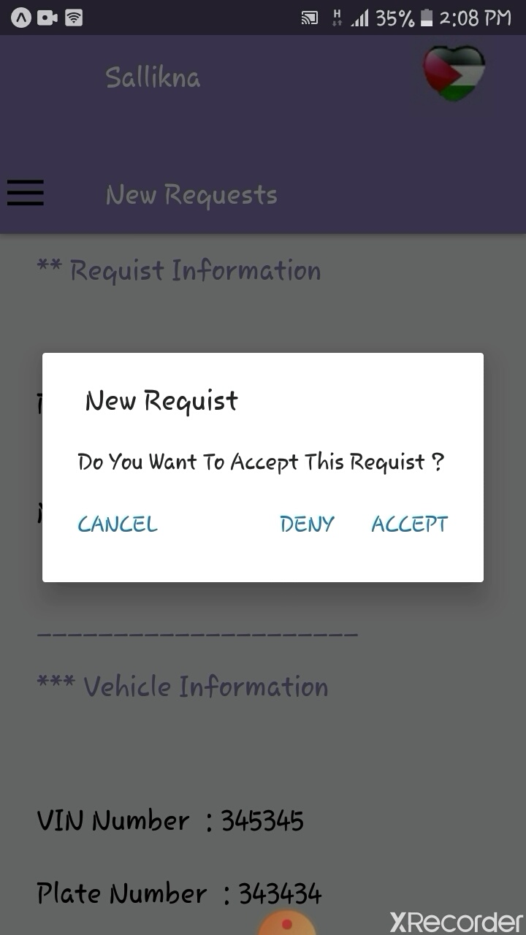

Slide 42
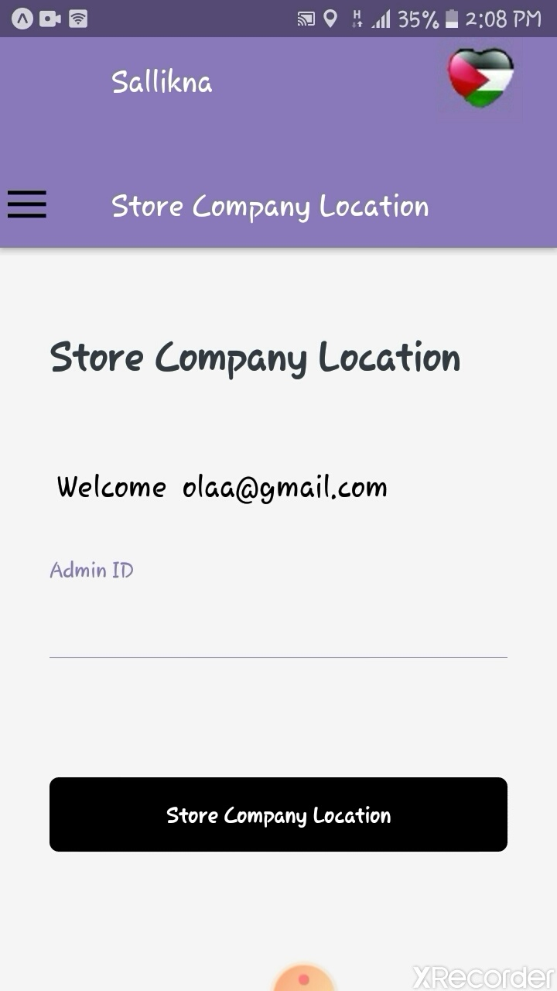

Slide 43
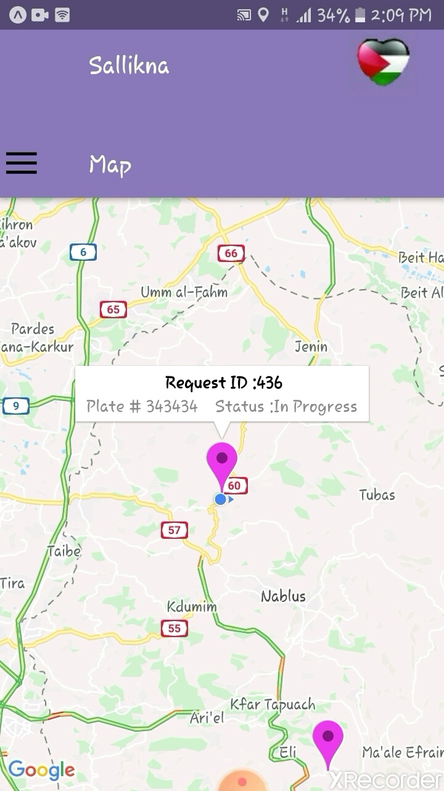
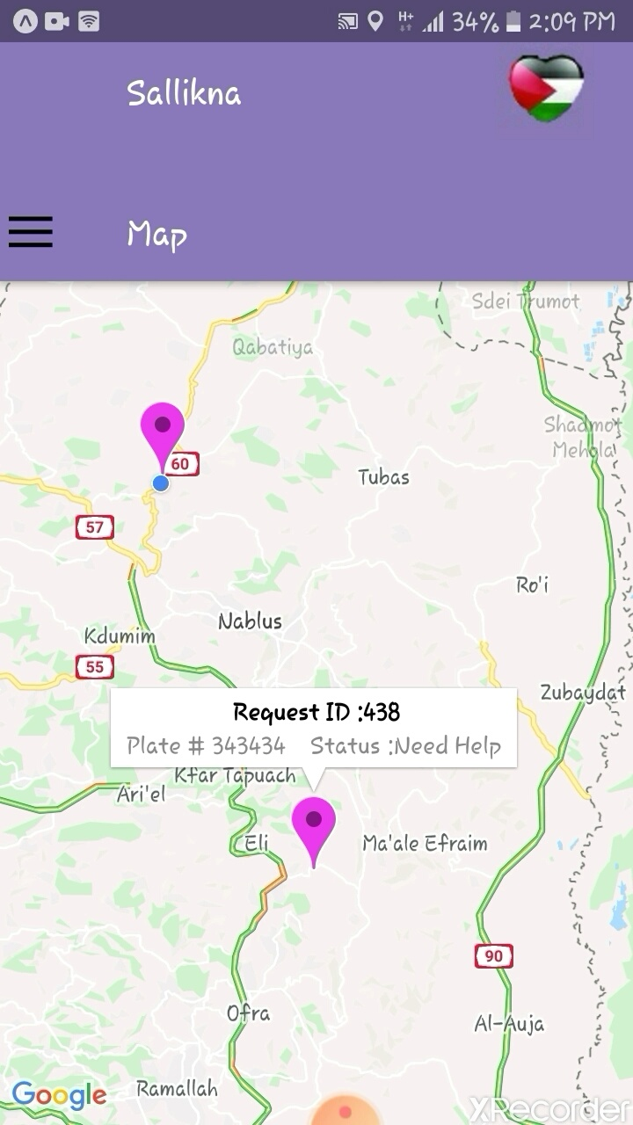

Slide 44
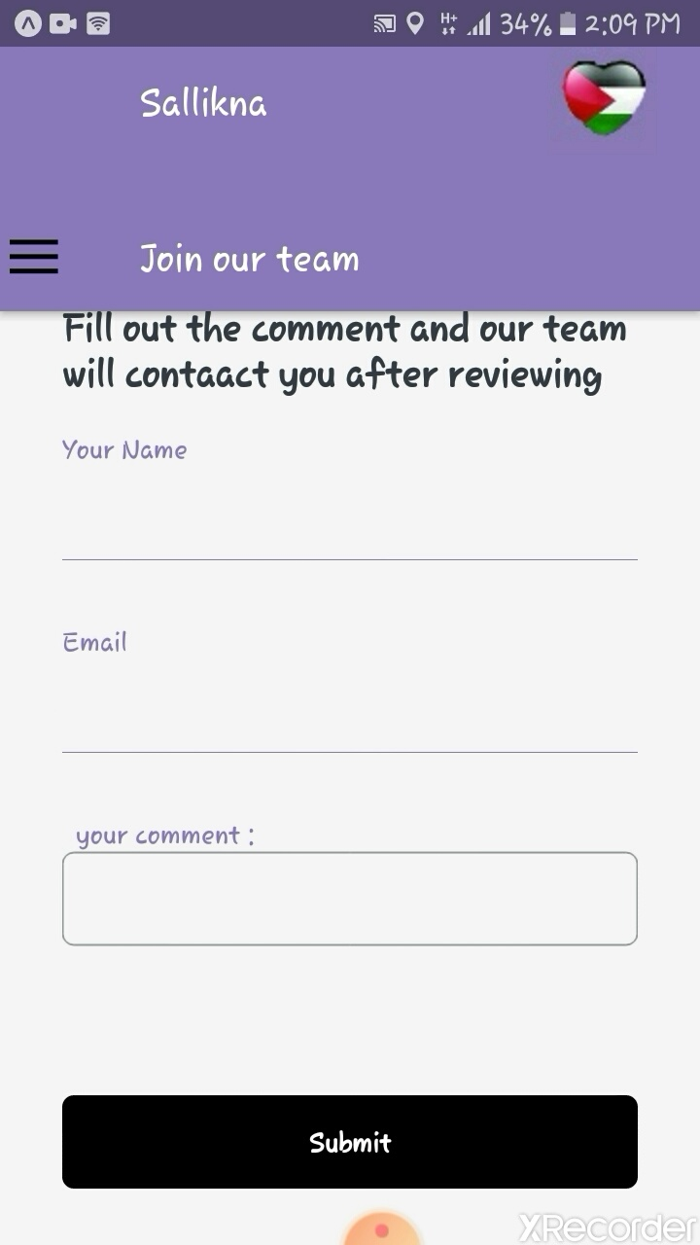
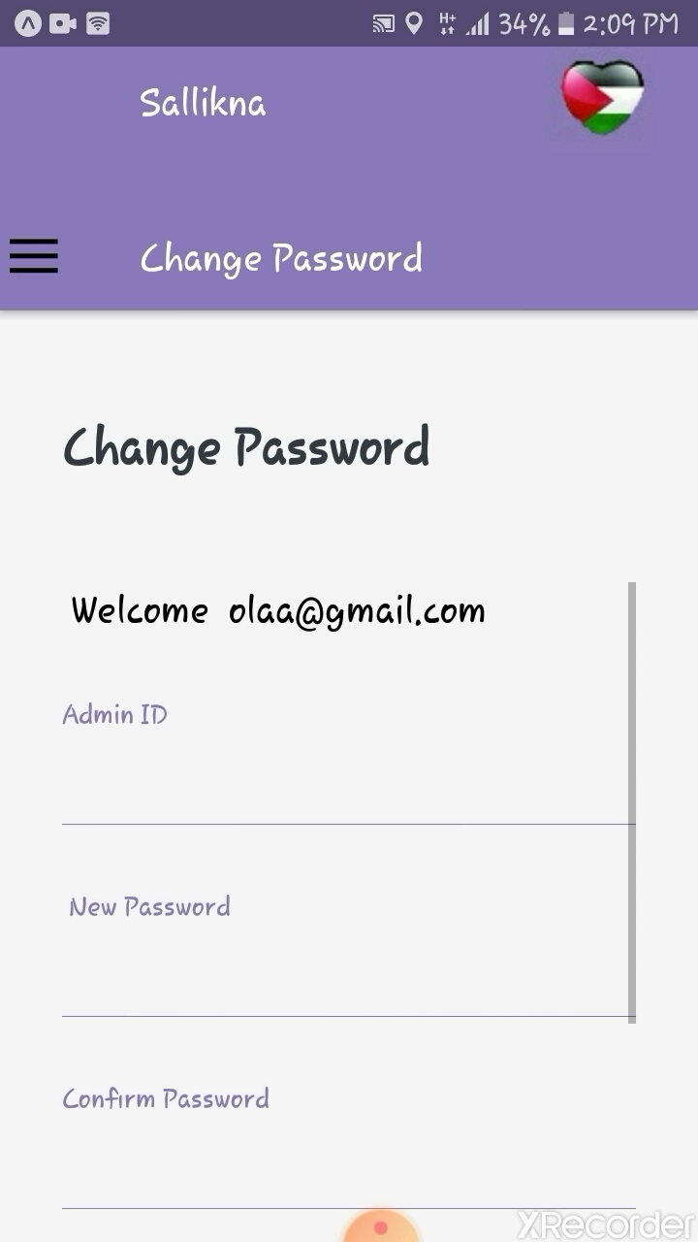

Slide 45
Results and Discussion
The system which we have created to facilitate vehicles owners in the tough event of various situations that may occur at any moment, by using Sallikna will simplify these hard situations and save customer efforts and time. Also, the availability of the emergency call feature is useful in case of emergency situations.
We have also provided direct support with system admins if you have any inquiries and questions .
This is an integrated system for a private company (website mange by admins ) And we provide applications

Slide 46
Constraints
The appearance of the Corona virus
The react native is completely new to us.
There were projects and homeworks that affect the completion of the project as required. As it contains a website and two mobile applications.
Internet problem where both of us have a 3G internet.

Slide 47
Conclusion and Future work
By the end this project presented to help the Palestinian community, it aims to organize and solve problems that facing drivers, and it is also aimed at helping the companies that provide the service by increasing the number of customers.
Future Work:
We will improve this system by:
Add Arabic Language.
Add chat between the customer and provider.
Add new services .
Add online payment.
Add motion tracking features.

