Slide 1


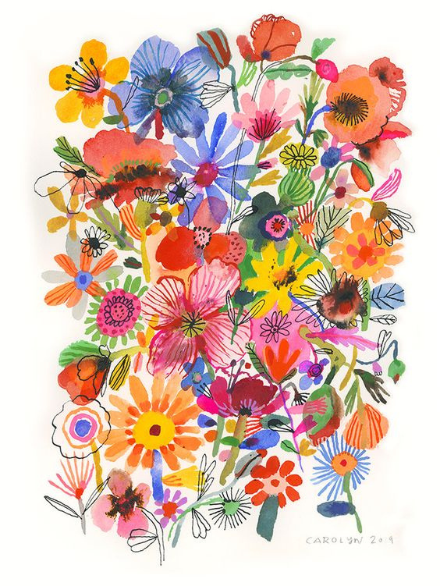



ArtiMixer
Done by:
Ethar Suwan & Shahd Lubbadah
Supervisor: Dr Aladin Masri

Slide 2



Outline
01
What is ArtiMixer?
02
Motivation
03
Feauters
Hardware Components
05
Constrains
Future work
04
06

Slide 3
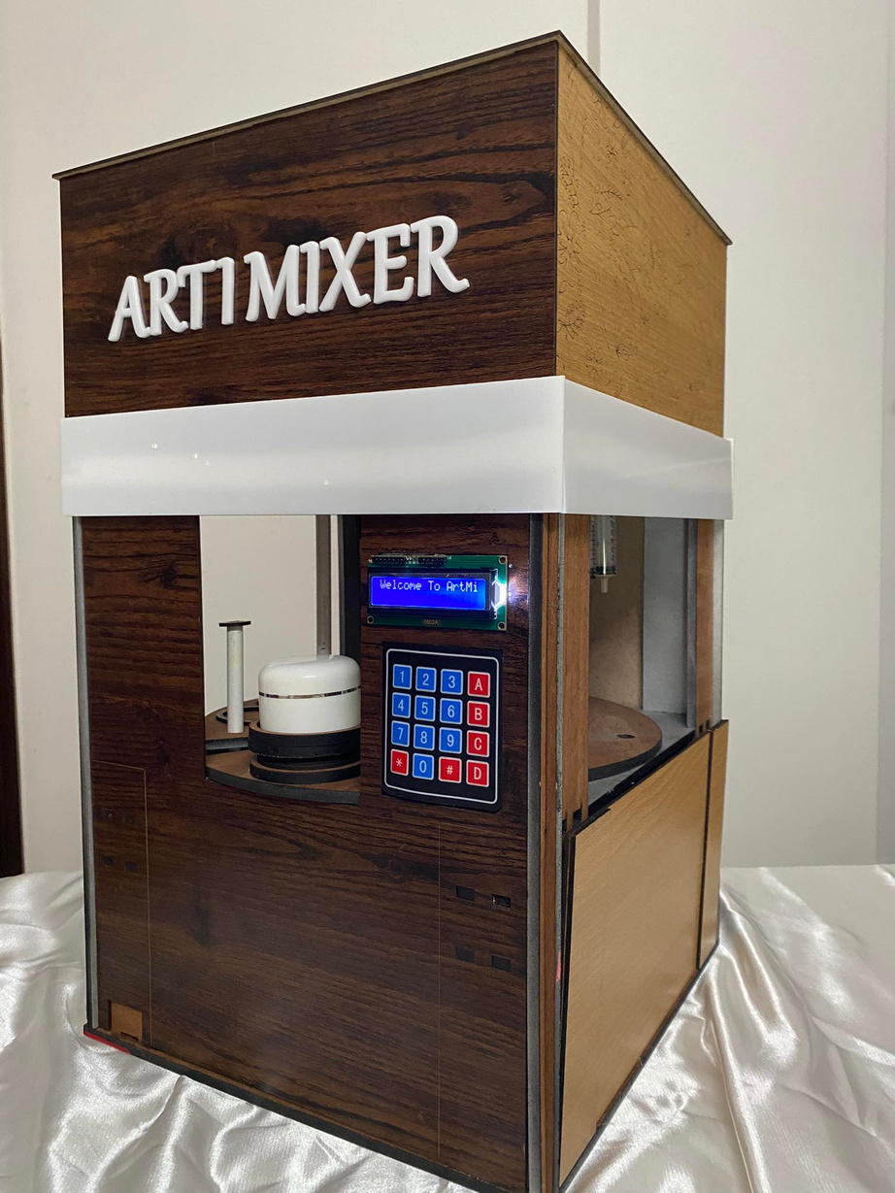

What is ArtiMixer?
A color mixer device that allows users to enter RGB values of their desired color via a keypad or mobile application.
Then it will produce the desired color using CMYK colors.

Slide 4


Motivation
01
02
Reducing Time
Reducing Cost
By decreasing the time needed to achieve the desired color, this device offers artists and art students significant benefits.
This device aims to minimize color waste and reduce costs during the process of achieving the desired color.

Slide 5
Features
01
Customized Color Production
03
Mixing
02
04
Cleaining
Mobile Application

Slide 6
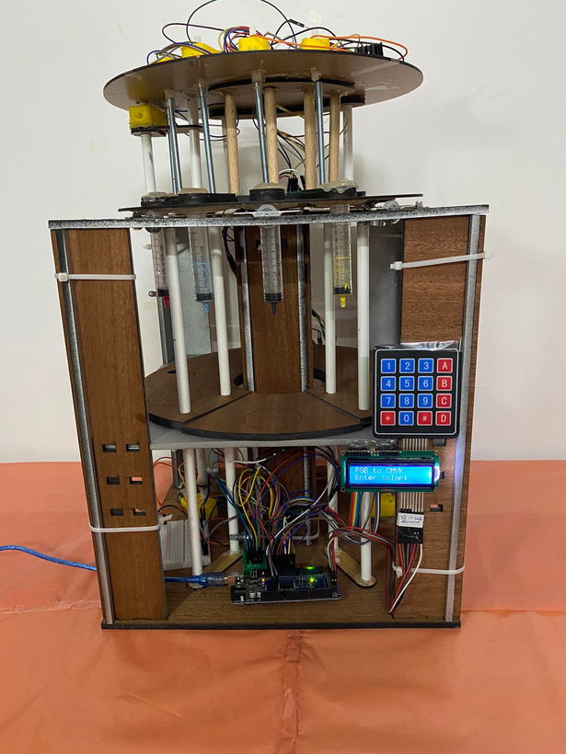
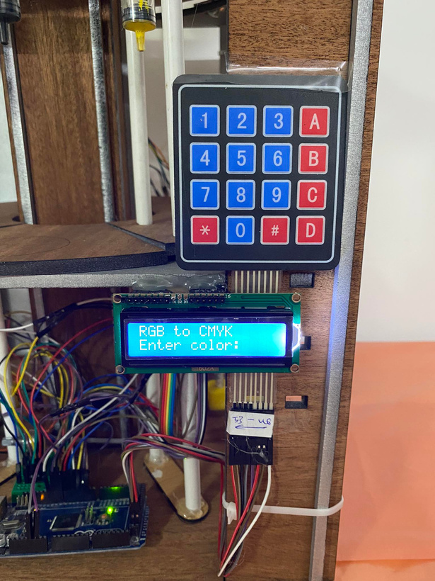
Hardware Components

Slide 7



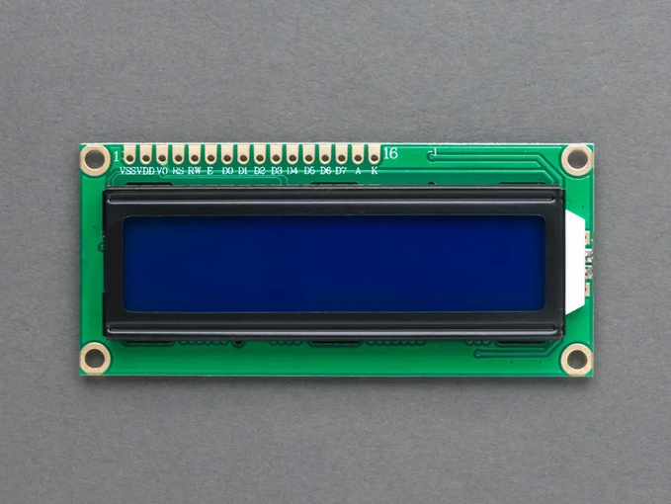
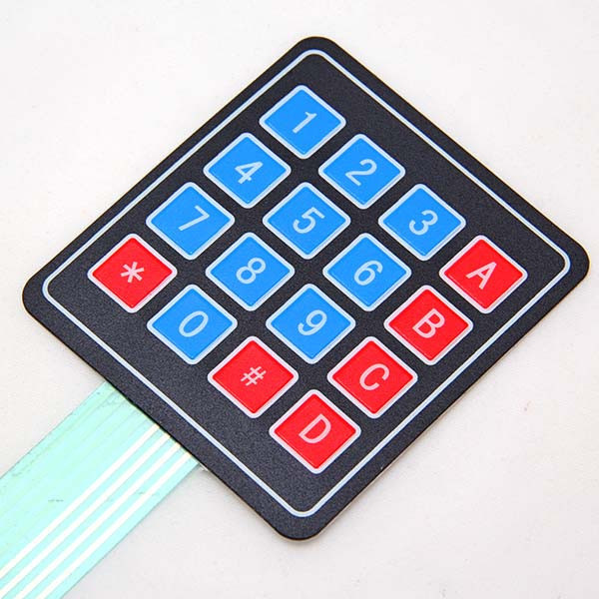


01
02
KeyPad
Lcd

Slide 8
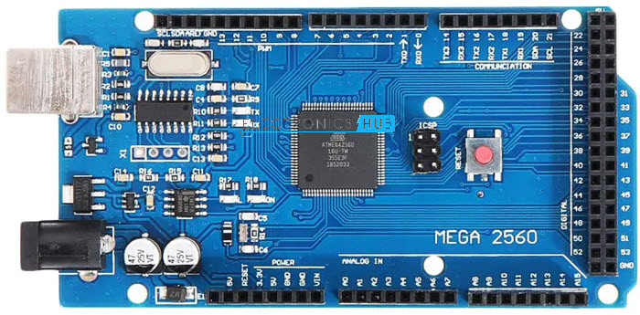
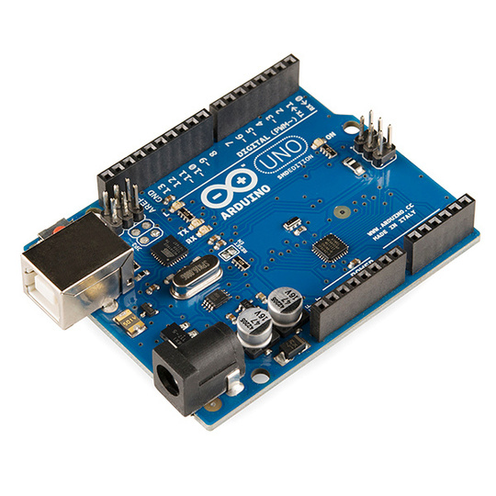
Microcontrollers
01
Arduino Mega
02
Arduino Uno

Slide 9
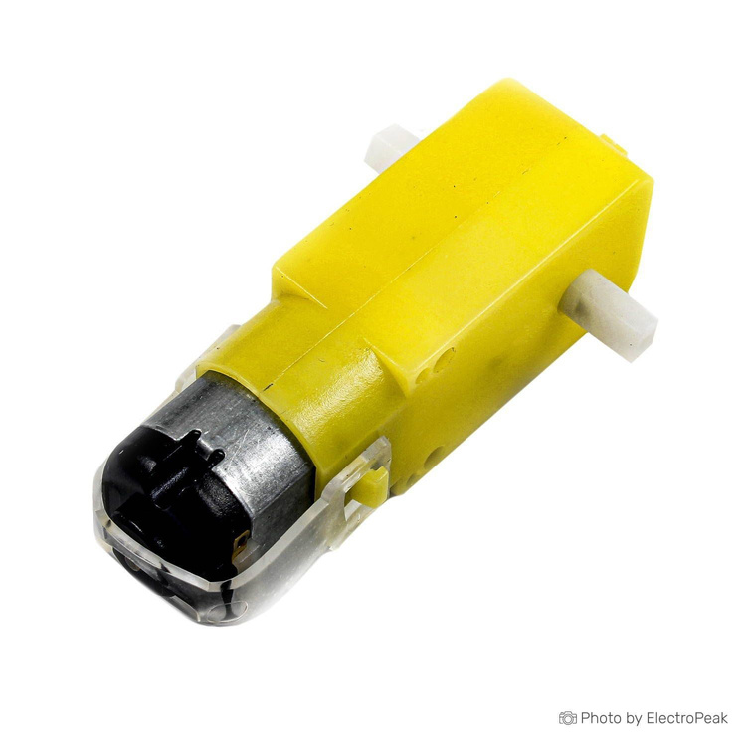
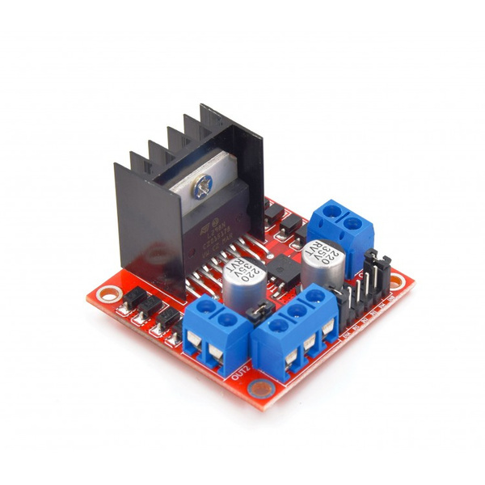
Color filling, emptying and Up/down movment
01
Dc Motor
02
L298N

Slide 10
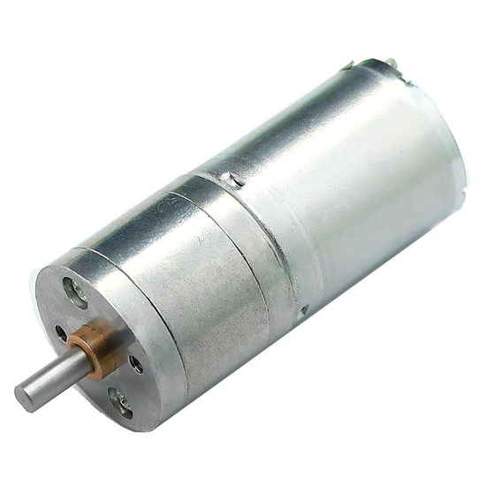
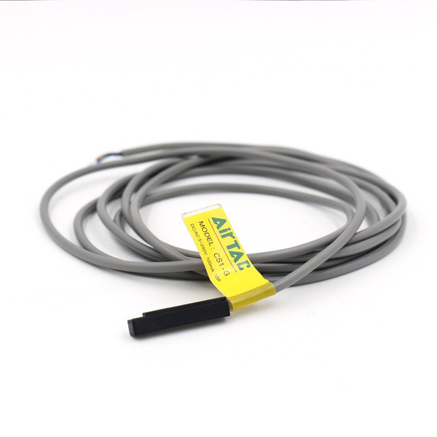
Rotation
01
DC Gear Motor 25GA370
02
L298N
03
Pneumatic Cylinder Magnetic Switch

Slide 11
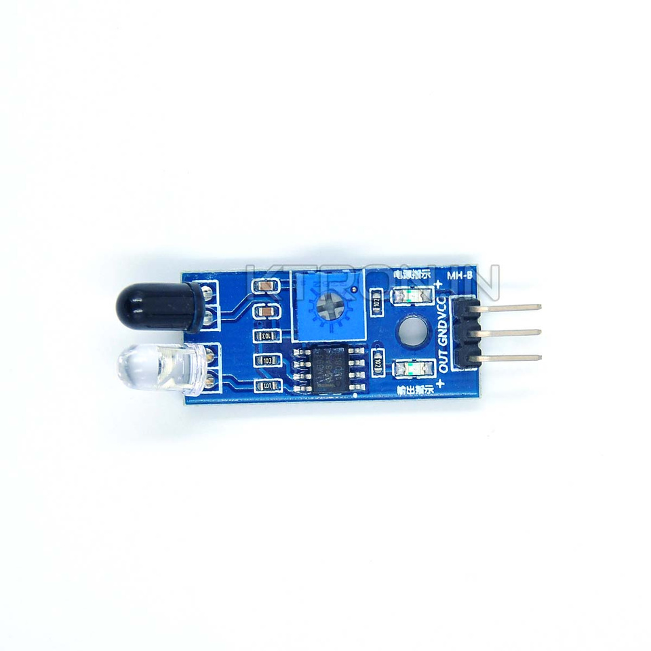
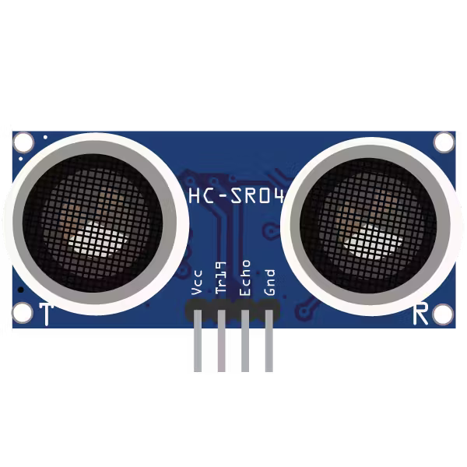
Sensors
01
IR sensor
02
Ultrasonic

Slide 12
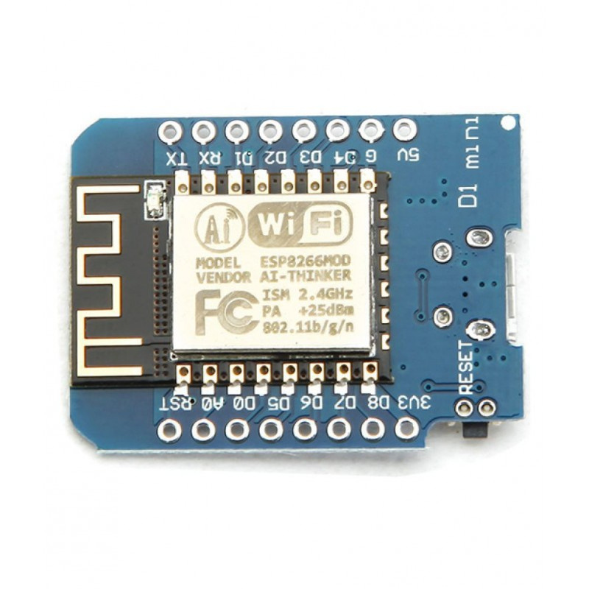
Mobile application Communications
Esp 8266 Wi- Fi Module

Slide 13

Constraints
Size and Design
Time
Cost

Slide 14
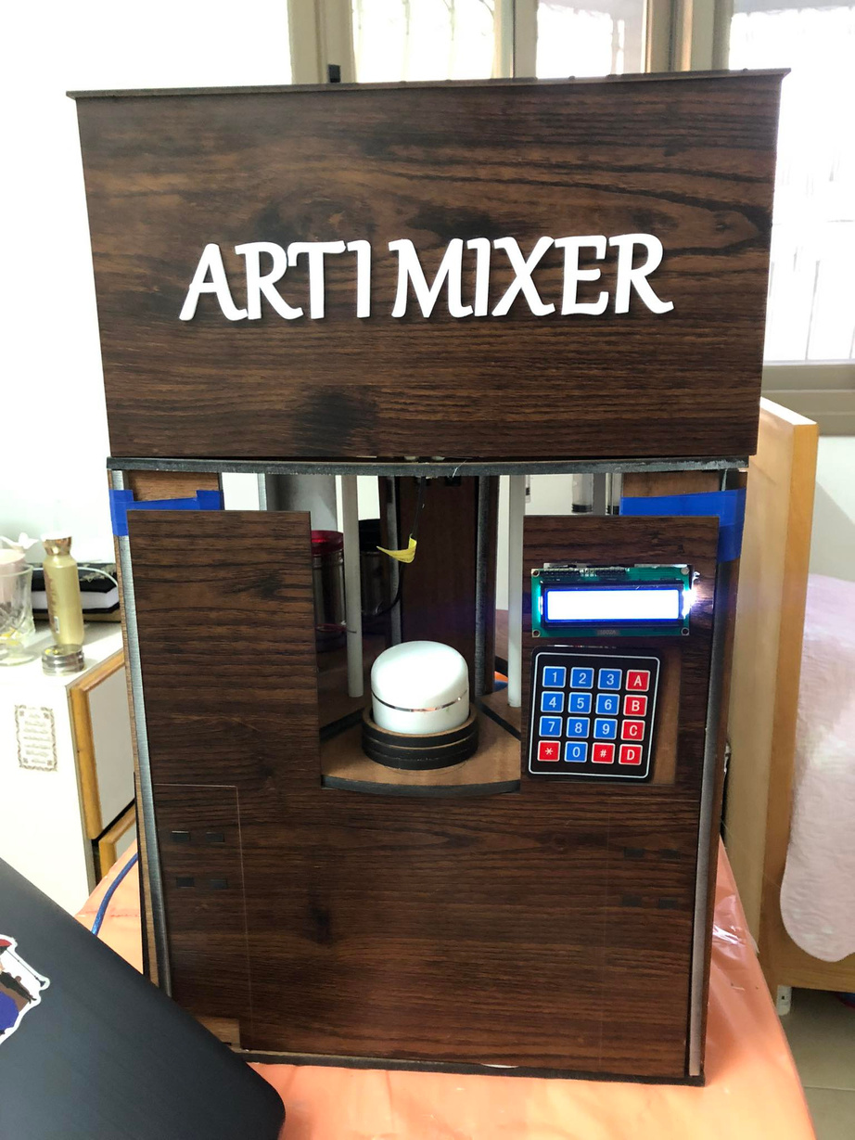
Future work
01
Optimize the speed and efficiency of the color mixing process.

Slide 15
Future work
02
Enhance color measurement accuracy by explore the integration of advanced sensors and feedback mechanisms to

Slide 16

Thank You
ANY QUSTIONS?

