Slide 1

Improvement of facility design at Shalhoub Industrial Co.
Prepared by:
Samer Darghma Aya Hindeya
Nimer Darghma Duha Mletat
Ghadeer Qotob
Supervisor:
Dr. Mohammed Othman

Slide 2
Agenda :
Introduction about company
Problem statement
Objectives
Market Study
Facility planning and layout
Literature review
Methodology
Future work
Conclusion

Slide 3
About Shalhoub industrial company :
Shalhoub factory established in 1975 .
Shalhoob factory produces different types of nuts by roasting, packaging and delivering them to different cities in Palestine.
In this project, we aim to find if there are any opportunities to maximize the total profit and reduce cost of the factory by using new layout .

Slide 4
Problem statement :
Shalhoub factory management wants all of its finished products to go to production seamlessly, without waste in time, space and money.
Today, we have too many kinds of wastes inside Palestinian factories that result in increasing total costs and losing the market share. Bad facility layout is considered one of the critical issues that produces wastes in space, time and money. If we ignore this problem; resources will need to increase to handle the cascading problems, and we may miss critical customer deadlines which could result in lost revenue, lost business, and further damage to our quality reputation.
We will use our facility planning methodologies in evaluating the existing layout of the factory to help us improve our processes.

Slide 5
Objectives:
Reduce costs by generating new layout.
Increase the profits.
Reduce obstacles for worker while doing their jobs .
Increase the workers productivity.
Enhance the possibility of increasing the market share.
Utilize the available space, resources and services.

Slide 6
Constraints of the project :
The total available budget
The space of the factory
Non-documented information

Slide 7
Literature review :
What is Supply Chain Management :
Supply Chain Management (SCM) is the process of planning, implementing and controlling the operations of the supply chain efficiently. SCM spans all movements and storage of raw materials, work-in-process inventory, and finished goods from the point-of-origin to the point-of-consumption. (M.T. Melo, S. Nickel and F. Saldanha-da-Gama ,2008)

Slide 8
What is facility layout:
Facility layout is a system to arrange physical location like machine, material, tools, work centers, department, warehouses, manufacturing cell for a production system. It is the most fundamental and strategic issues in manufacturing industries. (Singh ,2010)

Slide 9
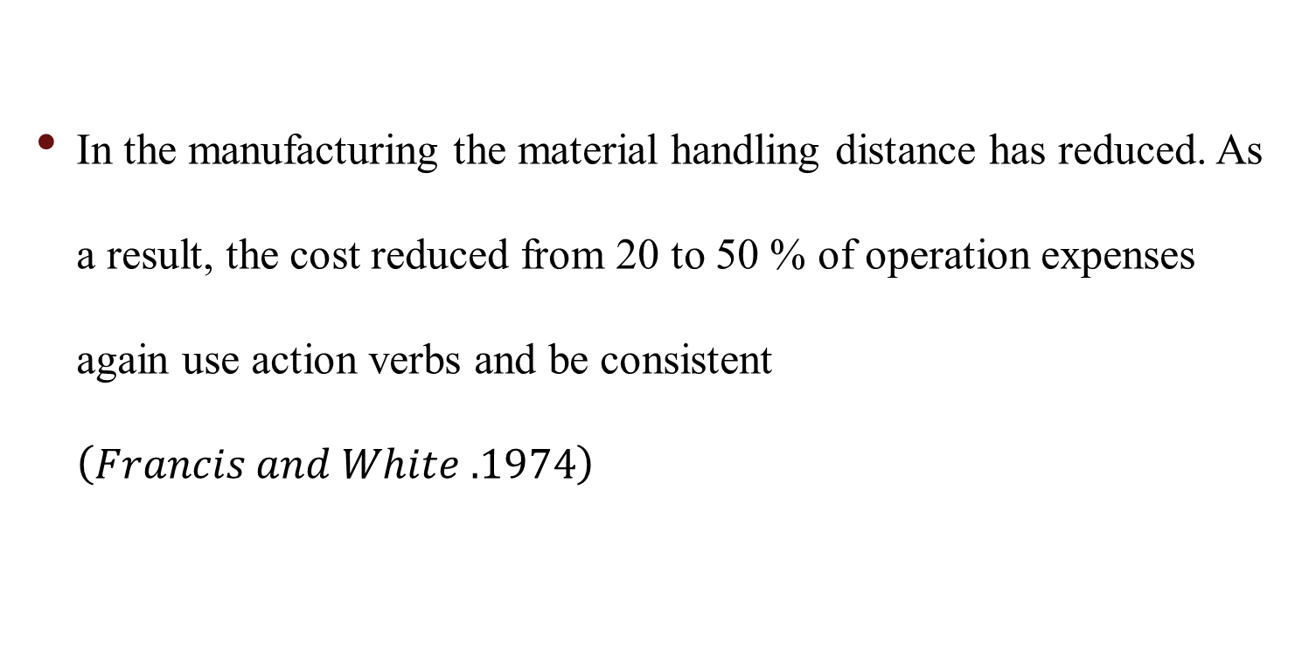
Facility layout objectives:
In the manufacturing the material handling distance has reduced. As a result, the cost reduced from 20 to 50 % of operation expenses again use action verbs and be consistent $\left(Francis and White .1974\right)$

Slide 10
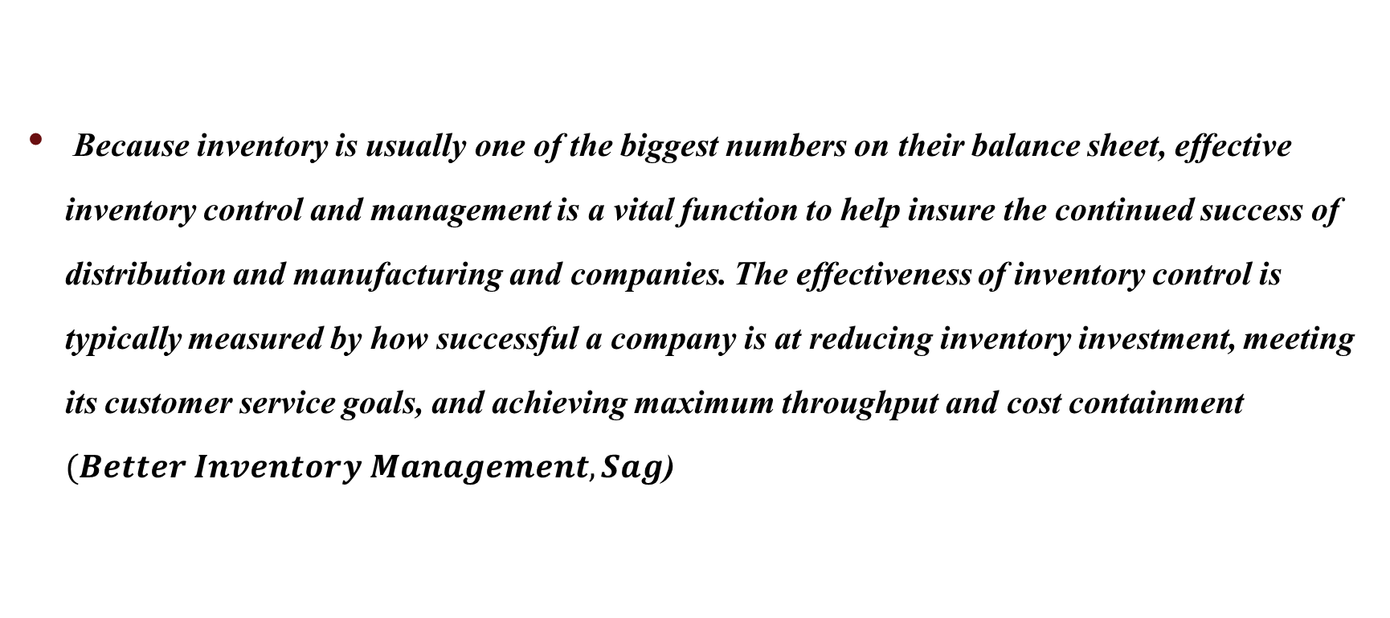
The importance of inventory management
Because inventory is usually one of the biggest numbers on their balance sheet, effective inventory control and management is a vital function to help insure the continued success of distribution and manufacturing and companies. The effectiveness of inventory control is typically measured by how successful a company is at reducing inventory investment, meeting its customer service goals, and achieving maximum throughput and cost containment $(Better Inventory Management,Sag$)

Slide 11
Methodology :
Collect the input data
Use SLP has seven-step procedure:
1. Travel chart .
2. Chart relationships.
3. Space Requirements.
4. Activity Relationship Diagram.
5. Layout Space Relationships LSR.
6. Evaluate alternative arrangements.
7. Select layout and install.

Slide 12
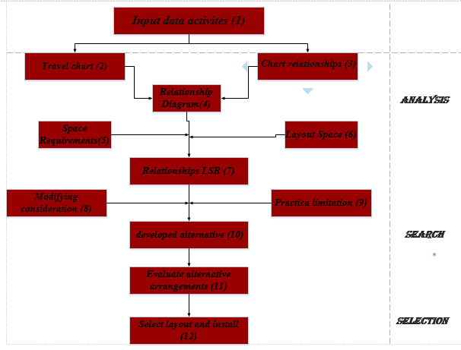

Slide 13
Market Study
Figure 4 : Number of small, medium, large Stores in the city of Nablusand

Slide 14
Market shaer for Shalhob COM. in Nables
Figure 5 : The percentage for each competitor in the market

Slide 15
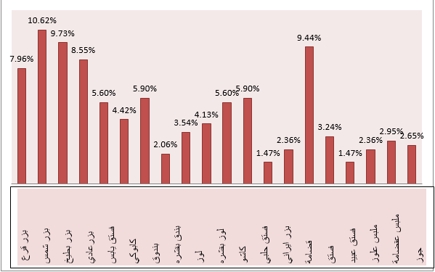
Figure 6: The demand percentage for each product in the local market

Slide 16
Figure 7: The percentage of non-customers willing to deal with Shalhoub Nuts in the future
Figure 8: The percentage of customers who could sell additional quantities of Shalhoub Nuts products

Slide 17

Network design in the supply chain
The first model : is to assist the current situation of the factory. We made the supply chain network in which a market is supplied from only one factory, referred to a seven sources. The plant location model discussed earlier needs some modification to accommodate this constraint.
Decision variables: decide whither if factory is located at site I , and decide which site H must be supplied.
Objective Function: minimum cost of the resulting supply chain network while providing customers with the appropriate responsiveness. Operation cost of one kilogram, shipping cost required to ship raw material from suppliers H to factory I, and the fixed cost of the factory at site I.

Slide 18
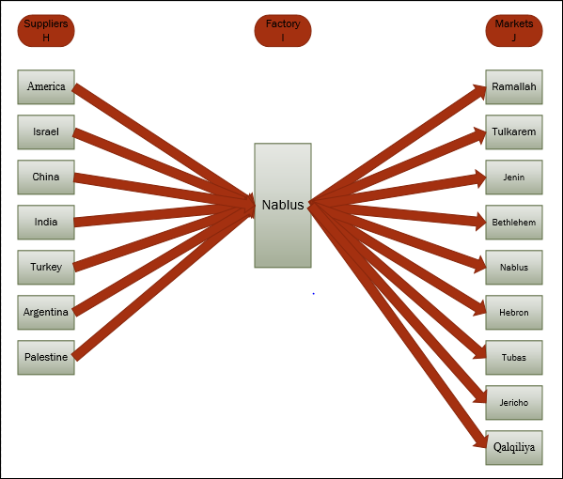
Figure 1: Supply Chain Management Model 1

Slide 19
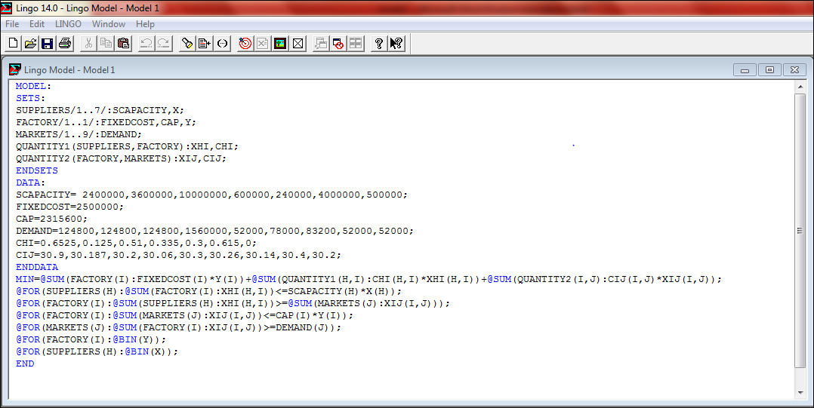
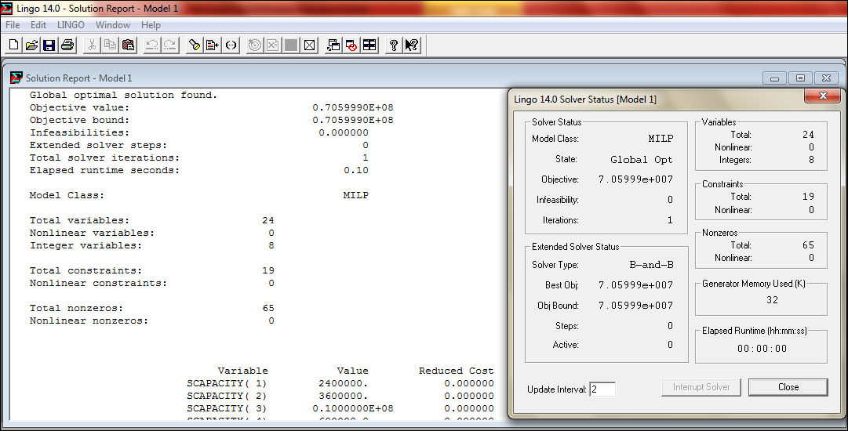

Slide 20
Result for Network design in the supply chain
Objective Function | Choose suppliers | Quantity shipped from Suppliers to factory
NIS | X1=X2=X3=X4=X5=X6=X7=1 X(i) Binary | XHI( 1, 1) 0.000000 Kg XHI( 2, 1) 1751600 Kg XHI( 3, 1) 0.000000 Kg XHI( 4, 1) 0.000000 Kg XHI( 5, 1) 0.000000 Kg XHI( 6, 1) 0.000000 Kg XHI( 7, 1) 500000.0 Kg

Slide 21
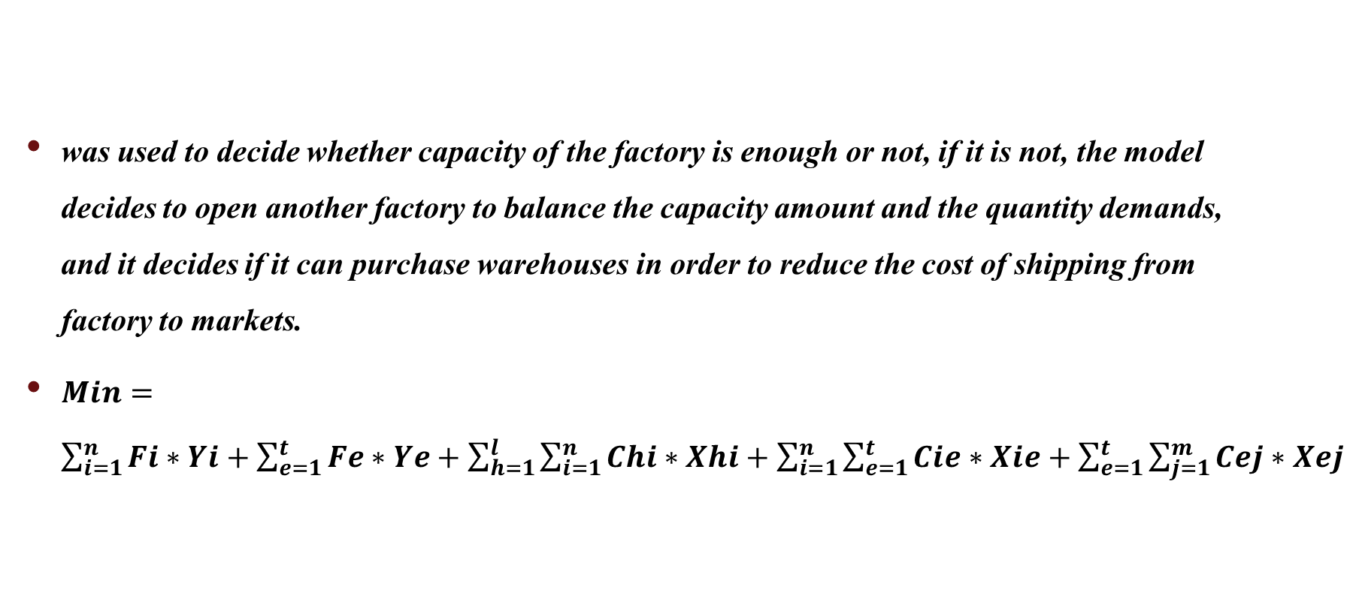
The second model
was used to decide whether capacity of the factory is enough or not, if it is not, the model decides to open another factory to balance the capacity amount and the quantity demands, and it decides if it can purchase warehouses in order to reduce the cost of shipping from factory to markets.
$Min=\sum_{i=1}^{n}{Fi∗Yi+\sum_{e=1}^{t}{Fe∗Ye}+\sum_{h=1}^{l}{\sum_{i=1}^{n}{Chi∗Xhi+\sum_{i=1}^{n}{\sum_{e=1}^{t}{Cie∗Xie}}+\sum_{e=1}^{t}{\sum_{j=1}^{m}{Cej∗Xej}}}}}$

Slide 22
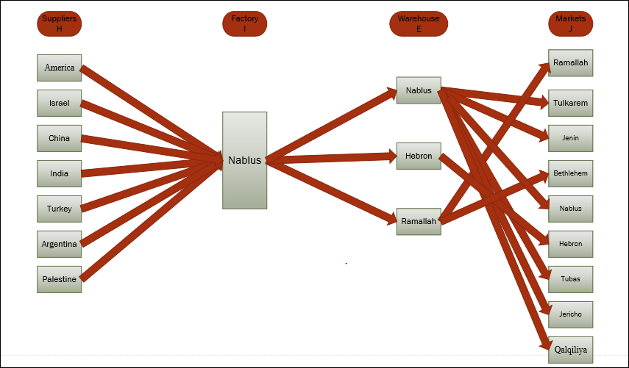
Figure 2 : Supply chain management Model 2

Slide 23
The results for Network design in the supply chain Model 2 are showed in the table below:
Objective Function | Choose where to build warehouse | Quantity shipped from Suppliers to factory | Quantity shipped from Factory to warehouse
NIS | Y( 1) 1.000000 Y( 2) 1.000000 Y( 3) 0.000000 | XHI( 1, 1) 0.000000 Kg XHI( 2, 1) 1751600 Kg XHI( 3, 1) 0.000000 Kg XHI( 4, 1) 0.000000 Kg XHI( 5, 1) 0.000000 Kg XHI( 6, 1) 0.000000 Kg XHI( 7, 1) 500000.0 Kg | XIE(1,1) 2126800Kg XIE(1,2) 124800Kg XIE(1,3) 0.000000

Slide 24
The results for Network design in the supply chain Model 2 with constrain of warehouses
Objective Function | Choose where to build warehouse | Quantity shipped from Suppliers to factory | Quantity shipped from Factory to warehouse
NIS | Y( 1) 1.000000 Y( 2) 1.000000 Y( 3) 0.000000 | XHI( 1, 1) 0.000000 Kg XHI( 2, 1) 1751600 Kg XHI( 3, 1) 0.000000 Kg XHI( 4, 1) 0.000000 Kg XHI( 5, 1) 0.000000 Kg XHI( 6, 1) 0.000000 Kg XHI( 7, 1) 500000.0 Kg | XIE(1,1) 2126800Kg XIE(1,2) 124800Kg XIE(1,3) 0.000000

Slide 25
The comparison between Actual station and the result from Network design in the supply chain
The manufacturing Capacity produce per day | Actual Capacity of machine
5000 Kg | 7718 Kg

Slide 26
Facility layout
In this stage, we evaluate the current layout and make several alternatives layout In order to show if the current situation inside the layout is optimal or not, therefore we collect such as distances among workstations and flow among them to create from-to-chart tool and calculate the total cost of the current layout and compare it with the optimal alternative.

Slide 27
Pareto ( frequency table ):
Flow segments | Departments | Frequency | %
1 | Dep. 9- Dep. 10 | 30 | 17.85
2 | Dep. 8- Dep. 7 | 25 | 14.88
3 | Dep. 7- Dep. 9 | 25 | 14.88
4 | Dep. 6- Dep. 9 | 15 | 8.93
5 | Dep. 2- Dep. 9 | 12 | 7.14
6 | Dep. 2- Dep. 4 | 10 | 5.95
7 | Dep. 4- Dep. 10 | 10 | 5.95
8 | Dep. 9- Dep. 11 | 10 | 5.95
9 | Dep. 3- Dep.11 | 5 | 2.97
10 | Dep. 1- Dep. 5 | 4 | 2.38
11 | Dep. 1- Dep. 6 | 4 | 2.38
12 | Dep. 5 - Dep. 9 | 4 | 2.38
13 | Dep. 1- Dep. 4 | 3 | 1.78
14 | Dep. 1- Dep. 2 | 2 | 1.19
15 | Dep. 3- Dep. 12 | 2 | 1.19
16 | Dep. 10- Dep. 11 | 2 | 1.19
17 | Dep. 1- Dep. 3 | 2 | 1.19
18 | Dep. 1- Dep. 8 | 1 | 0.595
19 | Dep. 3- Dep. 10 | 1 | 0.595
20 | Dep. 9- Dep. 12 | 1 | 0.595

Slide 28
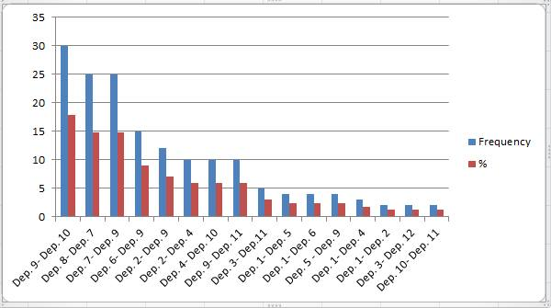
Frequency chart:
Symbol | A | E | I | O | U | X
Value | 25-30 | 12-15 | 10 | 2-5 | 1-2 | 0

Slide 29
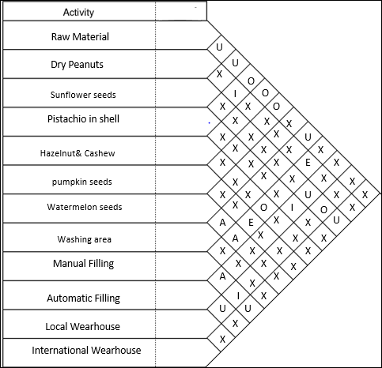
Relationship chart:

Slide 30
Areas of departments :
Department | Function | Area Dep. ( m ^ 2 )
Dep. 1 | R.M | 220 m^2
Dep. 2 | Dry Peanuts | 36 m^2
Dep. 3 | Sunflower seeds | 220 m^2
Dep. 4 | Pistachio in shell | 50m^2
Dep. 5 | Hazelnut& Cashew | 15 m^2
Dep. 6 | pumpkin seeds | 15 m^2
Dep. 7 | Watermelon seeds | 15 m^2
Dep. 8 | Washing area | 10 m^2
Dep. 9 | Manual Filling area+balance +cooling | 30 m^2
Dep. 10 | Automatic Filling | 24 m^2
Dep. 11 | Local Warehouses | 48 m^2
Dep. 12 | International warehouses | 50 m^2

Slide 31
From to chart:
 | Dep. 1 | Dep. 2 | Dep.3 | Dep. 4 | Dep. 5 | Dep. 6 | Dep.7 | Dep.8 | Dep.9 | Dep. 10 | Dep. 11 | Dep. 12
Dep. 1 | - | 62 | 27 | 51.8 | 59 | 59 | - | 67.2 | - | - | - | -
Dep. 2 | - | - | - | 20.4 | - | - | - | - | 8.4 | - | - | -
Dep. 3 | - | - | - | - | - | - | - | - | - | 41 | 38.4 | 37.5
Dep. 4 | - | - | - | - | - | - | - | - | - | 17.15 | - | -
Dep. 5 | - | - | - | - | - | - | - | - | 5.5 | - | - | -
Dep. 6 | - | - | - | - | - | - | - | - | 5.5 | - | - | -
Dep. 7 | - | - | - | - | - | - | - | - | 5.5 | - | - | -
Dep. 8 | - | - | - | - | - | - | 8.1 | - | - | - | - | -
Dep. 9 | - | - | - | - | - | - | - | - | - | 15.5 | 18 | 21.3
Dep. 10 | - | - | - | - | - | - | - | - | - | - | 17.1 | 27.3
Dep. 11 | - | - | - | - | - | - | - | - | - | - | - | -
Dep. 12 | - | - | - | - | - | - | - | - | - | - | - | -

Slide 32
From to chart ( No. of trips ):
 | Dep. 1 | Dep. 2 | Dep.3 | Dep. 4 | Dep. 5 | Dep. 6 | Dep.7 | Dep.8 | Dep.9 | Dep. 10 | Dep. 11 | Dep. 12
Dep. 1 | - | 2 | 2 | 3 | 4 | 4 | - | 1 | - | - | - | -
Dep. 2 | - | - | - | 10 | - | - | - | - | 12 | - | - | -
Dep. 3 | - | - | - | - | - | - | - | - | - | 1 | 5 | 2
Dep. 4 | - | - | - | - | - | - | - | - | - | 10 | - | -
Dep. 5 | - | - | - | - | - | - | - | - | 4 | - | - | -
Dep. 6 | - | - | - | - | - | - | - | - | 15 | - | - | -
Dep. 7 | - | - | - | - | - | - | - | - | 25 | - | - | -
Dep. 8 | - | - | - | - | - | - | 25 | - | - | - | - | -
Dep. 9 | - | - | - | - | - | - | - | - | - | 30 | 10 | 1
Dep. 10 | - | - | - | - | - | - | - | - | - | - | 2 | -
Dep. 11 | - | - | - | - | - | - | - | - | - | - | - | -
Dep. 12 | - | - | - | - | - | - | - | - | - | - | - | -

Slide 33
Result for the current layout
 | Dep. 1 | Dep. 2 | Dep. 3 | Dep. 4 | Dep. 5 | Dep. 6 | Dep. 7 | Dep. 8 | Dep. 9 | Dep. 10 | Dep. 11 | Dep. 12
Dep. 1 | 0 | 1317.5 | 573.75 | 1651.1 | 2507.5 | 2507.5 | 0 | 714 | 0 | 0 | 0 | 0
Dep. 2 | 0 | 0 | 0 | 2167.5 | 0 | 0 | 0 | 0 | 1071 | 0 | 0 | 0
Dep. 3 | 0 | 0 | 0 | 0 | 0 | 0 | 0 | 0 | 0 | 435.62 | 2040 | 796.875
Dep. 4 | 0 | 0 | 0 | 0 | 0 | 0 | 0 | 0 | 0 | 1822.18 | 0 | 0
Dep. 5 | 0 | 0 | 0 | 0 | 0 | 0 | 0 | 0 | 233.75 | 0 | 0 | 0
Dep. 6 | 0 | 0 | 0 | 0 | 0 | 0 | 0 | 0 | 876.56 | 0 | 0 | 0
Dep. 7 | 0 | 0 | 0 | 0 | 0 | 0 | 0 | 0 | 1460.9 | 0 | 0 | 0
Dep. 8 | 0 | 0 | 0 | 0 | 0 | 0 | 2151.5 | 0 | 0 | 0 | 0 | 0
Dep. 9 | 0 | 0 | 0 | 0 | 0 | 0 | 0 | 0 | 0 | 4940.6 | 1912.5 | 226.312
Dep. 10 | 0 | 0 | 0 | 0 | 0 | 0 | 0 | 0 | 0 | 0 | 363.4 | 0
Dep. 11 | 0 | 0 | 0 | 0 | 0 | 0 | 0 | 0 | 0 | 0 | 0 | 0
Dep. 12 | 0 | 0 | 0 | 0 | 0 | 0 | 0 | 0 | 0 | 0 | 0 | 0

Slide 34
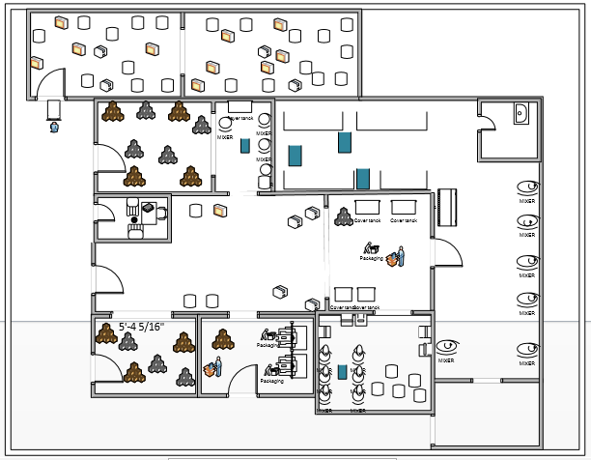
Visio represent the current layout for the first floor :

Slide 35
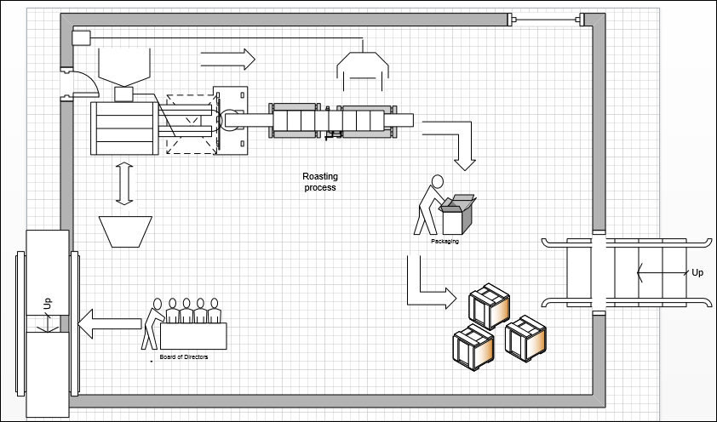
Visio represent the current layout for the second floor

Slide 36
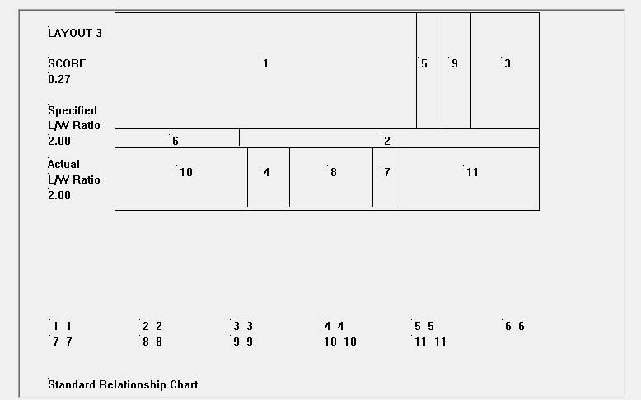
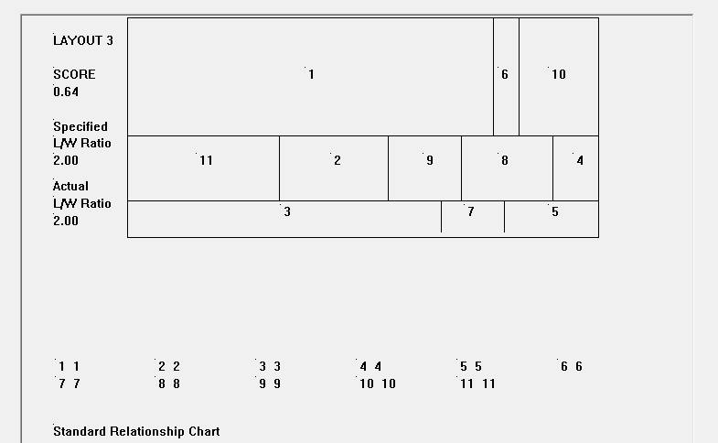
Figure 29 : Result of BLOCPLAN with no fixed workstation
Figure 28 : Result of BLOCPLAN with fixed workstation

Slide 37
from to chart(destance) in meter in new layout
 | Dep. 1 | Dep. 2 | Dep.3 | Dep. 4 | Dep. 5 | Dep. 6 | Dep.7 | Dep.8 | Dep.9 | Dep. 10 | Dep. 11 | Dep. 12
Dep. 1 | - | 16.2 | 27 | 16.2 | 59 | 59 | - | 67.2 | - | - | - | -
Dep. 2 | - | - | - | 20.4 | - | - | - | - | 6 | - | - | -
Dep. 3 | - | - | - | - | - | - | - | - | - | 41 | 38.4 | 62.5
Dep. 4 | - | - | - | - | - | - | - | - | - | 22.15 | - | -
Dep. 5 | - | - | - | - | - | - | - | - | 5.5 | - | - | -
Dep. 6 | - | - | - | - | - | - | - | - | 5.5 | - | - | -
Dep. 7 | - | - | - | - | - | - | - | - | 5.5 | - | - | -
Dep. 8 | - | - | - | - | - | - | 8.1 | - | - | - | - | -
Dep. 9 | - | - | - | - | - | - | - | - | - | 15.5 | 18 | 20.4
Dep. 10 | - | - | - | - | - | - | - | - | - | - | 17.1 | 27.5
Dep. 11 | - | - | - | - | - | - | - | - | - | - | - | -
Dep. 12 | - | - | - | - | - | - | - | - | - | - | - | -

Slide 38
From to chart (# of trip) of the new layout
 | Dep. 1 | Dep. 2 | Dep.3 | Dep. 4 | Dep. 5 | Dep. 6 | Dep.7 | Dep.8 | Dep.9 | Dep. 10 | Dep. 11 | Dep. 12
Dep. 1 | - | 1 | 1 | 1 | 1 | 1 | - | 1 | - | - | - | -
Dep. 2 | - | - | - | 10 | - | - | - | - | 12 | - | - | -
Dep. 3 | - | - | - | - | - | - | - | - | - | 1 | 5 | 2
Dep. 4 | - | - | - | - | - | - | - | - | - | 10 | - | -
Dep. 5 | - | - | - | - | - | - | - | - | 4 | - | - | -
Dep. 6 | - | - | - | - | - | - | - | - | 15 | - | - | -
Dep. 7 | - | - | - | - | - | - | - | - | 25 | - | - | -
Dep. 8 | - | - | - | - | - | - | 25 | - | - | - | - | -
Dep. 9 | - | - | - | - | - | - | - | - | - | 30 | 10 | 1
Dep. 10 | - | - | - | - | - | - | - | - | - | - | 2 | -
Dep. 11 | - | - | - | - | - | - | - | - | - | - | - | -
Dep. 12 | - | - | - | - | - | - | - | - | - | - | - | -

Slide 39
Unit cost (c) :
 | Dep. 1 | Dep. 2 | Dep.3 | Dep. 4 | Dep. 5 | Dep. 6 | Dep.7 | Dep.8 | Dep.9 | Dep. 10 | Dep. 11 | Dep. 12
Dep. 1 | - | 10.625 | 10.625 | 10.625 | 10.625 | 10.625 | - | 10.625 | - | - | - | -
Dep. 2 | - | - | - | 10.625 | - | - | - | - | 10.625 | - | - | -
Dep. 3 | - | - | - | - | - | - | - | - | - | 10.625 | 10.625 | 10.625
Dep. 4 | - | - | - | - | - | - | - | - | - | 10.625 | - | -
Dep. 5 | - | - | - | - | - | - | - | - | 10.625 | - | - | -
Dep. 6 | - | - | - | - | - | - | - | - | 10.625 | - | - | -
Dep. 7 | - | - | - | - | - | - | - | - | 10.625 | - | - | -
Dep. 8 | - | - | - | - | - | - | 10.625 | - | - | - | - | -
Dep. 9 | - | - | - | - | - | - | - | - | - | 10.625 | 10.625 | 10.625
Dep. 10 | - | - | - | - | - | - | - | - | - | - | 10.625 | -
Dep. 11 | - | - | - | - | - | - | - | - | - | - | - | -
Dep. 12 | - | - | - | - | - | - | - | - | - | - | - | -

Slide 40
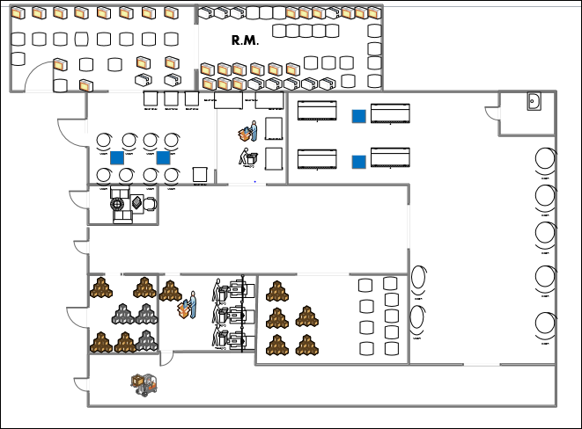
Visio represent the New layout for the first floor

Slide 41
The comparison between current layout and the alternative layout (new layout)
SUM(FLOW*DISTANCE*COST) | Current layout | New layout
Total cost | 29770.1875 NIS | 21791.875 NIS
As shows on the table above we reduce the total cost by 26.799% .

Slide 42
Inventory model
In this stage we evaluate the current raw material inventory in order to show if the current situation inside the inventory is optimal or not, therefore we collect confidence information related and calculate the essential things such as holding cost, economic order quantity and the total cost for the optimal inventory.

Slide 43
holding costs
Item Name | Amount of Inventory | Unit | Raw Material Cost (NIS) | Total Value | Weight | Holding Cost (NIS)
بزر الشمس | 240000 | Kg | 7.5 | 1800000 | 0.15 | 1.125
بزر البطيخ | 120000 | Kg | 30 | 3600000 | 0.17 | 5.1
بزر القرع | 72000 | Kg | 20 | 1440000 | 0.17 | 3.4
فستق | 360000 | Kg | 12 | 4320000 | 0.18 | 2.16
فستق حلبي | 24000 | Kg | 50 | 1200000 | 0.18 | 9
كاشو | 24000 | Kg | 40 | 960000 | 0.2 | 8
لوز | 24000 | Kg | 42 | 1008000 | 0.2 | 8.4
قضامة | 72000 | Kg | 17 | 1224000 | 0.15 | 2.55
بندق | 12000 | Kg | 50 | 600000 | 0.2 | 10

Slide 44
EOQ and total number of quantity order
Item Name | Annual Demand | Order Cost | Holding Cost | EOQ | EOQ (NIS) | Total Cost | # of quantity order
بزر الشمس | 240000 | 2400 | 1.125 | 32000 | 240000 | 36000 | 8
بزر البطيخ | 102000 | 2400 | 5.1 | 9798 | 2939388 | 49970 | 11
بزر القرع | 60000 | 2400 | 3.4 | 9204 | 184072 | 31292 | 7
فستق | 414000 | 2400 | 2.16 | 30332 | 363978 | 65516 | 14
فستق حلبي | 24000 | 2400 | 9 | 3578 | 178885 | 32199 | 7
كاشو | 36000 | 2400 | 8 | 4648 | 185903 | 37180 | 8
لوز | 36000 | 2400 | 8.4 | 4536 | 190494 | 38098 | 8
قضامة | 54000 | 2400 | 2.55 | 10082 | 171394 | 25709 | 5
بندق | 12000 | 2400 | 10 | 2400 | 120000 | 24000 | 5

Slide 45
The comparison between inventory managements Model and the current inventory station
Item Name | Q Current (Kg) | Actual # of quantity Order | New EOQ | # of quantity order | # of order times saved | Ordering cost saved NIS | The increase in quantity
بزر الشمس | 20000 | 12 | 32000 | 8 | 4 | 9600 | 12000
بزر البطيخ | 10000 | 10 | 9798 | 10 | - | 0 | 0
بزر القرع | 6000 | 10 | 9204 | 7 | 3 | 7200 | 3204
فستق | 30000 | 14 | 30332 | 13 | 1 | 480 | 332
فستق حلبي | 2000 | 12 | 3578 | 7 | 5 | 12000 | 1578
كاشو | 2000 | 18 | 4648 | 8 | 10 | 24000 | 2648
لوز | 2000 | 18 | 4536 | 8 | 10 | 24000 | 2536
قضامة | 6000 | 9 | 10082 | 5 | 4 | 7200 | 4082
بندق | 1000 | 12 | 2400 | 5 | 7 | 16800 | 1400
Total |  | 115 |  | 73 |  | 101280
We reduce the number of quantity order times by 60%

Slide 46
Item Name | current Total cost | New Total cost | Reduced cost %
بزر الشمس | 40050 | 36000 | 0.898
بزر البطيخ | 49980 | 49970 | 0.997
بزر القرع | 34200 | 31292 | 0.914
فستق | 65520 | 65516 | 0.999
فستق حلبي | 37800 | 32199 | 0.851
كاشو | 51200 | 37181 | 0.726
لوز | 51600 | 38099 | 0.738
قضامة | 29250 | 25709 | 0.878
بندق | 33800 | 24000 | 0.710
the percentage of the reduced cot for the new quantity and number of order between 71.99% .

Slide 47
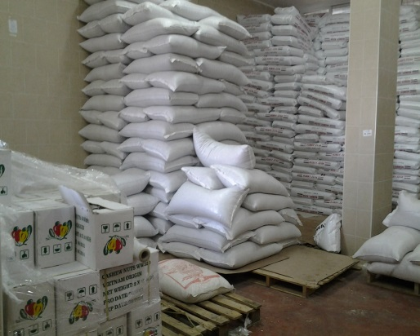
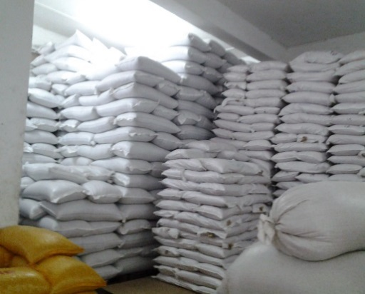
Raw material inventory Design
At Shalhoub food factory there are two raw material warehouses, each of them in the same building of the factory and they are opened to each other. Each warehouse contains different raw materials, the main problems in warehouses are lack of arrangement of pallets. There is a waste time because they have only one manual forklift for all warehouses also there is a difficulty to access the material.

Slide 48
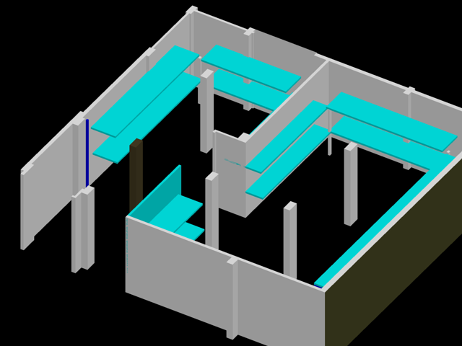
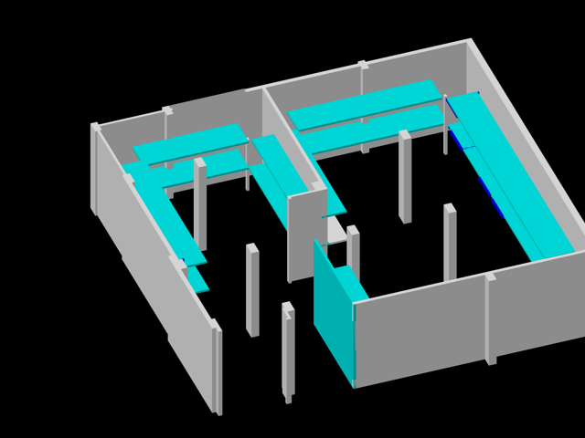
The new design for Raw material inventory

Slide 49
Comparison between raw material inventory Design and current inventory situation
 | Current (Bulk) | New (Pallets)
Storage capacity | 130 pallets | 114 pallets
Accessibility | 0.1538 | 0.8772
Area utilization rate | 0.5909 | 0.51818

Slide 51
Comparison between number of bags in the current situation and the new design
Item Name | # of bags before | # of bags after
بزر الشمس | 400 | 640
بزر الشمس | 250 | 400
بزر بطيخ 1 | 200 | 195
بزر بطيخ 2 | 125 | 122
بزر القرع | 200 | 307
فستق | 1200 | 1213
فستق حلبي | 80 | 143
كاشو | 80 | 185
لوز | 80 | 181
قضامة | 240 | 403
بندق | 40 | 96
المجموع | 2895 | 3888
the total number of bags from is increased from 2895 to 3888.

Slide 52
Administrative System
The administrative system is a key part of the supply chain and primarily aims to control the movement and storage of materials within a warehouse and process the associated transactions, including shipping, receiving, and picking. More precisely, warehouse management involves the receipt, storage and movement of goods, to intermediate storage locations or to a final customer.
Currently, the top manager makes an order and the worker receives this order and ensure that the amount of the goods received without regard to the level of quality of the goods and work and make reports of the receipt of certain bills from which part of the storage process which leads to wasting large amounts of inventory, leading to higher storage costs.
The objective of this system is to arrange all information that is needed during process from order raw material to deliver finish product, monitor and control the process and decrease the total time needed to finish this process.

Slide 53


Slide 54

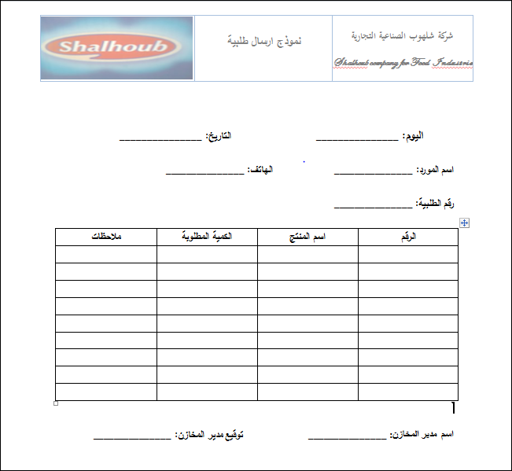

Slide 56


