Slide 1
Graduation project2
Supervisor : Dr.sufian samara
Students : Amal Hassoun , Duha Tubeileh

Slide 2
Gloves sign language translator

Slide 3
Outlines:
1. the importance of the project.
2. general idea.
3. demonstrations.
4. basic component.
5. obstacles we have faced.
6. future work.

Slide 4
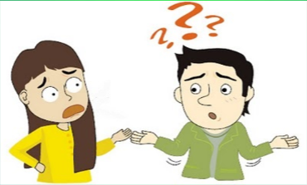
Importance of the project
Deaf people are 5% of the world populations.
Deaf people face problems in talking to people.

Slide 5
General Idea of the project:
Two gloves that translate the sign language (ASL) to written English and send the translated Speak via Bluetooth to an android application

Slide 6
demo

Slide 7
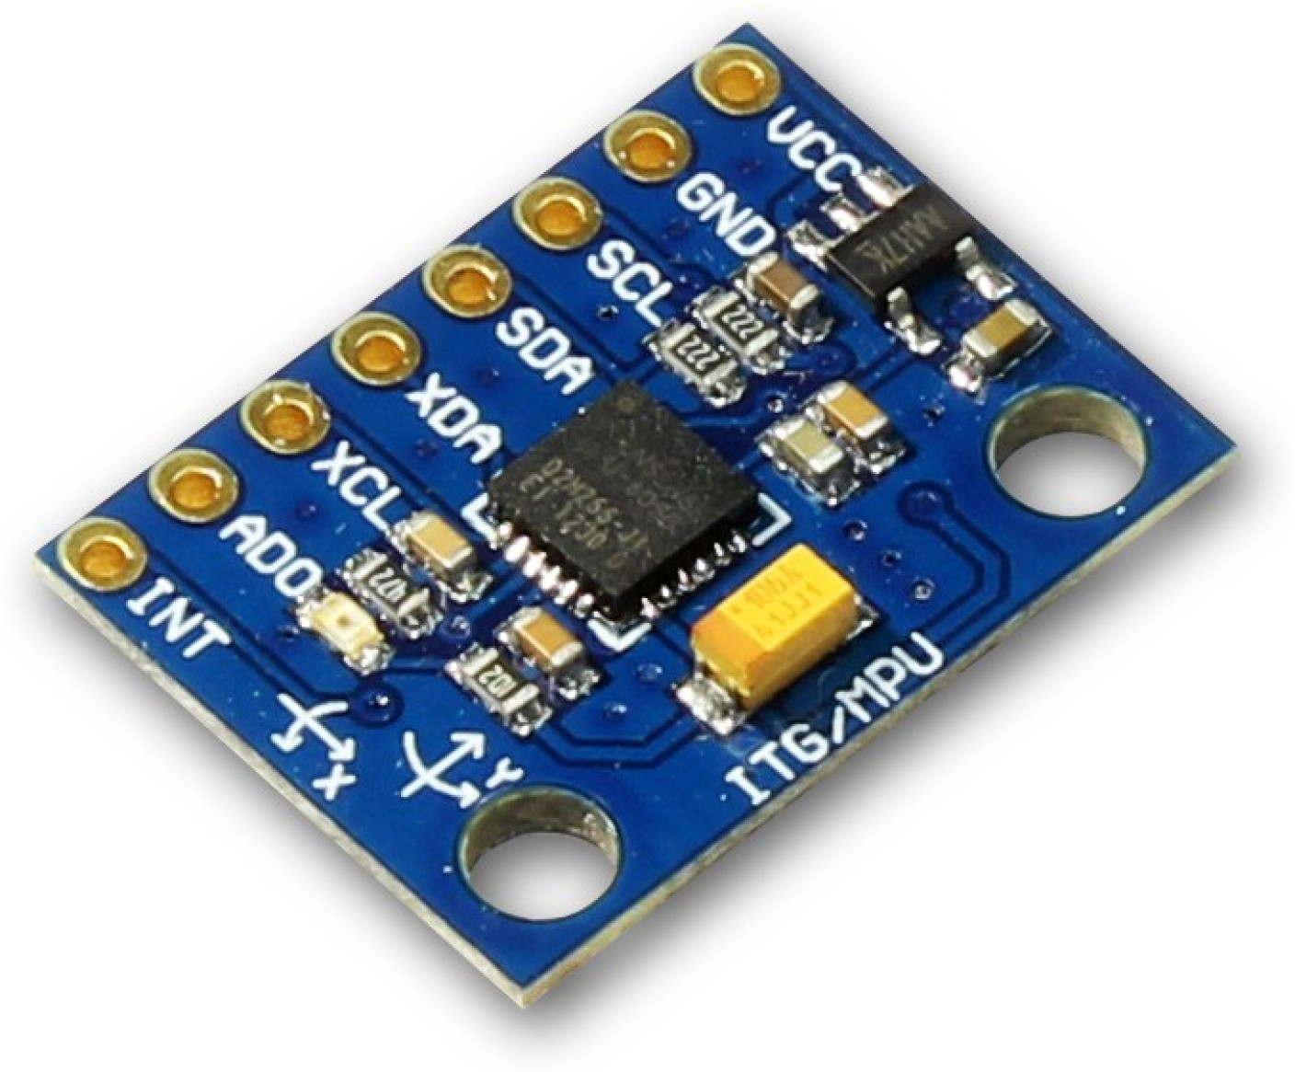
Basic Components
MPU6050

Slide 8
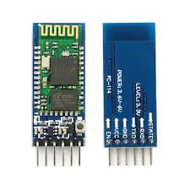
Basic Components
hc 05 bluetooth module

Slide 9
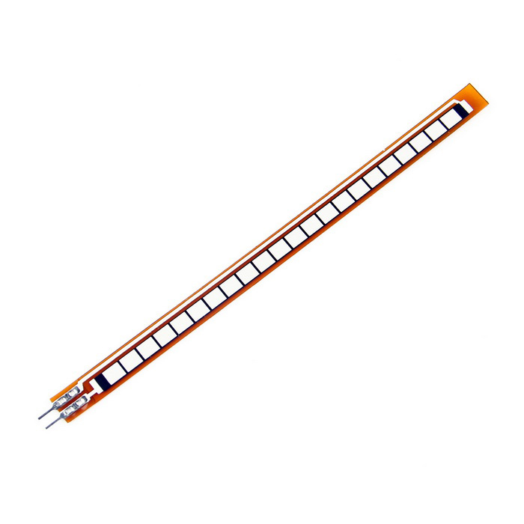
Basic Components
Flex sensor

Slide 10
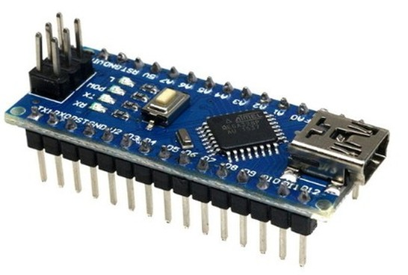
Basic Components
Arduino Nano

Slide 11
Obstacles we have faced
Flex sensor are very expensive , it's too hard to find it.
Letters like 'U' and 'V' have the same reading.

Slide 12
Future work
ASL(American Sign Language) is a very wide language which have some signs that depends on the head movement, so we hopped to improve our project to translate all the signs of that language.

