Slide 1

Graduation Project
Management Information System
Second semester 2016-2017
Adla Zahran & Ahlam Izzideen
Dr . Kamal Irshaid

Slide 2
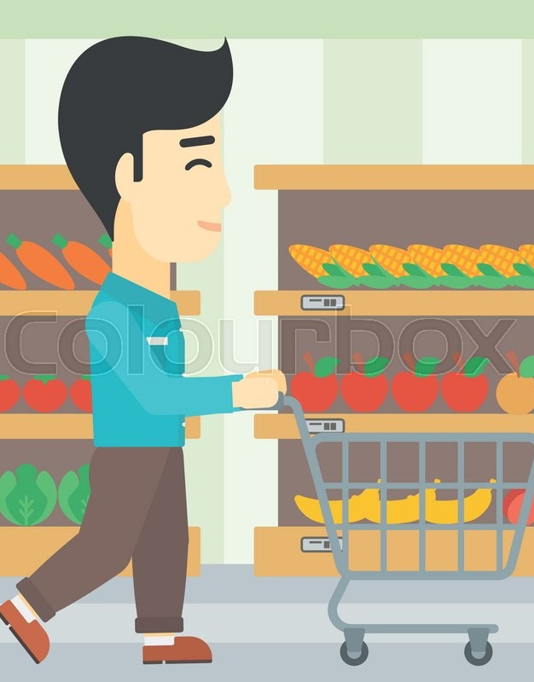
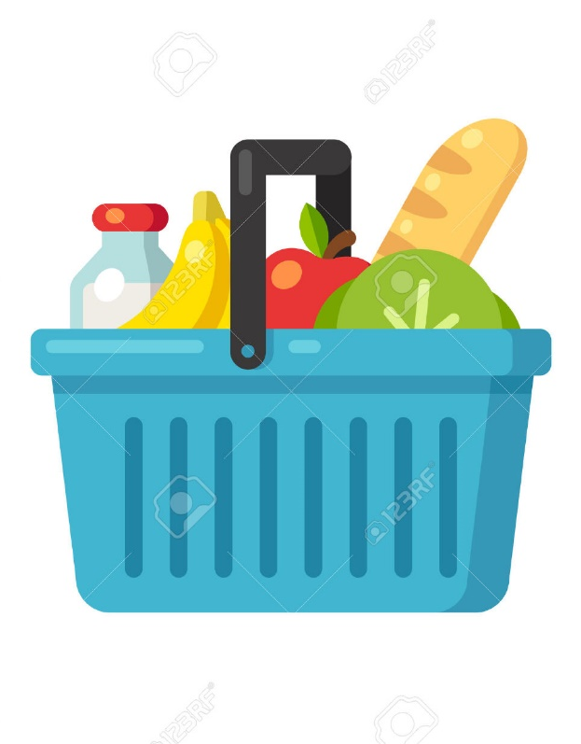
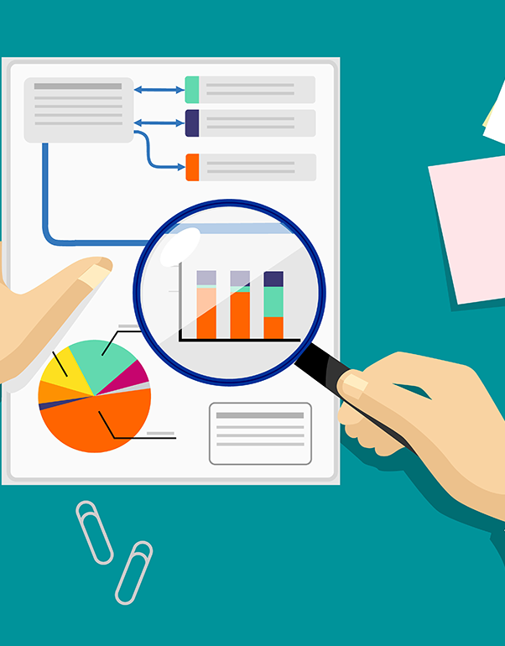
A comparison between general basket analysis and brand-flavor basket analysis and a study of their impact on Nofal mall
Notes:
NOTE: To replace a picture, just select and delete it. Then use the Insert Picture icon to replace it with one of your own!

Slide 3
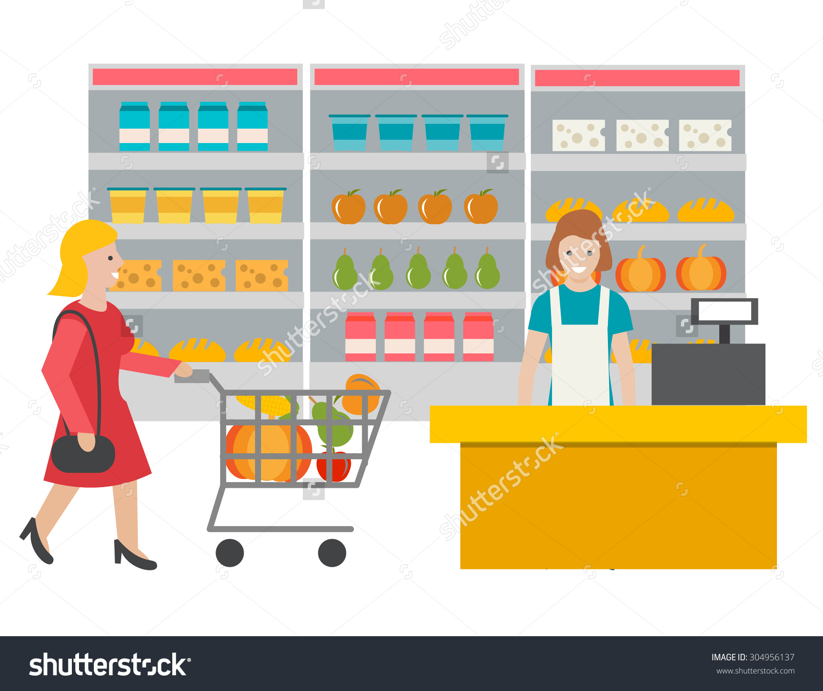
Outline
Project background description
Project objectives
Nofal Mall overview
Project Scope
Shopping basket analysis tool
Data selection and cleaning
Results and Recommendations
Conclusion
Project’s challenges
Future statement
Questions

Slide 4
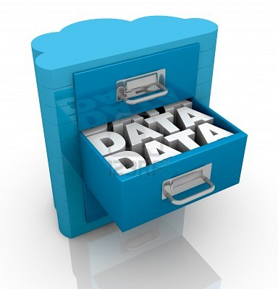
Project background and description
These days the world facing a great data evolution, businesses are depending on collecting a huge data about customers and their behaviors so they have to know how exploit it in an efficient way to satisfy customers and lead to more customer retention. Shopping Basket Analysis is one of the most important data mining and data analysis tools that analyze and transfer the data to understandable form, by analyzing purchases that commonly happen together and detecting unusual patterns.

Slide 5
Project objectives
Analyze customers shopping baskets and find the association rules.
Understand and explain the results and recommendations derived from the shopping basket analysis tool.
Visualize the results of the analyzed data in an understandable form.
Utilize the results to support decision making process in Nofal mall.

Slide 6

Nofal mall overview
Nofal mall was established in 1996 in Nablus city, they started with very small team that markets and distributes very limited products to local companies, then they developed to be One of the leading companies in Palestine in the field of importing and marketing personal care products and all the necessary needs of family members, this project was implemented on Nofal mall branch of- Deer sharaf street- , this branch provide foodstuff, beauty products, health products and housewares.

Slide 7
Project scope
The project is divided into three parts:
the first one is to conduct basket analysis on Nofal mall in general to know the public trend of customer behavior and purchases.
The second part is to apply what we named "brand-flavor" basket analysis which goes with more details of customer’s purchased products and deeply study what is in the basket taking into account the brand and also the flavor of the purchased products.
The third part is going to be a comparison between the first two parts. The idea is to see the impact of the two types of basket analysis on Nofal mall and find out which is more useful .

Slide 8

Shopping basket analysis tool
    Shopping basket analysis uses the Microsoft SQL Server Data Mining Add-ins
    It help you derive patterns and trends that exist in complex data, visualize those patterns in charts and interactive viewers, and generate rich, colorful summaries for presentation and for business analytics it identifies groups of products that are frequently purchased together, and also generates reports based on the price and cost of related product bundles, to aid in decision-making.
    It was chosen because it is available for all (Excel is available for everyone), efficient and easy to use.

Slide 9
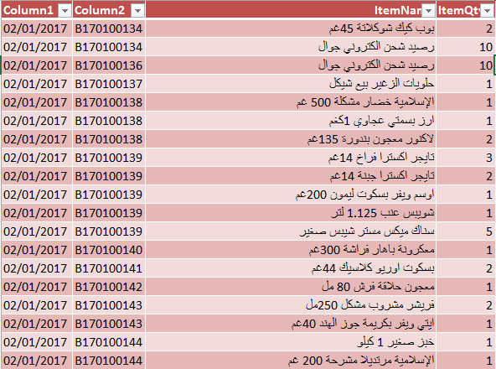
Data selecting and cleaning
Two months from Jan-Feb 2017 (67290 records) point of sale data have been received from Nofal mall and used in the study.
The weights were ignored (it does not matter the cola can 250 gm or 500 gm).

Slide 10
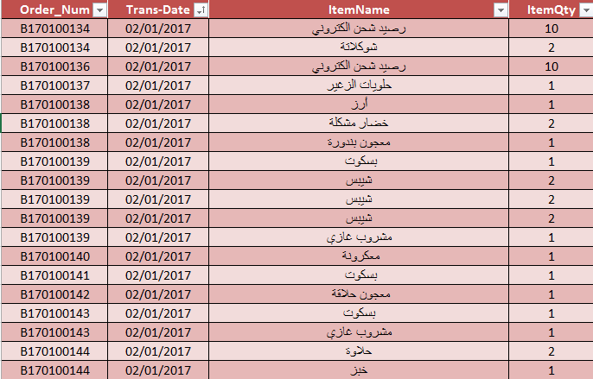
General Data
    1- General data: data have been filtered and cleaned for detecting the general trend for customer’s purchases without concerning for the brand name or the flavor of the product. (It doesn't matter if it is Galaxy chocolate or Kinder or even it is with nuts or with caramel it is simply a chocolate).

Slide 11
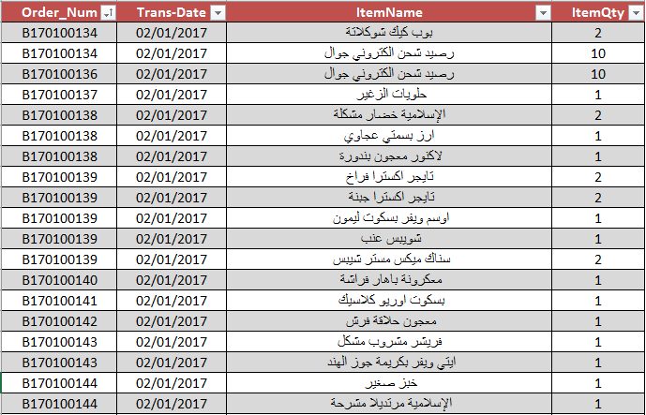
Brands-flavors data
    2- Brands and flavors data: data have been filtered and cleaned based on the brand name and the flavor of the product to take more detailed decisions. (There is a difference between Galaxy and kinder , lemon juice and grape juice ).

Slide 12
Results and Recommendations

Slide 13
Top 15 sold items in General
( الاصناف ال 15 الاكثر مبيعا )

Slide 14
مبيعات الشوكولاته ( الشوكولاته الاكثر مبيعا )

Slide 15
مبيعات الشوكولاتة (الشوكولاته الاقل مبيعا)

Slide 16
مبيعات الشيبس

Slide 17
مبيعات الشيبس

Slide 18
رصيد شحن الكتروني

Slide 19
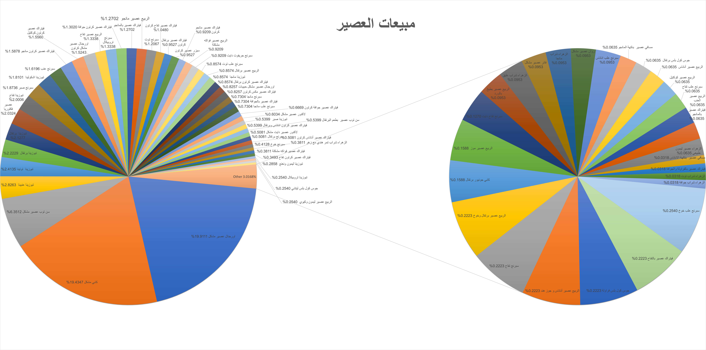
مبيعات العصير

Slide 20
مبيعات البسكوت

Slide 21
مبيعات السكر

Slide 22
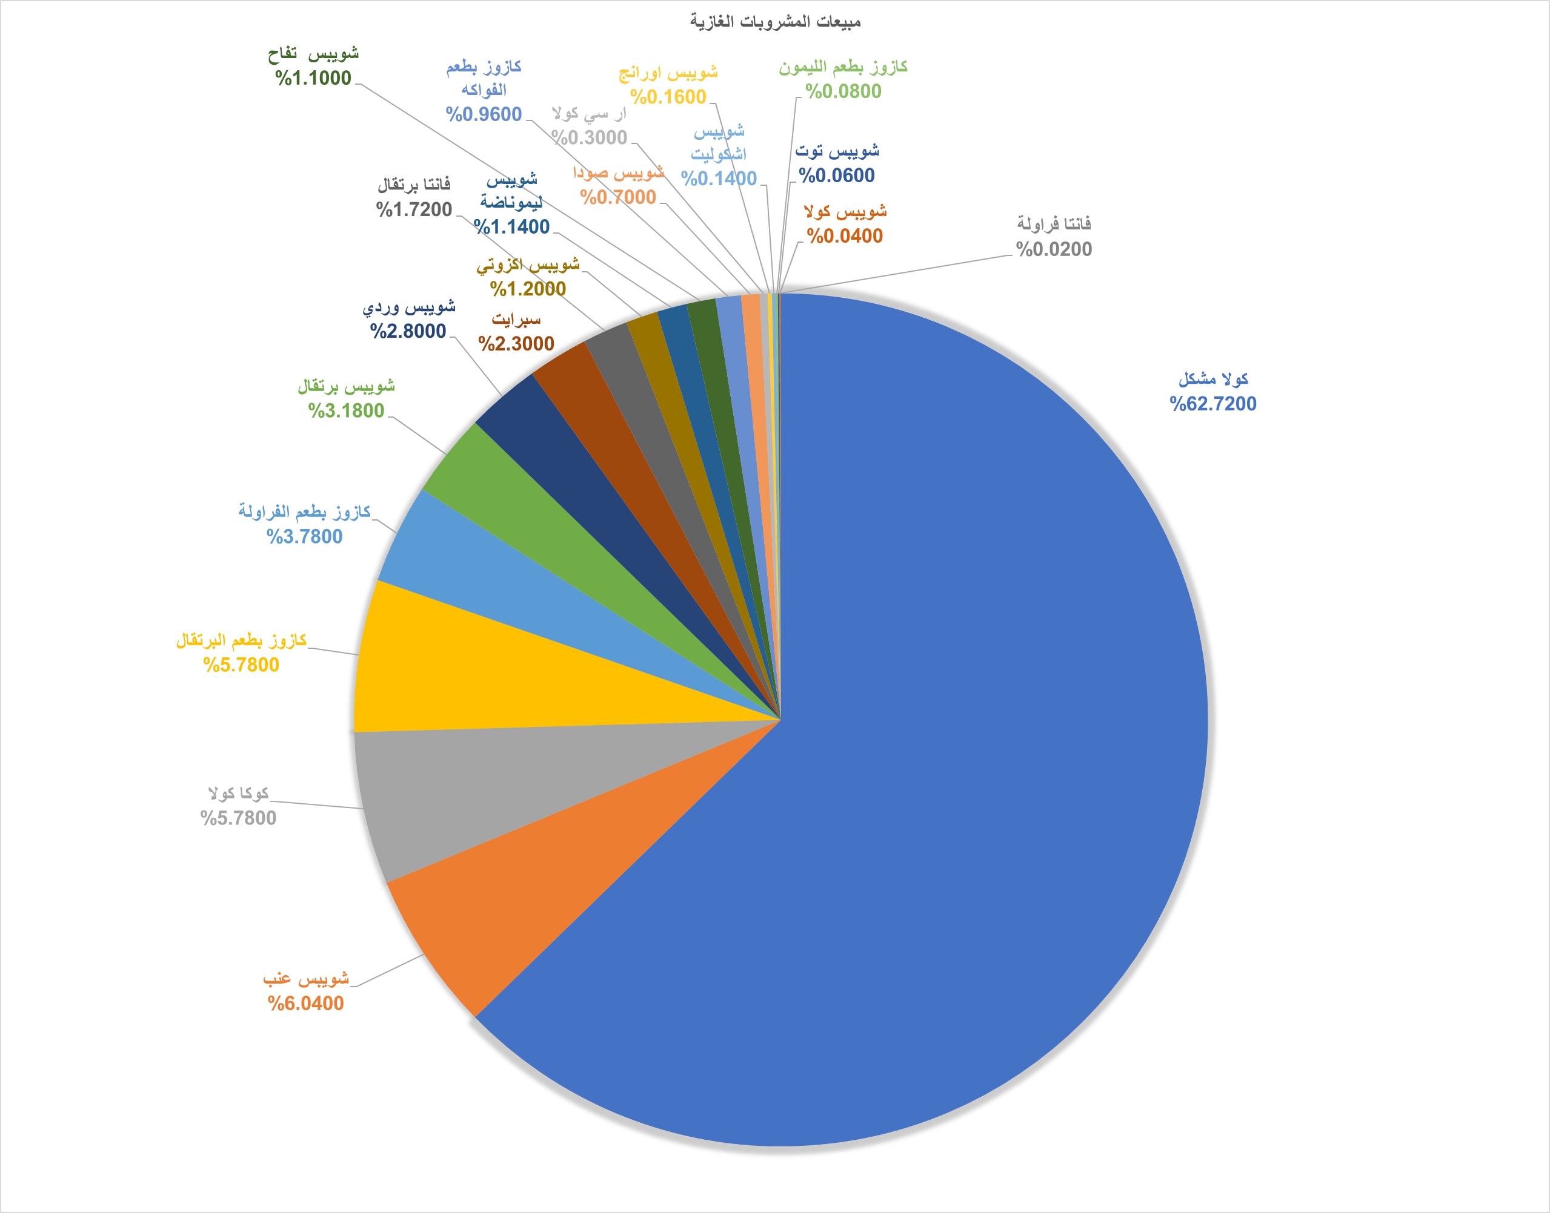
مبيعات المشروبات الغازية

Slide 23
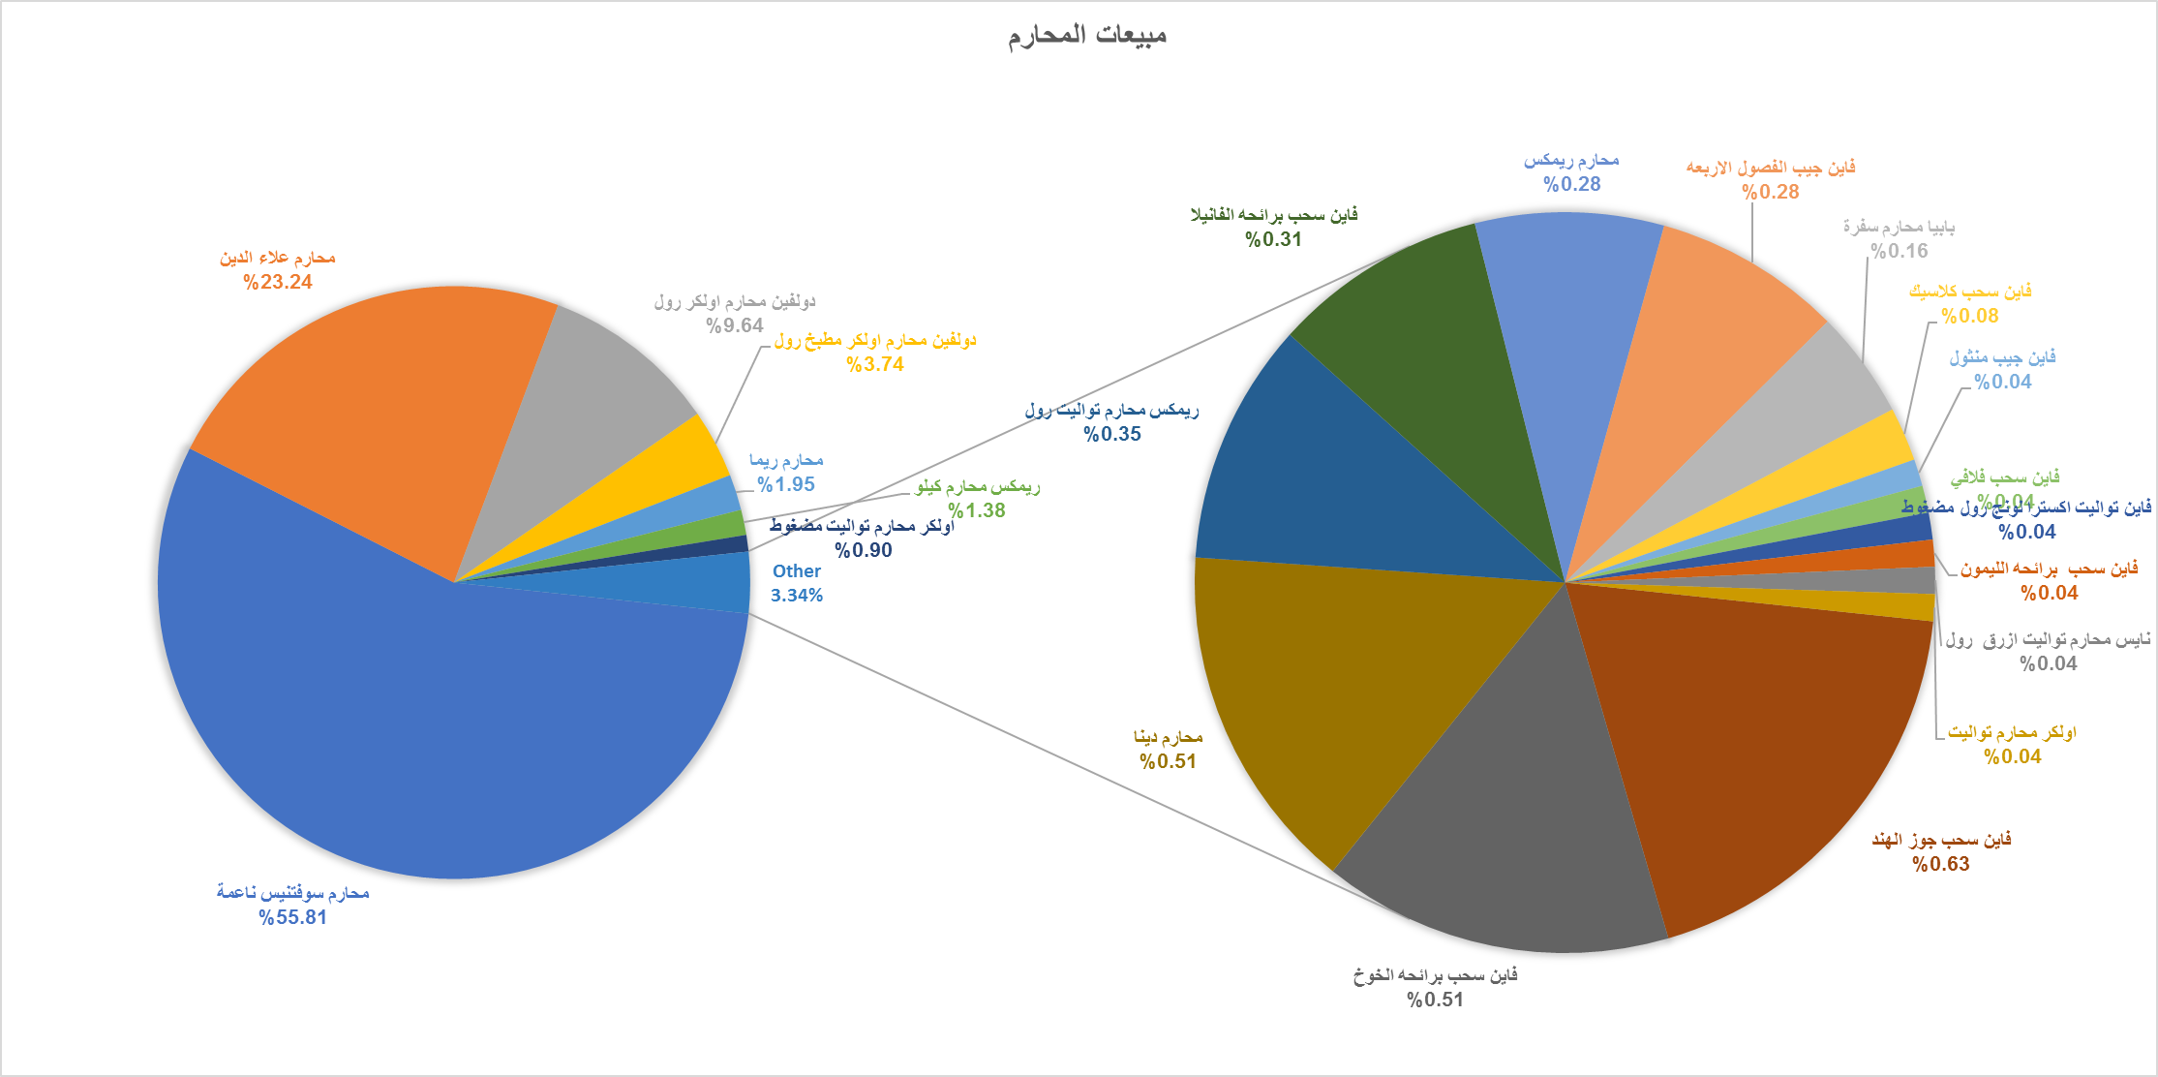

Slide 27
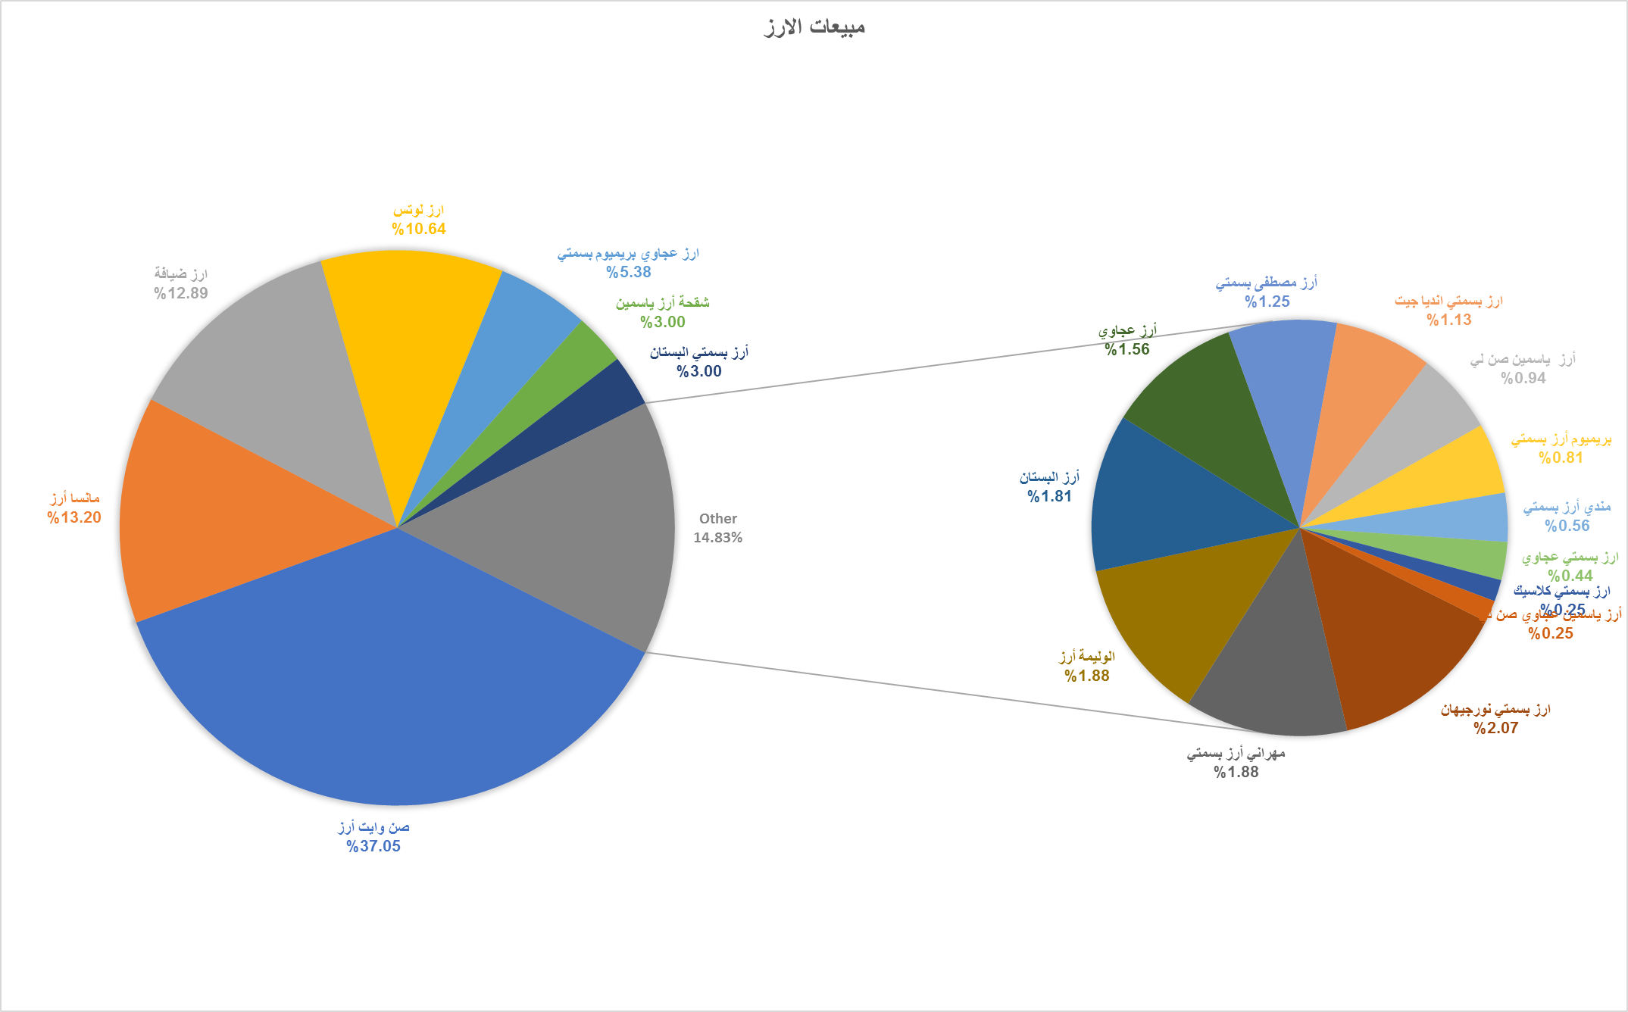

Slide 31
Shopping basket analysis tool’s results

Slide 32
General Basket Analysis

Slide 35
Detailed Basket Analysis

Slide 38
Recommendations
According to the study , Nofal mall should apply the following :
Related to shelves layout : products that usually bought together should be put far away from each other in the mall, so that the customer need to walk around all over the mall and make them buy more products , for example :
Related to sales and offers : products that usually bought together shouldn't put on sale together , because they are already bought together , for example :
Related to marketing : products that usually bought together shouldn't be in one package ,because they are already bought together , instead , another product (has a low percent selling in the mall ) could be put with them to encourage people to buy , for example :

Slide 39
Recommendations
Related to data entry process:
Insert data to the system based on predefined criteria and standardize labels.
Insert transaction date in suitable date and time format in order to make help performing prediction.

Slide 40
Conclusion
Both General and brand-flavor basket analysis are important for Nofal mall , each one has a specific use :
General basket analysis : used to explore the public trend of sales in the mall , and the customer behavior in that region in general , it will be helpful in defining the highest items sold in general such as chocolate, but it is nearly useless if we think about offers and packaging.
Brand-Flavor basket analysis : because it is high detailed data ,it will be more useful in offers, packaging and shelves layout . You know specifically what item to put next to another item or what item to put on sale , for example put Mars chocolate on sale because it has a low selling percentage.

Slide 41
Project’s Challenges
Difficulty in convincing the owners of the malls to provide us with required data.
delaying in delivering the required data from Nofal mall.
Difficulty in cleaning up the data, due to different labels for some products on one hand , and the extra spaces in products names on the other hand.

Slide 42
Future statement
Implement the results of the study and the recommendations on real.
Customized basket analysis : for golden customers , they can apply shopping basket analysis specifically for them , so that they can take care from their best customers and make special offers for them .
Expert system : an idea to build an expert system that takes the results derived from shopping basket analysis tool and use them to generate recommendations which will improve the decision making process.

Slide 43
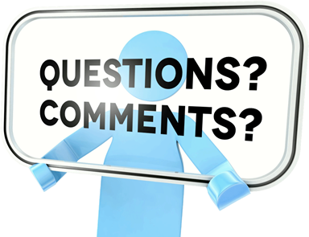

Slide 44


