Slide 1
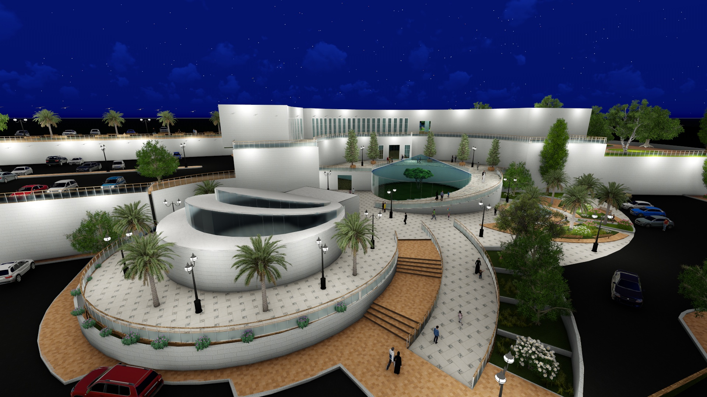
Scientific Museum

Slide 2
Outline:
Architectural design
Introduction
Site analysis
design
Environmental design
Comfort in the building
Indoor air Quality
Natural lighting
Safety
Structural design
Concrete
Steel
Electromechanical design
Electrical
Mechanical
Quantity survey & cost estimation

Slide 3
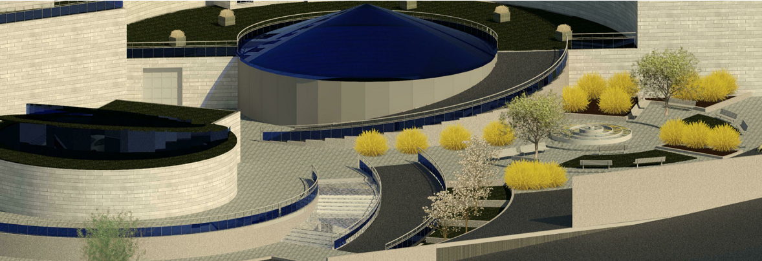
Architectural Design

Slide 4
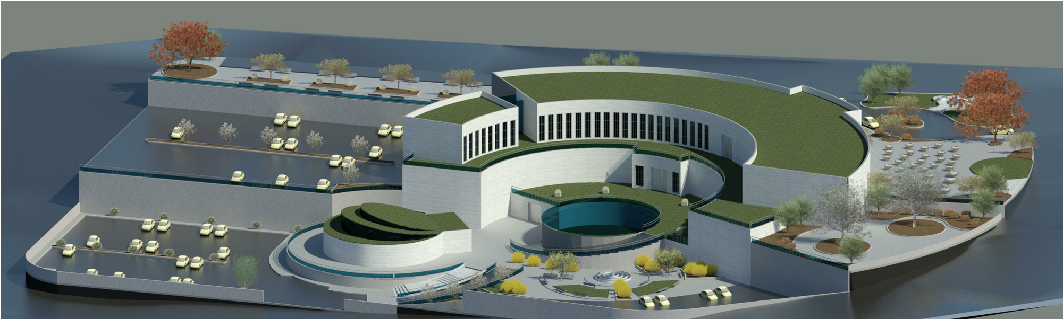
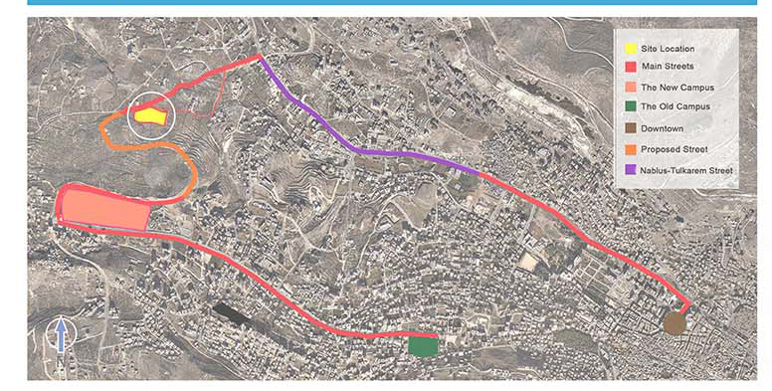
Site:

Slide 5
Introduction:

Slide 6
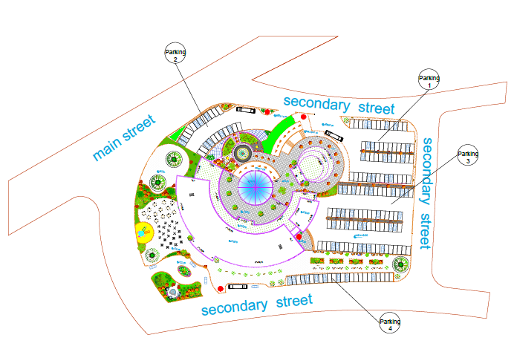
Site plan:

Slide 7
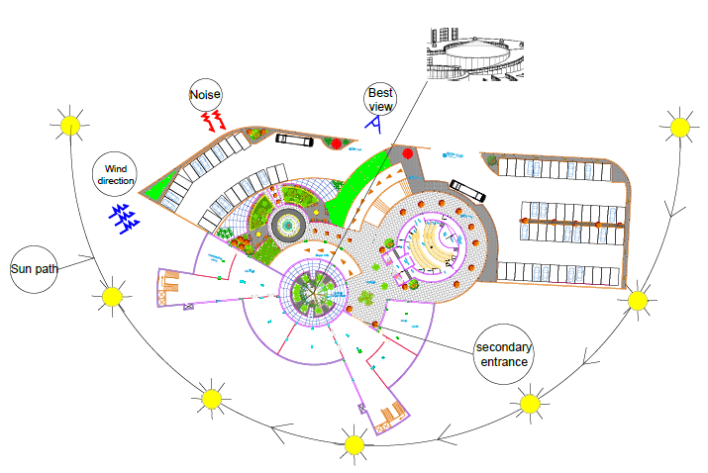

Basement floor plan:

Slide 8
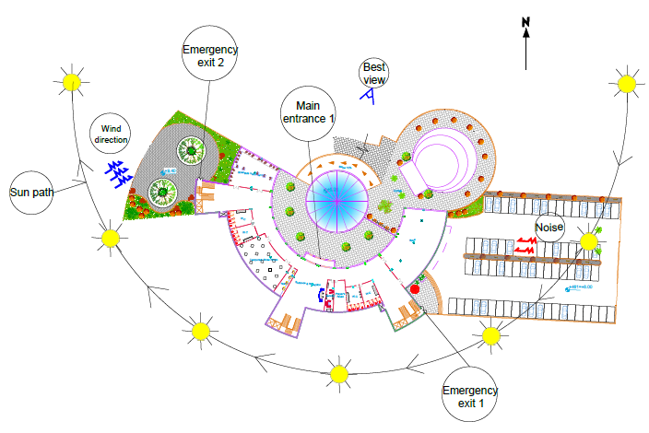
Ground floor plan:

Slide 9
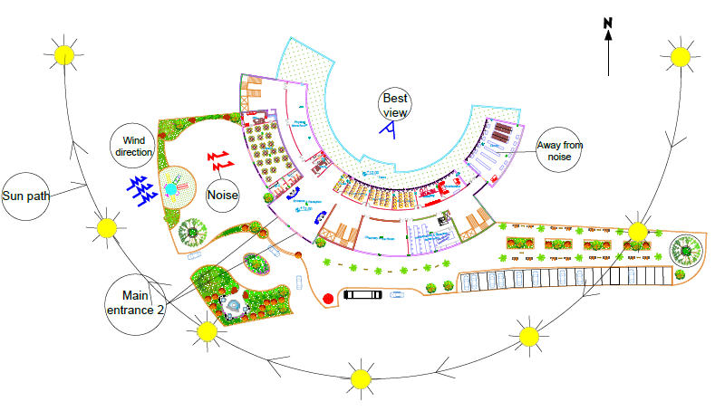
First floor plan:

Slide 10
Function percentage:

Slide 11
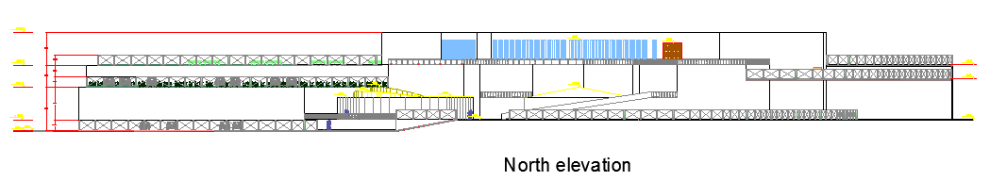
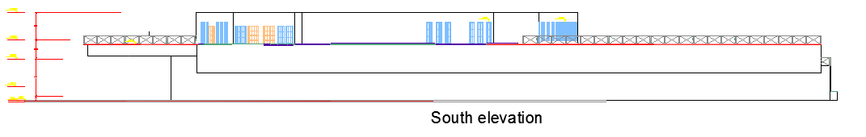
Elevations:

Slide 12
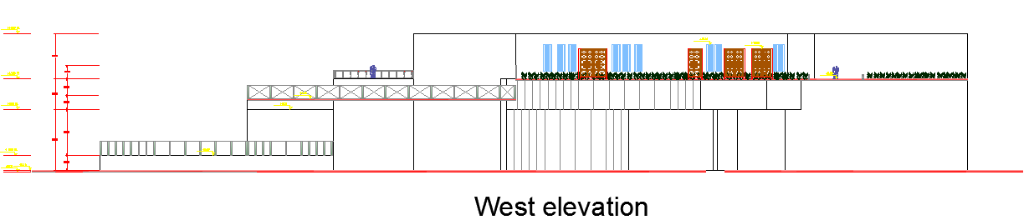
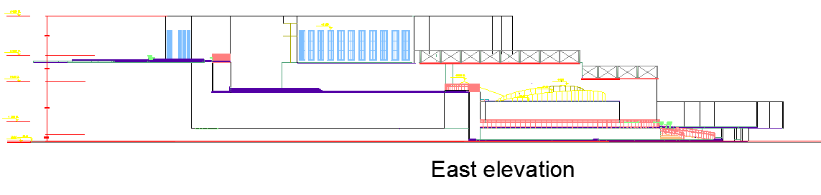
Elevations:

Slide 13
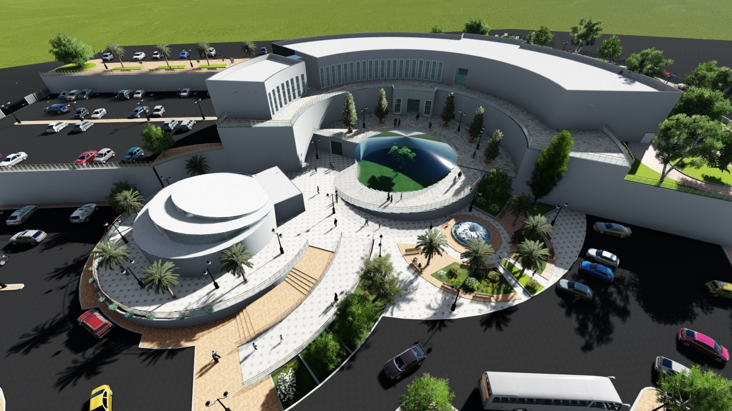
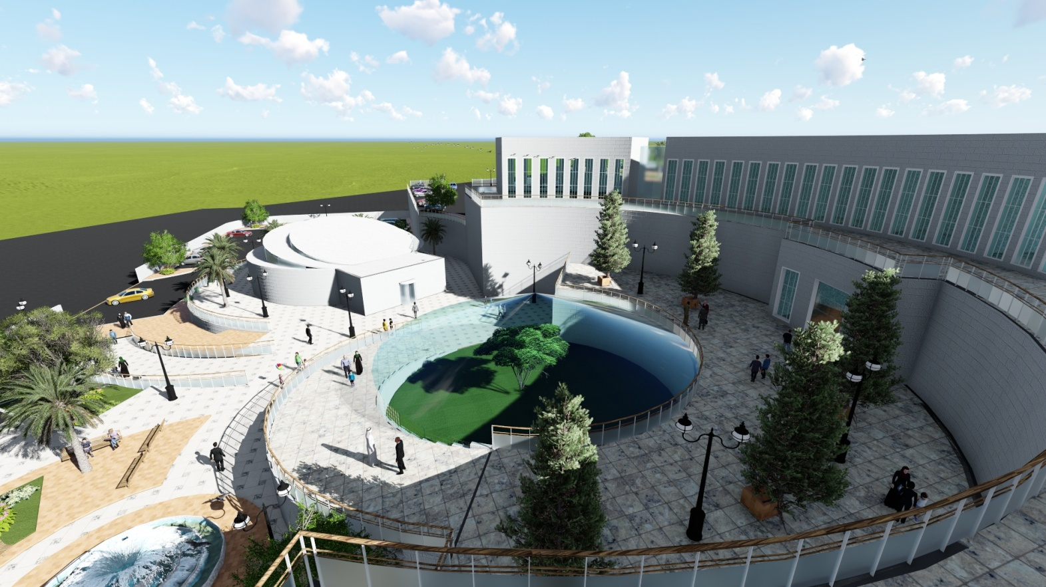

Slide 14


Slide 15
Environmental Design

Slide 16
Environmental design
Safety Systems.
Smoke Detectors ,Sprinklers,CO2 Systems .
Comfort In the Building.
Indoor Air Quality, Noise, Ventilation.
Natural Lighting System.
Lighting Pollution
Day lighting Factor
Emergency Exits, Fire Alarm, CCTV System.
Energy Efficiency .

Slide 17
Natural Lighting System .
Daylight Factor and Glare.
Glass Type
double glass Ref. tint. 6 mm air space and 13 mm argon.
Daylight Factor Dependence in Museum.
museums depend mostly on artificial lighting and due to the function daylight factor wasn't taken in considerations in most of the zones.
Transparency = 11.8 %

Slide 18
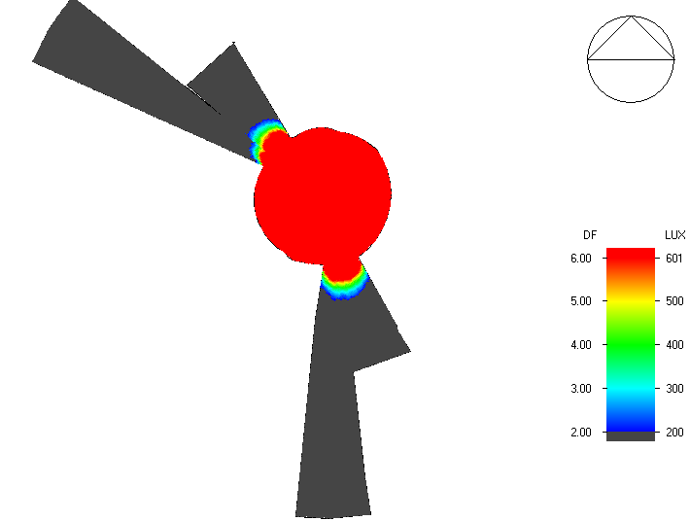
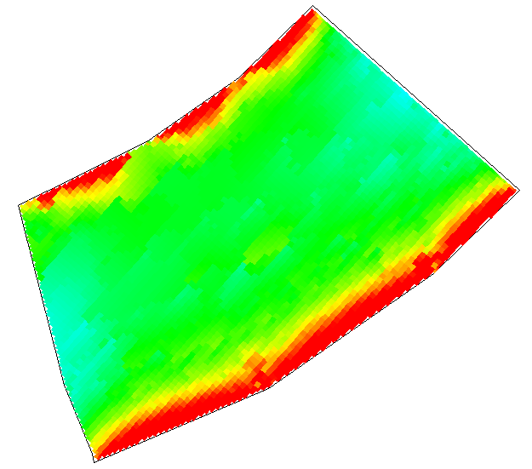
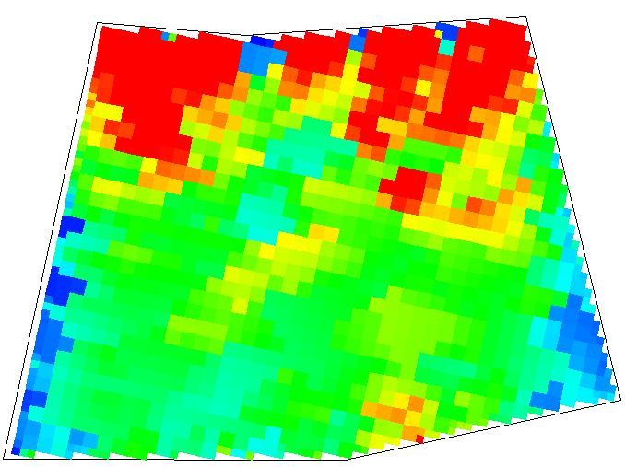

Slide 19
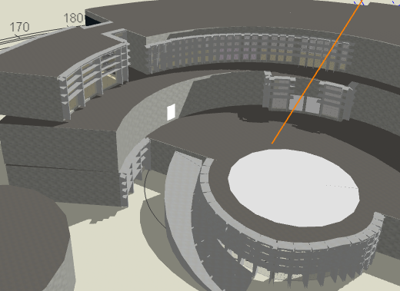
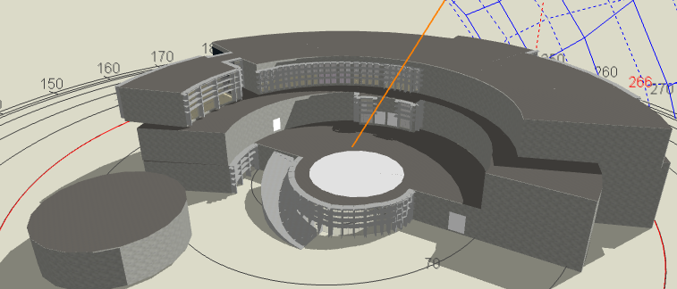
Shading

Slide 20
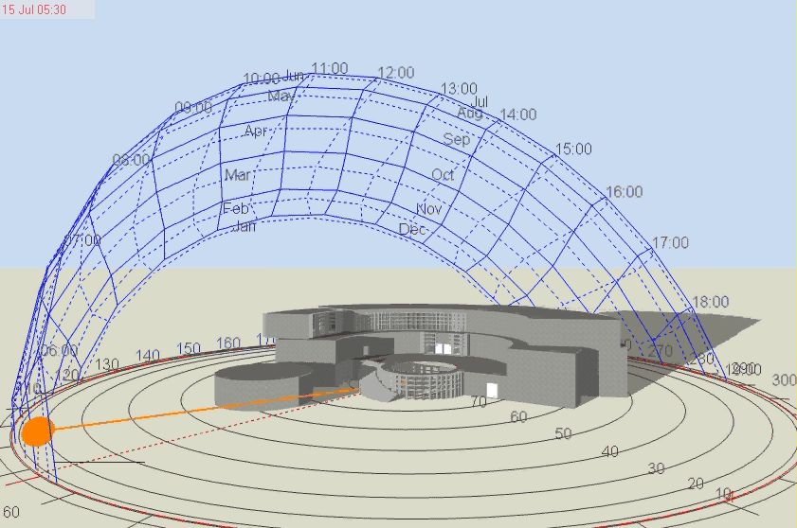

Slide 21
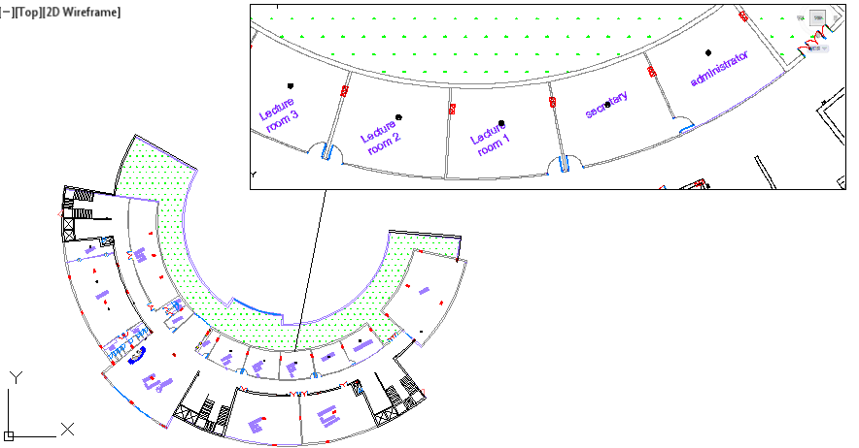
Indoor Environmental Quality.
Minimum Indoor air quality Performance.
Air quality Sensors are used as well as occupancy sensors to insure good performance and good indoor environment .

Slide 22
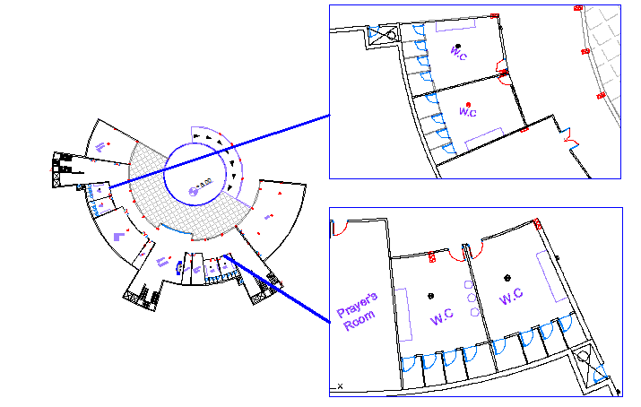

Slide 23
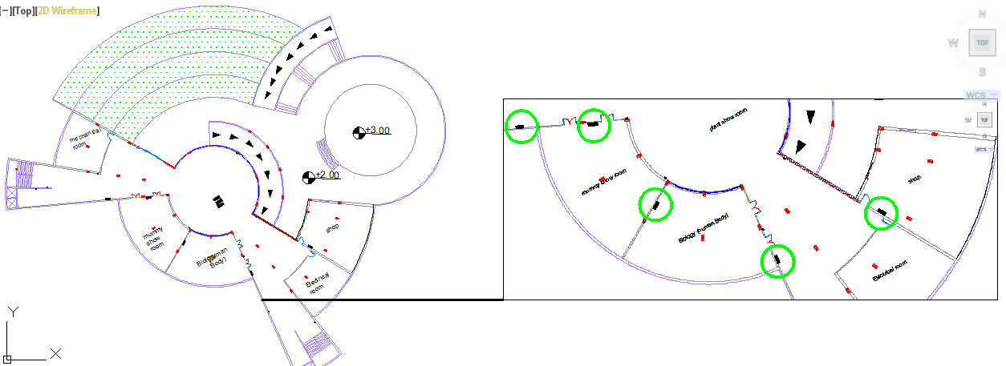
Comfort In the Building.
Thermostat and Ventilation Delivery.
HVAC system is always combined with CO₂ sensors as well as thermostat in the VAV box and in the room.

Slide 24
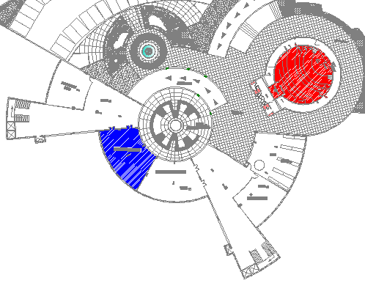
Acoustical analysis :

Slide 25
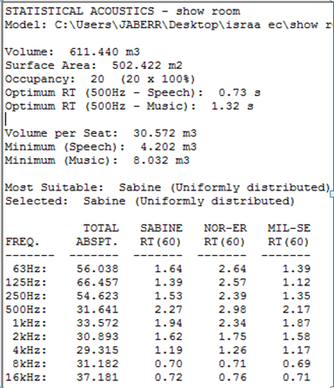
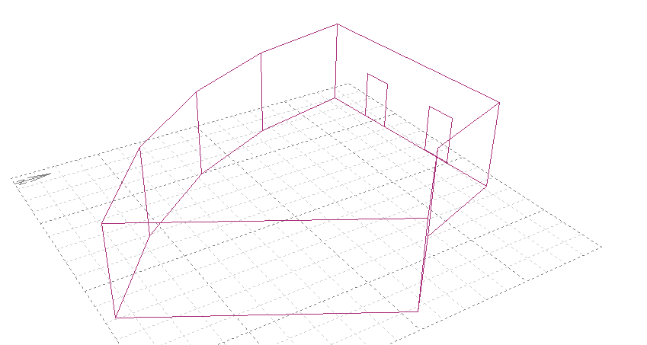
Acoustical Design :
1 - Acoustical Study and Modifications.

Slide 26
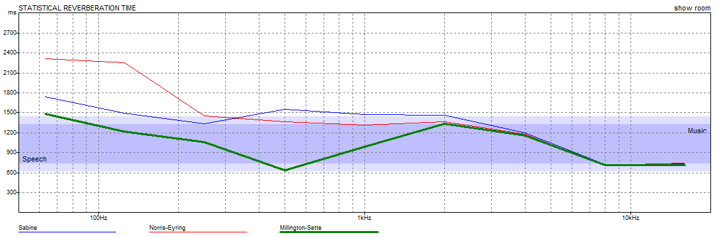
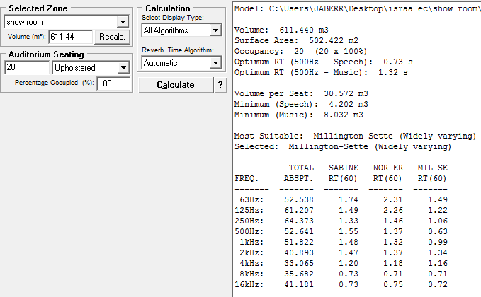

Slide 27
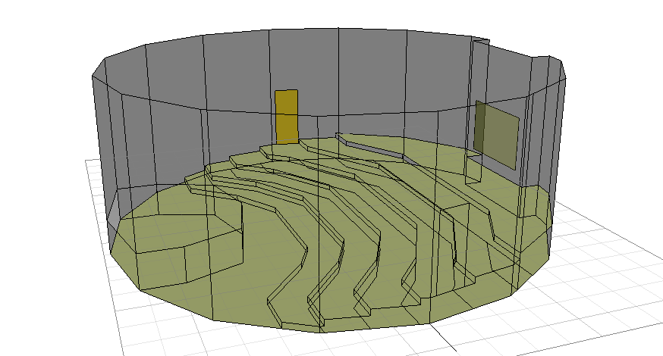
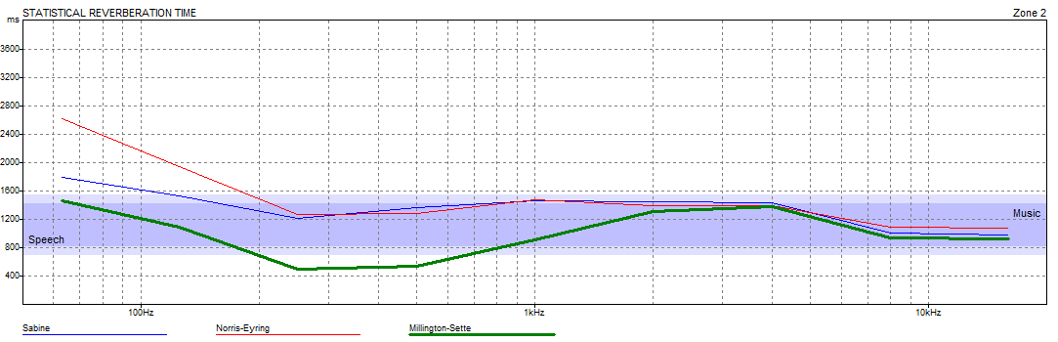
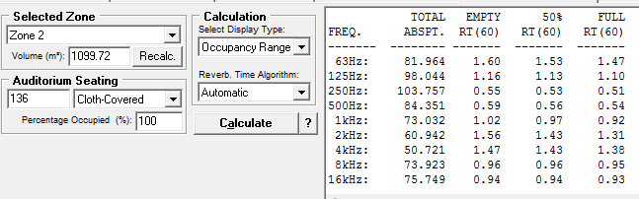

Slide 28
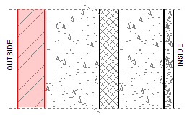
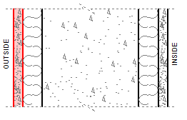
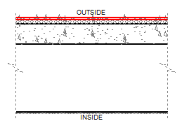
Layers | STC(dB)
 | STC = 54 > 40 acceptable
Layers | STC(dB)
 | STC = 38 < 40 not acceptable need for modification Add plaster via resilient mounting: One side +10 STC = 48 > 40 acceptable
Layers | Values
 | STC = 62 > 40 not acceptable IIC = 56 > 40 acceptable No need for modification.

Slide 29
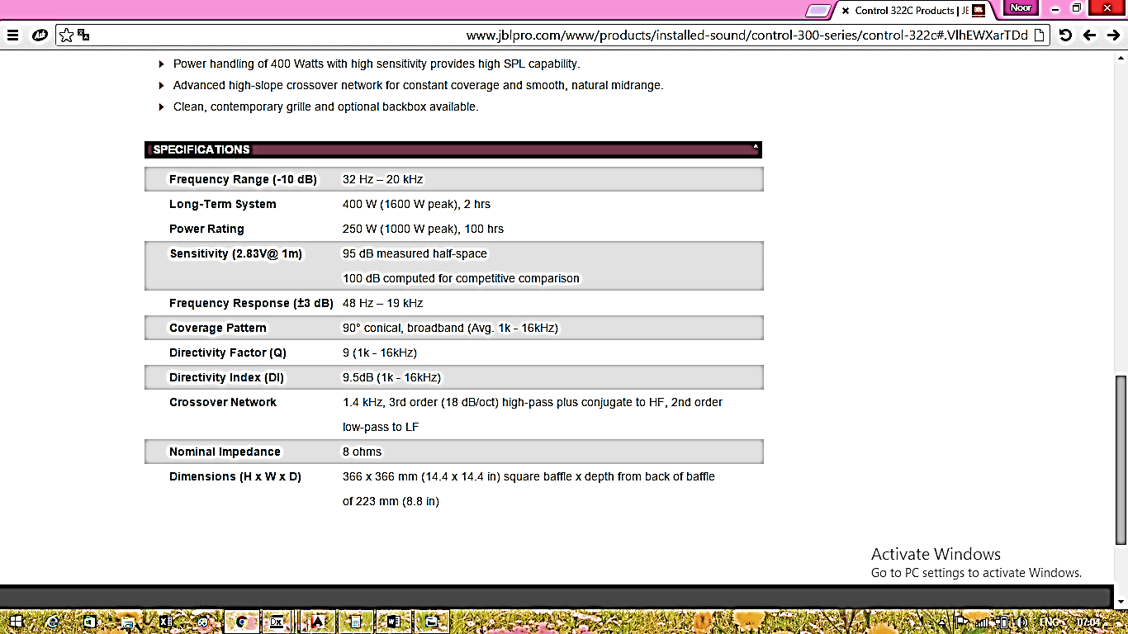
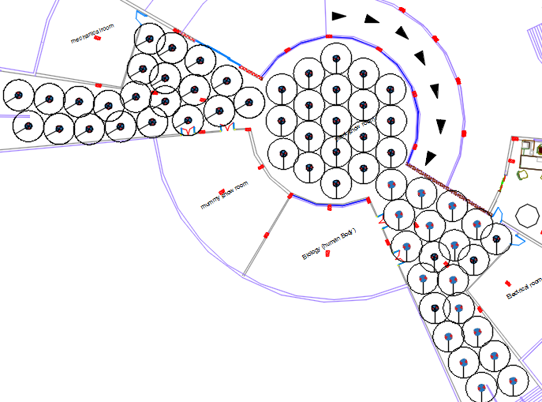
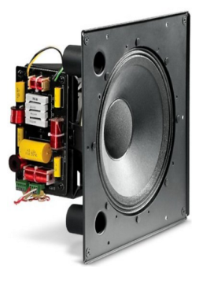
Loud Speakers:
The following Loudspeaker was Chosen to be installed in the corridor:

Slide 30
Energy Efficiency
  U- Value
Designed U-Value. | Structural Element.
0.4 | External Wall.
0.248 | Internal Wall
0.375 | Roof.
0.327 | Internal Slabs
0.289 | Simi Exposed Wall.
2.209 | Windows.
1.2 | Doors

Slide 31
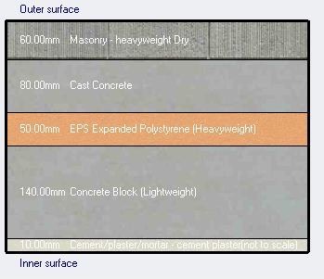
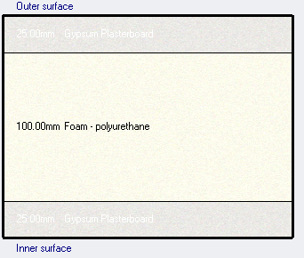
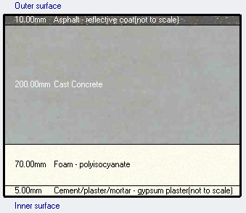
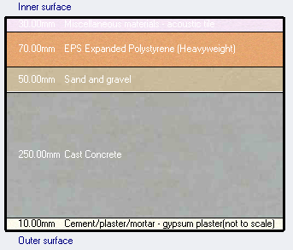
External Wall
Internal Wall
Internal Slab
Roof Slab

Slide 32
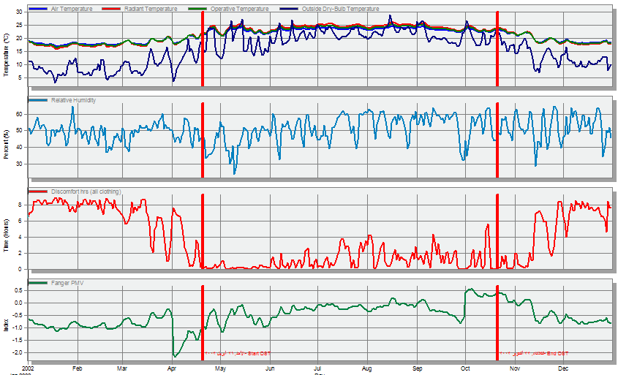
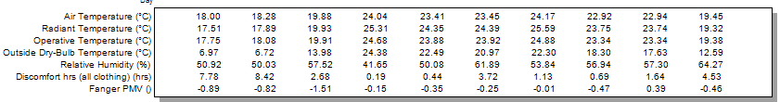

Slide 33
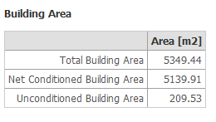
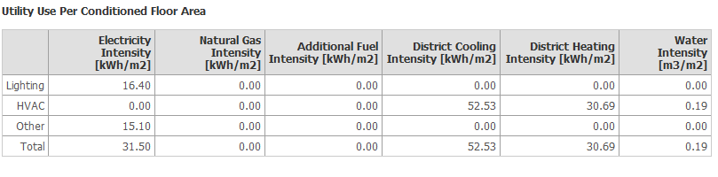

Important :
Energy consumption = 110.23 kWh/m2 / year which is around 73% of baseline energy consumption intensity for museums (154 kWh /m2 /year).

Slide 34
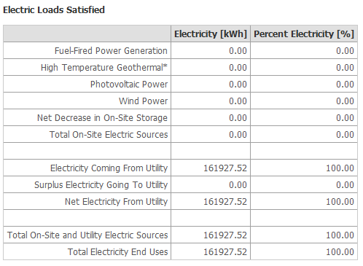
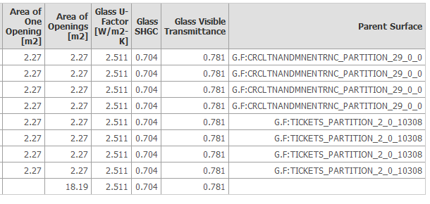
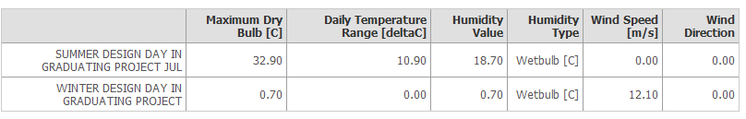

Slide 35
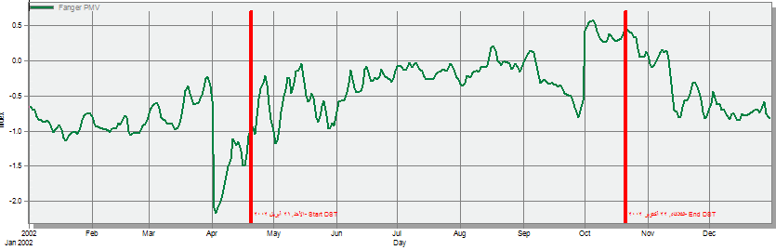
Note :
This Fanger is done when the HVAC is OFF.

Slide 36
Structural Design

Slide 37
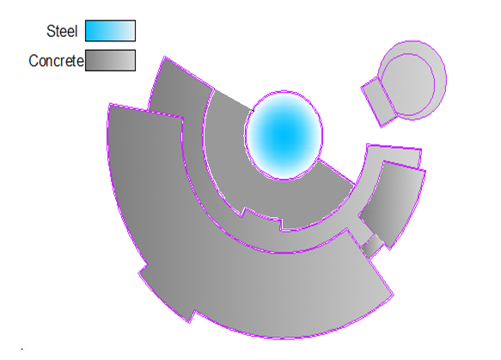
Structural Design:
Two structural systems were used in the project:
Steel Structure
Concrete Structure.

Slide 38
Steel structure:
Materials Design Data:
A36 steel with yielding strength (F_{y}) = 250 Mpa.
and ultimate strength (F_{u}) = 400 Mpa.
Glass with argon with weight of 3.1KN/m²
E70xx welding material, with strength F =480 Mpa.
Loads:
Loads Type | Value
Live | 1 KN/m²
SID | 3.1 KN/m²
Snow | 2.1 KN/m²
Wind For Roof | 0.20 KN/m²

Slide 39

Steel structure:
Truss

Slide 40

Steel structure:
Compatibility check
T= 0.0432 sec

Slide 41

Steel structure:
Equilibrium check

Slide 42

Result:
Steel Section used:

Slide 43


Detailing for connection
e

Slide 44
Concrete structure:
Design Data:
Concrete F`c For Columns, Shear walls and Footing = 28 Mpa
Concrete F`c for slab ,Beams = 24 Mpa.
Steel yielding strength Fy = 420 Mpa
Bearing Capacity For Soil 300 Mpa.

Slide 45

Seismic Design Data:
Location:
Nablus → Zone: 2B
Importance factor = 1.25
Reduction factor=5.5

Slide 46

Concrete structure:

Slide 47

Compatibility Check:

Slide 48
Equilibrium Check:
Loads | ETABS- Results | Manual Results | Error
Dead Load | 22699.55KN | 22134.29KN | 2.25
Live load | 8050.4984KN | 8050.00KN | 0.01
SID load | 11717.5825KN | 11740.12KN | 0.19
Error = ( ( Manual – ETABS Load ) / Manual Load ) X 100% < 5%

Slide 49

Design Stage:
Tow – Way Ribbed Slab Reinforcements For Block A:

Slide 50



Design Stage:
Beams Reinforcements:

Slide 51


Column Reinforcements:

Slide 52


Design Stage:
Wall Footing Detailing:
Isolated Footing Detailing:

Slide 53


Stair:

Slide 54

Retaining wall :

Slide 55
Electro-Mechanical Systems.

Slide 56

HVAC System.

Slide 57


HVAC unit Design:

Slide 58

Diffuser Calculations :
Toshiba Diffusers were used.

Slide 59

        Outdoor Set:
WE NEED 6 UNITS of MAP1144HT9UL of cooling capacity 112 kbtu/hr and heating
capacity 130 kbtu/hr for the G.F and F.F.
WE NEED 3 UNITS of MAP1144HT9UL of cooling capacity 112 kbtu/hr and heating capacity 130 kbtu/hr for the B.S .

Slide 60
Remote Control .
Displays all Indoor Units in one screen.
Shows Basic Indoor Unit settings on main screen
schedule functions available
Up to 4 Concurrent users can be connected.
Multi-Language Display Screen.
Energy Monitoring and report creation.
Advanced and master schedules

Slide 61


Slide 62


Water System:
Conference room
First Floor

Slide 63



Ground Floor

Slide 64


Drainage System:

Slide 65




Slide 66
Electrical Design.
Total Power for Basement Floor= 5016.
Total Sockets Power in the first floor =8976.
Total Sockets Power in the first floor = 3960.
Lighting load from the first Floor = 4190.
Lighting load from the Ground Floor = 2968.
Lighting load from the Basement = 2878.
Current needed in the basement floor = Socket + lighting / (220x3x0.8) = 15
Current needed in the first floor = Socket + lighting / (220x3x0.8) = 25
Current needed in the basement floor = Socket + lighting / (220x3x0.8) = 13.12

Slide 67

Electrical Box AND Earthlings.

Slide 68

Computer System Riser.

Slide 69



Artificial Lighting.
Lighting Name | Watt | Lumen | Producing Company
BBS464 W6L60 1xLED48/840 PC-MLO | 39 Watt | 3800 | Philips
Slot Square Ceiling | 27 Watt | 1280 | Simes
BBS464 W30L120 1xLED48/840 AC-MLO | 39 Watt | 3800 | Philips
BPS680 W7L122 1xLED24/840 MLO-PC | 21.0 W | 1750 lm | Philips
BBS411 W9L120 1xLED24/840 MLOPC | 21.0 W | 1750 lm | Philips

Slide 70


Lux Range = 300-400
Min. Uniformity = 0.6
MAX. Allowed UGR = 19
Lux achieved = 360
Uniformity = 0.62
UGR = 17

Slide 72


Lux = 229
Uniformity = 0.6
UGR = 18
Lux = 150-200
Uniformity = 0.6
UGR = 19

Slide 73


Lux = 429
Uniformity = 0.664
Lux = 400-500
Uniformity = 0.6

Slide 74

Lux = 153
Uniformity = 0.74
UGR = 16
Lux = 100-150
Uniformity = 0.6
UGR = 19

Slide 75


Corridors Lighting .
As in Corridors our main concentration is on the fact that the UGR should be acceptable especially when the design and the function needs long corridors with new technologies in exhibition like screens and touch screens.

Slide 76
Lux = 195
UGR =>10- 16
Uniformity = 0.5
Lux = 150-200
UGR = 18
Thus the lighting is in the desired level as there is no glare and the lighting is good at the same time the uniformity is good too as a plus point.

Slide 77


Corridor 2 :
Lux = 178
Uniformity = 0.612
Glare = 17
Lux = 150 - 200
Glare = 19

Slide 78

Circulation Corridors 1+2
Lux = 189 , 207
Uniformity = 0.6
Glare = 17.1
Lux = 150-200
Uniformity = 0.6
Glare = 19

Slide 79
Quantity survey:
Type | Unit | Quantity/number | Unit cost include labor (NIS) | Total cost (NIS)
leveling | m³ | 11020 | 30 | 330600
Excavation of footing | m³ | 1703 | 30 | 51090
Base coarse | m³ | 1500 | 20 | 30080
Insulation | m² | 6150 | 10 | 61500
Columns | kg | 31300 | 3.5 | 109550
Footings | kg | 30062 | 3.5 | 105220
Tie beams | kg | 64080 | 3.5 | 224280
Slab | kg | 204142 | 3.5 | 714500
beams | kg | 344424 | 3.5 | 1205500
Shear walls | kg | 68600 | 3.5 | 240110
blinding | m³ | 193 | 350 | 67500
Footings | m³ | 968 | 450 | 435600
Tie beams | m³ | 499 | 450 | 224320
Columns and shear wall | m³ | 1095 | 480 | 525980
Beams and slabs | m³ | 7983 | 400 | 3193320
stairs | m³ | 180 | 400 | 75950
Block 10 |  | 72288 | 2.5 | 180720
Block for slabs |  | 135065 | 4 | 540260
Stone | M² | 5992 | 250 | 1498050
Plaster | M² | 10040 | 30 | 301200
Glass | M² | 5000 | 450 | 2250000
Tile | M² | 18008 | 90 | 1620750
the total cost of the project = 13,986,080 NIS.

