Slide 1

Presented by:
Ameen Odah
Ayman Ghanem
Supervisor:
Dr. Emad Alnatsheh Dr. Aladdin AlMasri
Graduation
Project Presentation

Slide 2
outline
Idea
Frameworks and Tools.
MIX in details.
Future Work.
Conclusion

Slide 3
Idea
How ?
What ?
Why MIX ?

Slide 4
Frameworks and Tools.
Codegniter PHP FrameWork back-end
BootStrap
Sublime Text2 Editor
Xamp Server
Database: MySQL

Slide 5
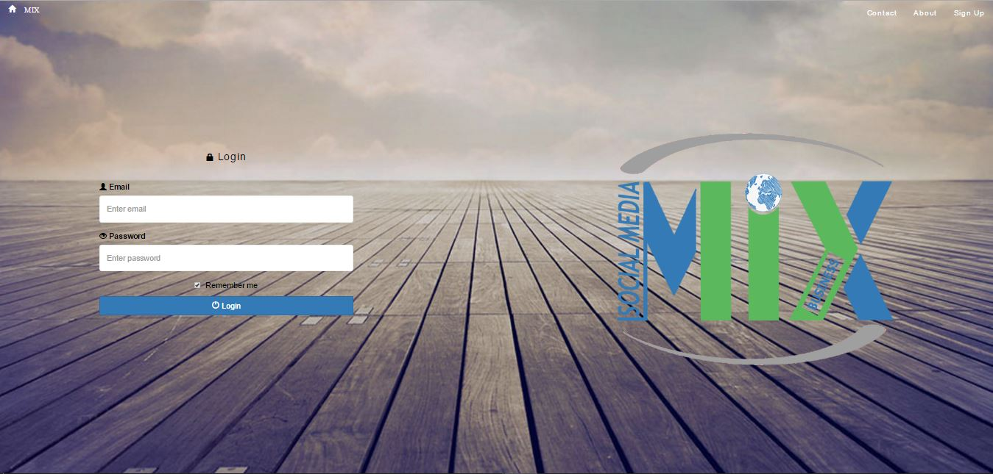
Mix in details

Slide 6
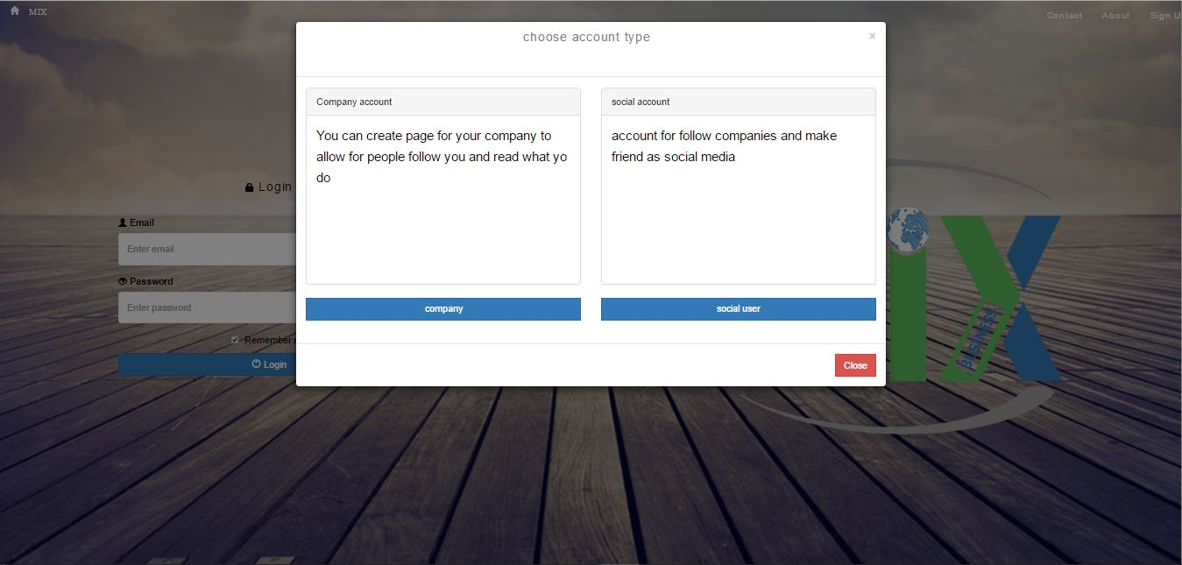
Mix in details

Slide 7
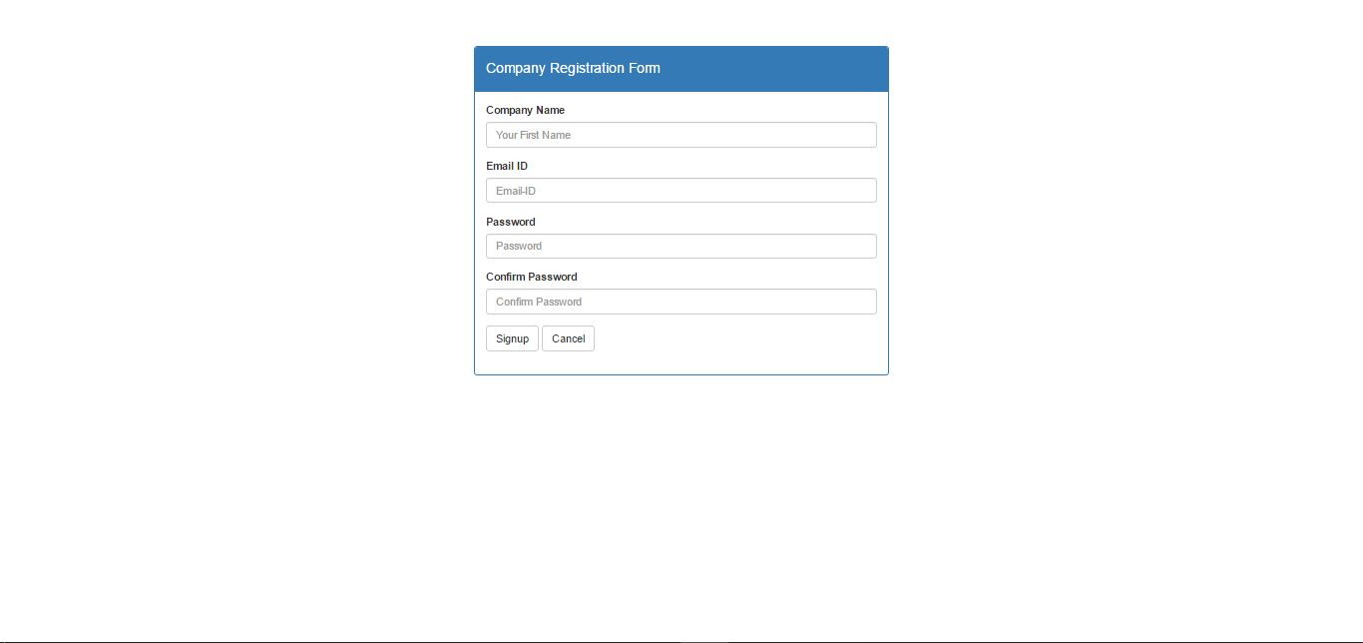
Mix in details

Slide 8
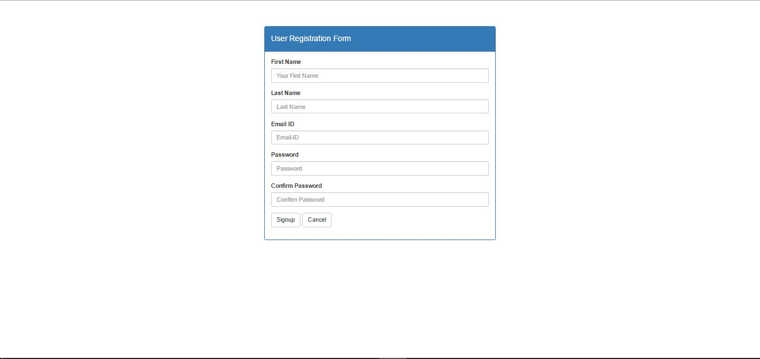
Mix in details

Slide 9
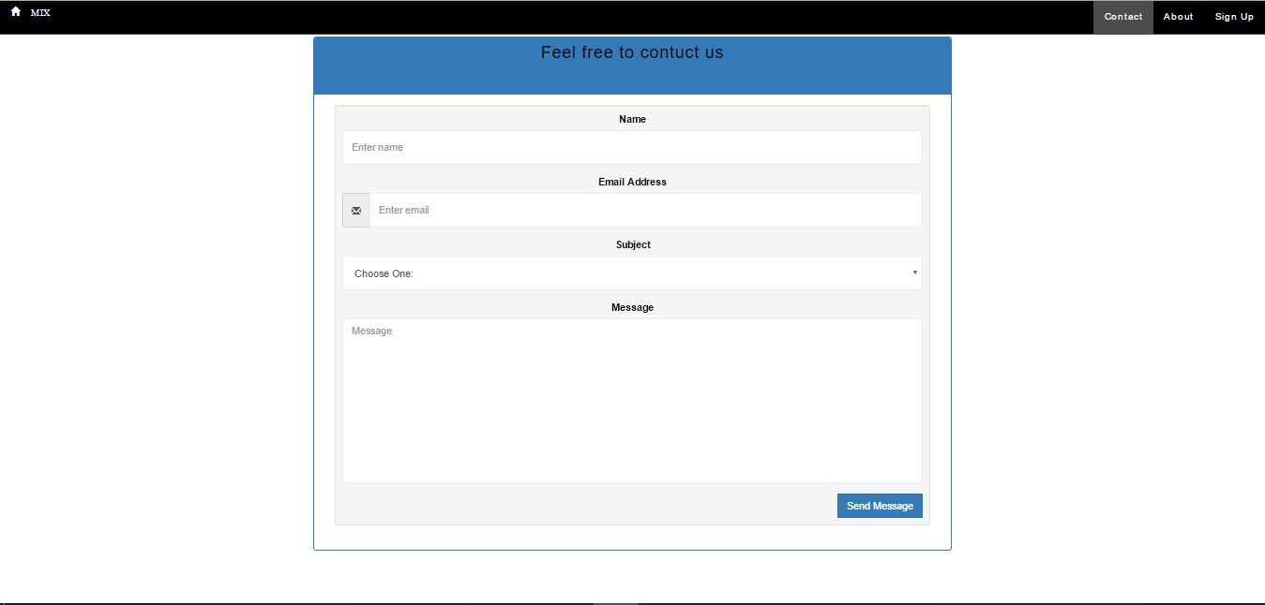
Mix in details

Slide 10
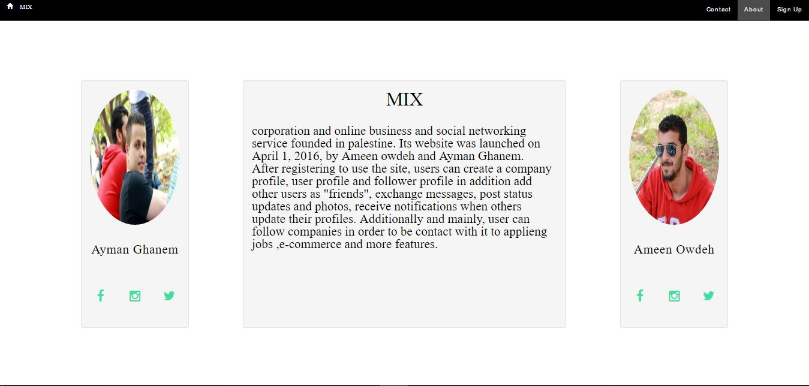
Mix in details

Slide 11
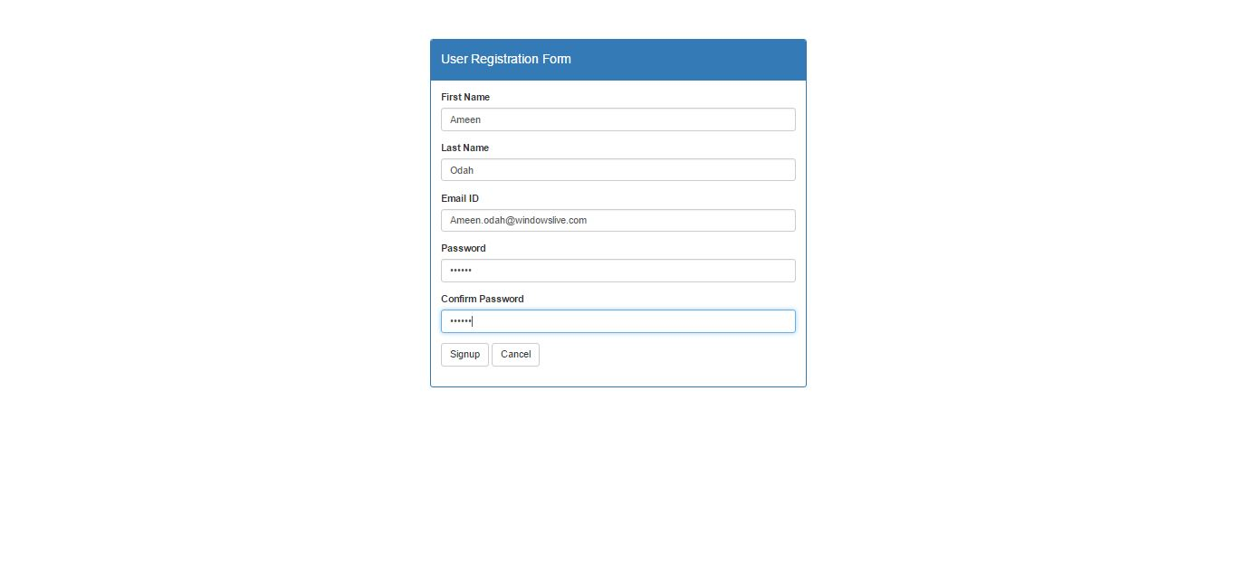
Mix in details

Slide 12
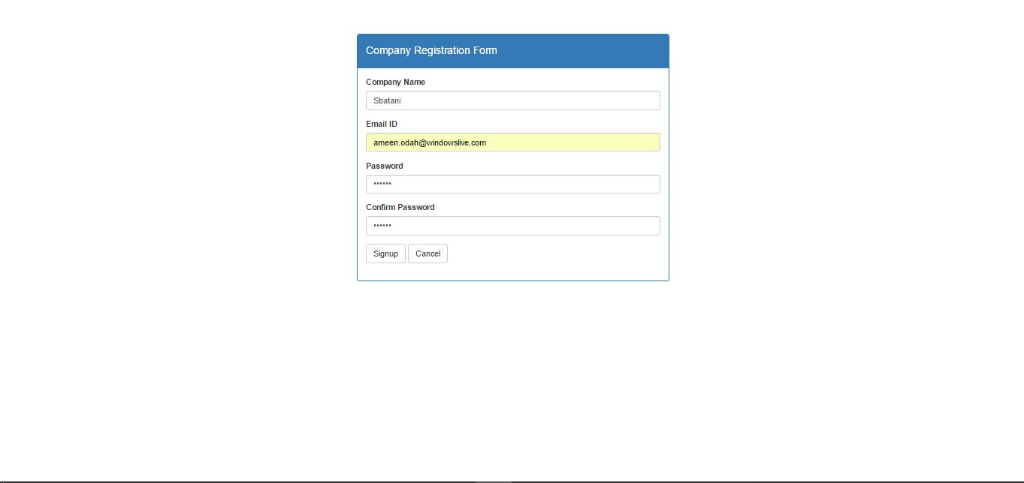
Mix in details

Slide 13
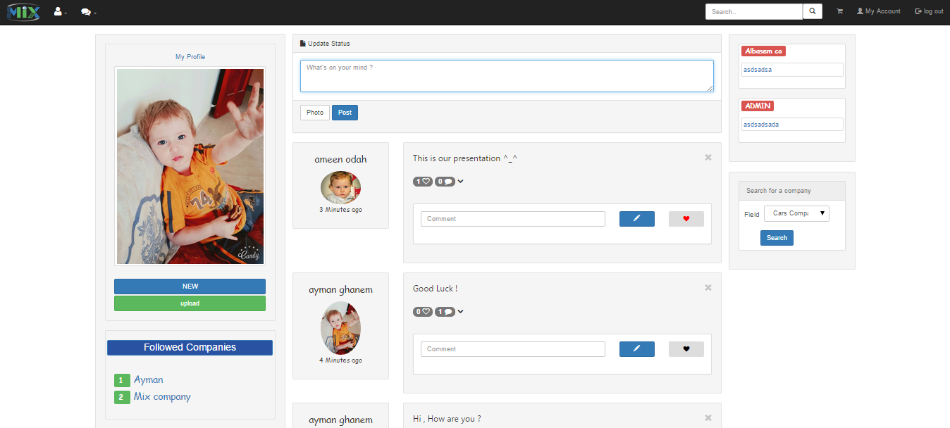
Mix in details

Slide 14
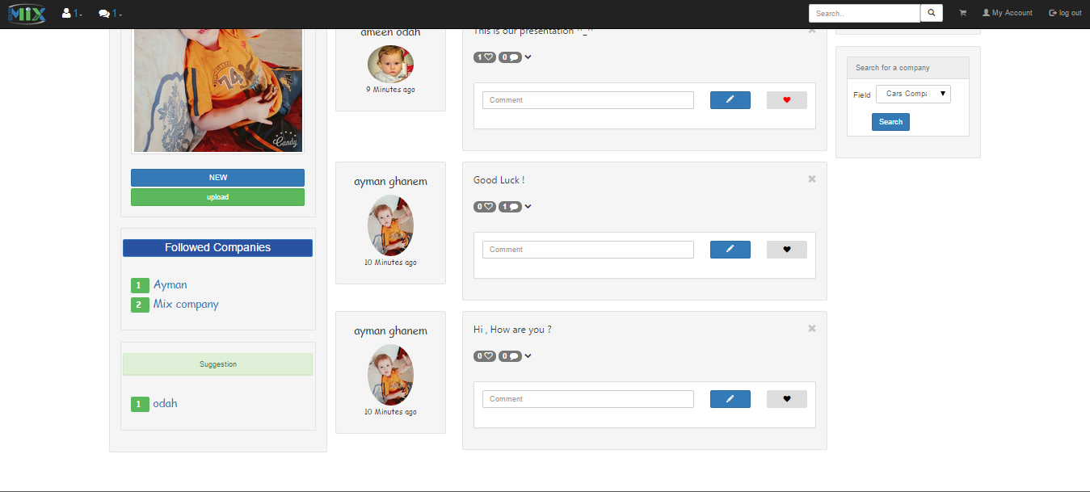
Mix in details

Slide 15
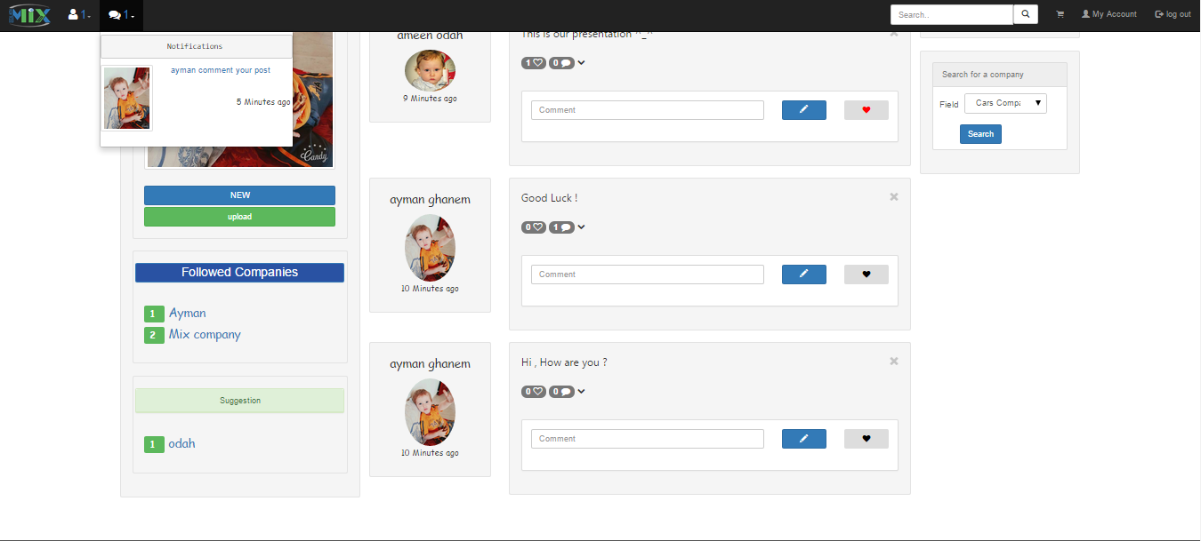
Mix in details

Slide 16
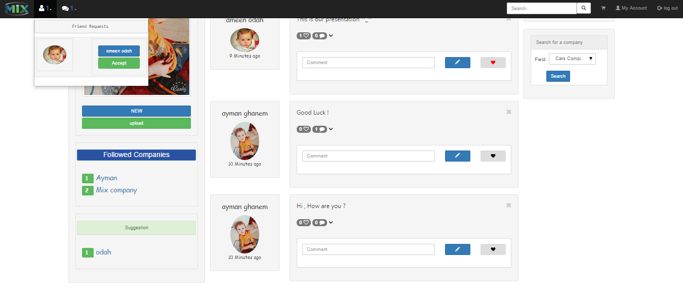
Mix in details

Slide 17

Mix in details

Slide 18
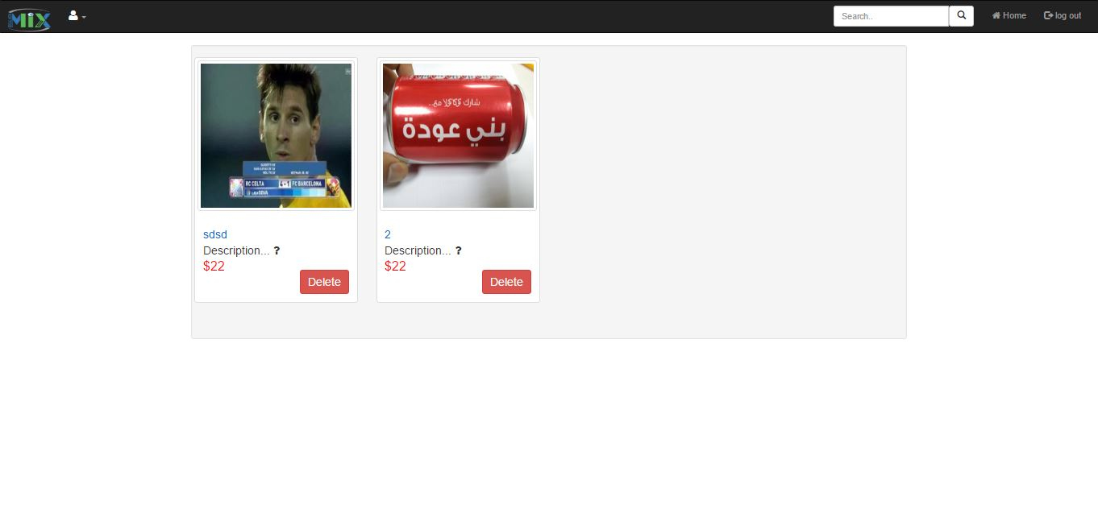
Mix in details

Slide 19
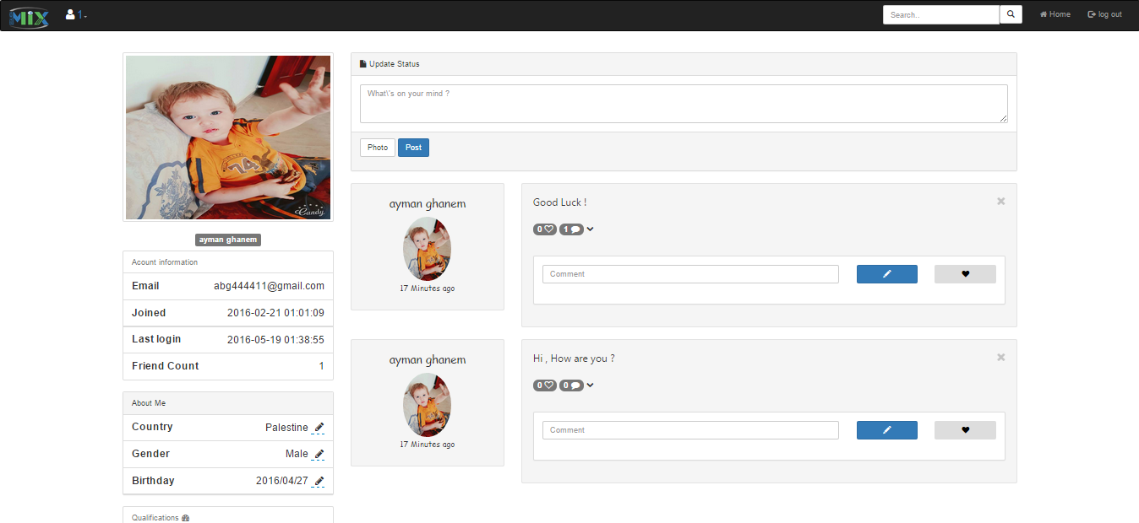
Mix in details

Slide 20
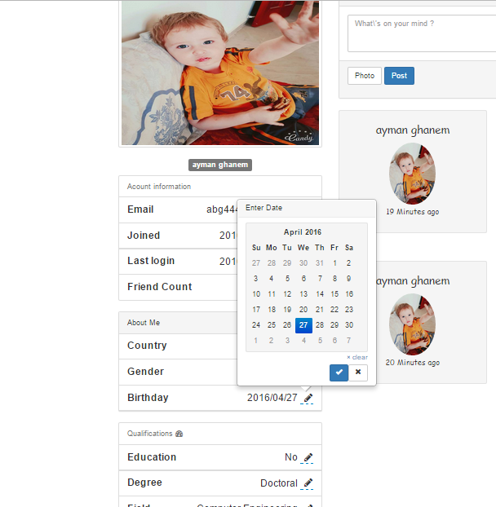
Mix in details

Slide 21
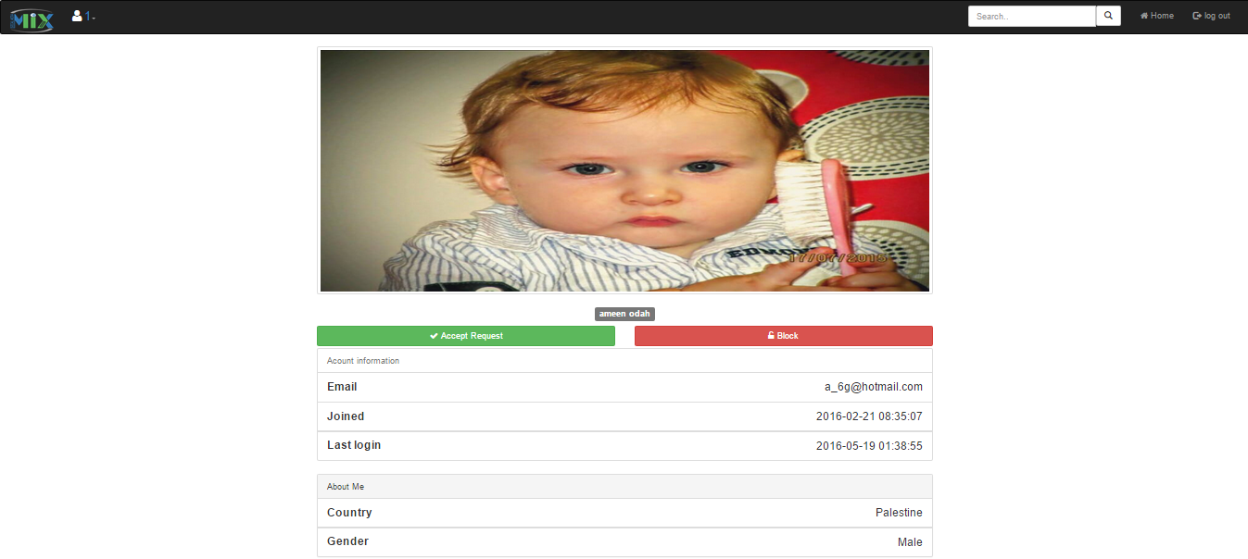
Mix in details

Slide 22
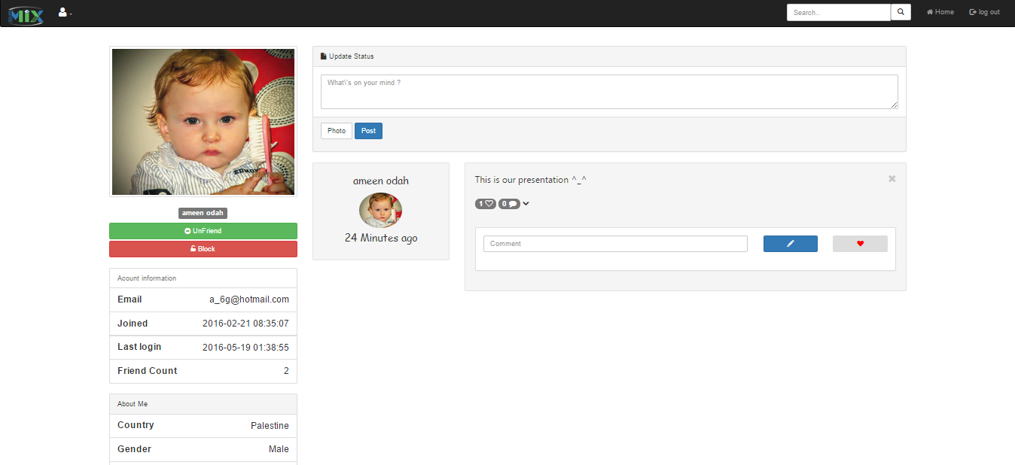
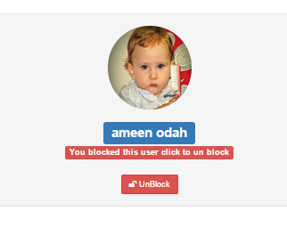
Mix in details

Slide 23
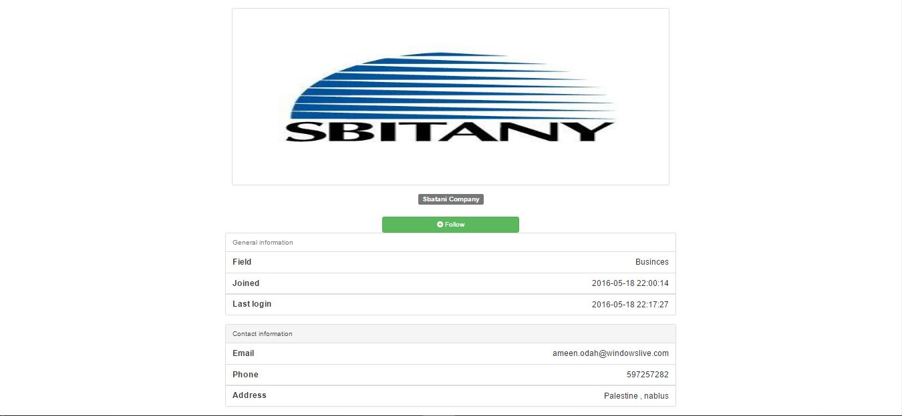
Mix in details

Slide 24
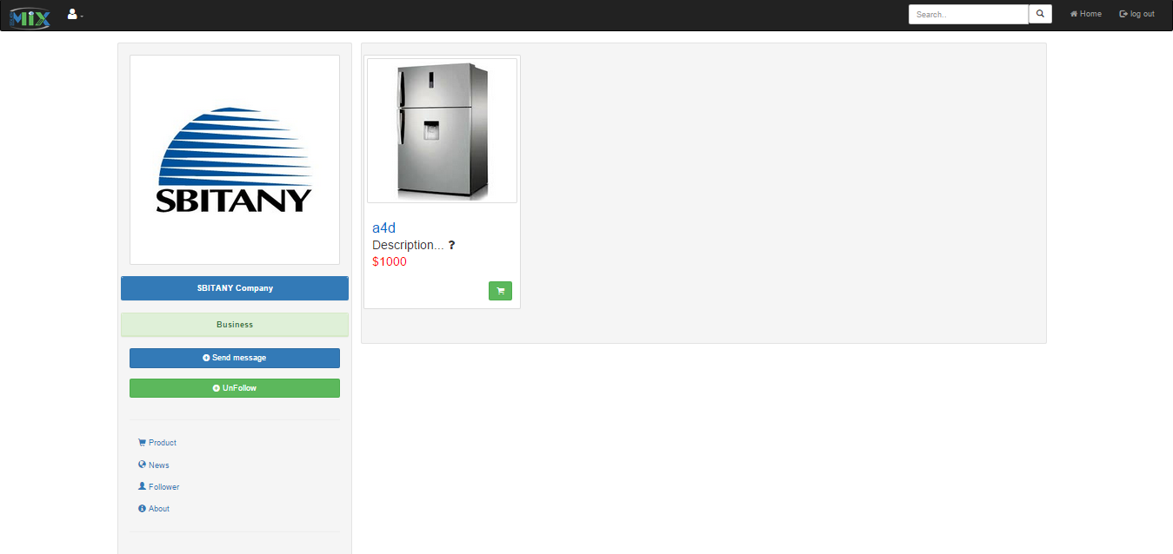
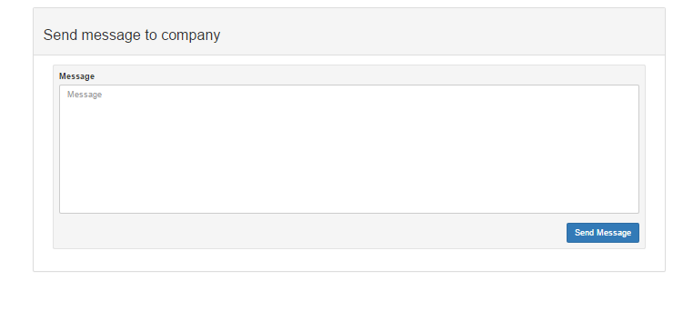
Mix in details

Slide 25
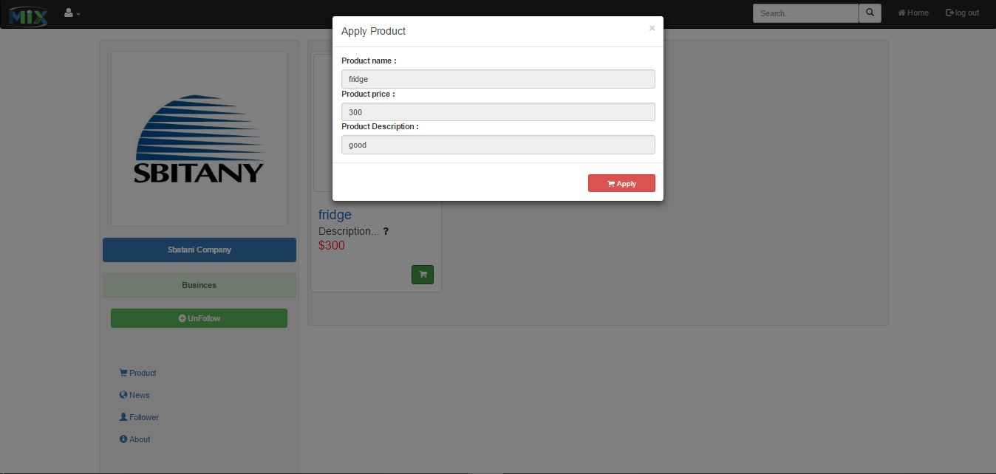
Mix in details

Slide 26
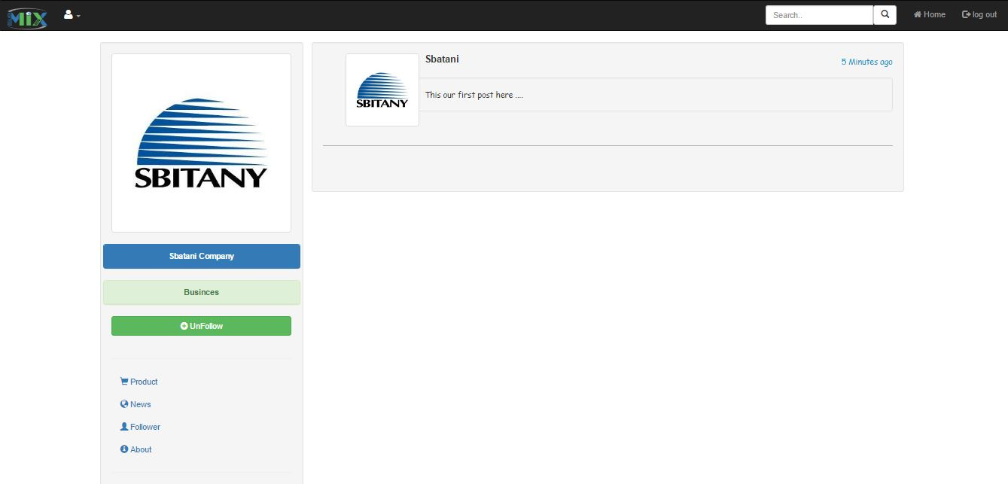
Mix in details

Slide 27
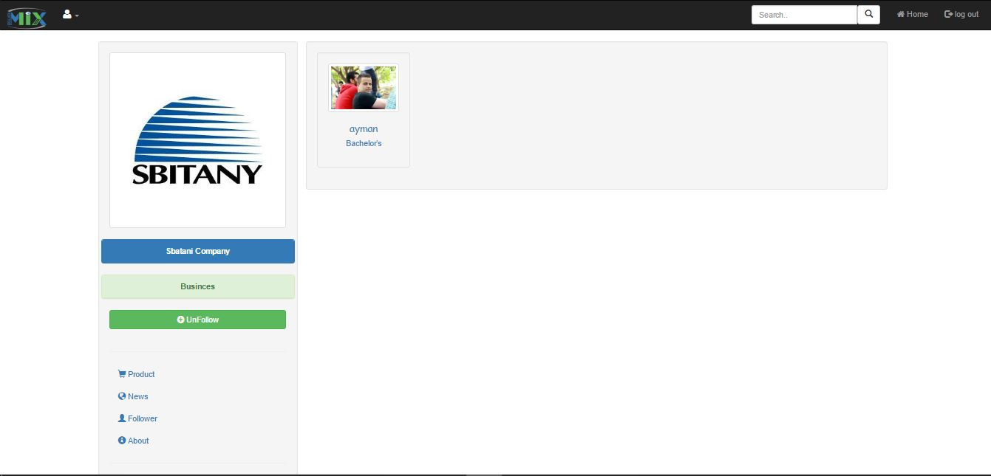
Mix in details

Slide 28
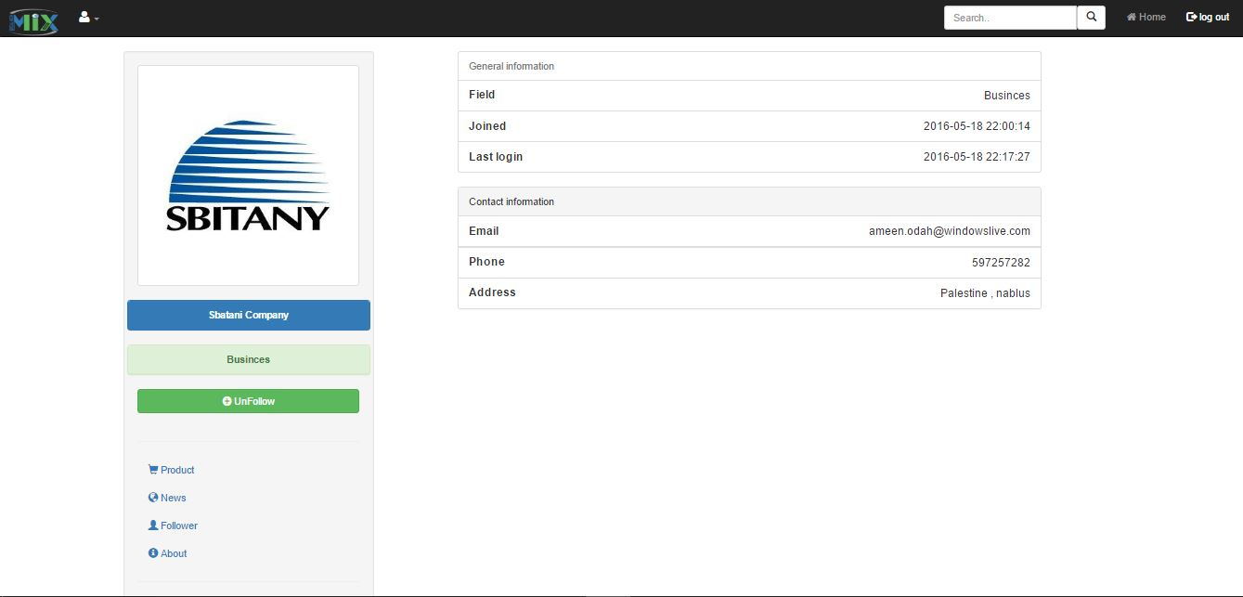
Mix in details

Slide 29
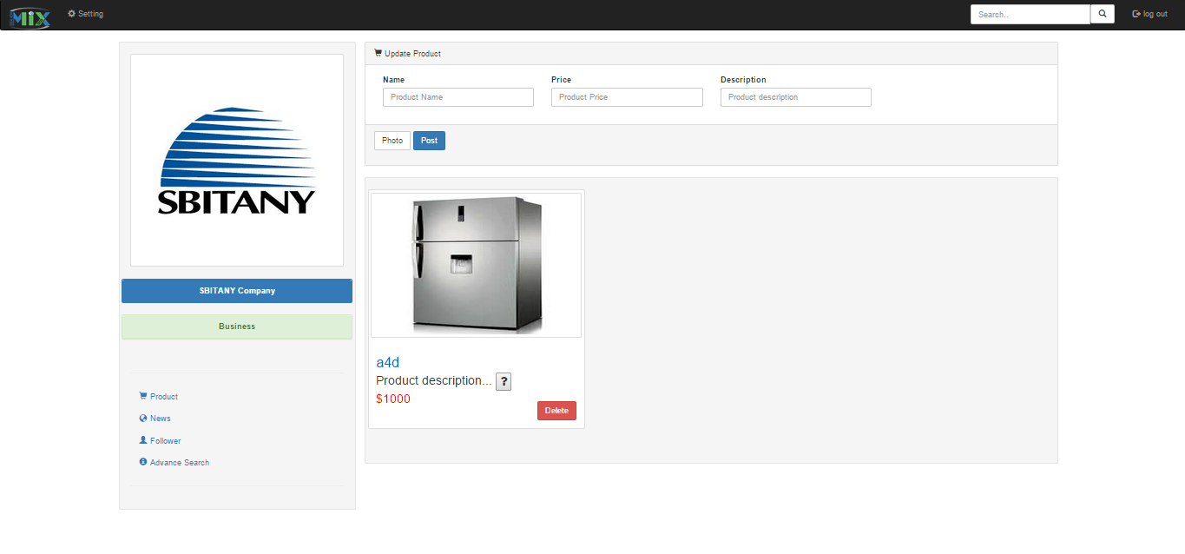
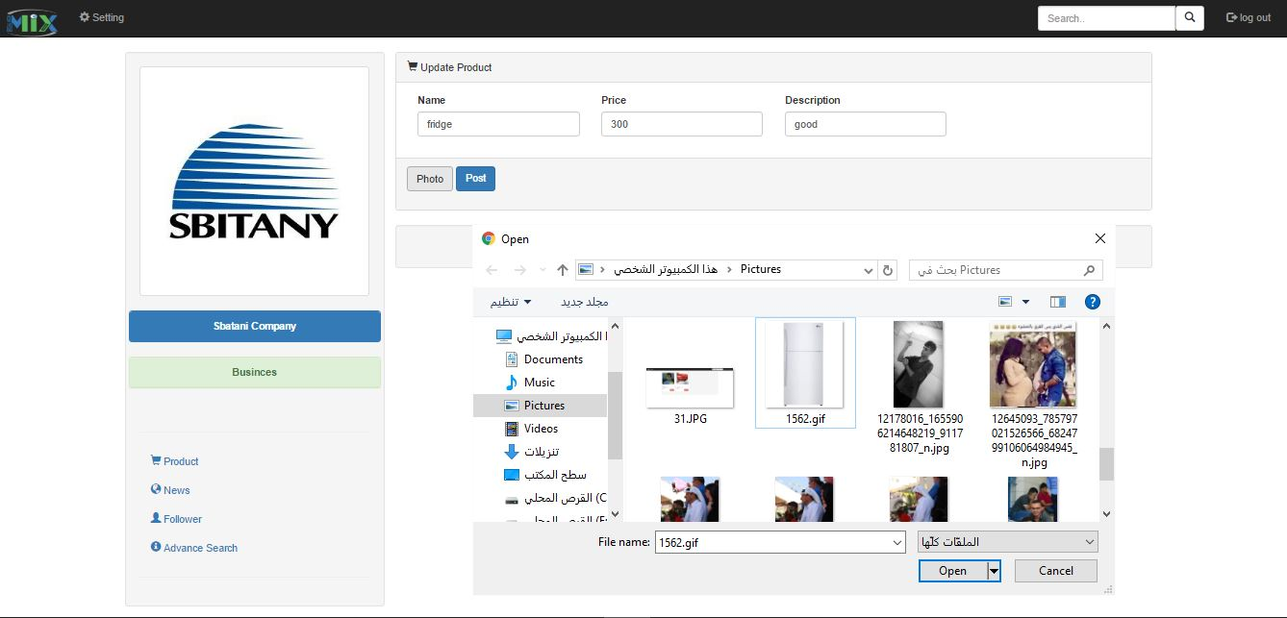
Mix in details

Slide 30
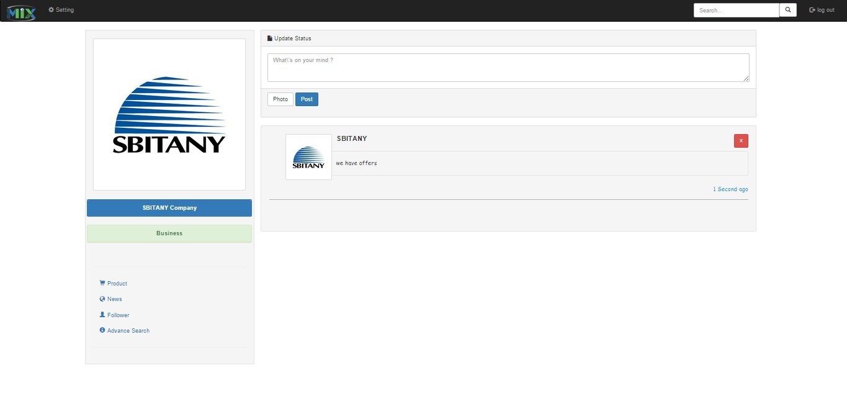
Mix in details

Slide 31
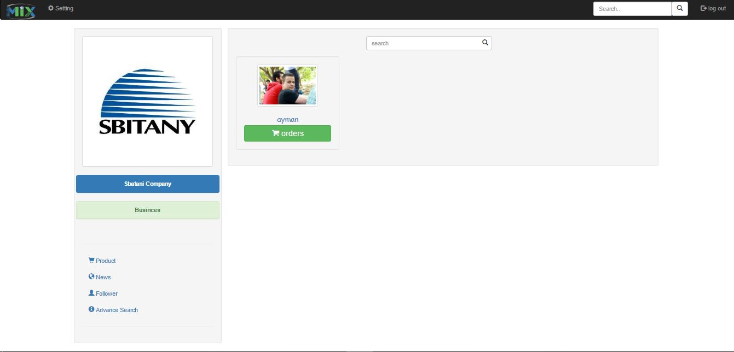
Mix in details

Slide 32
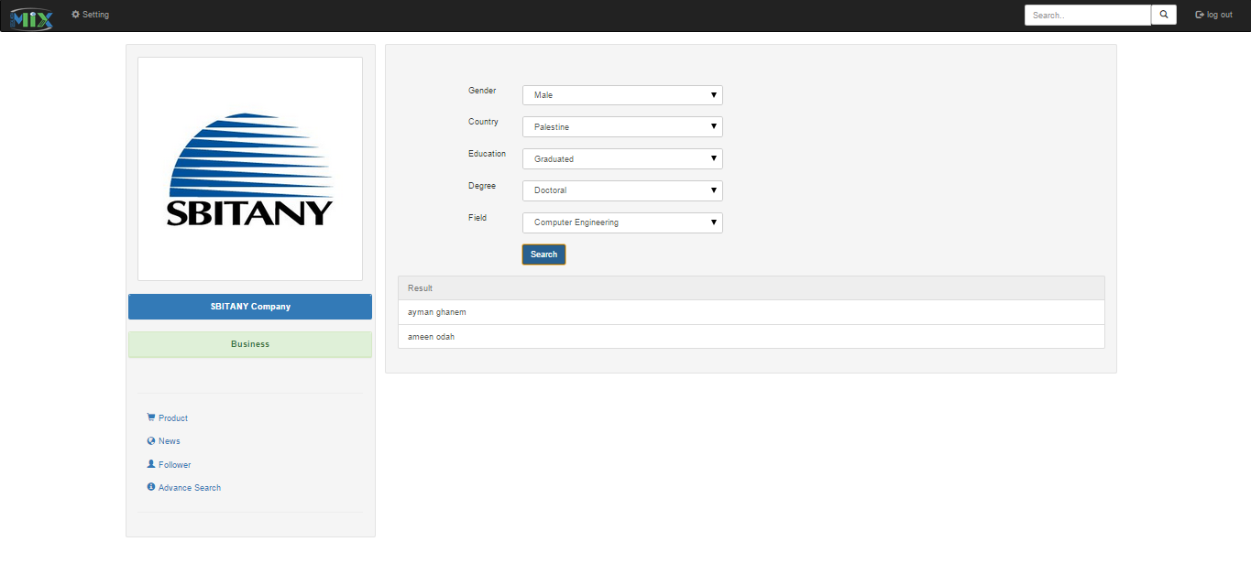
Mix in details

Slide 33
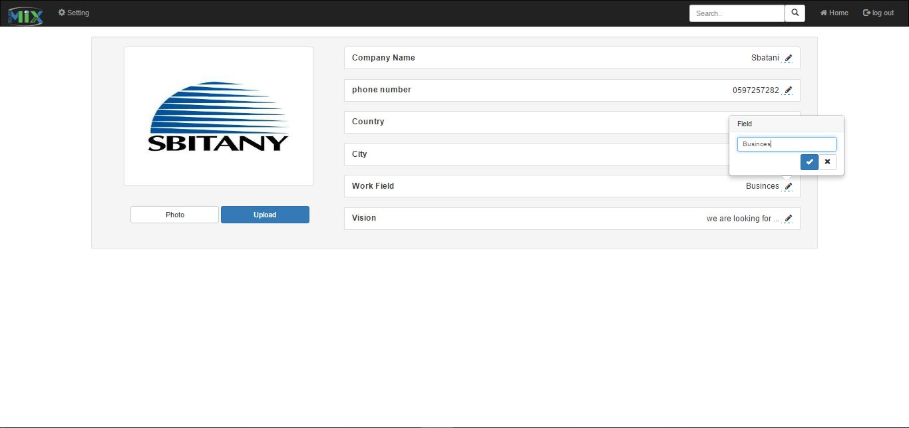
Mix in details

Slide 34
Future Work
Improvement message system between users and companies
Improve the e-commerce feature in the system

Slide 35
Conclusion

Slide 36
Thanks

