Slide 1

An-Najah National University
Faculty Of Engineering
Civil Engineering Department
Graduation Project 2
Analysis And Re-design Of Water Distribution Network and Design of Wastewater Collection System for Biddya
Prepared by: Amal Surakji
Haya Salameh
Noor Hinde
Under supervision of: Dr. Sameer Shadeed

Slide 2
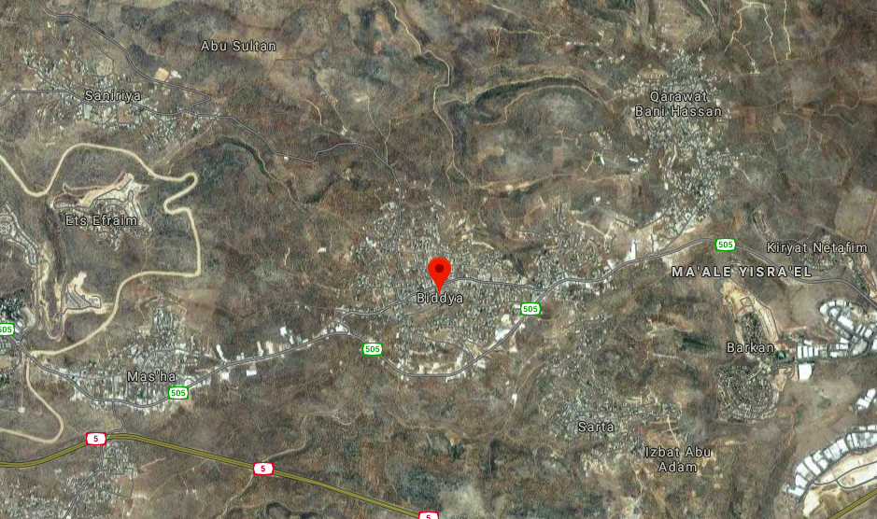
Study area: Biddya

Slide 3
Location: Biddya is a Palestinian town in the Salfit Governorate, located 32
.kilometers southwest of Nablus
Area: The total area is 13000 dunums.
Population: According to PCBS-2017, it had a population of 10451 capita.
Topography: The slops in the town area moderate slopes
min. elevation= 260 m
max. elevation= 400 m
Water service provider: Biddya municipality purchase water from mekarot company.
Main water network source: Biddy has one main tank , his capacity is 500 m³

Slide 4
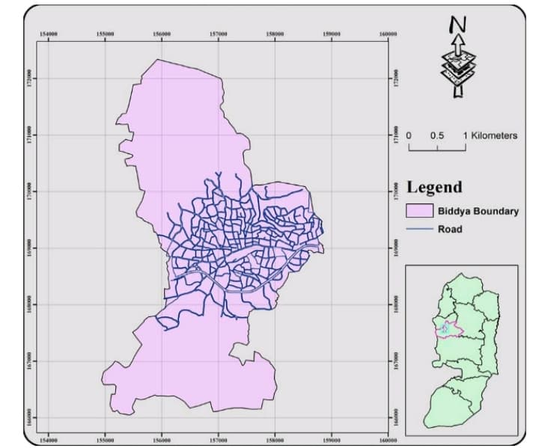

Slide 5
Our project includes :
1. Analysis of existing network
2. Re-design of existing network
3. Future analysis for the existing redesigned network
4. Future redesigned
5.Design of wastewater collection system
6.Cost estimate for wastewater collection system

Slide 6
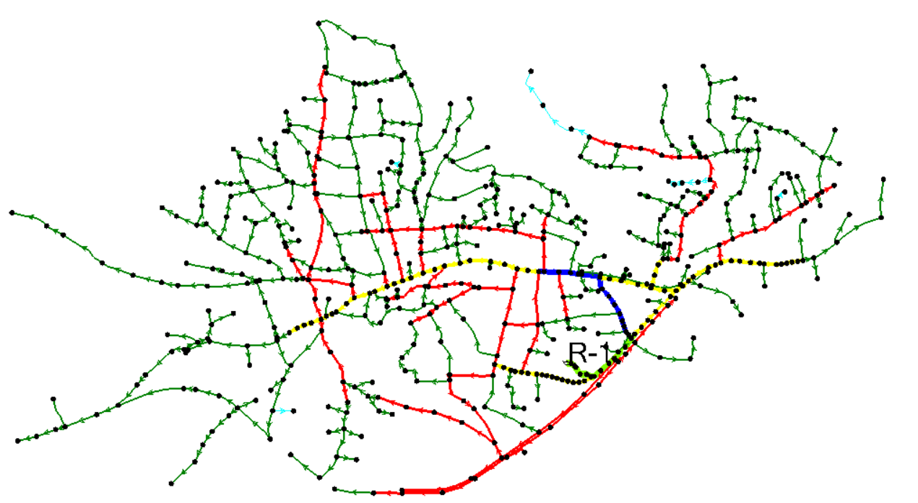
Analysis of existing network

Slide 7
Data collection:
. Shapefiles ( Building, contour, existing network, road network and demand area)
. The total consumption for the town in 2018= 1068.67 m³/d
. Total consumption of factors in 2018= 360 m³/d
. Total net consumption of the population in 2018= 708.67 m³/d
. Population in 2018= 10733 capita
. The average consumption per capita= 66.1 l/c.d
. Supply in 2018= 1473.68 m³/d
. Losses in 2018= 27.5%

Slide 8
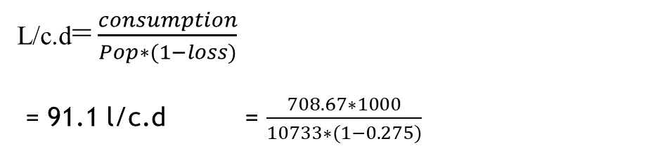
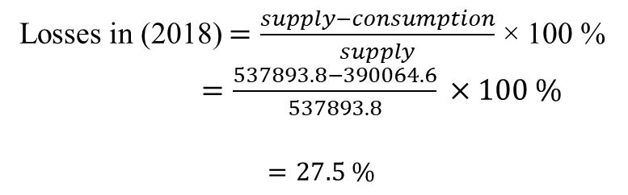
Data Calculations:
P = p (1 + r) ^{n}
Population in 2018 =10451(1 + 0.027)¹ = 10733 capita
r = 2.7%
L/c.d=$\frac{consumption}{Pop∗(1−loss)}$
= 91.1 l/c.d = $\frac{708.67∗1000}{10733∗(1−0.275)}$
Losses in (2018) $=\frac{supply−consumption}{supply}$ × 100 %
$=\frac{537893.8−390064.6}{537893.8} ×100 \%$
$=27.5 \%$

Slide 9
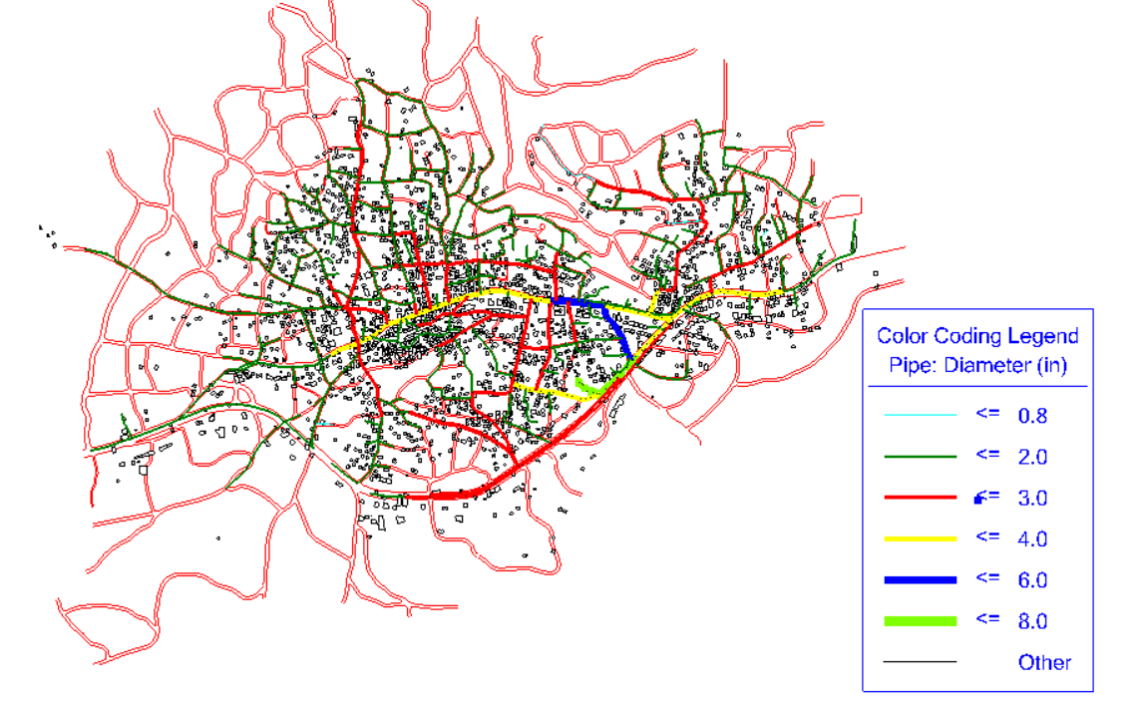
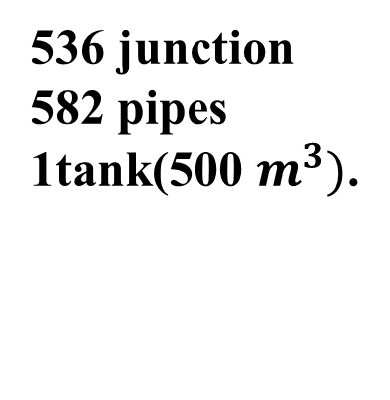
Modeling of network :
Obtained the network by called the Network AutoCAD shape that was got from the municipality file then draw the network by distribution the junction and drawing the pipes .
536 junction
582 pipes
1tank(500 $m^{3})$.

Slide 10
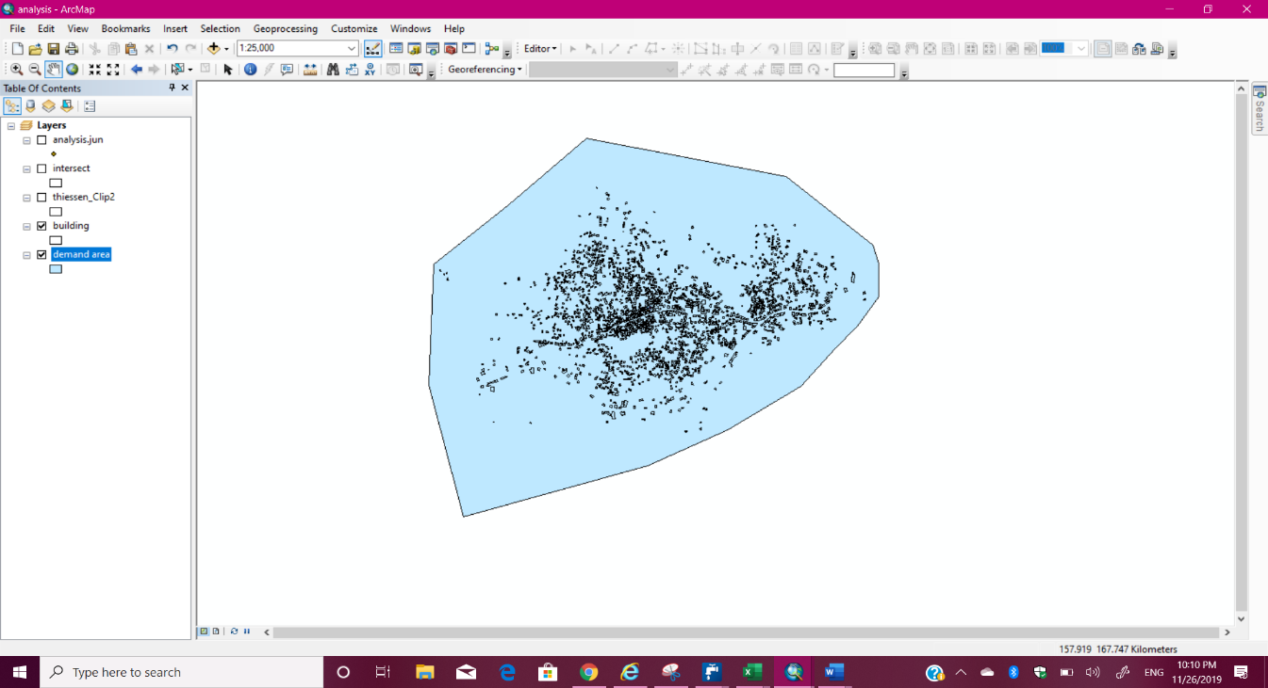
Demand Area:
By using GIS software, we draw the demand area.

Slide 11
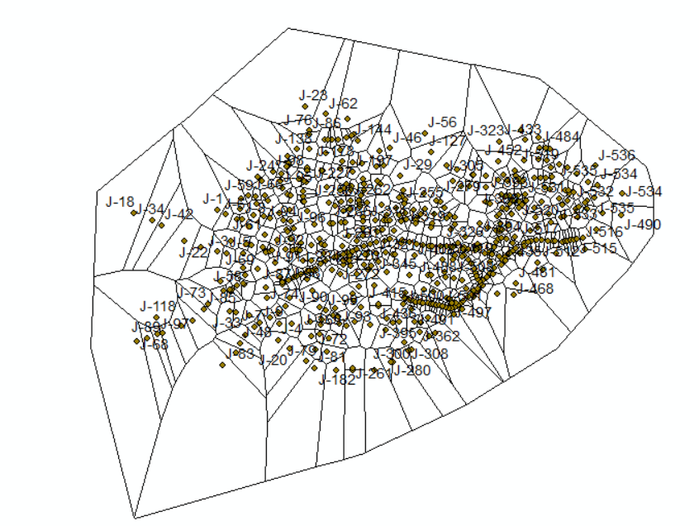
Demand calculations and distribution:
By using GIS program we calculated the surface area of the building that serve by each junction.
By using thiessen polygon in GIS

Slide 12
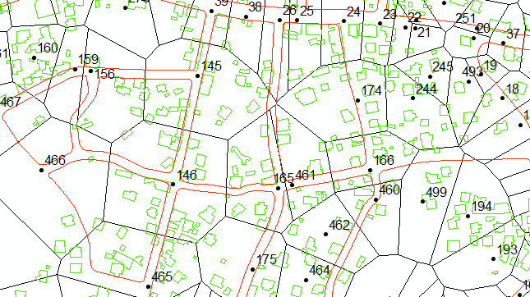
Demand calculations and distribution:
By using GIS program we calculated the surface area of the building that serve by each junction.

Slide 13
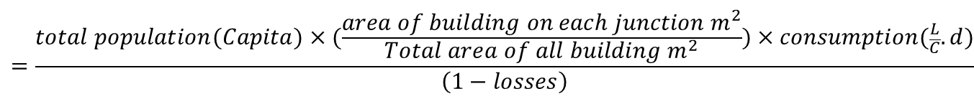
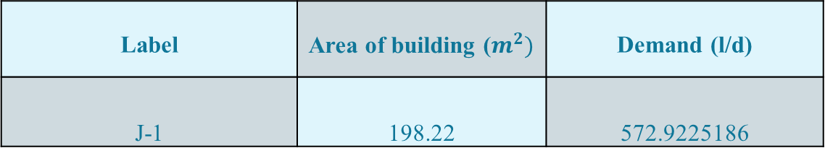
Demand calculations and distribution :
Demand on each junction (l/d)=
$$=\frac{total population(Capita)×(\frac{area of building on each junction m^{2}}{Total area of all building m^{2}})×consumption(\frac{L}{C}.d)}{\left(1−losses\right)}$$
Sample calculation:
$$=\frac{10733×(198.22/338291.75)×(91.1)}{\left(1−0.275\right)}=572.92 \frac{l}{d}$$
Label | Area of building ($m^{2})$ | Demand (l/d)
J-1 | 198.22 | 572.9225186

Slide 14
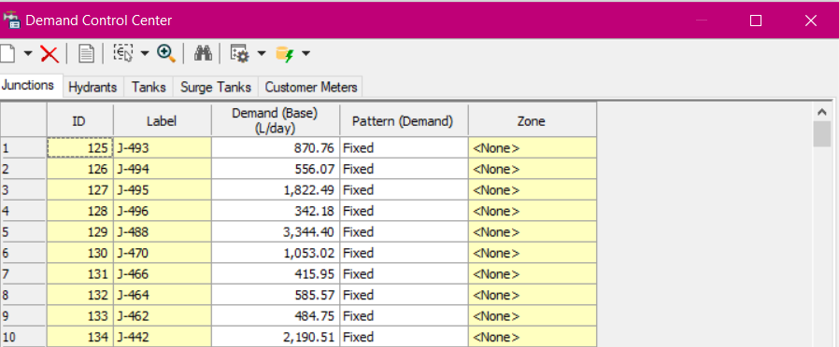
Demand calculations and distribution:
The demand calculated on the same formula for all junction , and entered on WaterCAD:
Using 1.8 as a maximum factor and 0.27 as a minimum factor , we get these results:

Slide 15
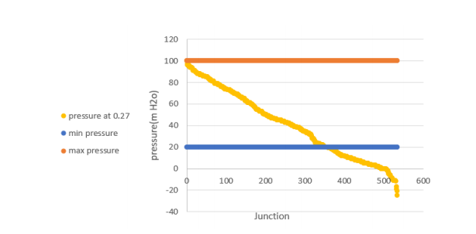
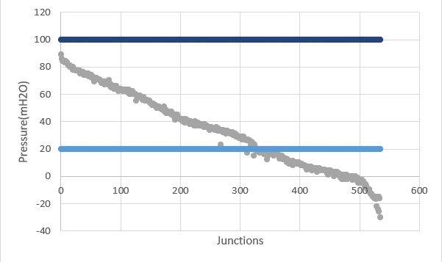
Results
Pressure at junction at min. peak factor
Pressure at junction at max. peak factor

Slide 16
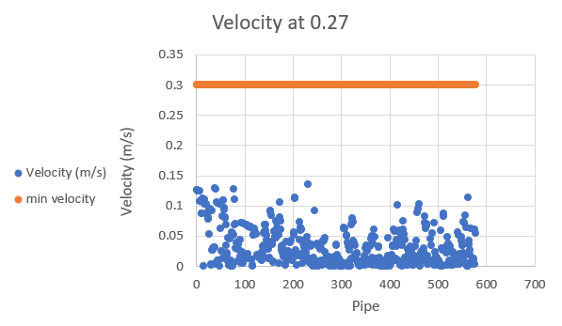
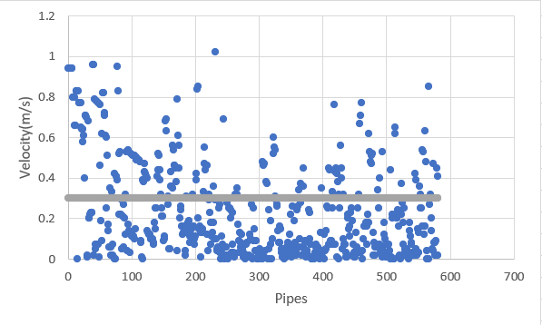
:Results
Velocity at min. peak factor
Velocity at max. peak factor

Slide 17
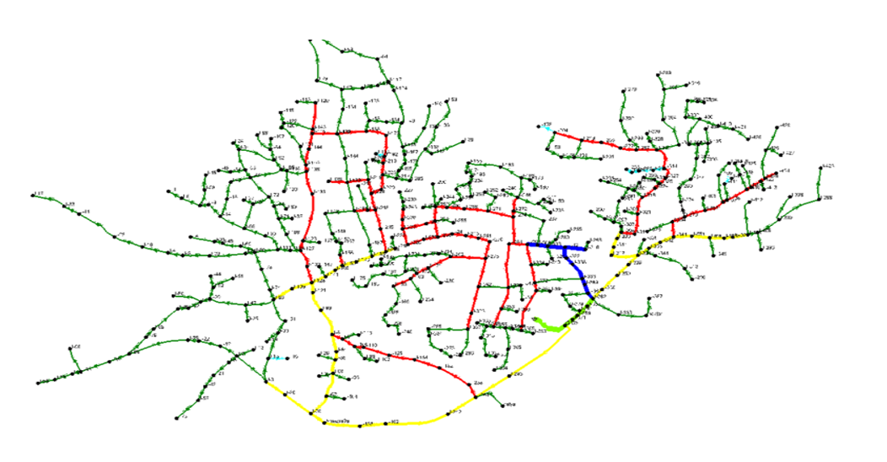
Re-design of existing network

Slide 18
Data collection:
. Shapefiles ( Building, contour, existing network, road network and demand area)
. The total consumption for the town in 2018= 1068.67 m³/d
. Total consumption of factors in 2018= 360 m³/d
. Total net consumption of the population in 2018= 708.67 m³/d
. Population in 2018= 10733 capita
. The average consumption per capita= 66.1 l/d
. Supply in 2018= 1473.68 m³/d
. Losses in 2018= 27.5%

Slide 19
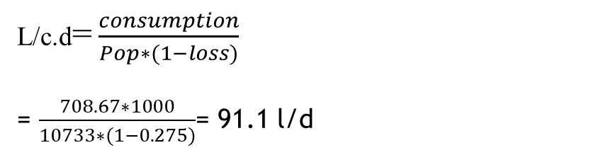
Data Calculations:
P = p (1 + r) ^{n}
Population in 2018 =10451(1 + 0.027)¹ = 10733 capita
r = 2.7%
L/c.d=$\frac{consumption}{Pop∗(1−loss)}$
= $\frac{708.67∗1000}{10733∗(1−0.275)}$= 91.1 l/d
Losses in (2018) $=\frac{supply−consumption}{supply}$ × 100 %
$=\frac{537893.8−390064.6}{537893.8} ×100 \%$
$=27.5 \%$

Slide 20
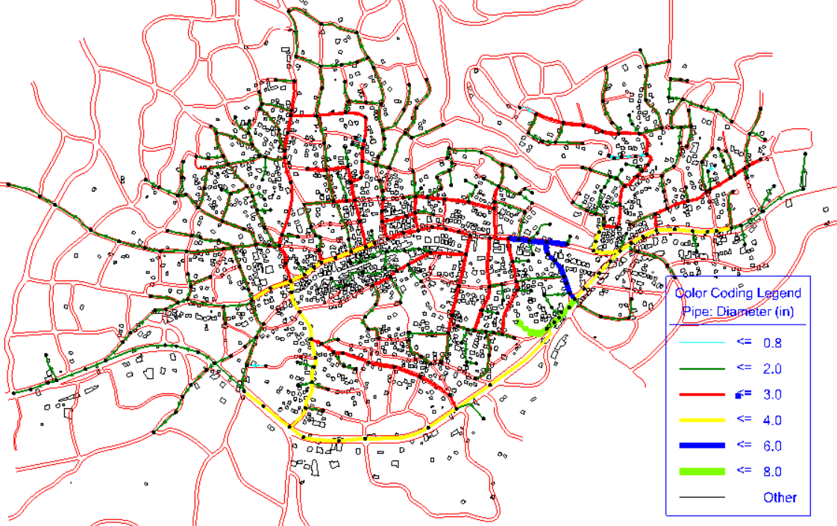

Redesigning of network :
By modifying the existing network , by adding and deleting junction ,pipes and changing in diameters and flow direction we got the next model :
433 junction
457 pipes
1tank(500$m^{3})$.

Slide 21
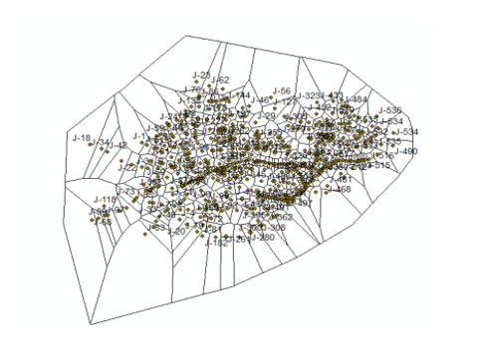
Demand distribution and calculation :
Calculating the surface area served by each junction using THIESSEN POLYGONS:

Slide 22
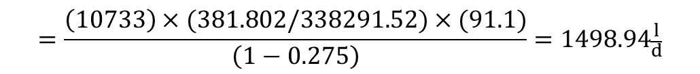
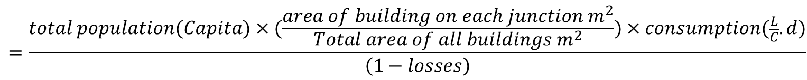
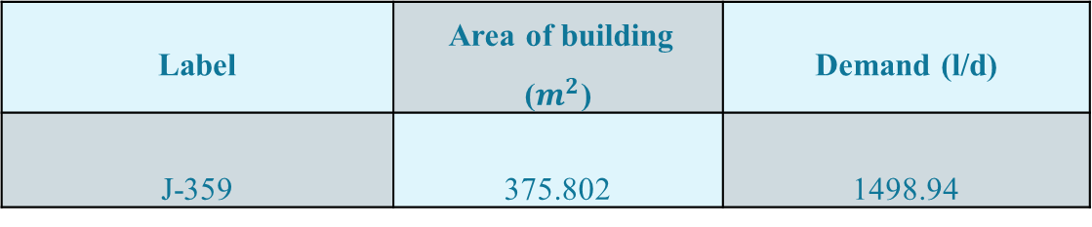
Demand calculations and distribution :
Demand on each junction (l/d)=
$$=\frac{total population(Capita)×(\frac{area of building on each junction m^{2}}{Total area of all buildings m^{2}})×consumption(\frac{L}{C}.d)}{\left(1−losses\right)}$$
Sample calculation:
$$=\frac{\left(10733\right)×(381.802/338291.52)×(91.1)}{\left(1−0.275\right)}=1498.94\frac{l}{d}$$
Label | Area of building ($m^{2}$) | Demand (l/d)
J-359 | 375.802 | 1498.94

Slide 23
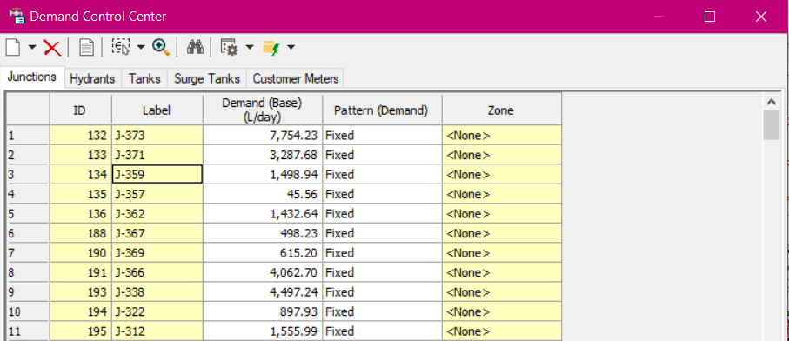
Demand calculations and distribution:
The demand calculated on the same formula for all junction, and entered on water CAD:
Using 1.8 as a maximum factor and 0.27 as a minimum factor, we get these results:

Slide 24
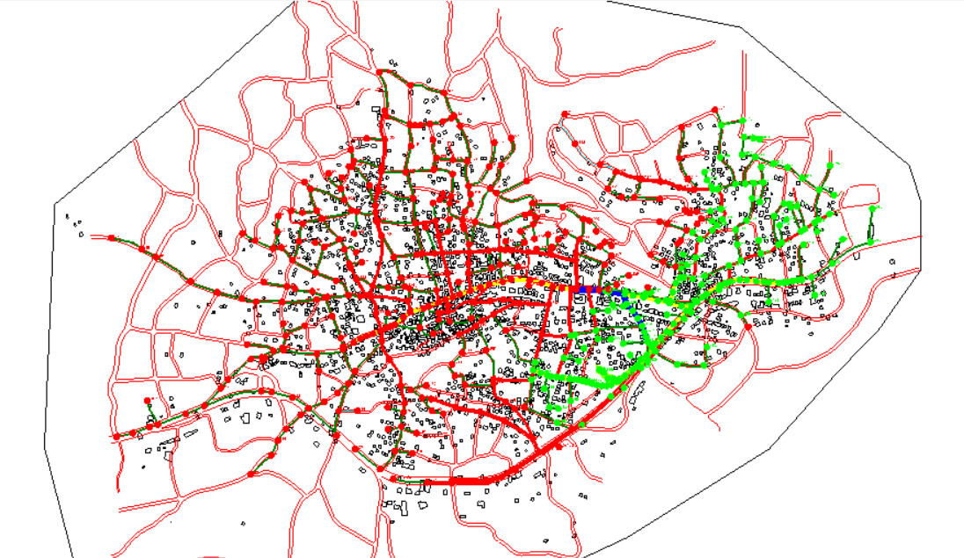
Redesign existing WDN

Slide 25
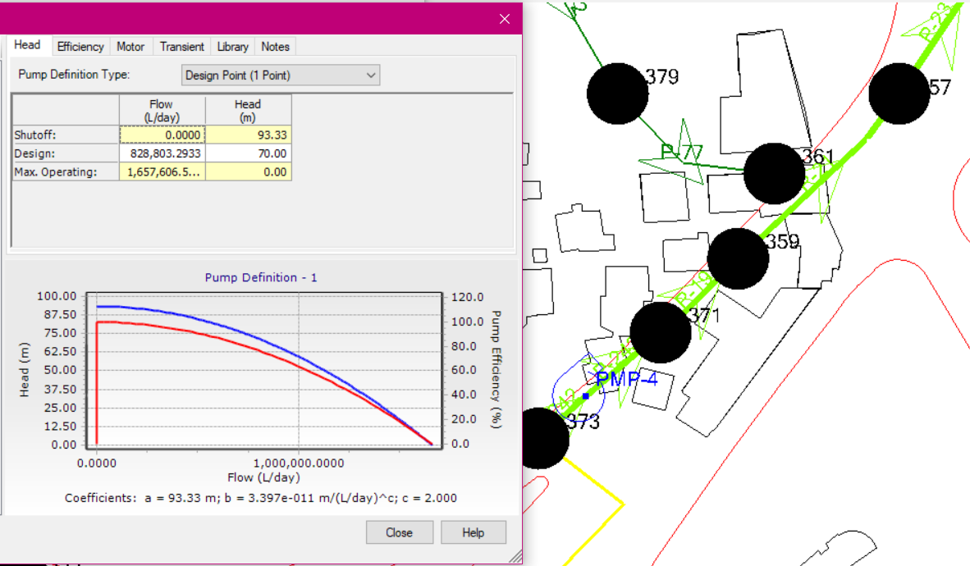
Adding pump to the network :

Slide 26
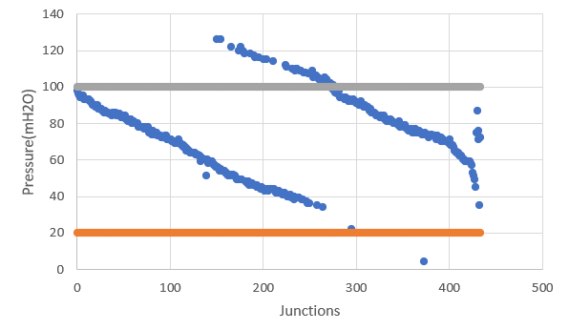
Pressure at junction at min. factor
For existing WDN (junction ID & pressure)
For Redesign existing WDN (junction ID & pressure)

Slide 27
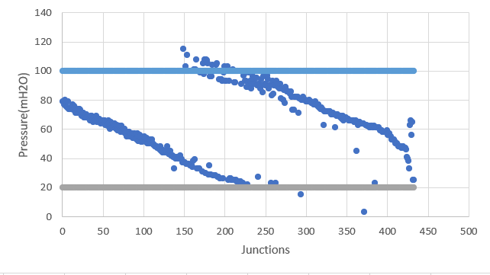
Pressure at junction at max. factor
For current WDN (junction ID & pressure)
For Redesign existing WDN (junction ID & pressure)

Slide 28
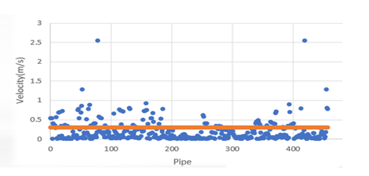
Velocity in pipes at max. factor
For current WDN (pipe ID & velocity)
For Redesign existing WDN (pipe ID & velocity)

Slide 29
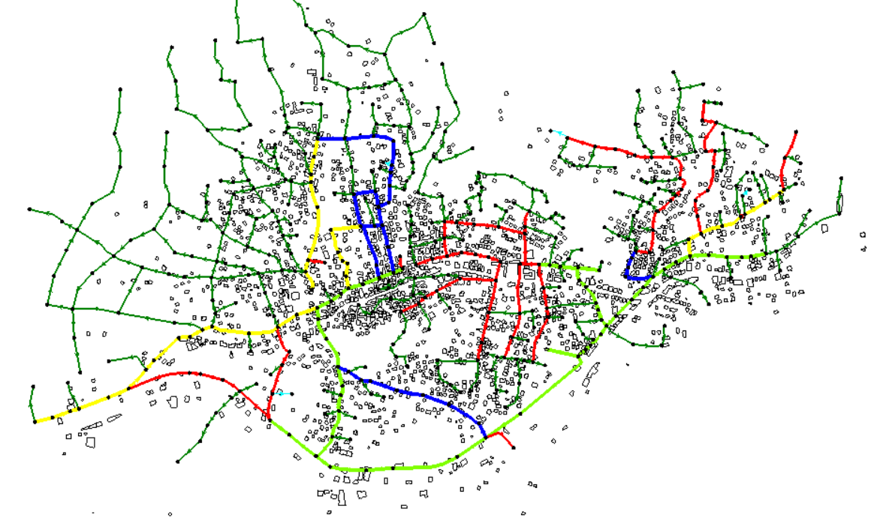
Future analysis for the existing redesigned network

Slide 30
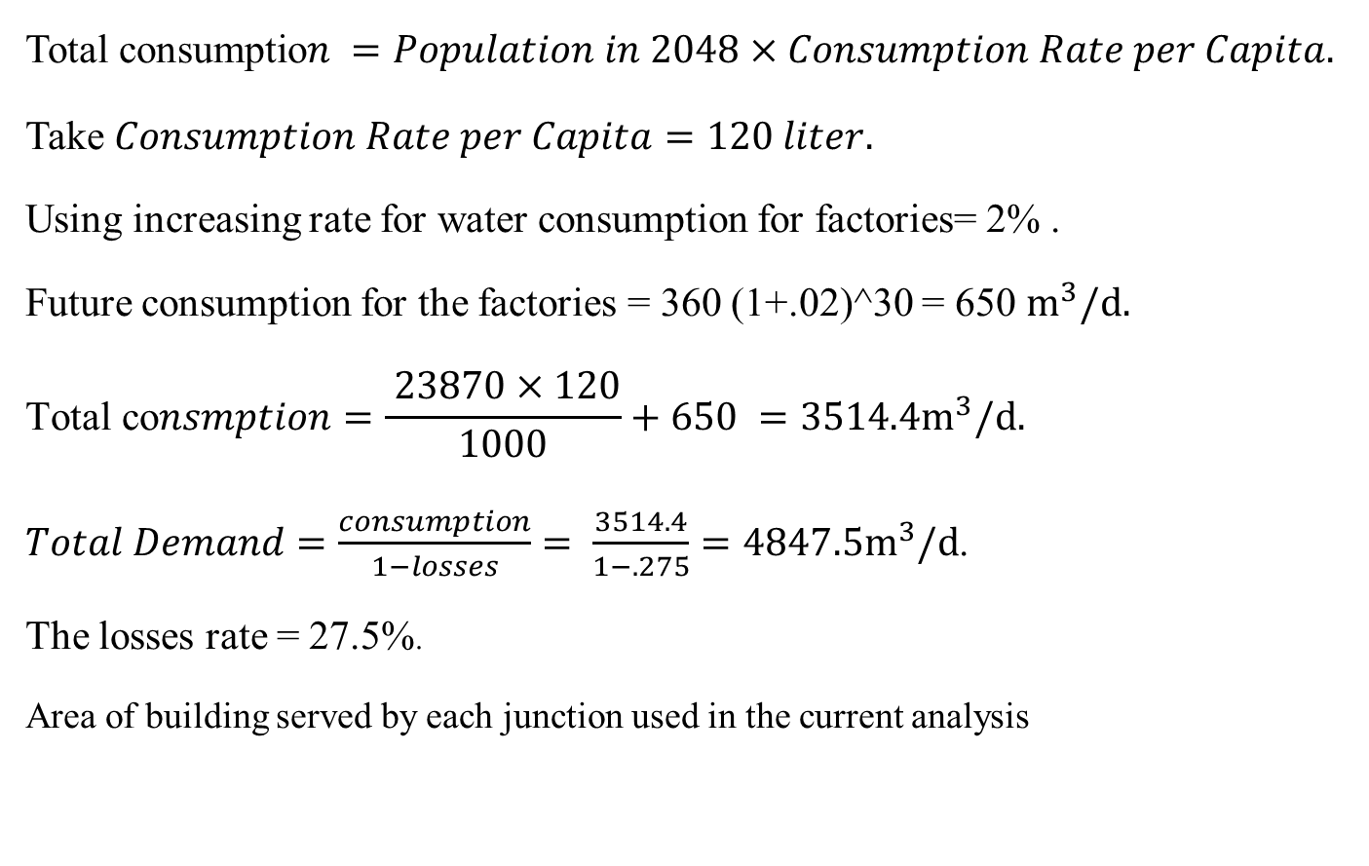
Data Collection:
$$\text{Total} \text{consumptio}n =Population in 2048×Consumption Rate per Capita.$$
Take $Consumption Rate per Capita=120 liter.$
Using increasing rate for water consumption for factories= 2% .
Future consumption for the factories = 360 (1+.02)^30 = 650 $m^{3}/d.$
$$\text{To}\text{tal} \text{co}nsmption=\frac{ 23870×120}{1000}+650 =3514.4m^{3}/d.$$
$Total Demand=\frac{consumption}{1−losses}= \frac{3514.4}{1−.275}=4847.5m^{3}/d$.
The losses rate = 27.5%.
Area of building served by each junction used in the current analysis

Slide 31
Demand calculation and distribution after 30 years:
. For the distribution of the future population we assumed that the density of the building in middle areas ( main street area ) of the town will stay the same (fixed density areas)
. The expansion in the building will be in the areas which its density is smaller than the middle areas (unfixed density areas)
. The increased population will uniformly distribute in the unfixed density area

Slide 32
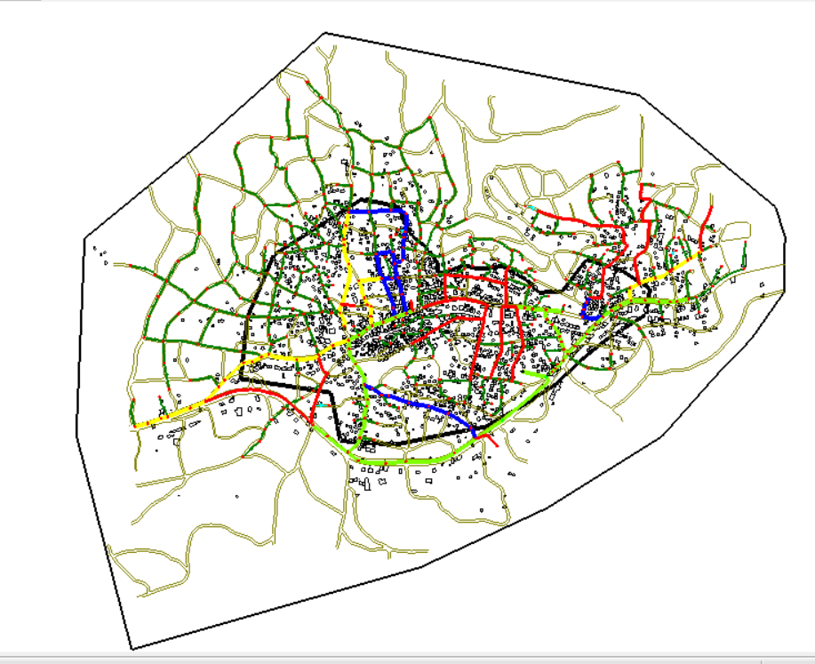
Demand calculation and distribution after 30 years:

Slide 33
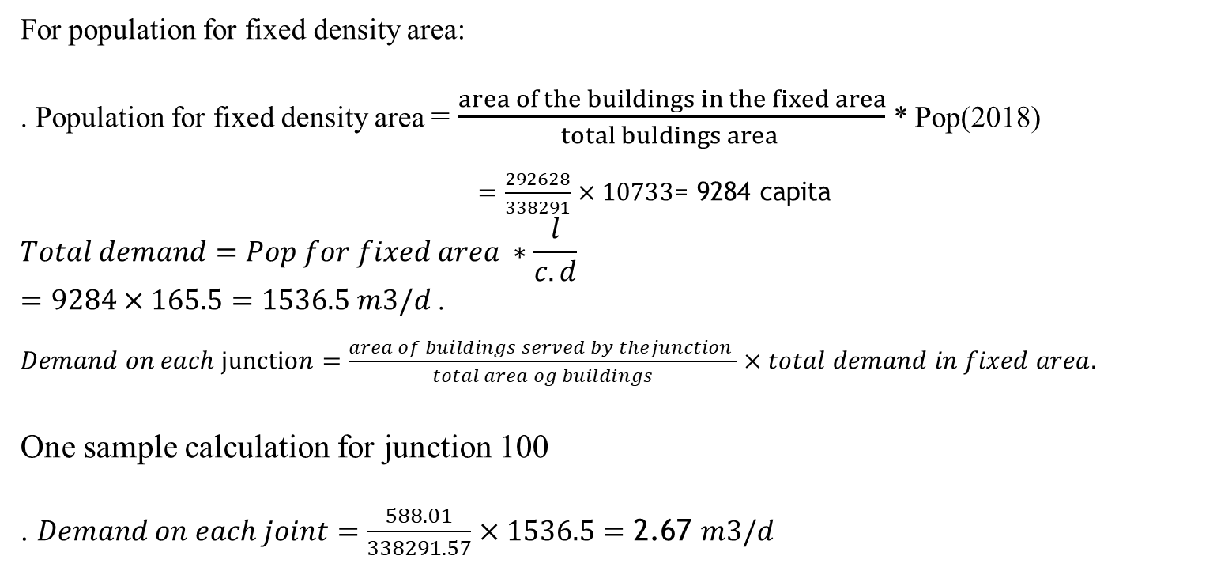
Demand calculation and distribution after 30 years:
For population for fixed density area:
. Population for fixed density area = $\frac{area of the buildings in the fixed area}{total buldings area }$ * Pop(2018)
$=\frac{292628}{338291}×10733$= 9284 capita
$$Total demand=Pop for fixed area ∗\frac{l}{c.d}$$
$=9284×165.5=1536.5 m3/d$ .
$Demand on each junction=\frac{area of buildings served by thejunction }{total area og buildings}×total demand in fixed area.$
One sample calculation for junction 100
. $Demand on each joint=\frac{588.01}{338291.57}×1536.5=\text{2}\text{.}\text{67 }m3/d$
Label | Area (m²) | Area fraction | Demand (l/d)
J-100 | 588.01 | 0.00174 | 2673.5
J-101 | 522.73 | 0.00155 | 2381.6
J-102 | 830.73 | 0.00246 | 3779.8

Slide 34
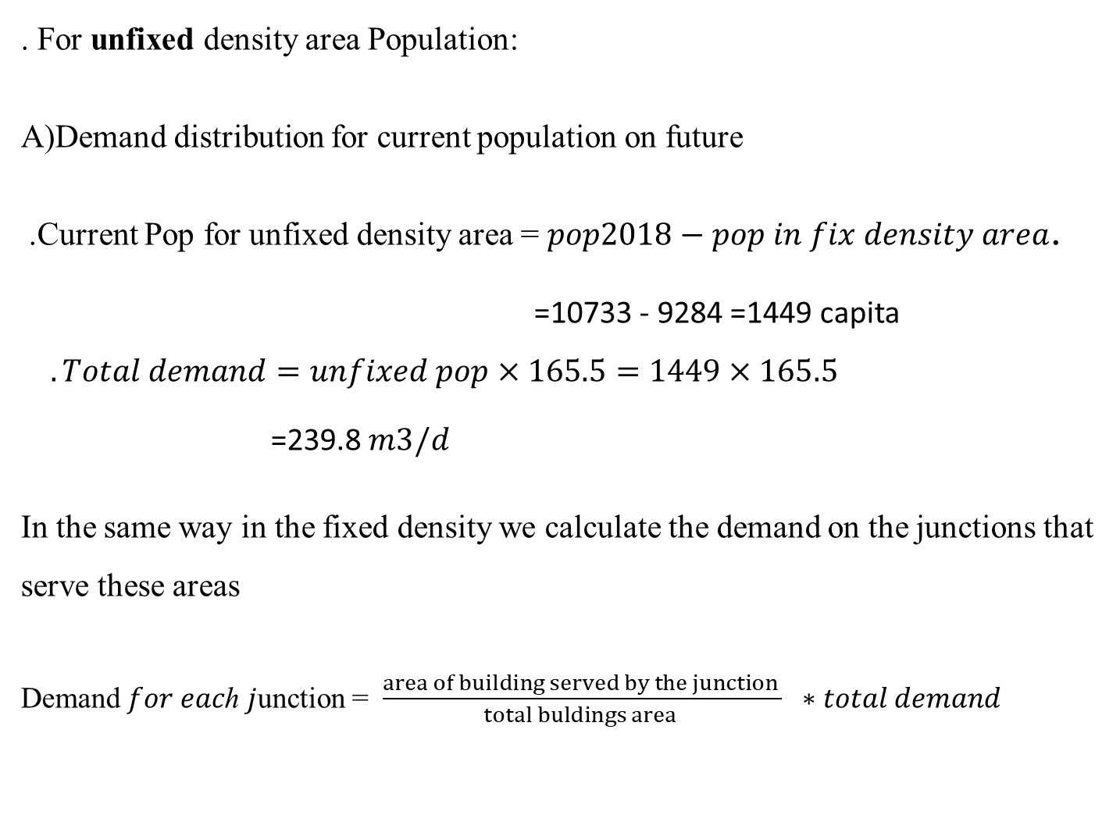
Demand calculation and distribution after 30 years:
. For unfixed density area Population:
A)Demand distribution for current population on future
.Current Pop for unfixed density area = $pop2018−pop in fix density area$.
=10733 - 9284 =1449 capita $.Total demand=unfixed pop×165.5=1449×165.5$
=239.8$m3/d$
In the same way in the fixed density we calculate the demand on the junctions that serve these areas
Demand 𝑓𝑜𝑟 𝑒𝑎𝑐ℎ 𝑗unction = $\frac{area of building served by the junction }{total buldings area } ∗total demand$

Slide 35
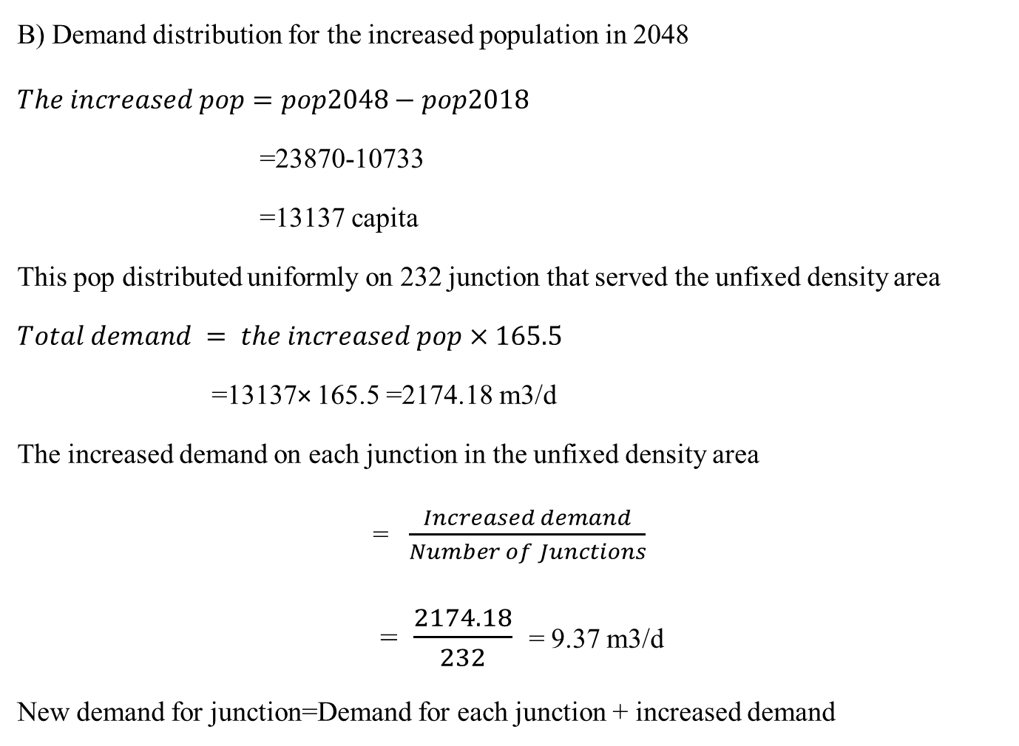
Demand calculation and distribution after 30 years:
B) Demand distribution for the increased population in 2048
$$The increased pop=pop2048−pop2018$$
=23870-10733
=13137 capita
This pop distributed uniformly on 232 junction that served the unfixed density area
$$Total demand = the increased pop×165.5$$
=13137× 165.5 =2174.18 m3/d
The increased demand on each junction in the unfixed density area
= $\frac{Increased demand}{Number of Junctions}$
= $\frac{2174.18}{232}$= 9.37 m3/d
New demand for junction=Demand for each junction + increased demand

Slide 36
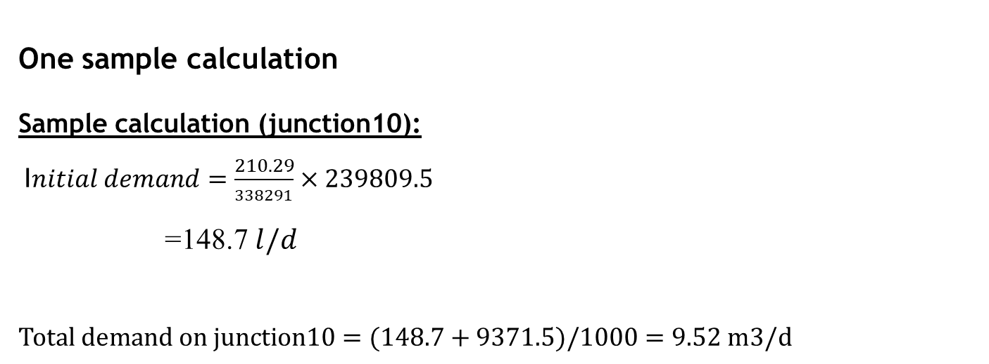
One sample calculation
Sample calculation (junction10):
I$nitial demand=\frac{210.29}{338291}×239809.5$
=148.7 $l/d$
$$Total demand on junction10=(148.7+9371.5)/1000=9.52 m3/d$$
Label | Area (m²) | Area fraction | Demand(l/d)
J-10 | 210.29 | 0.00062 | 9520.2
J-11 | 737.17 | 0.00218 | 98943.3
J-12 | 634.46 | 0.00188 | 9822.3
J-13 | 669.34 | 0.00198 | 9846.3

Slide 37
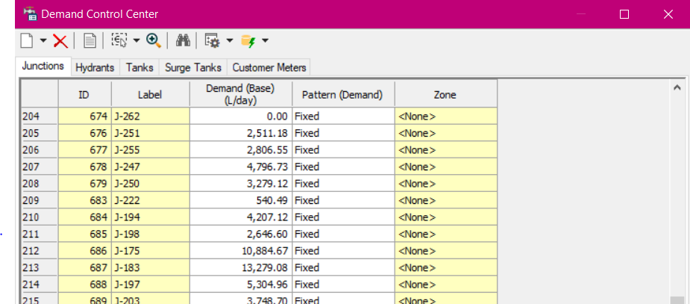
Demand calculations and distribution :
The demand calculated on the same formula for all junction , and entered on water CAD:
Using 1.8 as a maximum factor and 0.27 as a minimum factor , we get these results:

Slide 38
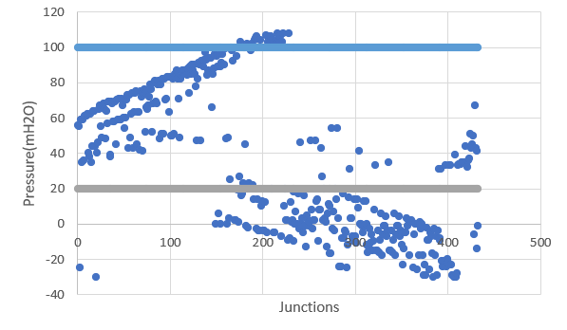
Result:
After 30 year
Pressure at junction at max. peak factor

Slide 39
Future redesign
After redesigning the existing network and check it on the future demand, the network did not bear the excess flow ,so we redesign the future situation as in the figure we change the diameter of some pipes.

Slide 40
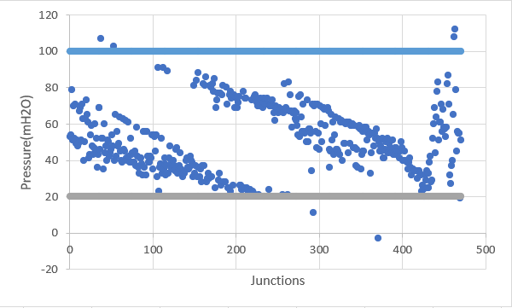
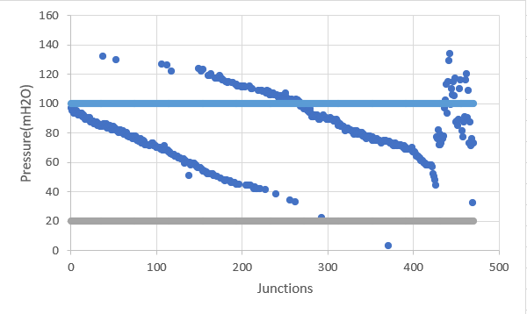
Results:
After 30 years
Pressure at junction at max. peak factor
Pressure at junction at min. peak factor

Slide 41
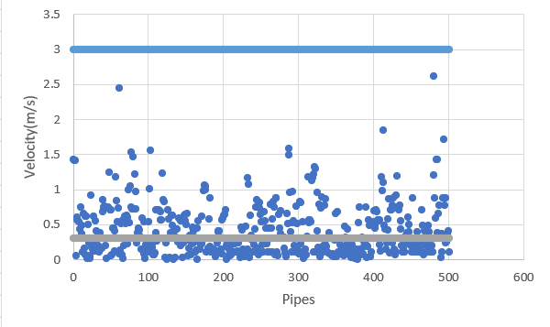
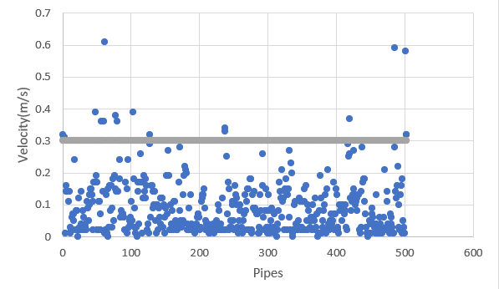
Velocity at pipes at max. peak factor
Velocity at pipes at min. peak factor

Slide 42
Design of wastewater collection system

Slide 43
Design waste water collection network
-Biddya doesn’t have wastewater network.
-The terrain of the town allows to use gravity system, to let the wastewater goes downwards.
-The contour line of the town shows that there are 3 lowest points.
So, it is recommended to locate the outfalls in these points.
-SewerCAD software will be used to design the wastewater networks

Slide 44
Design wastewater collection network
The assumption that will considered in the design is: -
Design period 30years
Future Population = 23870 capita
120 l/c. d water consumption
80% of produced waste water from consumed water
20% infiltration
Peak factor calculated by (PF =14P^{-1/6})
The maximum distance between adjacent manholes is 50m, depends on the direction, slope and pipe size
PVC circular pipes

Slide 45
Design waste water collection network
The constraints for the design of WWCS are:
Velocity between (0.6 – 3) m/s
Cover between (1 – 5) m
Slope between (1 – 12) %

Slide 46
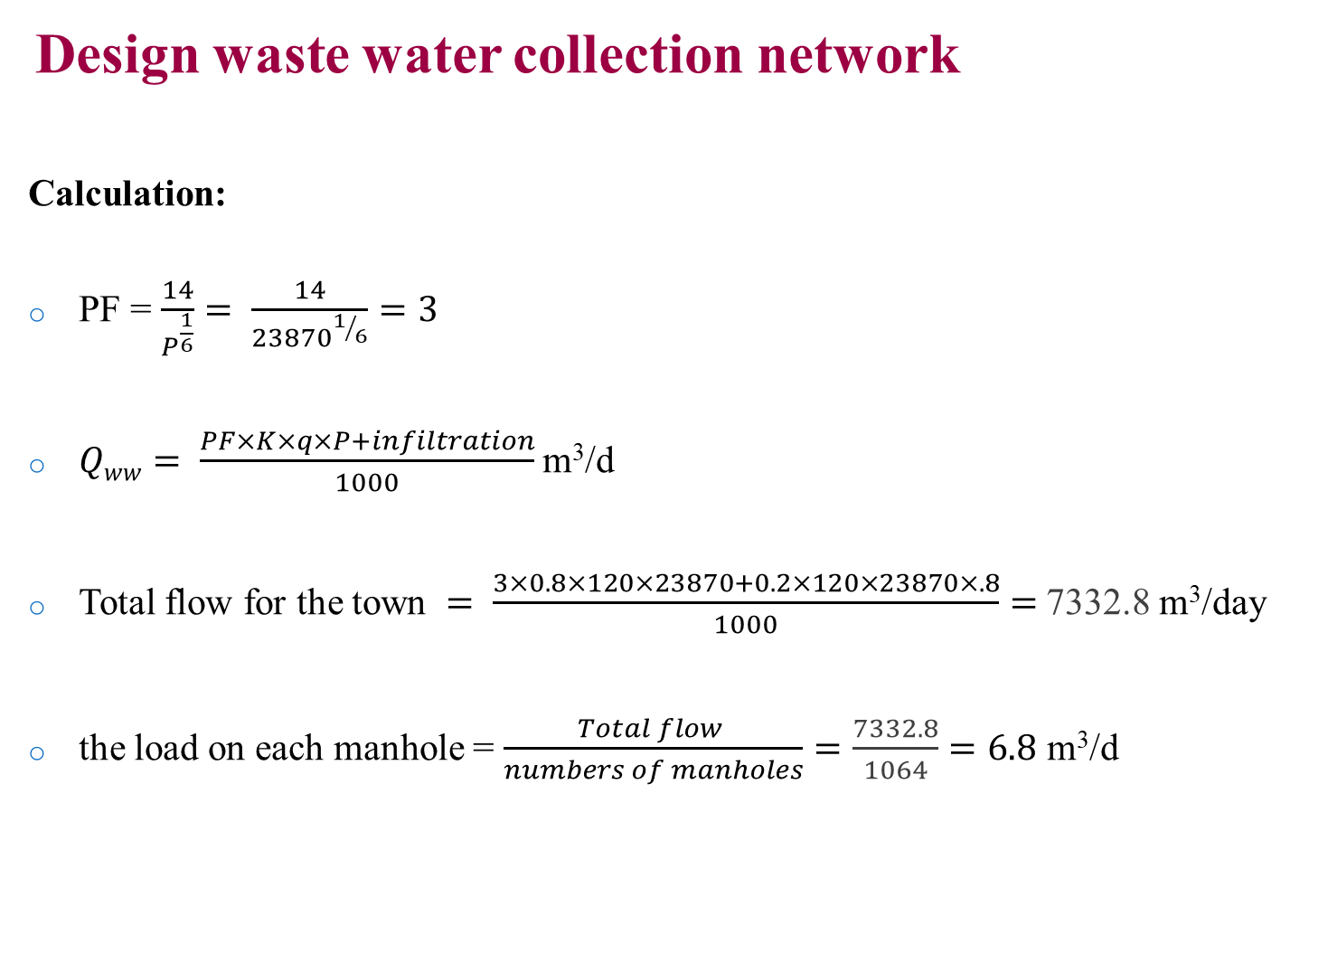
Design waste water collection network
Calculation:
PF = $\frac{14}{P^{\frac{1}{6}}}= \frac{14}{{23870}^{1/6}}=3$
$Qww= \frac{PF×K×q×P+infiltration}{1000}$m³/d
Total flow for the town $= \frac{3×0.8×120×23870+0.2×120×23870×.8}{1000}=$7332.8 m³/day
the load on each manhole = $\frac{Total flow }{numbers of manholes}=\frac{7332.8}{1064}=6.8$ m³/d

Slide 47
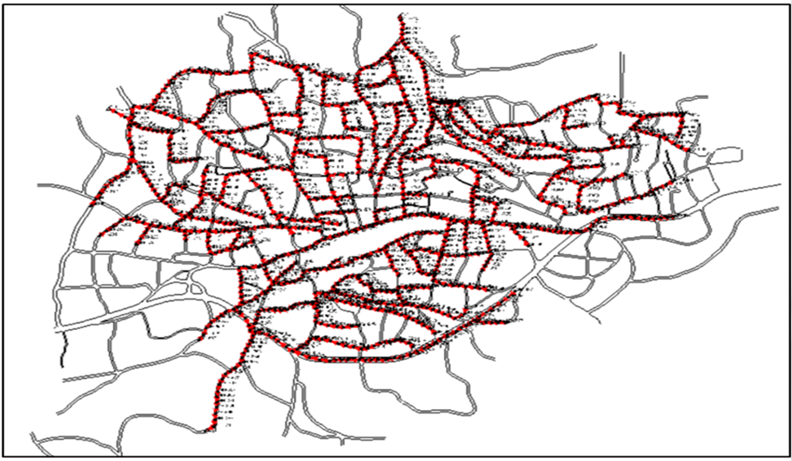
Design waste water collection network

Slide 48
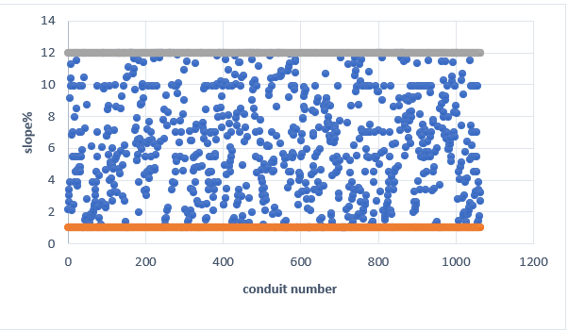
Result of Design WWCN
*Slope

Slide 49
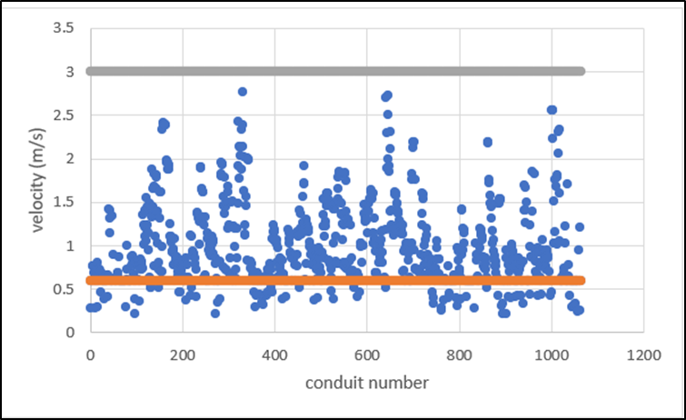
Result of Design WWCN
*Velocity

Slide 50
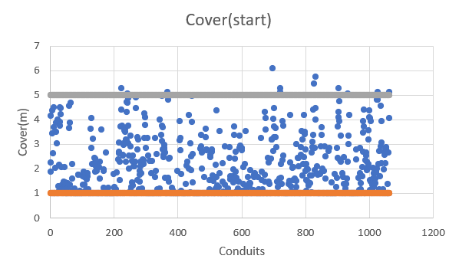
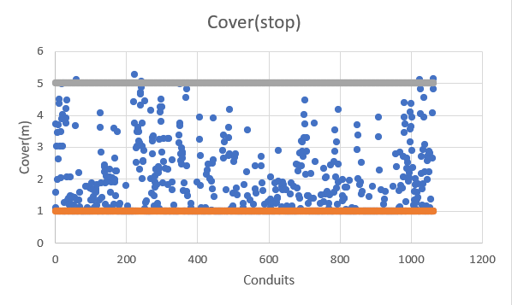
Result of Design WWCN
*Cover

Slide 51

Profiles
Some profile section and their location on the network

Slide 52

Result of Design WWCN

Slide 53

Result of Design WWCN

Slide 54

Result of Design WWCN

Slide 55

Result of Design WWCN
All the diameters in the network are 8 in

Slide 56
Cost estimate for WWCS
to estimate the total cost of network, 3 main parts should be considered:
Excavation and filling cost
Conduits cost
Manholes cost

Slide 57

Cost estimate for WWCN
-Conduits cost(8in) = 15 x 33869.2= 508038 NIS
-excavation of pipes tracks and filling = 60 x33869.2 = 2032152 NIS
-Manholes = 900 x 1064 =957600 NIS
-Total cost = 3497790 NIS

Slide 58

Problems that was solved
-Problem of the Hard and the quick change in topography and slops.
solution:
Changing the direction of the flow and modifying the distance between manholes.
(red color means cover is out of range and green means cover is in range).

Slide 59


Problems that was solved
Adding more than one outfall

Slide 60

Problems that was solved

Slide 61
Discussion And Conclusion
In WDN after the Hydraulic analysis and comparing the results with the specifications the water distribution network can served Biddya town until 2048 generally without any Hydraulics problems.
In WWCN the results are very good for covers and it is not good for velocities.
Because of the small velocity in some conduits in the WWCN should flushed at least one in the year because the small velocity makes depositions in the conduits.

Slide 62
Thank you

