Slide 1
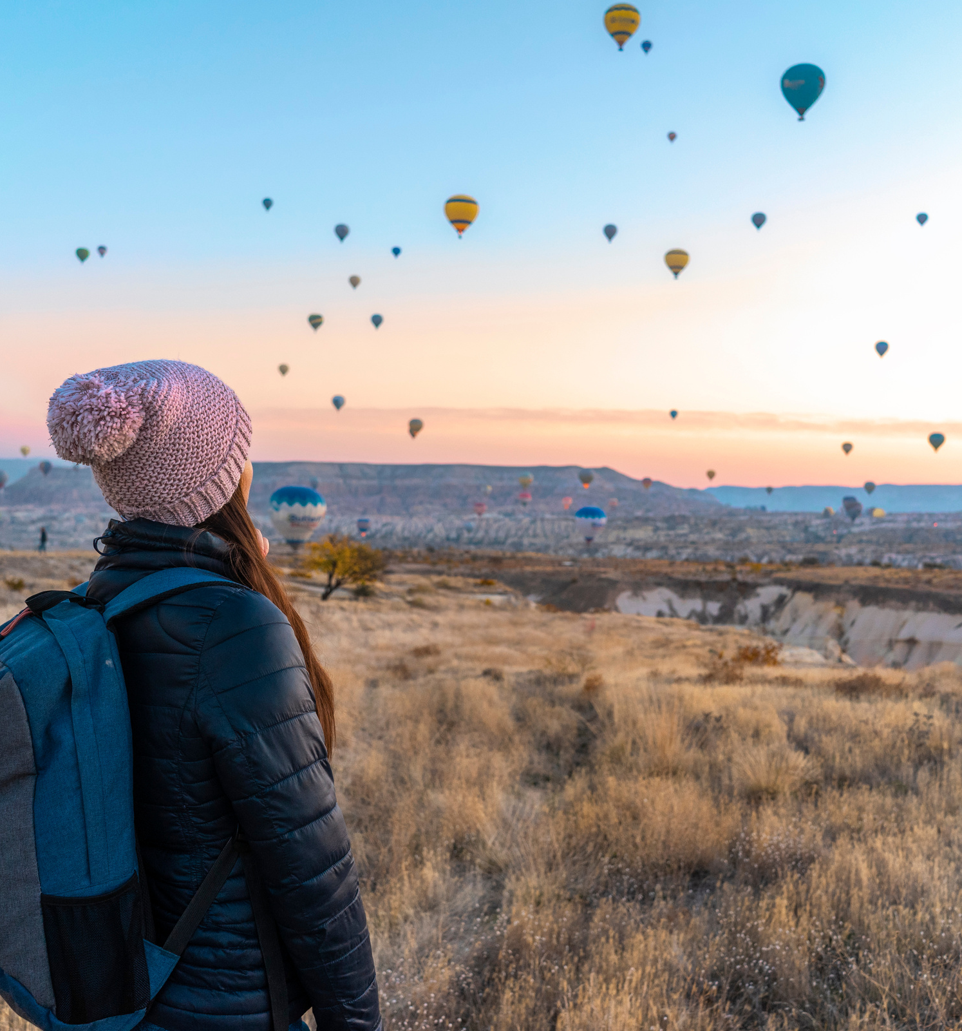
Aventura
liana al- nabulsi
Tala shakhsher
The perfect match palestine

Slide 2

We created a website called Aventura by using “wix platform”. This site help tourists from outside Palestine also the resident in Palestine to know about some places in Palestine also we offer trips to all of west bank so they can book a trip with us and we have online store contains Some handmade Palestinian traditional products.

Slide 3
Why would user use our site?
We provide distinguished services:
1-The existence of the Expert System feature that analyzes the user’s directions and advises him on the appropriate trip
2- What matters most to the customer is the price, and we have taken into account the transparency of prices (the price is at hand)
3- The offers that we offer to the members

Slide 4
Why would user use our site?
4 - Everything related to travelers and products in one destination
5- An additional forum feature that makes transparency between the customer and the people so that they can hear about us from each other

Slide 5







Tools we used

