Slide 1
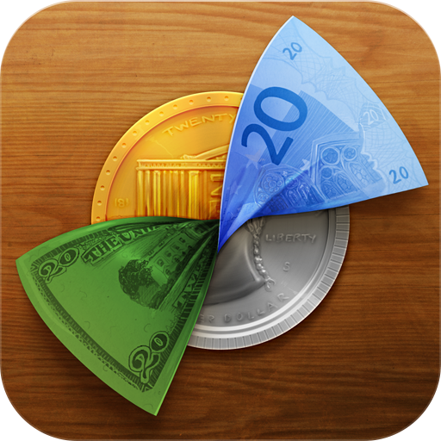
Graduation Project
Money Reader
Prepared By :
Hulwa Amjad Rudab Naser
Supervisor :
Dr. Hanal abu zant Dr Haya Sammaneh

Slide 2
Outline
What is Money Reader?
Motivation, objectives.
Implementation.
Programming techniques.
Future Work.
Demo.

Slide 3
Outline
What is Money Reader ?
Motivation, objectives.
Implementation.
Programming techniques.
Future Work.
Demo.

Slide 4
What is MoneyReader ?
Android Application that help users identifying different currencies.
Allow visually impaired people to recognize currencies using voice system .
Currency conversion feature to convert between different currencies.

Slide 5
Outline
What is MoneyReader ?
Motivation, objectives.
Implementation.
Programming techniques.
Future Work.
Demo.

Slide 6
Motivation
High percentage of the visually impaired world-wide and in Palestine.
The Evolution of tourism
  more difficult for people to deal with currencies for each country and do conversion between them.

Slide 7
Objectives
Our application helps the ordinary and visually impaired people in three ways:
Recognize the Bill by taking an image for it.
Speaks out the value of the Bill.
currency conversion.

Slide 8
Outline
What is Money Reader?
Motivation, objectives.
Implementation.
Programming techniques.
Future Work.
Demo.

Slide 9
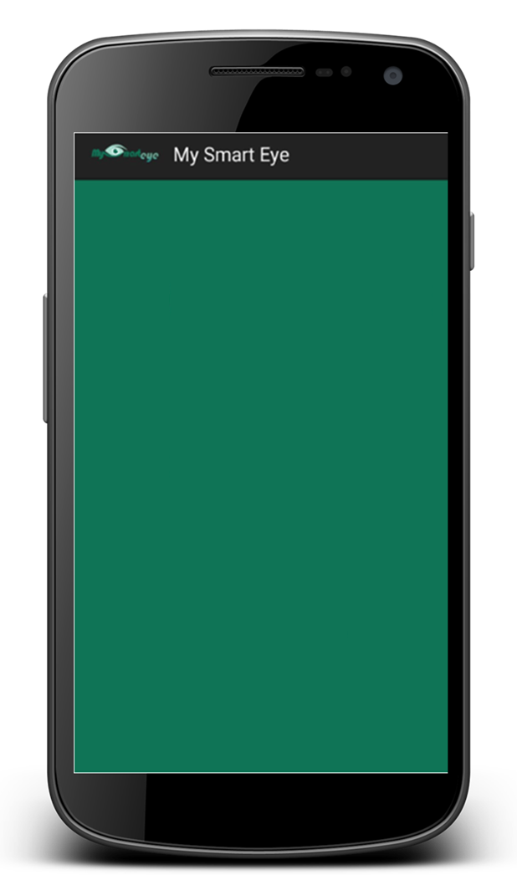
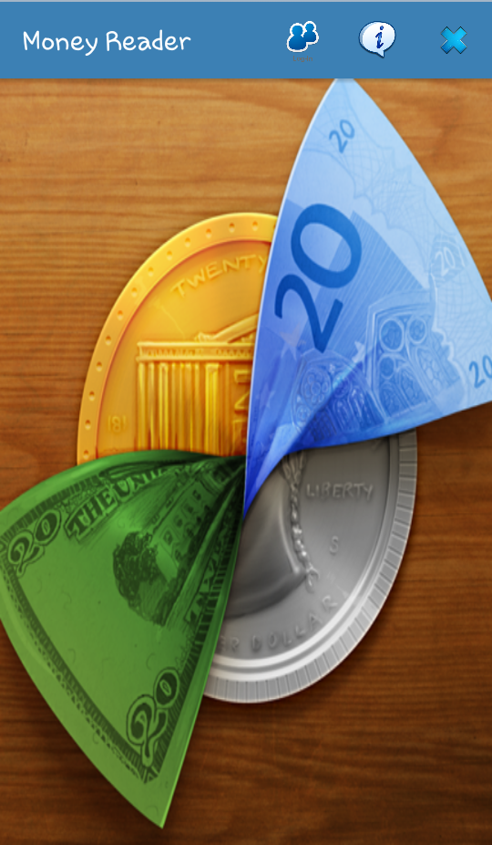
MoneyReader main page

Slide 10
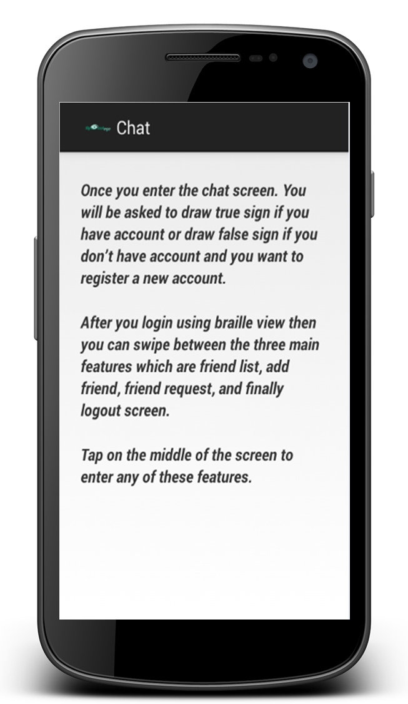
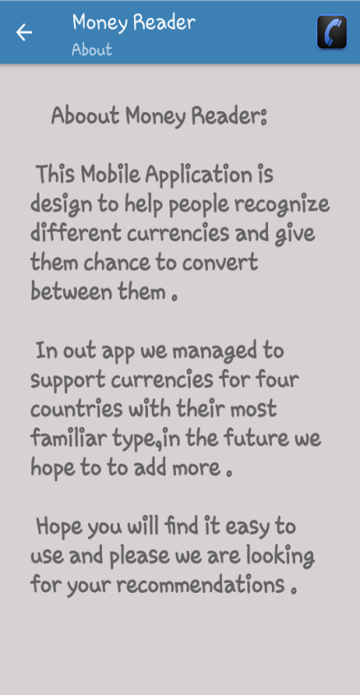
About
It provides a description about application and services that support for users.

Slide 11
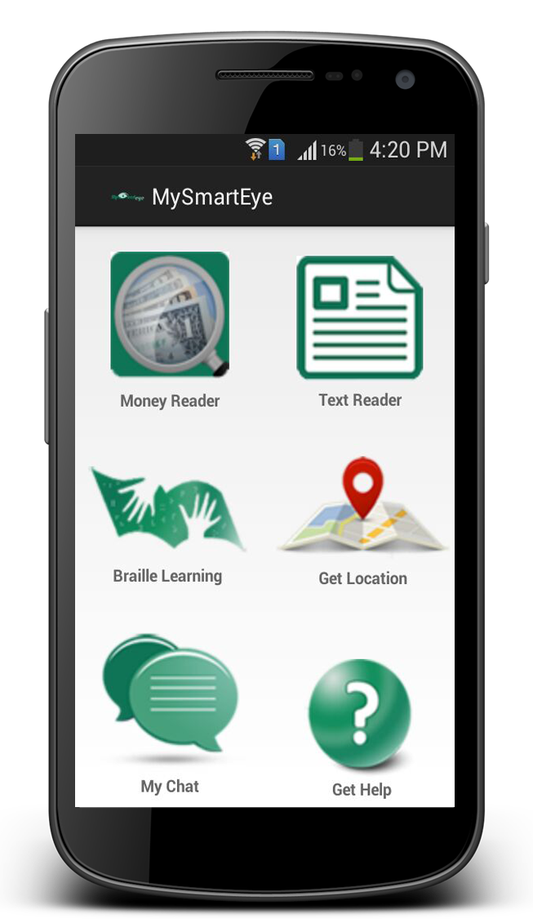
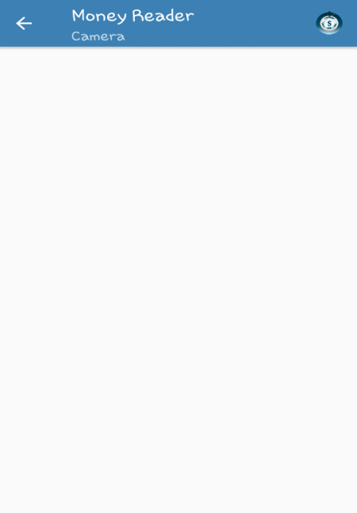
Sub Applications
Our application consists of 2 sub
Applications.
Money Reader.
Currency Conversion.

Slide 12
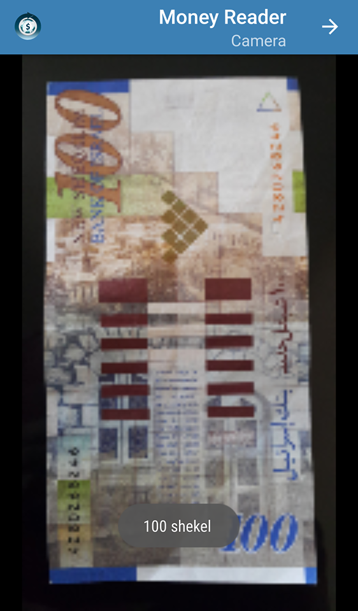
Money Reader
Recognize the values of different bills.
Dollar , Shekel , Dinar and euro

Slide 13
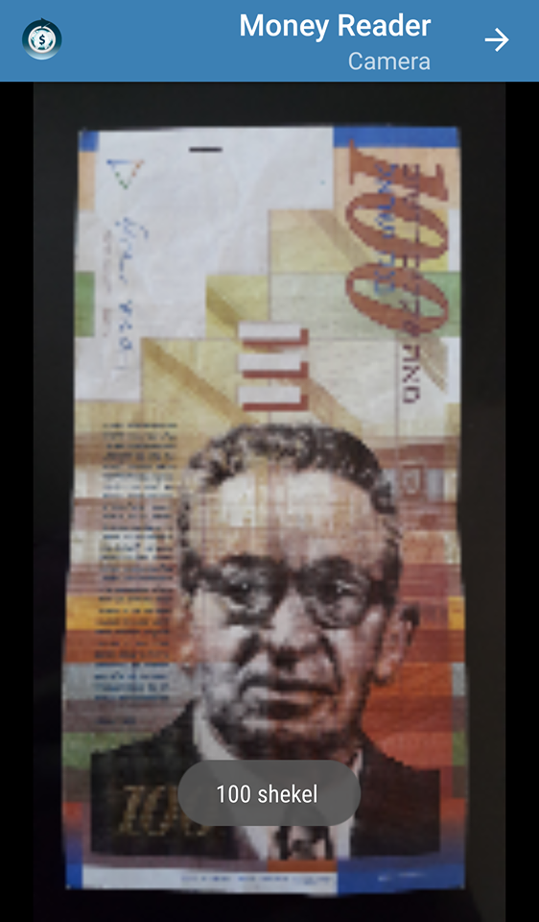
Money Reader
Recognize the values of different bills.
Dollar , Shekel , Dinner, euro

Slide 14
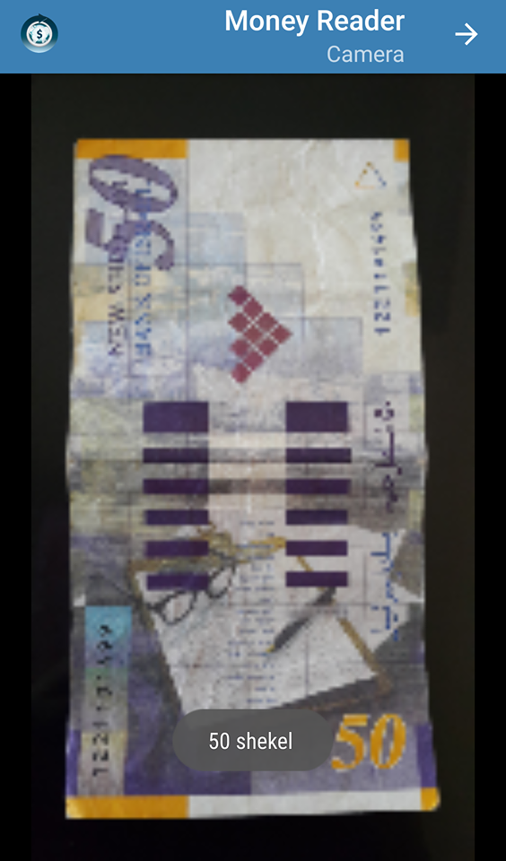
Money Reader
Recognize the values of different bills.
Dollar , Shekel , Dinner, euro

Slide 15
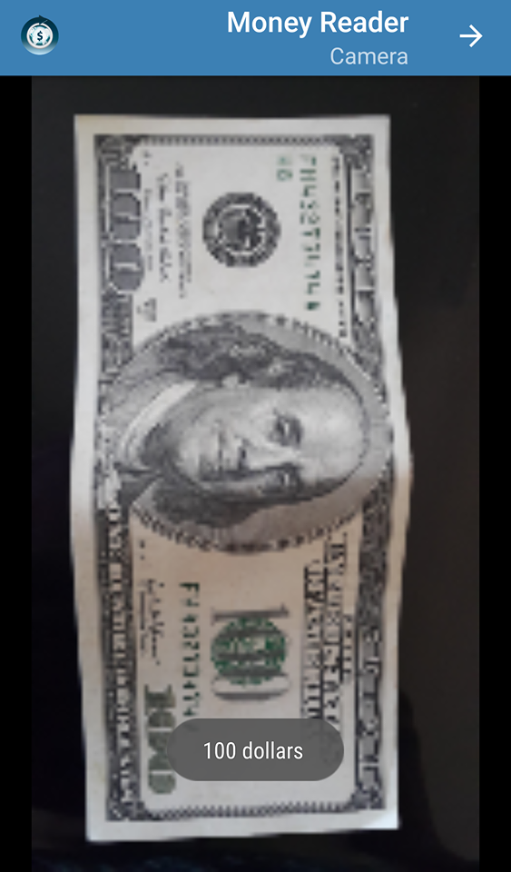
Money Reader
Recognize the values of different bills.
Dollar , Shekel , Dinner, euro

Slide 16
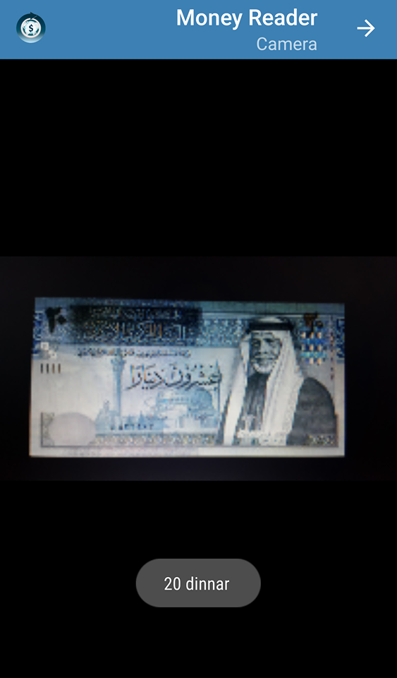
Money Reader
Recognize the values of different bills.
Dollar , Shekel , Dinner, euro

Slide 17
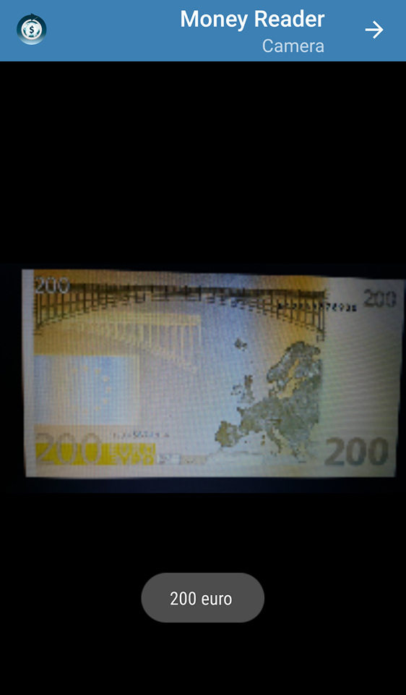
Money Reader
Recognize the values of different bills.
Dollar , Shekel , Dinner, euro

Slide 18
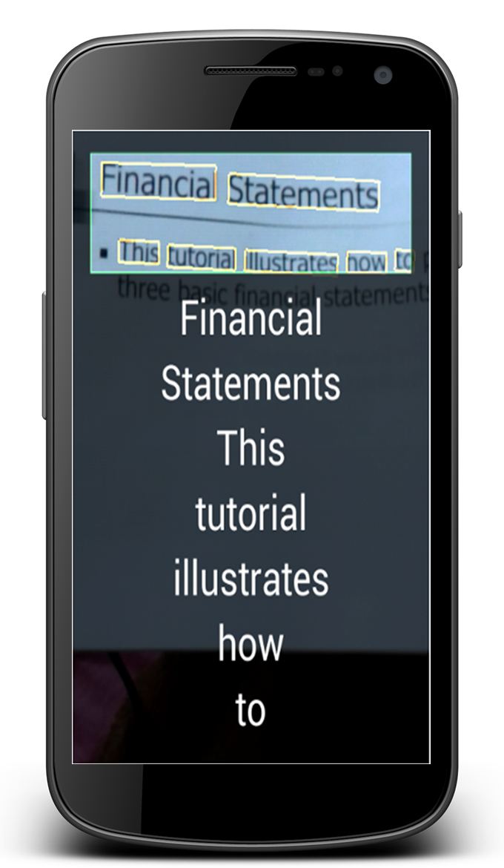
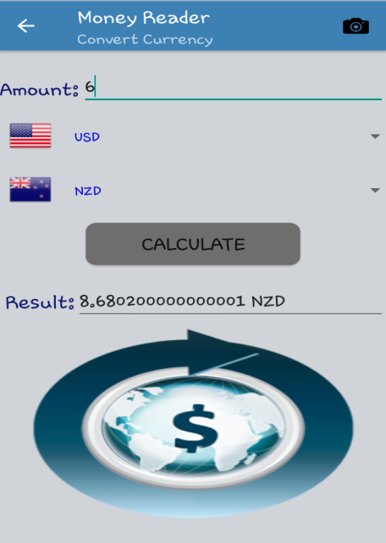
Currency Converting.
Convert between many currencies.

Slide 19
Outline
What is Money Reader ?
Motivation, objective.
Implementation.
Programming techniques.
Future Work.
Demo.

Slide 20
Text-To-Speech Synthesizer
The Android platform includes a Text-to-Speech (TTS) capability which enables an Android device to "speak" text in various languages.

Slide 21
2. SIFT Algorithm
Scale Invariant Feature Transform (SIFT) is an image descriptor for image-based matching and recognition , and it is mainly the basic algorithm that was used in this application.

Slide 22
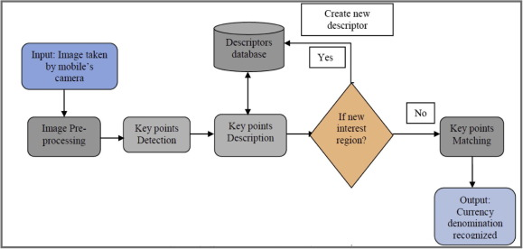
2. System flow

Slide 23
Outline
What is MySmartEye ?
Motivation, objective.
Implementation.
Programming techniques.
Future Work.
Demo.

Slide 24
Future work
Improve the moneyReader App to get more accurate results and to be able to recognize more than one bill at the same image.
Improve the moneyReader App to recognize coins.
Increasing processing speed by adding a neural network.

Slide 25
Outline
What is Money Reader ?
Motivation, objective.
Implementation.
Programming techniques.
Future Work.
Demo.

Slide 26
Questions?
Thank you

