Slide 1
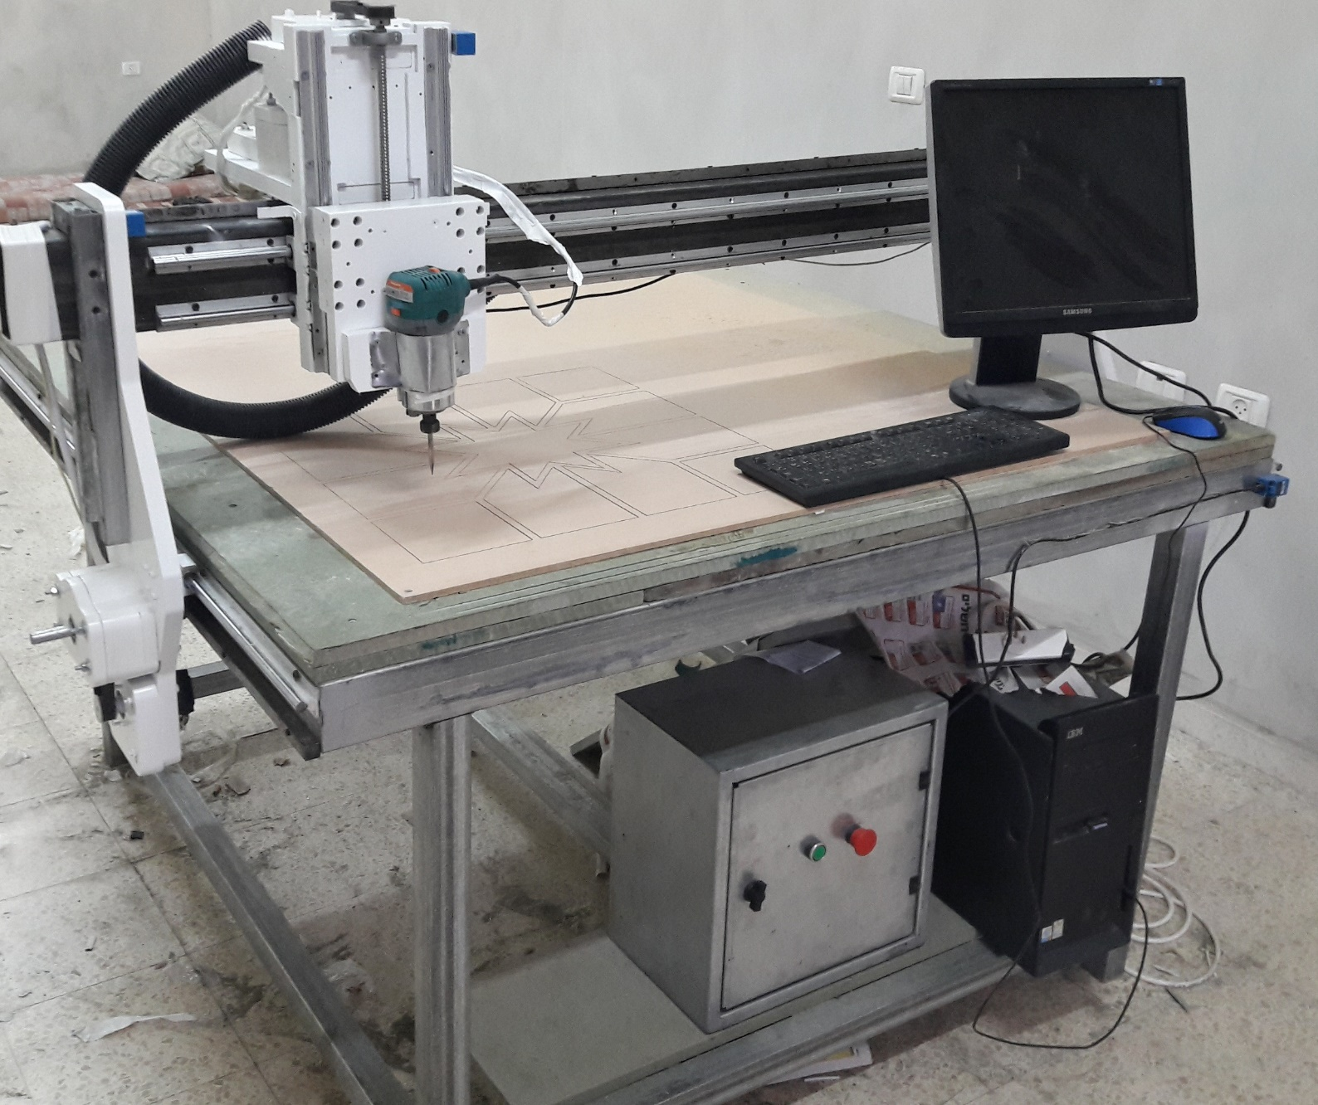
CNC Milling Machine
Supervisor: Dr. Bashir Nouri.
Group members:
-Motaz Shtiwe.
-Abedulrahman Khraishi.
-Hamza Najjar.

Slide 2
Presentation Layout
Introduction
Mechanical Design
Electrical Component
Software and Programming
Conclusion

Slide 3
Introduction

Slide 4
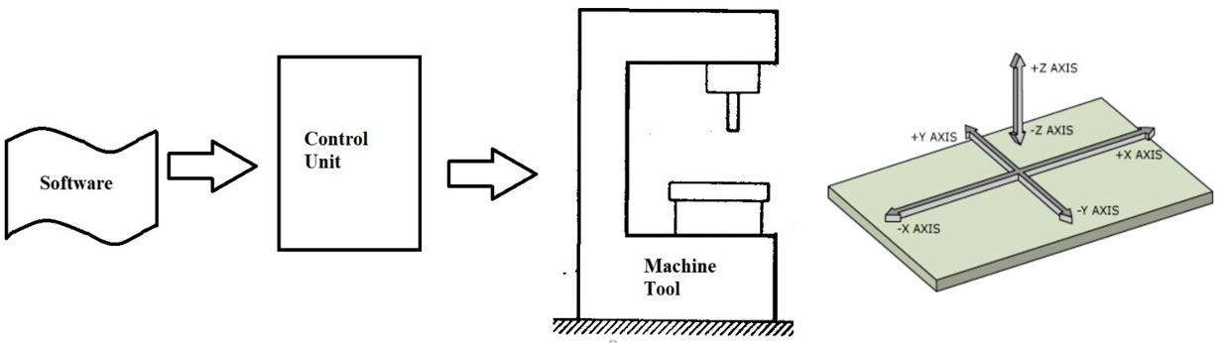
what is CNC?
A Computer Numeric Control (CNC) system consists of three basic components:
Software.
Machine Control Unit.
Machine tool.

Slide 5
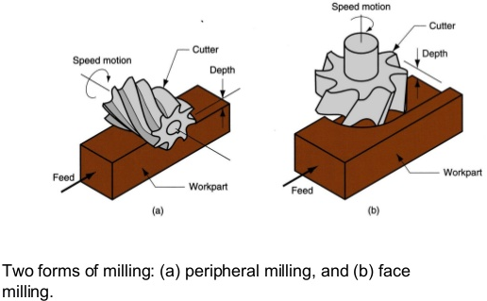
Milling process
The milling process removes material by performing small cuts. This is accomplished by using a cutter with several teeth, spinning the cutter at high speed
Milling operations
a)Peripheral Milling.
b)Face Milling.

Slide 6
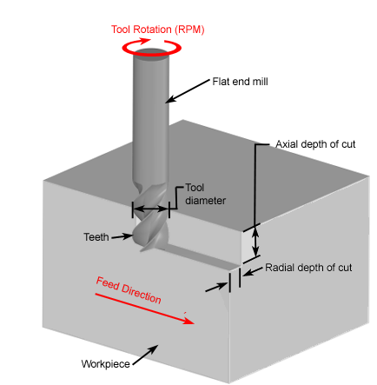
Cutting parameters
Surface feed per minute(SFM).
Depth of cut.
Feed rate.
Revolution per min(RPM).
Cutter diameter.
Number of cutting points.
Cutter and workpiece material.
Rigidity.

Slide 7
Speed and feeds
Why we must know the speed and feeds in machining process?
Surface finish
Safety
Tool life
Efficiency

Slide 8
Mechanical Design

Slide 9
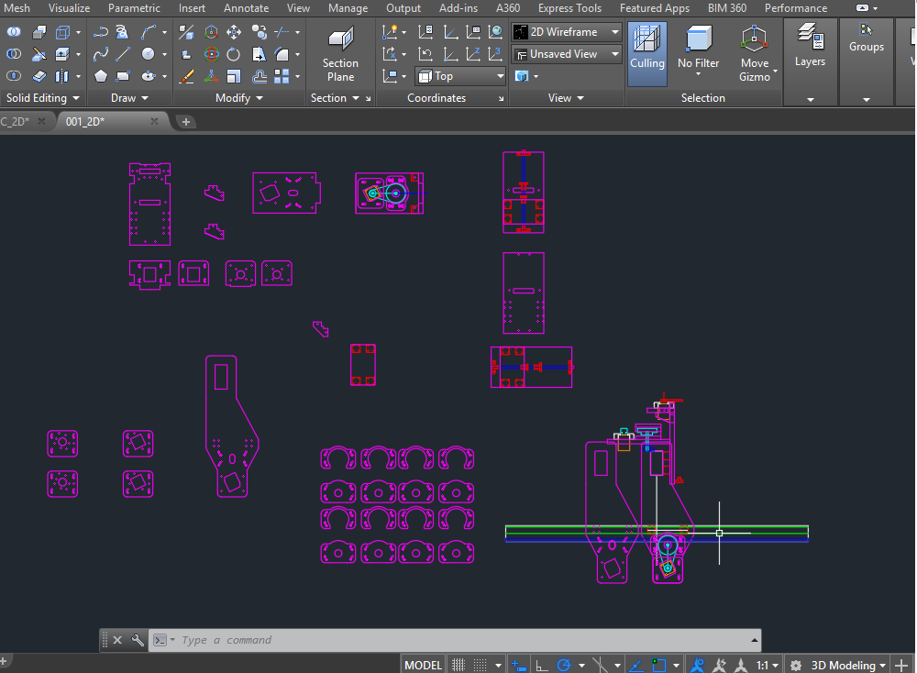
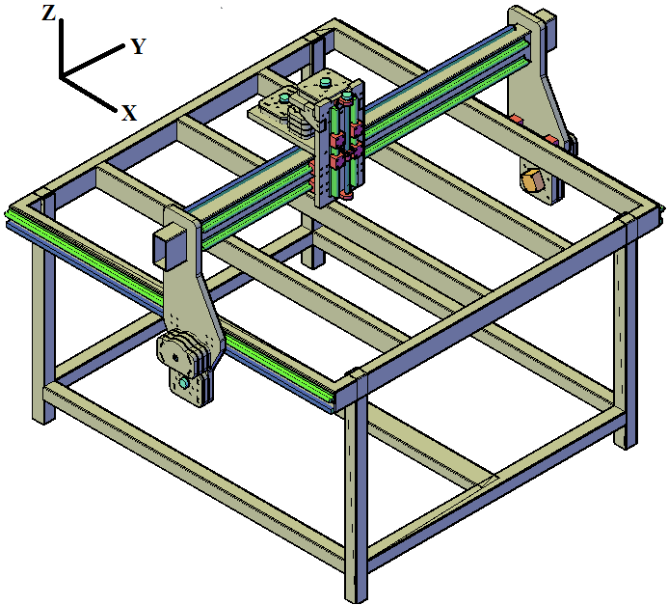

2D Drawings
Mechanical Design
3D Drawings

Slide 10
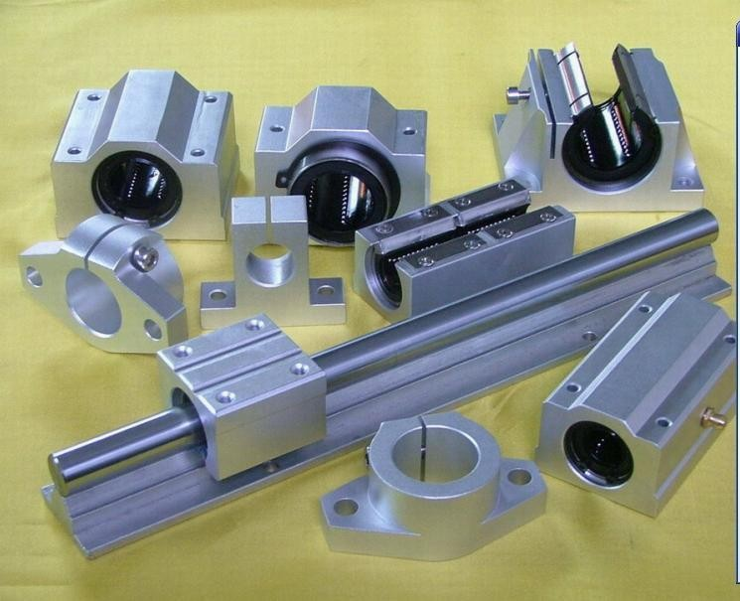
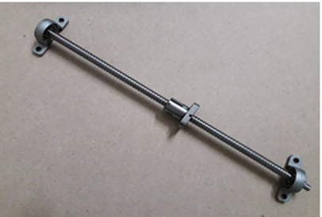

Transmission System Design
$$\frac{Halfstep}{PD}=\frac{400}{4.5}=177.8 (step/mm)$$
Guides
Ball screw

Slide 11
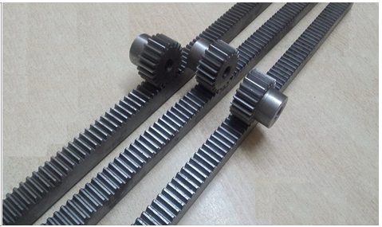
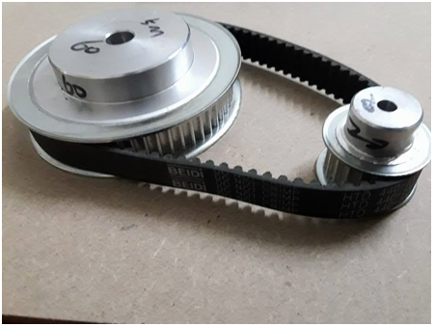
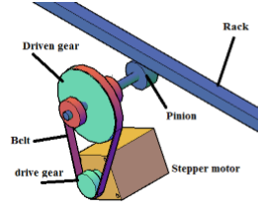


$\frac{microstep}{PD}=\frac{4800}{33π}=46.3 (step/mm$)
$$\frac{microstep}{PD∗π}=\frac{1600}{33π}=15.4 (step/mm)$$
Timing belt and pulleys
Rack and pinion
Movement mechanical system

Slide 12
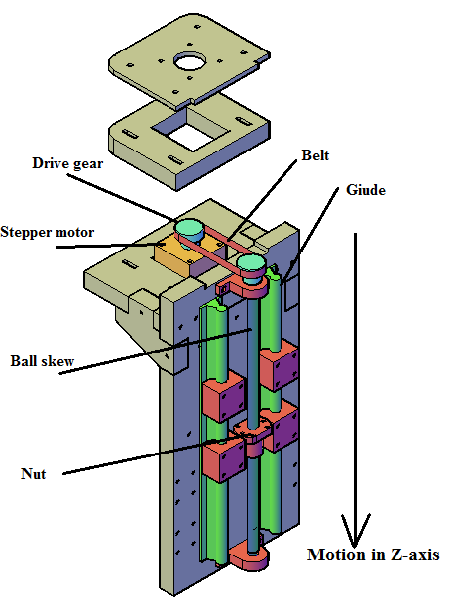
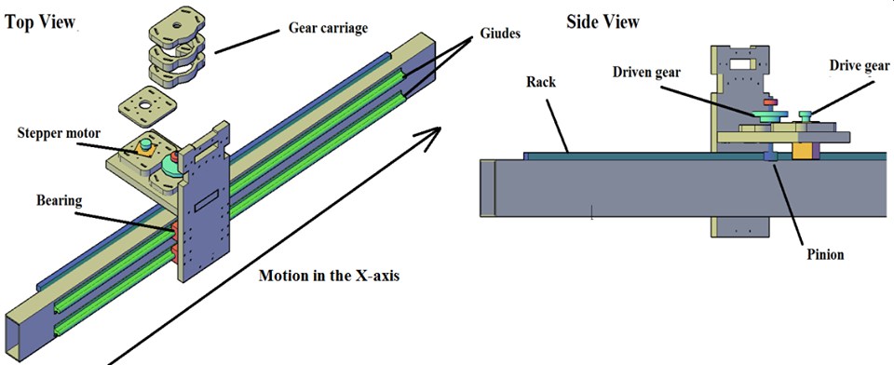
Mechanical Design component assembly
X-axis component
Z-axis component

Slide 13
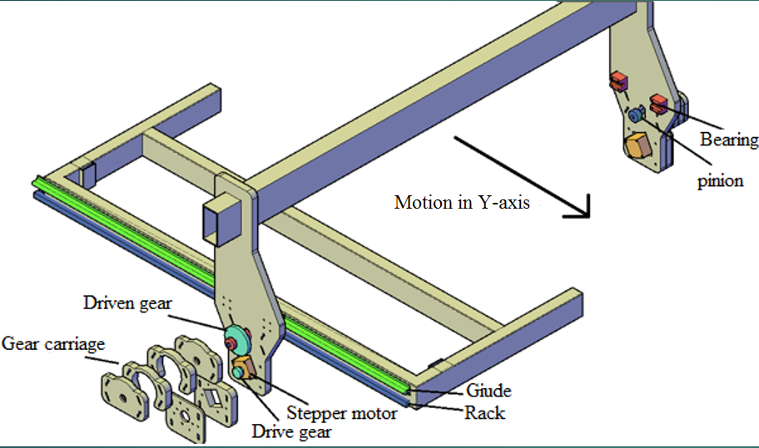
Y-axis component

Slide 14
Electrical component

Slide 15
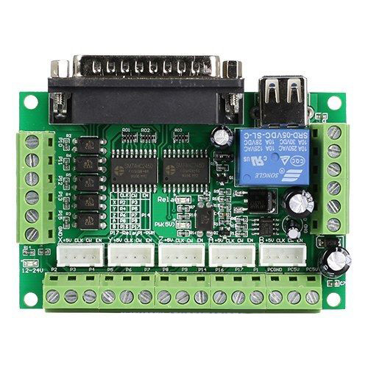
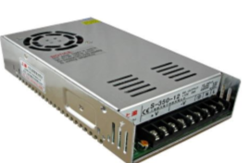
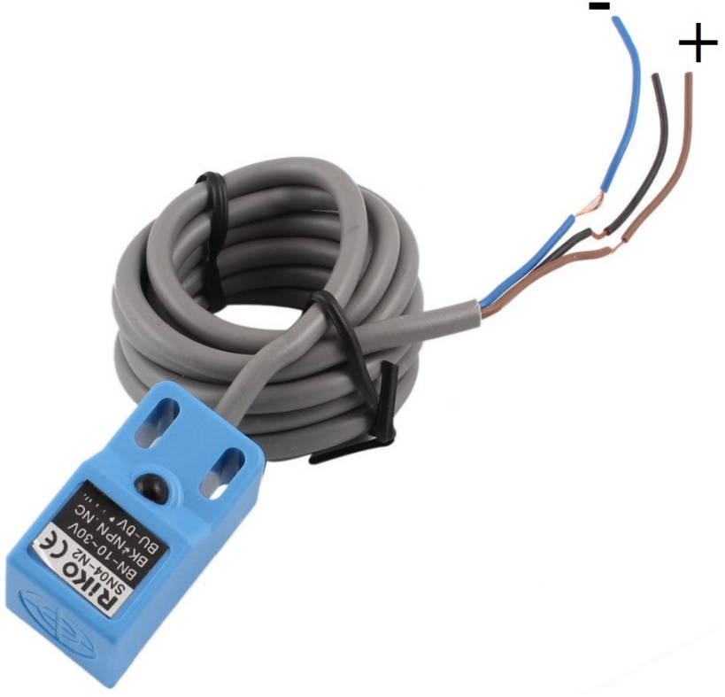
Power Supply
Breakout board
Inductive sensor

Slide 16
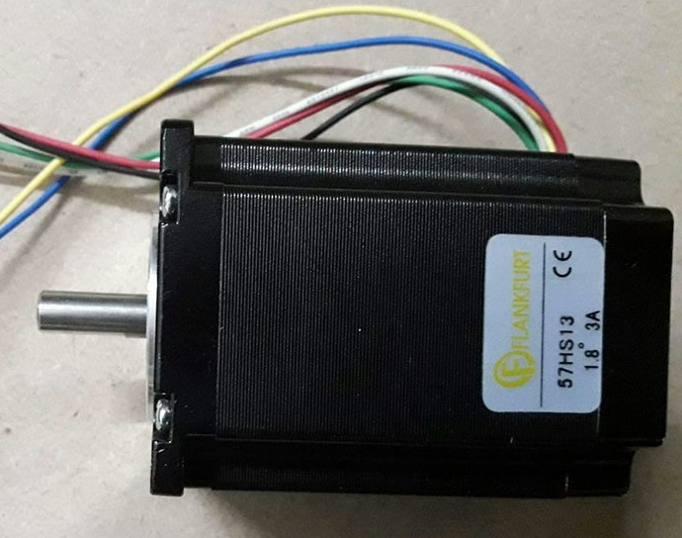
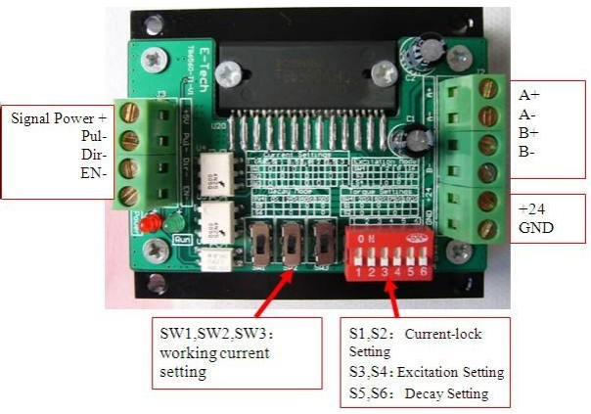
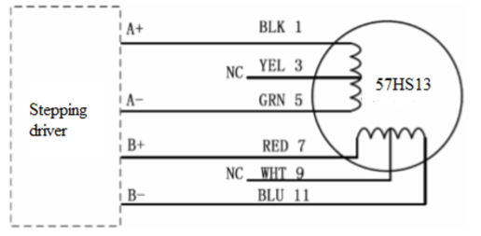
Stepper Motor
Stepper Motor Drivers

Slide 17
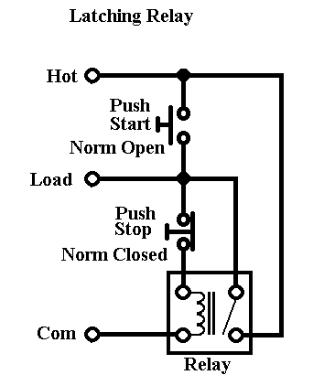
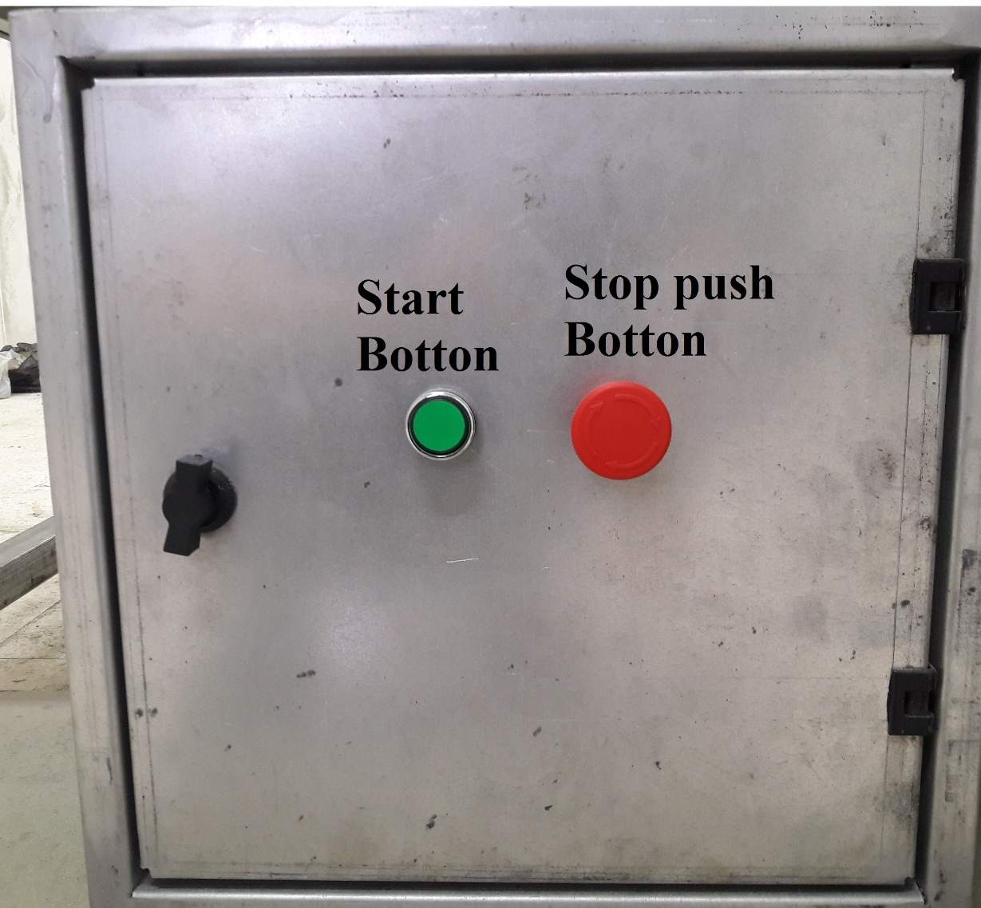
Start Stop latching circuit

Slide 18
Software and Programming

Slide 19
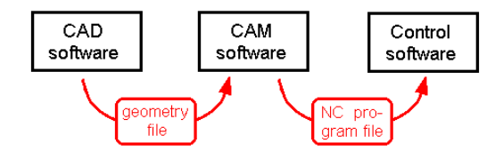
SOFTWARE AND PROGRAMING
CAD, CAM, and control software

Slide 20
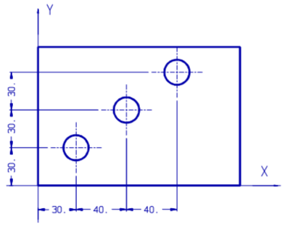
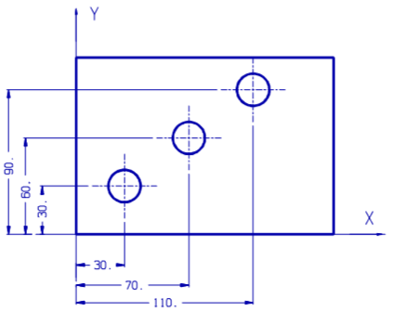
Absolute and incremental coordinates
a) Incremental
b) Absolute

Slide 21
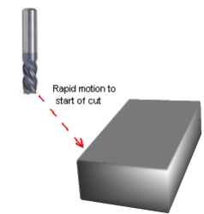
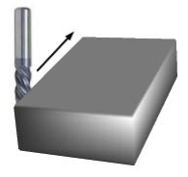
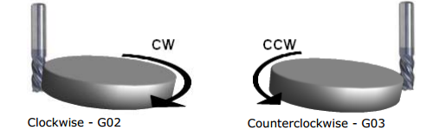
Point to point movement
Linear interpolation
Circular interpolation

Slide 22
Conclusion

Slide 23
