Slide 1

Waterjet cutting machine

Slide 2

Prepared by:
Hadeel Jaber
Khalid Hattab
Alaa Allan
Omar yahya
Supervised by:
Dr.Salma Abdel AL-fatah

Slide 3

Software&
program
Future work
Project plane
Design of work
Review project 1

Slide 4

Review project1
CNC machine
Waterjet cutting machine
(WJM)
Type of CNC
Application of WJM
CNC machine
Printed Circuit Boards
Rivet Removal
Food Preparation
Tool Steel
Wood Cutting
Paint Removal
Milling machine
Lathe machine
WaterJet Cutter Machine
Plasma cutting machine
Application of WJM
Type of CNC
Waterjet cutting machine
(WJM)

Slide 5

Design of
work

Slide 6

Mechanical part
Electrical part

Slide 7

Mechanical part

Slide 8

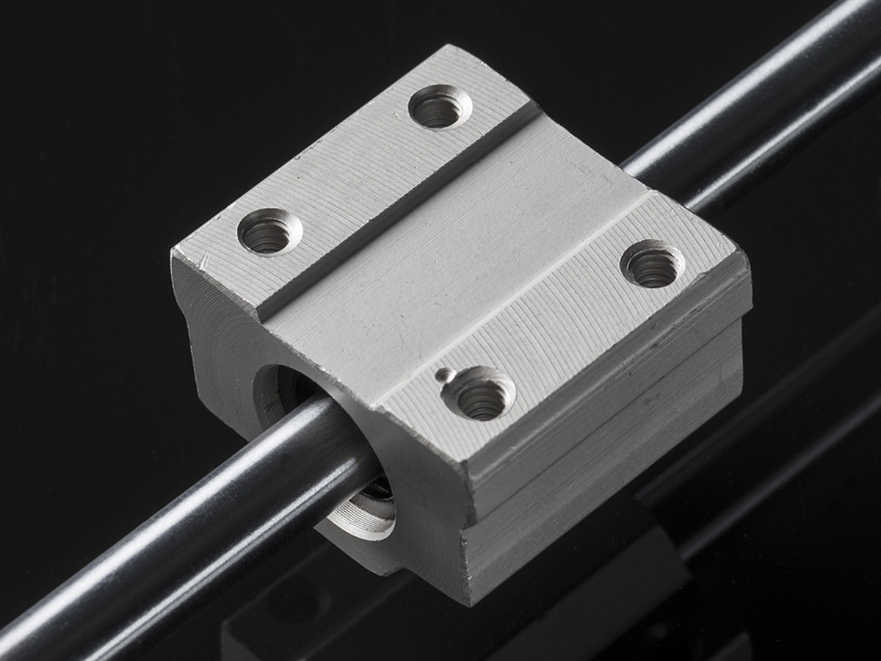
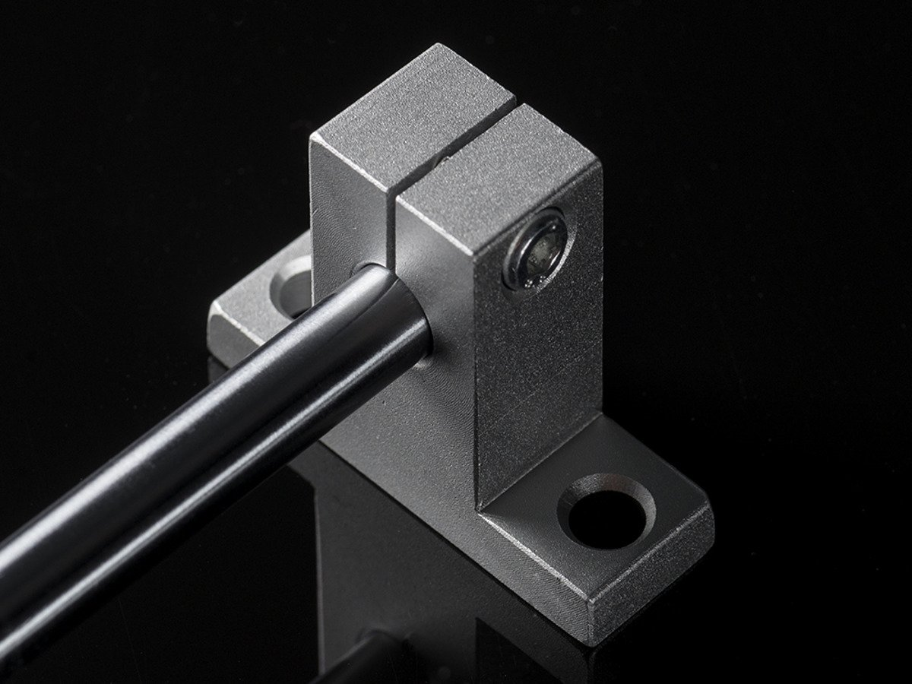
linear bearing block
&
rail (support)

Slide 9

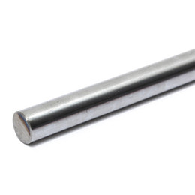
linear smooth rod

Slide 10
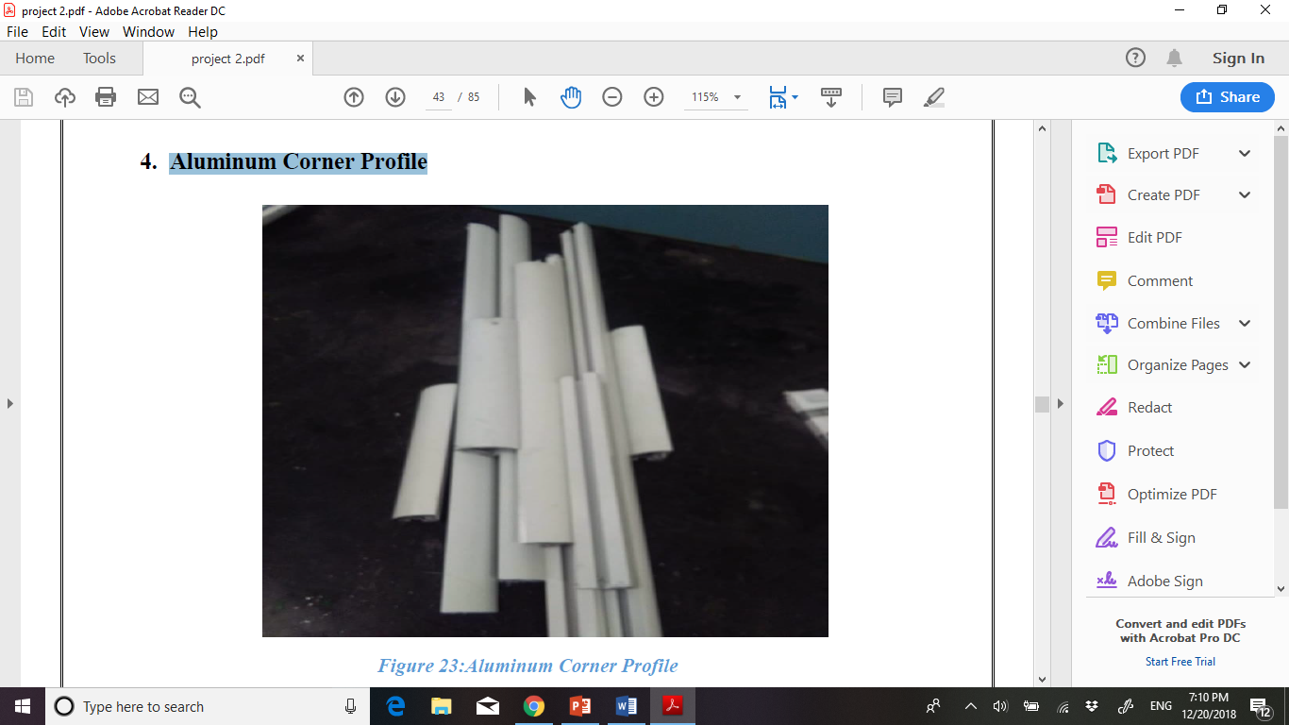
Aluminum Corner Profile

Slide 11
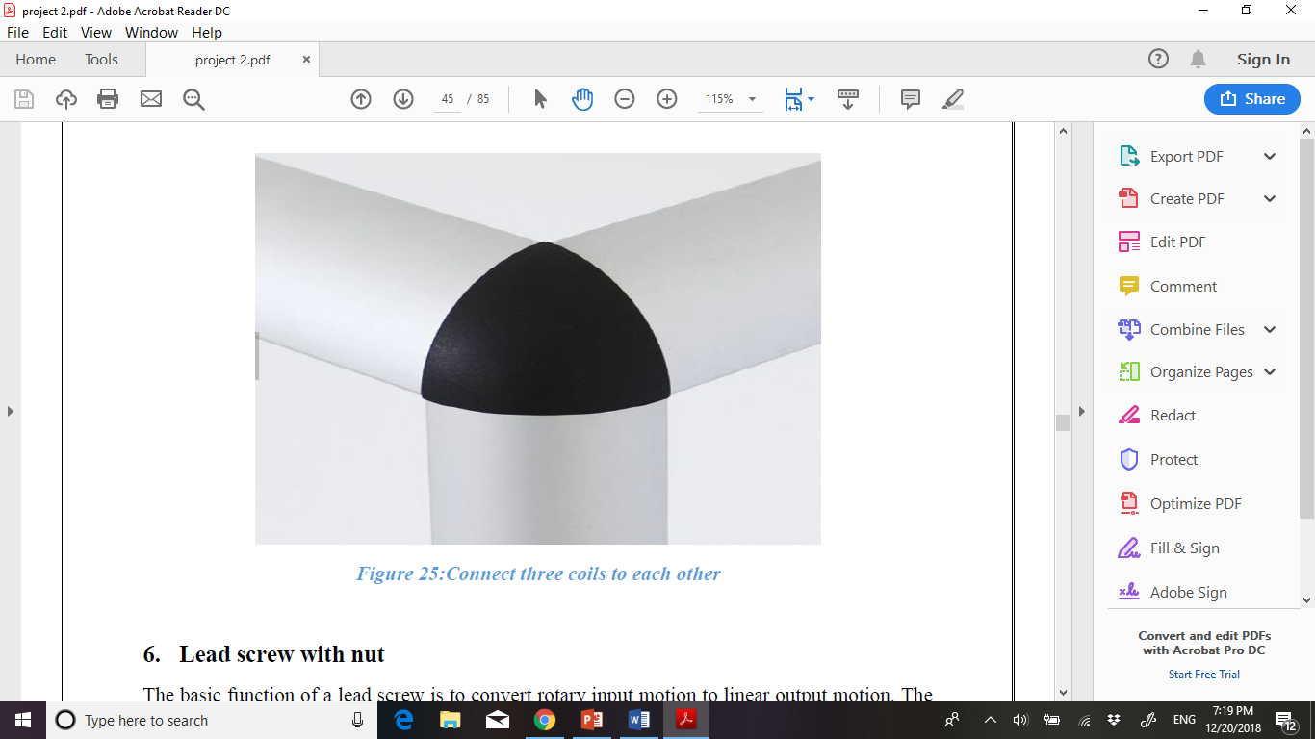
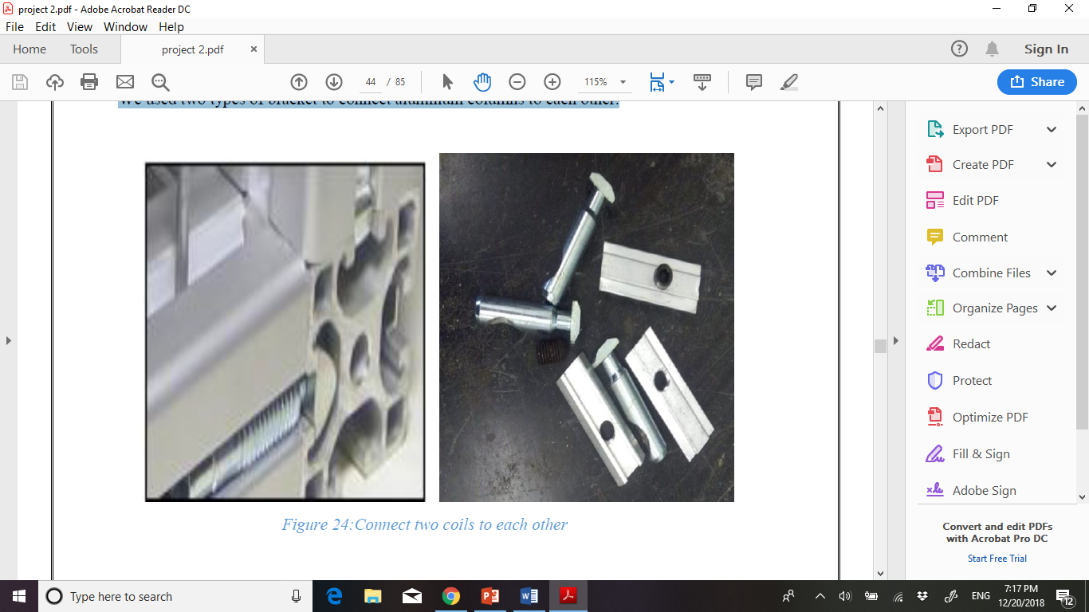
Bracket

Slide 12
Screw
&
nut

Slide 13
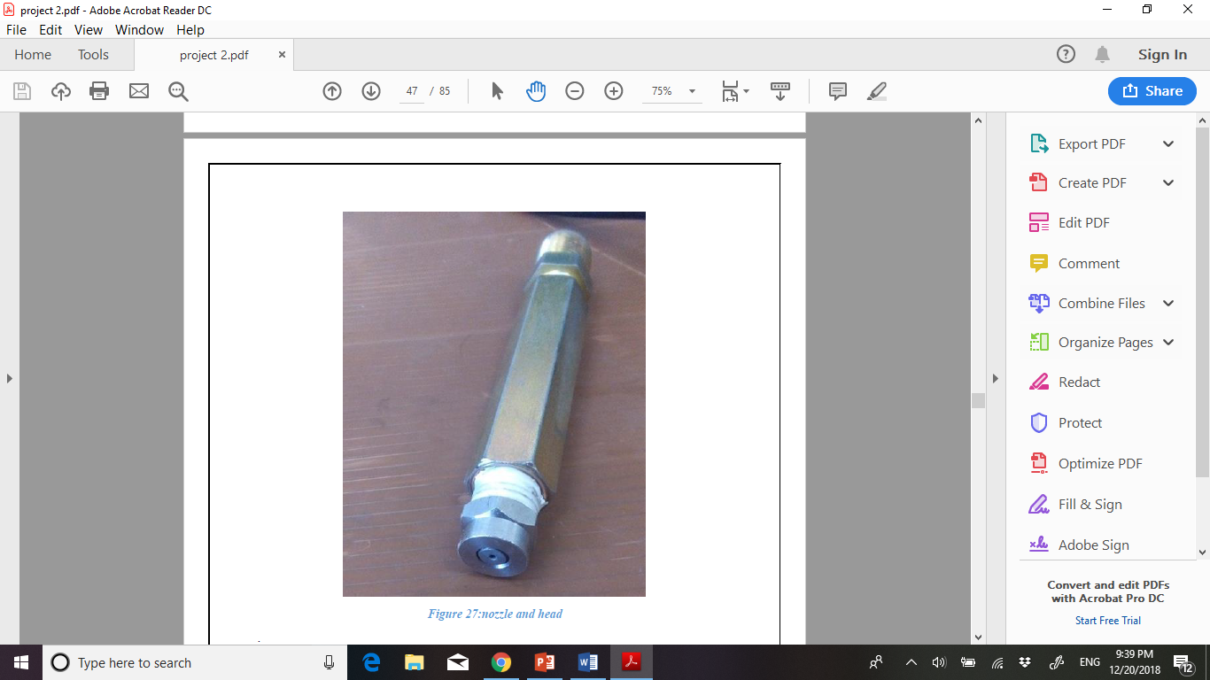
Nozzle

Slide 14
Couplings

Slide 15

Helical Beam
Coupler
Flexible Coupling

Slide 16
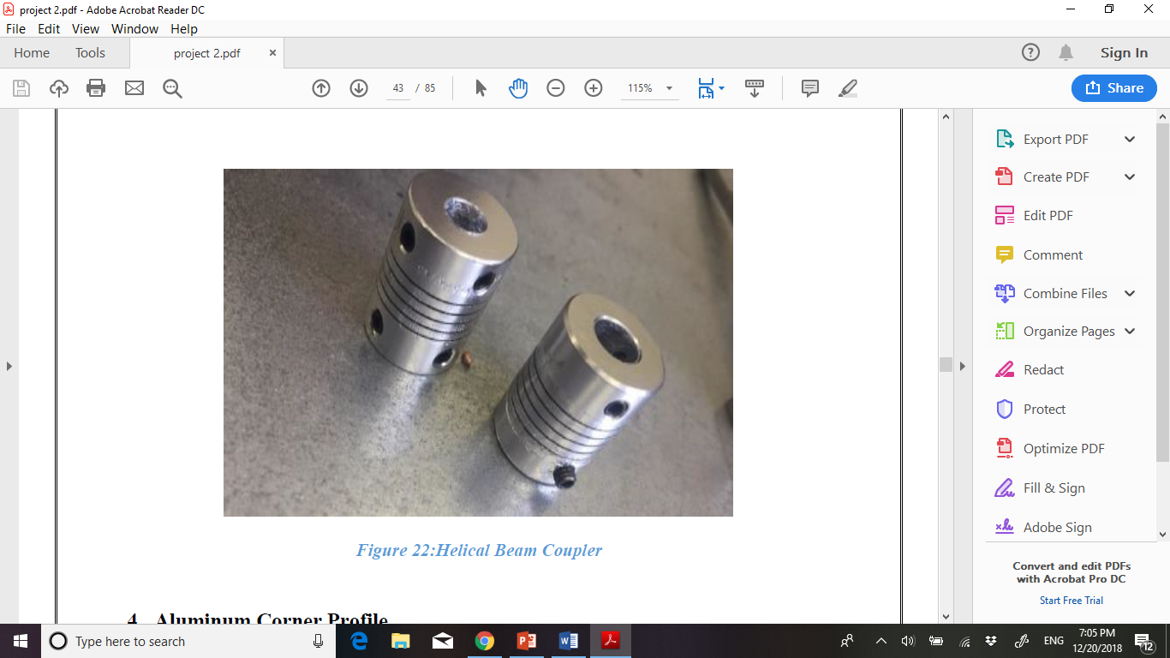
Helical Beam Coupler

Slide 17
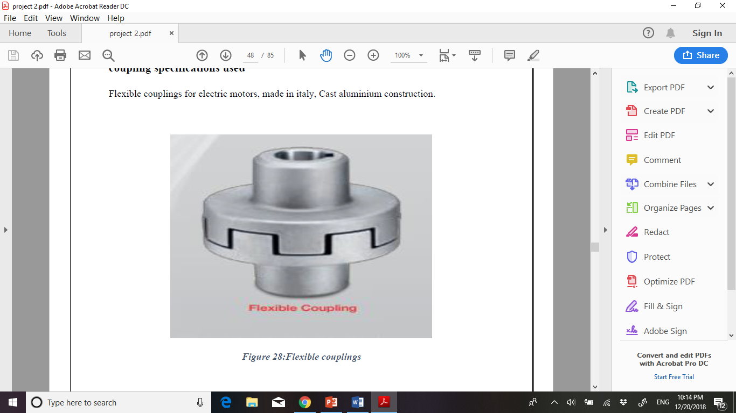
Flexible Coupling

Slide 18
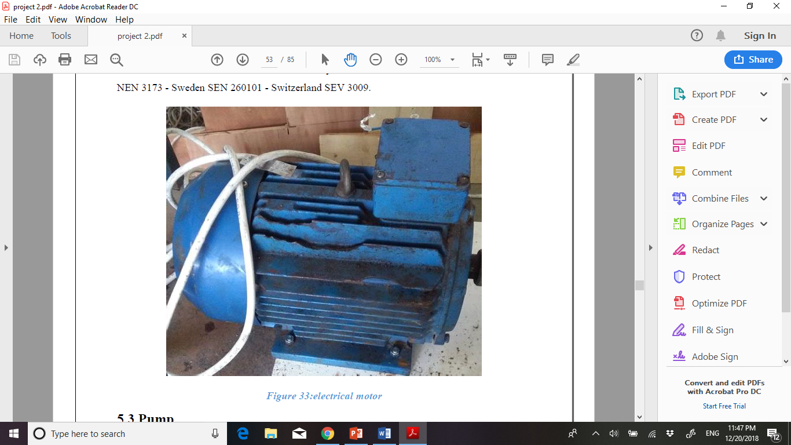
Motor

Slide 19
Pump

Slide 20

Direct Drive
intensifier
pump

Slide 21
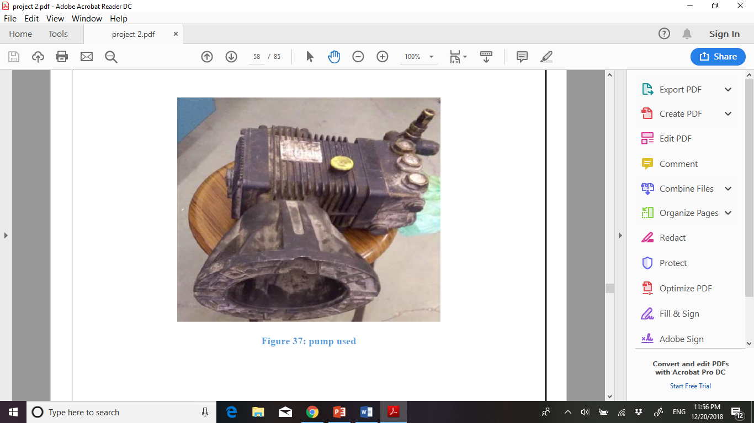
pump specifications used

Slide 22
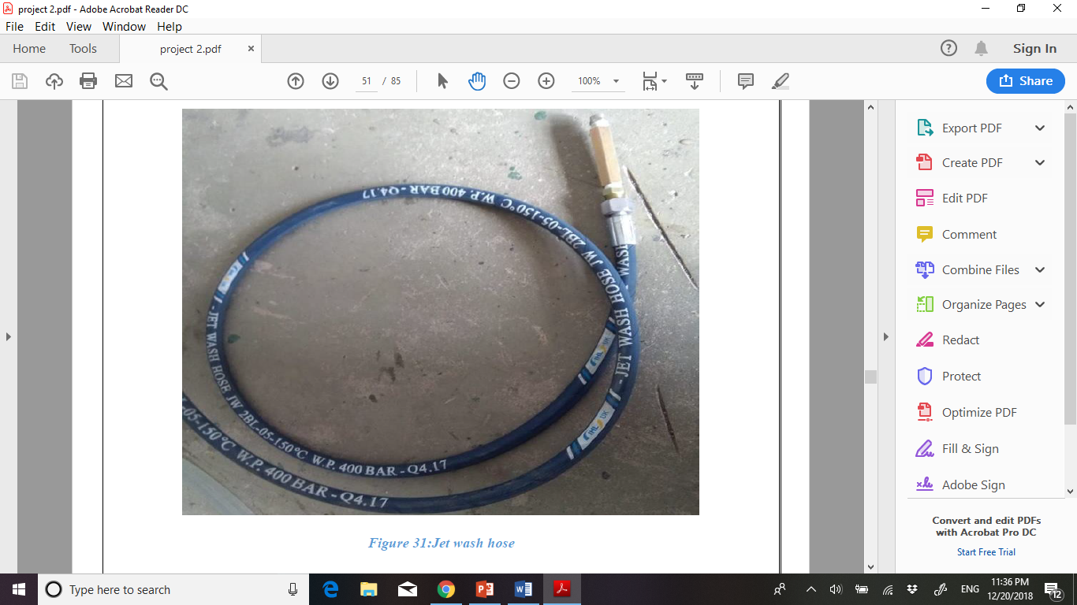
Jet wash hose

Slide 23
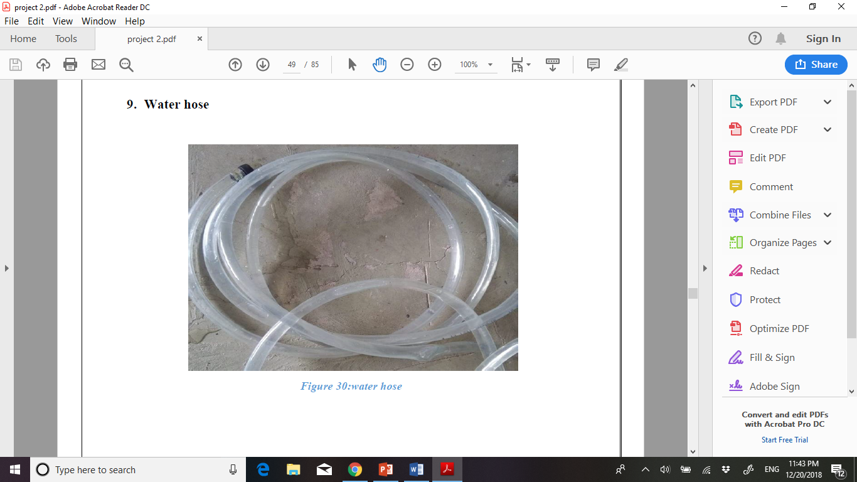
Water hose

Slide 24

Electrical part

Slide 25

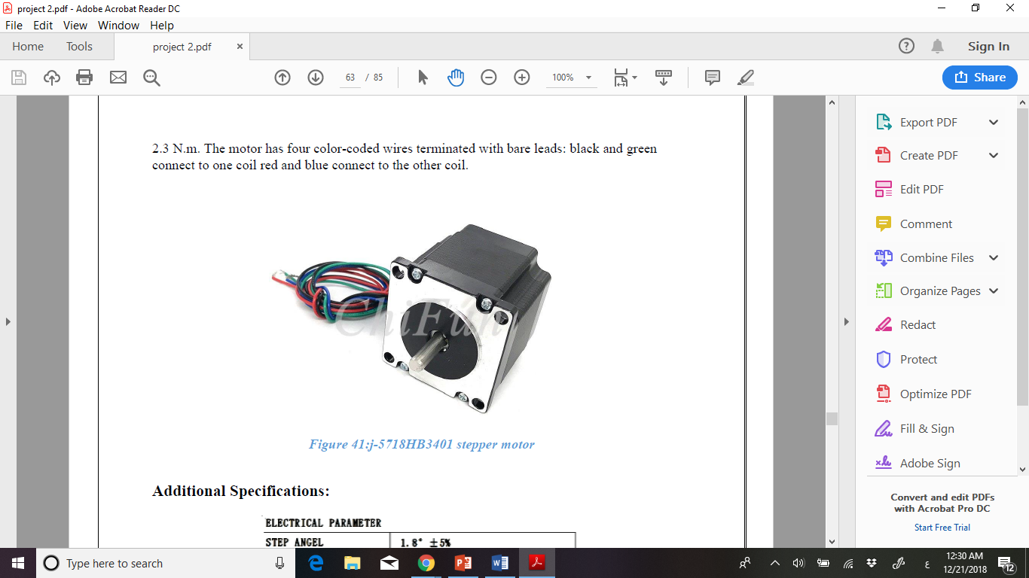
Stepper motor

Slide 26

Types of Stepper Motor
Permanent magnet stepper
Hybrid synchronous stepper
Variable reluctance stepper

Slide 27
The rotation angle of the motor is proportional to the input pulse
Excellent response to starting, stopping and reversing
The motors response to digital input pulses provides open-loop control
The motor has full torque at standstill.
Advantages

Slide 28

Specifications of stepper motor used
Max current= 3.5 A
Max voltage = 3.2 V
Max torque= 2.3 N/m
stepping motor has a 1.8° step angle (200 steps/revolution)

Slide 29

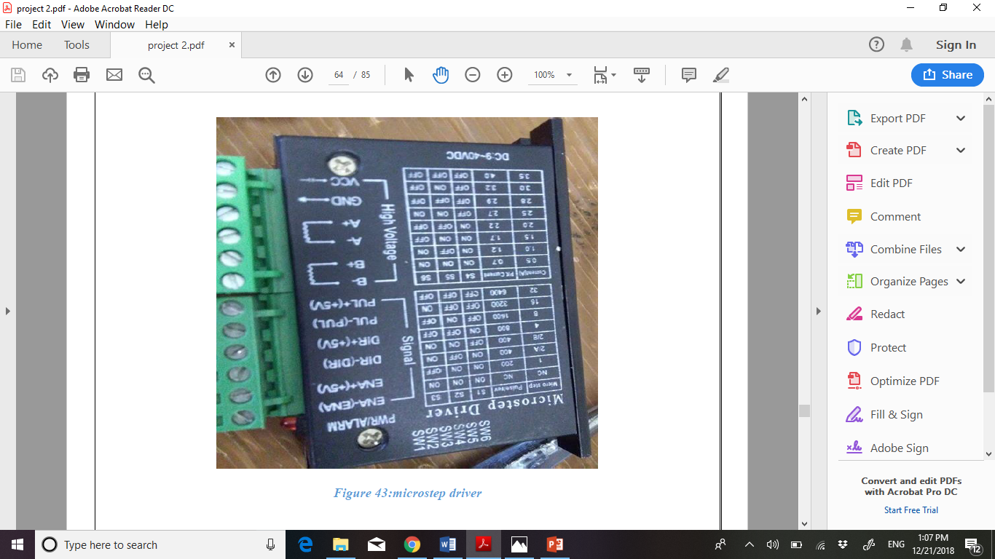
Micro step Driver

Slide 30

ENA
Direction (DIR)
Pin Descriptions
PULSE (PUL)
B-, B+:
GND
A-, A+:

Slide 31
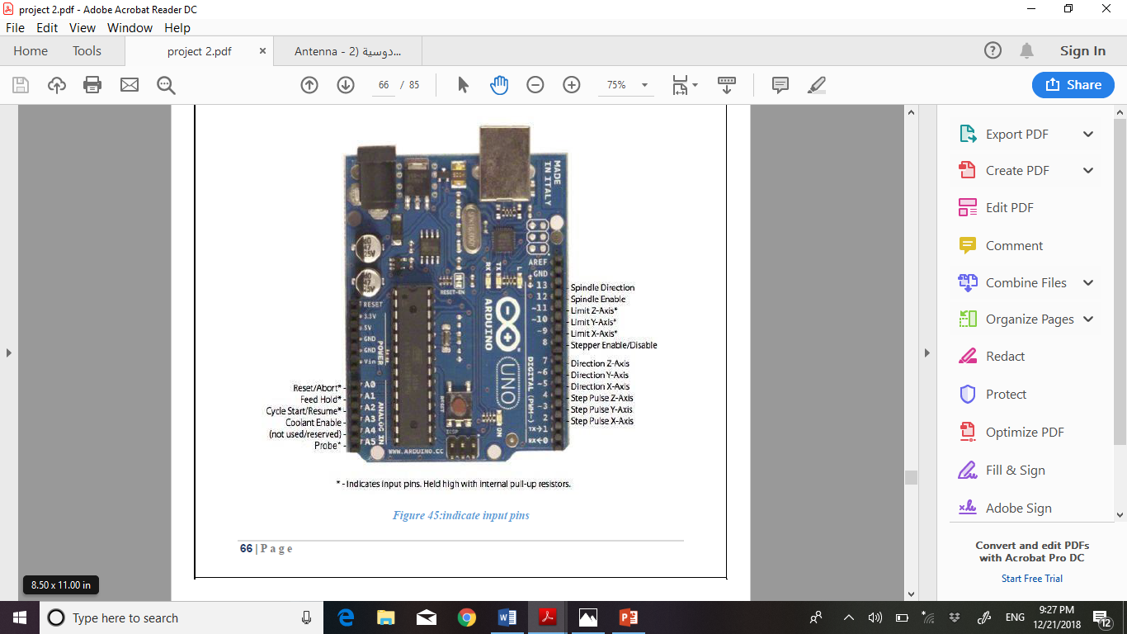
Arduino

Slide 32
Inexpensive
Cross-platform
Simple, clear programming environment
Open source and extensible software
Open source and extensible hardware

Slide 33
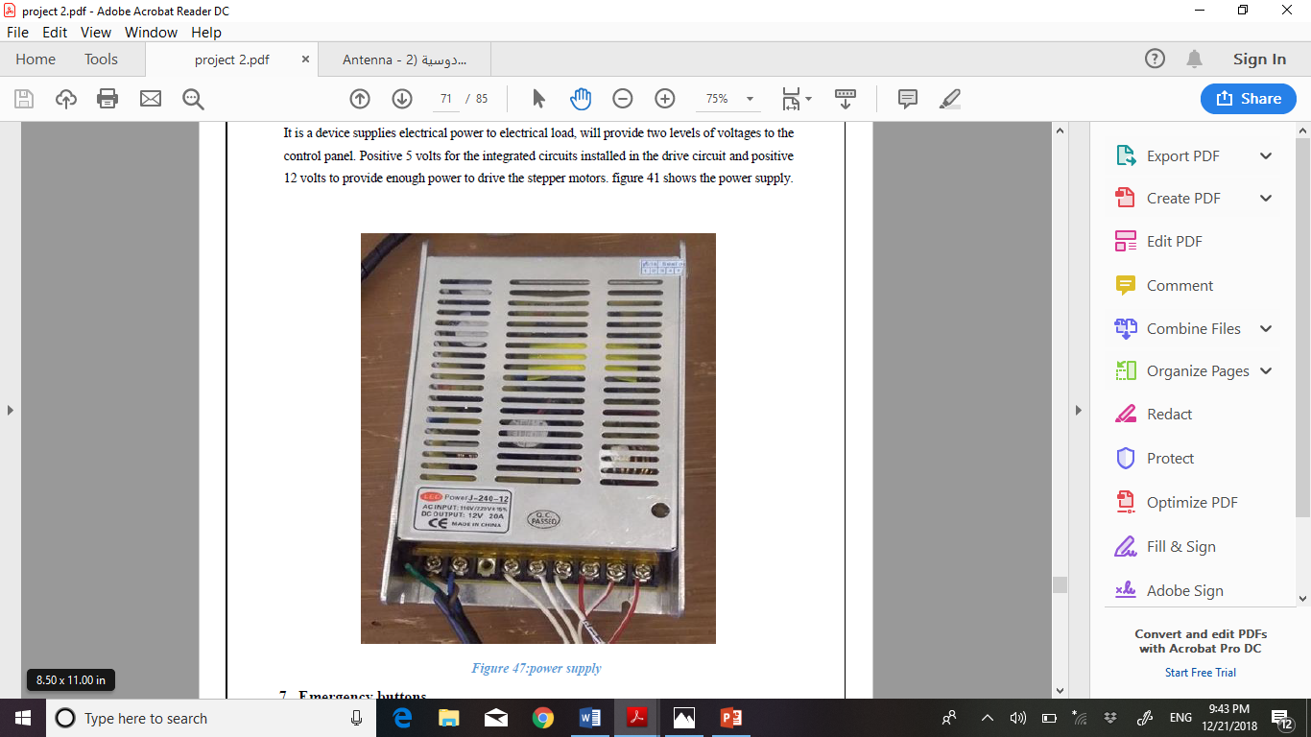
Power supply

Slide 34


Slide 35

Thank you
someone@example.com

