Slide 1

White-Simulation

Slide 2
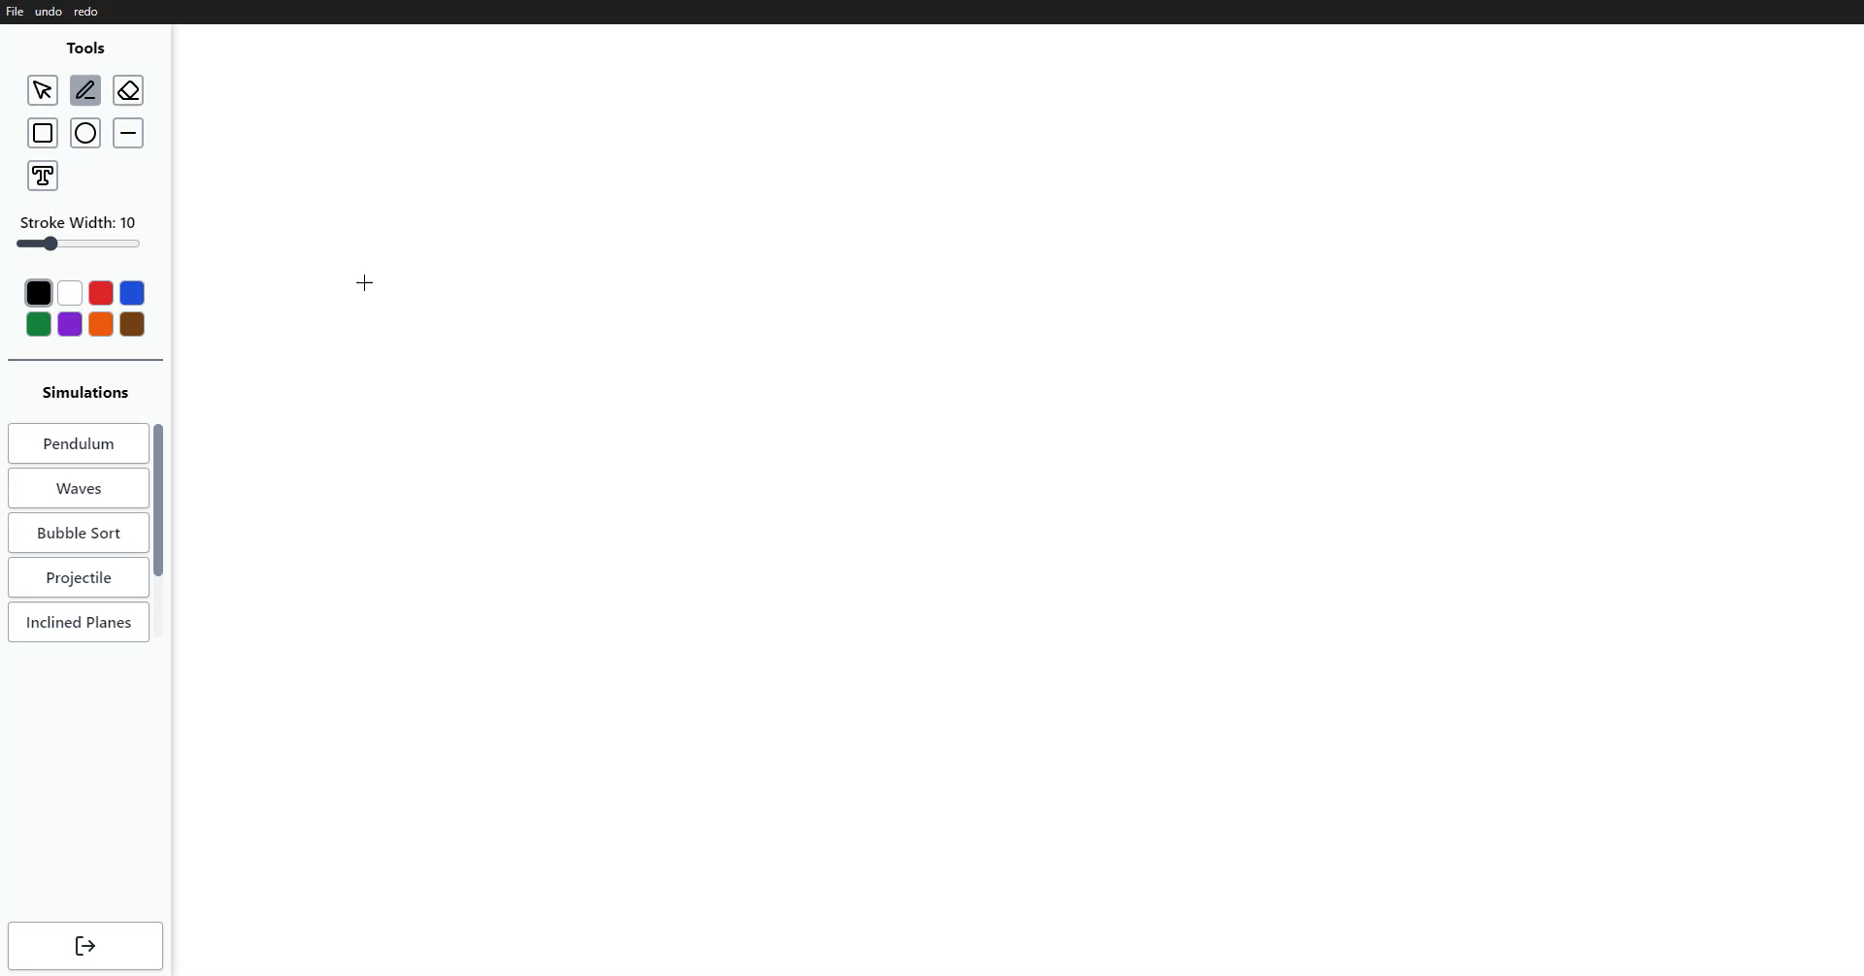
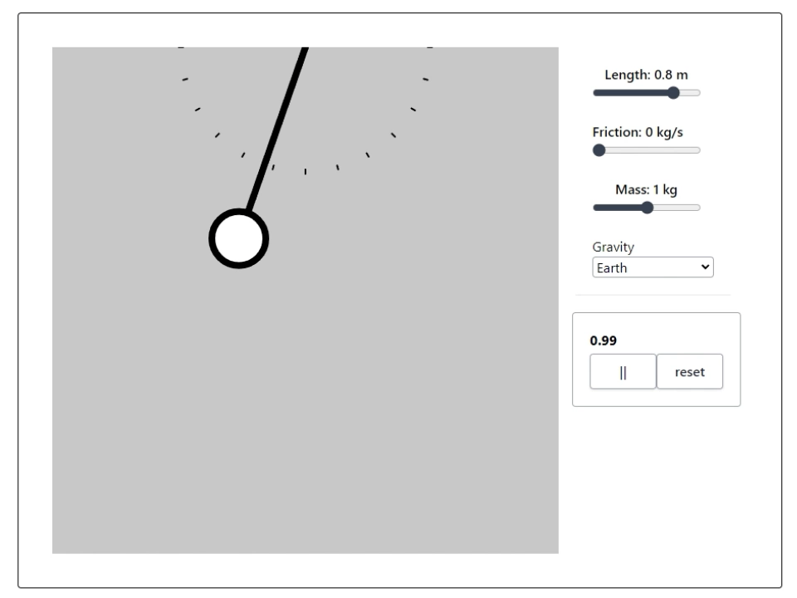
Whiteboard / Simulation

Slide 3
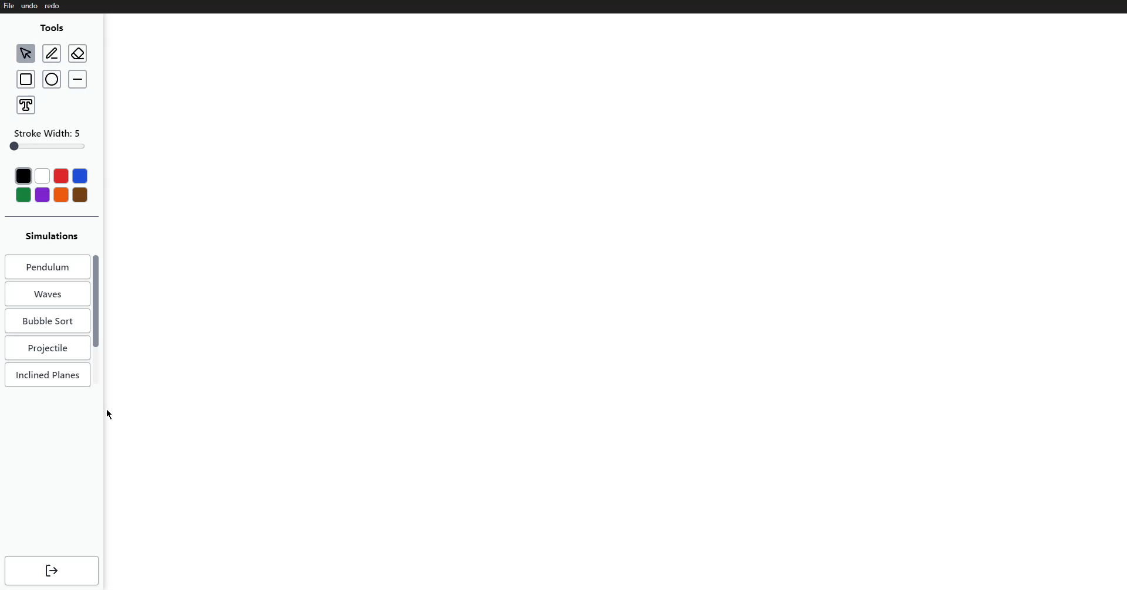
Integrating Whiteboards with Simulations

Slide 4
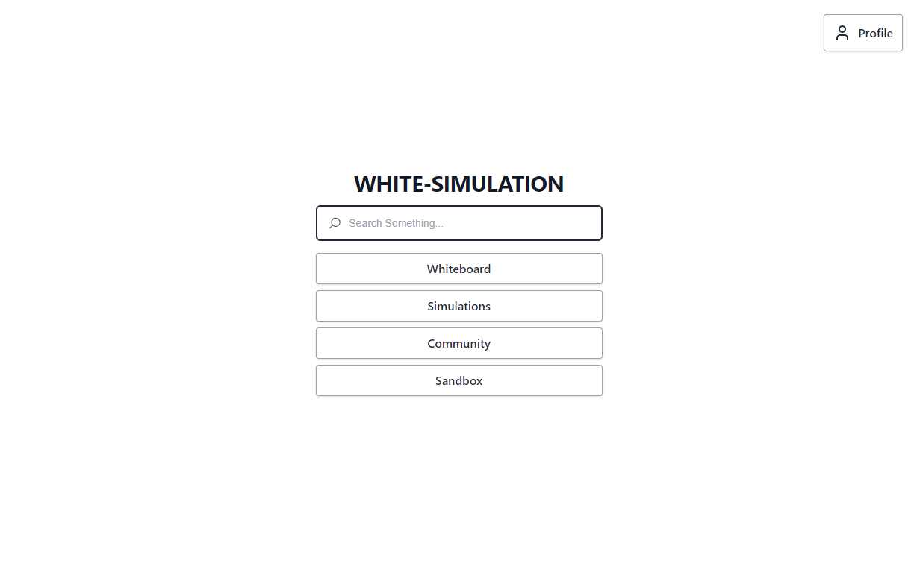
Main Page

Slide 5
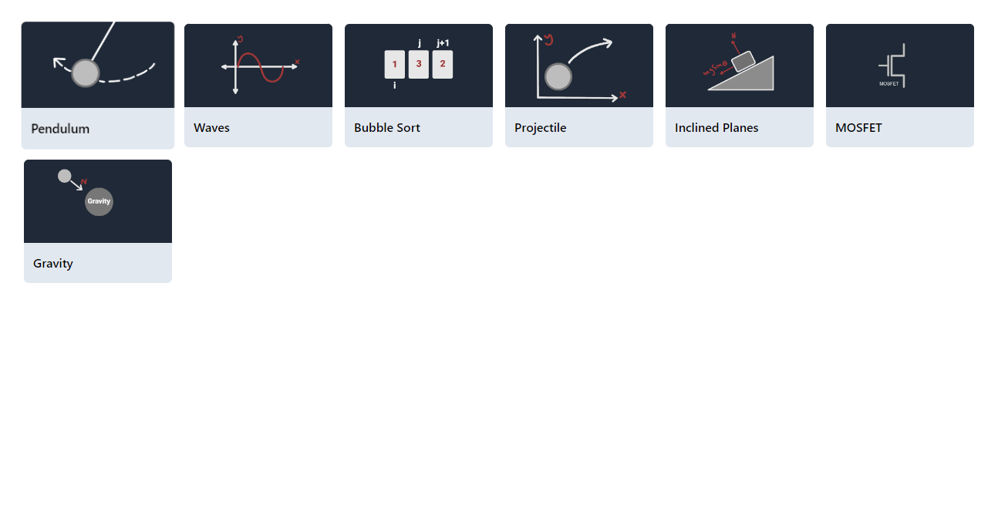
Simulations List

Slide 6
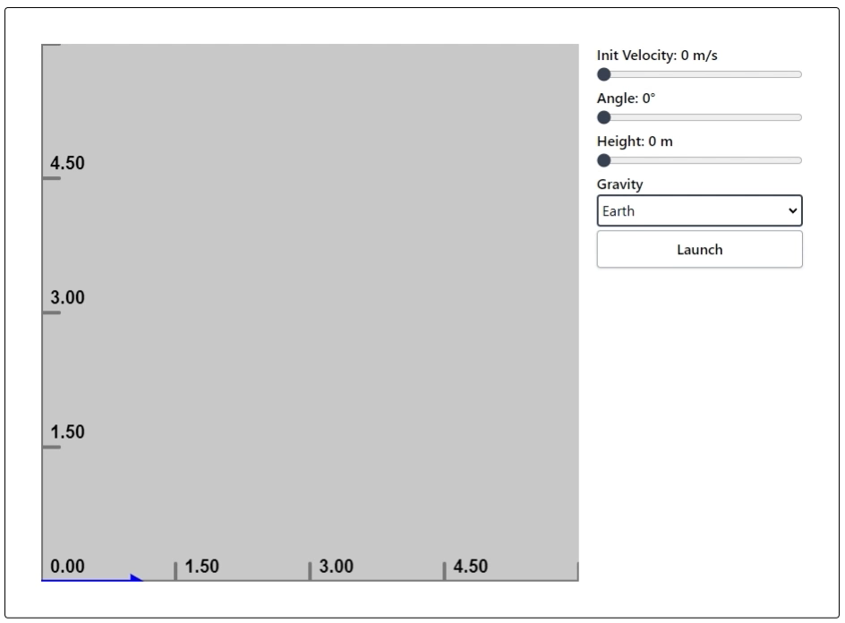
Projectile Motion

Slide 7
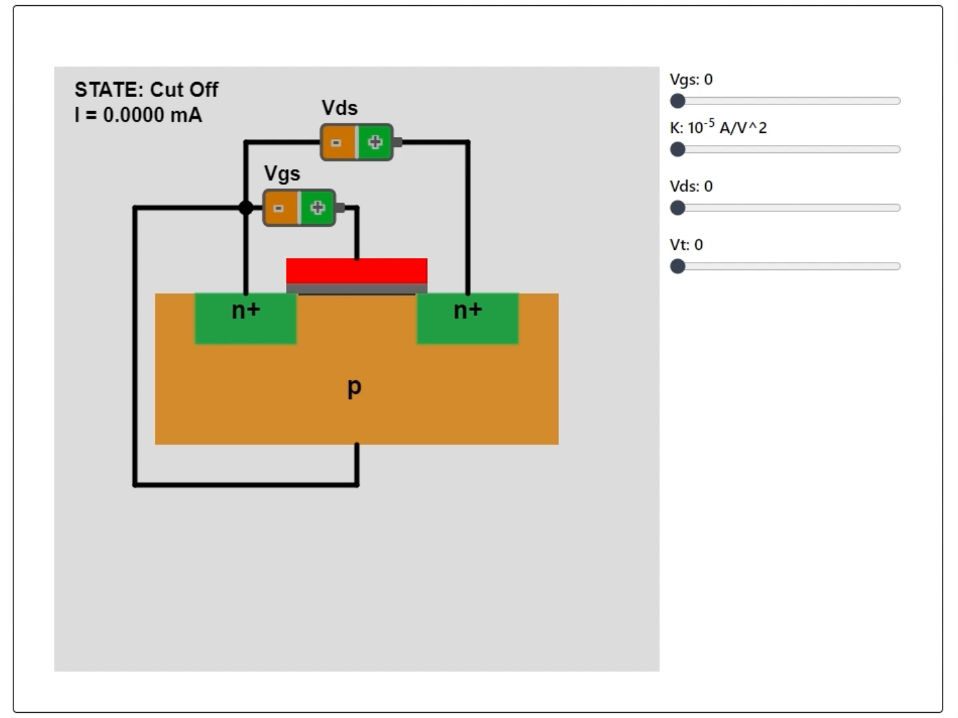
MOSFET

Slide 8
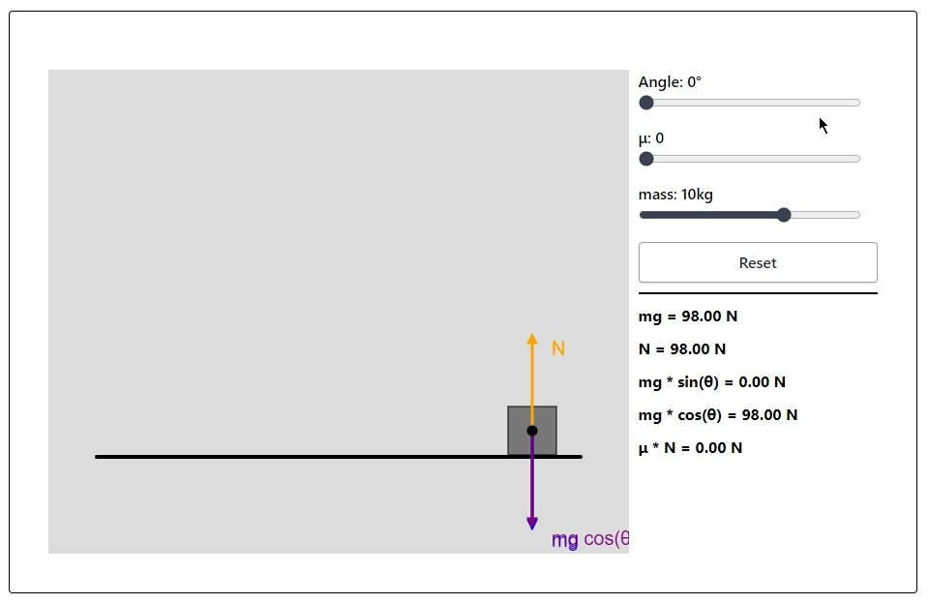
Inclined Plane

Slide 9
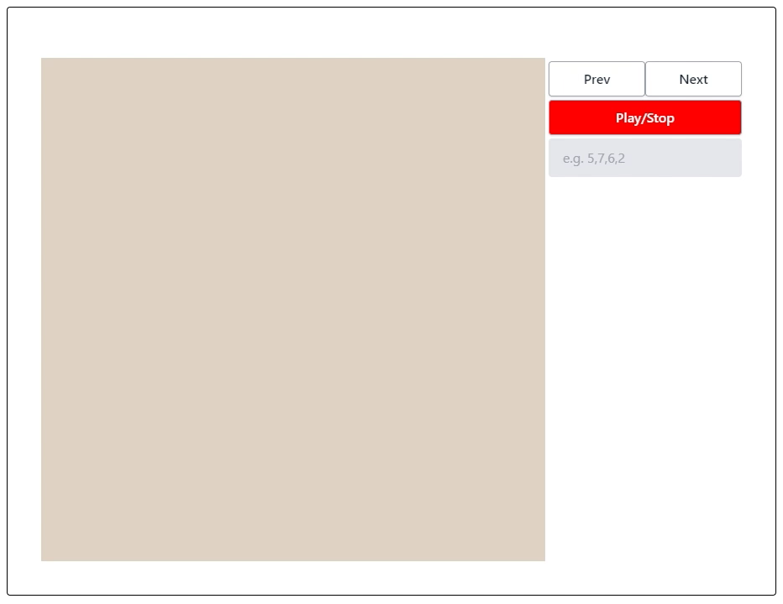
Bubble Sort

Slide 10
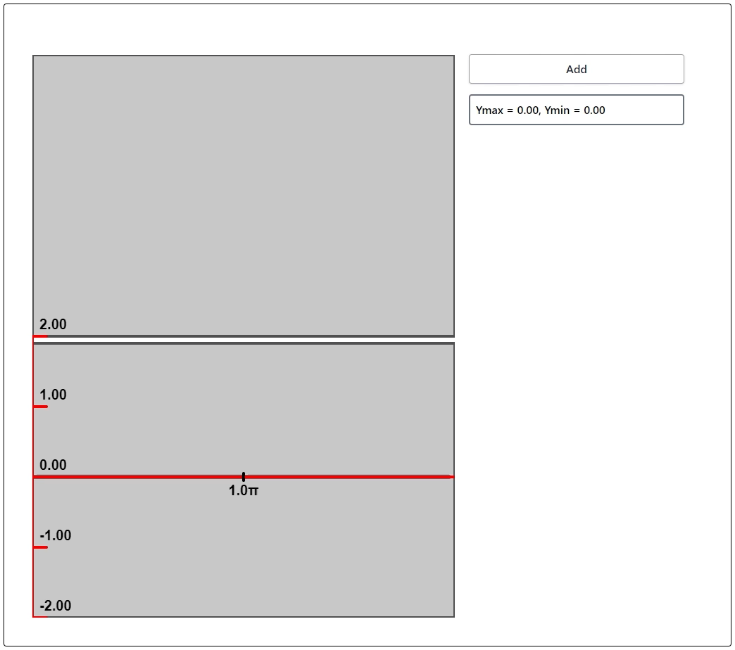
Waves

Slide 11
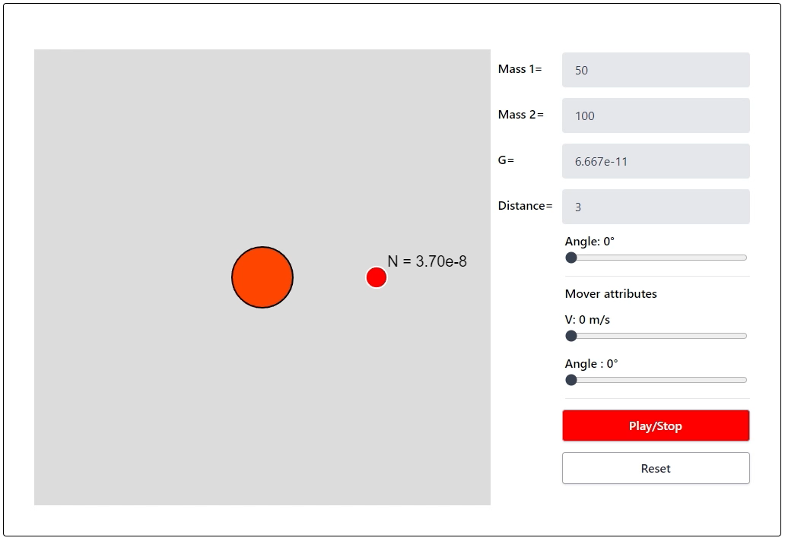
Gravity

Slide 12
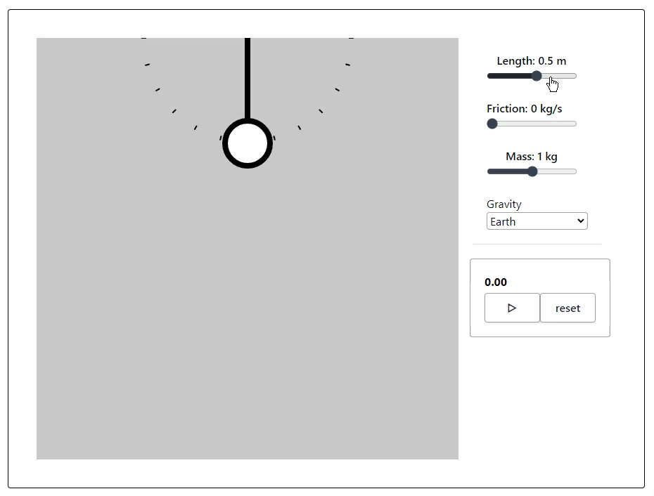
Pendulum

Slide 13
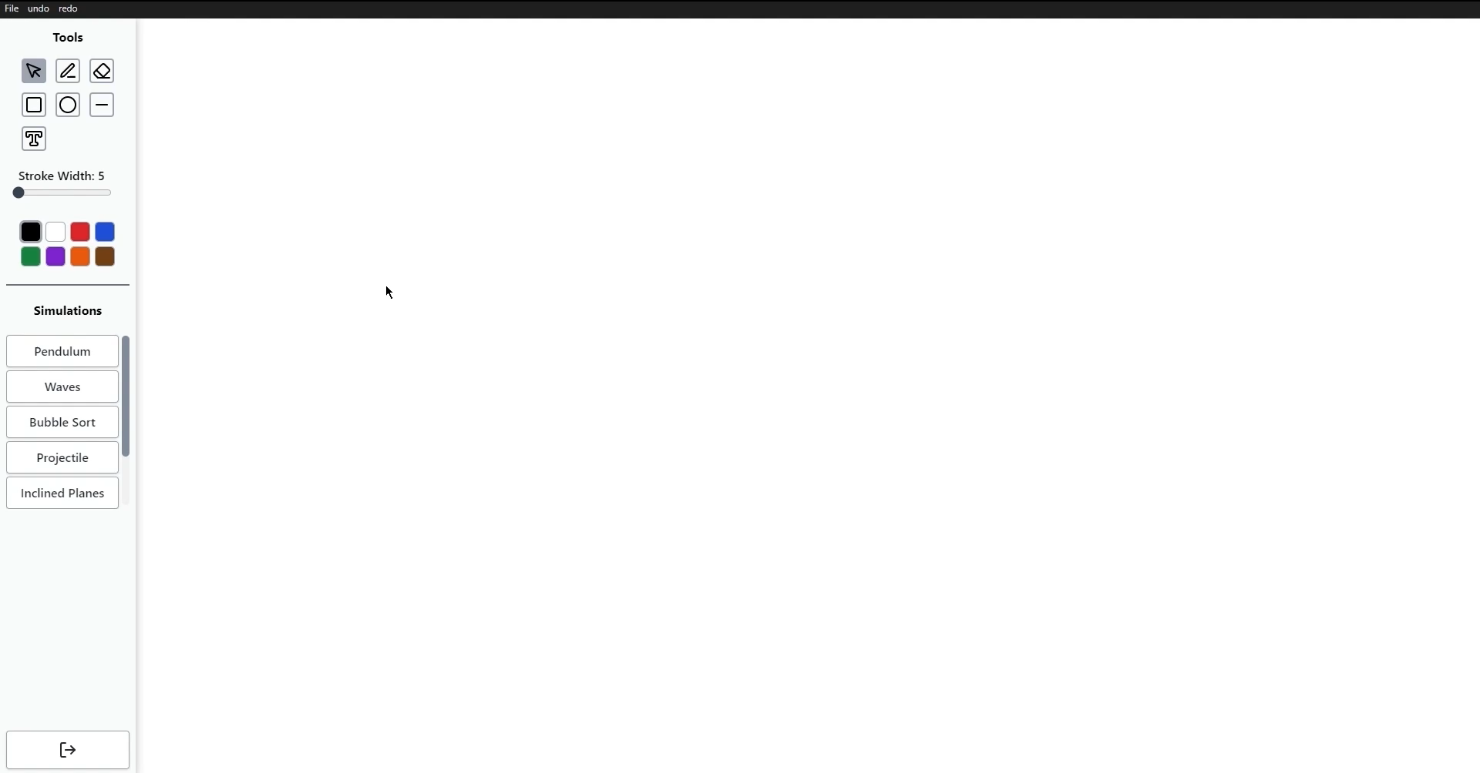
Whiteboard

Slide 14

Whiteboard + Simulations

Slide 15
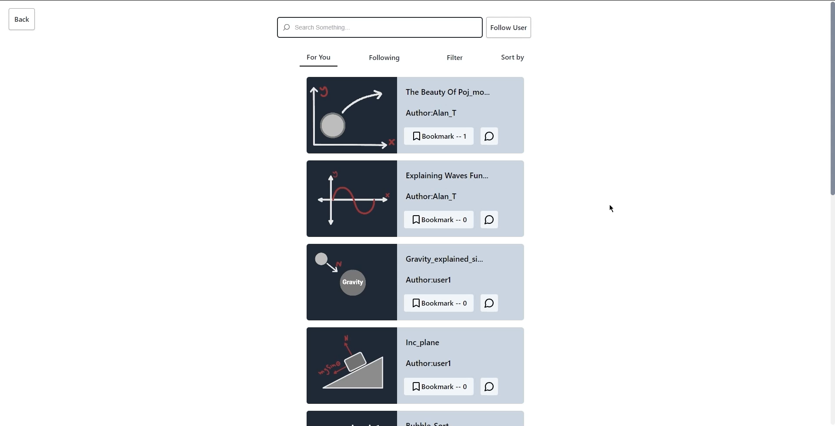
Community

Slide 16
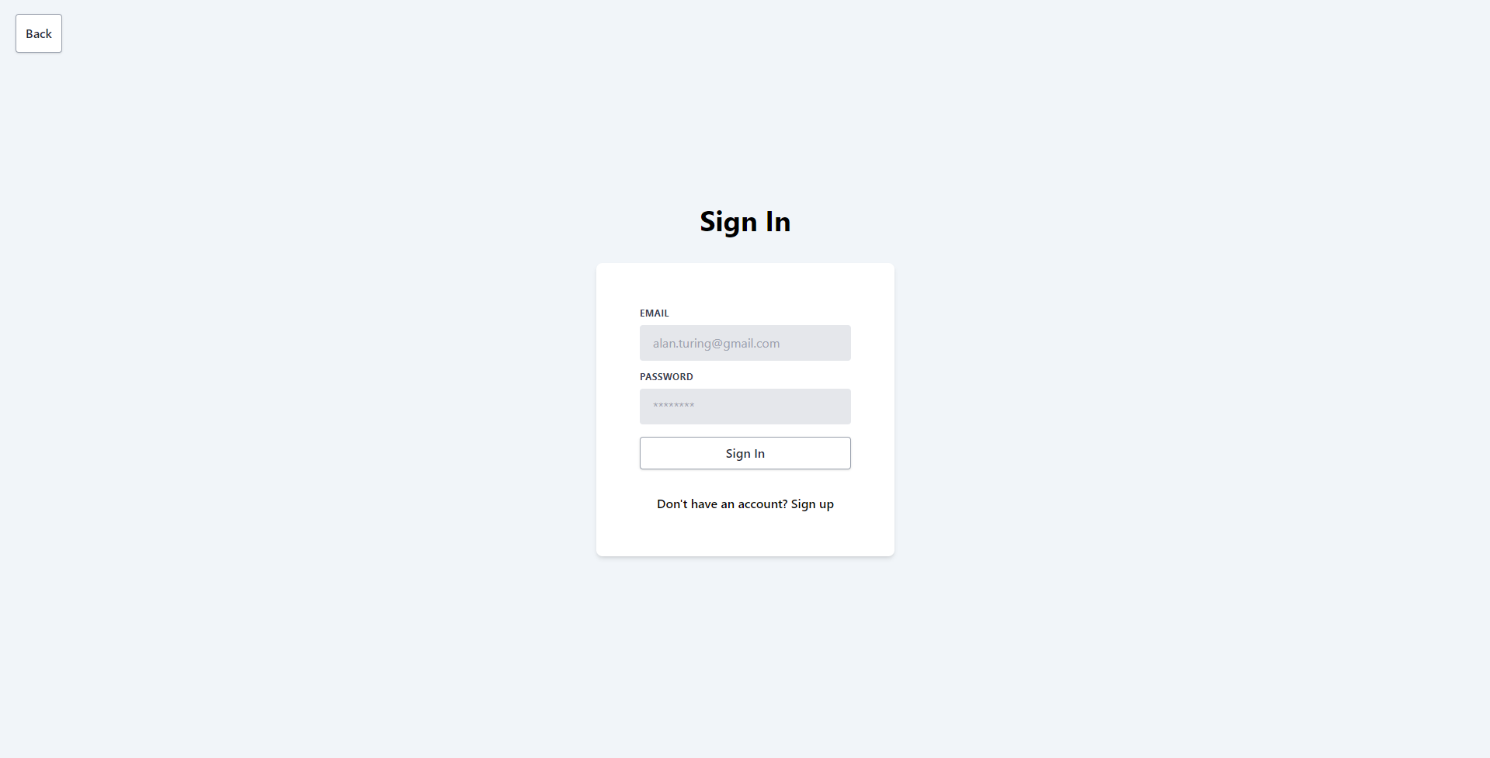
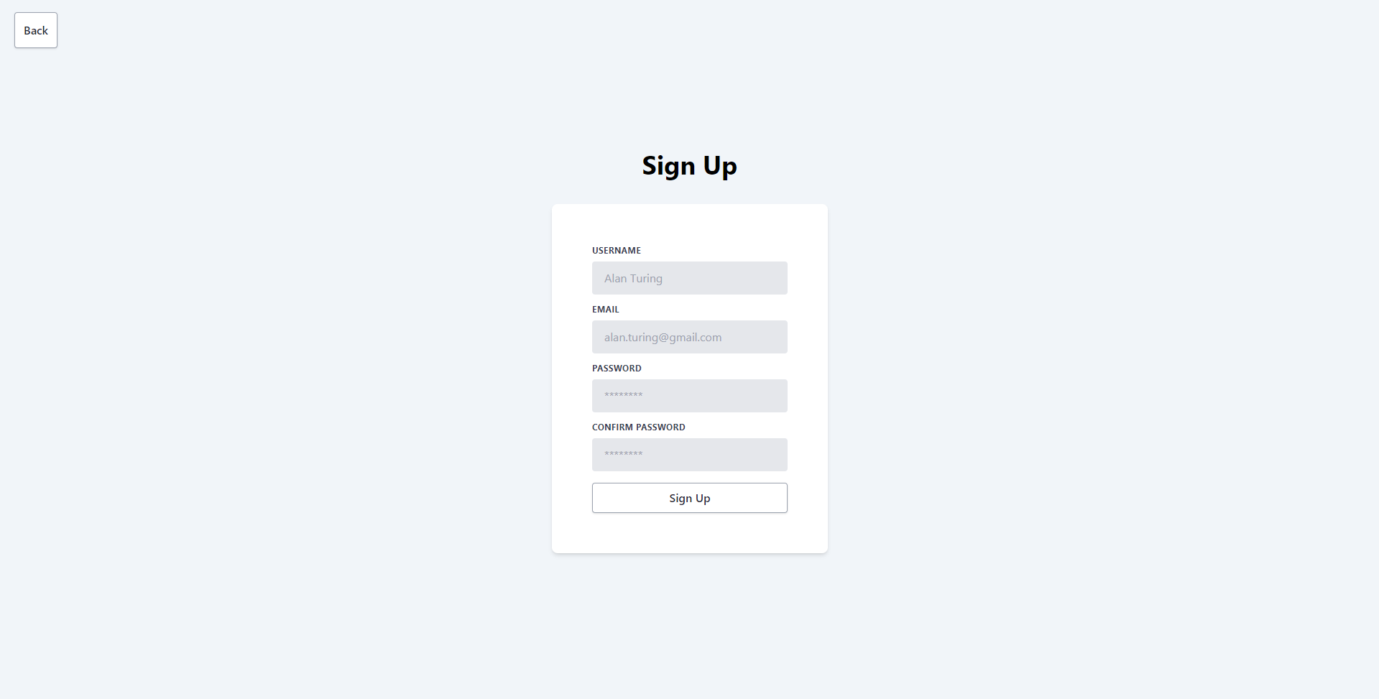
Authentication

Slide 17
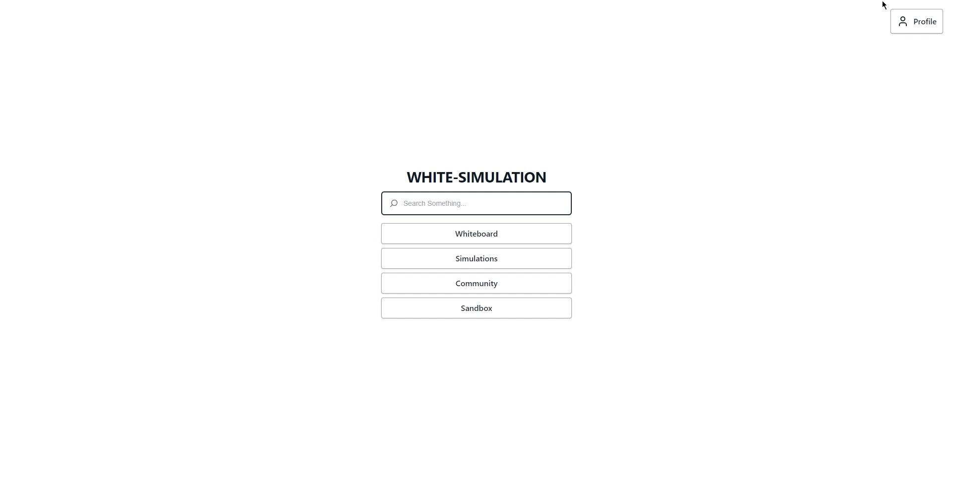
User Profile

Slide 18
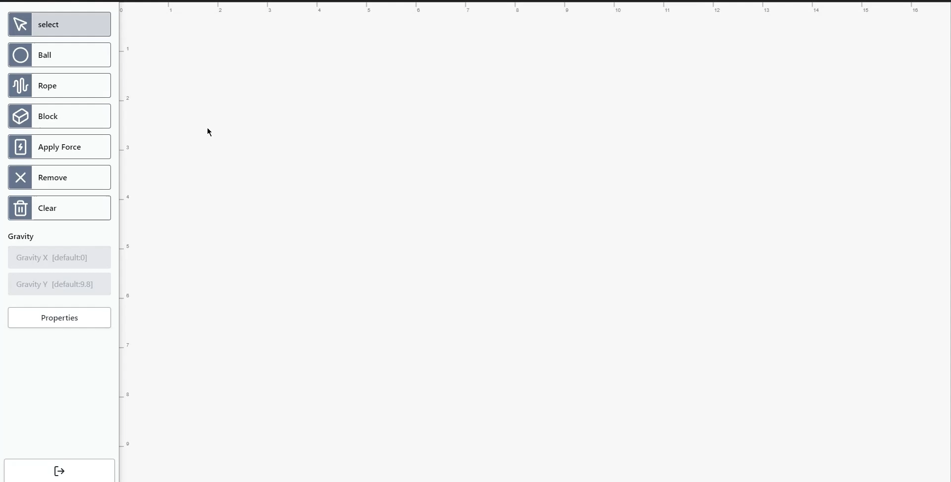
Sandbox

Slide 19
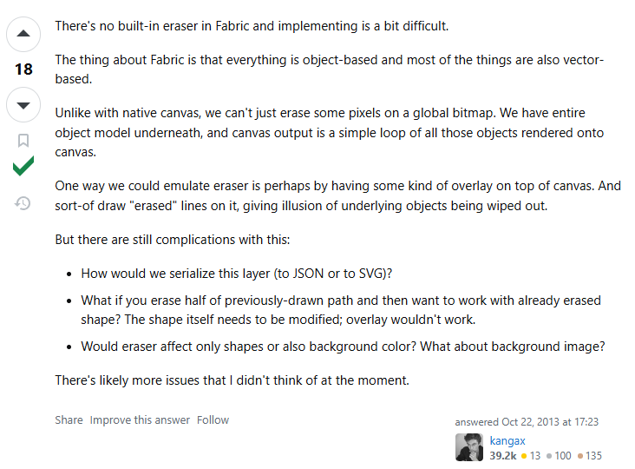
Challenges: Eraser

Slide 20
Technology Stack
•
Electron.js
•
Renderer
•
Database: PostgreSQL
React.js
P5.js
Fabric.js
•
Server: Express.js
•
Auth: supabase

