Slide 1

An-Najah National University
Faculty of Engineering and Information Technology
Civil Engineering department
The effect of using pyrolyzed carbon black (PCB) derived from waste tires as a partial substitute for cement in concrete mixes.
Prepared by
Obada Khaled Janajreh
Supervisor
DR. Mohammad Samaaneh

Slide 2
Content::
1 Introduction:
concrete Industry
Waste Tires
Pyrolysis carbon black
Materials and Methodology
4 Results and discussion
Slump test
Compressive strength test
Tensile Test
5 Conclusion
2 Objectives
3 Methodology:
Concrete compositions and specimen preparation
Mixing Pattern

Slide 3
1 Introduction
Concrete Industry
The concrete industry is considered one of the most important industries in the construction sector. Concrete is widely used in most construction operations. Today, the world needs large quantities of cement to keep pace with urban development. Every day the manufacturing of cement is expanding Causing seriously environmental impacts due to the massive production of cement. Cement production only is responsible about 5-6% of all CO2 in the world, manufacturing a 1kg of cement can released 1kg of CO2 into the atmosphere, also responsible about 4% of global warming.

Slide 4


1 Introduction
Concrete Industry
Emissions of concrete production

Slide 5
1 Introduction
Waste Tires
Waste tires are a big problem facing humanity because of their
huge numbers and the inability to dispose of them in a way
that does not harm the environment.

Slide 6
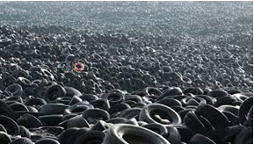
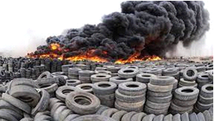
1 Introduction
Waste Tires
Harmful effects of waste tires

Slide 7
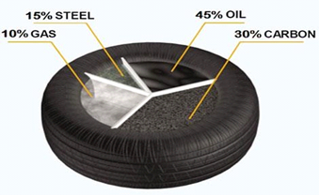
1 Introduction
Waste Tires
Pyrolysis is the process of converting waste tires into gases, fuel oil, steel and a by-product, which is (PCB). Black carbon is present in tire waste in a very good proportion, representing 30%-35% of the components of the tire, attached below is a picture representing the contents of the tire.
Component of tire

Slide 8
1 Introduction
Pyrolysis carbon black
This product is harmful to the environment and human health if left for a long period of time and the release of toxic gases. Therefore, finding a suitable application process for carbon black will make the process environmentally friendly.

Slide 9
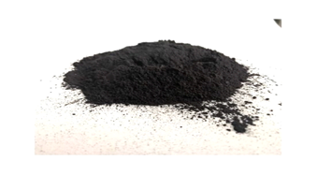
1 Introduction
Pyrolysis carbon black
PCB

Slide 10
1 Introduction
Methodology Laboratory Tests
66 specimens of concrete will be prepared, mixed, and test
following international standards.
A set of tests are conducted considering basic properties of fresh and hardened concrete including the following:

Slide 11
2 Objectives
Objectives
The specific objectives of this project include the following:
• Investigate the ability to partially substitute for cement with the PCB in concrete mixes by Applying multiple tests to measure the effectiveness of the mixtures.
• Determine the mechanical properties of concrete and characterize it when adding PCB powder at various percentage.
• Investigate the proportion of PCB effects on the mechanical properties of the concrete.
• Investigate which is the best ratio of PCB (various percentage) partially substitute for cement in concrete that would lead to a better concrete performance.

Slide 12
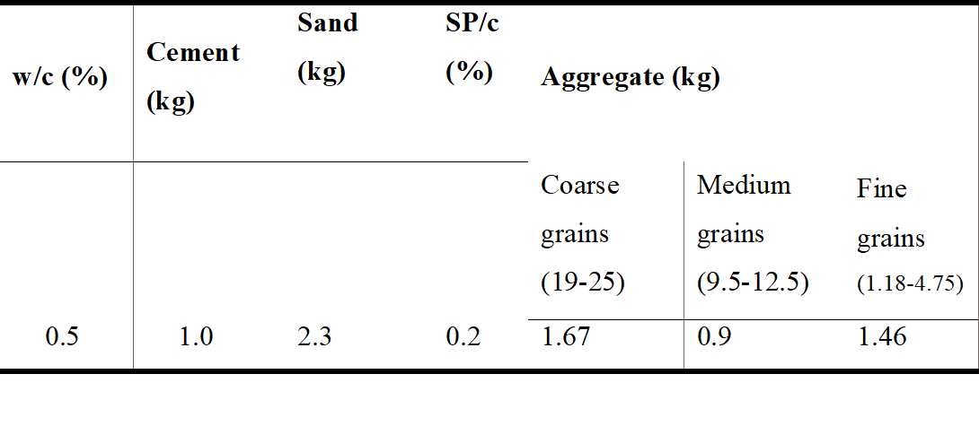
3 Methodology
Concrete compositions and specimen preparation
Concrete will be mixed according to the following mass portions.
To obtain typical concrete cube compressive strength of 30 MPa (equivalent to 24 cylindrical compressive strength). This compressive strength is widely used for slabs, and walls.
Mix proportion of concrete formulations.

Slide 13
3 Methodology
Mixing Pattern
Set of different percentages of PCB will be added to the mix to investigate the optimum mix percentage of PCB.
Total of six different mass percentages of PCB are added to different samples of mix beside a reference one with zero percent of PCB. Mass ratios of PCB to cement (PCB/c) (0%,2.5%,5%,7.5%,10% and 15%) will be used in this research.

Slide 14
4 Results and discussion
Slump Test
percentage | Result (cm)
0% | 12cm
2.5% | 11cm
5% | 13cm
7.5% | 15cm
10% | 17cm
15% | 19cm
The slump value for the reference specimen is 12 cm while increasing the PCB/c ratio decreases.
The slump readings are still within the acceptable range of workable concrete for most applications as the slump is greater than 7.1 cm.
The increase in the slump values at higher dose percentages of PCB (10% and 15%) could be attributed to the aggregation of PCB.

Slide 15
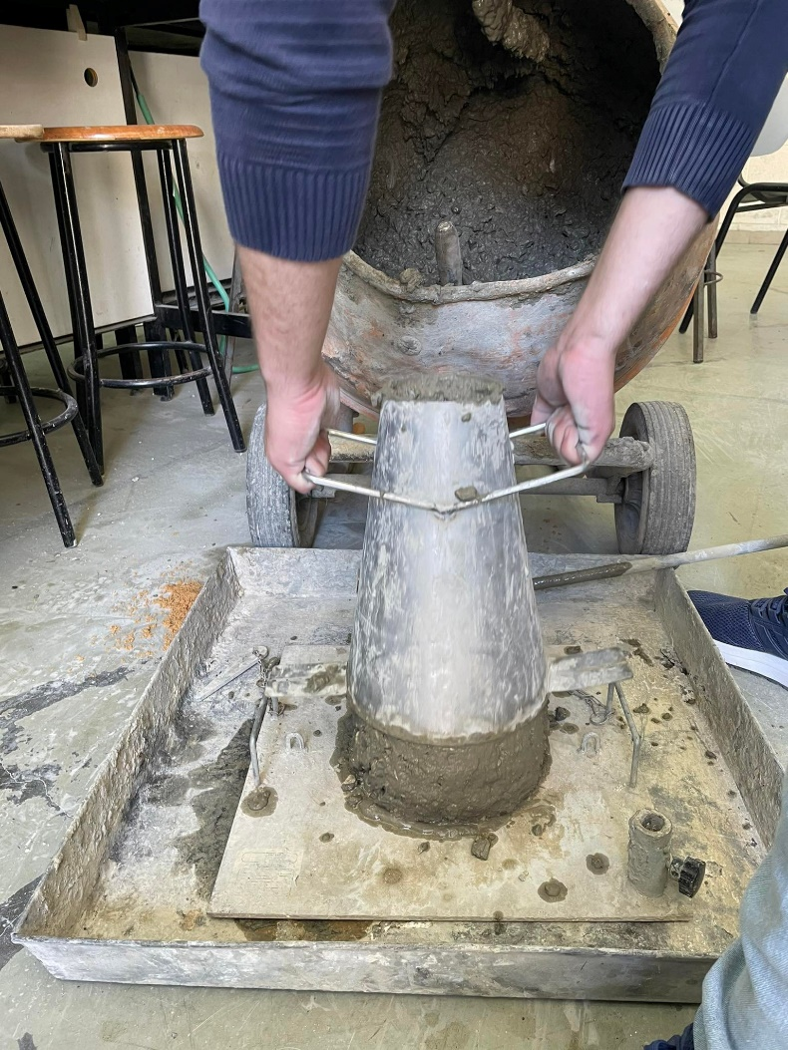

4 Results and discussion
Slump Test
Based on these results, all concrete mixes with the different PCB/c ratios are workable for structural applications.

Slide 16

4 Results and discussion
A total of 54 specimens are prepared for concrete compressive test considering the demanded ratios of PCB/c and tested using the compression strength testing machine. Part of the specimens are tested at 7 days while the second part is tested at 28 days to figure out the progress of gaining compressive strength and to compare them with reference specimens.

Slide 17
4 Results and discussion
Compressive Strength Test
Compression test at 7 days for 10x10x10 cubes:
% | Wight(g) --- KN | Wight(g) --- KN | Wight(g) --- KN
0% | 2.422g --- 198kn | 2.362g --- 201kn | 2.360g --- 195kn
2.5% | 2.318g --- 174kn | 2.364g --- 169kn | 2.381g --- 171kn
5% | 2.282g --- 172kn | 2.314g --- 165kn | 2.326g --- 172kn
7.5% | 2.268g --- 168kn | 2.250g --- 155kn | 2.328g --- 169kn
10% | 2.324g --- 159kn | 2.364g --- 163kn | 2.348g --- 166kn
15% | 2.360g --- 153kn | 2.380g --- 146kn | 2.280g --- 156kn

Slide 18
4 Results and discussion
Compression test at 28 days for 10x10x10 cubes:
% | Wight(g) --- KN | Wight(g) --- KN | Wight(g) --- KN | Wight(g) --- KN | Wight(g) --- KN | Wight(g) --- KN
0% | 2.416g --- 265kn | 2.376g --- 261kn | 2.329g --- 273kn | 2.399g --- 262kn | 2.364g --- 277kn | 2.421g --- 274kn
2.5% | 2.332g --- 257kn | 2.348g --- 263kn | 2.338g --- 255kn | 2.324g --- 254kn | 2.364g --- 259kn | 2.419g --- 259kn
5% | 2.500g --- 250kn | 2.362g --- 255kn | 2.336g --- 249kn | 2.451g --- 250kn | 2.389g --- 261kn | 2.412g --- 240kn
7.5% | 2.276g --- 226kn | 2.289g --- 229kn | 2.463g --- 230kn | 2.237g --- 237kn | 2.251g --- 245kn | 2.267g --- 239kn
10% | 2.376g --- 202kn | 2.338g --- 194kn | 2.401g --- 202kn | 2.351g --- 198kn | 2.378g --- 200kn | 2.404g --- 215kn
15% | 2.356g --- 203kn | 2.408g --- 190kn | 2.338g --- 205kn | 2.324g --- 200kn | 2.364g --- 201kn | 2.349g --- 195kn

Slide 19
4 Results and discussion
The compressive strength tests at 7 and 28 days show a consistency of gaining compressive strength for all specimens with different PCB/c ratios. This indicates that the use of concrete with PCB will have the same design strategy of casting concrete and removing formwork as normal concrete. Since the gained strength of concrete with PCB at 7 days compared to 28 days is relatively the same as for normal concrete.

Slide 20
4 Results and discussion
The results showed that the highest percentage of destructive power was for the lowest replacement ratios, The results were good, but not as expected and according to the results that appeared, it is not preferable to use the previous concrete mixes in construction uses, and the best is to use them in non-structural uses. As for the weights of the samples, they remained within the basic mixture.

Slide 21
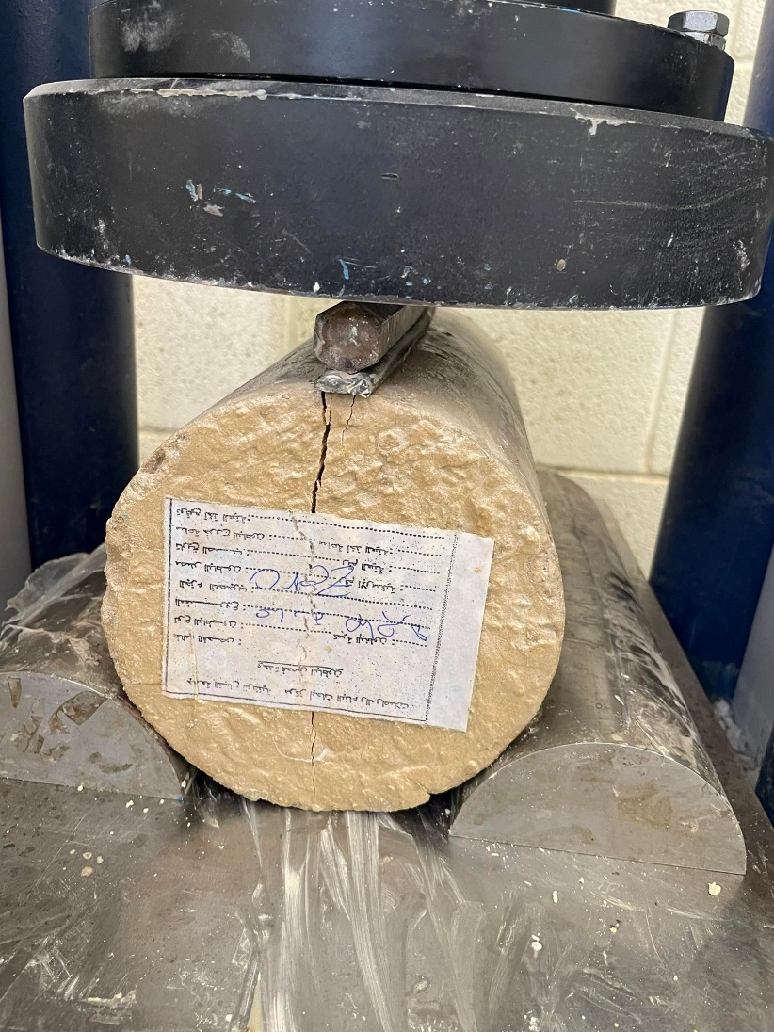

4 Results and discussion
Tensile Test
The Tensile test for cylinders is no less important than any other test. A 12 samples was taken and sampling was taken 27 days later.

Slide 22
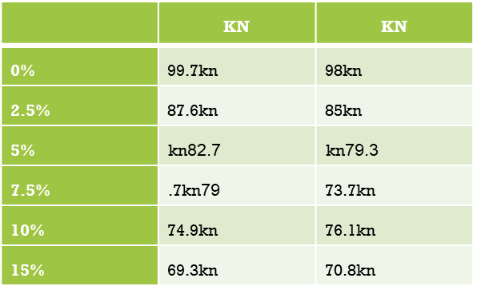
4 Results and discussion
Tensile Test
Tensile test for cylinders at 27 days:

Slide 23
4 Results and discussion
Tensile Test
The results were good, but not as expected. The best results showed at 2.5% and 5% of pcb cement replecment according to the results that appeared, it is not preferable to use the previous concrete mixes in construction uses, and the best is to use them in non-structural uses.

Slide 24
5 Conclusion
Conclusion
The idea of this project is a such great idea because of the good results based in previous researches.
Based on the results of our three previous experiments, it can be said that concrete mixes that contain black carbon as a partial substitute for cement may not be the safe option to use them for structural purposes such as using them in columns or ceilings, but they can certainly be used for non-structural purposes such as floors and others.

Slide 25
Finally
All thanks to the Supervising
Dr. Mohammad Samaaneh
And everyone who helped me complete this work.

