Slide 1
Mr. Autonomous
Presented by: Ban Afanah & Rema’ Bdair
Supervised by: Dr. Hanal AbuZant

Slide 2
Outline
Project’s idea.
Users’ segment.
Process.
Features.
Challenges.
Future work.

Slide 3
What is Mr. Autonomous?
Multi-robot system.
Dedicated for working areas.
Replaces humans’ work.
Moving robots with master-slave communication.

Slide 4

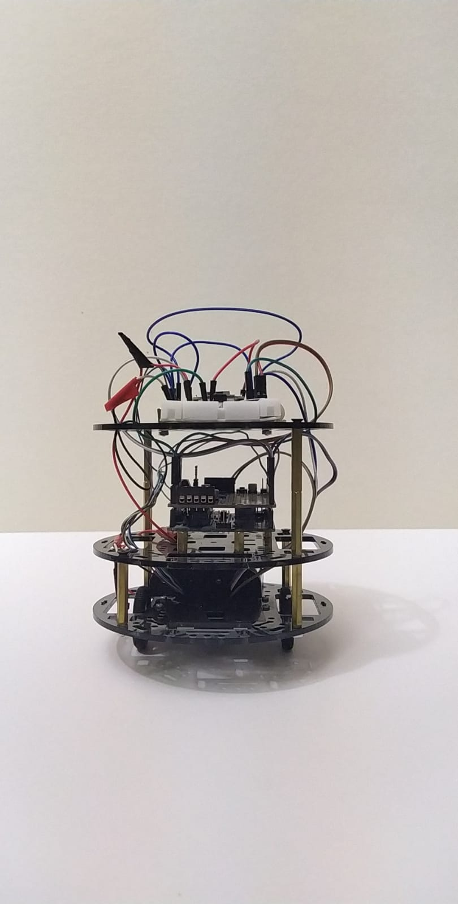


What is Mr. Autonomous?

Slide 5



Process
Data collection
Development
Testing

Slide 6
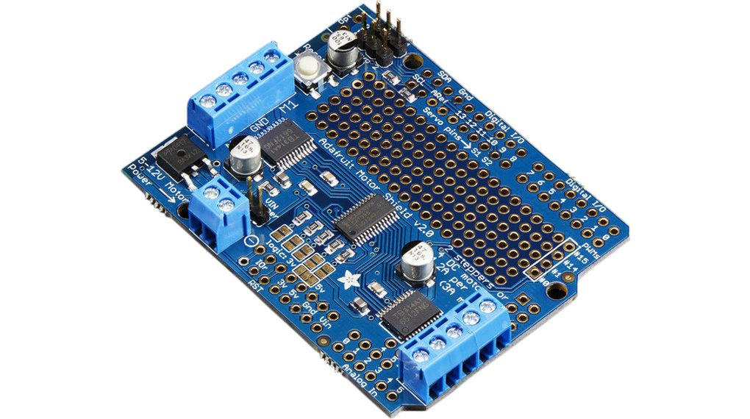
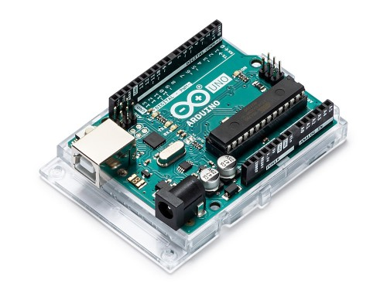
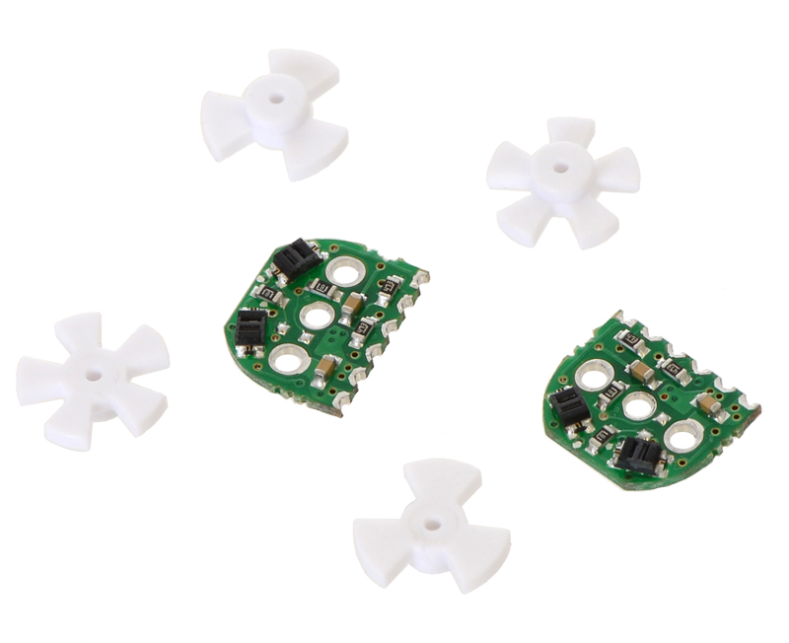
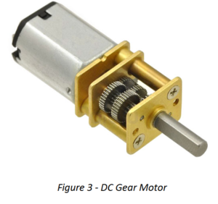
Features: Motion
Walk through a given path.
High accuracy.

Slide 7
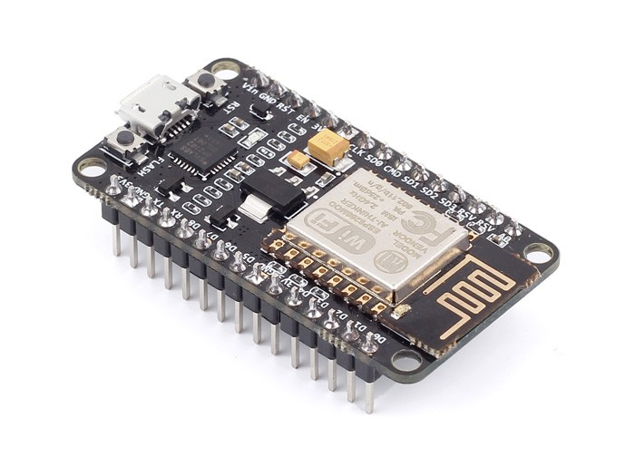
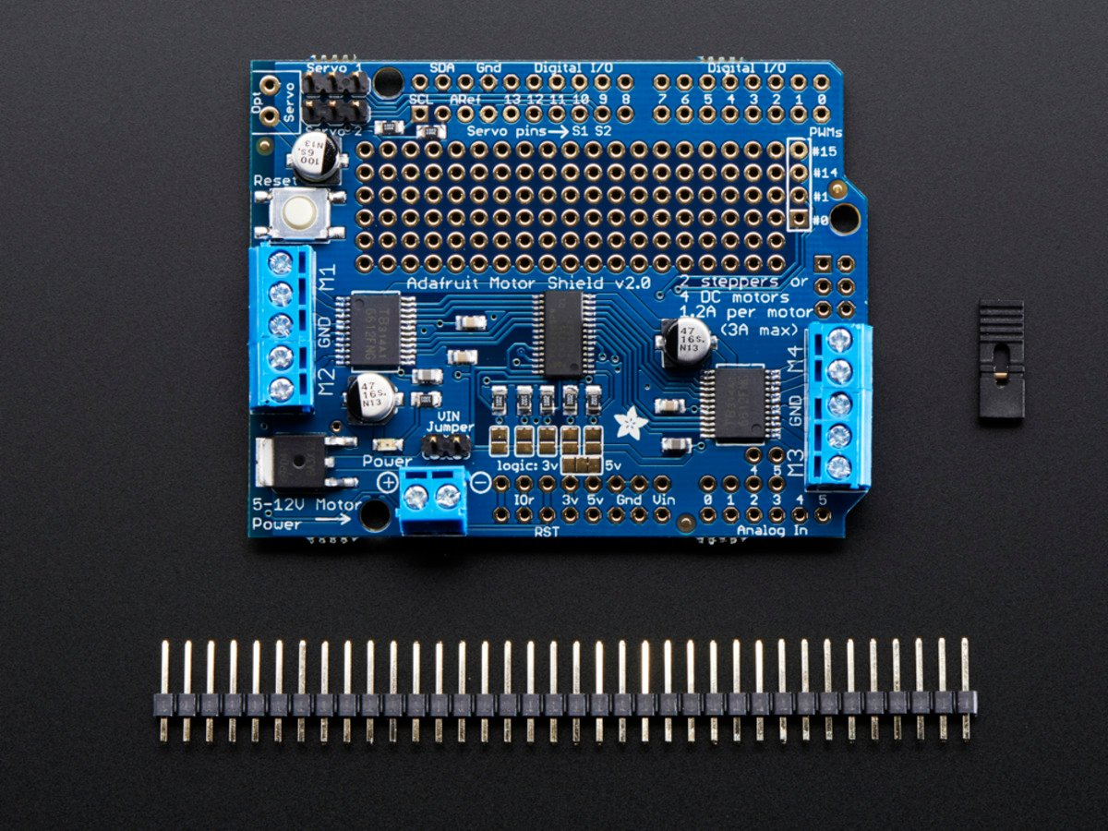
Features: WiFi Communication
Network communication using NodeMCU.
Server-client web App.

Slide 8
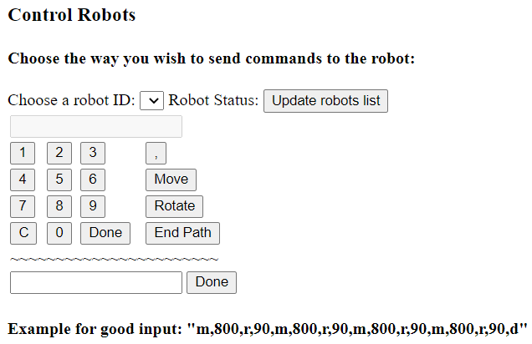
Feature: WiFi Communication

Slide 10
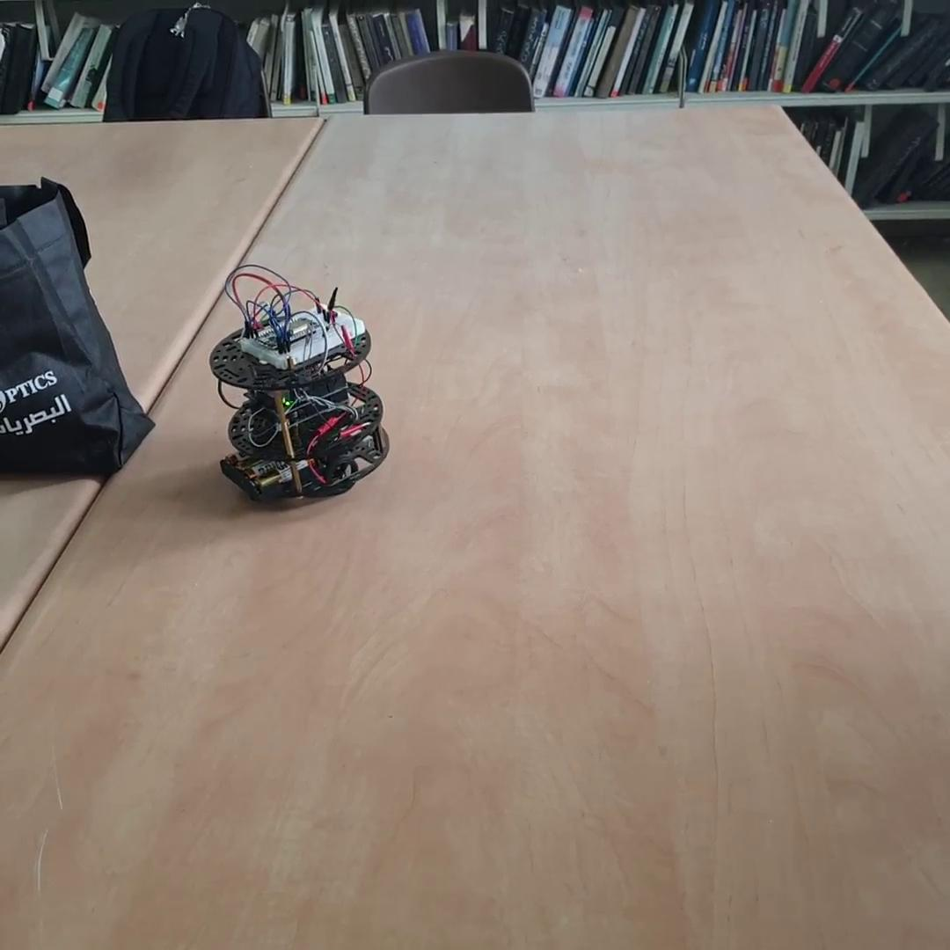

Slide 11
Challenges
Lack of hardware knowledge.
Testing in sight.
Covid-19.

Slide 12
Future Work
Way points.
Autonomous path.

Slide 13

Thank you!

