Slide 1

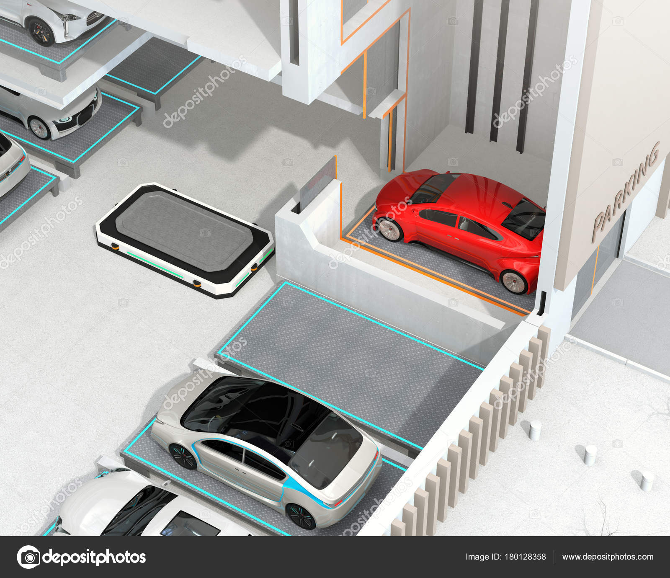
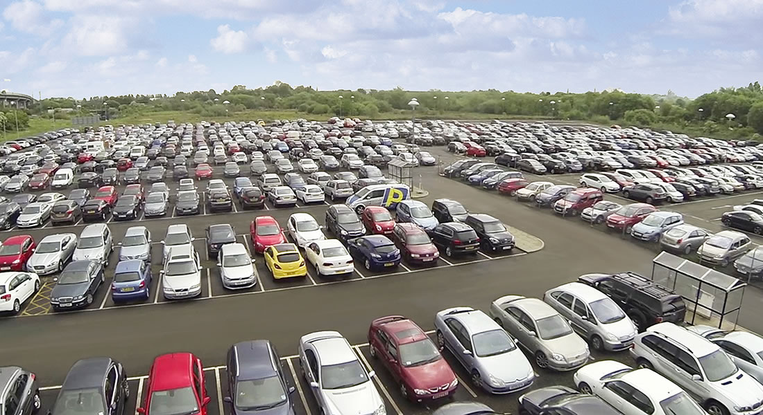
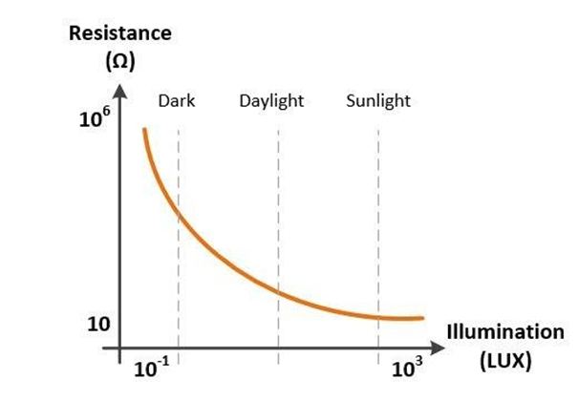
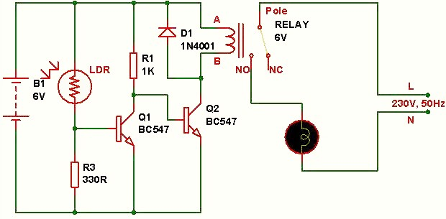
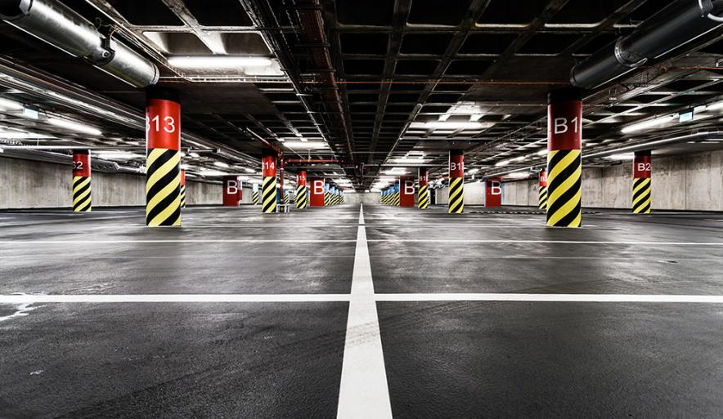
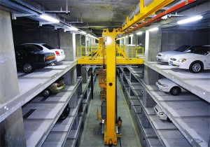
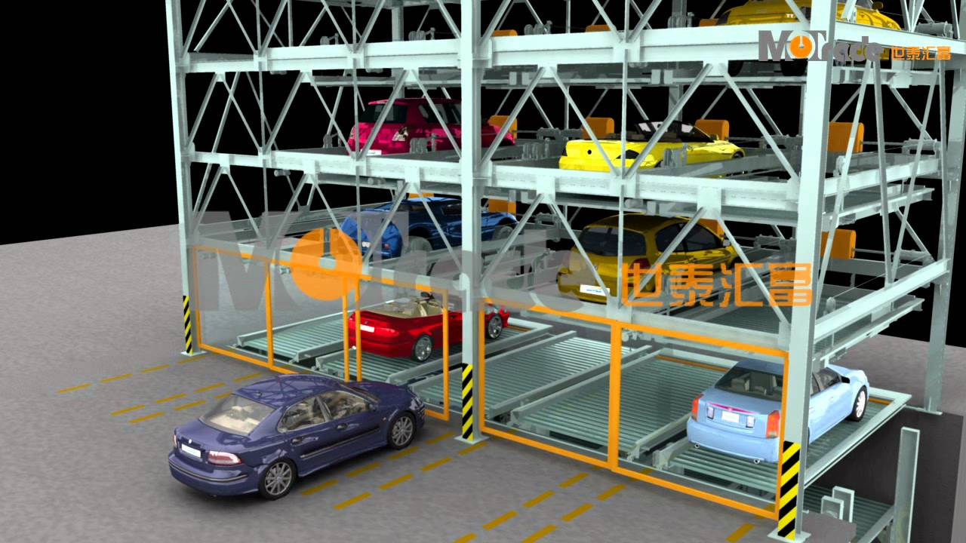
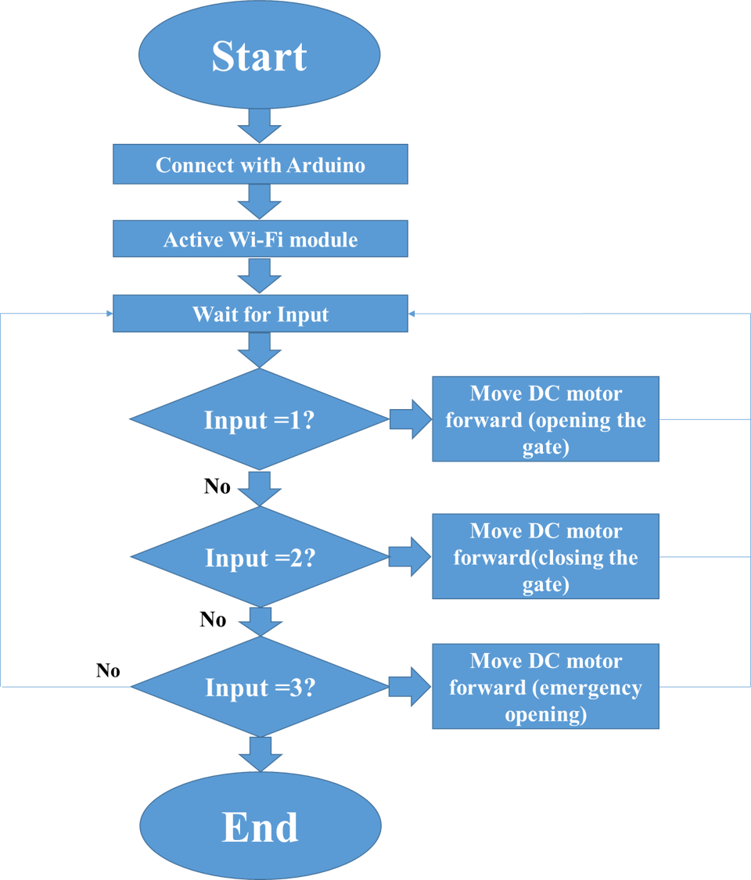
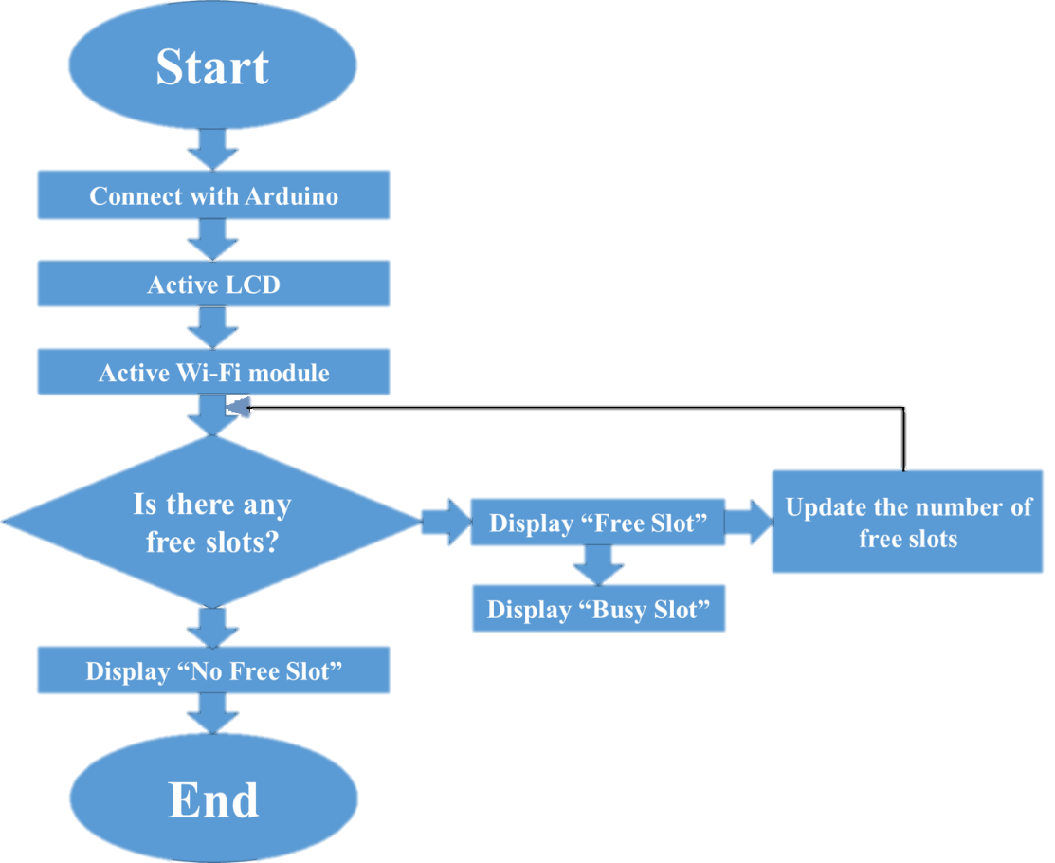
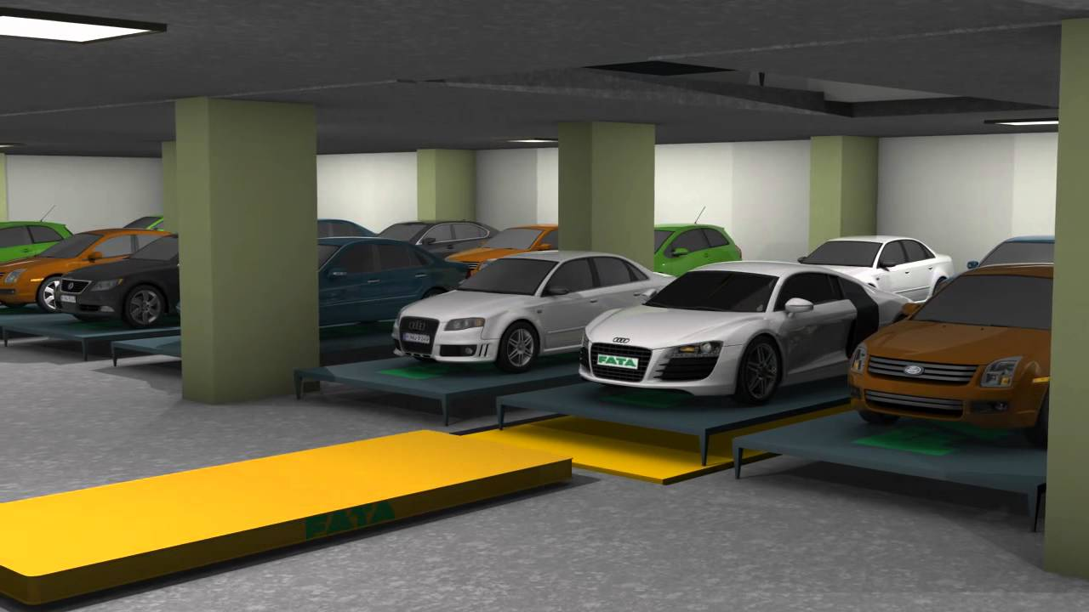
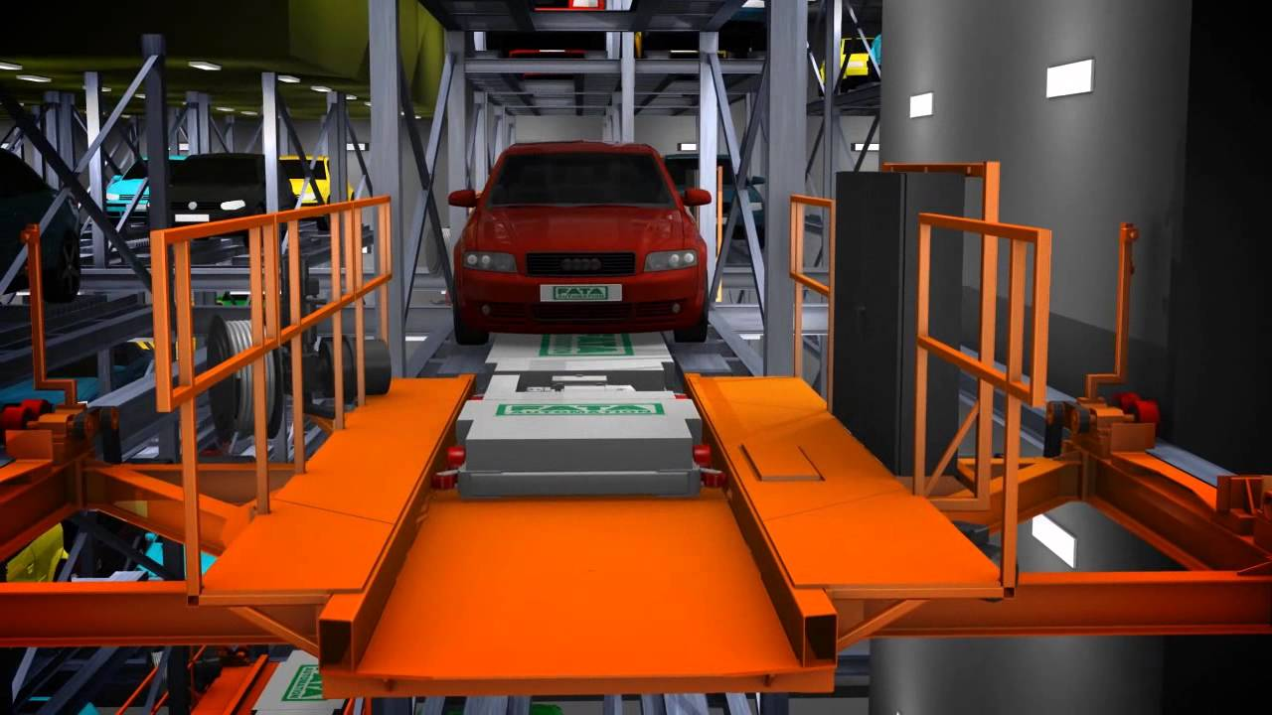
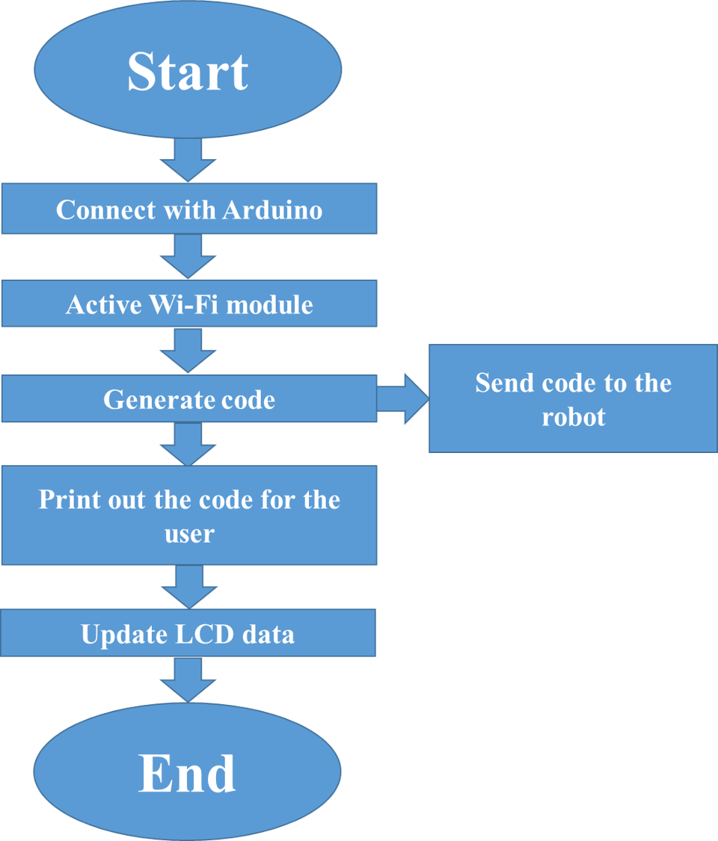
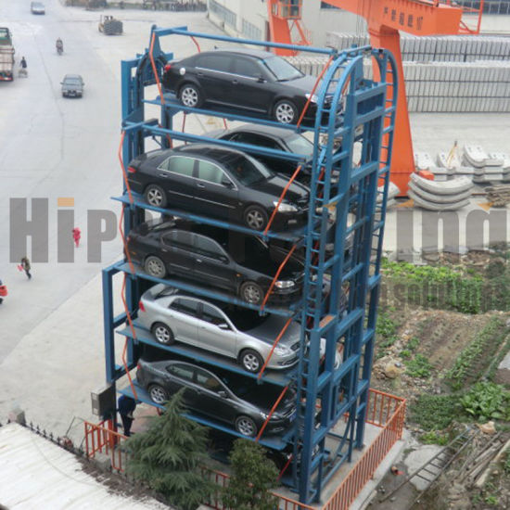
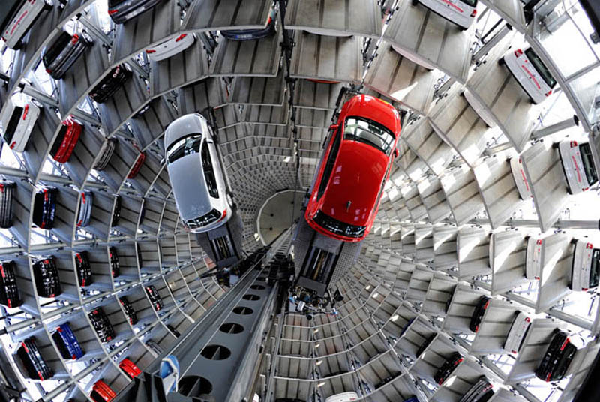
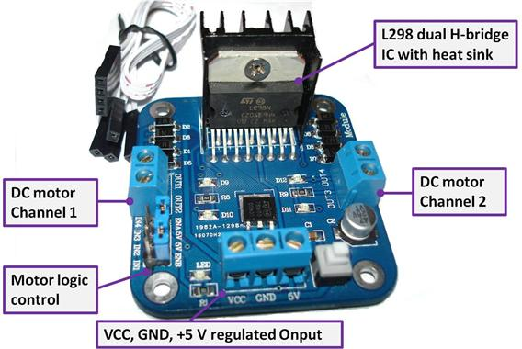
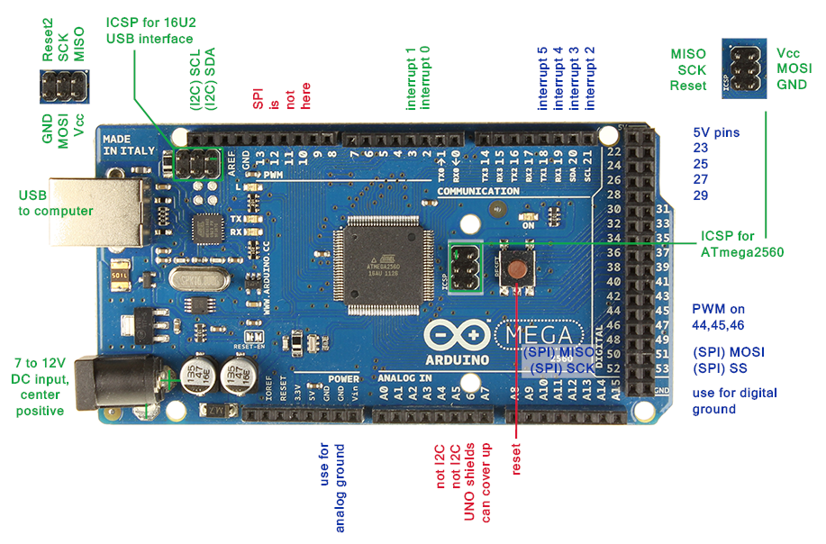
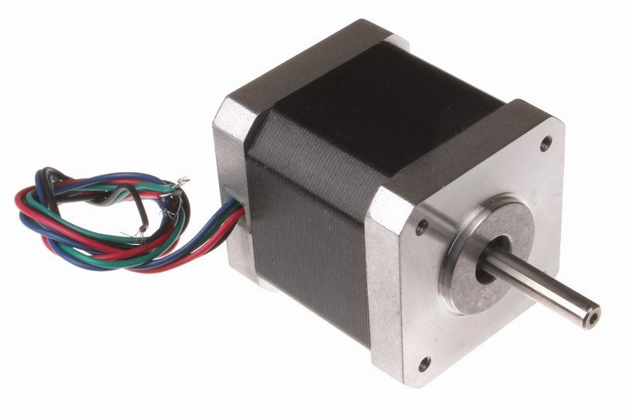
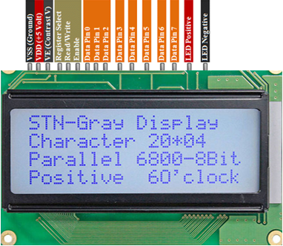
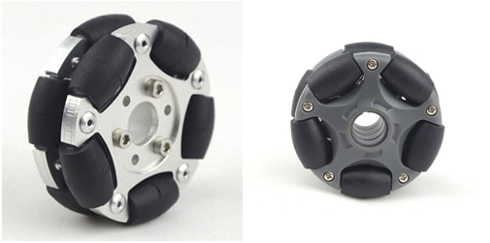
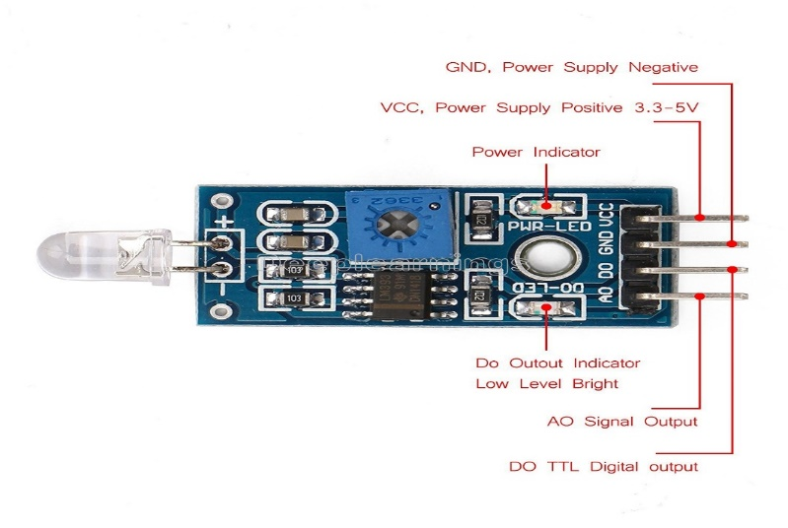
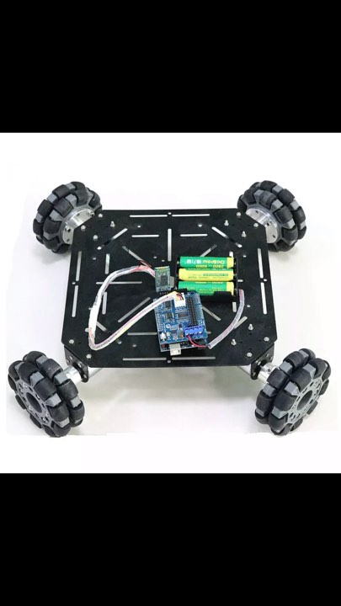
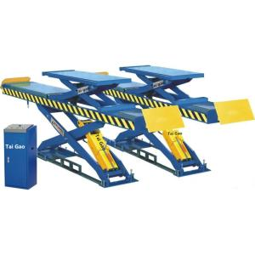
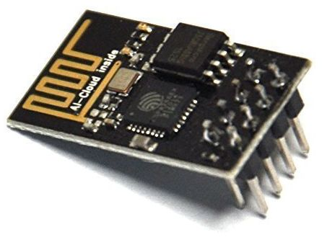

Automated Car Parking system (ACPS)
Aya Hawawrah , Maria Halabi, Ahmad Abbas , Dr.Kamel Saleh
AL-NAJAH NATIONAL UNIVERSITY
Electrical Engineering Department
Introduction
Results
A parking lot is an area that is assigned for parking.
The relationship of optical sensors with the robot and control its path and movement:
.1Traditional car parking system
Light Intensity vs LDR Resistance
Practical Light Sensor Circuit Working Operation
Working Procedure of prototype
Problems with the Traditional car parking system
Theft and lack of protection for cars and people, where there are many problems between people in the absence of security and theft of cars in parking.
Traffic congestion is great especially in many shopping centers and hotels where the guard stops the entire car and gives the receipt of the payment that also leads to wasting a lot of time.
The difficulty of finding a place to park the car thus leads to wasting time and wasting more fuel.
The extra cost is paid to the parking staff of the parking.
.2Automated parking systems
AGV systems
Crane systems
Puzzle systems
RGC systems
Shuttle systems
Silo systems
Tower systems
Flowchart for the display
Flowchart for the gate
Add your information, graphs and images to this section.
Methodology
Flowchart for central command
  Software Design
This project was mainly depend on the robot programming that will control it motion. First, we chose to create X-Y axis plotter shows the paths that the robot will use it in its process and convert it to G-code then sending the G-code file to the Arduino
Conclusion
Hardware Design
After we conducted a study on the automation car parking, we find that automatic parking can be done in our country. On the one hand, it saves time and money, reduces the chaos and accidents and reduces the gas emissions caused by fuel combustion, which also makes it environmentally friendly and provides security for parking vehicles.
As well as its presence in our country promotes automation engineering and develops it in which it is also possible to develop and find other ideas and added to the project, making our country prosperous and technologically advanced.
Therefore, the automated parking system, a system that simulates the increasing technological development and we must offer it and enjoy its advantages.
L298 Motor Controller/Driver
Arduino Mega:
Stepper motor
LCD (Liquid crystal display)
Omni-directional wheel
Light sensor
Future Ideas
During the next semester, a miniature model of automatic parking will be used by Arduino Mega , where the system will take information from the driver such as the ID number and give him a secret code so that he can retrieve his car. During the period of stay in the car will be calculated the number of hours and the cost of parking.
Robot used in our prototype
Electric hoist
ESP8266 Wi-Fi

