Slide 1

Refrigerator Control App
By : ikram Abu Mazen
Ameena Deeb
Subervised By:Dr.Mona Demeidii
.

Slide 2
Outlines :
- What is refrigerator control app ?
- Objects and aims
- Refrigerator Design
- Image processing implementation and Algorithms
- Android App Demo
- Constraints
- Future work

Slide 3
What is Refrigerator control App ?
Refrigerator Control app : is a mobile application, designed specifically to deal with a software related to a smart family refrigerator . This refrigerator is designed in a particular way with cameras inside it .
such that these cameras are located in a specific location and with a specific angle to allow them to take images of all content of refrigerator.
And each camera takes a photo every time the door of the refrigerator is closed.
Then these images will be sent by the refrigerator's processor to a specific PC to deal with. Using OpenCV , application make analyzing for these images and processes them to get a list of food and the amount of each type then store them in database.
Finally , user can use android application to deal with the analyzing data and make some functionalities.

Slide 4
What is the the main aims of this application ?

Slide 5
Objects and aims
What are the App objects ?
Control and deal with refrigerator .
User can know what he have in his refrigerator from outside home.
Based on this information, users can view list of available food and do shopping for the unavailable kinds of food.
this app helps the user to get recipe of meal that can be done using the available content of the refrigerator
Send notification for expiry date of food inside refrigerator and the amount for each type.
.

Slide 6
Refrigerator design Demo
.
.

Slide 7
Image processing implementation and Algorithms
After processor sends Refrigerator’s images to PC, it stores it in a specific folder with a specific number according to cameras, then the program starts analyzing images to find each food type.
This program fragmented to 3 classes, each class analyzing a certain number of camera's outputs, so it processes a specific kind of food.
.

Slide 8
How to detect Eggs ?
Class 1:
Image 1 in PC folder taken by camera 1 in Refrigerator, which contains shelf of eggs.
Main Algorithm:
Program detect the objects in image by houghcircles function.
.

Slide 9
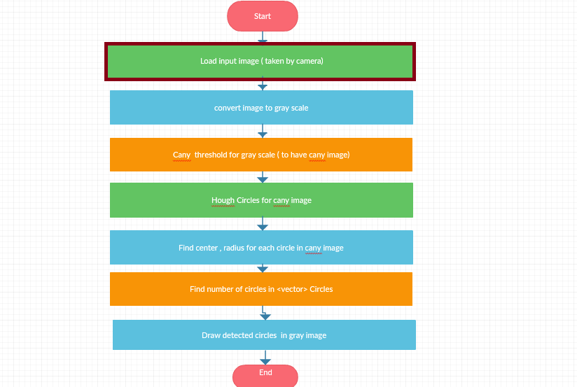
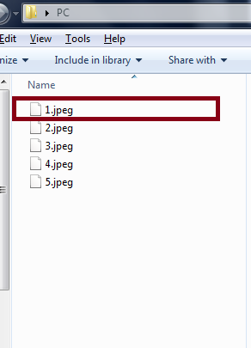
.
.

Slide 10
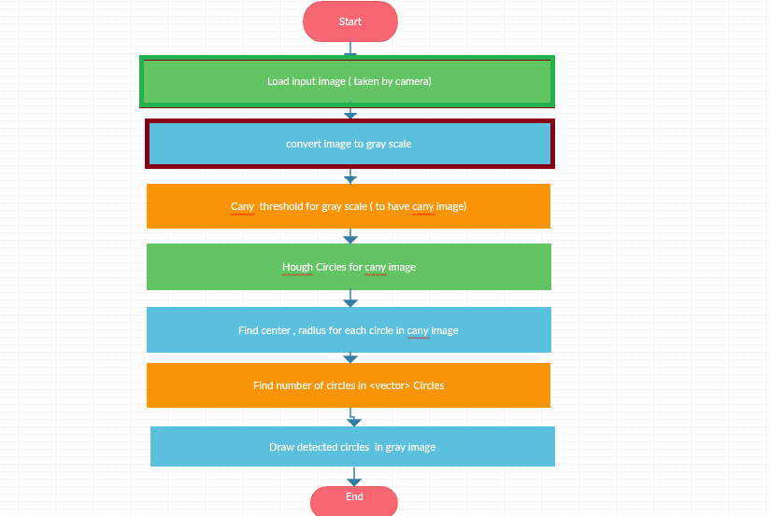
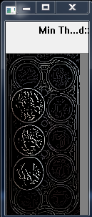
.
Find the Gray scale
Then,
apply canny threshold on image

Slide 11
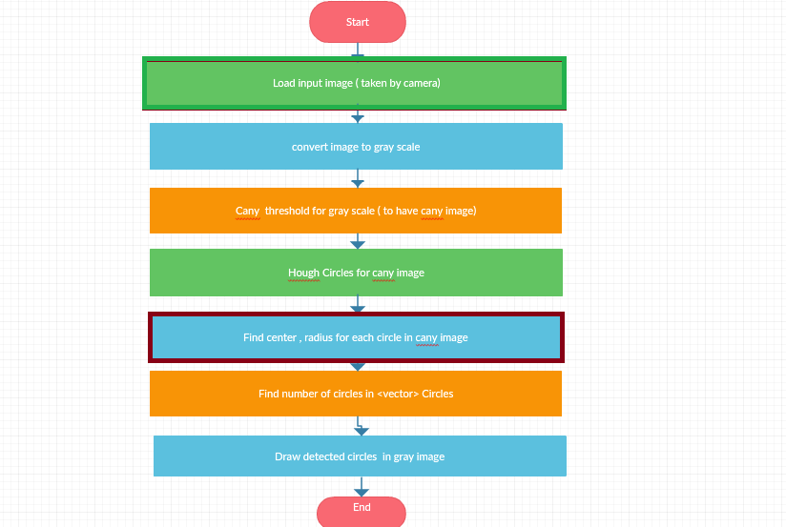
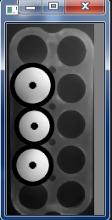
.
Apply hough circles for canny images
Then,
detect each object center and radius

Slide 12
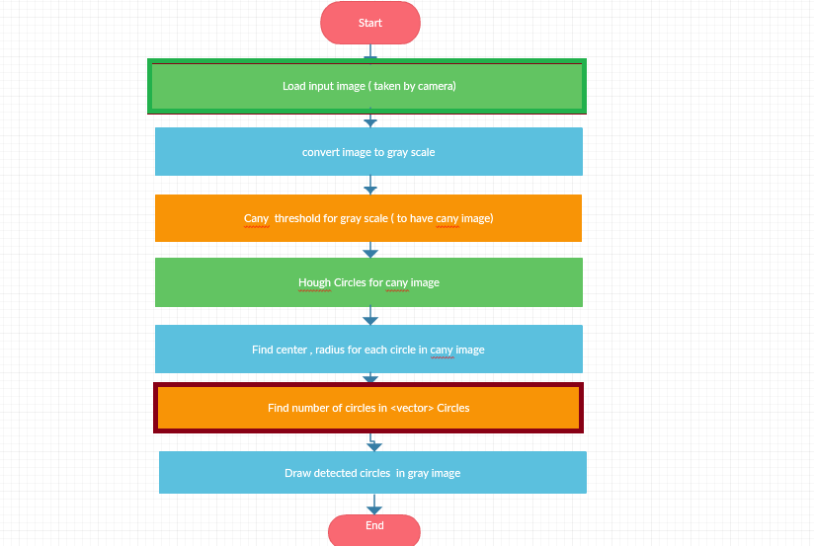
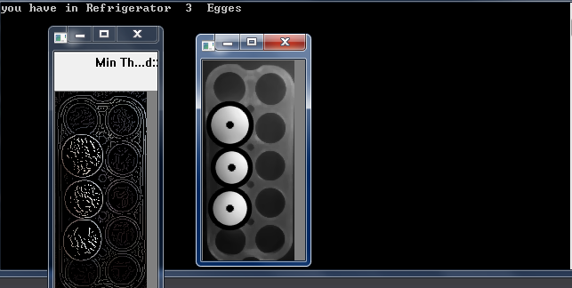
.
Find the number of objects from vector <circles>

Slide 13
How to detect if there is bread or not ?
Class 2:
Image 2 in PC folder taken by camera 2 in Refrigerator, which contains shelf for bread.
Main Algorithm:
Program find if there is bread using Histogram comparison.
.

Slide 14
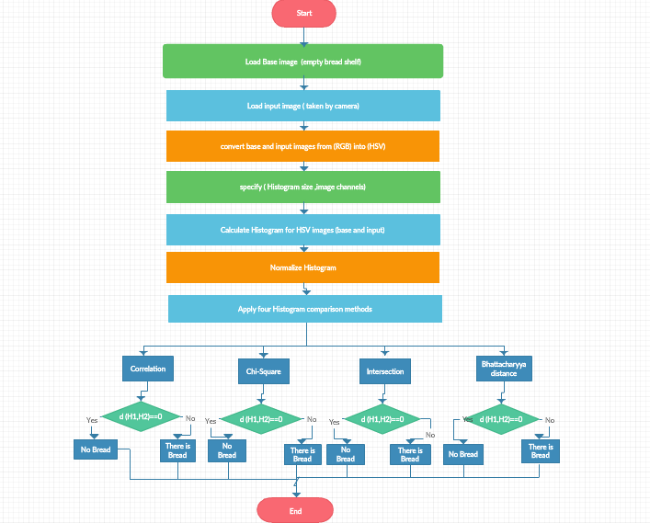
.
.

Slide 15
.
For bread processing is done as follows:
First load base image taken by camera 2 for the first time before putting anything inside the refrigerator, which is in this class represent empty bread shelf, then load input image taken by camera 1, after closing the refrigerator door. The program then converts these two images, base and input image from RGB to HSV format, then specify histogram size, image channels and it uses 50 binaries for HSV and 60 for saturation. After that, it calculates histogram for base and input HSV images, then normalizes histogram for each image

Slide 16
.
Finally, program have to compare the two histograms of input and base images, to compare two histograms (H1,H2) , the first program has to choose a metric ( ) to express how well both histograms match. OpenCV implements the function compareHist to perform a comparison. It also offers 4 different metrics to compute the matching:
A-Correlation ( CV_COMP_CORREL )
B-Chi-Square ( CV_COMP_CHISQR )
C-Intersection ( method=CV_COMP_INTERSECT )
D-Bhattacharyya distance ( CV_COMP_BHATTACHARYYA
Each metric return a double value, which represent the proportion of similarity

Slide 17
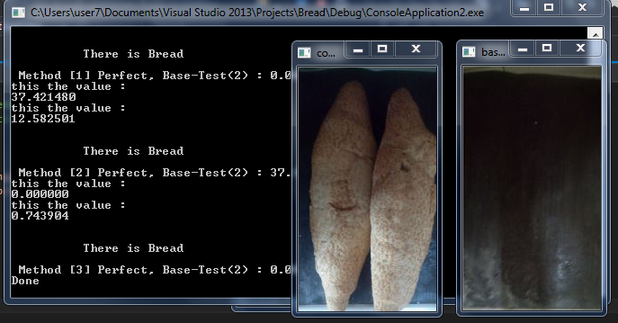
.
.

Slide 18
What about vegetables ?
Class 3:
This class algorithm for some types of vegetables and fruits, tomatoes
apples, oranges, and lemon, which detected by number of cameras in refrigerator .
Main Algorithm:
Program detect each type according texture of pixels .
.

Slide 19
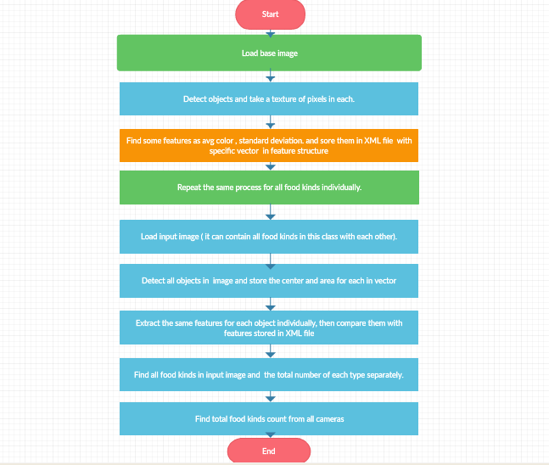
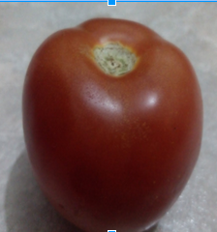
First load based image for each kind of foods. Then,program detects the object to find a texture of pixels .
.

Slide 20
After that program takes some features as color average and standard deviation and store it in feature structure, in XML file.
.

Slide 21
Then when refrigerator doors closing and cameras take input images, which can contain some kind of vegetables, the first program
detect objects in input image then find the center of each to find texture of pixels then extract the
same features.
.

Slide 22
Then by compare the object values and the base values ,
program can detect the object type and then count it and find the total amount of each in this self ,
then store it to use it in android app.
.

Slide 23
The average value range :
Orange (orange) : inRange(hsv_image, cv::Scalar(0, 100, 100), cv::Scalar(10, 255, 255), hue_range);
Tomato (red) cv::inRange(hsv_image, cv::Scalar(160, 100, 100), cv::Scalar(179, 255, 255), red_hue_range);
Lemon (yellow)
InRangeS(imgHSV, cvScalar(20, 100, 100), cvScalar(30, 255, 255), imgThreshed)
Apple (between yellow and green )
If not in any previous ranges
We use the first feature only, which give more accurate result .
According to the base image the range of average values for each type is as follows :
.

Slide 24
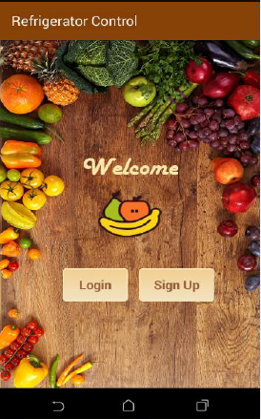
Android Demo
.
.

Slide 25
Constraints
The main constraint that we have faced in our project is the refrigerator design since we want the refrigerator in a particular design ,such that these drawers have specific height to prevent users from putting things over each other, in order to enable cameras inside each drawer to take clear images of the content to get approximately correct answers .Unluckily, we did not find a refrigerator with these features.
The second constraints are getting images of food to be processed since we do not have a real design of the refrigerator and we want to process real images. We overcome this constraint by using real images from our own refrigerator such that we use the part of the refrigerator that has the characteristic that we want in the refrigerator we designed . The third constraint is the location of cameras inside each part of the refrigerator to get clear images

Slide 26
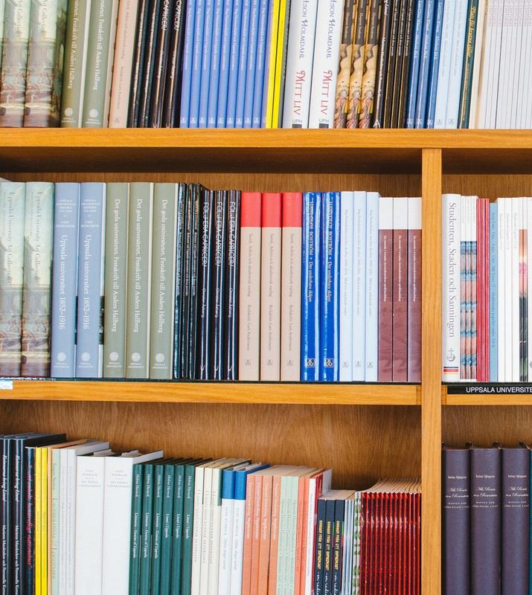
What will we do next?
It seems we can do many useful and extended ideas .

Slide 27
Future work
First we hope to reduce the error percentage we get which was 20% by using more advanced algorithms in image processing .Also ,we want to add the functionality that we did not do in the project due to the time which are:
1. Giving the users the ability to order meal on line such that he will enter the name of the recipe and the mobile application will display on a map all restaurants that offer this meal and will draw a path to the nearest restaurant.
2. Using a calendar with advanced option such that the user can insert the name of the recipe for any date he wants , and the application should give the user a notification for the gradients that are needed but not found in the refrigerator at the start of that date.

Slide 28
Conclusion
We expected the results to be more limited, but good results can be obtained with image processing with a lot of experience with everything possible to do. As a result of the project, the most important results from it, obtain a list of the basic types of food, which can prepare a whole meal and benefit from The shopping list also carries out the process of checking the validity of the food, and there are many things included in the project as
well. We thought that the project was more complex and we faced a lot of problems, especially at the beginning, but then we managed to detect the world of image processing and android.

