Slide 1
Structural Analysis and design of Ammar Tower on Ramallah- Palestine.
By:
Karsou Othman (11819320)
Osaid Abu Shanab (11821753)
Mahmoud Najjar (11821751)
Under supervision of:
Dr. Munther Diab

Slide 2

Outline.
Design final dimensions
Design of frames
Design of slab system
Design of shear wall
2

Slide 3
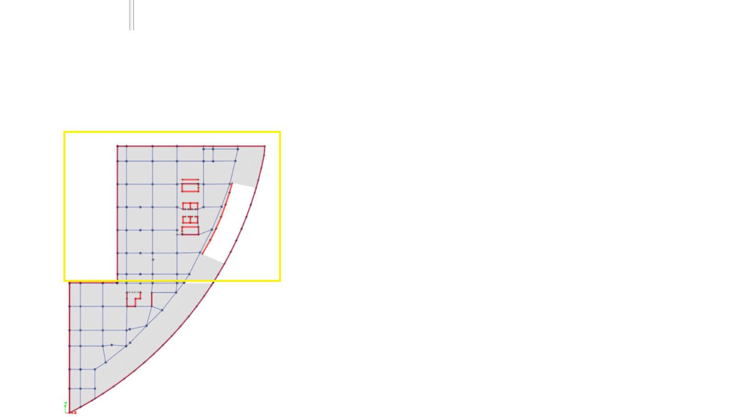
Part to be design.
The structure is formed by two isolated parts, and in this project the upper part will be designed.
3

Slide 4
Design final dimensions.
the results came out as shown in the following table.
Property | Cross section(mm)
Slab | Solid slab (300)
Columns (first 7 stories) | 1100*1100
Columns (stories from8 to the top) | 850*850
Beams | 950*600&950*750
Shear walls | 400

Slide 5
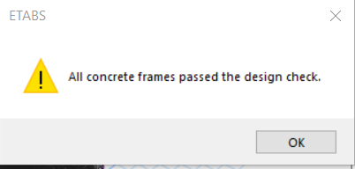
Design final dimensions.

Slide 6
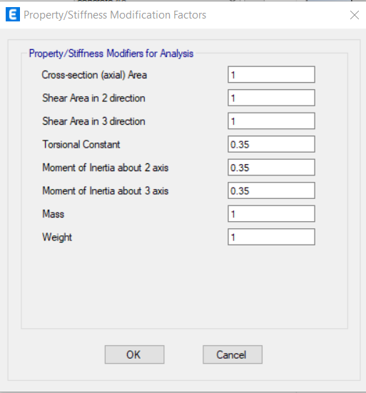
Properties modifiers.
Beam modifiers:
From the ACI code, the stiffness modifiers are as shown in the following figures.
6

Slide 7
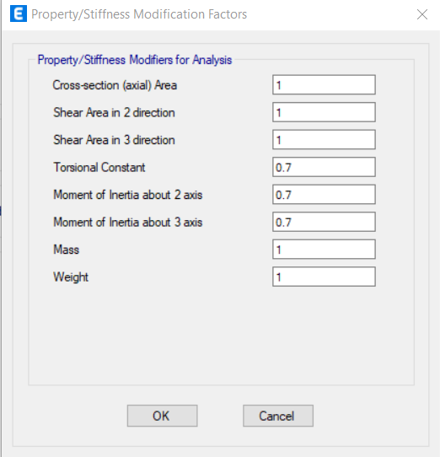
Properties modifiers.
Column modifiers:
From the ACI code, the stiffness modifiers are as shown in the following figures.
7

Slide 8
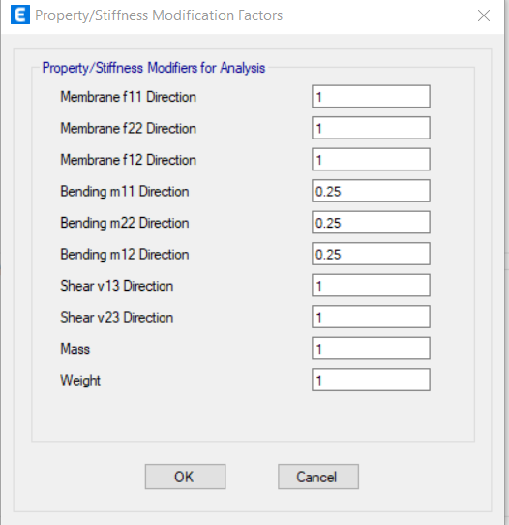
Properties modifiers.
slab modifiers:
From the ACI code, the stiffness modifiers are as shown in the following figures.
8

Slide 9
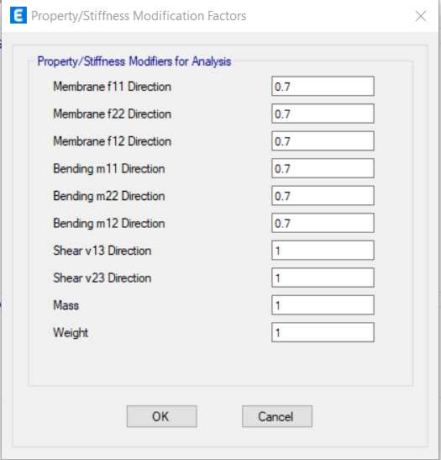
Properties modifiers.
Shear wall modifiers:
From the ACI code, the stiffness modifiers are as shown in the following figures.
9

Slide 10
Design load combinations.
Ev= 0.2*SDs*D= 0.2*0.275*D=0.055D
1.4D.
1.2D + 1.6L.
1.2D + L ± Ex + Ev= 1.2D + L ± Ex + 0.055D= 1.25D + L ± Ex.
1.2D + L ± Ey + Ev= 1.2D + L ± Ey + 0.055D= 1.25D + L ± Ex.
0.9D ± Ex - Ev= 0.9D ± Ex - 0.055D= 0.85D ± Ex.
0.9D ± Ey - Ev= 0.9D ± Ey - 0.055D= 0.85D ± Ey.
10

Slide 11
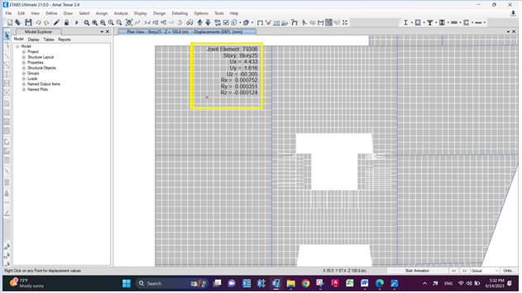
Deflection Check.
11

Slide 12
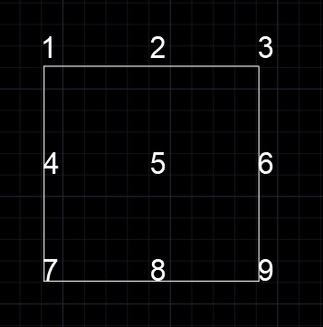
Deflection Check.
The points at which the deflection value was checked
12

Slide 13
Deflection Check.
Point | 1 | 2 | 3 | 4 | 5 | 6 | 7 | 8 | 9
Deflection mm | 46.159 | 53.635 | 52.595 | 55.505 | 68.305 | 49.138 | 57.606 | 57.130 | 38.681
line | 1-2-3 | 4-5-6 | 7-8-9 | 1-4-7 | 2-5-8 | 3-6-9
Avg Deflection mm | 4.303 | 15.9835 | 9.2092 | 3.6225 | 12.9225 | 3.545
Allowable deflection mm | 37.08 | 37.08 | 37.08 | 34.7 | 34.7 | 34.7
13

Slide 14
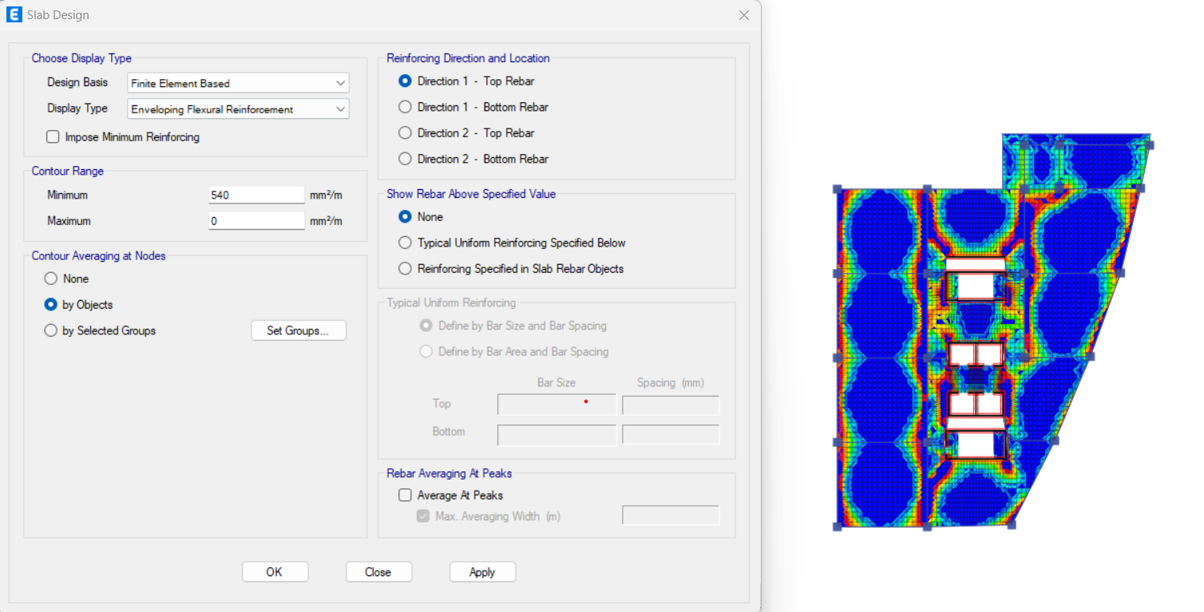
Design of Slab system.
The slab of the 25th story will be designed: ρ min = 0.0018
As min = 540 mm2 /m
14

Slide 15
Design of Slab system.
The slab of the 25th story will be designed: ρ min = 0.0018
As min = 540 mm2 /m
15

Slide 16
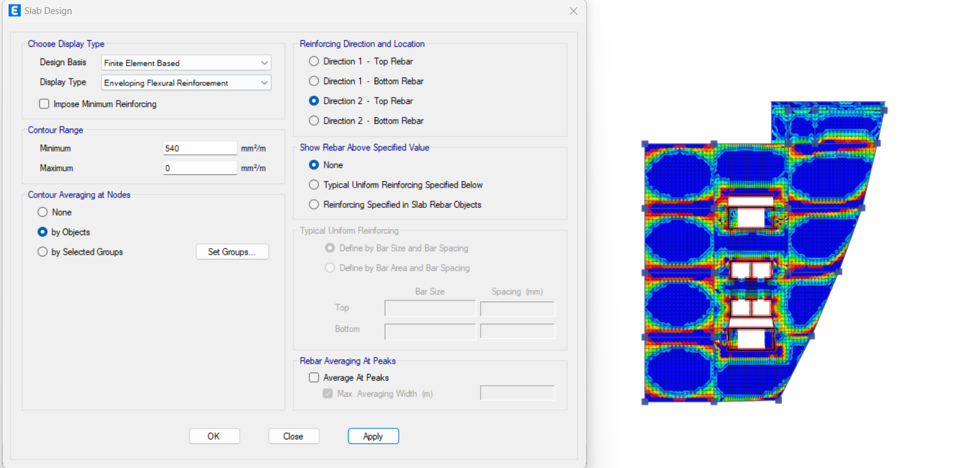
Design of Slab system.
The slab of the 25th story will be designed: ρ min = 0.0018
As min = 540 mm2 /m
16

Slide 17
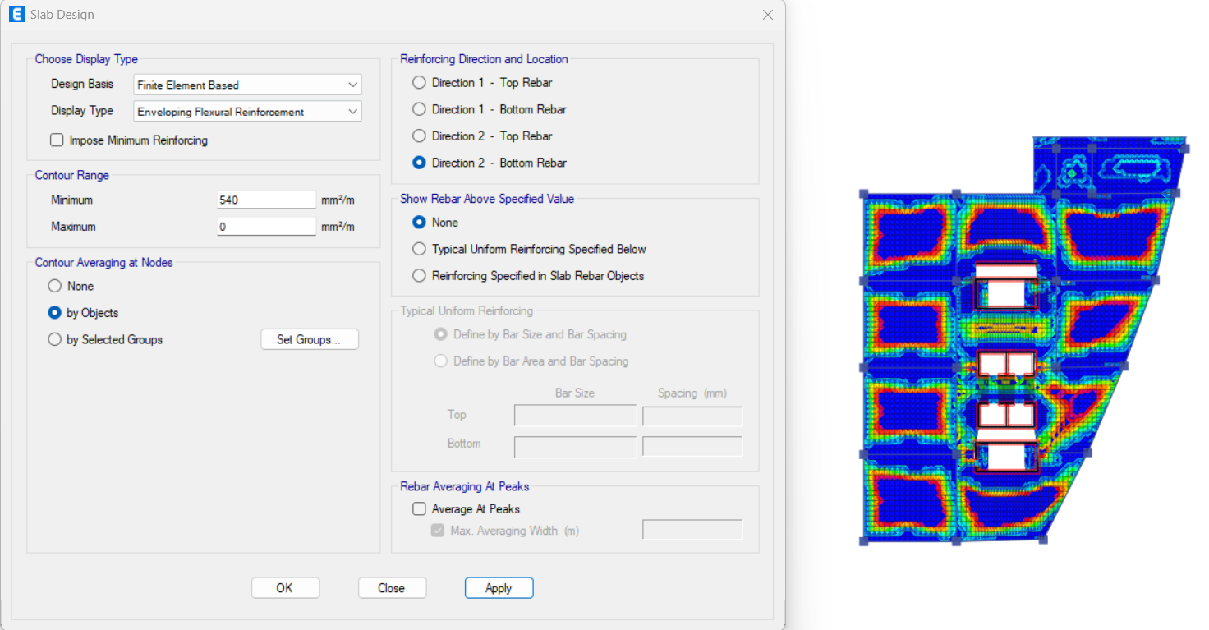
Design of Slab system.
The slab of the 25th story will be designed: ρ min = 0.0018
As min = 540 mm2 /m
17

Slide 18
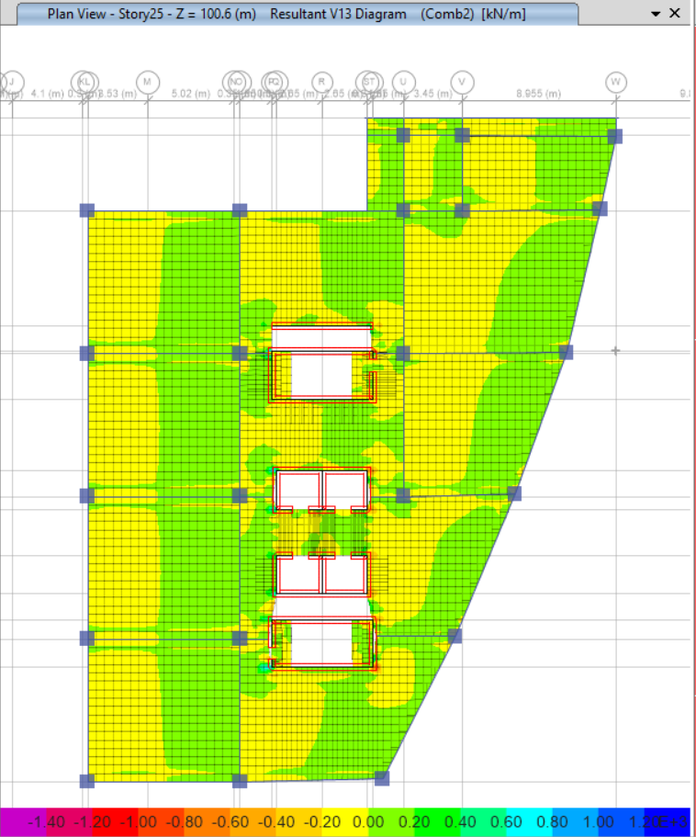
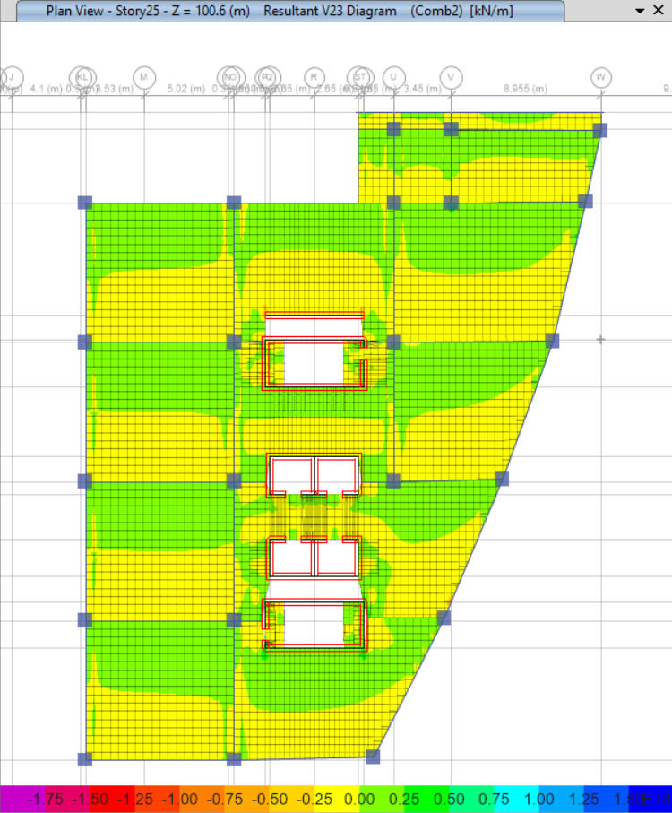
Design of Slab system.
no need for shear reinforcement.
18

Slide 19
Design of frames.
Special frames
The frames on the ETABS were defined as special frames (that is, pressure steel is added at the edges of the beam and the stirrups are thickened at the edges of the beam according to the instructions of the ACI318-19), so the reinforcement given is the full reinforcement of the special frames.
19

Slide 20
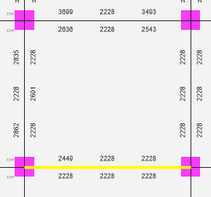
Design of frames.
Design for beam.
Interior beam.
Design for shear and torsion
20

Slide 21
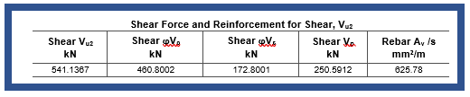
Design of frames.
Design for shear and torsion
Interior beam.
AV/S
Manual | Etabs
0.4 mm2 /mm | 0.63mm2 /mm
21

Slide 22
Design of frames.
Design for shear and torsion
Interior beam.
the spacing is 150 mm between stirrups, then 8mm stirrups can be used.
the spacing is 100 mm between stirrups at the edge of beam, then 10mm stirrups can be used.
Since it’s an interior beam, no reinforcement against torsion to be added.
22

Slide 23
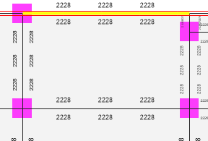
Design of frames.
Design for shear and torsion
Exterior beam.
23

Slide 24
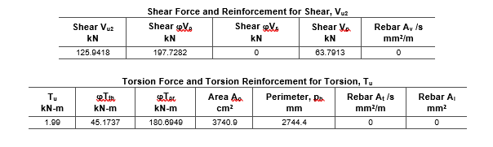
Design of frames.
Design for shear and torsion
Exterior beam.
Vu < ɸVc, then no shear reinforcement.
24

Slide 25
Design of frames.
Design for shear and torsion
Exterior beam.
Section capacity against torsion:
ɸTth
Manual | ETABS
34.6 kN.m | 45.23 kN.m
Tu > ɸTth, no reinforcement against torsion to be added.
25

Slide 26
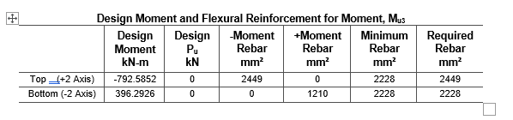
Design of frames.
Design against flexural.
interior beam.
As
Manual | ETABS | %error
2200.2mm2 | 2228mm2 | 1.26%
26

Slide 27
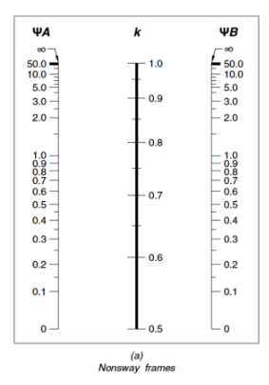
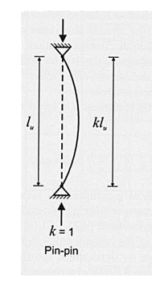
Design of frames.
Design for column.
Slenderness check:
K=1
27

Slide 28
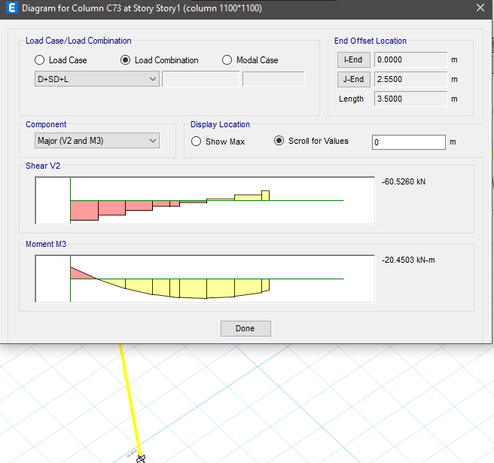
Design of frames.
Design for column.
Slenderness check:
assuming that it’s a single curvature and M1/M2 = 1 (the worst cases),
28

Slide 29
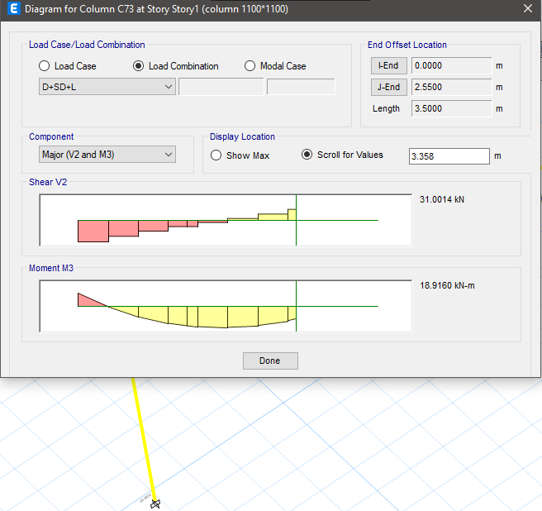
Design of frames.
Design for column.
Slenderness check:
assuming that it’s a single curvature and M1/M2 = 1 (the worst cases),
29

Slide 30
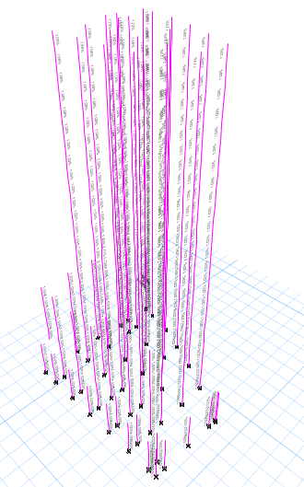
Design of frames.
Design for column.
Rebar percentage:
According to ETABS, rebar percentage is (1%), which is the desired value because it’s -according to experts- the most economical design for columns.
30

Slide 31
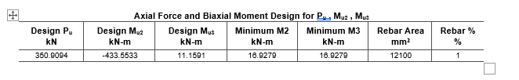
Design of frames.
Design for column.
Manual verification:
31

Slide 32
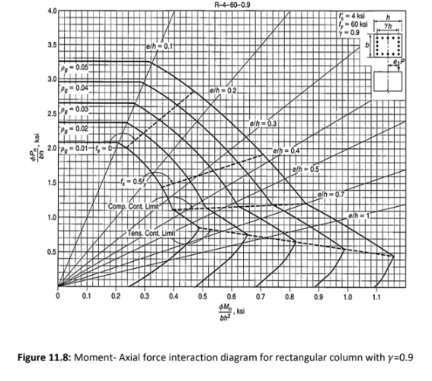
Design of frames.
Design for column.
Manual verification:
32

Slide 33
Design of frames.
Design for column.
Manual verification:
Manual | ETABS | %error
12100mm2 | 12100mm2 | 0%
Spacing between ties will be 200 mm and have a diameter of 20 mm.
33

Slide 34
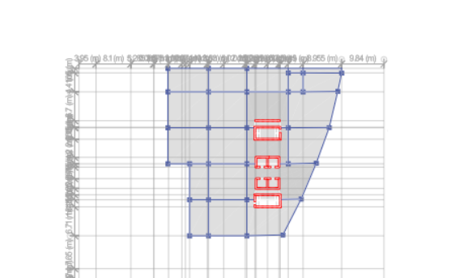
Shear walls design.
Shear walls layout
34

Slide 35
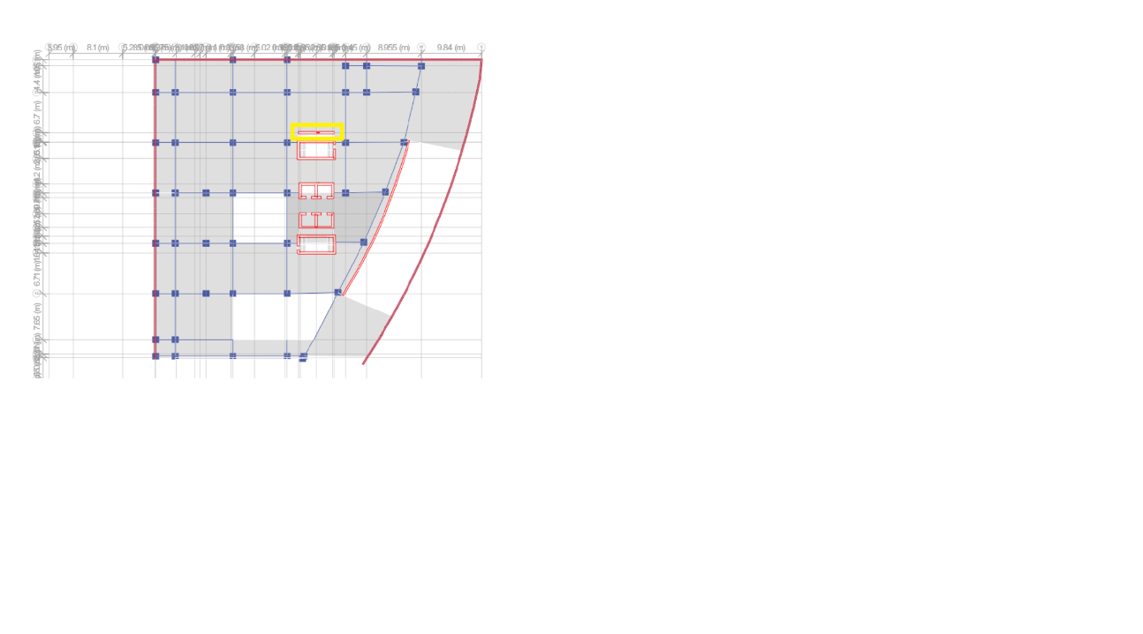
Shear walls design.
The calculations were made on this wall section
35

Slide 36
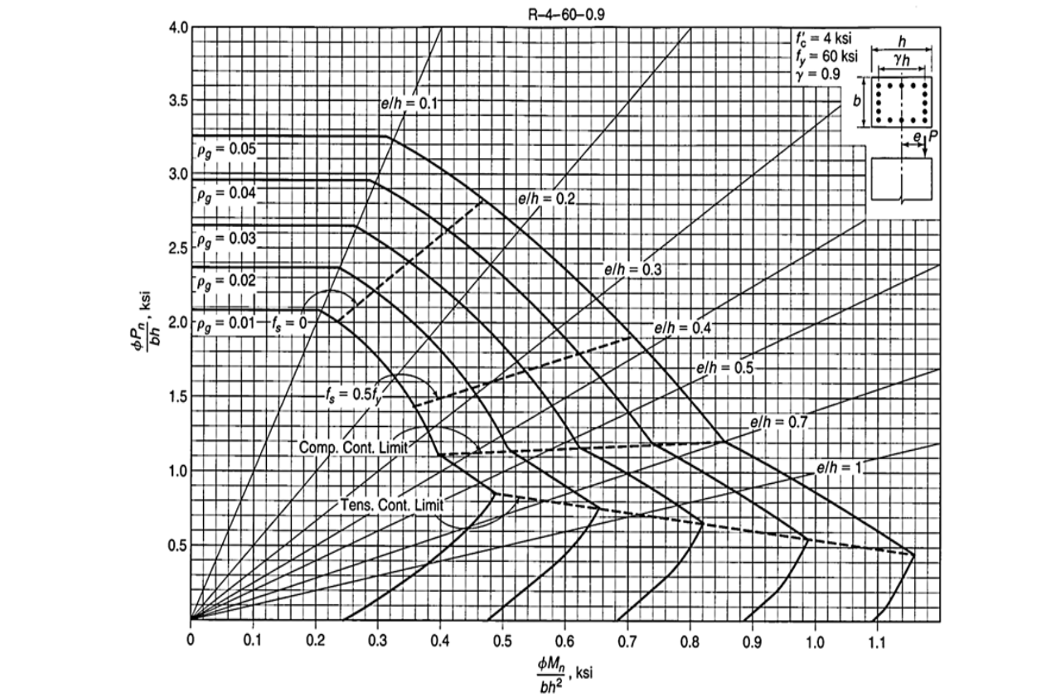
Shear walls design.
The following interaction diagram were used in the calculations
36

Slide 37
Shear walls design.
Reinforcement | values
longitudinal | 5900mm²
Av/s | 1000mm²/m
37

Slide 38
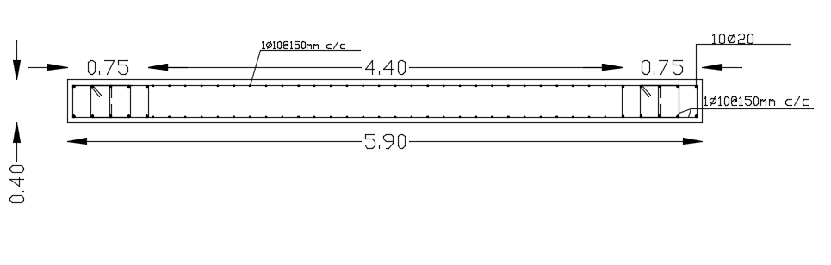
Shear walls design.
The reinforcement details are illustrated in the following figure:
38

Slide 39

Thanks all for listening

