Slide 1
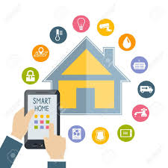
Smart Home & Smart Garden
Enas Mashaqi & Rwida Al-Safadi & Muna Al-Hasan

Slide 2
Contents:
What is a smart home.
Why smart home.
What are the challenges ?
Hardware Components
Methodology

Slide 3
What is a Smart Home?
Smart home is a house that uses information technology to monitor the environment, control the electric appliance and communicates with the outer world. Smart home is a complex technology, at the same time it is developing

Slide 4
Why Smart Home?
Comfort and ease of control
Energy Management Appliance and lighting control
Security
Safety

Slide 5
What are the challenges?
Arduino mega rather than Arduino uno.
Some pieces damage.
Problem in connection.
Complexities in multiple functionality of the technology.

Slide 6
Hardware Components
Arduino Mega:
The Arduino Mega is a microcontroller board based on the ATmega1280 .It has 54 digital input/output pins (of which 14 can be used as PWM outputs), 16 analog inputs, 4 UARTs (hardware serial ports), a 16 MHz crystal oscillator, a USB connection, a power jack, an ICSP header, and a reset button.
Android mobile phone.

Slide 7
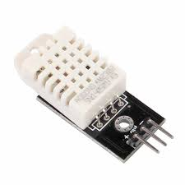
Temperature and humidity
sensor (DHT22).
In this project, An one DHT22
used this responsible for control Heating and air conditioning system in our project.

Slide 8
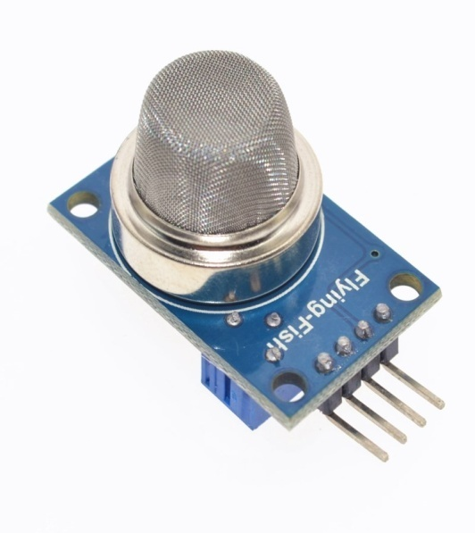
Gas sensor (MQ-6):
Features:
Continuous Analog output
3-pin interlock connector
Low cost and compact size
In this project, A gas sensor used this responsible for smoking detection in Fire extinguishing system in our project.

Slide 9
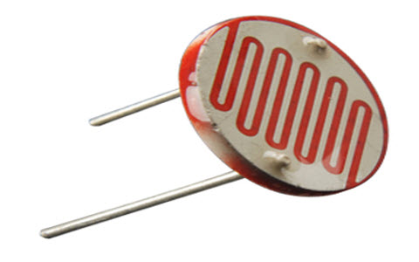
LDR Sensor:
In this project, A LDR sensor used this responsible for Detection of sunlight in irrigation system and Rationalization of energy consumption in our project.

Slide 10
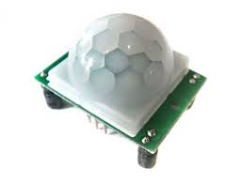
PIR Sensor:
PIR sensors allow you to
sense motion, almost always used to detect whether a human has moved in or out of the sensors range.
In this project, A PIR sensor used this responsible for motion detection in security system and Energy Conservation System in our project.

Slide 11
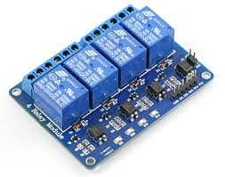
Servo
4-Channel Relay module:
In this project, we used relay to switch devices on and off by connect the first channel with heater ,the second and third channels with water pumps and the final channel with fans.

Slide 12
Fan
Piezo buzzer .
Water Pump and pipes
LCD.
Keypad 4x4.

Slide 13
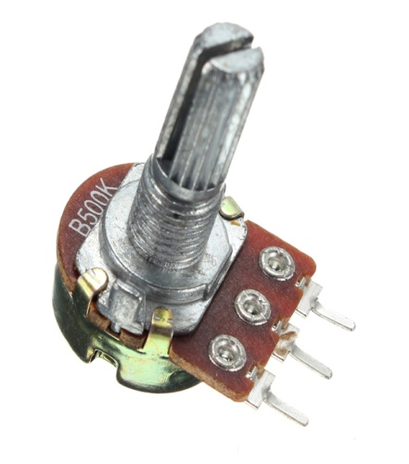
Potentiometer:
In this project, we used two potentiometer one for LCD used to adjust brightness of LCD. sometime light is high so we can't read value on the LCD and another for LDR used to adjust level of light detected by LDR .

Slide 14
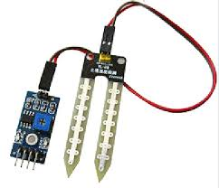
Bluetooth module:
Using Bluetooth to communicate with an Arduino.
In this project, we used Bluetooth module for controlling some devices with Smart phone.
Soil moisture sensor:
In this project, A Soil moisture
sensor used this responsible for
mesure moisture in irrigation
system in our project.

Slide 15
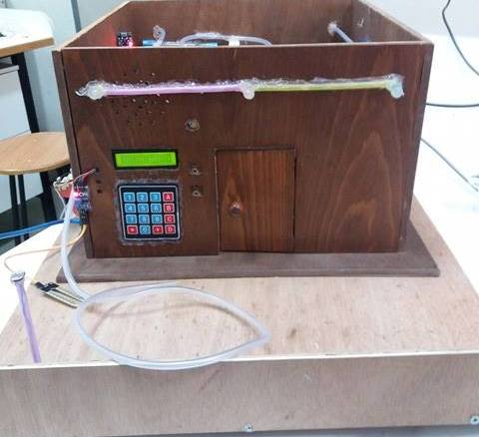
Methodology
We will talk about the Systems that have been build in our project.

Slide 16
1.Security System:
When someone want to enter the home, he must enter the password by keypad then the door will open ,if who enter the password three times not correct or try to open the door without password the buzzer will turn on.

Slide 17
When someone motion around the window (the motion detect by PIR) without enter the password ,the buzzer will turn on.

Slide 18
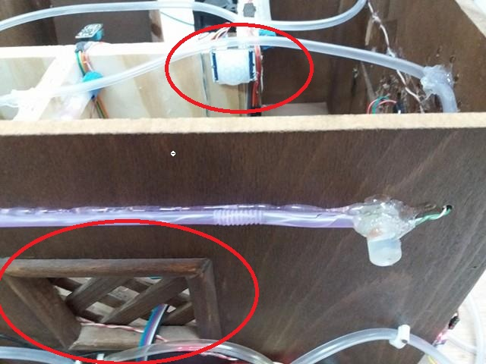
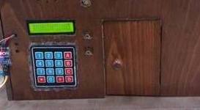

Slide 19
Lighting System & Energy conservation System:
In home, if someone enter the home(enter correct password) and there sunshine, the windows will open to enter the light to home.
while the night comes and there no sunshine and the motion happened in one of rooms(detect by PIR),the light in this room will turn on.

Slide 20
In garden, entering the password is not required ,in the morning the garden's light are not lit. when the night comes, the garden's light turn on directly.

Slide 21
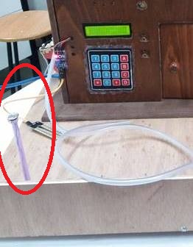
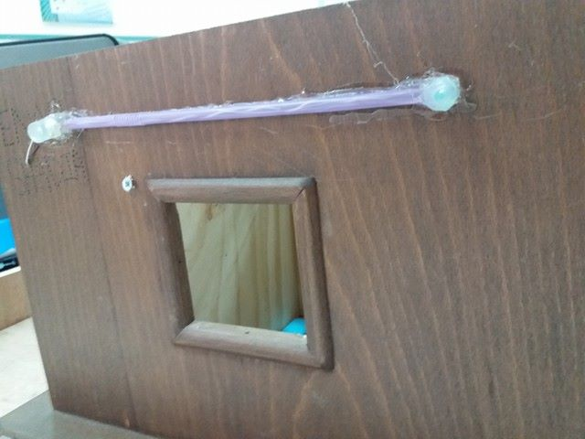
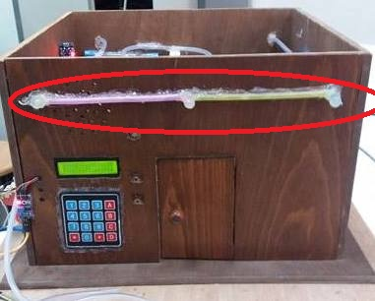

Slide 22
3.Irrigation System:
If moisture for plant become Less than a certain limit and no sunshine the water pump that specific for irrigation will turn on .

Slide 23
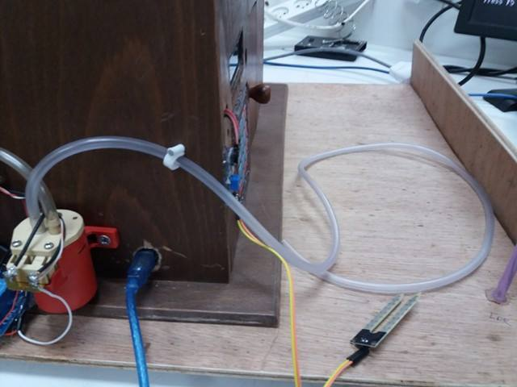

Slide 24
4.Heating and air conditioning system:
In our project , if temperature in home is less than 17° ,the heater will turn on .if its more than 17°,the fans will turn on.

Slide 25
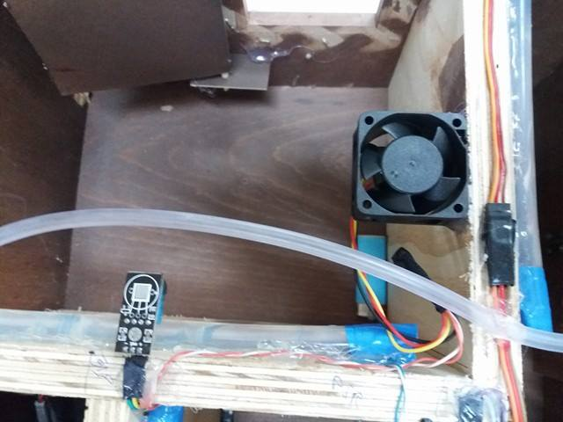

Slide 26
5.Fire extinguishing system:
If high smoking happened (detect by gas sensor), the water pump that specific for fire will turn on .

Slide 27
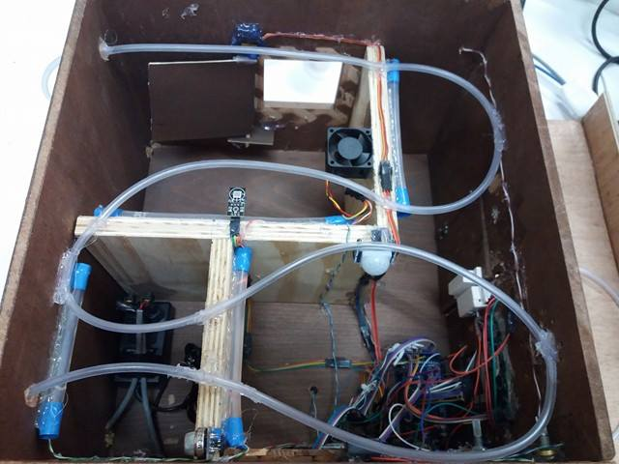
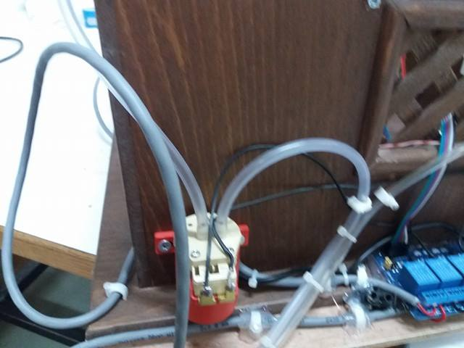

Slide 28

Android Application
The Android Total Control application could also be used to control the lights , fan , heater , irrigation and fire pumps.

Slide 29
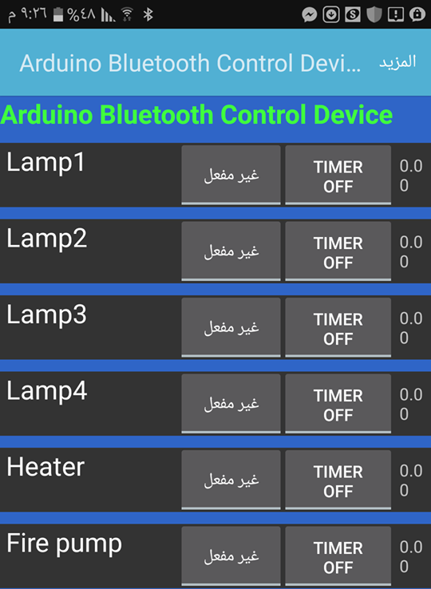
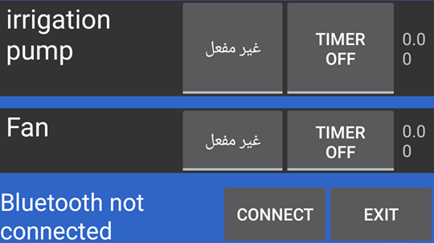

Slide 30


