Slide 1

Amr J. Eshtiwi
Ahmed A. Al-Qerem
Supervisor
Dr.Mona Demaidi
معك بكل خطوة قضائية

Slide 2
Table of contents
01
04
02
05
03
About Qadaa
Features
Architecture
Future work
Technologies

Slide 3
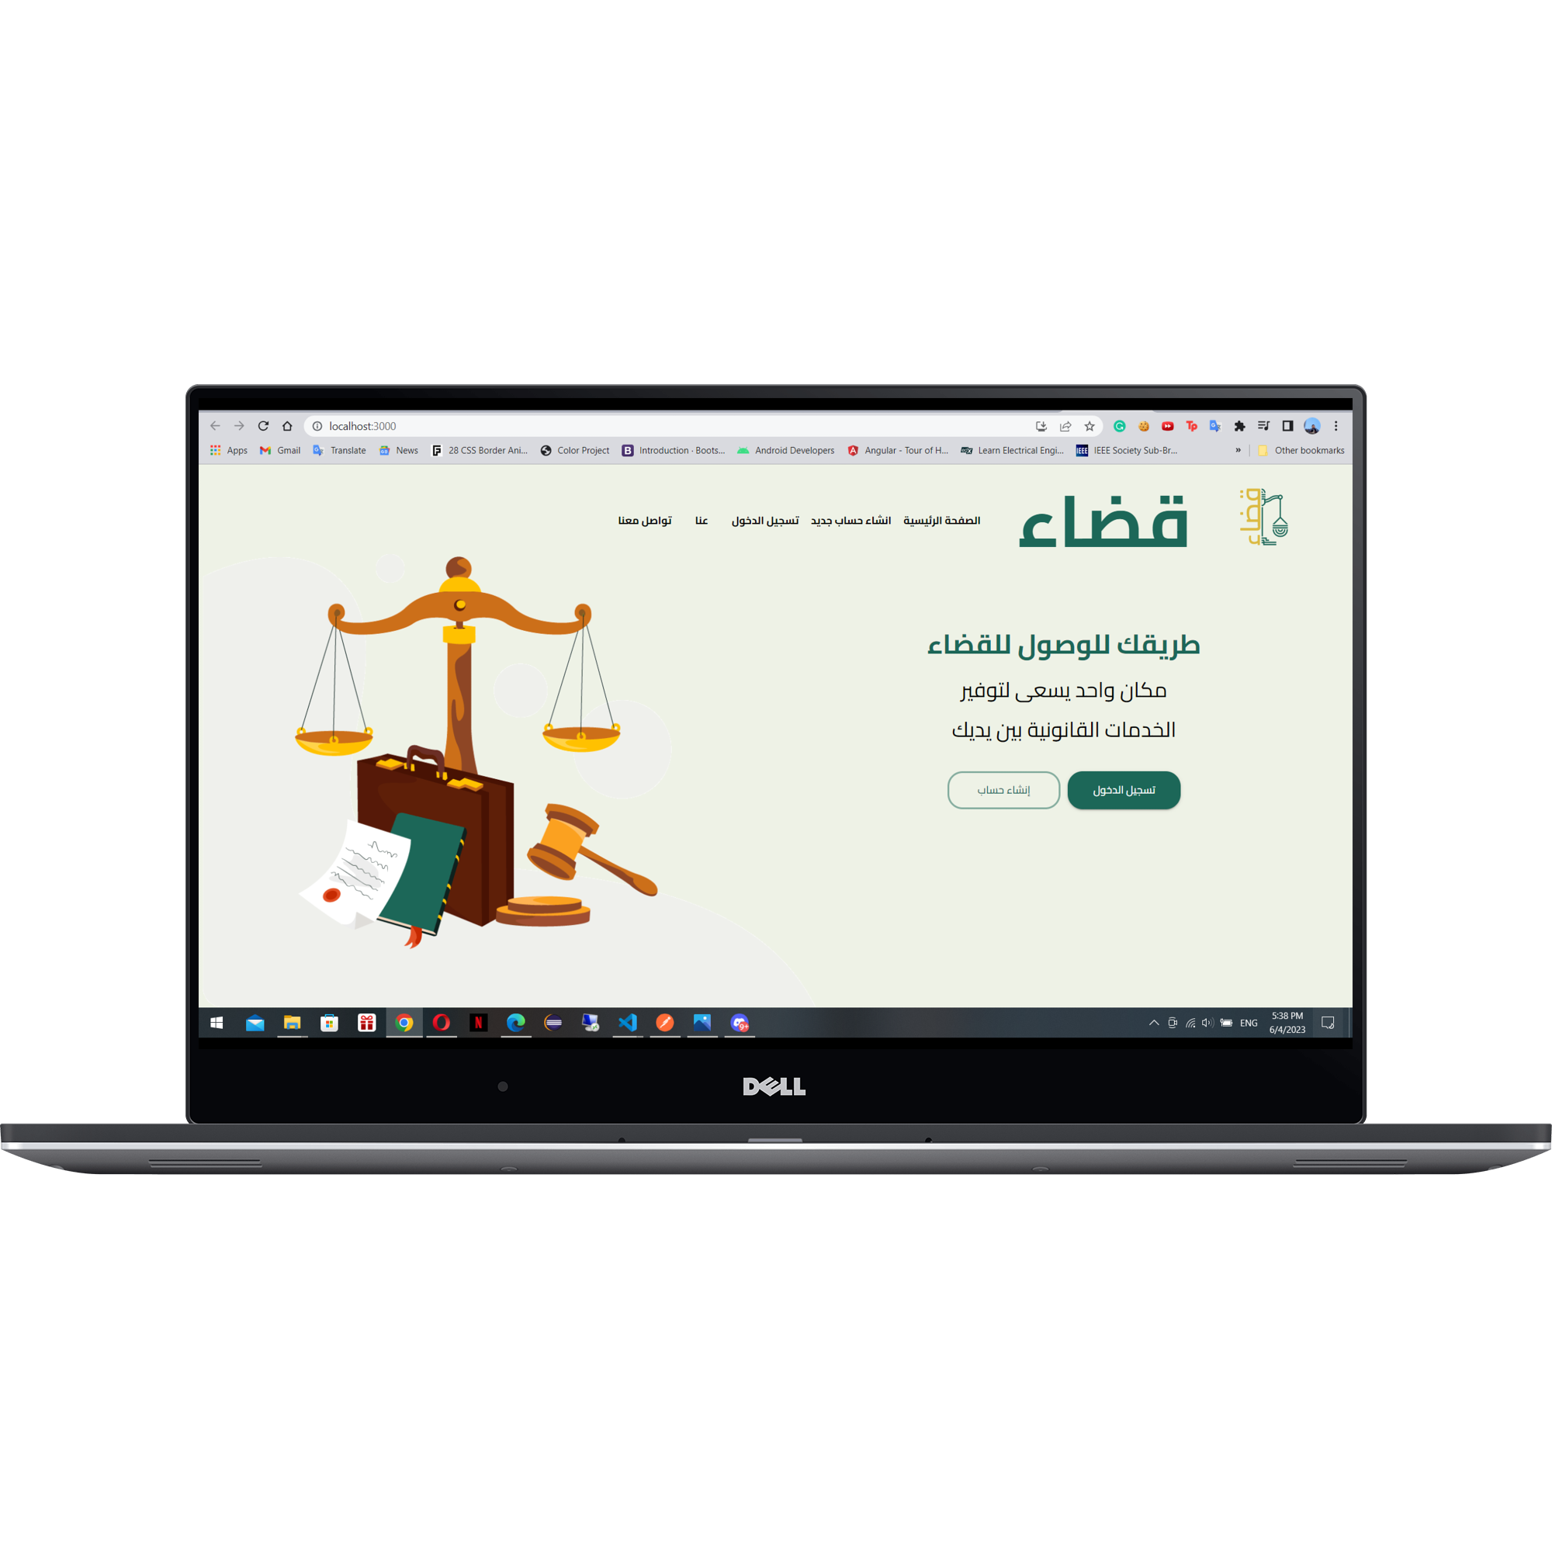
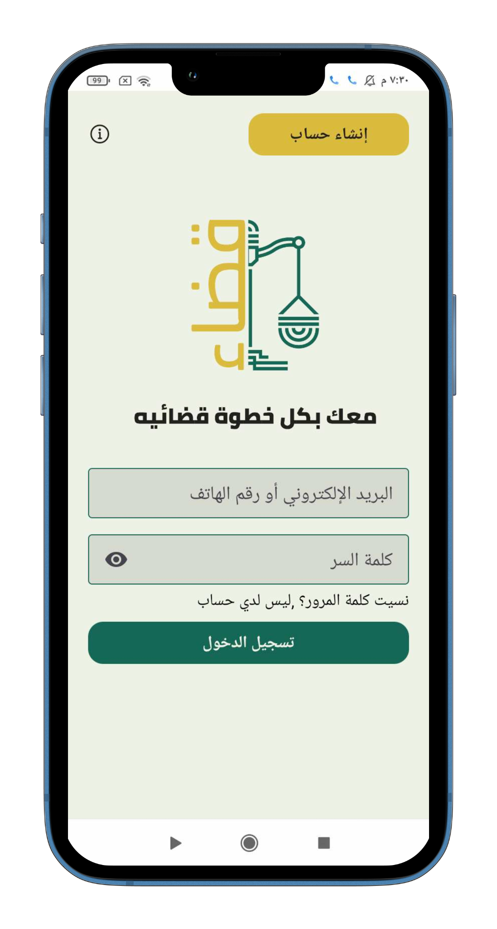
IDEA

Slide 4
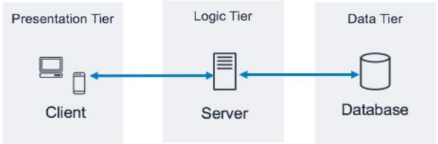
Architecture
Layered Arc

Slide 5




Technologies

Slide 6
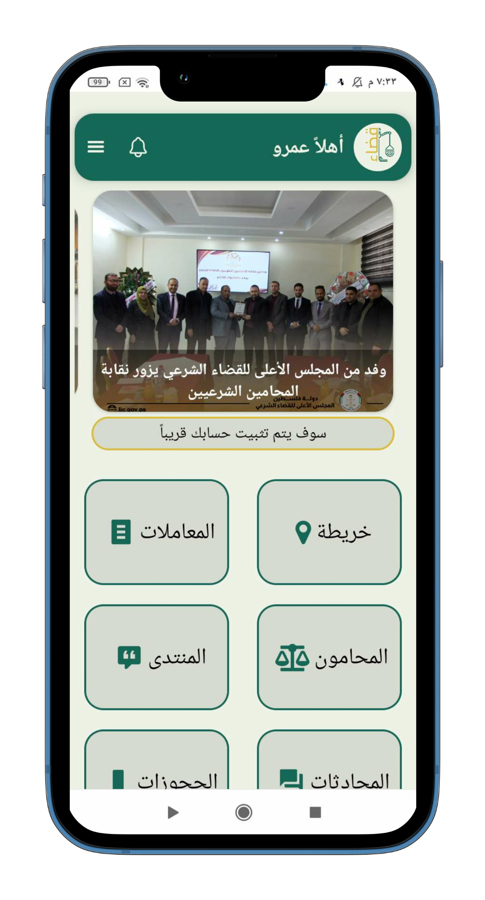
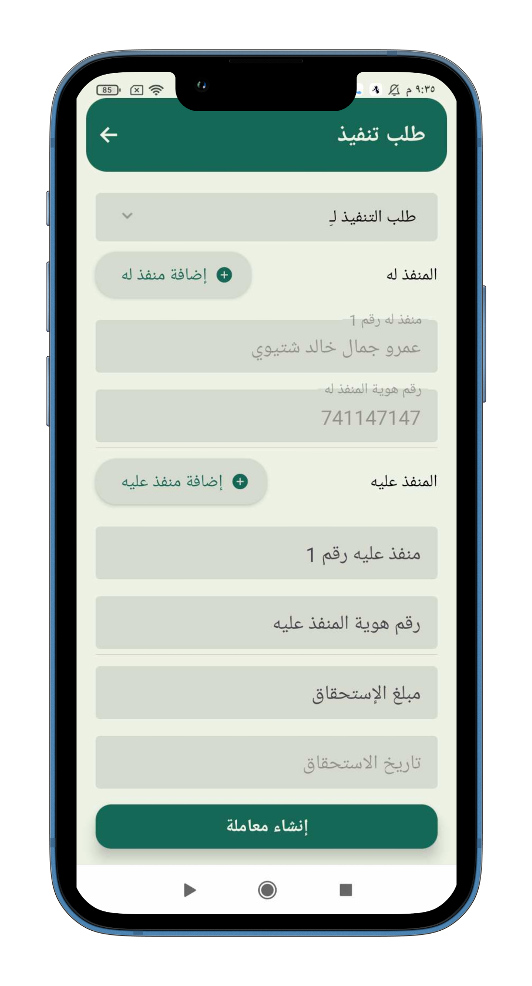
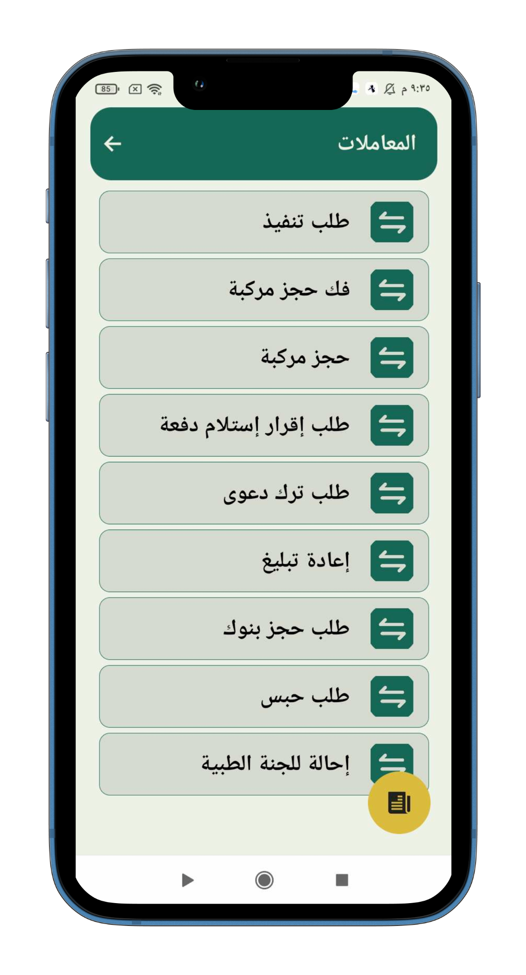
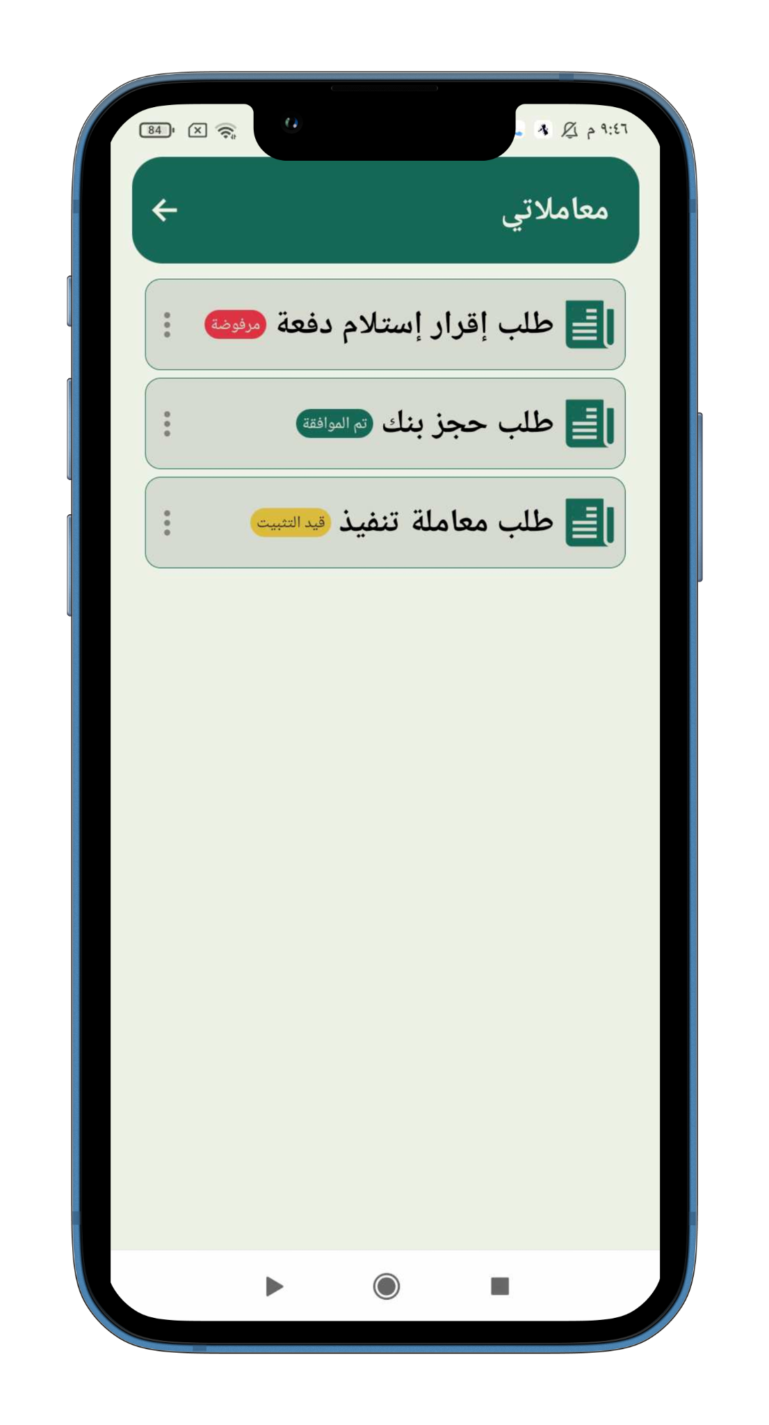
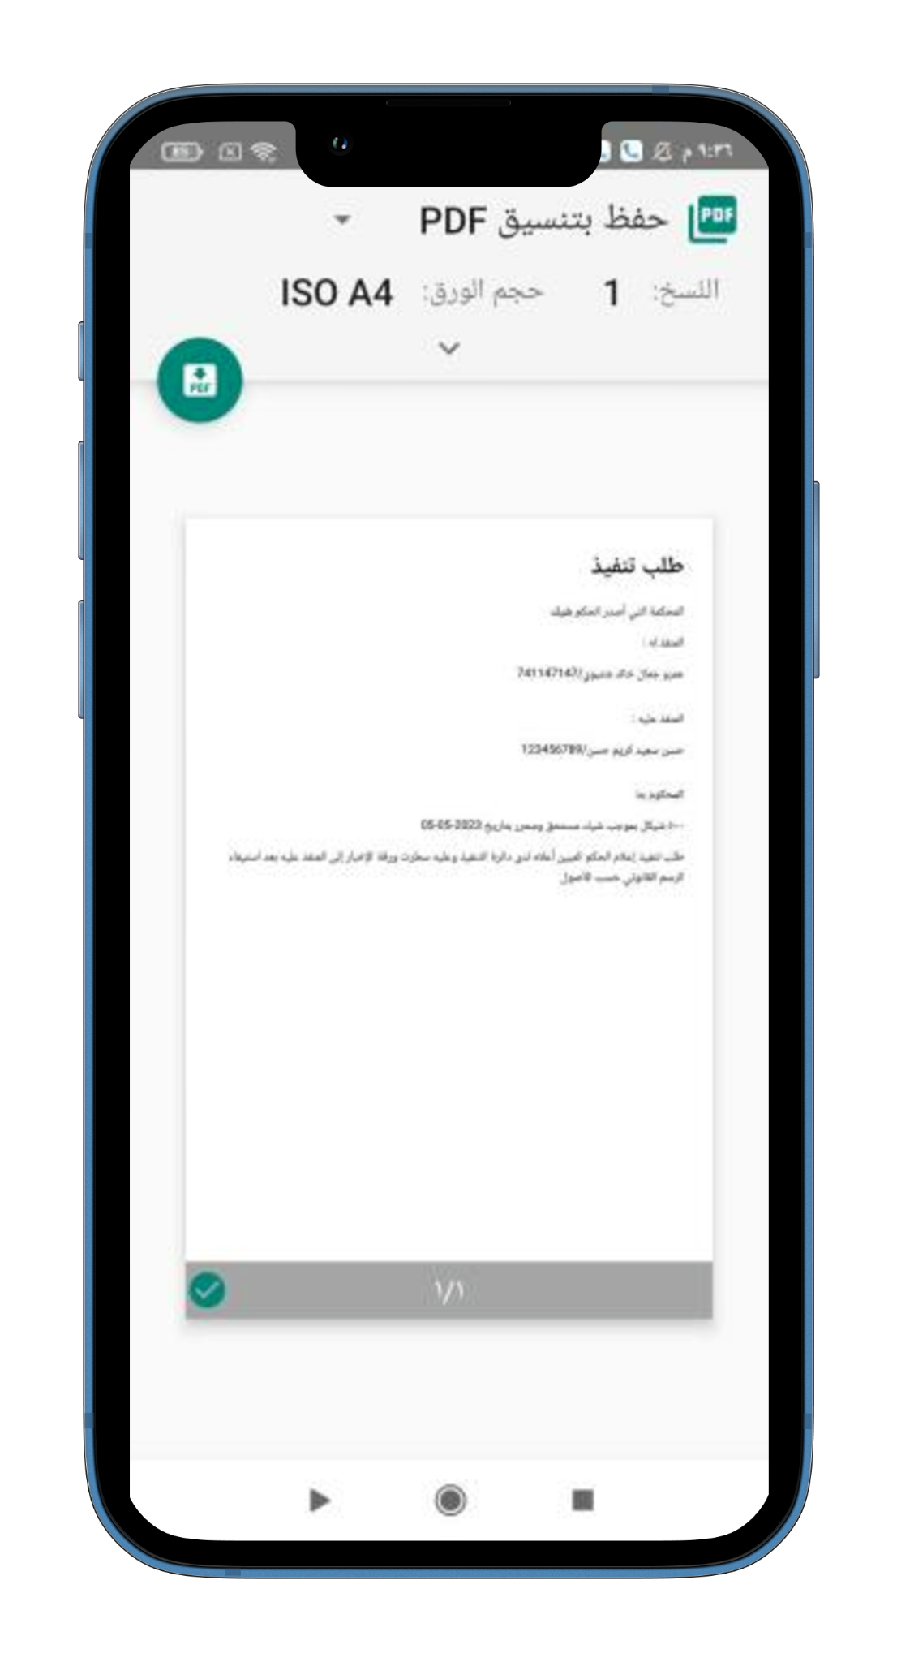
Features
Transactions

Slide 7
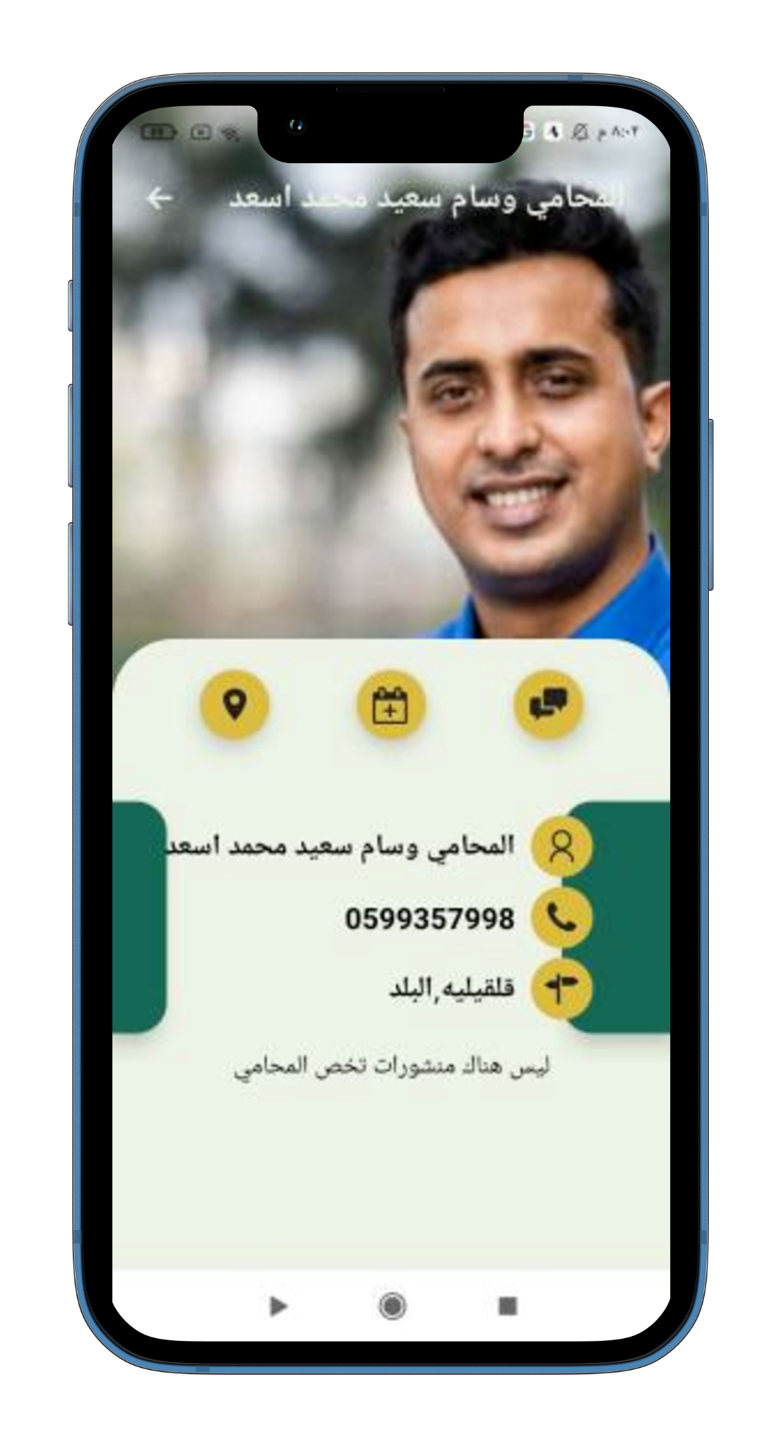
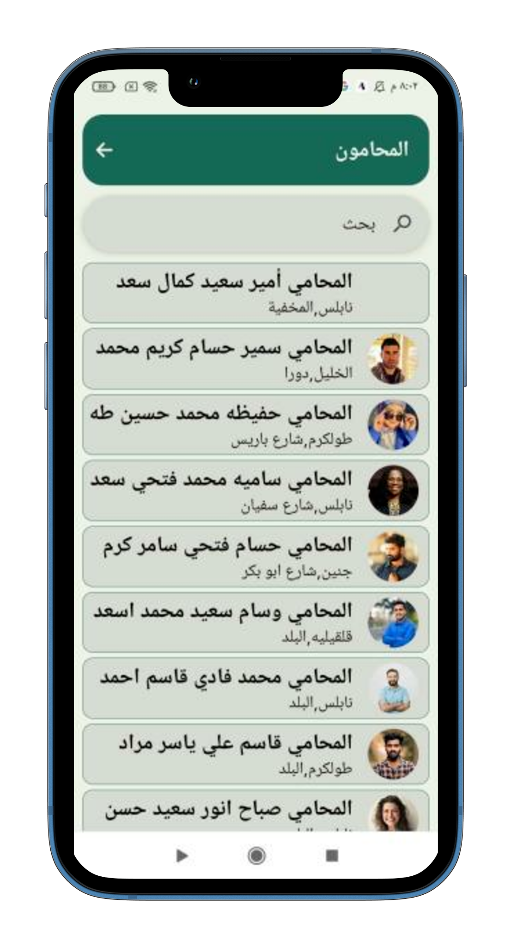
Features
Lawyers

Slide 8
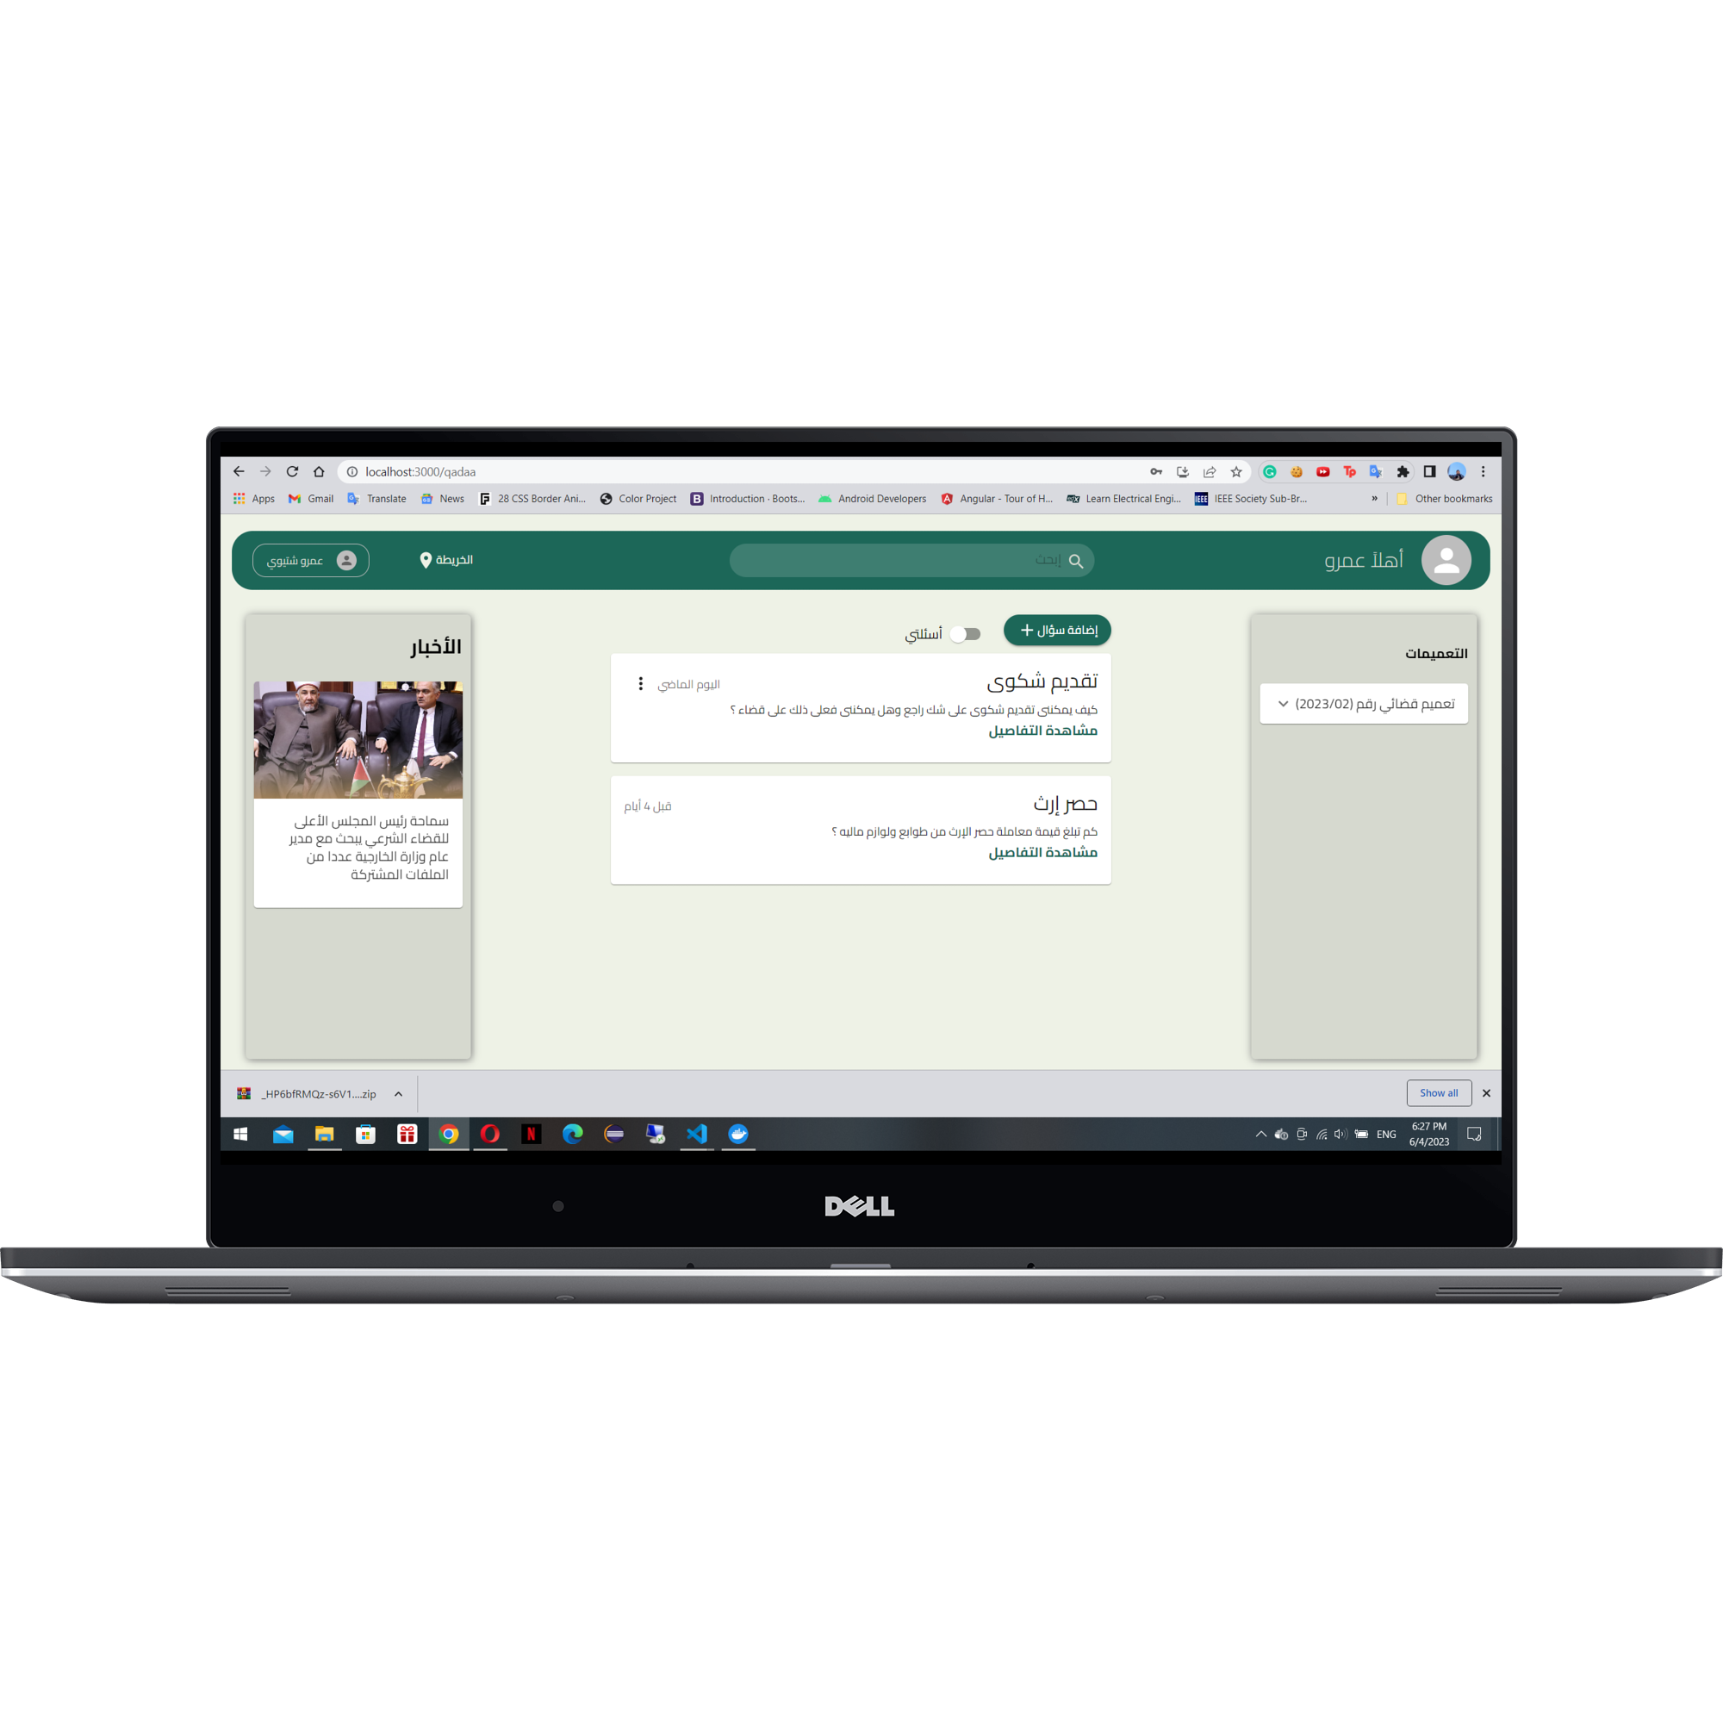
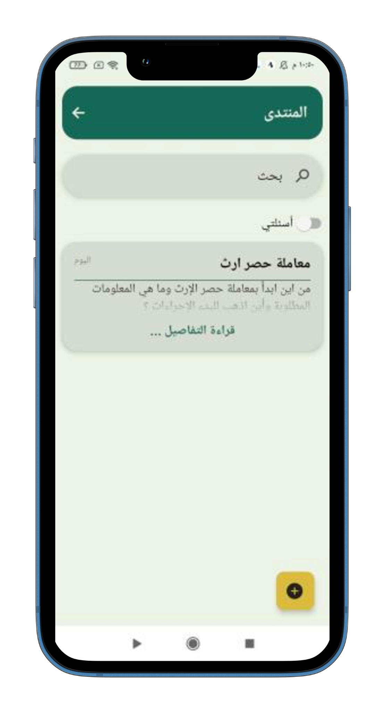
Features
Forum

Slide 9
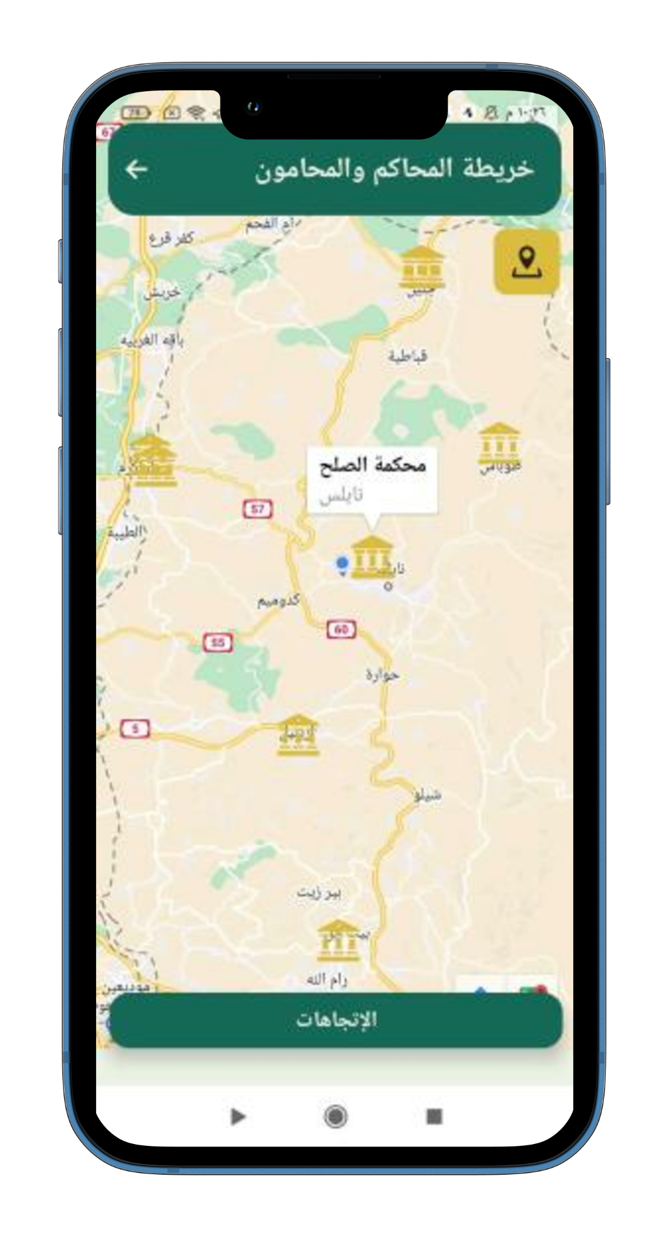
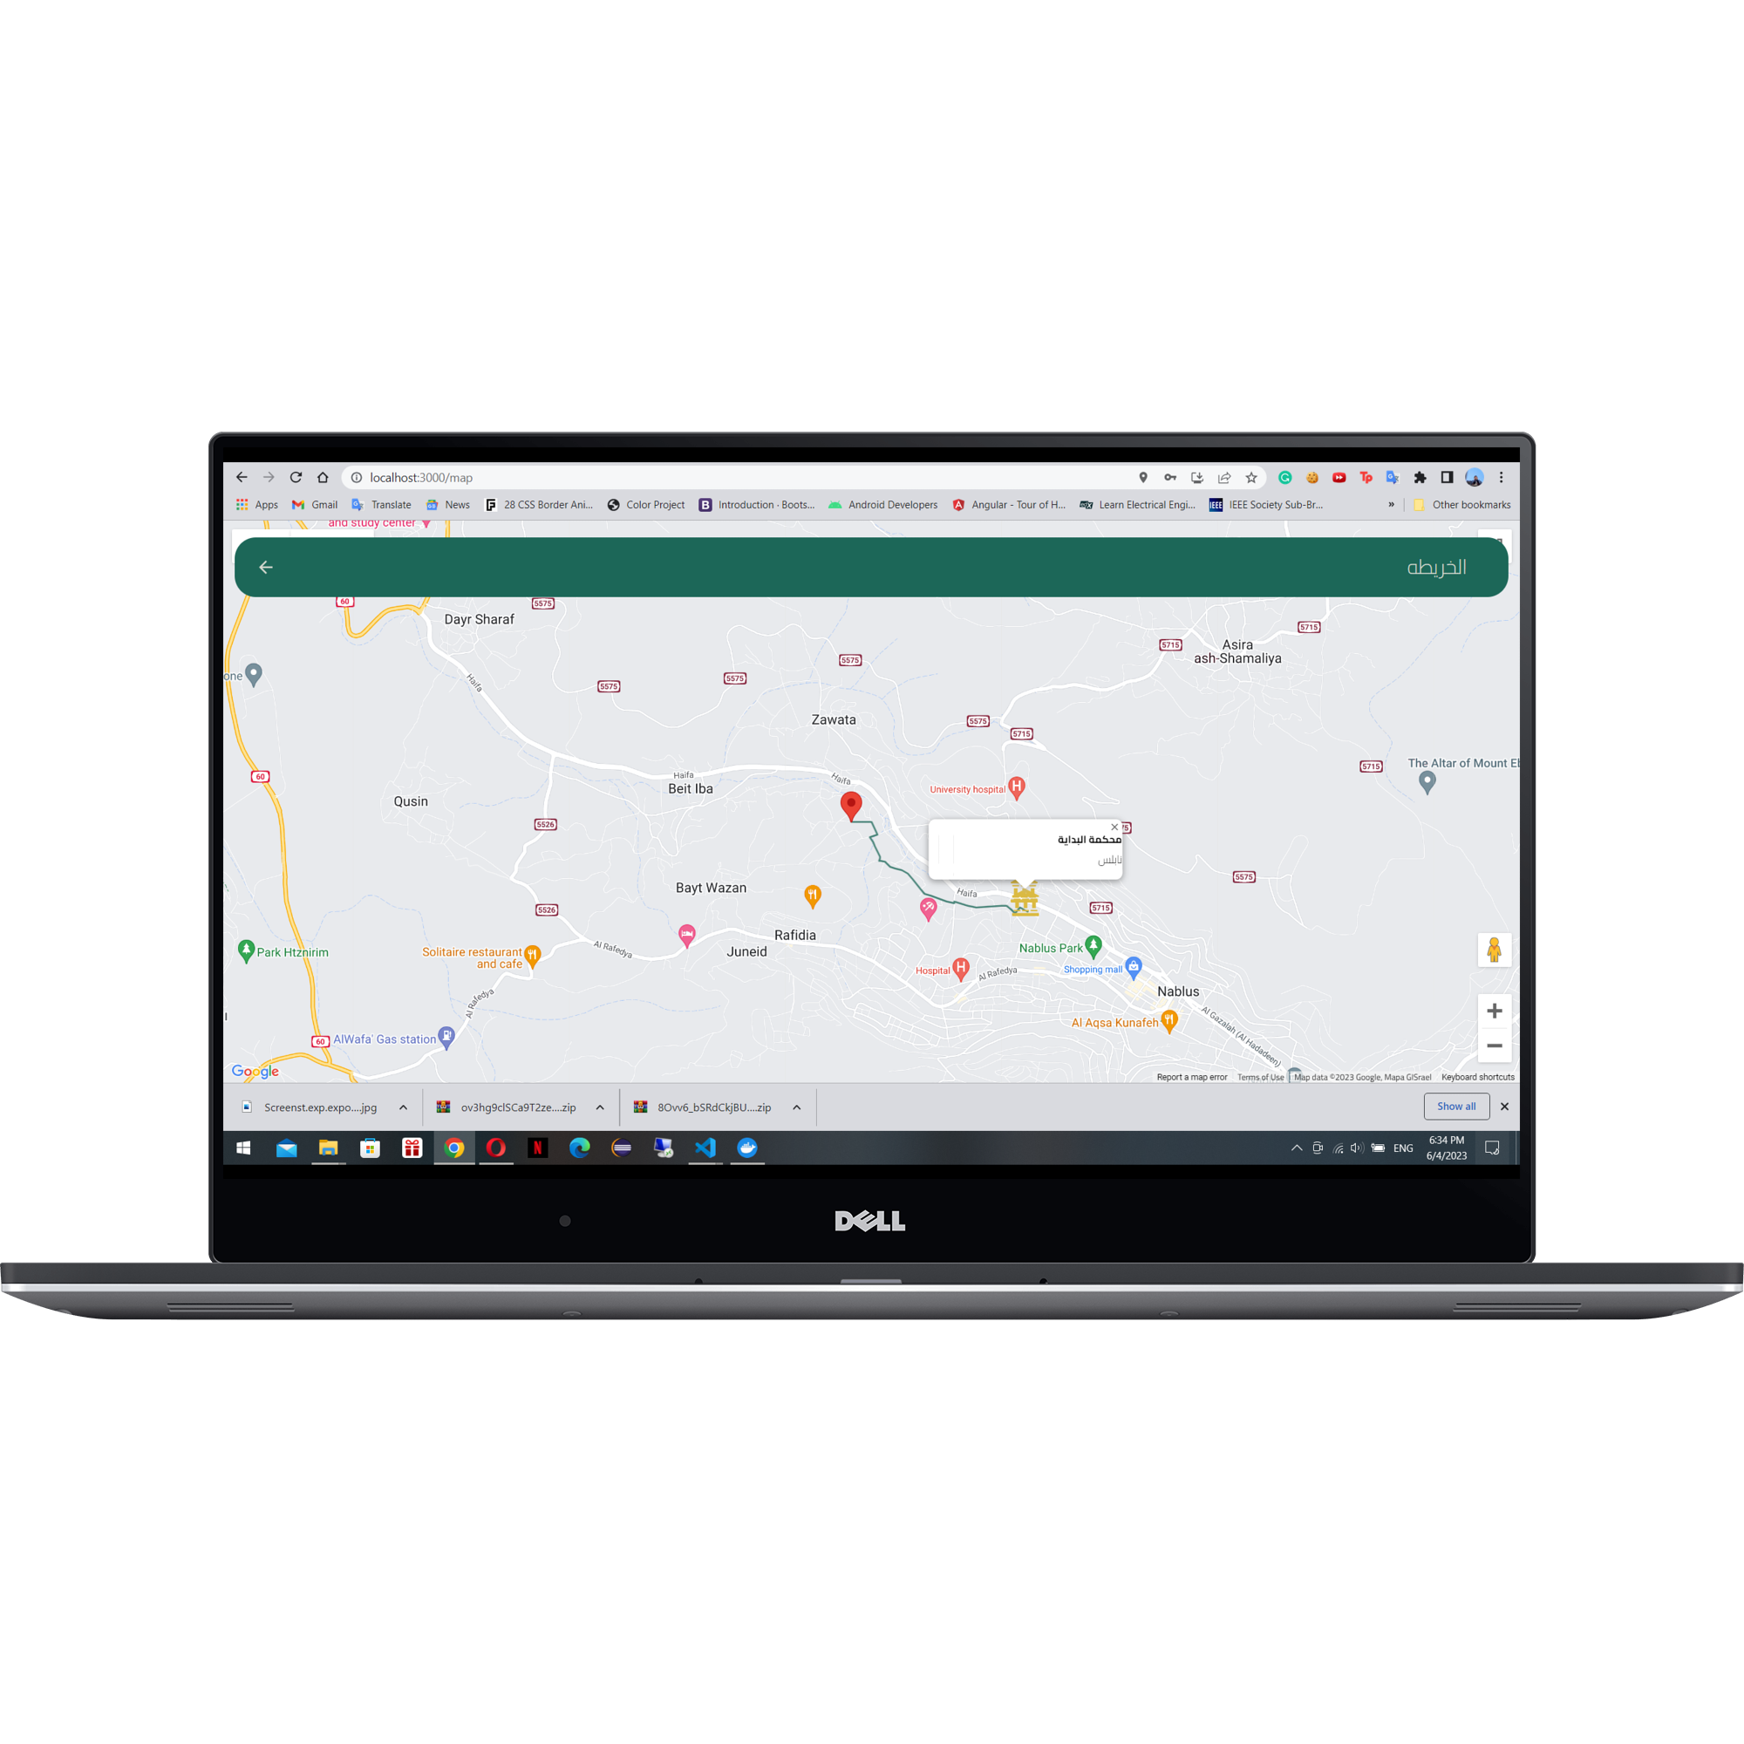
Features
Map

Slide 10
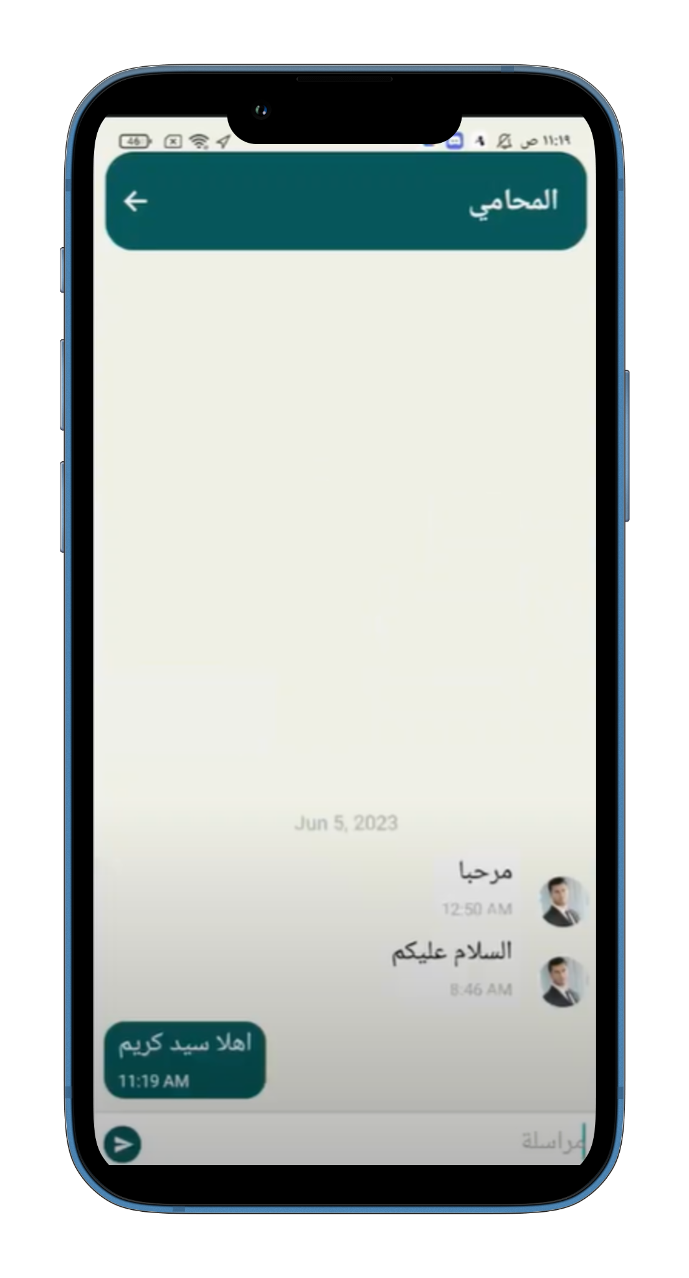
Features
Chat and Notification

Slide 11
Features
News and Circular legal

Slide 12
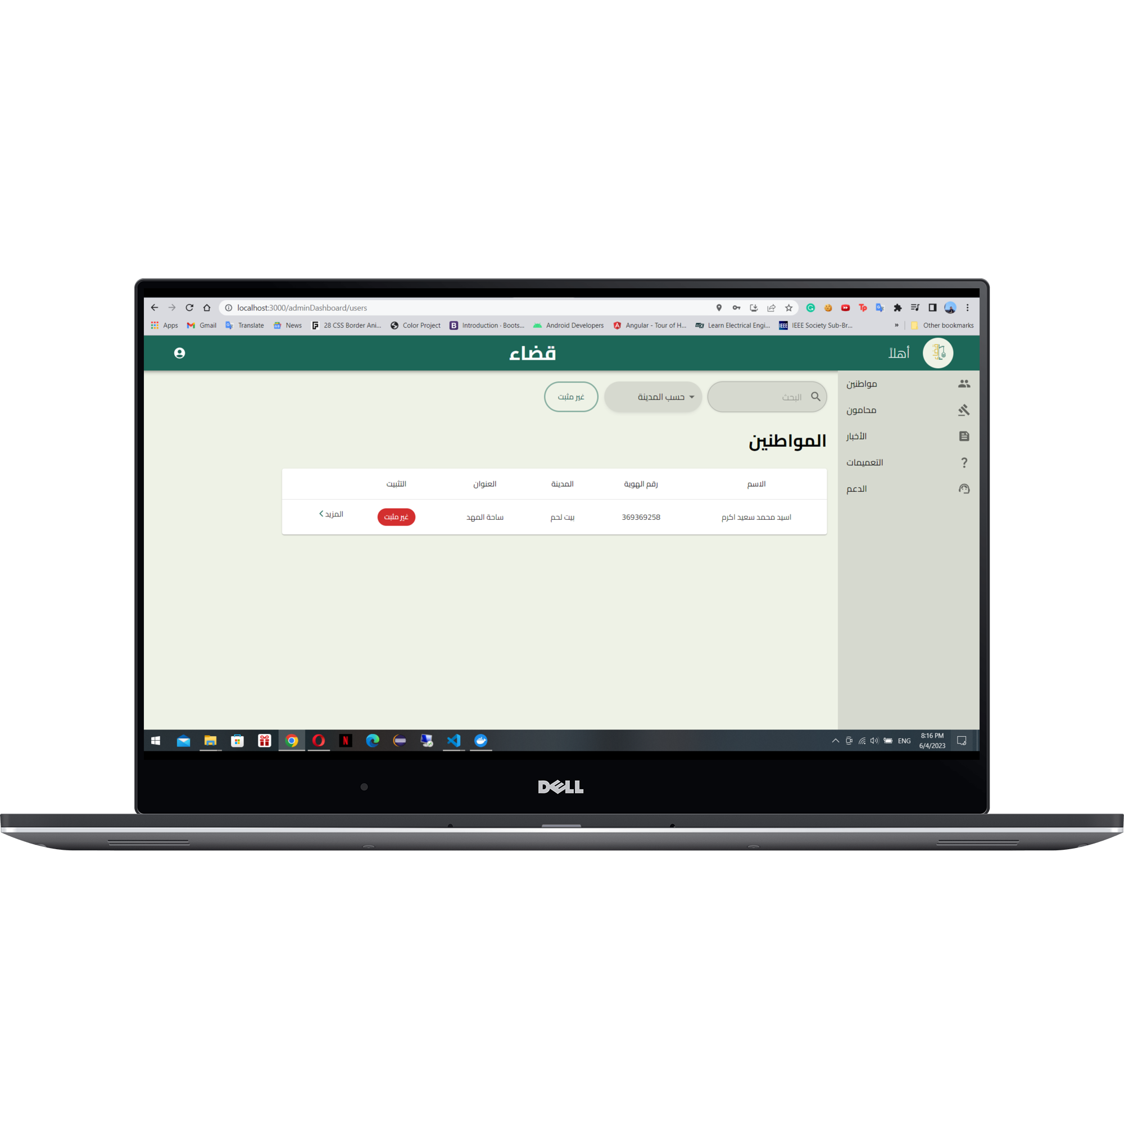
Features
Admin

Slide 13
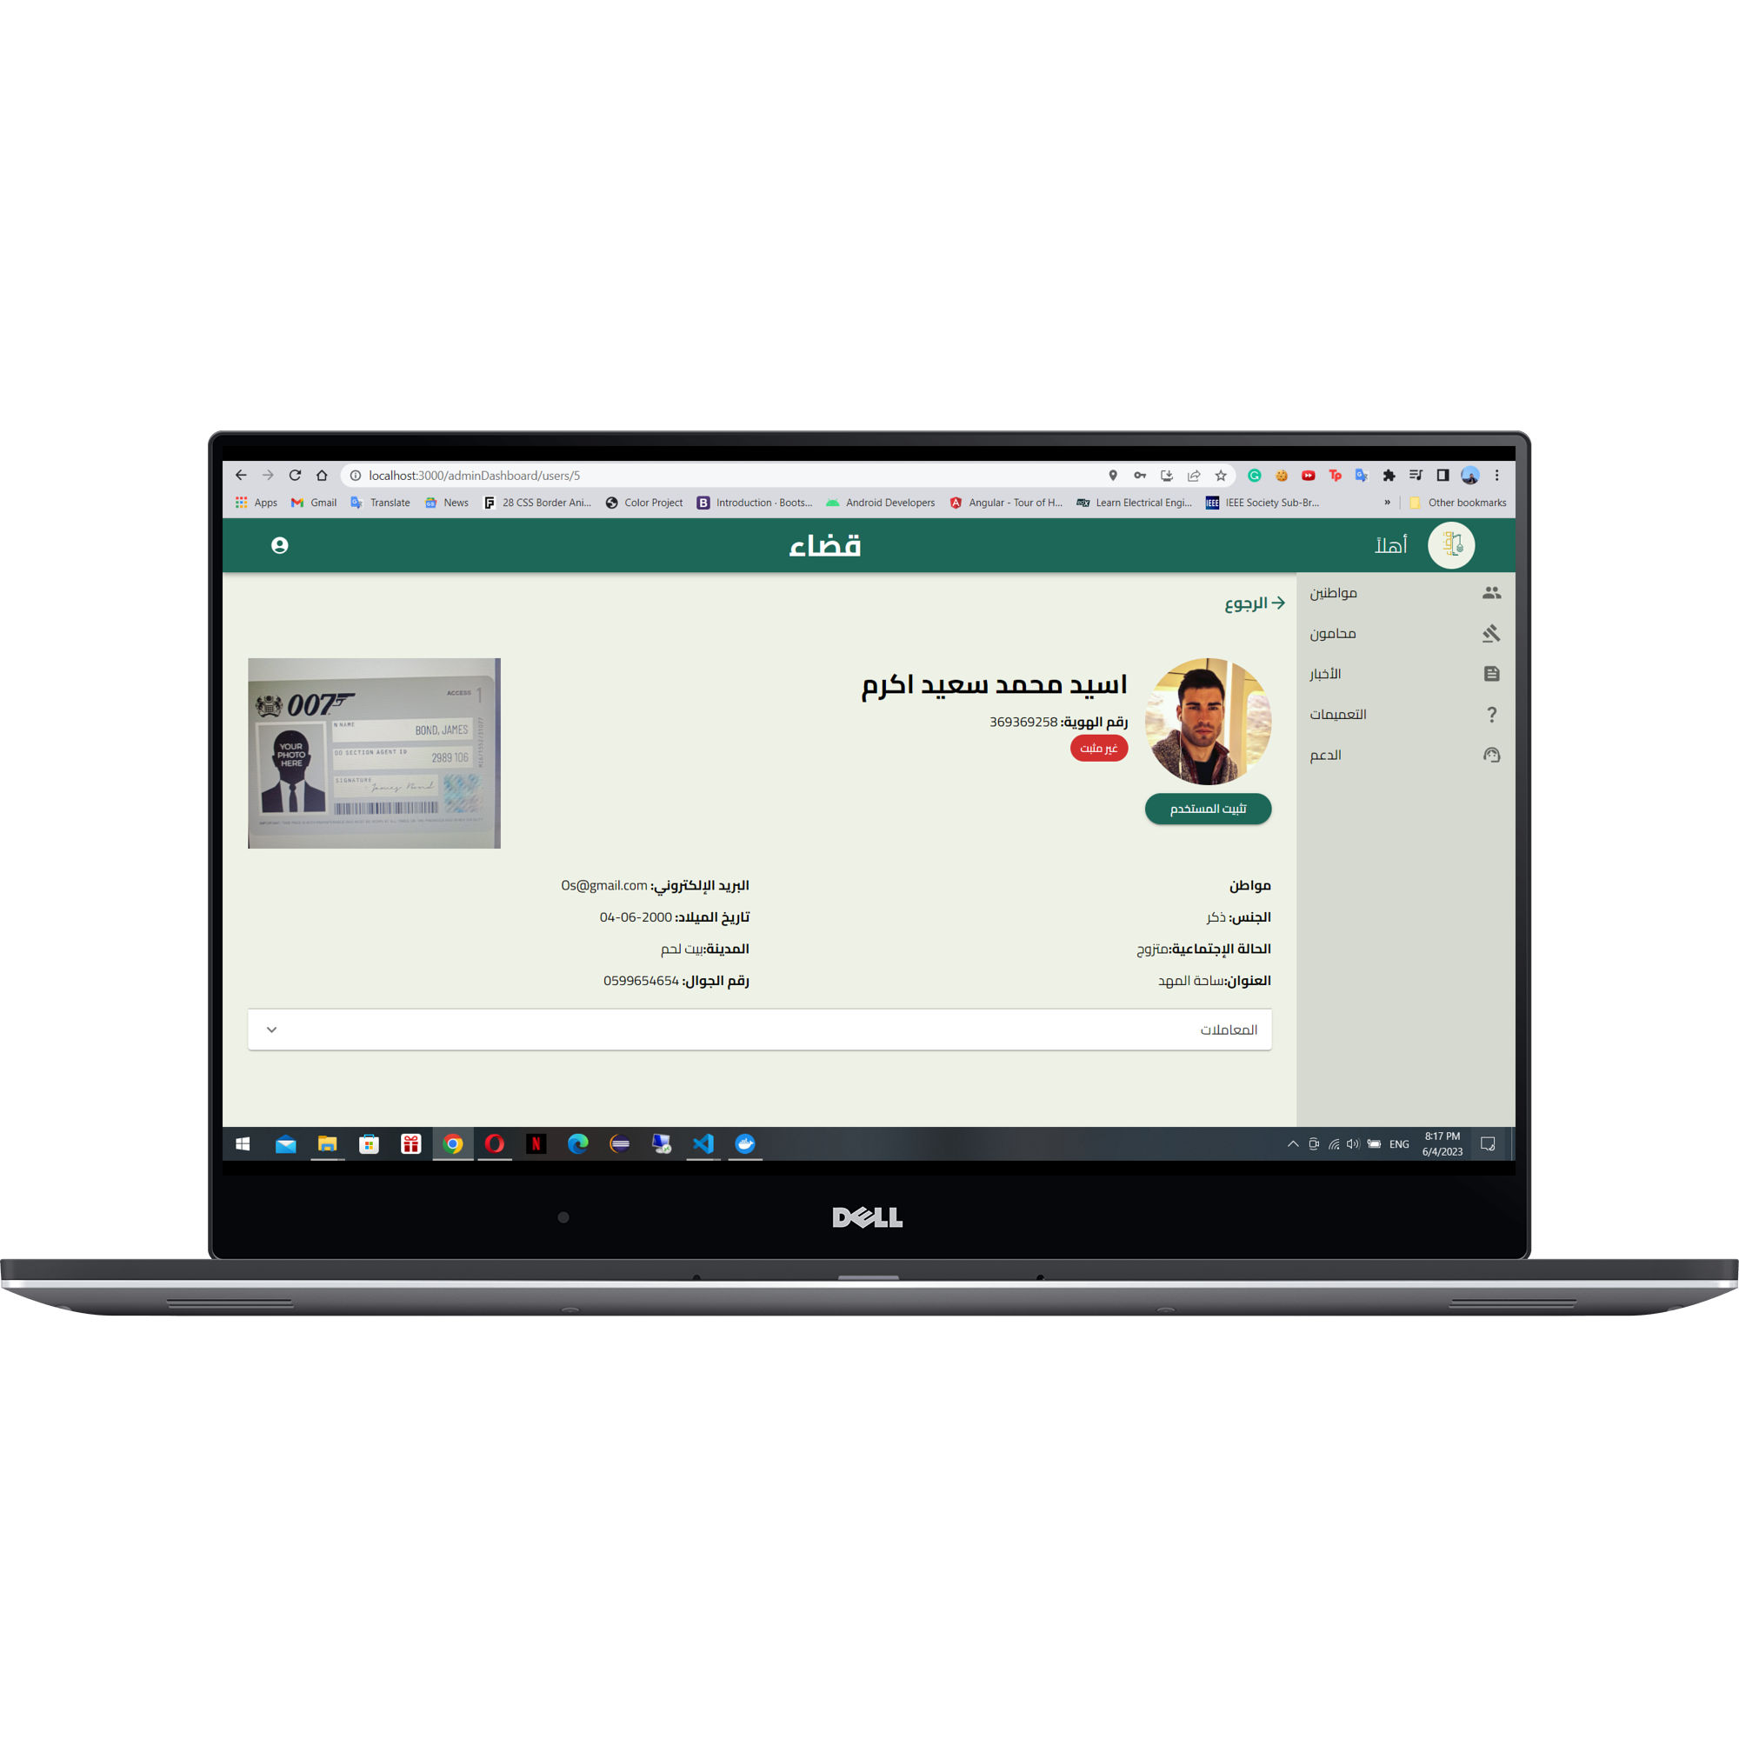
Features
Admin

Slide 14
Features
Admin

Slide 15
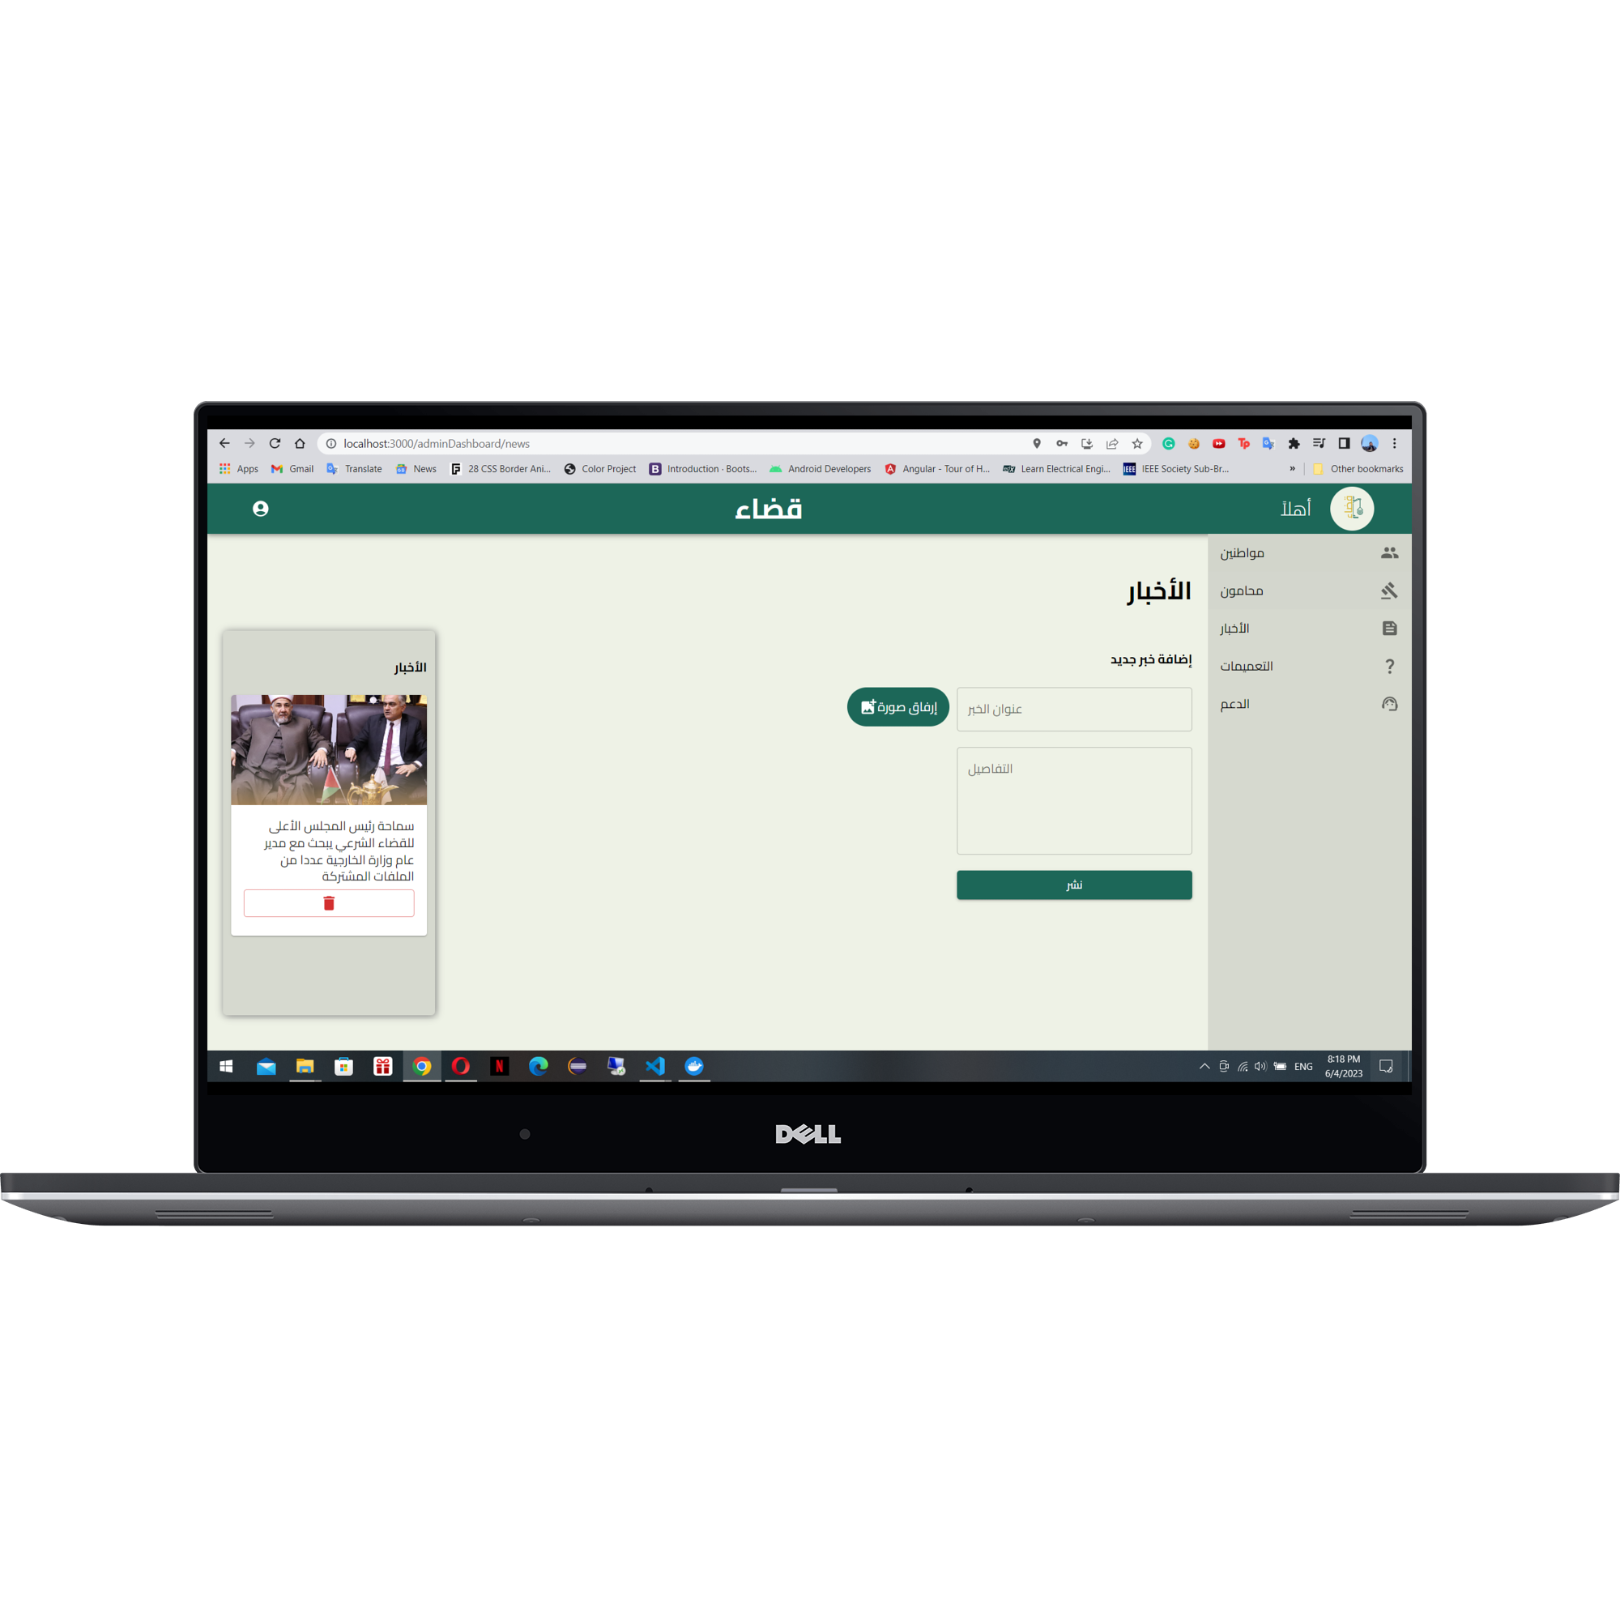
Features
Admin

Slide 16
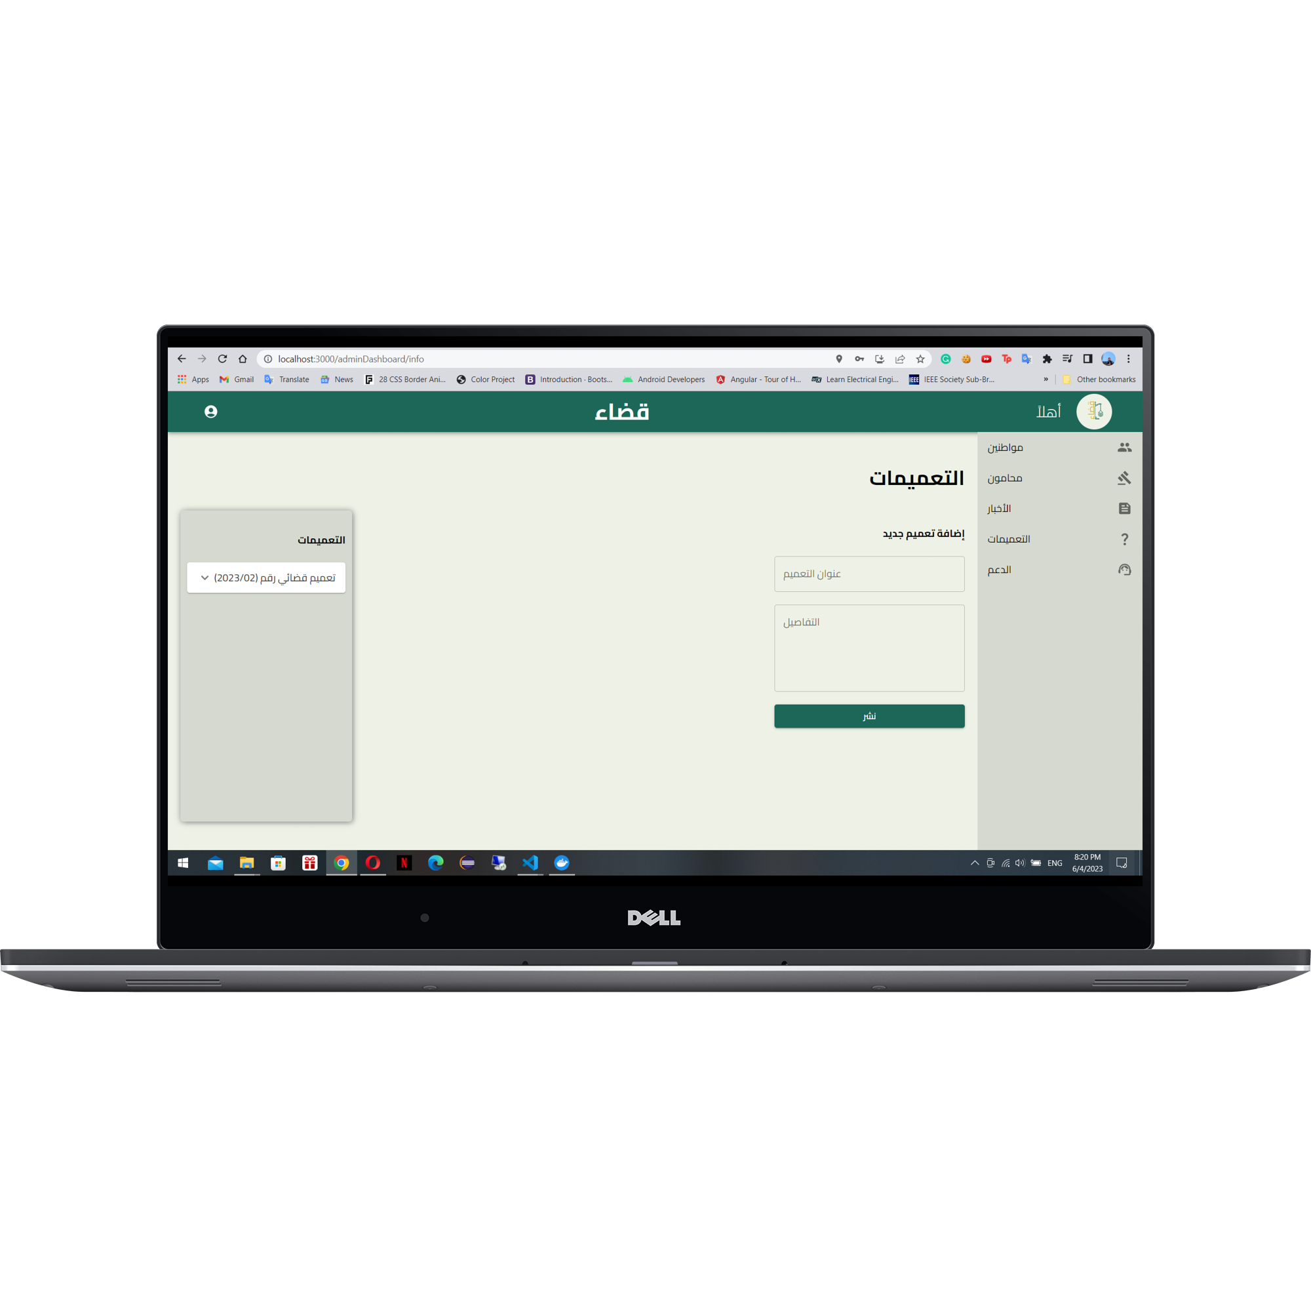
Features
Admin

Slide 17
Future work
Collaboration with Legal Institutions.
Integration of AI and automation.
Integration of E-Payment Systems.

Slide 18
Thanks …
Any Questions ?!

