Slide 1

Cash Core

Slide 2
Group Members
Mohammad Khamalan
Adnan Ennab

Slide 3
Table of contents
1- Problem statement 3- Process
2- Idea 4-Goal

Slide 4
Problem Statement
Outdated banking systems.
Delayed response to customer inquiries.
Ineffective internal communication.
Ineffective advertising monitoring and poor customer reach
Difficulty engaging customers with traditional ads.
Banking delays due to old systems.
Need for targeted financial products.

Slide 5
Solutions
Develop a detailed app and website designed to be an effective solution

Slide 6
Idea
Account Creation and Management
Banking Transactions and Balance Checking
Advertisement Interaction
Friendly System

Slide 7
Idea
Scheduling and Emergency Communication
Customizable Alerts and Notifications
to motivate, a points system was adopted for prizes

Slide 8
Process
Cash core

Slide 9
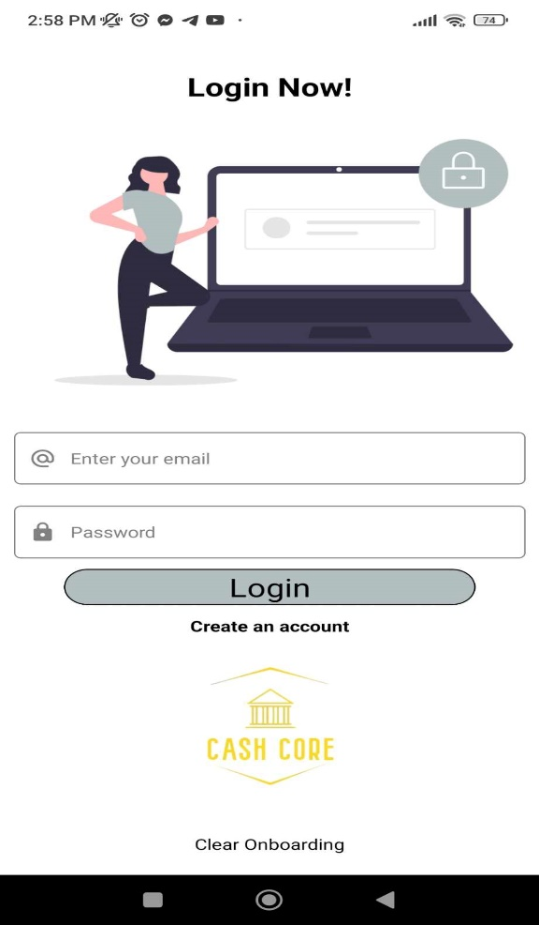
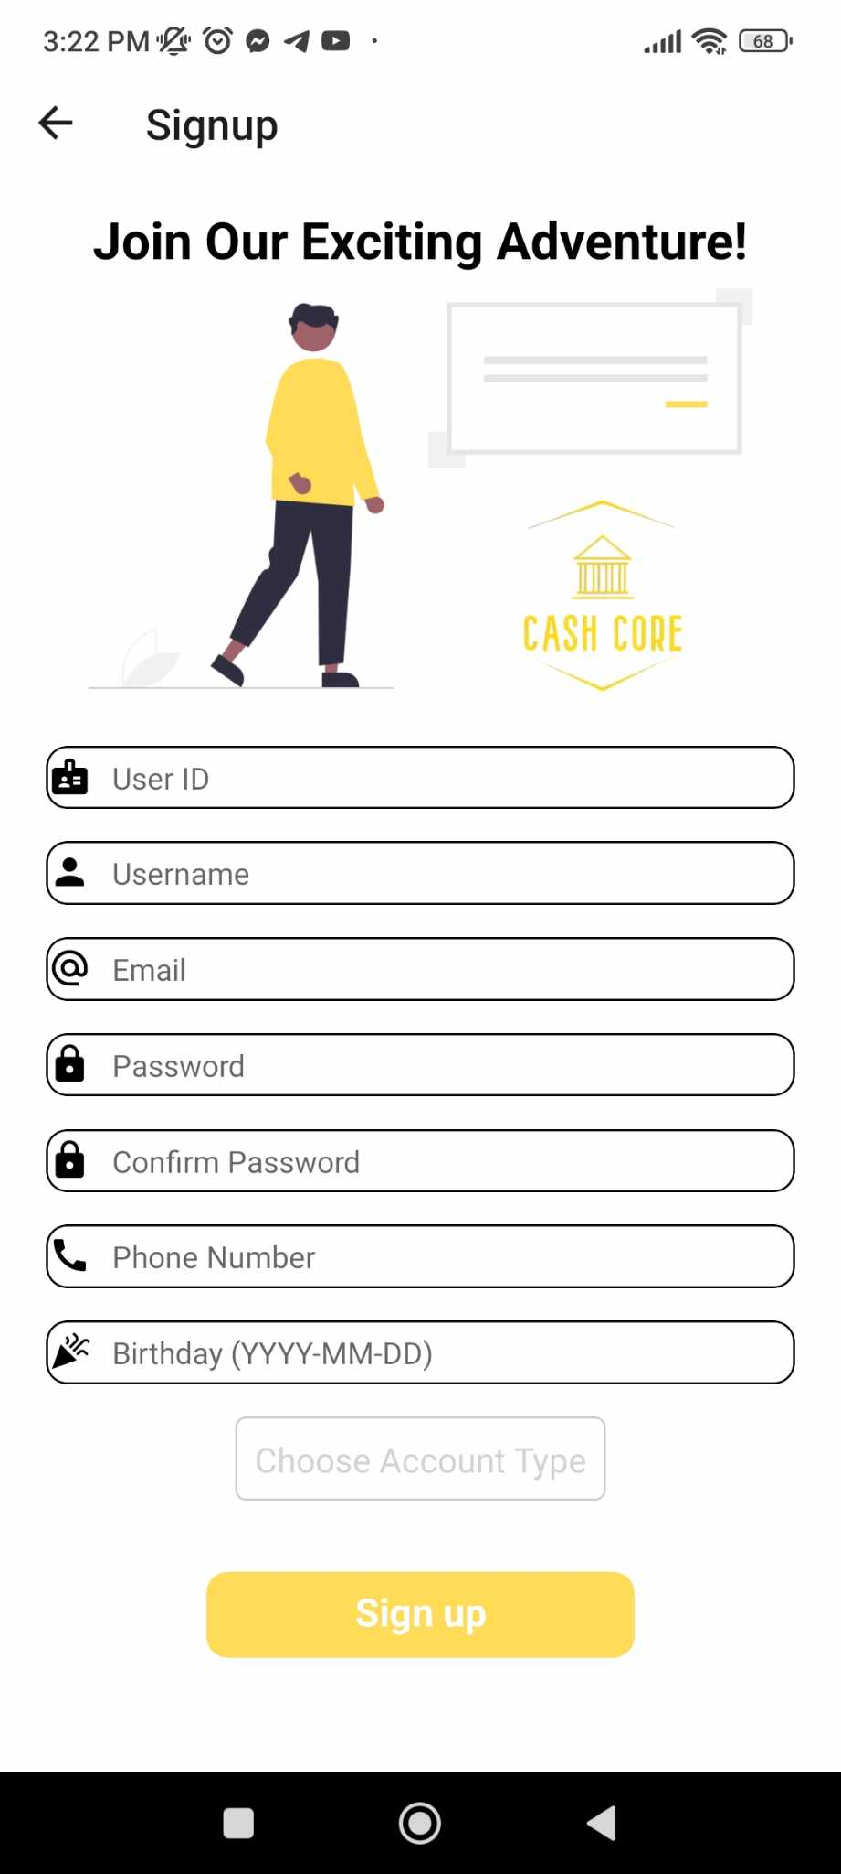
Mobile Application
Login and Sign up Pages

Slide 10
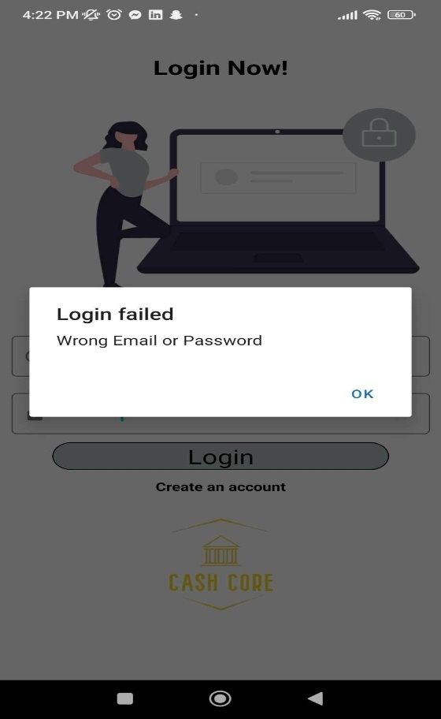
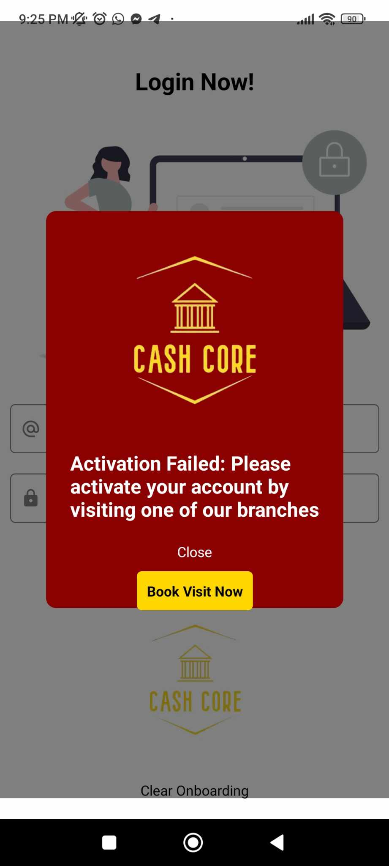
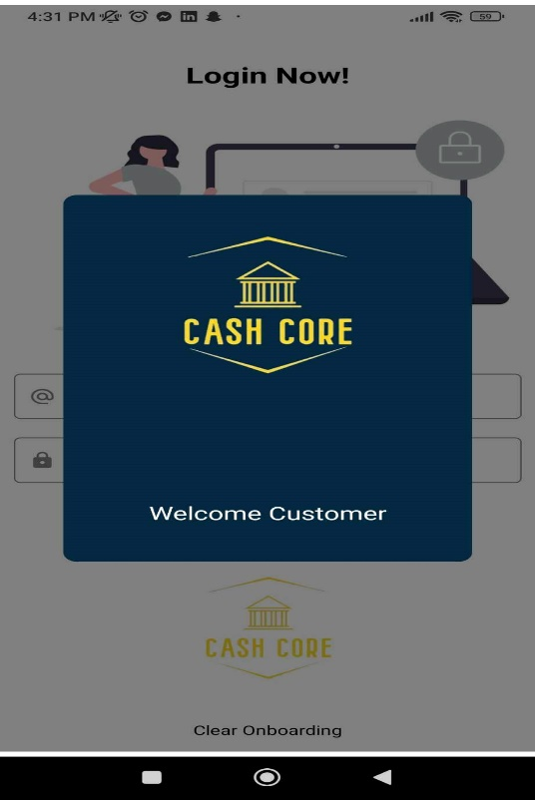
Mobile Application
Login Check

Slide 11
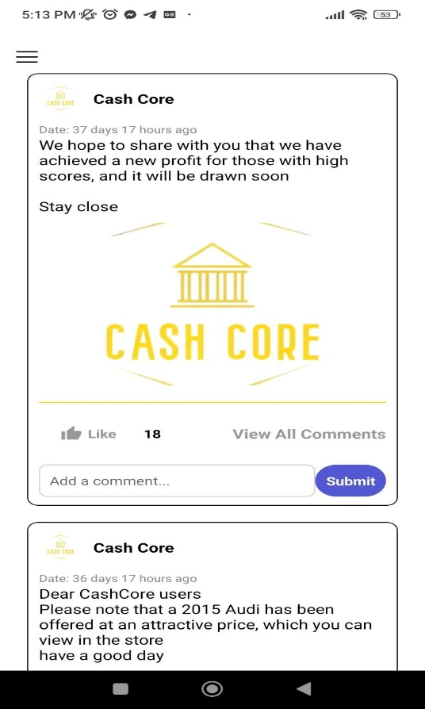
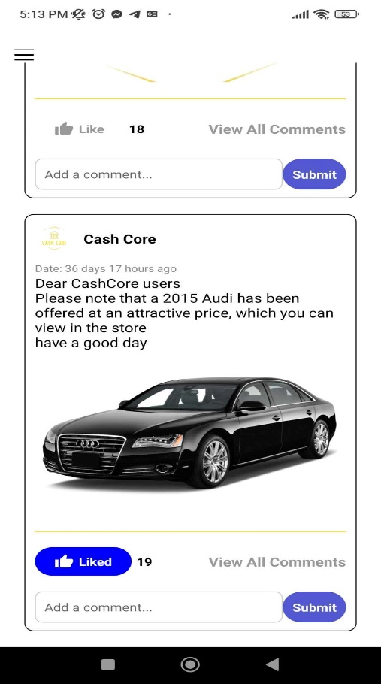
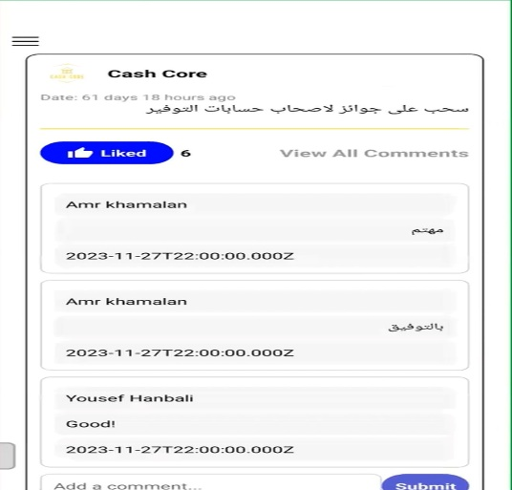
Mobile Application
Posts & Likes &Comments

Slide 12
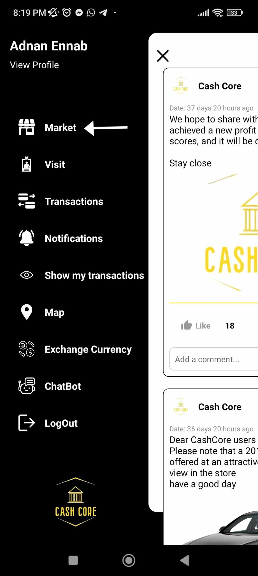
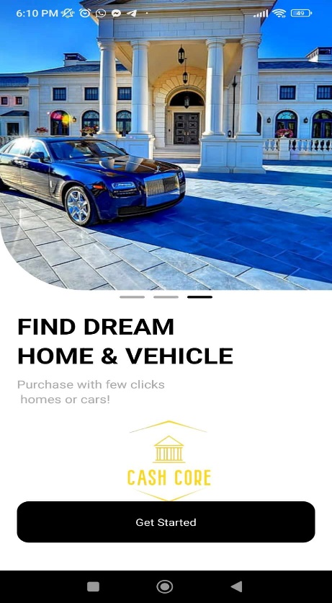
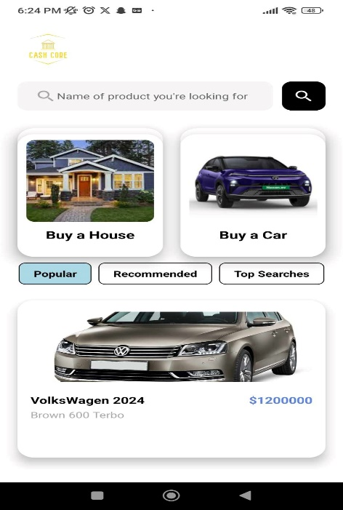
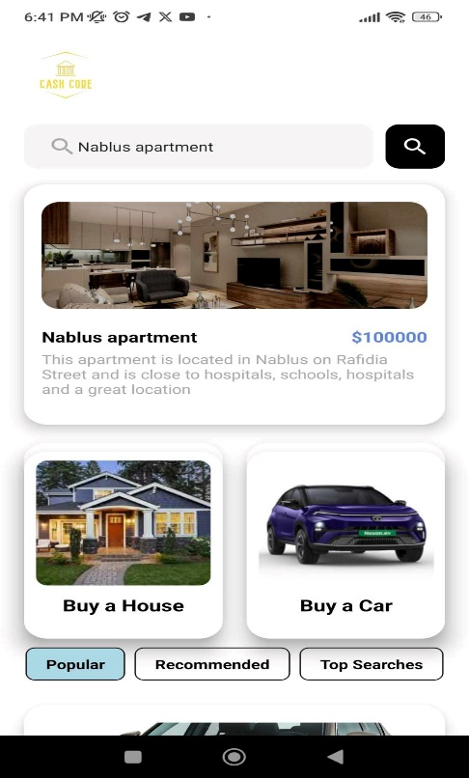
Mobile Application
Market Page

Slide 13
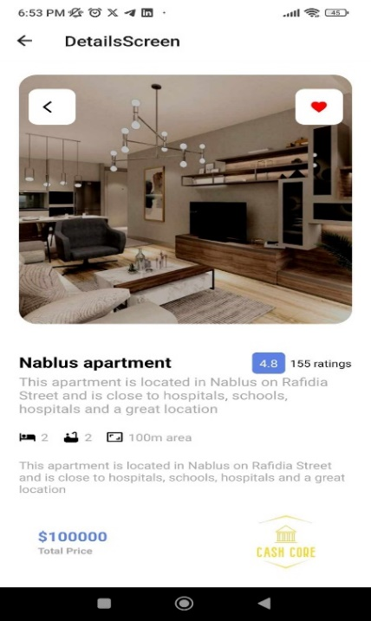
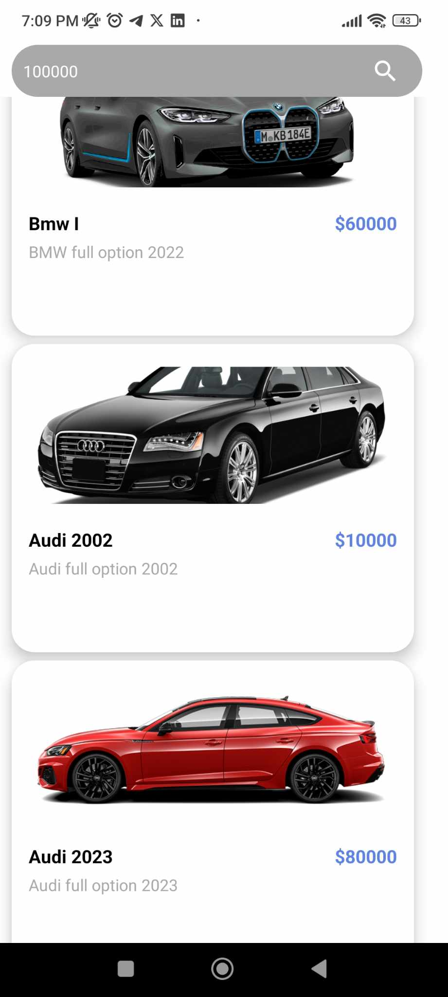
Mobile Application
Market Continue

Slide 14
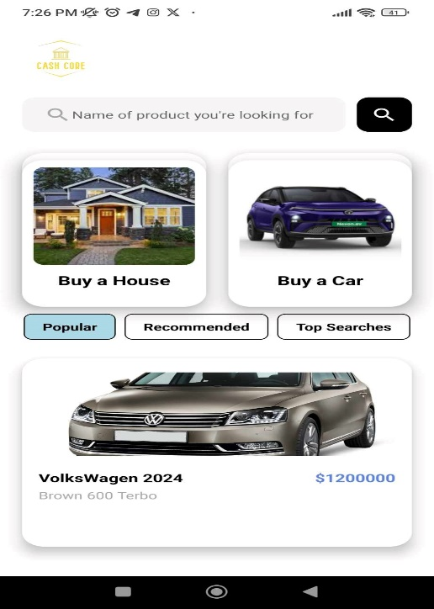
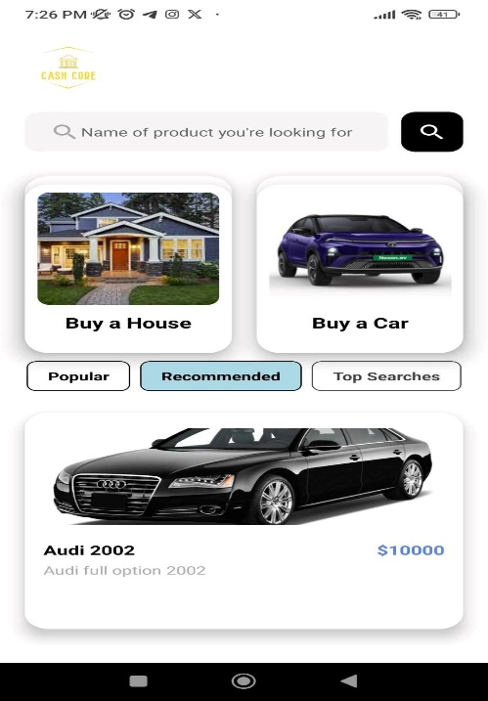
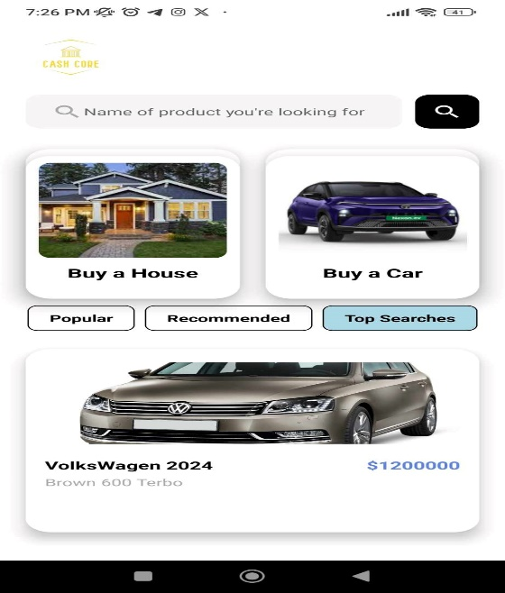
Mobile Application
Market Continue

Slide 15
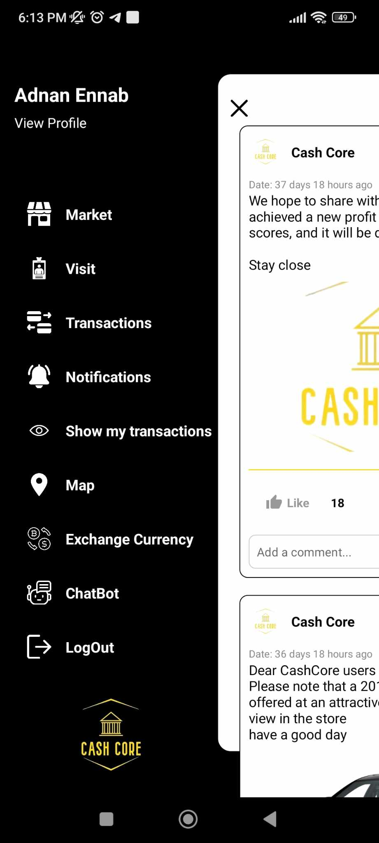
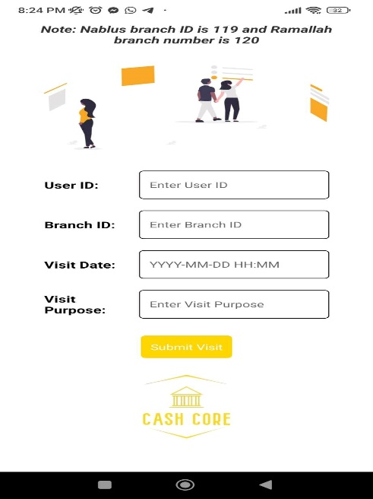
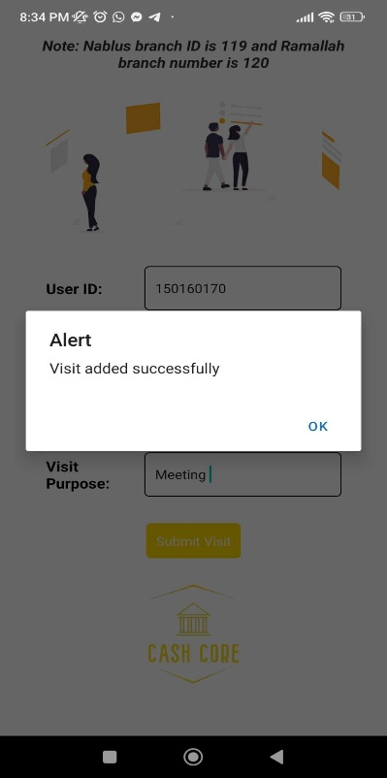
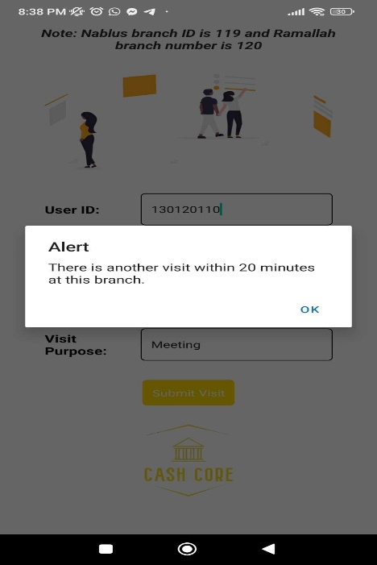
Mobile Application
Visits

Slide 16

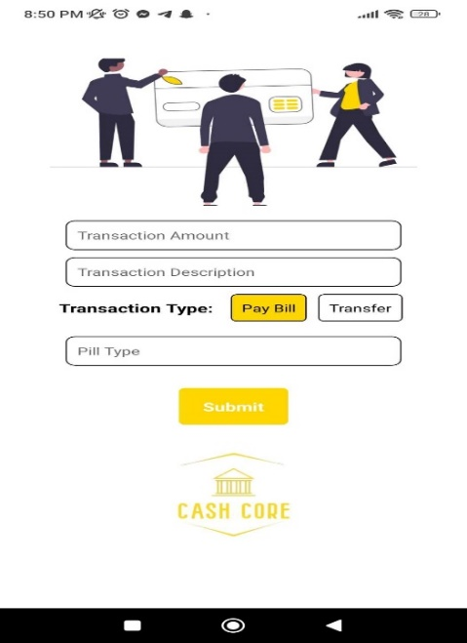
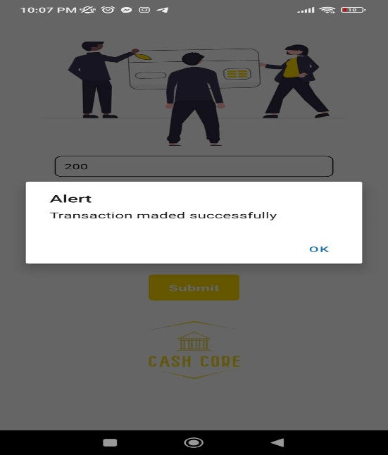
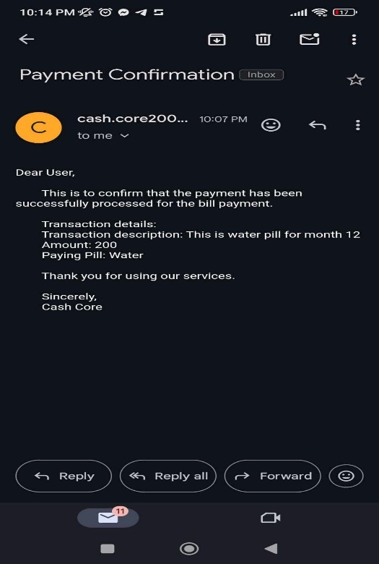
Mobile Application
Transactions Page

Slide 17
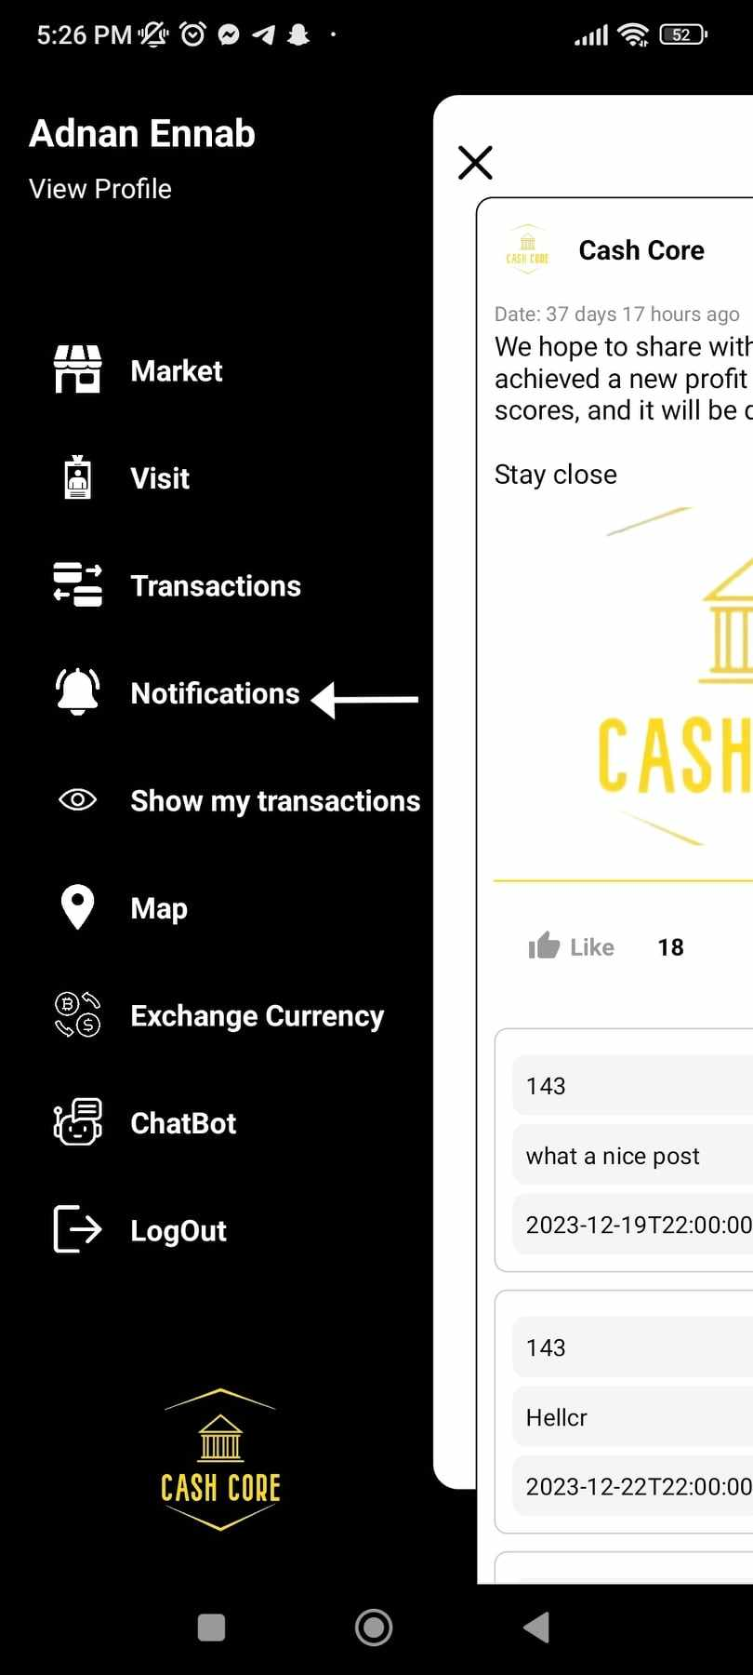
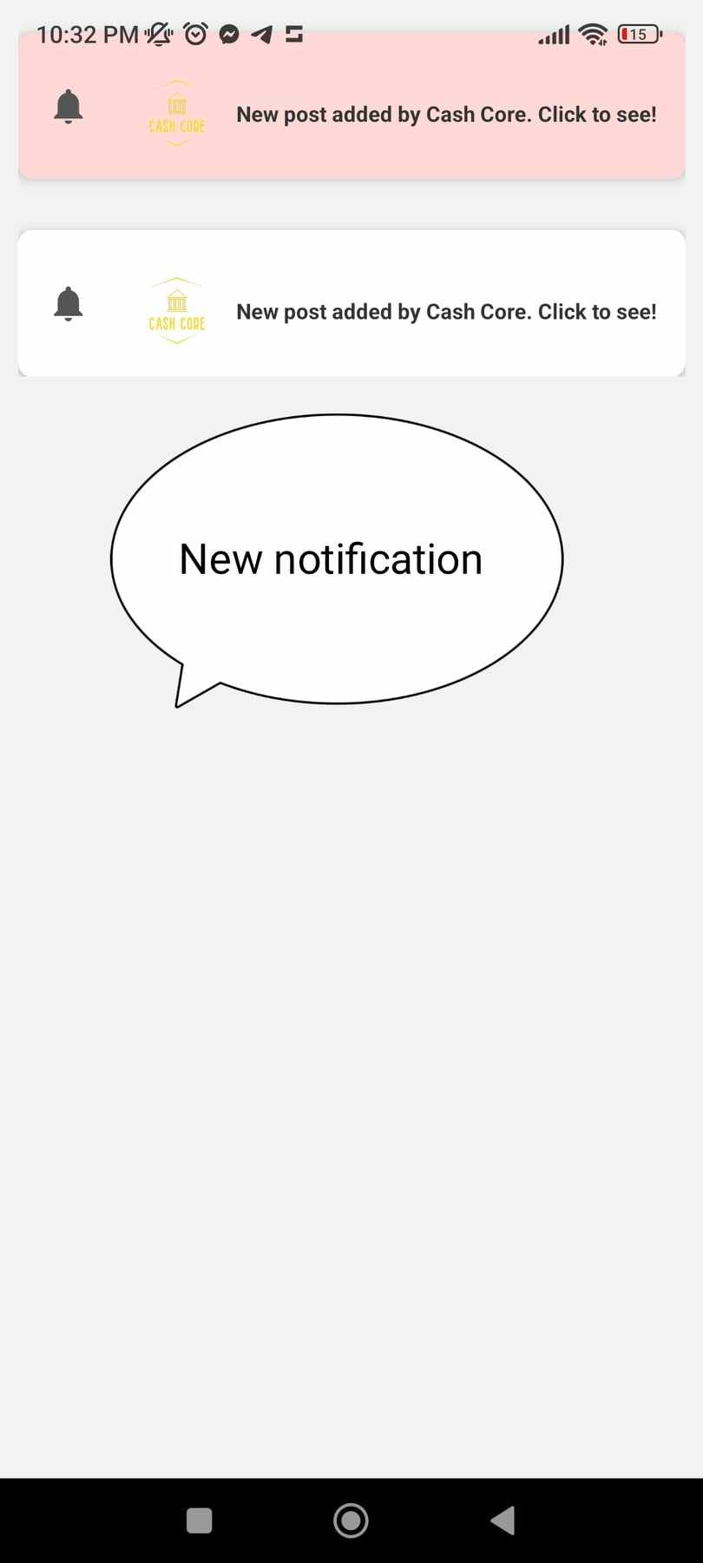
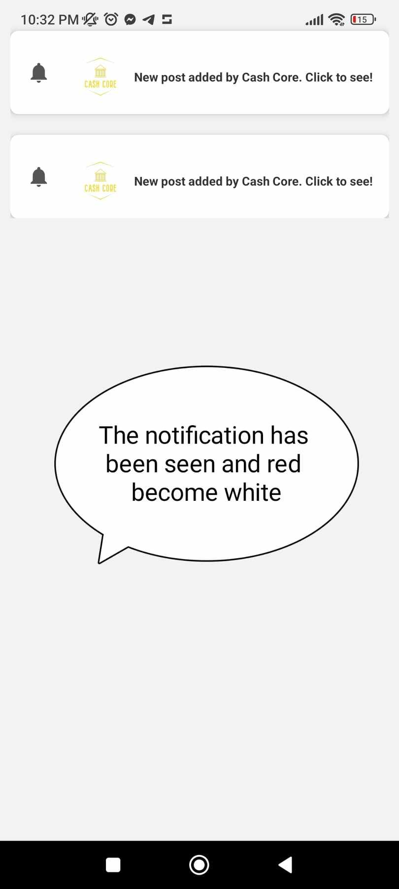
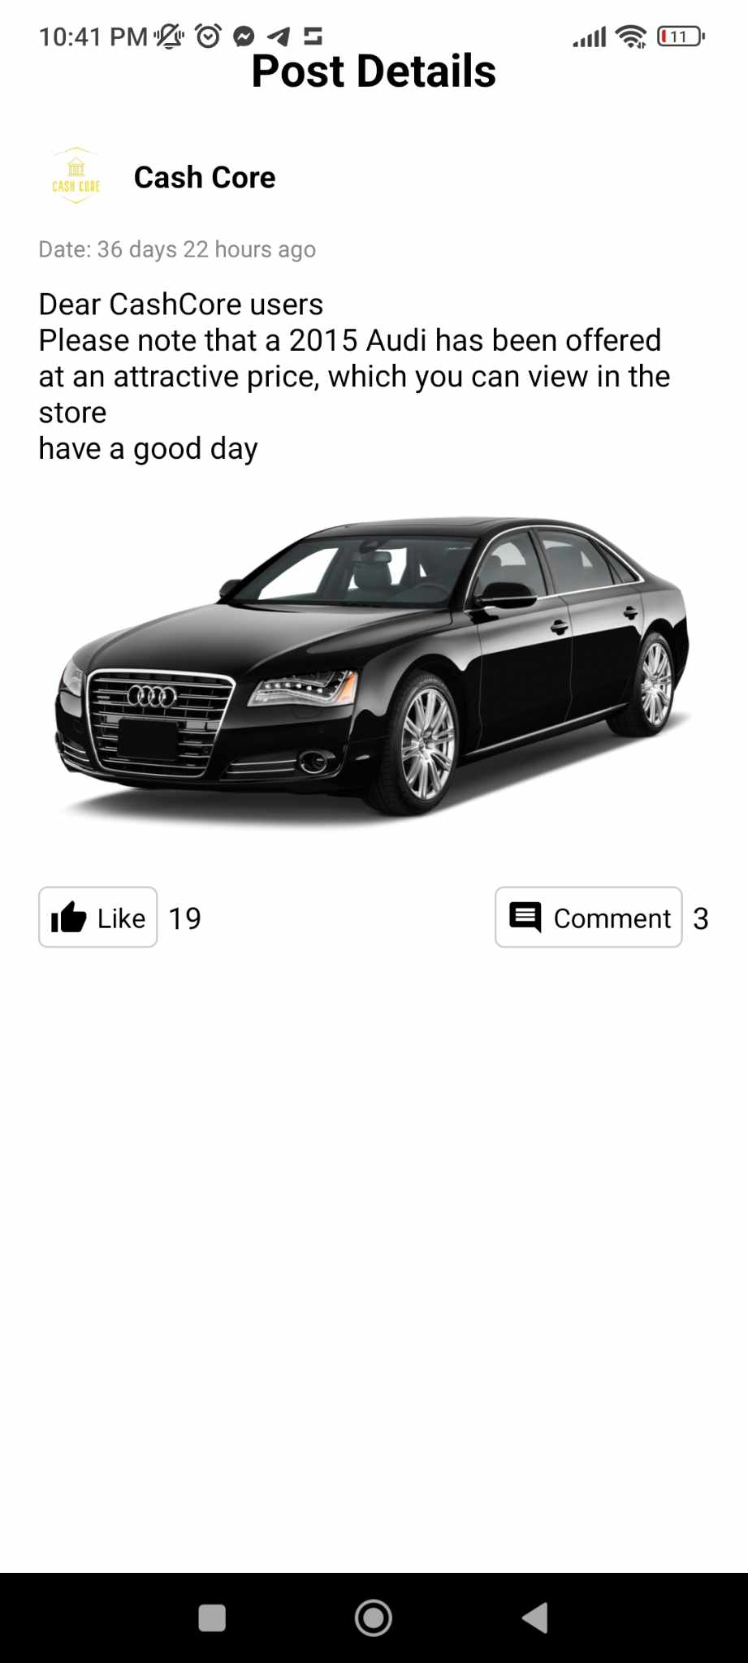
Mobile Application
Notifications Page

Slide 18
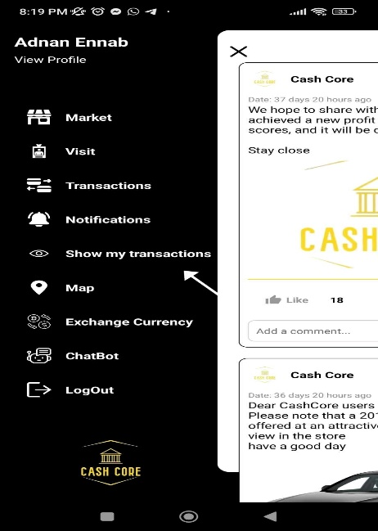
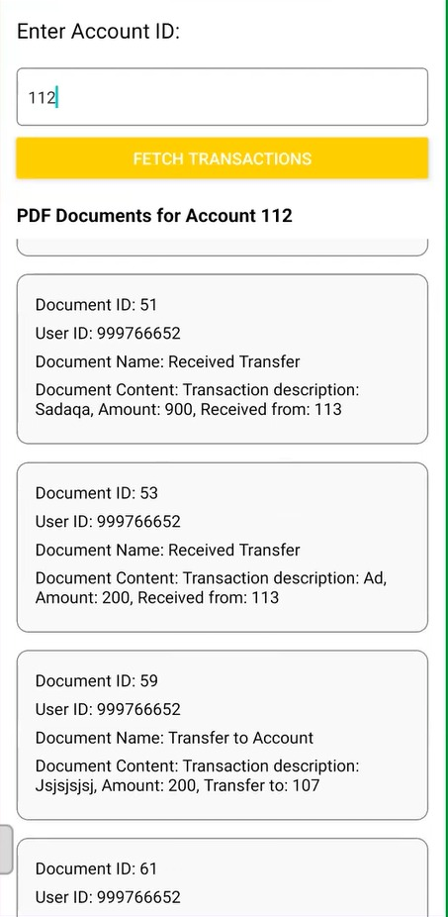
Mobile Application
Show transaction page

Slide 19
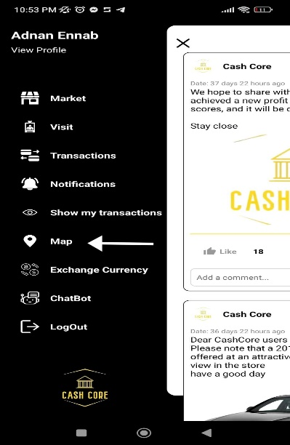
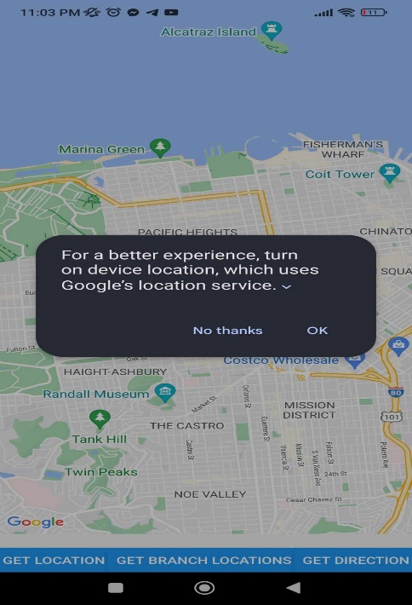
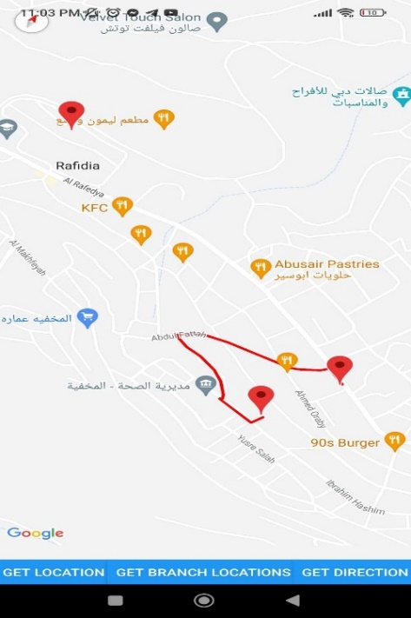
Mobile Application
Map page

Slide 20
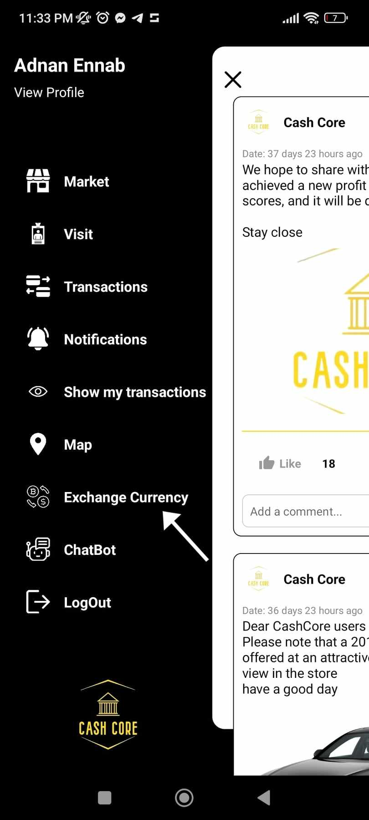
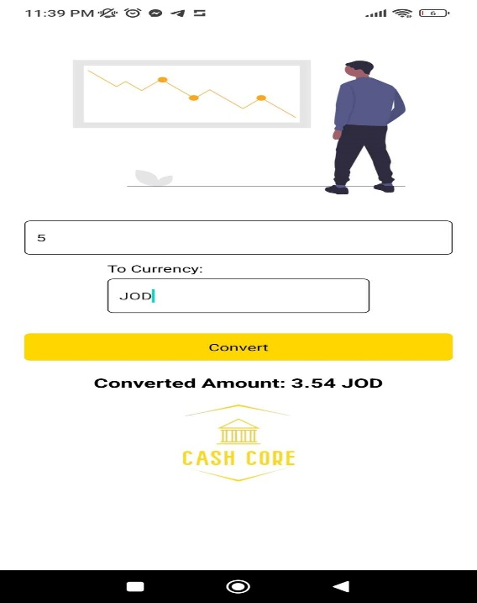
Mobile Application
Exchange Currency

Slide 21
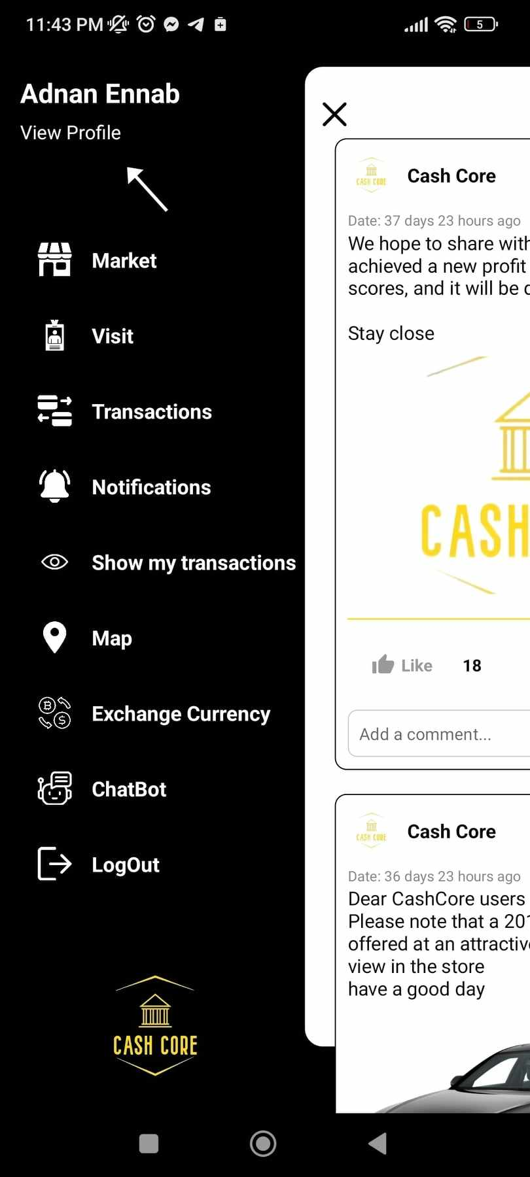
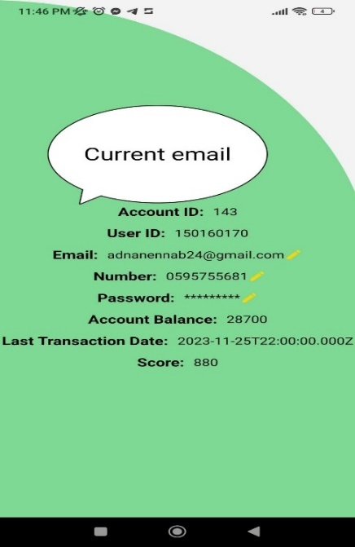
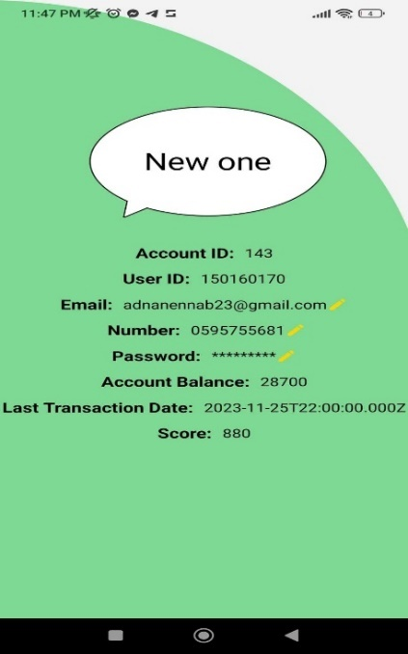
Mobile Application
View profile page

Slide 22

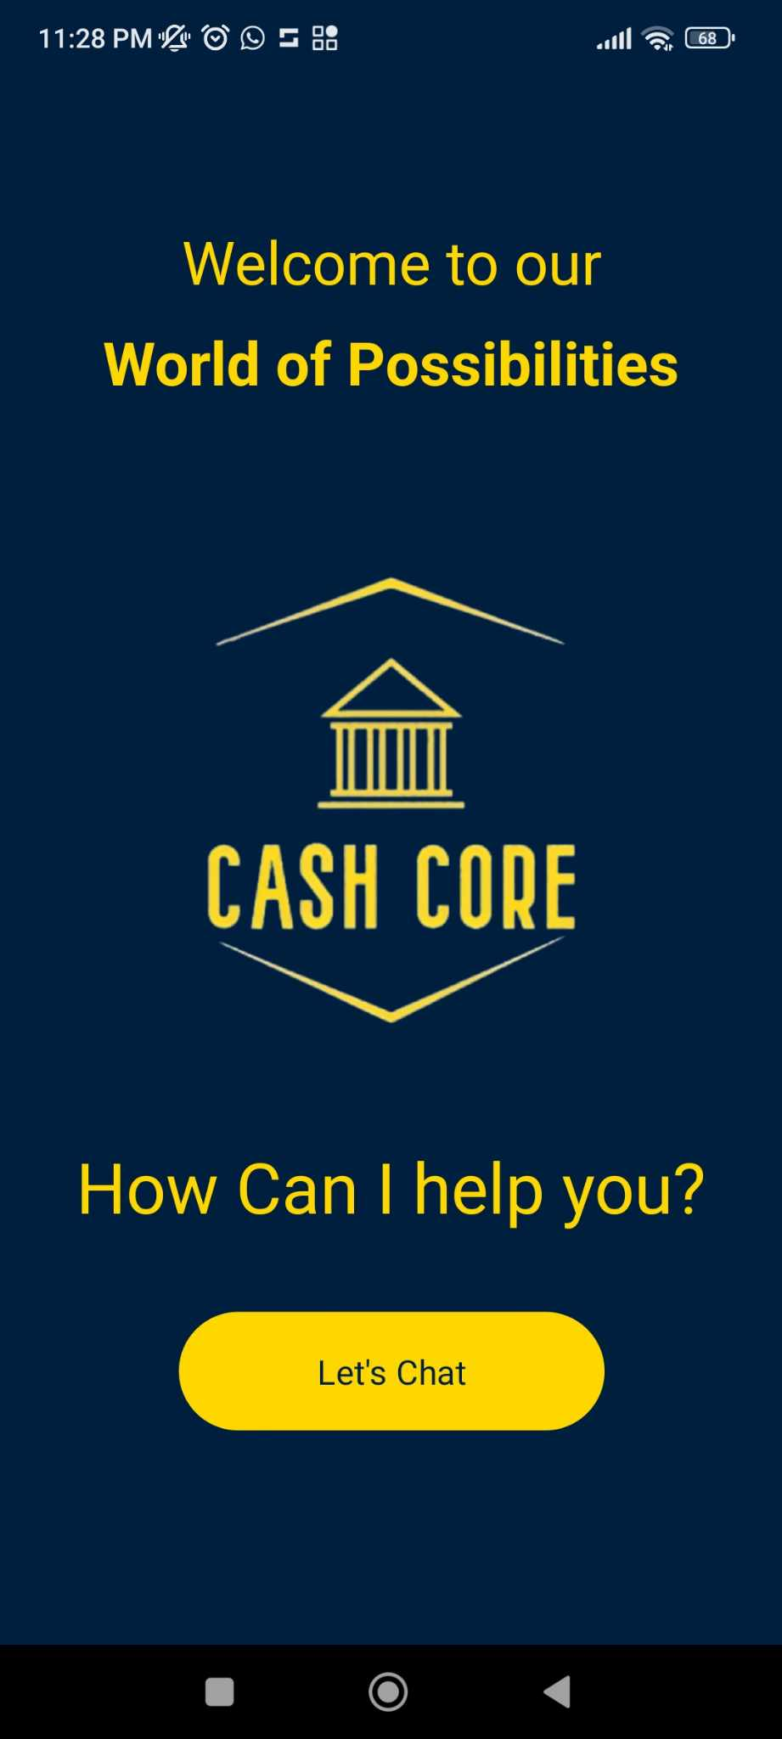
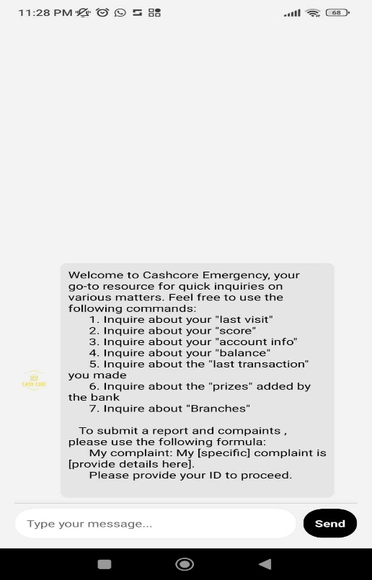
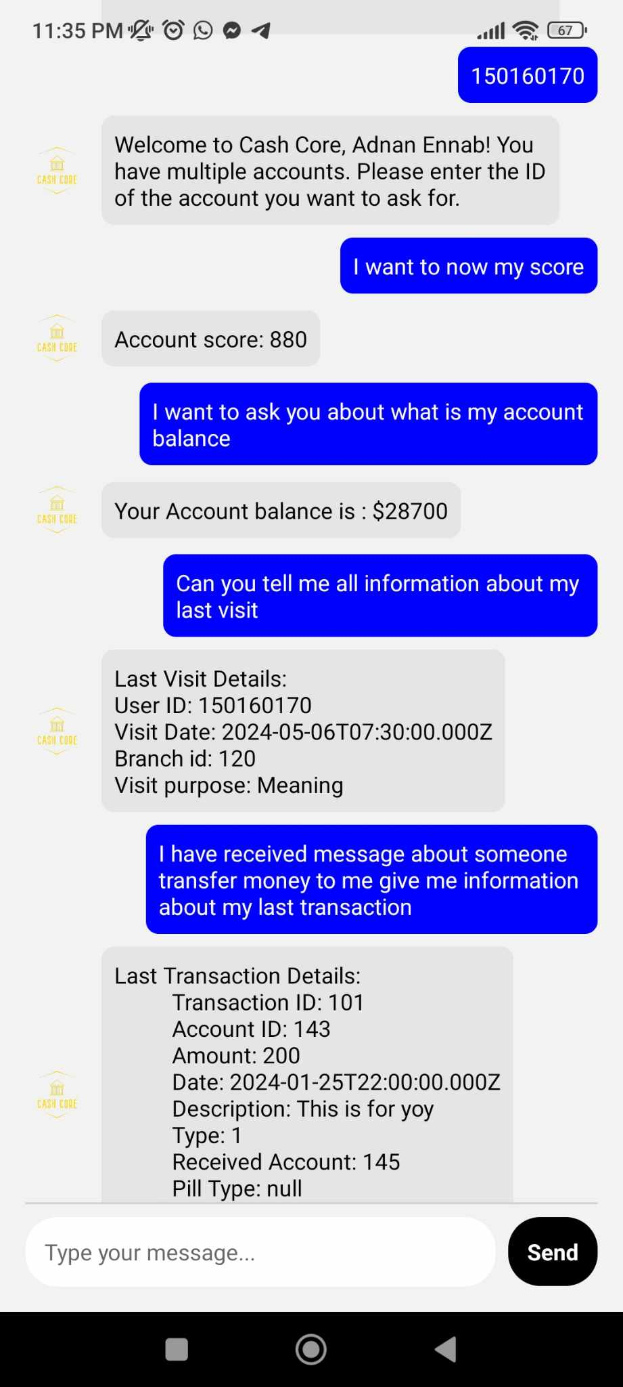
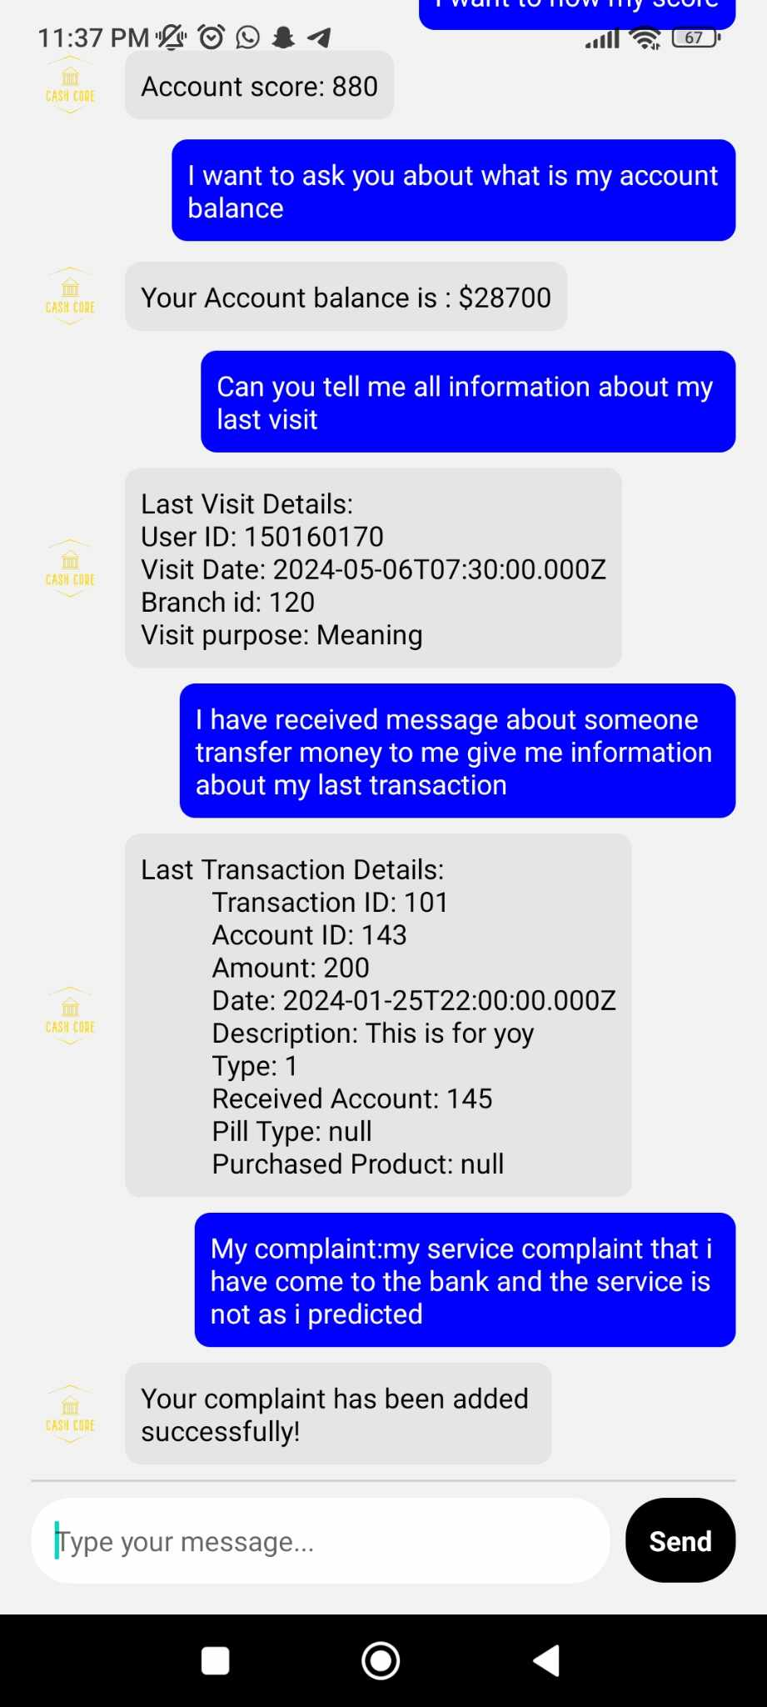
Mobile Application
ChatBot page

Slide 23
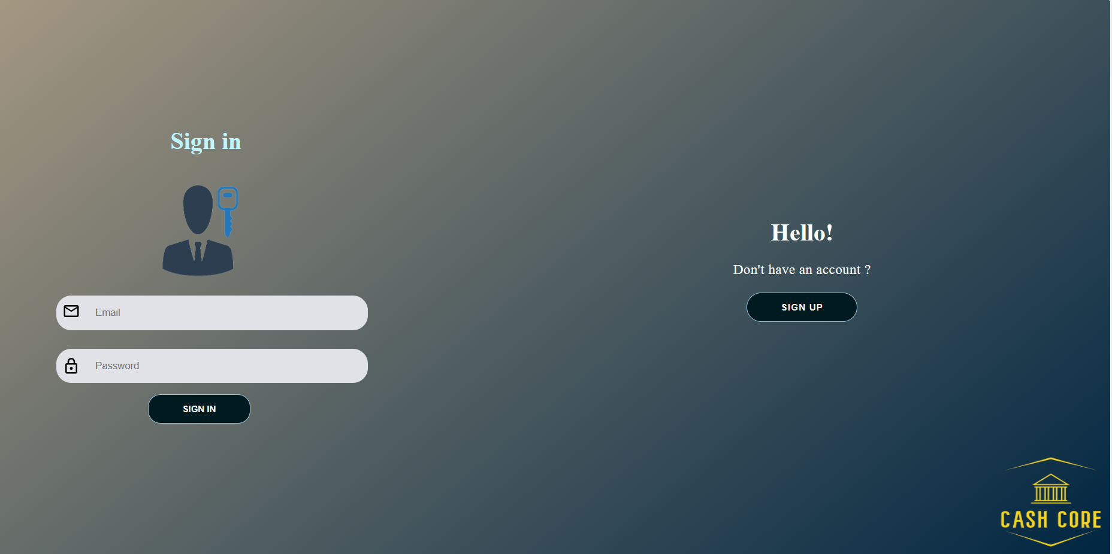
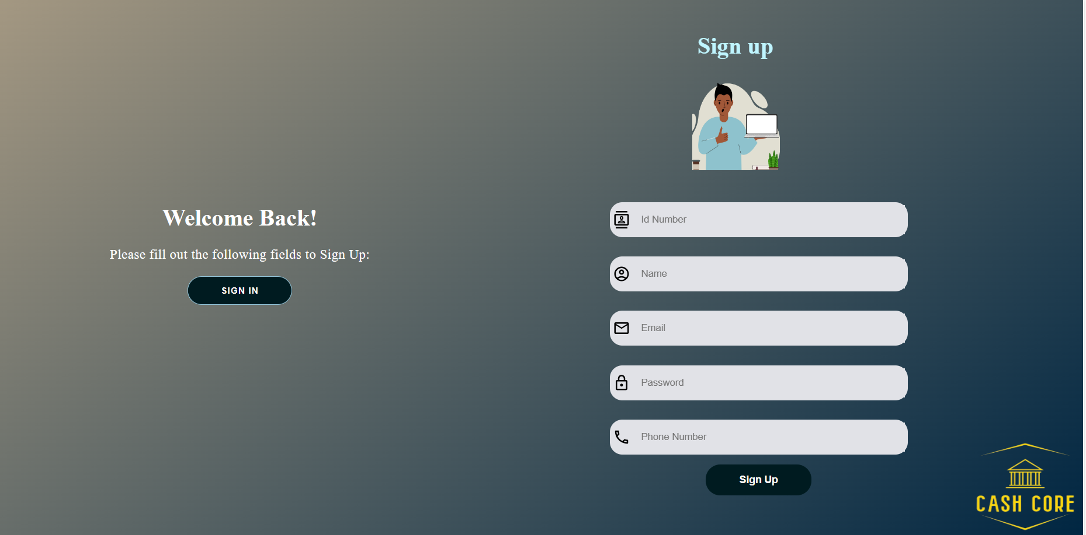
Admin Website
Login and registration

Slide 24
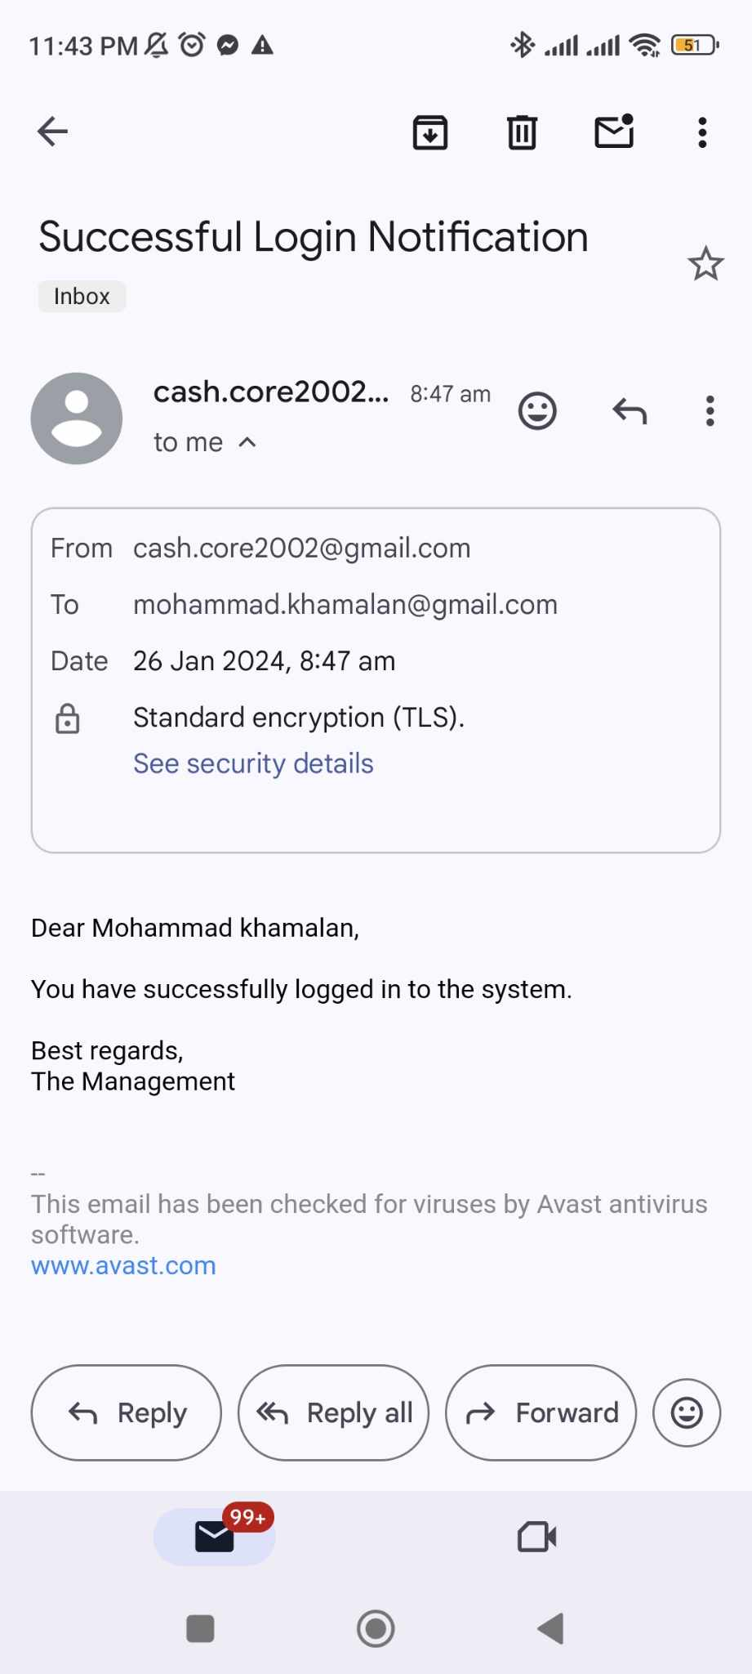
Admin Website confirmation sending email to employee

Slide 25
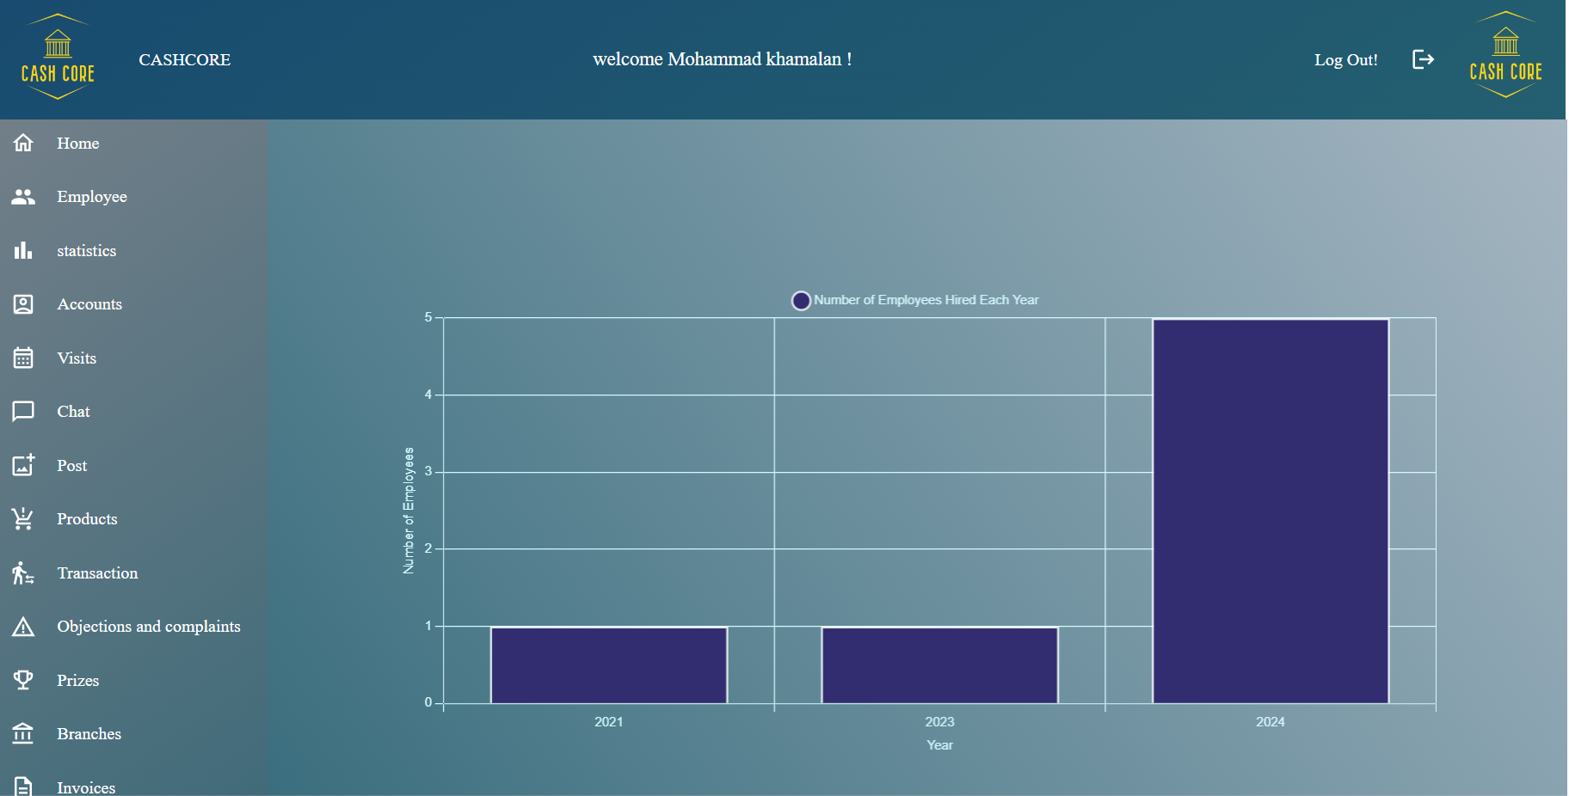
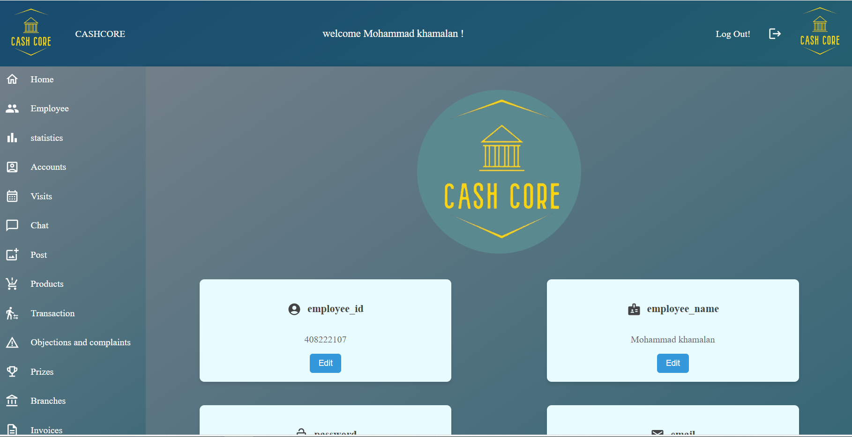
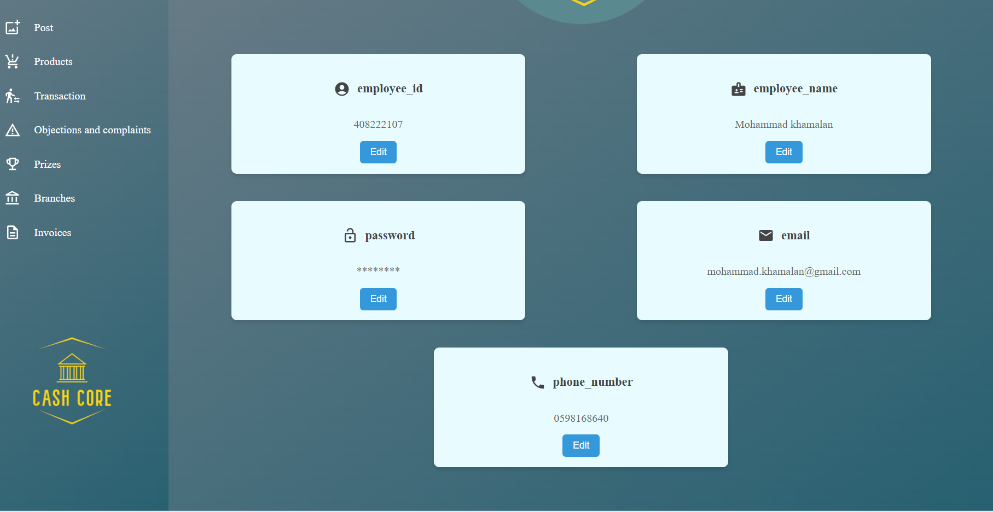
Admin Website
Supervisor

Slide 26

Admin Website employee

Slide 27
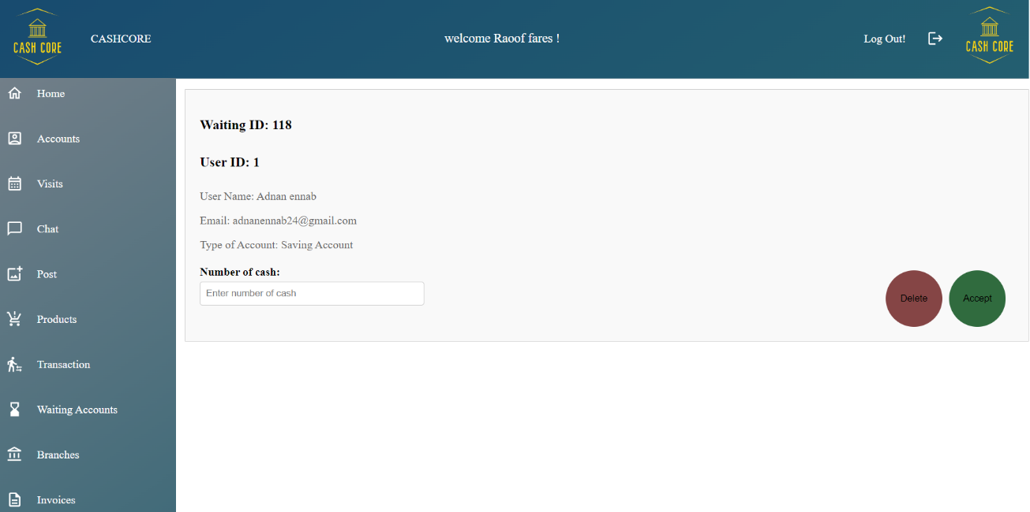
Admin Website employee waitaing accounts page

Slide 28
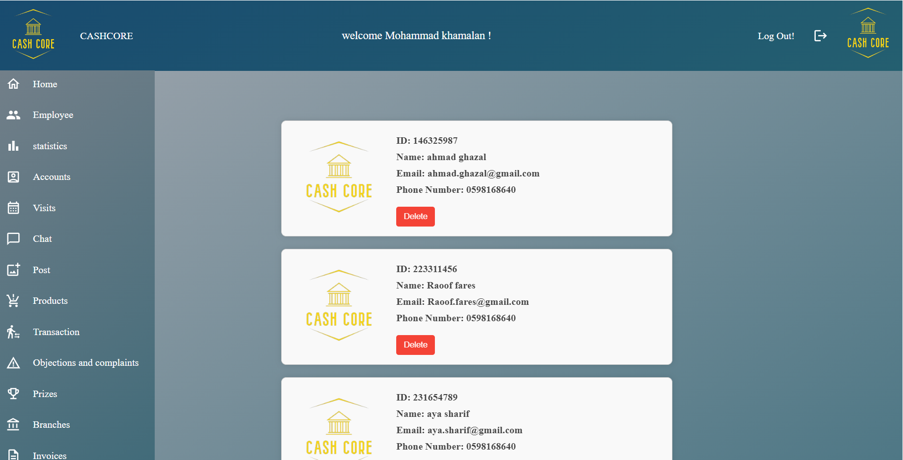

Admin Website
Supervisor employees page and accounts page

Slide 29

Admin Website
Supervisor and employee visit page

Slide 30


Admin Website
Supervisor and employee chat page

Slide 31


Admin Website
Supervisor posts page

Slide 32

Admin Website
Employee posts page

Slide 33


Admin Website
Supervisor and employee products page

Slide 34

Admin Website
Supervisor and employee products page continue

Slide 35

Admin Website
Supervisor and employee Transaction page

Slide 36


Admin Website
Supervisor and employee Transaction page continue

Slide 37


Admin Website
Supervisor objections page

Slide 38


Admin Website
Supervisor prizes page

Slide 39

Admin Website
Supervisor prizes page continue

Slide 40

Admin Website
Supervisor and employee Branches page

Slide 41


Admin Website
Supervisor and employee invoices page

Slide 42

Admin Website
Supervisor and employee invoices page continue

Slide 43
Goal
Cash core

Slide 44
Goal
1- Reducing time and effort for clients and minimizing the congestion inside banks.
2- Enhancing communication between employees and customers.
3- Facilitating banking transactions for clients.
4- Encouraging users to use the app through prize draws.

Slide 45
Future work
Adding a loan system to the system.
Handling credit cards and linking them to accounts, enabling customers to purchase any of their needs.
Integrating checks into the system to facilitate transactions through them.

Slide 46




TECHNOLOGIES

Slide 47



TECHNOLOGIES

Slide 48
Thank You!

