Slide 1

“Optimization Of Insulation Thickness For Building’s External Walls And Ceilings In Palestine (West Bank)”
Graduation Project 2
Presented by: Abd Elmuhsen Salamh Supervisor: Dr. Ihab H. Al Surakje
Muhammad Jaarah
Muhanad Abu Alwafa
Zaid Almasoud
Committee members: Dr. Iyad Assaf & Dr. Luqman Herzallah
2017/2018

Slide 2
Outline
1-Introduction and Background
2-Research Objectives
3-Literature Review
4-Methodology
5-climatic zone, Wall& Ceiling structure
7-Discussions and calculations
8-Results

Slide 3

Introduction

Slide 4
Introduction
Discussions and calculations
climatic zone ,Wall& Ceiling structure
Methodology
Literature Review
Research Objectives
Results
1/6
Importing energy sources, such as oil, natural gas and others in large quantities, is a real problem facing developing countries such as Palestine. So energy conservation is an important part of any national energy strategy in a country without resources . Moreover, saving energy would protect the environment and achieve economic development.

Slide 5
Introduction
Discussions and calculations
climatic zone ,Wall& Ceiling structure
Methodology
Literature Review
Research Objectives
Results
2/6
One of the Solution to reduce the energy consumption of the heating and air conditioning in the buildings. Whereas more than 50% of energy consumption is used for heating and air conditioning in buildings.
Notes:
Can we reduce this consumption?
If we can, how ?
From these questions, our research are came !

Slide 6
Introduction
Research Objectives
Literature Review
Methodology
Discussions and calculations
climatic zone ,Wall& Ceiling structure
Results
3/6
Thermal insulation is one of the most common ways to reduce the impact of the external climate on the internal climate of the buildings as it reduces energy consumption in the construction sector.

Slide 7
Introduction
Research Objectives
Literature Review
Methodology
Discussions and calculations
climatic zone ,Wall& Ceiling structure
Results
Optimum Insulation Thickness
Is to choose a suitable insulations thickness for the insulation layer in the walls and ceilings, so that the thermal conductivity of the walls and ceilings is reduced as much as possible, so providing best thermal insulation possible that is reducing the energy consuming in air conditioning and heating and costs it.
4/6

Slide 8
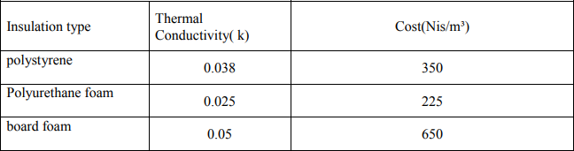
Introduction
Research Objectives
Literature Review
Methodology
Discussions and calculations
climatic zone ,Wall& Ceiling structure
Results
5/6
  Types of the famous insulation material on construction is shown in table 1

Slide 9

Research Objectives

Slide 10
Introduction
Discussions and calculations
climatic zone ,Wall& Ceiling structure
Methodology
Literature Review
Research Objectives
Results
1-Understanding definitions and
benefits of insulation.
2-Literature review.
3-Summarize the techniques and
methods using to optimize the
wall insulation thickness.
4-Collecting data
from engineering Offices.
5- Calculate the optimum insulation thickness for walls and ceilings ,by using the best 3 insulating materials , which are board foam , polystyrene and polyurethane foam .
6-compare the optimum thickness with insulation thickness that is taken from engineering offices.
7- compare the result of our research with the results of the previous research e.g. Afif Hasan paper).

Slide 11

Literature Review
11

Slide 12
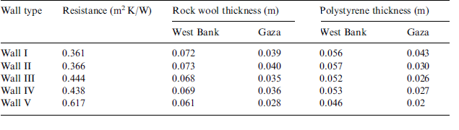
Introduction
Discussions and calculations
climatic zone ,Wall& Ceiling structure
Methodology
Literature Review
Research Objectives
Results
1/3
Hasan, A., (1999) " The optimization is based on the life cycle cost analysis. Life cycle savings of the insulated buildings are computed for Palestine. Savings up to 21 $/m2 of wall area are possible for rock wool and polystyrene insulation. Payback periods between 1 and 1.7 years are possible for rock wool and payback periods between 1.3 and 2.3 years for polystyrene insulation, depending on the type of wall structure.
Table(2) optimum insulation thickness for two type of insulation material

Slide 13
Introduction
Discussions and calculations
climatic zone ,Wall& Ceiling structure
Methodology
Literature Review
Research Objectives
Results
2/3
Dombaycı, Ö.A.,et al ,( 2006), The optimum result has been obtained using coal as the energy source and expanded polystyrene as the insulating material. Then energy savings up to 14 $/m2 of wall area can be obtained when the optimum insulation-thickness is applied.

Slide 14
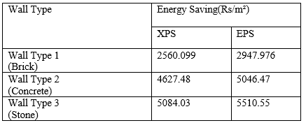
Introduction
Discussions and calculations
climatic zone ,Wall& Ceiling structure
Methodology
Literature Review
Research Objectives
Results
Subhash Mishra, et al .(2012), Optimum insulation thickness varies between 0.068 m and 0.074 m for Expended polystyrene (EPS) and optimum thickness varies between 0.052 m and .057 m for Extruded polystyrene(XPS), depending on the fuel and wall type
3/3
Energy saving for different type of walls construction in India as shown in Table 3

Slide 15
Methodology

Slide 16
Introduction
Discussions and calculations
climatic zone ,Wall& Ceiling structure
Methodology
Literature Review
Research Objectives
Results
1/2
1- Data gathering such as basic components and common buildings from engineering offices in different areas such as Nablus, Jenin, Tulkarem, Salfeet and Ramallah.
2-insert and sort the data collected then calculate the heat load, annual heating cost and insulation cost for walls and ceilings. Then calculate the optimum insulation thickness of walls and ceilings ,by using the best 3 insulating materials , which are board foam , polystyrene and polyurethane foam

Slide 17
Introduction
Discussions and calculations
climatic zone ,Wall& Ceiling structure
Methodology
Literature Review
Research Objectives
Results
2/2
3- analyze the data collected by MATLAB program to know the effect of wall thickness and the materials used on annual energy requirement by using Degree-day method .
4-compare the optimum thickness with insulation thickness that is taken from engineering offices.
5-compare the result of our research with the results of the previous research(Afif Hasan paper).

Slide 18
Climatic zone, Wall& Ceiling structure

Slide 19
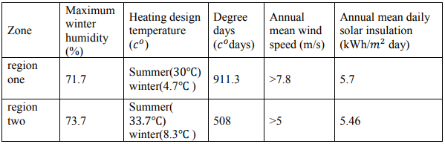
Introduction
Discussions and calculations
climatic zone ,Wall& Ceiling structure
Methodology
Literature Review
Research Objectives
Results
The cities covered by this study can be divided according to the Palestinian code of buildings into two climatic zones for space heating purposes.
Where region one included Nablus, Ramallah and region two included Salfite, Jenien and Tulkarem.
Climatic zone in our research as shown in Table 4

Slide 20
Introduction
Discussions and calculations
climatic zone ,Wall& Ceiling structure
Methodology
Literature Review
Research Objectives
Results
In this study, we collected data of 27 walls and 10 ceilings from engineering offices in five cities in the West Bank
Wall structures vary from one region to another. In general, stone and concrete walls are used in the West Bank. The most common type of artificial stone is used in Residential buildings is Explosive stone and in villas is Topaseh stone.

Slide 21
Introduction
Discussions and calculations
climatic zone ,Wall& Ceiling structure
Methodology
Literature Review
Research Objectives
Results
We removed the insulating materials from the walls assembled from the engineering offices in order to calculate the optimum insulation thickness. We placed the walls containing insulation in a separate table to compare them with the optimum insulation we calculated.

Slide 22
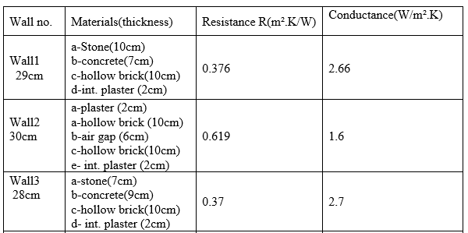
Introduction
Discussions and calculations
climatic zone ,Wall& Ceiling structure
Methodology
Literature Review
Research Objectives
Results
Nablus
A sample of walls taken from engineering offices as shown in Table 5

Slide 23
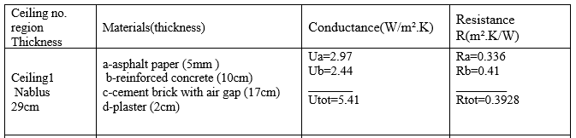
Introduction
Discussions and calculations
climatic zone ,Wall& Ceiling structure
Methodology
Literature Review
Research Objectives
Results
In general, the reinforced concrete, cement brick with air gap, plaster and sometimes followed by asphalt paper or asphalt mix are used in building ceiling in the West Bank.
A sample of ceilings taken from engineering offices as shown in Table 6

Slide 24
Discussions and calculations

Slide 25

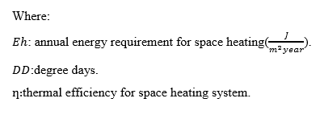
Introduction
Discussions and calculations
climatic zone ,Wall& Ceiling structure
Methodology
Literature Review
Research Objectives
Results
Heating load for uninsulated walls and ceilings

Slide 26
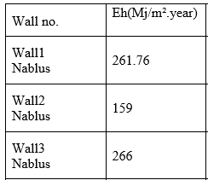

Introduction
Discussions and calculations
climatic zone ,Wall& Ceiling structure
Methodology
Literature Review
Research Objectives
Results
Heating load for uninsulated walls and ceilings
Energy requirement for space heating for walls without insulation as shown in Table 7
Energy requirement for ceiling without insulation as shown in Table 8

Slide 27
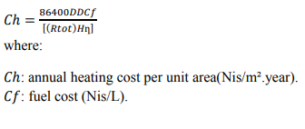
Introduction
Discussions and calculations
climatic zone ,Wall& Ceiling structure
Methodology
Literature Review
Research Objectives
Results
Annual heating cost un insulated walls and ceilings :

Slide 28
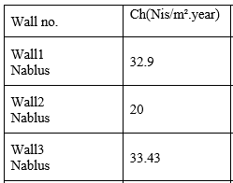

Introduction
Discussions and calculations
climatic zone ,Wall& Ceiling structure
Methodology
Literature Review
Research Objectives
Results
Annual heating cost per unit area for walls without insulation as shown in Table 9
Annual heating cost per unit area for ceilings without insulation as shown in Table 10

Slide 29
Introduction
Discussions and calculations
climatic zone ,Wall& Ceiling structure
Methodology
Literature Review
Research Objectives
Results
Total cost of heating for un insulated walls and ceilings
Ct
The life cycle cost analysis employed in this study computes the heating cost over the lifetime of the building.
𝐶𝑡 = 𝑃𝑊𝐹𝐶ℎ + 𝐶𝑖X
where:
𝐶𝑖𝑛 is the cost of insulation in $/m²
𝐶𝑖 is the cost of insulation in $/m³
𝑋 is the insulation thickness
𝐶𝑡: Now the total cost of heating the insulated in present Nis

Slide 30
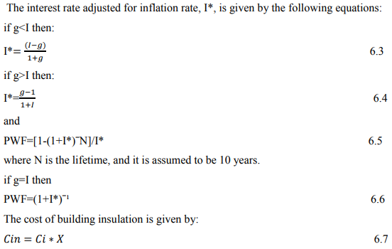
Introduction
Discussions and calculations
climatic zone ,Wall& Ceiling structure
Methodology
Literature Review
Research Objectives
Results
PWF

Slide 31
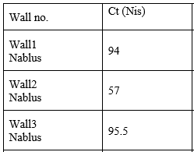

Introduction
Discussions and calculations
climatic zone ,Wall& Ceiling structure
Methodology
Literature Review
Research Objectives
Results
Total cost of heating the uninsulated wall in present NIS as shown in Table 11
Total cost of heating the uninsulated ceiling in present NIS as shown in Table 12

Slide 32
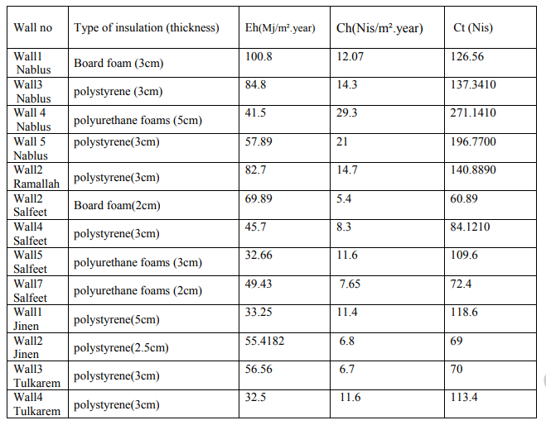
Introduction
Discussions and calculations
climatic zone ,Wall& Ceiling structure
Methodology
Literature Review
Research Objectives
Results
walls with insulation material taken from engineering offices.

Slide 33
Introduction
Discussions and calculations
climatic zone ,Wall& Ceiling structure
Methodology
Literature Review
Research Objectives
Results
Optimization of insulation thickness
𝑋𝑜𝑝 = 293.94 {𝐶𝑓 * 𝐷𝐷 *k*PWF/ H* 𝐶𝑖 *ƞ } ½ − k* 𝑅𝑡𝑜𝑡
where:
𝑋𝑜𝑝: Optimum insulation thickness(m). 𝑃𝑊𝐹:Present worth factor.
𝐶𝑓:Fuel cost(Nis/L) .
𝑅𝑡𝑜𝑡:Total thermal resistance without
insulation(m².K/W).
𝑘:Thermal conductivity for insulation(W/m.𝐶 0 ).
𝐷𝐷:Degree days.
𝐻:Heating value(J/L).
𝐶𝑖:Insulation cost(Nis/m³).
ƞ:System efficiency(%).

Slide 34
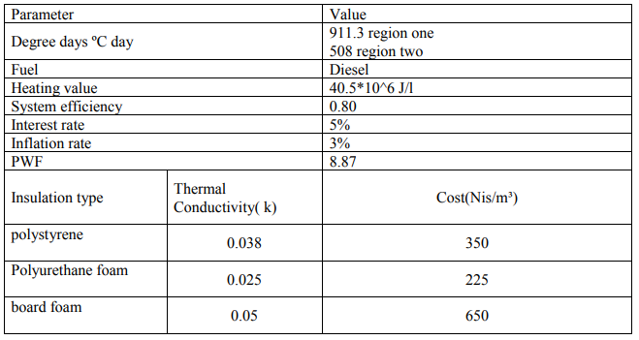
Introduction
Discussions and calculations
climatic zone ,Wall& Ceiling structure
Methodology
Literature Review
Research Objectives
Results
Parameters used in the optimization of insulation thickness

Slide 35
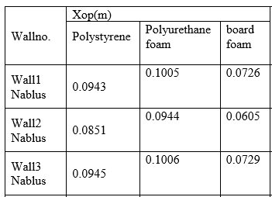
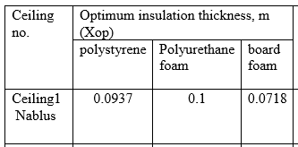
Introduction
Discussions and calculations
climatic zone ,Wall& Ceiling structure
Methodology
Literature Review
Research Objectives
Results
Optimum insulation thickness for walls
Optimum insulation thickness for walls as shown in Table
Optimum insulation thickness for ceilings as shown in Table

Slide 36
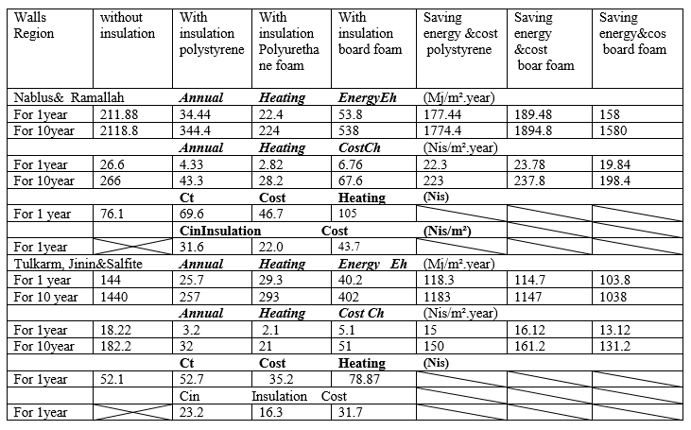
The average energy requirement for space heating , annual heating cost per unit area and the total cost of heating for walls and ceiling in West Bank are shown in below table

Slide 37
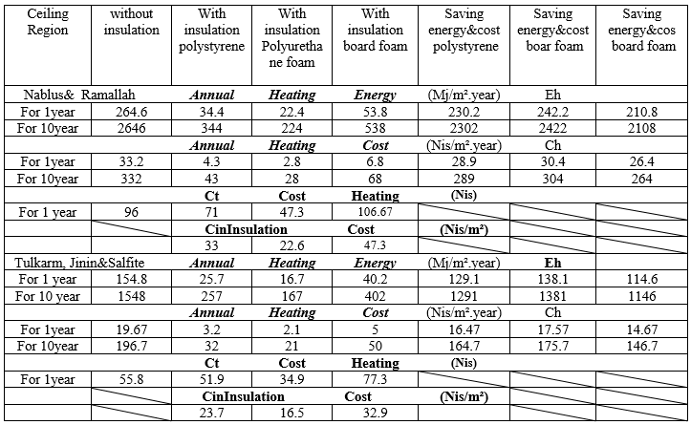
Introduction
Discussions and calculations
climatic zone ,Wall& Ceiling structure
Methodology
Literature Review
Research Objectives
Results
Average required annual heating energy Eh in Palestine for ceilings as shown in Table

Slide 38
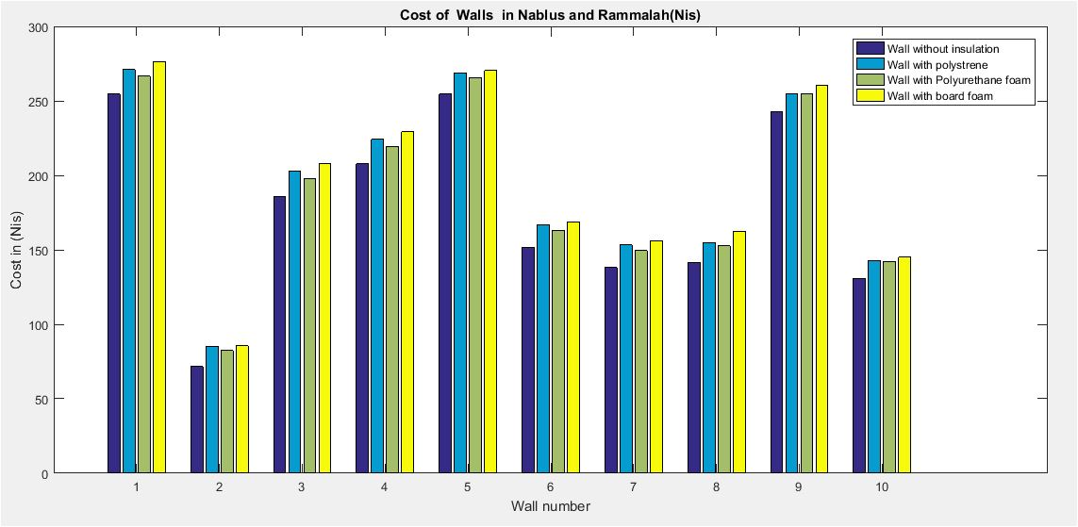
Introduction
Discussions and calculations
climatic zone ,Wall& Ceiling structure
Methodology
Literature Review
Research Objectives
Results
Cost of constructer material
The cost of the material depend on the thickness of layers and if we have insulation material, when we calculated the cost of constructer material for walls and ceilings we take the average cost for every type of material and we take in account the application of ceiling building.

Slide 39
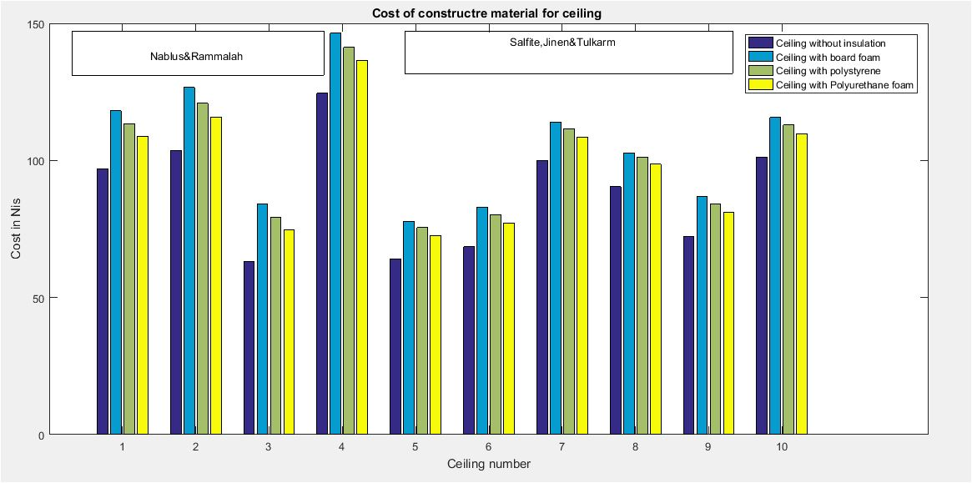
Introduction
Discussions and calculations
climatic zone ,Wall& Ceiling structure
Methodology
Literature Review
Research Objectives
Results
The cost of the constructer material for ceilings in west bank.

Slide 40
Results and comparisons

Slide 41
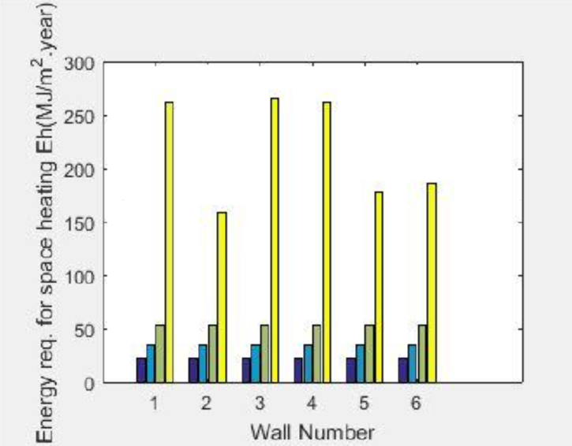

Introduction
Discussions and calculations
climatic zone ,Wall& Ceiling structure
Methodology
Literature Review
Research Objectives
Results
Wall
As insulation thickness increases the heating load decreases as shown in Figure below

Slide 42
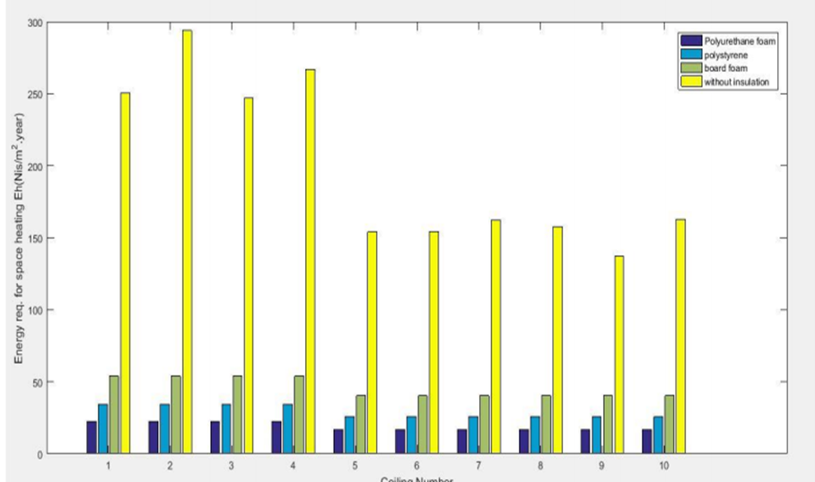
Introduction
Discussions and calculations
climatic zone ,Wall& Ceiling structure
Methodology
Literature Review
Research Objectives
Results
Ceiling
As insulation thickness increases the heating load decreases as shown in Figure below

Slide 43
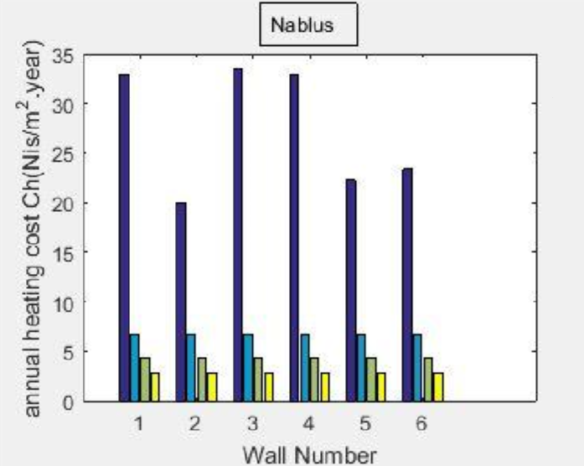
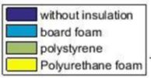
Introduction
Discussions and calculations
climatic zone ,Wall& Ceiling structure
Methodology
Literature Review
Research Objectives
Results
As insulation thickness increases the annual heating cost decreases as shown in Figure

Slide 44
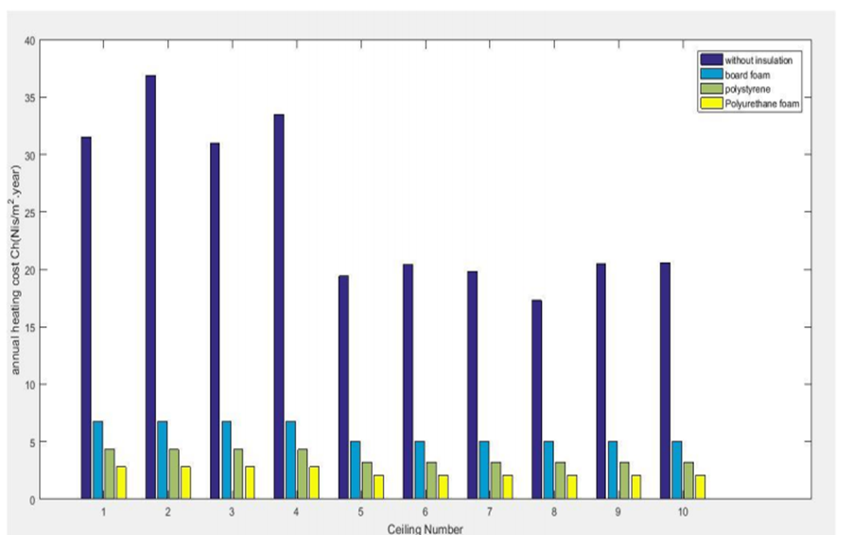
Introduction
Discussions and calculations
climatic zone ,Wall& Ceiling structure
Methodology
Literature Review
Research Objectives
Results
As insulation thickness increases the annual heating cost decreases as shown in Figure

Slide 45
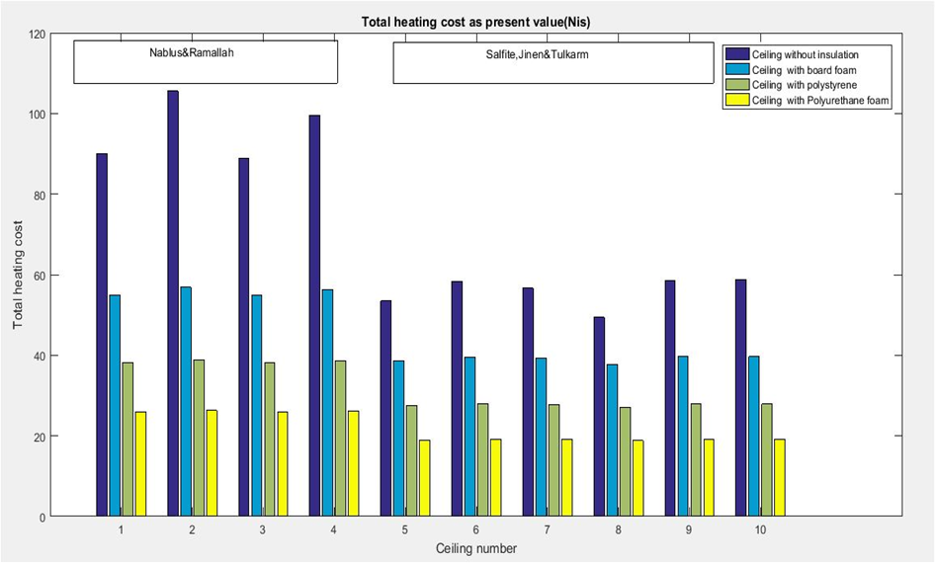
Introduction
Discussions and calculations
climatic zone ,Wall& Ceiling structure
Methodology
Literature Review
Research Objectives
Results

Slide 46
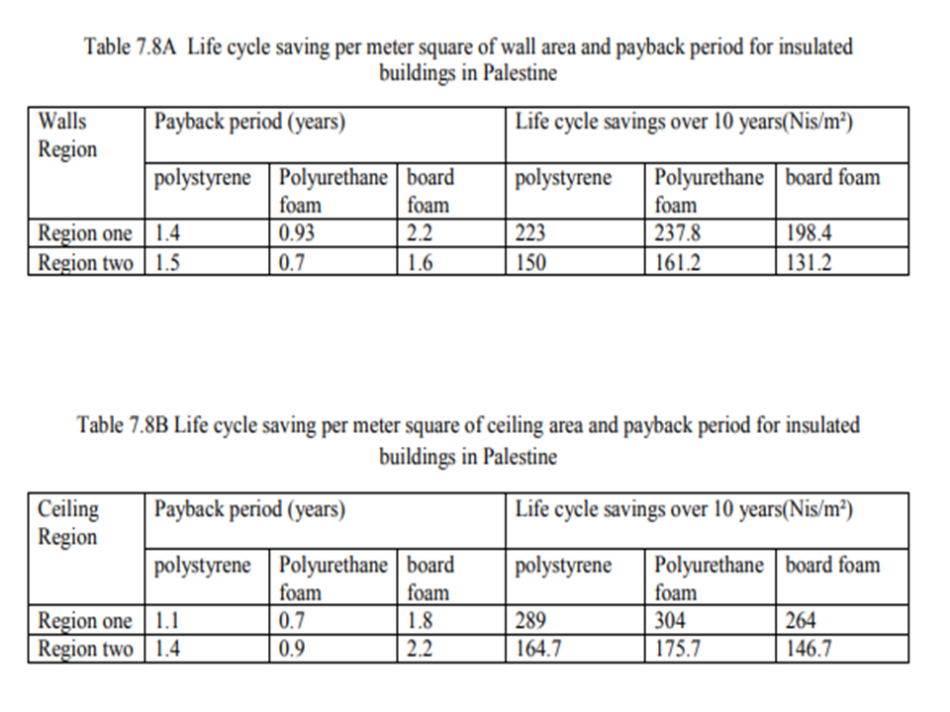
Introduction
Discussions and calculations
climatic zone ,Wall& Ceiling structure
Methodology
Literature Review
Research Objectives
Results

Slide 47
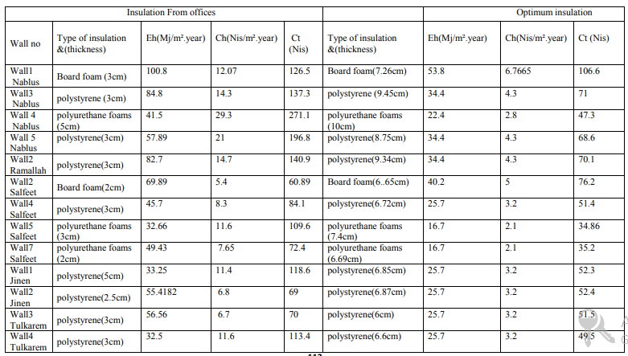
Compare the optimum insulation with insulation thickness that is taken from engineering offices

Slide 48
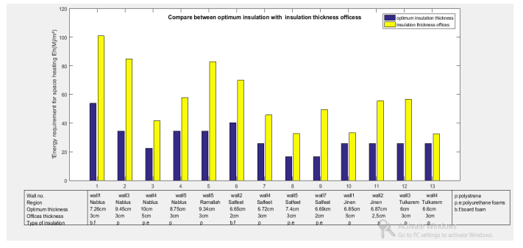

Slide 49
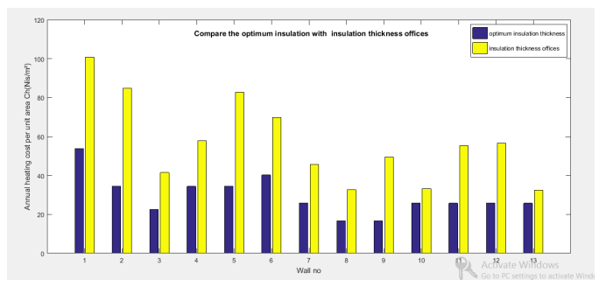
Different between insulation thickness offices and optimum insulation thickness in annual heating cost Ch(Nis/m²)

Slide 50
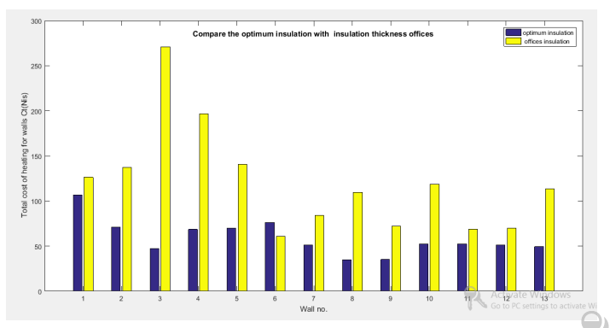
Different between insulation thickness offices and optimum insulation thickness in Total cost of heating for walls Ct(Nis).

Slide 51
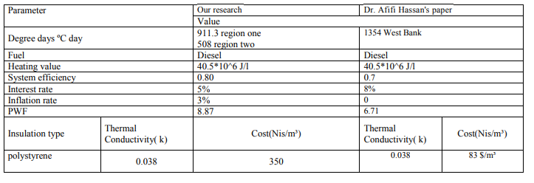
Compare the optimum insulation with optimum insulation in paper for Afif Hasan

Slide 52
Different parameters affected on the optimum insulation thickness so that in Dr. Afifi
Hassan's paper the optimum of insulation thickness for wall in West bank that have a range from 4.5cm to 6 cm when he use polystyrene while in our research the range from 8cm to 9cm for walls in region one in West Bank and from 6cm to 7cm in region two when he use polystyrene, depending on the parameters.
Different parameters affected on the payback period for walls so that in Afifi paper when he used polystyrene is from 1.3 to 2.3 years and life cycle savings over 10 years is from 270
to 760 Nis while the payback period in our research for walls in region one is 1.4 and 1.5for region two when we use polystyrene and life cycle savings over 10 years 223Nis for region one and 150 Nis for region two

Slide 53
Thank you

