Slide 1
Designing a proper solid waste system for Deir
AL-Ghusun town
Prepared By: Deema Badran
Lubna Taslaq
Reem Obeid
Sahar Othman Supervisor : Dr. Ahmad Al Ramhi

Slide 2
Outline
Introduction
Objectives
Problem
Methodology
Calculations
GIS program
Design an operating costs and Tariff system
Design a job description
SPSS Program
Conclusion and recommendation

Slide 3
Introduction
What is waste ?
Examples of solid waste.
Solid Waste Management.
Deir Al – Ghusun.

Slide 4
Objectives
Main Objectives of Study:
Assessing the current solid waste management system at Deir
Al-Ghusun.
Re-engineering the solid waste management to be more sustainable with higher performance at Deir Al-Ghusun.
Suggesting some practices that optimize municipal solid waste management.

Slide 5
Problem statements:
The random distribution of containers.
The road network used in the waste collection process is not well.
Municipality faces financial crisis through weakness in operating cost and tariff system.
the municipality doesn't have sufficient management system

Slide 6
Methodology
Scope identification
What, when and how things should be done
Data collection
meeting ,interview
Design a new solid waste system
Calculations
observations.
Design a questionnaire
GIS program
Design a job description
Design an operating costs and Tariff system

Slide 7
solid Collection waste system
Stationary container system (SCS) is the collection system
Notes:
Hauled container system (HCS)
Collection systems in which the containers used for the storage of wastes are hauled to the processing, transfer or disposal site, emptied and returned to either their original location or some other location are defined as hauled container systems.
Stationary container system (SCS)
Container systems in which the containers used for the storage of wastes remain at the point of waste generation, except when moved for collection are defined as stationary container system.
So, Stationary container system (SCS) is the collection system used in Deir Al-Ghusun town, which means trips to the disposal site, transfer station are made after the contents of number of containers have been collected and compacted and the collection vehicle is full. This system is used for the collection of all types of wastes

Slide 8
Factors that must be considered when selecting vehicle types
Waste generation (kg/capita/day)
Waste volume per ton(m3/ton)
waste constituents
Transport distance and road conditions .
fuel consumption .
Notes:
7-A key element of sustainability in any solid waste management system is the rapid supply of spare parts and access to maintenance facilities for the vehicles and other equipment being used.

Slide 9
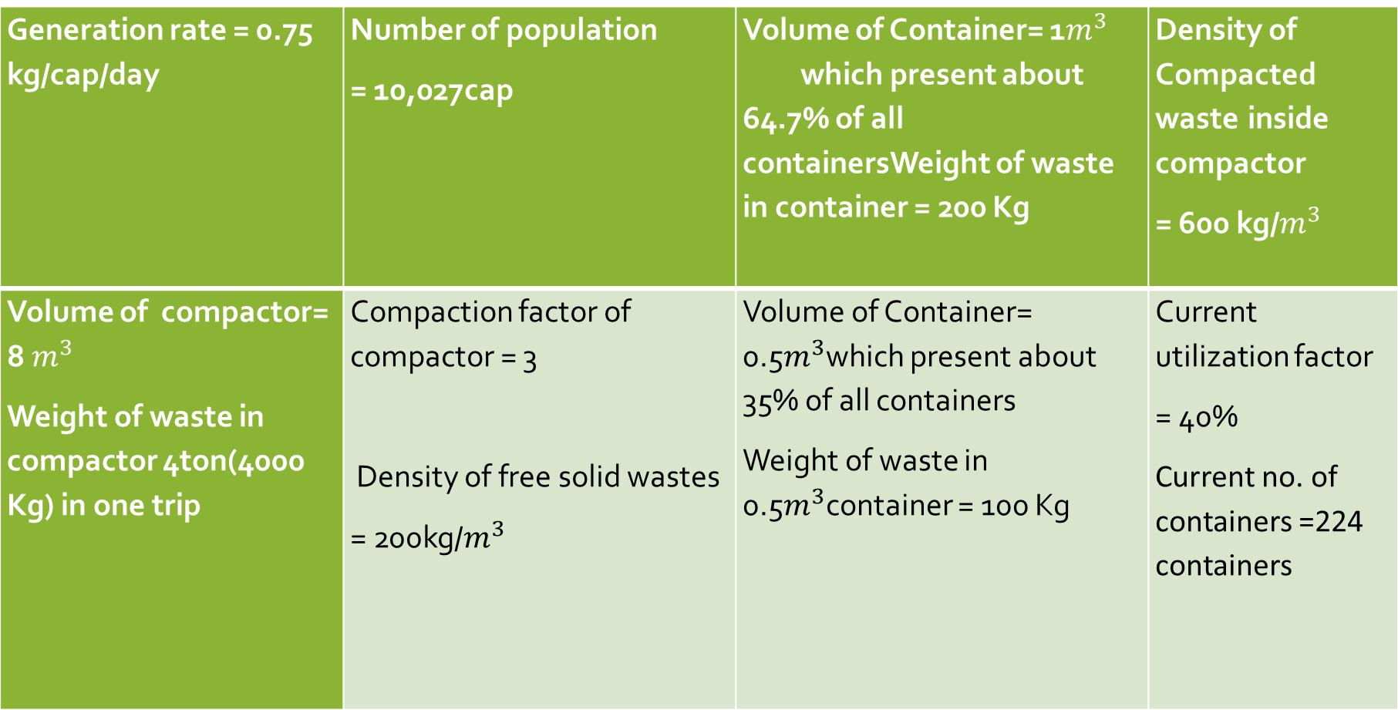
Current situation of a collection system in Deir Al-Ghusun
Generation rate = 0.75 kg/cap/day | Number of population = 10,027cap | Volume of Container= 1$m^{3}$ which present about 64.7% of all containersWeight of waste in container = 200 Kg | Density of Compacted waste inside compactor = 600 kg/$m^{3}$
Volume of compactor= 8 $m^{3}$ Weight of waste in compactor 4ton(4000 Kg) in one trip | Compaction factor of compactor = 3 Density of free solid wastes = 200kg/$m^{3}$ | Volume of Container= 0.5$m^{3}$which present about 35% of all containers Weight of waste in 0.5$m^{3}$container = 100 Kg | Current utilization factor = 40% Current no. of containers =224 containers

Slide 10
Consideration and Calculations
Weight of solid waste = (Generation rates* Number of population*Number of days)
Volume of solid waste = (Weight of solid waste/ Free density)
Number of containers=(Volume of solid waste /(Volume of container* Utilization factor))
Number of containers in one trip:(weight of waste in compactor in one trip/∑〖utilization factor * weight of waste in container*percentage of containers 〗)

Slide 11
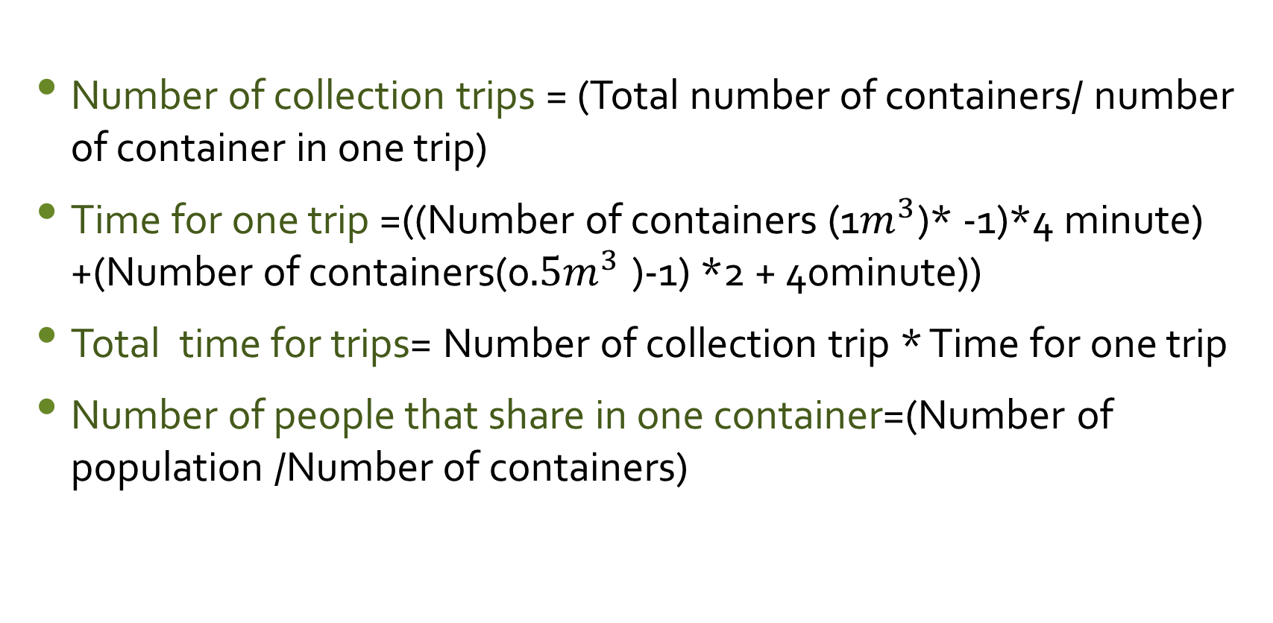
Number of collection trips = (Total number of containers/ number of container in one trip)
Time for one trip =((Number of containers (1$m^{3}$)* -1)*4 minute) +(Number of containers(0$.5m^{3}$ )-1) *2 + 40minute))
Total time for trips= Number of collection trip * Time for one trip
Number of people that share in one container=(Number of population /Number of containers)

Slide 12
Current design | New design
Utilization factor equals 40% | Utilization factor to 60%
Number of containers=217containers | Number of containers=146 Ideal number of containers
61 containers in one trip. | 40 containers in one trip.
3.7hour for one trip 4 trips during two days.(two trips on a day) | 2.7hour for one trip 4 trips during two days.(two trips on a day)
Total time for trips=7 hour a day (for two trips). | Total time for trips=5.4 hour a day(for two trips).
Number of people that share in one container= 46 persons | Number of people that share in one container)= 69 persons

Slide 13
Applying (GIS) system

Slide 14
This technique is used to generate optimal routes for collecting solid waste.
By the use of GIS we can select the side can lead to reduction of time and cost.

Slide 15
Advantages of using GIS system
Cost saving
increase efficiency
Improve communication.

Slide 16
4. Improve records keeping.
5. Leads to proper Decisions making

Slide 17
Requirements needed to implement the (GIS) in SW
Information requirements (Geographical Information )
Spatial data
Map ) Aerial photograph( Included containers sites, demographic distribution in buildings.

Slide 18
2. Descriptive data/ Attribute data
Walking distance with 100m.
Buildings .
Distributing the ideal number of containers from our calculations then Drawing the vehicles lines of collection solid waste.

Slide 19
GIS map of Collection Solid Waste Routes

Slide 20
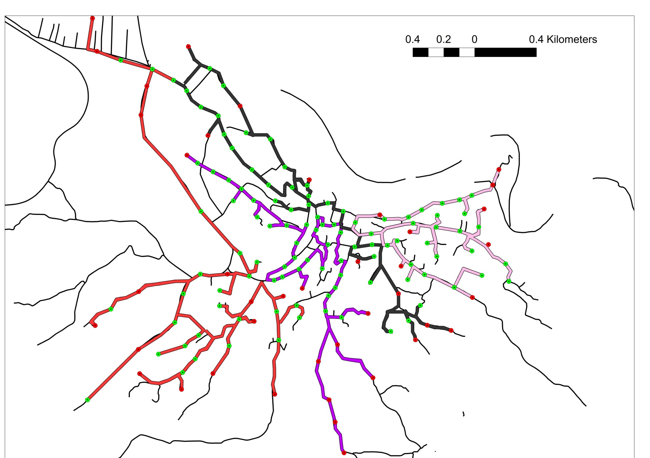


Slide 21
Cost of solid waste Service

Slide 22
SWM cost in municipality
Fixed costs | NIS/month | NIS/year
Salaries and Insurances | NIS/month | NIS/year
Head of municipality and members(7% of his time for solid waste) | 7% *18000 = 1,260 | 15,120
Head of Health department (100% of his time) | 3,118 | 37,416
Total salaries of five Street sweepers | 11,054 | 132,648
Purchasing Tools of street sweeping | 425.50 | 5,106
Total fixed costs | 15,858 | 190,290

Slide 23
Current Operating costs of Solid Waste at JSC and municipality .

Slide 24
Operating Costs | Cost/year | Expression
Driver cost (one driver) | 50,656 | Cost of driver/ton *Amount of waste/Yr
Collecting labors cost( for two labors) | 56,172.02 | cost of two operators/ton * Amount of waste/Yr
Fuel cost in SW collection | 88,421.05 | {(working dis./day*day/yr )/(km/L) } *NIS/L
Vehicle maintenance and insurance | 50,213.64 | cost of maintenance/ton * amount of waste/Yr
Others personnel wages overheads | 14,925.96 | Cost of salaries in JSC 213,228 *0.07
Collection cost | 263,389 | Total of expeditors
Maintenance of (224)Containers | 44,800 | cost of maintenance/one container *No. of containers
Depreciation of ( 224 )Containers | 19,040 | (cost of purchasing one container * No. of container purchased)/10years of depreciated
Transferring SW cost | 169,051 | cost of transferring SW/ton *Amount of waste /Yr
Total costs in Municipality wages and materials | 190,290
Total current operating cost | 671,029

Slide 25
Operating costs of suggested SWM system at JSC and Municipality

Slide 26
Operating Costs | Cost/year | Expression
Driver cost (one driver) | 50,656.97 | Cost of driver/ton *Amount of waste/Yr
Collecting labors cost( for two labors) | 57,172.02 | cost of two operators/ton * Amount of waste/Yr
Fuel cost in SW collection | 86,063 | {(working dis./day*day/yr )/(km/L) } *NIS/L
Vehicle maintenance and insurance | 50,213.64 | cost of maintenance/ton * amount of waste/Yr
Others personnel wages overheads | 14,925.96 | Cost of salaries in JSC 213,228 *0.07
Collection cost | 247,848 | Total of expenditure
Maintenance of (146)Containers | 29,200 | Cost of maintenance/one container *No. of containers
Depreciation of (146)Containers | 12,410 | (cost of purchasing one container * No. of container purchased)/10years of depreciated
Transferring SW cost | 169,051.05 | cost of transferring SW/ton *Amount of waste /Yr
Total costs in Municipality | 190,290 | -
Total suggested operating cost | 648,799 | -

Slide 27
Comparison between current and suggested Operating costs
Current Operating costs | Suggested Operating costs
671,029 | 648,799

Slide 28
Current Tariff system

Slide 29
Description | Number of Participators | Fee NIS/month | Total Fee (NIS)monthly | Yearly
Household | 2,400 | 17 | 40,800 | 489,600
Commercial shops and restaurant | 123 | 50 | 6,150 | 73,800
Industrial Sector(factories) | 29 | 200 | 5,800 | 69,600
Wedding halls | 7 | 200 | 1,400 | 16,800
Slaughters | 2 | 250 | 500 | 6,000
Current Tariff Total | 2,561 | 717 | 54,650 | 655,800

Slide 30
Current situation of Tariff fees
Total operating current costs | NIS/yearly | 671,029
Total current Tariff fees | NIS/yearly | 655,800
Disability/surplus | NIS/yearly | -15,229

Slide 31
Tariff suggested system
With current study we are going to make a new plan to balance the expenses and revenues to achieve financial profit in the SWM system.

Slide 32
Subscribers | Number of subscriber | Tariff fees | Factor of changing | Tariff after changing | Tariff annually | Annual Total
Household A | 1,500 | 17 | 1 | 17 | 204 | 306,000
Household B (Villa) | 710 | 17 | 1.4 | 23.8 | 285.6 | 202,776
Household C (Big Villa) | 170 | 17 | 1.5 | 25.5 | 306 | 52,020
Slaughters | 2 | 17 | 15 | 255 | 3,060 | 9,180
Commercial 1 | 55 | 17 | 2.6 | 44.2 | 530.4 | 29,172
Commercial 2 | 50 | 17 | 3.2 | 54.4 | 652.8 | 32,640
Commercial 3 | 45 | 17 | 3.5 | 59.5 | 714 | 32,130
Wedding halls | 7 | 17 | 12 | 204 | 2,448 | 17,136
Tariff Suggested total | 2,524 | 136 | 40.2 | 705.5 | 8,466 | 681,054

Slide 33
Suggested system for operating costs and Tariff fees
Total operating suggested costs | NIS/yearly | 648,799
Total suggested Tariff fees | NIS/yearly | 681,054

Slide 34
The Job descriptions:
Job descriptions can assist in creating a detailed job application that will attract qualified job candidates.
It generally includes duties, purpose, responsibilities, scope, and working conditions of a job along with the job's title.
.

Slide 35
Job descriptions are helpful in that they:
Give a clear understanding to candidates of what their duties and responsibilities for a particular position would be.
Create boundaries regarding employees’ responsibilities.
Justify an employee’s pay.

Slide 36
Job Description 1 : Street Sweeper
Functional name : Street sweeper.
Department : Health Department at municipality.
Reporting to: Head of Health at municipality.
Responsible for : Street sweeping process.
Job privacy : Working start at six o’clock in the morning and they work six hours daily.
Jop sammary :Keep the city clean by sweeping the streets, road side and around the containers.

Slide 37
Job Description 2 : Lorry Waste Driver
Function name : The lorry waste driver.
Department :Collection supervision at joint service council.
Reporting to: Supervisor/Director of joint service council .
Responsible for : Direct Supervisor of collecting process.
Job privacy :Working time equal 6 Hour daily.
Job summary :Drives the lorry , keeping clear and Responsible for supervising the waste collect worker.

Slide 38
Job Description 3 : Collection Worker
Functional name : Collection worker.
Department :Collection supervision at joint service council.
Reporting to:Driver Lorry/supervisor .
Responsible for :Supervisor of collection process.
Job privacy : Working time equal 6 Hour daily.
Job summary :Collect waste from area of the town and dispose it in dumpsite.

Slide 39
Job Description 4 : Health Inspector/Head
Functional name : General supervisor of health and environmental department.
Department : Health Department at municipality.
Reporting to: Head of municipality.
Responsible for : Managing of collecting process and street sweeping.
Job privacy : Working time equal 6 Hour daily.
Jop Summary: Department management, distribution, supervision, organization, guidance, and follow-up of the department staff working in solid waste management.

Slide 40
SPSS Program
A survey can only be truly valuable when it’s reliable and representative for our research.
The total size of the population being studied or our target segment in this research is each house in Deir Al-Ghusun.
There are three measures that affect the accurateness of the data:
the margin of error.
the confidence level.
the standard deviation.

Slide 41
SPSS Program
In Deir Al-Ghusun we have almost 1,455 residual houses as a total size of the population, so we chose a margin of error of 5% and a confidence level of 95% to have the true population value within the range of precision earlier as shown in figure below.
Through our calculations we get the size of the representative sample304.8 houses .
we used a 311 sample size of houses to get more accurate data.

Slide 42
The Hypotheses
The first hypothesis:
The Citizens' awareness of solid waste management.
The second hypothesis:
Citizens satisfaction and improvement of service level.
The third hypothesis:
The willingness of citizens to participate in improving the level of sustainability.

Slide 43
The first hypothesis
We found that 67.8% of the sample study had a prior knowledge of the importance of waste disposal.
32.5% of respondents are aware of the importance of waste disposal through television programs.

Slide 44
hypothesis
We have used 5-point likert scale in our questioner which show that
Strongly agree 1-1.79
Agree 1.8-2.59
Undecided 2.6 -3.39
Disagree 3.4 -4.19
Strongly Disagree 4.2 – 5

Slide 45
The second hypothesis:
Our hypotheses is
Ho: µ =2.59
H1: µ< 2.59
Citizen’s satisfaction and improvement of service level
The test was used t-test ( one Sample T test) for our sample
Ho = Citizens are not satisfied
H1= Citizens are satisfied
the t-value 8.413 <1.645 t-tabulated value for α= 0.05 and degree of freedom = 310 so we reject the null hypothesis which indicate that the Citizen’s satisfied of the current solid waste management system

Slide 46
The third hypothesis
The willingness of citizens to participate in improving the level of sustainability
Ho = Citizens are not readiness of citizens
H1= Citizens are readiness of citizens
the t-value is 9.088 <1.645 t-tabulated value for α= 0.05 and degree of freedom = 310 so we reject the null hypothesis which indicate that the Citizens have readiness to participate in improving the level of sustainability

Slide 47
ANOVA test
characteristic | The second hypothesis | The third hypothesis
gender | are no differences | are no differences
age | are no differences | there are differences
education level | are no differences | are differences(reject hypothesis Ho)
Social status | there are no differences | there are differences(reject hypothesis Ho)
Income family | there are no differences | there are differences(reject hypothesis Ho
Notes:
There were no statistically significant differences at the level of α = 0.05 significance among the average responses of the survey sample members on Citizens satisfaction and improvement of service level also, The readiness of citizens to participate in improving the level of sustainability (second assumption, third assumption)

Slide 48
Do you willing to pay a high fee against improve the service ?

Slide 49
CONCLUSION:
Citizens have readiness to participate in improving the level of SWM sustainability so we can do improvement in the system and make it more sustainable.
In our new design we are reducing the number of containers and redistributing them correctly to serve the entire town and reduce costs by choosing appropriate routes base on proper equations and by using GIS to determined accurate routes.
The new solid waste collection design explains the changes in fuel costs that reflects positively on the total operating costs which is decreased by 2,358.05 NIS of its yearly current fuel cost.

Slide 50
The Recommendations:
The municipality has to work on the numbering of containers to ease the maintenance process and refer back to it in an emergency cases.
We recommend to involve people in a future plan which includes separation and recycling the solid waste so that will increase the sustainability in three aspects economic ,environment and social.
It is recommended to increase the change factor (Tarrif) by 2% per year in order to increase the amount of revenue that will be used to develop the country's situation (buying new containers, cleaning equipment ...
Provide the municipality with a job descriptions for a job of each worker until the jobs are organized among the workers.

