Slide 1
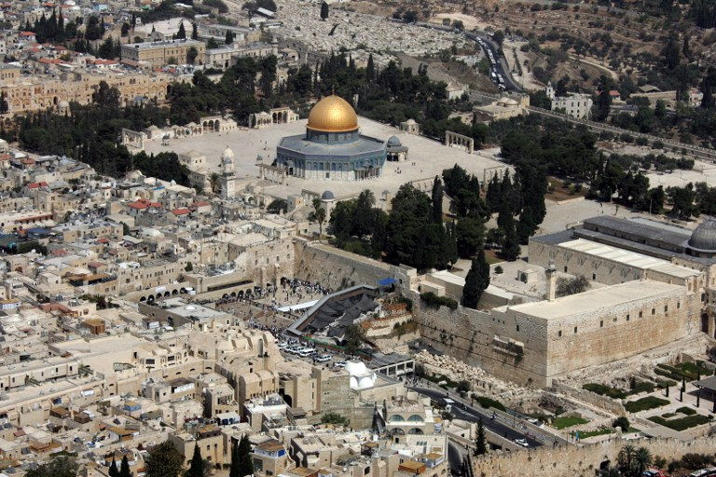
Conservation of the Material Cultural Heritage in Al-Aqsa Mosque
Prepared by:
Aya AL-Omary
Sara Hamza
Mariana Mari
Supervisor:
Dr. Hamdallah Bearat
2019-2020

Slide 2
Table of contents:
Abstract
Introduction
Description of samples
Methodology
Conclusion
Future Work

Slide 3
Abstract :
This project contributes to the progressive efforts in restoration and preservation (conservation) of the material Islamic heritage in Al-Aqsa mosque and Dome of The Rock in Jerusalem city. These monuments contains various types of materials (metals & alloys, ceramics, glass, stones, masonry, pigments, wood, and cementitious agents, whether organic or inorganic). Different types of materials behave and perform separately under the same environmental conditions. Some electrochemical and chemical experiments were conducted on the materials.

Slide 4
Introduction:
Because of the great importance of the city of Jerusalem which holds the Dome of the Rock and Al-Aqsa Mosque. It was our duty to preserve these holy sites furthermore the valuable materials plus culture that we have received over the years.
The most common procedure in conservation and restoration of metals is the cleaning process. This process can vary between mechanical, chemical, electrochemical, ultrasonic, plasma and laser cleaning. Chemical treatment includes acids, bases, electrolysis, electrochemical reduction, ultrasonic, and other processes. Mechanical treatment includes cleaning with toothpicks/brushes, soaking before cleaning and other processes.

Slide 5
Description of samples:
This project started to study the problems facing a group of materials founded in the Dome of the Rock and Al-Aqsa Mosque, which are corrosion, color change, fragmentation and falling from its place.
Wood sample with longitudinal fragmentation and change in color.
Lead sample with corrosion.
Marble sample with unwanted color.
Kashani sample and problem of falling out from its place from the wall.

Slide 6
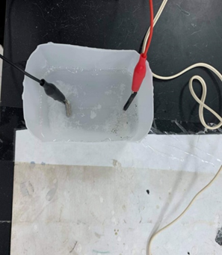
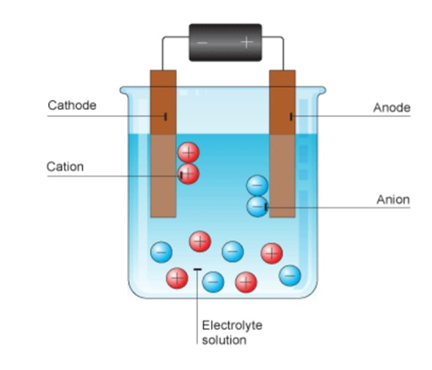
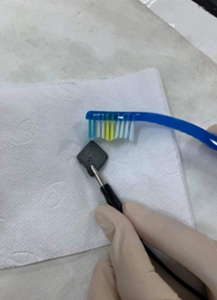
1.Electrochemical process:
Methodology
Lead sample treatments :
A small electrolytic cell was created. Power source 12V and 1.5 A. Electrolyte were used: aqueous solution (sodium carbonate) Anode: a piece of carbon. Cathode: lead sample.
1- An aqueous solution (dissolved sodium carbonate in deionized water) was placed in a beaker.
2- The carbon electrode is attached to a negative terminal clamp that acts as an anode, the lead sample connected to the positive terminal as a cathode.
3- The plug is inserted into the socket (power source)
4- The electrolytic cell was left 10 minutes to complete the reaction.
5- The lead sample was separated from the clip and washed with water and cleaned using a toothpick.

Slide 7
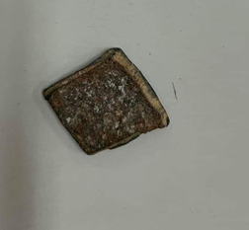
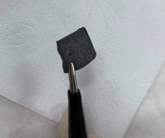
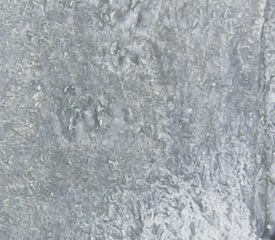
Electrochemical process:
This method was effective and quick in cleaning the lead piece of corrosion as the pictures show. However, there is difficulty in applying them to the lead plates that cover the dome.
Before treatment.
After treatment.
The sample under microscope after
treatment.

Slide 8
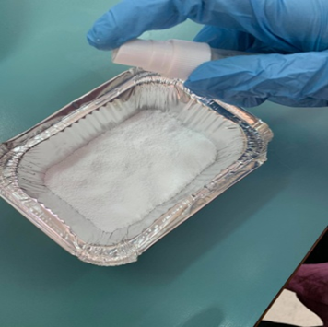
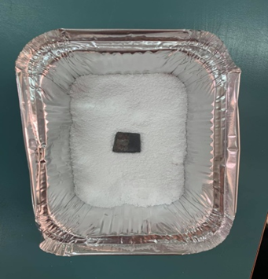
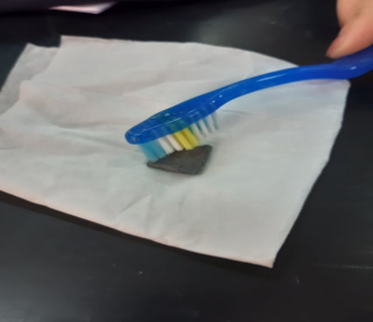
:2.Oxidation reduction
A chemical reaction in which the oxidation numbers (oxidation states) of the atoms changed.
1. Sodium carbonate was placed in an aluminum plate
2. a small amount of hot water was sprayed (hot water was used to speed up the reaction)
3. The lead sample was placed in the plate for approximately one hour.
4. The sample was thoroughly washed with water and cleaned by toothbrush.
Sodium carbonate in the plate
The sample is in the plate.
Clean the sample with the brush.

Slide 9
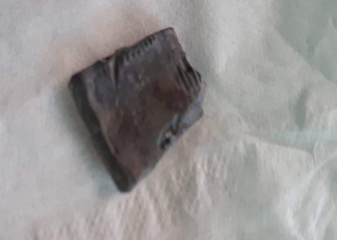
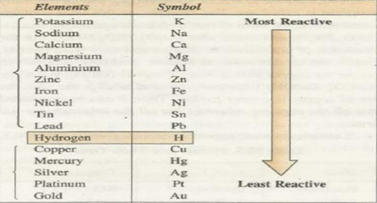
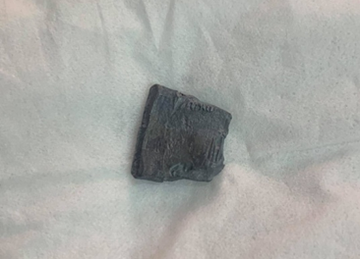
Oxidation reduction:
Oxidation reduction gave successful results, and treatment by Oxidation reduction is the most practical method of application.
The sample before treatment
The sample after treatment

Slide 10
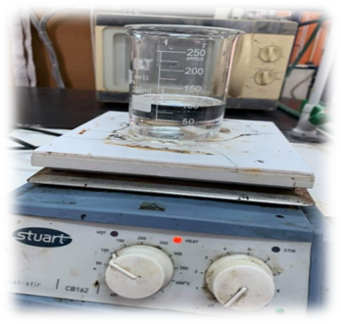
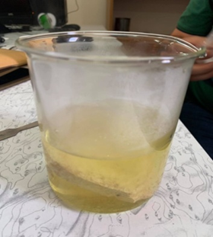
:Chemical treatments on marble
1.Hydrogen Peroxide:
2.Citric Acid
H2O2 was placed inside a beaker.
The marble was placed inside the beaker and placed on a heat source.
After a period of time, the sample was removed from the beaker, washed it with water and dried it.
Hot water was put inside the baker in a quantity of 400 ml.
Then 60 g of lemon salt was dissolved in hot water.
A marble sample was taken and placed inside the beaker.
Leave the sample for 10 minutes in solution.

Slide 11
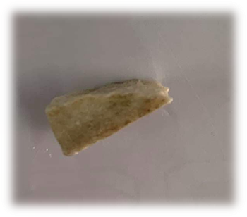
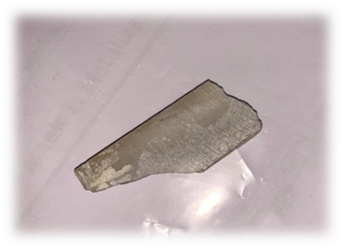
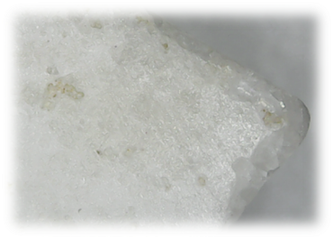
Hydrogen Peroxide
The marble surface is cleaned with hydrogen peroxide (H2O2) - a strong oxidizing agent and its pH value is equal to 6.2, where the brown disappearance is observed within 10 minutes. So, this method was very effective in removing unwanted color.
Marble sample before hydrogen peroxide treatment.
Marble sample after hydrogen peroxide treatment.
Marble sample after hydrogen peroxide treatment under microscope

Slide 12
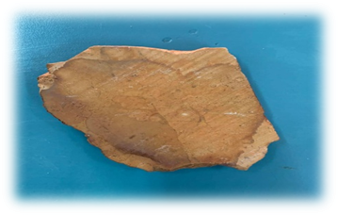
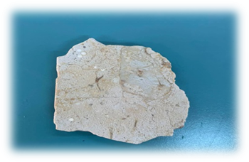
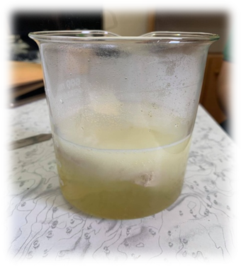
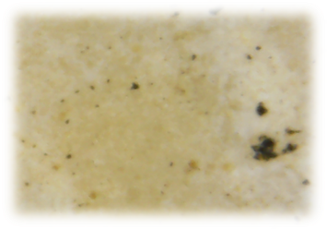
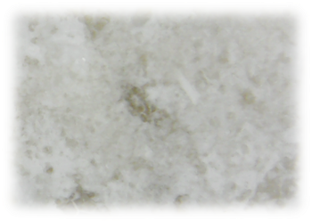
marble sample after citric acid treatment. | marble sample before citric acid treatment.
marble sample after citric acid treatment under microscope. | marble sample before citric acid treatment under microscope.
Citric Acid :
This method is considered an easy and effective way to clean the marble sample from the brown color.

Slide 13
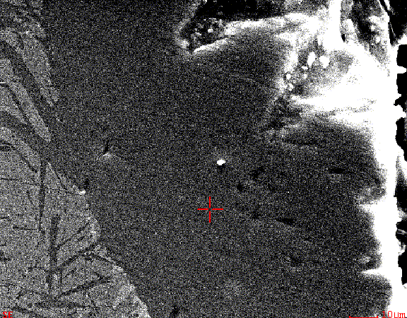
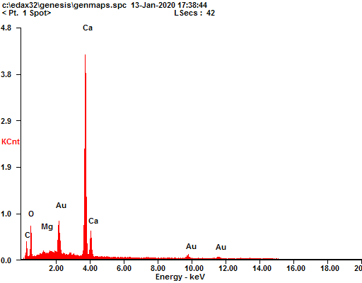
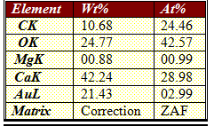
EDX analysis of the marble sample:
Chemical composition of marble obtained with EDX.

Slide 14
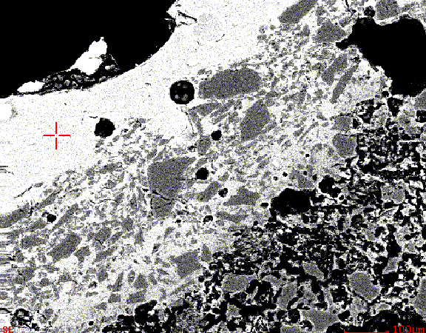
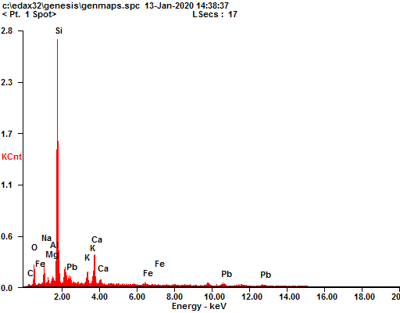
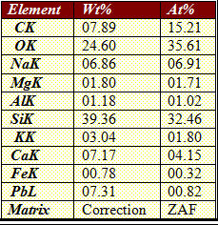
EDX analysis of the Kashani sample(1):
Chemical composition of kashani obtained with EDX.

Slide 15
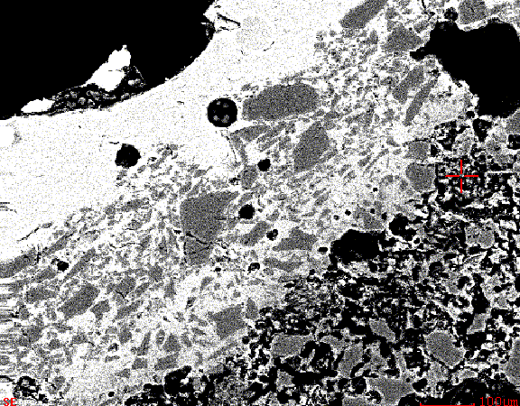
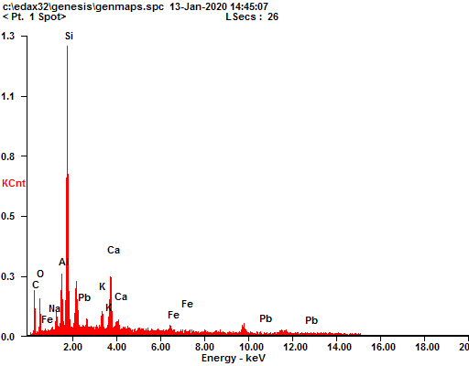
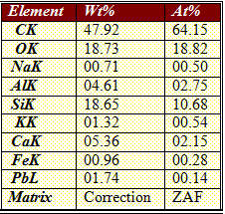
EDX analysis of the Kashani sample(2):
Chemical composition of kashani obtained with EDX.

Slide 16
Conclusion:
The anticipated objectives of this project have been to identify the causes and mechanism of degradation in each type of these archeomaterial. Some experiments were conducted on the samples in order to understand the problems and find solutions to them. An electrochemical and chemical experiment (oxidation reduction)were carried on the lead sample, which gave a very good result in removing rust from the sample. Another two chemical experiments were conducted on the Marble samples, and their results were effective. The first experiment was with H2O2 acid and citric acid.

Slide 17
Future work:
After studying the samples and their problems and conducting some practical experiments on them in order to treat them or limit their deterioration and note the good results, we hope that they will be applied in practice in order to preserve these valuable materials and protect them from being lost, and the SESAME facility provides a unique opportunity to advance conservation research on these valuable effects. Each of the three technologies currently available in SESAME: infrared spectroscopy, X-ray diffraction and near-spectral X-ray absorption, where Al-Aqsa Mosque and Dome of the Rock samples will be provided to this facility by Dr. Hamdallah Bearat in order to understand the mechanisms of its degradation and perhaps suggest Some treatments to protect / restore them.

Slide 18
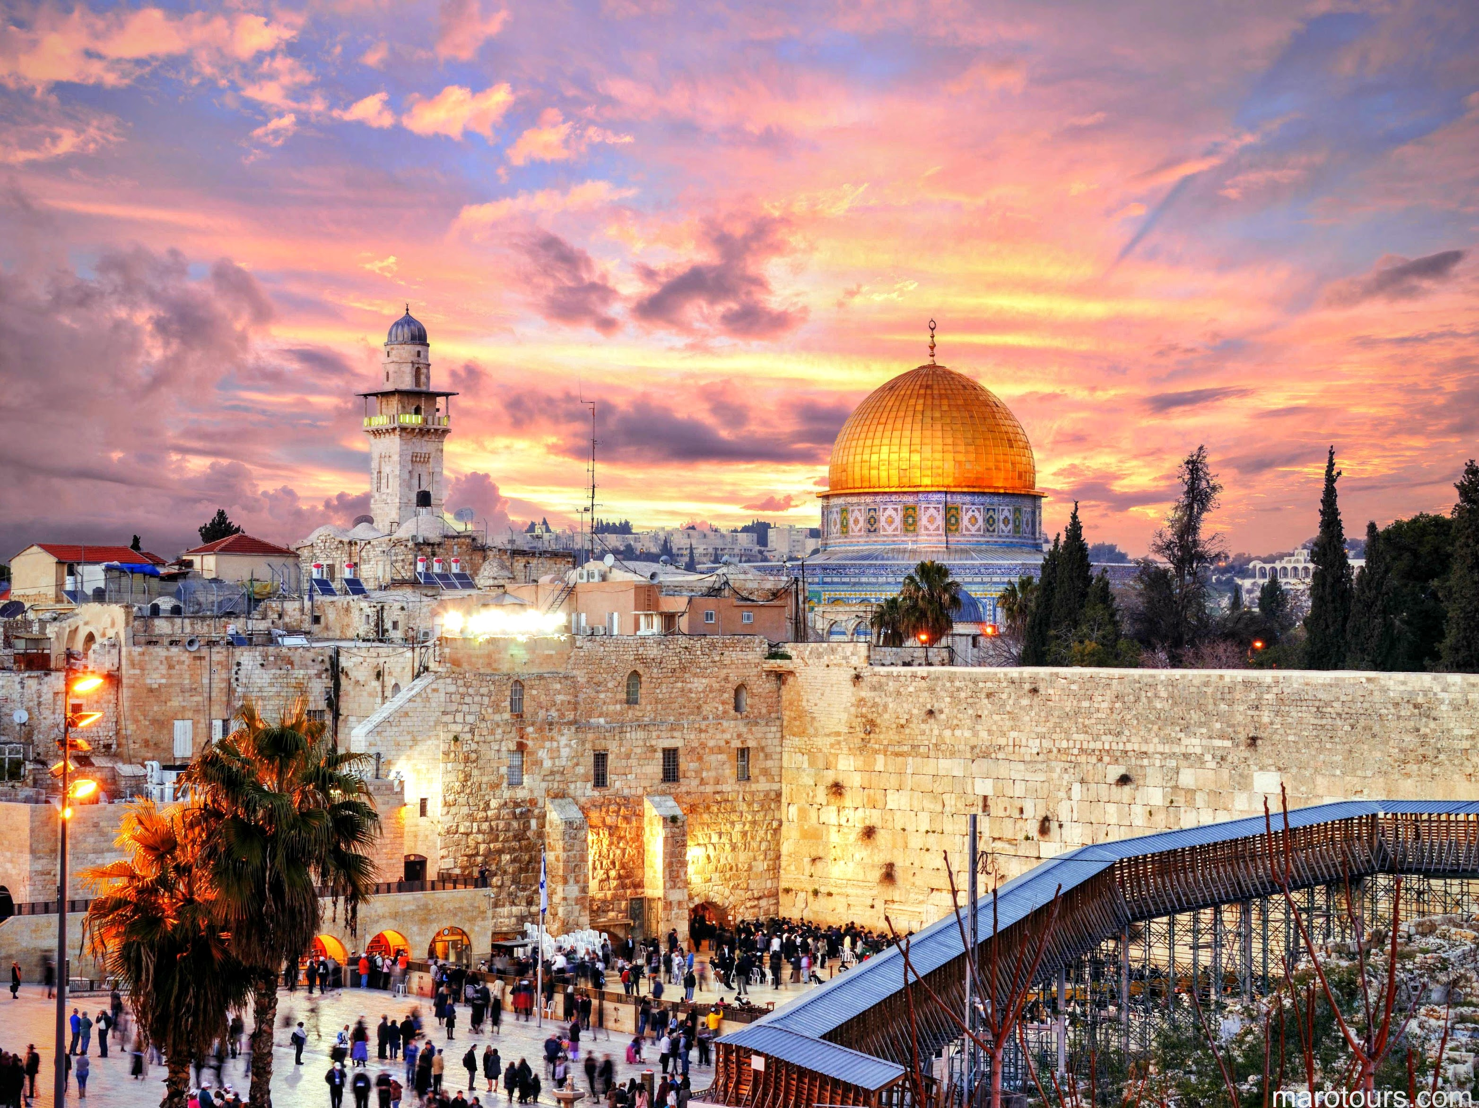
Thank you

