Slide 1
Automoive smart parking system

Slide 2
Done By:
Sabe Abu Saleh
Yazan Aldeek
Manal Jebrel
Supervised by:
Dr. Jamal Kharousheh
Presented in partial fulfilment of the requirements for
Bachelor Degree in Electrical Engineering

Slide 3
CONTENTS
01
Motivation
02
What is Automoive
smart parking system?
03
System Methodology and Flow-Chart
04
System Main Components
05
circuit diagram
06
limitations and issues
07
Conclusion

Slide 4
Reduce time and space.
Reduce fuel consumption.
Create a smart city and make it better.
Reducing car thefts and possible damages.
Decreased Management Costs.
01
Motivation

Slide 5
02
What is Automoive
smart parking system?
An Automated Parking System (APS) is a mechanical system designed to reduce the space and/or volume required for parking a vehicle. Like a multi-storey car garage, APS provides parking on multiple levels that are stacked vertically to increase the number of parking spaces while reducing land use. However, APS uses a mechanical system to move cars to and from parking spaces (instead of the driver) in order to eliminate a lot of wasted space in a multi-story parking garage.

Slide 6
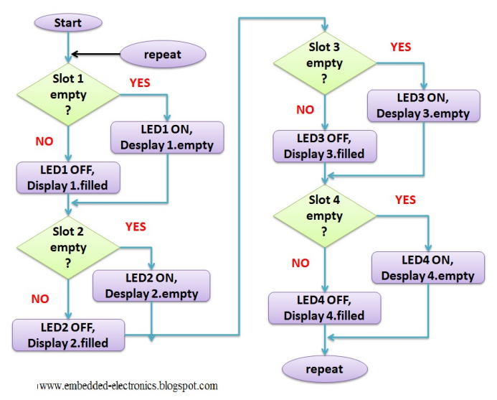
System Methodology and Flow-Chart
03

Slide 7
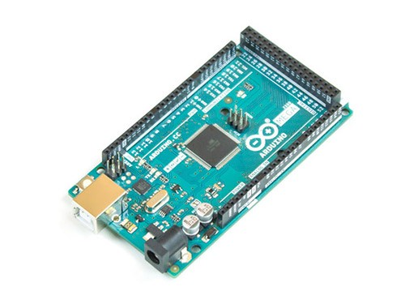
System Main Components
04
Arduino Mega 2560 is a microcontroller board based on the ATmega2560. It has 54 digital input/output pins (of which 15 can be used as PWM outputs), 16 analog inputs, 4 UARTs (hardware serial ports), a 16 MHz crystal oscillator, a USB connection, a power jack, an ICSP header, and a reset button. It contains everything needed to support the microcontroller; simply connect it to a computer with a USB cable or power it with a AC-to-DC adapter or battery to get started. The Mega 2560 board is compatible with most shields designed for the Uno and the former boards Duemilanove or Diecimila.

Slide 8
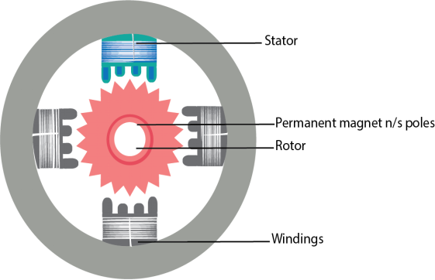
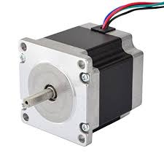
stepper motor
B
A stepper motor is a brushless DC
electric motor that divides a full rotation
into a number of equal steps. The motor's position can then be commanded to
move and hold at one of these steps without any position sensor for feedback (an
open-loop controller), as long as the
motor is carefully sized to the application in respect to torque and speed. Switched
reluctance motors are very large stepping
motors with a reduced pole count, and
generally are closed-loop commutated.

Slide 9
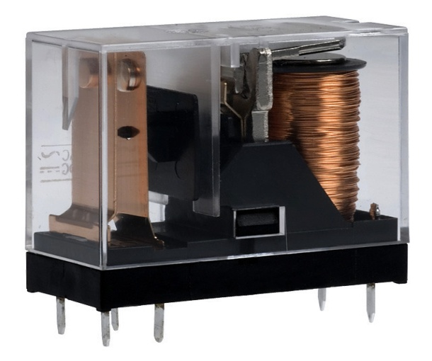
TWO MODULE RELAY
C
A relay is an electrically operated switch, many relays use an electromagnet to mechanically operate a switch , but other operating principles are also used, such as solid-state relays, Relays are used where it is necessary to control a circuit by a low-power signal (with complete electrical isolation between control and controlled circuits), or where several circuits must be controlled by one signal.

Slide 10
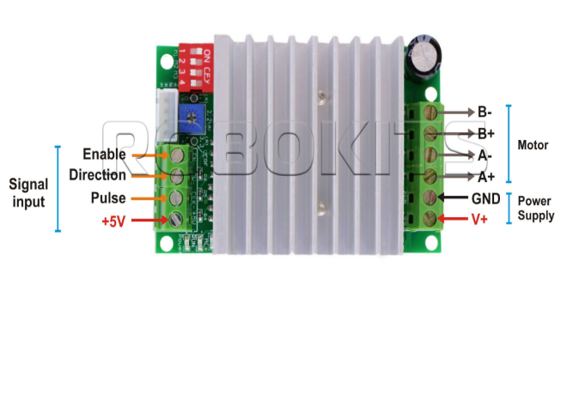
STEPPER MOTOR DRIVE
D
A stepper motor may run at voltages varying from 5 V to 12 V and similarly the
current draw will be somewhere in the
range of 100 mA to 400 mA. It is
important that the power must be
regulated so that fluctuations in speed
and torque can be avoided

Slide 11

KEYBAD
E
A keypad is a set of buttons arranged in a block or "pad" which bear digits, symbols or alphabetical letters. Pads mostly containing numbers are called a numeric keypad. Numeric keypads are found on alphanumeric keyboards and on other devices which require mainly numeric input such as calculators, push-button telephones, vending machines, ATMs, Point of Sale devices, combination locks, and digital door locks.

Slide 12
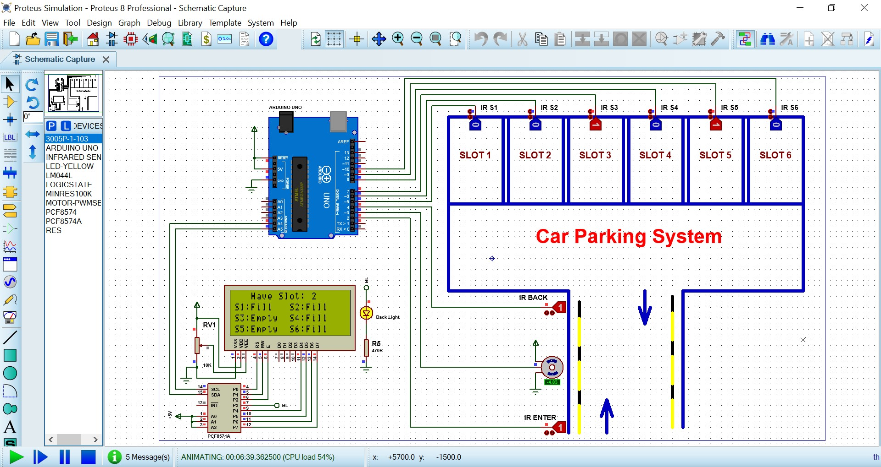
circuit diagram
05

Slide 13
limitations and issues
06
Think of how to make the crane stable.
2. Thinking about the best way to make the quad move 360 ​​degrees, in addition to determining the appropriate place for the stepper motor responsible for doing this process.
3. Determine the mechanical parts that achieve the best desired results from the project, and these parts are easy to obtain.

Slide 14
Obtaining a preliminary conception of what should be implemented in Project No. 2, in order to achieve the best expected results from the project.
07
Conclusion

Slide 15
THANK YOU

