Slide 1

An-Najah National University
Faculty of Engineering
Civil Engineering Department
Graduation Project (2)
‘ Causes of Delay During Construction Phase at Palestine ’
By : Abdallah Ordoniya
Aya Dwaikat
Khaled Shtaiwe
Radi Abu Shanab
Supervisor : Ins. Mohammad Abu Neama
May 2013

Slide 2
Abstract
Construction delay is a fundamental problem in the construction industry. So identifying the main causes of delays is required to improve project management.
This research identifies the main causes of delays from the perspectives of clients, contractors and consultants.
The followed methodology is collecting data from the field in different methods, then analyzing these data to get sufficient results.
Finally recommendations were provided to improve the performance.

Slide 3
Objectives
Identify the main causes of delay during construction phase at Palestine.
Classify these causes based on the responsibility of the parties involved in project.
Determine the rate of occurrence of these causes in the construction industries.
Provide recommendations to avoid or minimize construction delays.

Slide 4
Justification
This research assists in identifying the causes of the delays during the construction phase at Palestine, and finding appropriate solutions to avoid these causes.
Also assists the parties to avoid incurred additional cost due to delays, and allow project to be completed smoothly on time and within budgeted cost.

Slide 5
Justification
For the contractor, this will lead develop his productivity and creating a good reputation with owners.
For the owner, he will be encouraged to establish more advanced projects with high cost and long period without fear of any risks.

Slide 6
Types of Delays
Excusable Delays: delays that are nearly accepted, and caused through many reasons like labor disputes and unusual delay in deliveries.
Non Excusable Delays: delays that are nearly unaccepted and caused through reasons like financing problems and poor workmanship.

Slide 7
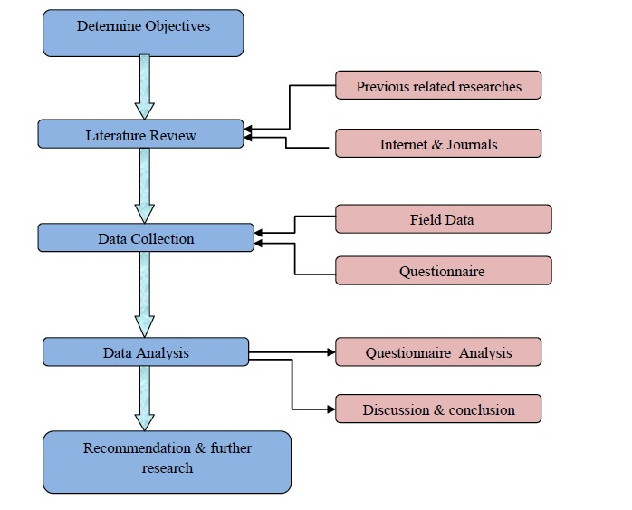
Methodology

Slide 8
Questionnaire
The questionnaire consists of two parts.
Part I: includes general information about the respondents like experience, job title company name, and level of education.
Part II: include the causes of construction delays where respondents are invited to rate the degree of ocuurrence of these causes.

Slide 9
Questionnaire Survey
The questionnaire was distributed to the study sample size in Nablus (20 contractors, 20 consultants and 20 owners).
Method of sending the questionnaire.
By interviews (visiting firms).
By electronic e-mails.
Received questionnaires.
15 out of 20 contractors.
16 out of 20 consultants.
10 out of 20 owners.

Slide 10
Analysis of Questionnaire
(Microsoft office Excel) program used to analyze the questionnaire, the analysis discusses five parts to extract results:
  The first part discusses respondent characteristics.
  The second part includes analyzing questionnaires obtained from contractors only.
  The third part includes analyzing questionnaires obtained from consultants only.
  The fourth part includes analyzing questionnaires obtained from owners only.
  The fifth part includes analyzing questionnaires obtained from overall respondents regardless who are the respondents.

Slide 11
Respondents Characteristics

Slide 12
Educational Level

Slide 13
Respondents’ Experience

Slide 14
Percent of respondents encountered delay in previous projects

Slide 15
Causes of Delay

Slide 16
Top 5 causes of delay from contractors point view
Caused by | Rank | Weight % | Cause | No.
Consultant | 1 | 68.00 | Delay in approving major changes in the scope of work. | 32
Owner | 2 | 64.00 | Delay in progress payments by owner | 44
Consultant | 3 | 62.67 | Inflexibility (rigidity) of consultant. | 26
Owner | 4 | 60.00 | Change orders by owner during construction Owner. | 46
Owner | 5 | 57.33 | Delay in approving shop drawings | 37

Slide 17
Top 5 causes of delay from consultants point view
Caused by | Rank | Weight % | Cause | No.
Owner | 1 | 75.00 | Delay in obtaining permits from municipality. | 45
Contractor | 2 | 66.25 | Conflicts in sub-contractors schedule in execution of project. | 7
Owner | 3 | 66.25 | Delay in progress payments by owner. | 44
Owner | 4 | 62.50 | Late in reviewing and approving design documents. | 34
Owner | 5 | 61.25 | Slowness in decision making process by owner. | 48

Slide 18
Top 5 causes of delay from owners point view
Caused by | Rank | Weight % | Cause | No
Contractor | 1 | 60.00 | Conflicts in sub-contractors schedule in execution of project | 7
Owner | 2 | 60.00 | Delay in progress payments by owner. | 44
Other | 3 | 58.00 | Road closures and their impact on the transfer of work crews as a result of the occupation. | 55
Contractor | 4 | 56.00 | Does not work on schedule of activities and events. | 20
Consultant | 5 | 56.00 | Delay in approving major changes in the scope of work. | 32

Slide 19
Top 5 causes of delay from owners point view
Caused by | rank | Weight % | Cause | No.
owner | 1 | 63.90 | Delay in progress payments by owner. | 44
owner | 2 | 59.51 | Delay in obtaining permits from municipality. | 45
owner | 3 | 57.56 | Change orders by owner during construction. | 46
consultant | 4 | 57.07 | Delay in approving major changes in the scope of work. | 32
owner | 5 | 56.10 | Slowness in decision making process by owner. | 48

Slide 20
Recommendation
The owner should preserve a compatibility time between payments and performed activities by contractor.
the owner should dedicate significant effort and exploit time to obtain the necessary permits from responsible bodies to start the project or implement activities.
The owner must take enough time to think about design of the construction with a careful review to the main desires and main objectives of the project .
Owners should accommodates well the sudden changes in work and be able to make the right decision as soon as possible with minimum losses.

Slide 21
Distribution and scheduling tasks to sub-contractors should prevent any disputes among themselves, so "conflicts in sub-contractors schedule in execution of project" should be considered.
The contractor must take all means of prevention, and alternative plans for the implementation of activities expected to be implemented in the rainy air, with giving a suitable free float to these activities so he should consider .
consultants should allocates an appropriate time and attention to shop drawings for reviewing and giving approval without delay.
Contractors should gives significant more time , deposits and provision equipment and material before starting dates of projects and as a result the cause of " difficulty in the transfer of equipment and introduced to the Palestinian territories (political conditions)"

Slide 22
Further Research
The scope of construction delays studies is wide and forked, so the researchers in this study make the following recommendations.
Expand the scope of research on construction delays in Palestine.
Search for more causes of delays affecting the lifetime of projects.
Make studies about the effects and seriousness of construction delays on projects.
Risk evaluation for causes of delays at construction phase , and size of casualties.

Slide 23
Thank you for attention
We welcome your questions,
suggestion, and comments

