Slide 1

Strengthening of Al-Yasmeen Building against gravity and seismic loads using FRP technique and jacketing
Prepared by: Amro Nather Nassar
Huda Loai Yahya
Mohammad Hakam Assi
Mohammad Maher Jaradat
Raghad Abdel-Salam Owaidat
Supervised By: Dr. Munther Diab

Slide 2
Content
Chapter One: Description of Project
Chapter Two : Seismic Analysis
Chapter Three: Redesign for gravity and seismic loads
Chapter Four: Strengthening of Weak elements

Slide 3
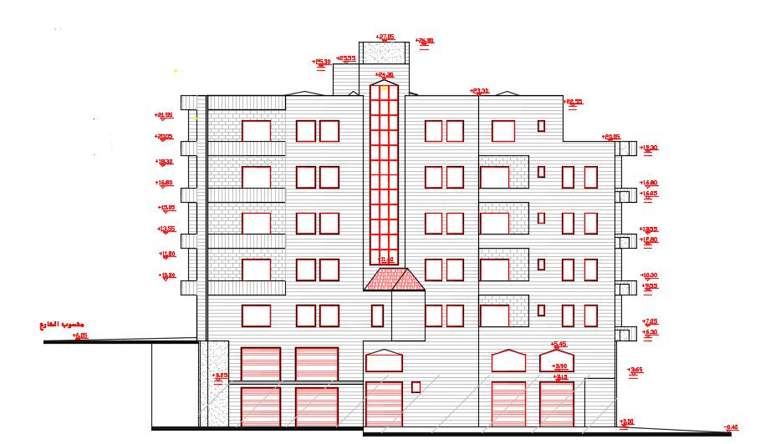
Chapter one: Description of Project
About The Project:
"Al-Yasmeen building" is located in Nablus city. It's a building of 6 floors; used as residential and storage building of masonry walls and the floor area of 700 m2.

Slide 4
Chapter one: Description of Project
Soil Bearing capacity = 250 KN/m^2
Compressive strength of concrete, f 'c = 28 MPa
Unit weight of reinforced concrete,ϓ=25KN/m3

Slide 5
Chapter one: Description of Project
Loads
S.D=4.7
KN/m^2
Wall=21 KN/m
L.L=2.5
KN/m^2

Slide 6
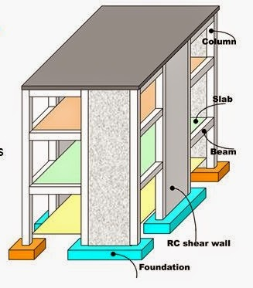
Chapter one: Description of Project
Structural System

Slide 7
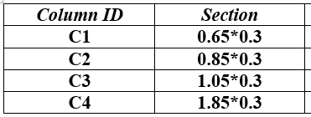
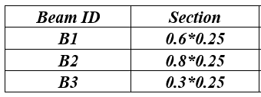
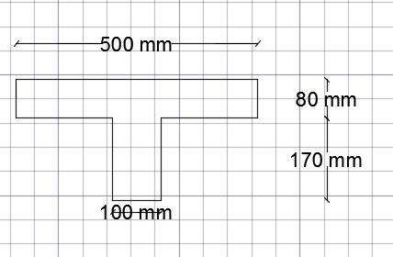
Chapter one: Description of Project
Sections used in reality:

Slide 8
Chapter two: Seismic Analysis
After analysis of Structural behavior → Structural Constraint
Horizontal Irregularities
Vertical Irregularities

Slide 9
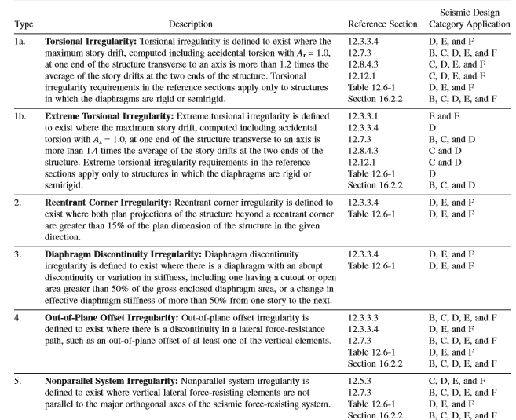
Chapter two: Seismic Analysis
Types of Horizontal irregularities

Slide 10
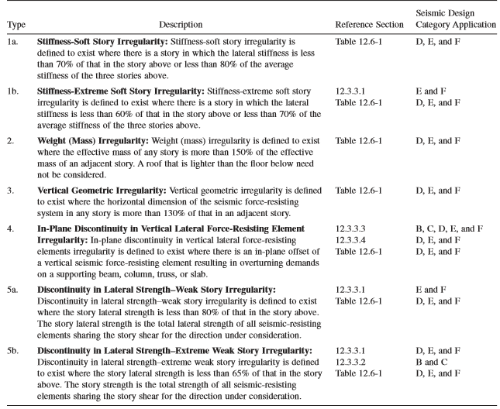
Chapter two: Seismic Analysis
Types of Vertical irregularities

Slide 11
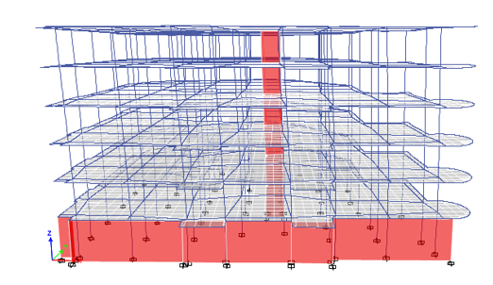
Chapter two: Seismic Analysis

Slide 12
Chapter two: Seismic Analysis
Manually
Etabs
Limit
Period
0.6
0.64
Drift
70 mm
Period
1.72
99 mm
Drift

Slide 13
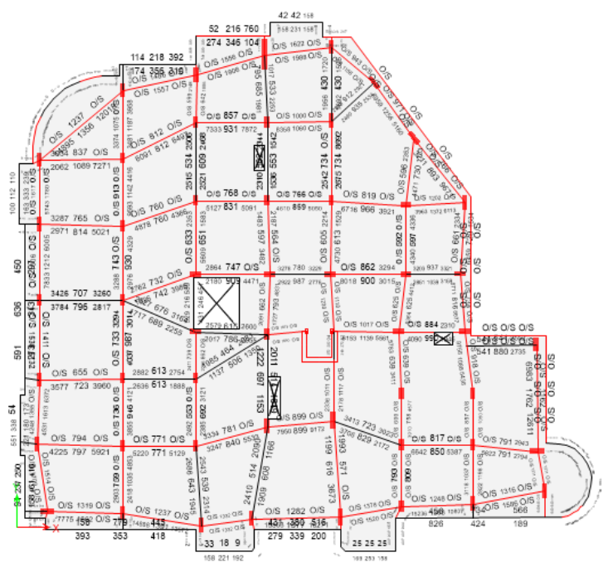
Chapter two: Seismic Analysis

Slide 14
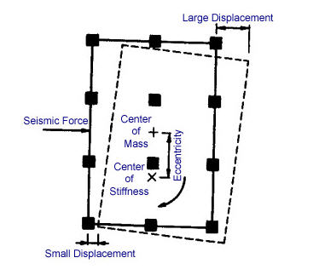
Chapter two: Seismic Analysis
Difference between Center of Mass and Center OF Rigidity

Slide 15
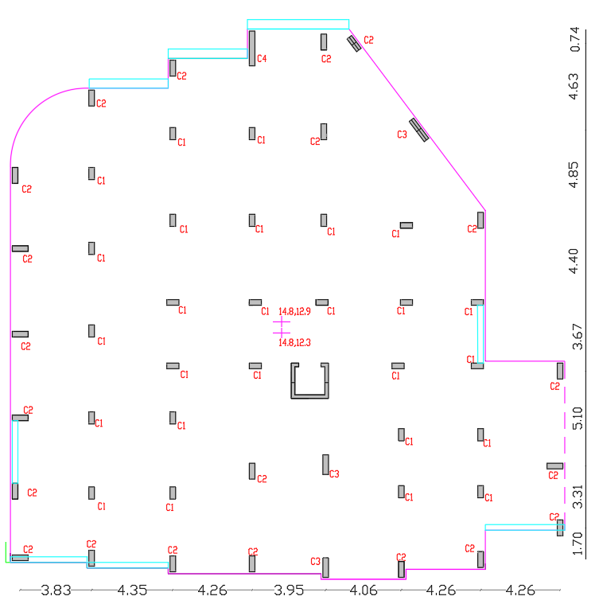
Chapter two: Seismic Analysis
Solve Structural Problem
Remove and add shear walls

Slide 16
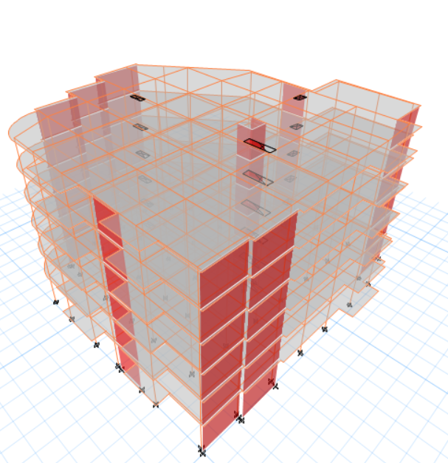
Chapter two: Seismic Analysis

Slide 17
Chapter two: Seismic Analysis
Manually
Etabs
Limit
Period
0.71
0.64
Drift
70 mm
Period
0.862
7.75 mm
Drift

Slide 18
Chapter two: Seismic Analysis
Start Seismic analysis
Equivalent lateral force method
Response Spectrum Analysis
Time History Analysis

Slide 19
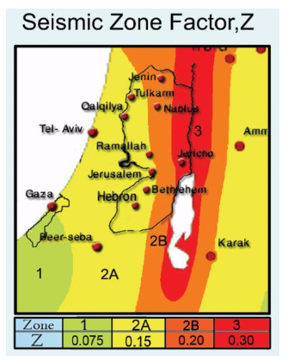
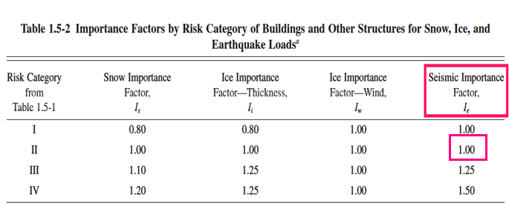
Chapter two: Seismic Analysis
Seismic Requirements:
  Zone II Seismic Activity ( Z=0.2)
  Occupancy Category:
  Risk Category II → I = 1.0

Slide 20
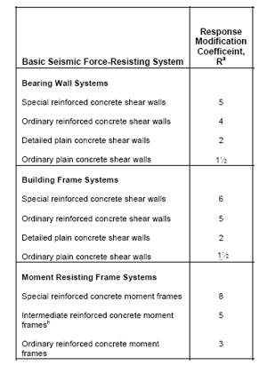
Chapter two: Seismic Analysis
  Response Modification factor
  Moment Resisting Frame with shear
  walls, for ductility requirements
  Consider R=5

Slide 21
Chapter two: Seismic Analysis
Determining suitable seismic analysis approach according to IBC2012 with ASCE7-10 that is related with this version of code.
1
S_{S} and S₁
2
Soil
3
S_{MS} and S_{M1}
4
S_{DS}
5
SDC
S_{D1}

Slide 22
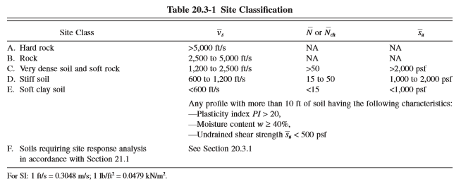
Chapter two: Seismic Analysis
Step 1 :
S_{s} = 2.5Z = 0.5
S₁=1.25Z = 0.25
Step 2 : Site Soil Classification
bearing capacity of soil = 250KN/m² →Soft Rock

Slide 23
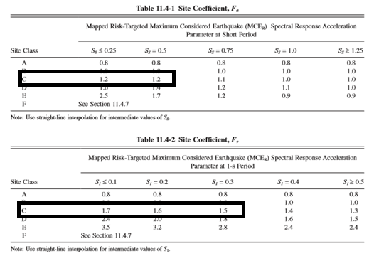
Chapter two: Seismic Analysis
Step 3 : S_{MS} = F_{a}*S_{S}
S_{M1} = F_{v}*S₁
S_{MS} = 1.2*0.5 = 0.6
S_{M1} = 1.55*0.25 = 0.3875
Step 4 :
S_{DS} = S_{MS} = 0.6
S_{D1} = S_{M1} = 0.3875

Slide 24
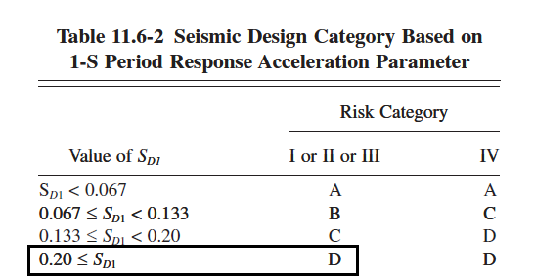
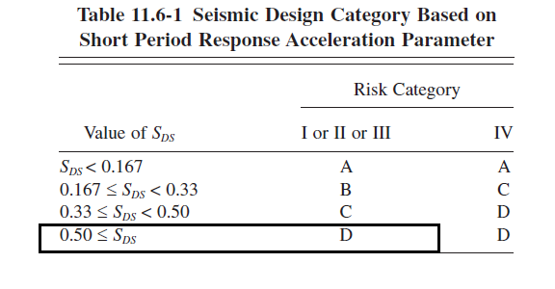
Chapter two: Seismic Analysis
Step 5: Seismic Design
Category D

Slide 25
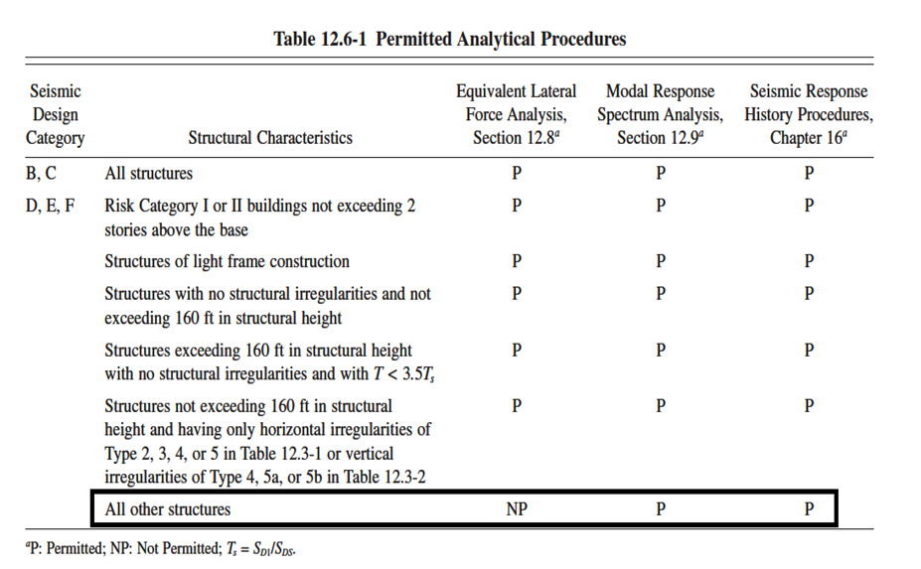
Chapter two: Seismic Analysis
Permitted analytical
Procedure

Slide 26

Chapter two: Seismic Analysis
Equivalent Static Method
Manually:
V = Cs*W
In Y-Direction: T = 0.863 > 0.65, second equation is adopted
V = 5960 KN
In x-Direction: T = 0.441 < 0.65, first equation is adopted
V = 7946 KN

Slide 27
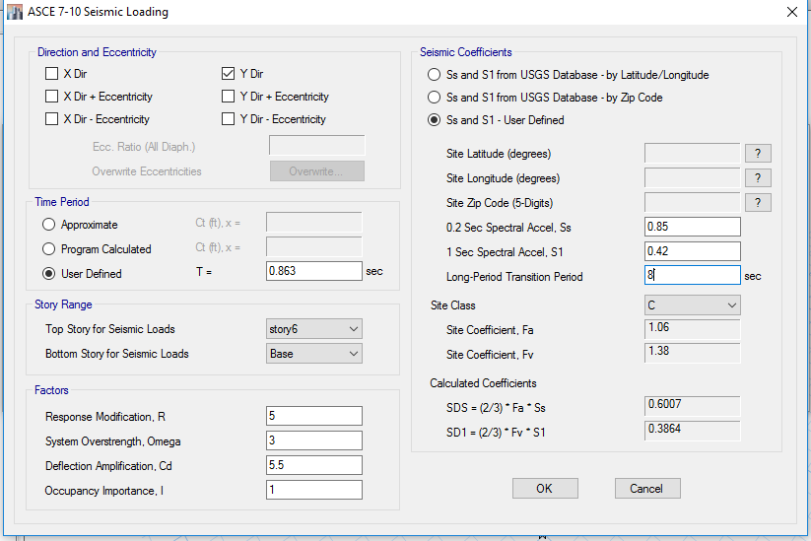
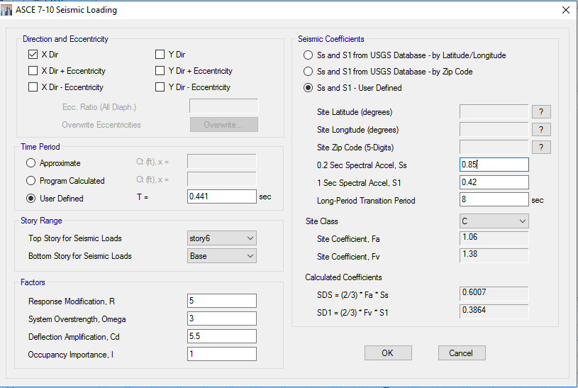
Chapter two: Seismic Analysis
Analysis by Etabs
y

Slide 28
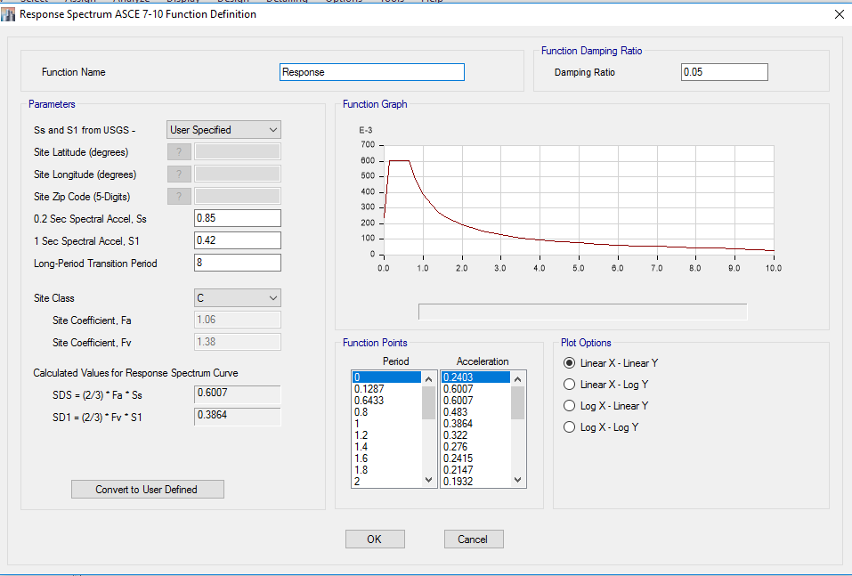
Chapter two: Seismic Analysis
Response Spectrum Analysis
V_{Etabs} = Mei*value from curve (a/g) *scale factor.
V_{i} = value from curve*W_{i}*(I/R)

Slide 29
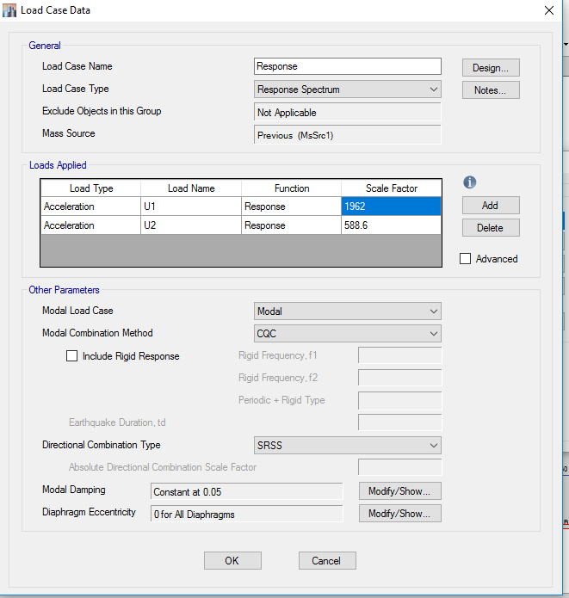
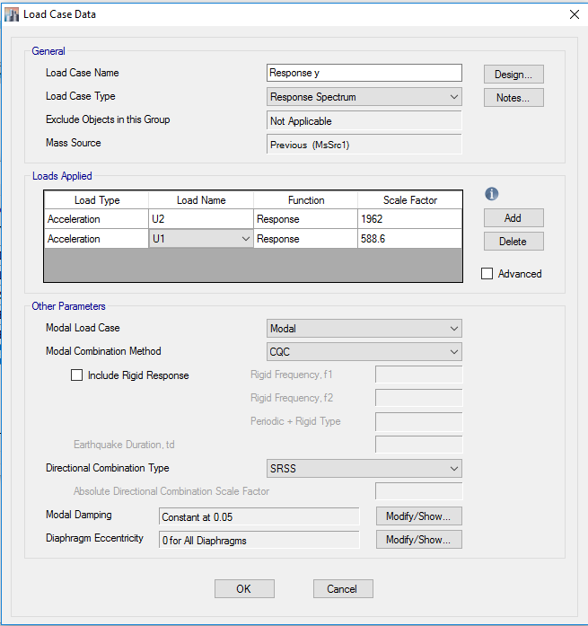
Chapter two: Seismic Analysis

Slide 30
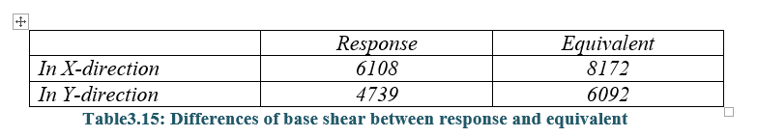
Chapter two: Seismic Analysis
Modification on Response scale factor

Slide 31
Chapter Three: Redesign for gravity and seismic loads
Response spectrum is to be adopted to develop Ultimate load combinations
Load combinations according to ASCE 7-10:
1. 1.4D
2. 1.2D + 1.6L
3. 1.2D+ 1.0L + 1.0E
4. 0.9D + 1.0E
Sections to be used as real sections
In reality , 1% (percentage of rough) is used in most beam and columns

Slide 32
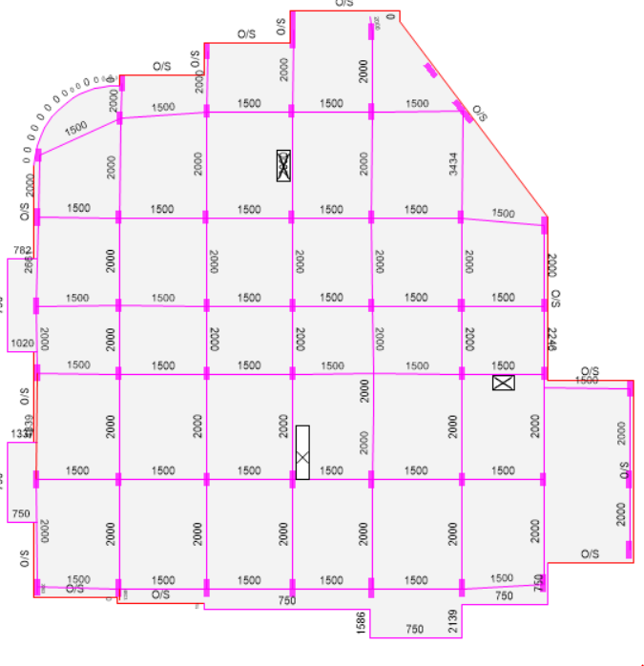
Chapter Three: Redesign for gravity and seismic loads
Design of beams:
Three different beams is designed
manually to check design by Etabs
In three beams:
< ρmin=0.0033
OK
Also, Shear design is OK

Slide 33
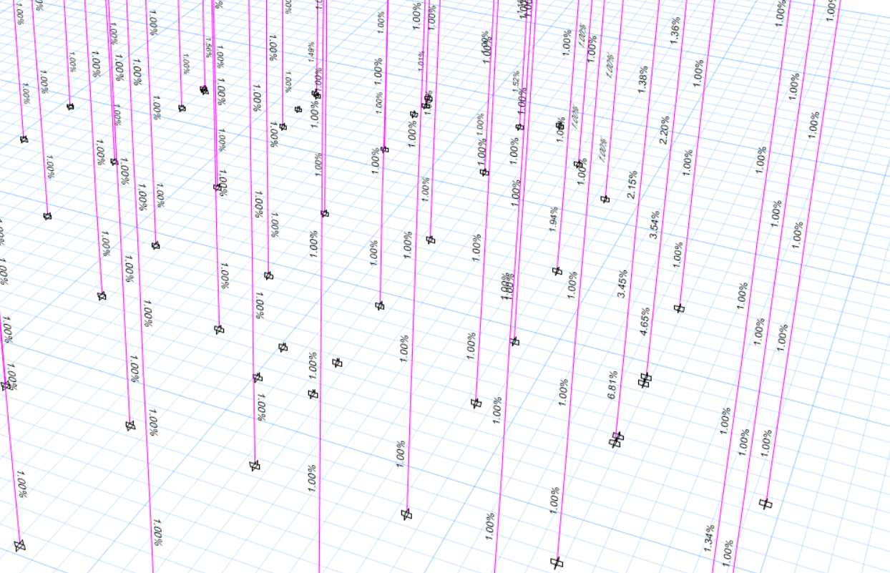
Chapter Three: Redesign for gravity and seismic loads
Design of Columns
Manual design:
Check beam-column design
Check P-δ effect
From interaction diagram
→ ρ < 0.01
OK

Slide 34
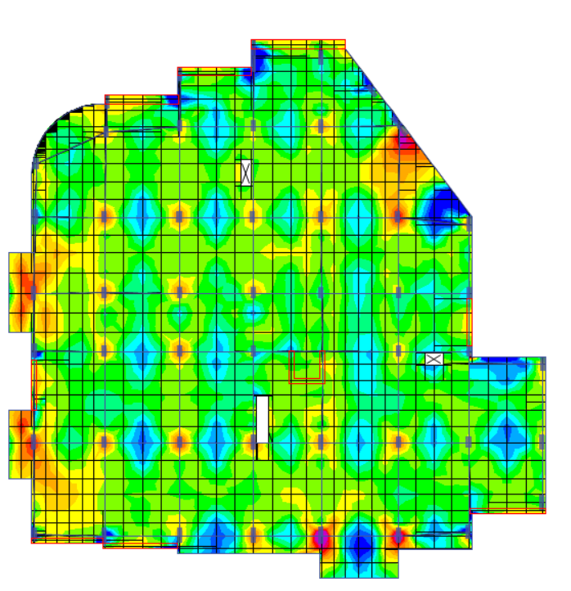
Chapter Three: Redesign for gravity and seismic loads
Design of Slab:
ɸMn for As,min is determined = 7.5 KN.m
Moment In all slab around 20KN.m
It needs 2 ɸ14 Top and Bottom Reinforcement

Slide 35
Chapter Three: Redesign for gravity and seismic loads
Design of footings
Service loads
Grouping
Design
Single footing
Types used:
Wall footing

Slide 36

Chapter Three: Redesign for gravity and seismic loads
Design of Single footing:
Steps:
Area of footing → Dimensions
Check one-way shear and punching shear → Thickness
Area of steel

Slide 37
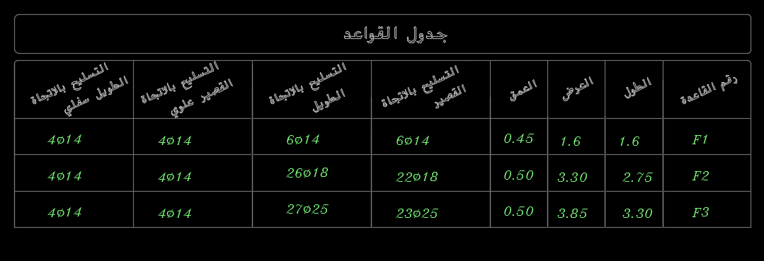
Chapter Three: Redesign for gravity and seismic loads
Compare with existing footings
One section used under all columns: 3.5 * 2.5 * 0.5

Slide 38
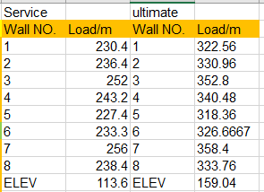
Chapter Three: Redesign for gravity and seismic loads
Design of wall footings:
All values are nearly equal
One Type of wall footing is to be used:
Steps:
Area of footing → Width = 1 m
Check one-way shear → Thickness = 350 mm
Area of steel → 5ɸ14/m
Compare with existing: 1.25 m width *0.5 m thickness
Design is SAFE

Slide 39
Chapter Four: Strengthening of weak elements
Columns reinforcements exceeds maximum allowed
Column 1: ρ = 6.81 % BUT 3% is used
Column 2: ρ = 4.65 % BUT 3% is used

Slide 40
Chapter Four: Strengthening of weak elements
Problems in beams
Beam 1: ρ = 2. 25% but exist reinforcement = 1%
Beam 2: ρ = 2. 42% and Av/s exceeds maximum allowed
Beam 3 : Av/s exceeds maximum allowed

Slide 41
Chapter Four: Strengthening of weak elements
Different alternatives for Strengthening
Concrete Jacketing
Steel jacketing
FRP

Slide 42
Chapter Four: Strengthening of weak elements
Concept of Concrete Jacketing
Increase section dimensions
Increase area of steel ( longitudinal rebar and stirrups)
Use Anchor bolts

Slide 43
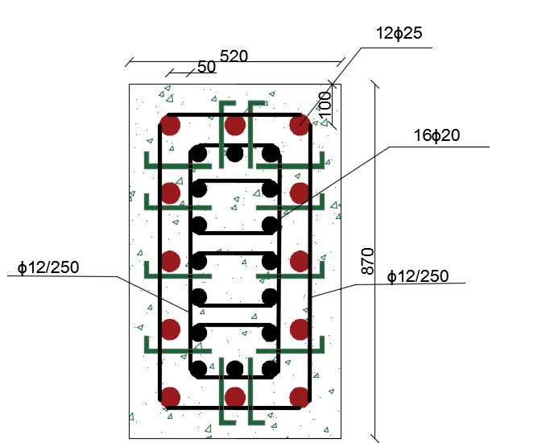
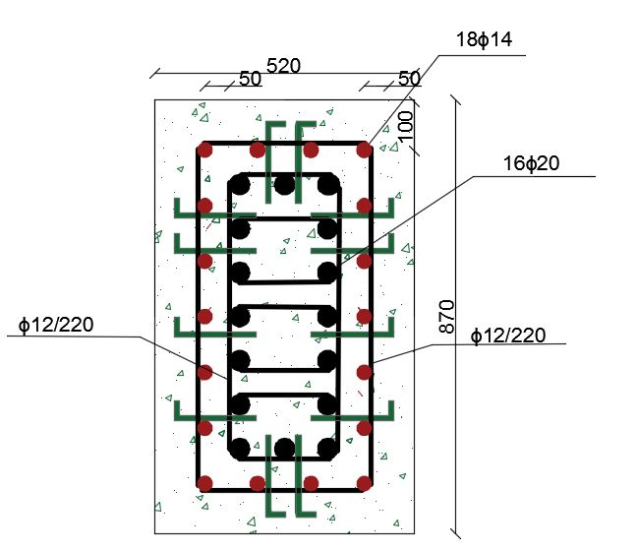
Chapter Four: Strengthening of weak elements
Concrete jacketing of columns
Column #1
1. New dimensions : 870 * 520 mm
2. As needed : 12Φ25
3. Anchor bolts : 12Φ40 with 150 mm development length
Column #2
1. New dimensions : 870 * 520 mm
2. As needed : 18Φ14
3. Anchor bolts : 12Φ40 with 150 mm development length

Slide 44
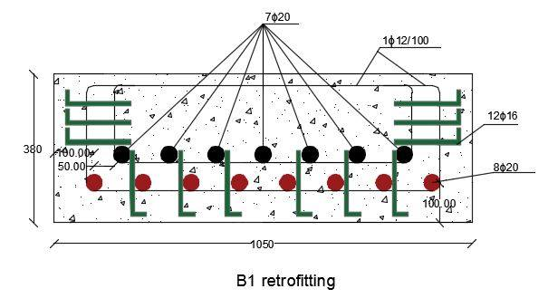
Chapter Four: Strengthening of weak elements
Concrete jacketing of Beams
Beam #1
1. New dimensions : 1050*380 mm
2. As needed : 8Φ20
3. Anchor bolts : 12Φ16 with 150 mm development length

Slide 45
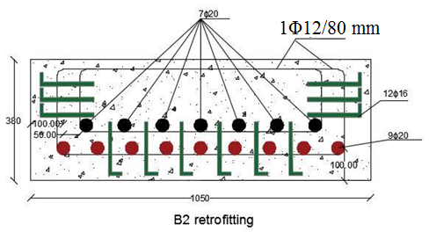
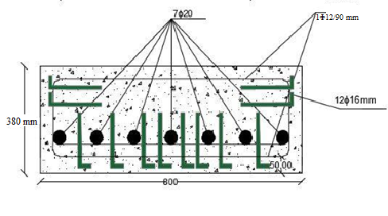
Chapter Four: Strengthening of weak elements
Concrete jacketing of beams
Beam #2
1. New dimensions : 1050*380 mm
2. Reinforcement : 9Φ20 and 1Φ12/80mm
3. Anchor bolts : 12Φ16 with 150 mm development length
Beam #3
1. New dimensions : 800*380 mm
2. Reinforcement needed : 1Φ12/90mm
3. Anchor bolts : 12Φ16 with 150 mm development length

Slide 46
Chapter Four: Strengthening of weak elements
FRP : Fiber Reinforced Polymer
Materials used
Functions
Concept of work

Slide 47
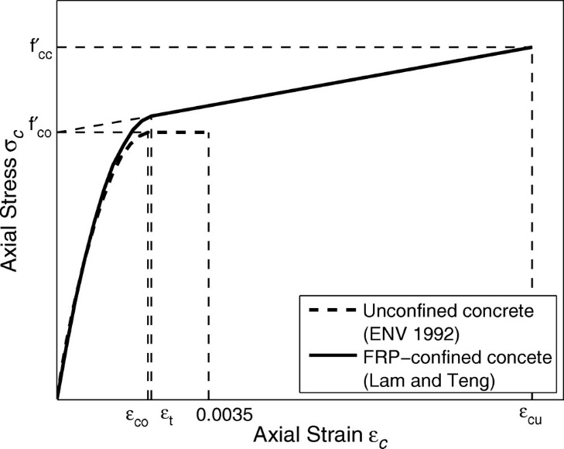
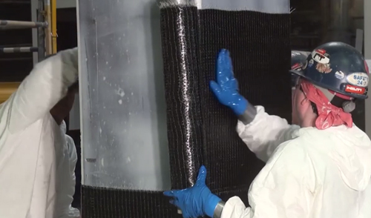
Chapter Four: Strengthening of weak elements
FRP : Fiber Reinforced Polymer

Slide 48
Thank You for your attention

