Slide 1
A new method for extracting I-V characteristic curve for photovoltaic modules using artificial neural networks
By:
Ahmed Ghareeb Maan Tamimi
Mahmoud Jaber Saif Jaradat
Dr.Tamer Khatib

Slide 2
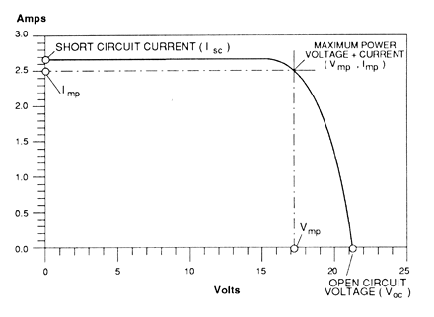
Introduction
I-V characteristic curve .

Slide 3
Literature review
Method | Accuracy | Advantages | Disadvantages
variable resistance | Not available | Measure the I-V curve of a PV module. | Can’t achieve the boundary. Can be used only in PV module with low power capacity.
capacitive load | More than 80% | Measuring open circuit voltage and short circuit current. | Relatively high percentage error. Testing time.
DC-DC boost converter | In the range of 61–67% | Extract the IV curve without the need for further external devices. | Relatively high error
Artificial neural network | In the range of 85.3–97.6% | Predict the IV curve at different solar radiation. | Not generalized

Slide 4

Artificial Neural Network (ANN’s)
An artificial neural network is a network that attempts to perform brain functions.
ANN has high speed, accuracy and
accessibility.
Neural networks performs specific task through learning process. When inputs and outputs are provided, they
form a relationship between them.

Slide 5
Proposed method
In this research two artificial neural networks are utilized for predicting the I-V curve namely generalized regression artificial neural network (GRNN) and cascaded feedback forward artificial neural network (CFNN).
In this research the training and validation database is collected by using two types of PV modules , which are polycrystalline 120 Wp PV module and polycrystalline 325 Wp PV module

Slide 6
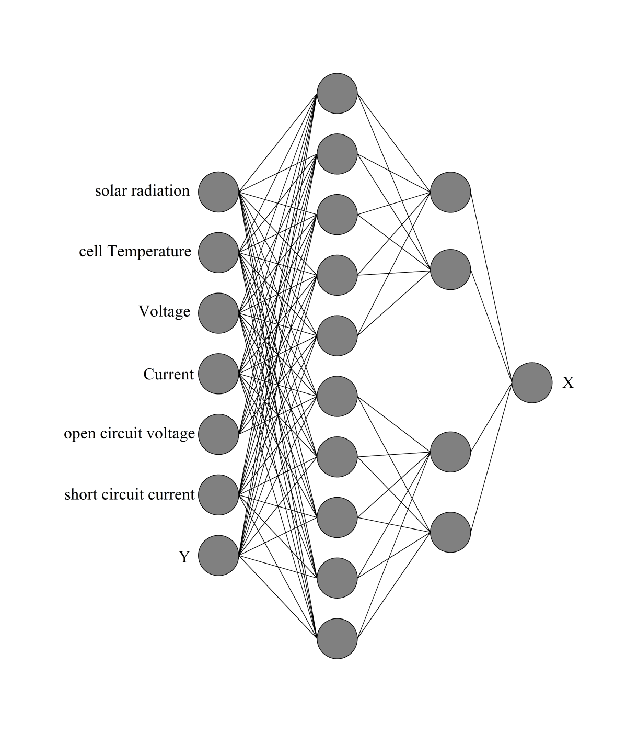
GRNN

Slide 7
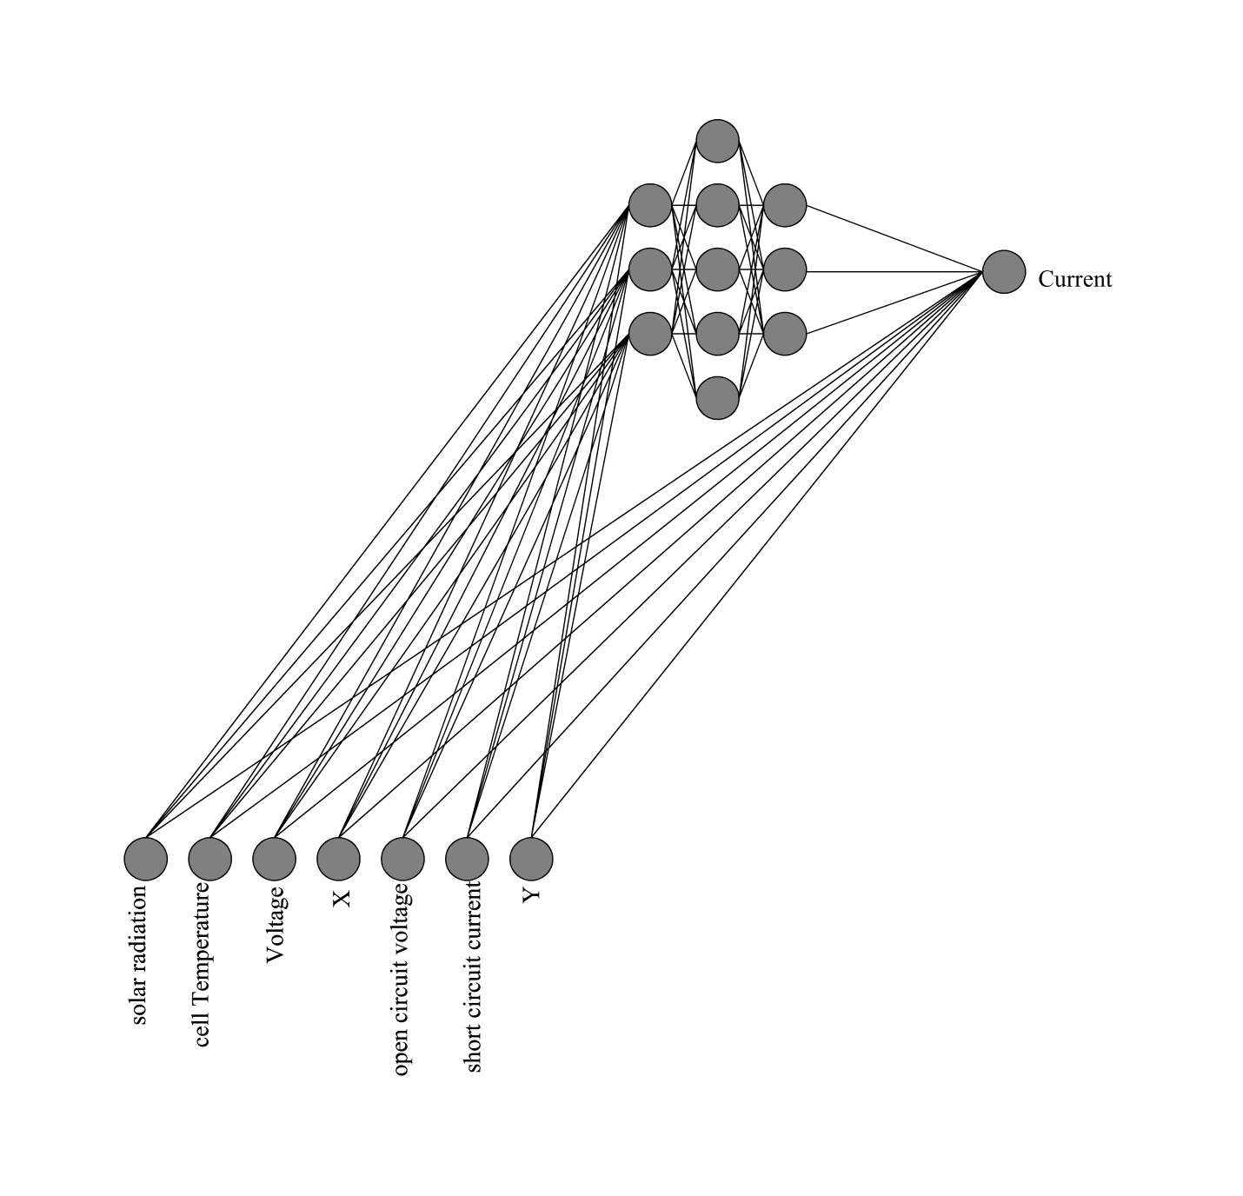
CFNN

Slide 8
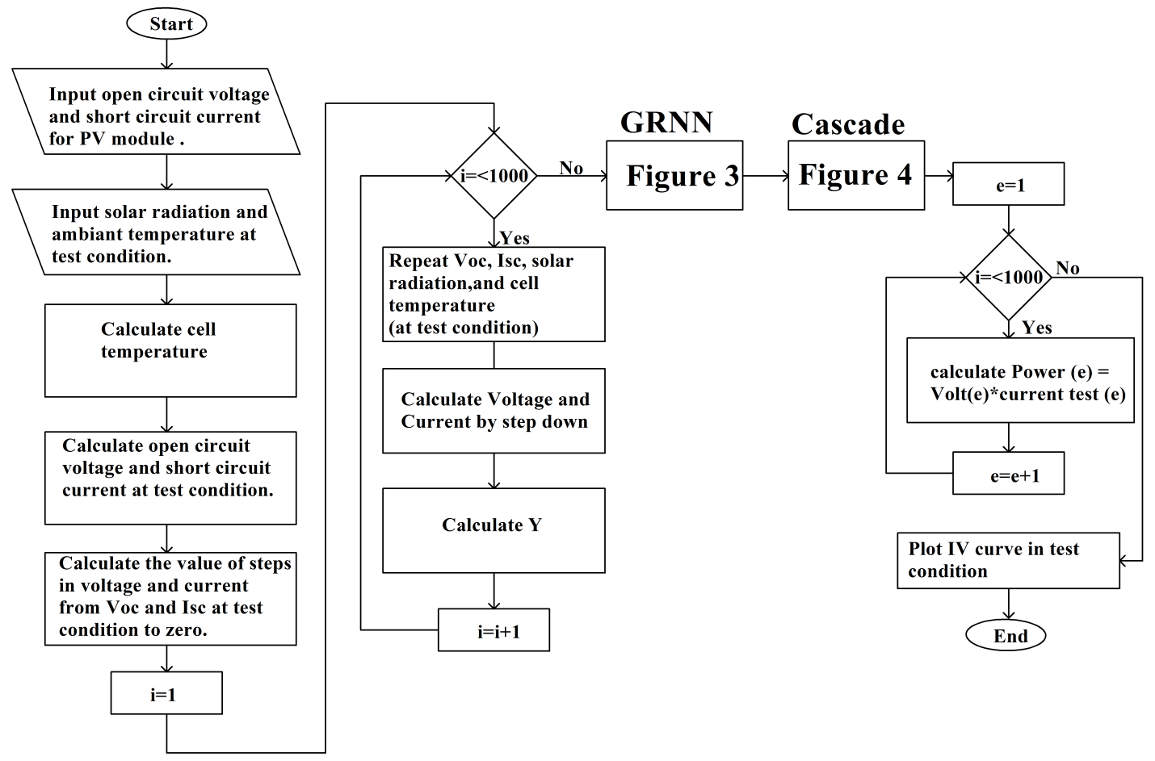
The proposed algorithm

Slide 9
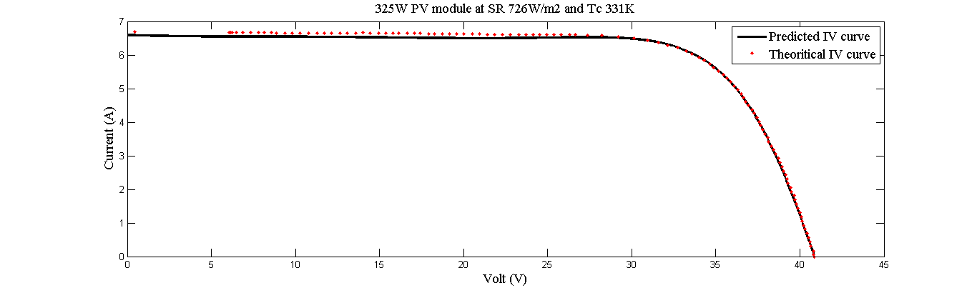
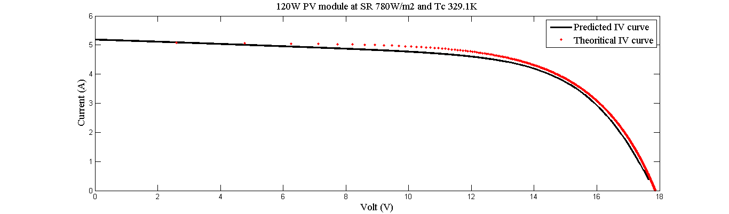
Results

Slide 10
Errors
Three types of error used: MAPE, MBE, RMSE
Radiation (W\m2) | Temperature (K) | MAPE | MBE(A) | RMSE(A)
571.8855 | 335.1181 | 1.4% | -0.047 | 0.048
647.9605 | 335.3757 | 1.2% | 0.0185 | 0.028
688.3134 | 332.2141 | 0.5% | 0.007 | 0.014
726.6816 | 331.6333 | 2.1% | -0.043 | 0.073
802.0951 | 329.8909 | 0.5% | 0.004 | 0.013
858.6552 | 329.3101 | 1.1% | -0.028 | 0.028
933.0764 | 327.5676 | 0.7% | 0.011 | 0.029
959.868 | 327.5676 | 1.3% | 0.024 | 0.042
970.4524 | 326.9868 | 0.8% | -0.024 | 0.028

Slide 11
Conclusion
The results showed that the proposed model has MAPE values in the range of 0.5% to 2.1%. In the meanwhile, MBE and RMSE values were in the range of (0.007 to 0.047) A (0.013 to 0.073) A, respectively.
The results proved the efficiency of the proposed model for predicting the I-V curve for different PV modules.

